Slide 1

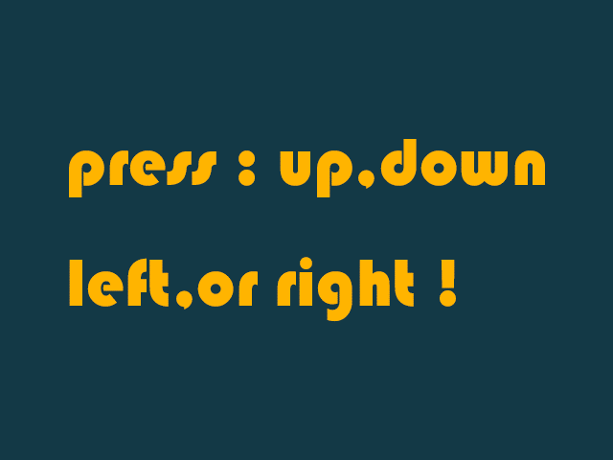
Key Presses
响应键盘事件
主讲教师： 刘新国
点击这里下载本节课程源码与相关资源

Slide 2
枚举型定义符号化常量
enum KeyPressSurfaces
{
KEY_PRESS_DEFAULT,
KEY_PRESS_UP,
KEY_PRESS_DOWN,
KEY_PRESS_LEFT,
KEY_PRESS_RIGHT,
KEY_PRESS_TOTAL
};
枚举型是设置符号化常量的捷径
KEY_PRESS_DEFAULT = 0, KEY_PRESS_UP = 1…

Slide 3
loadSurface(char* path)
//The images that correspond to a keypress
SDL_Surface* gKeyPressSurfaces[KEY_PRESS_TOTAL];
//Current displayed image
SDL_Surface* gCurrentSurface = NULL;
//Loads individual image
SDL_Surface* loadSurface(char* path)
{
SDL_Surface* loaded Surface = SDL_LoadBMP(path);
if (loadedSurface == NULL){
printf("Unable to load image %s! SDL Error: %s\n", path, SDL_GetError());}
return loadedSurface;
}
loadSurface函数加载图片，反馈加载过程中产生的bug.

Slide 4
loadMedia()
BOOL loadMedia(){
BOOL success = TRUE;
//Load default surface
gKeyPressSurfaces[KEY_PRESS_DEFAULT] = loadSurface (“03_key_presses/press.bmp”);
if (gKeyPressSurfaces[KEY_PRESS_DEFAULT] == NULL){
printf("Failed to load default image!\n");
success = FALSE;
}
//Load up surface
gKeyPressSurfaces[ KEY_PRESS_UP ] = loadSurface
("03_key_presses/up.bmp");
if (gKeyPressSurfaces[ KEY_PRESS_UP ] == NULL){
printf("Failed to load up image!\n");
success = FALSE;
}
… //Load the rest of surface
return success;
}
loadMedia()加载所有图片

Slide 5
main()
//Main loop flag
BOOL quit = FALSE;
//Event handler
SDL_Event e;
//Set default current surface
gCurrentSurface =gKeyPressSurfaces[KEY_PRESS_SURFACE_DEFAULT];
//While application is running
while( !quit )
{
while( SDL_PollEvent( &e ) != 0 )
{
//Handle events on queue
if( e.type == SDL_QUIT )
{ quit = true; }
main函数中设置默认显示的surface

Slide 6
Key Presses
//User presses a key
else if( e.type == SDL_KEYDOWN ){
switch( e.key.keysym.sym )
{
case SDLK_UP:
gCurrentSurface = gKeyPressSurfaces[KEY_PRESS_UP];
break;
case SDLK_DOWN:
gCurrentSurface = gKeyPressSurfaces[KEY_PRESS_DOWN];
break;
… //switch to other surfaces
default:
gCurrentSurface =gKeyPressSurfaces[KEY_PRESS_DEFAULT];
break;
}
}
//update surface
SDL_BlitSurface( gCurrentSurface, NULL, gScreenSurface, NULL );
SDL_UpdateWindowSurface( gWindow );
keysym （ SDL_Keysym ）含有被按下按键的信息，该数据类型中的 sym (SDL_Keycode)识别具体哪个按键被按下

Slide 7
小结
SDL_Keyboard_event含有键盘事件的信息
SDL_Keysym是有关按键信息的数据类型
SDL_Keycode标识按键ID

