Slide 1

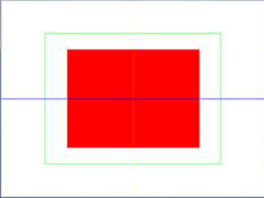
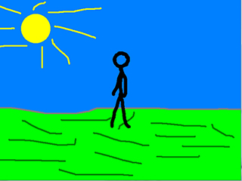
Geometry Rendering and Texture Clip Rendering
几何元素绘制,纹理裁剪,旋转翻转，精灵动画
主讲教师： 刘新国
点击这里下载本节课程源码与相关资源

Slide 2
Geometry rendering
绘制几何元素

Slide 3
绘制几何元素
void geometryRendering()
{
int i;
SDL_Rect fillRect = { W/4, H/4, W/2, H/2 };
SDL_Rect outlineRect ={ W/6, H/6, W*2/3, H*2/3 };;
//绘制红色填充区域
SDL_SetRenderDrawColor( gRenderer, 0xFF, 0x00, 0x00, 0xFF )
SDL_RenderFillRect( gRenderer, &fillRect );
//绘制绿色方形轮廓线
SDL_SetRenderDrawColor( gRenderer, 0x00, 0xFF, 0x00, 0xFF );
SDL_RenderDrawRect( gRenderer, &outlineRect );
//绘制蓝色水平线
SDL_SetRenderDrawColor( gRenderer, 0x00, 0x00, 0xFF, 0xFF );
SDL_RenderDrawLine( gRenderer, 0, H/2, W, H/2);
//绘制黄色点构成的虚线
SDL_SetRenderDrawColor( gRenderer, 0xFF, 0xFF, 0x00, 0xFF );
for( int i = 0; i < H; i += 4 )
{
SDL_RenderDrawPoint( gRenderer, W/2, i );
}
}
int W = SCREEN_WIDTH;
int H = SCREEN_HEIGHT;

Slide 4
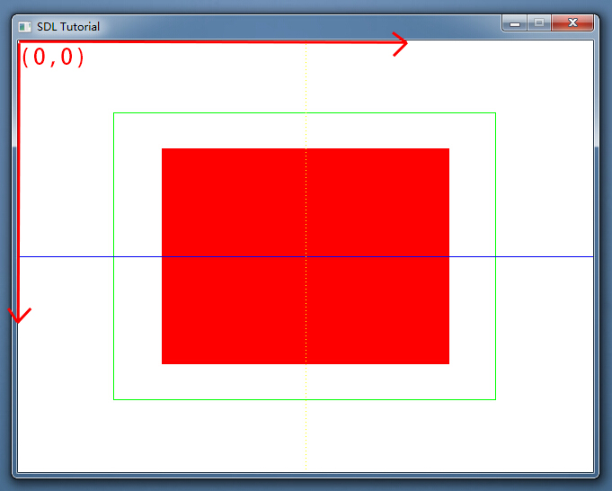
绘制几何元素

Slide 5
Clip rendering and Animated sprites
纹理裁剪，旋转翻转，去除色彩，精灵动画

Slide 6
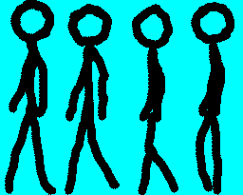
定义变量
#define WALKING_ANIMATION_FRAMES 4
//包含尺寸信息的纹理结构体
typedef struct {
SDL_Texture* mTexture;
int mWidth;
int mHeight;
}LTexture;
//Walking animation
LTexture gSpriteTexture;
SDL_Rect gSpriteClips[ WALKING_ANIMATION_FRAMES ]; //裁剪矩形数组
SDL_Rect* currentClip; //当前裁剪矩形的索引
int frame = 0; //动画帧号
//Background texture
LTexture gBackgroundTexture;

Slide 7
init()（ Vertical Sync）
//Create vsynced renderer for window
gRenderer = SDL_CreateRenderer( gWindow, -1,
SDL_RENDERER_ACCELERATED | SDL_RENDERER_PRESENTVSYNC );
if( gRenderer == NULL )
{
printf( ... );
success = false;
}
垂直同步(Vertical Sync)：渲染更新与显示器垂直刷新保持一致。本例中，这使动画不会运动太快。

Slide 8
loadTexture()
LTexture loadTexture(char* path ){
Ltexture ltexture = NULL;
SDL_Surface* loadedSurface = IMG_Load( path );
if(loadedSurface== NULL ){ ... }
else
{ //设定去除色彩的RGB,该颜色将透明显示
SDL_SetColorKey( loadedSurface, SDL_TRUE,
SDL_MapRGB( loadedSurface->format, 0, 0xFF, 0xFF ) );
ltexture.mTexture=SDL_CreateTextureFromSurface( gRenderer, loadedSurface );
if(ltexture.mTexture== NULL ){ printf(...); }
else
{//获取纹理的宽高
ltexture.mWidth=loadedSurface->w;
ltexture.mHeight=loadedSurface->h;
}
SDL_FreeSurface( loadedSurface );
}
return ltexture ;
}
SDL_MapRGB:跨平台地根据RGB值创建一个像素

Slide 9
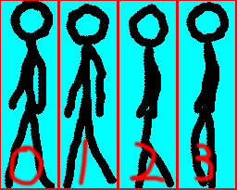
loadMedia()
BOOL loadMedia(){
BOOL success = TRUE;
//加载PNG texture
gTexture = loadTexture( "04_geometry_and_texture/animation.png" );
if(gTexture == NULL ){ … }
else
{
//裁剪矩形0
gSpriteClips[ 0 ].x = 0; gSpriteClips[ 0 ].y = 0;
gSpriteClips[ 0 ].w = 64; gSpriteClips[ 0 ].h = 205;
//裁剪矩形1
gSpriteClips[ 1 ].x = 64; gSpriteClips[ 1 ].y = 0;
gSpriteClips[ 1 ].w = 64; gSpriteClips[ 1 ].h = 205;
//裁剪矩形2
gSpriteClips[ 2 ].x = 128; gSpriteClips[ 2 ].y = 0;
gSpriteClips[ 2 ].w = 64; gSpriteClips[ 2 ].h = 205;
//裁剪矩形3
gSpriteClips[ 3 ].x = 196; gSpriteClips[ 3 ].y = 0;
gSpriteClips[ 3 ].w = 64; gSpriteClips[ 3 ].h = 205;
}
return success;
}

Slide 10
close ()
void close()
{
//释放图片纹理
freeLTexture(gSpriteTexture);
freeLTexture(gBackgroundTexture);
//销毁窗口与渲染器
SDL_DestroyRenderer( gRenderer );
SDL_DestroyWindow( gWindow );
gWindow = NULL;
gRenderer = NULL;
//退出SDL子系统
IMG_Quit();
SDL_Quit();
}

Slide 11
freeLTexture()
//Free LTexture
void freeLTexture(LTexture ltexture)()
{
if( ltexture.mTexture != NULL )
{
SDL_DestroyTexture(ltexture.mTexture);
ltexture.mWidth=0;
ltexture.mHeight=0;
ltexture.mTexture=NULL;
}
}

Slide 12
main loop
while( !quit )
{
while( SDL_PollEvent( &e ) != 0 )
{
if( e.type == SDL_QUIT )
{
quit = TRUE;
}
}
//清楚屏幕原有内容
SDL_SetRenderDrawColor( gRenderer, 0xFF, 0xFF, 0xFF, 0xFF );
SDL_RenderClear( gRenderer );
//将精灵动画绘制在屏幕上
spriteRendering();
//更新屏幕内容
SDL_RenderPresent( gRenderer );
}

Slide 13
spriteRendering( )
void spriteRendering()
{
//绘制背景图案
SDL_RenderCopy(gRenderer,gBackgroundTexture.mTexture,NULL,NULL);
//每循环8次选择下一裁剪矩形
currentClip = &gSpriteClips[ frame / 8 ];
//在屏幕中心绘制精灵动画
renderTexture( gSpriteTexture,(SCREEN_WIDTH - spriteW())/2,
(SCREEN_HEIGHT-spriteH())/2,currentClip,0,NULL);
++frame;
//循环播放动画
if( frame / 8 >= WALKING_ANIMATION_FRAMES )
{
frame = 0;
}
}

Slide 14
spriteW () 和spriteH()
//获取单帧动画的纹理宽度
void spriteW ()
{
return gSpriteTexture.mWidth / WALKING_ANIMATION_FRAMES;
}
//获取单帧动画的纹理高度
void spriteW ()
{
return gSpriteTexture.mHeight
}

Slide 15
renderTexture()
//绘制LTexture
void renderTexture(LTexture ltexture, int x, int y, SDL_Rect* clip,
double angle, SDL_Point* center)
{
//设定纹理在屏幕的绘制区域
SDL_Rect destRect = { x, y, ltexture.mWidth,ltexture.mHeight};
if (clip!=NULL)
{
destRect.w=clip->w;
destRect.h=clip->h;
}
//SDL_RenderCopyEx入参 clip:纹理裁剪矩形 destRect:目标矩形区域
//angle:旋转角度 center:旋转中心点 最后一个参数：是否翻转
SDL_RenderCopyEx( gRenderer, ltexture.mTexture, clip, &destRect,
angle, center, SDL_FLIP_NONE );
}

Slide 16
小结
加载纹理时保留尺寸信息
SDL_SetColorKey使指定色彩透明显示
SDL_RenderCopyEx提供了纹理显示的旋转与翻转选项
通过设置裁剪矩形与目标矩形，可绘制纹理局部至屏幕指定区域
精灵动画是播放帧序列
SDL2提供了绘制点，线，面，线框等几何图元的函数

