Slide 1

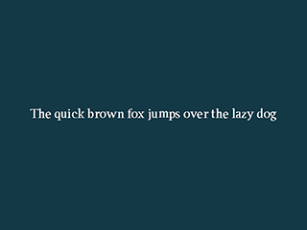
True Type Fonts
配置SDL_ttf库,加载并显示字符纹理
主讲教师： 刘新国
点击这里下载本节课程源码与相关资源

Slide 2
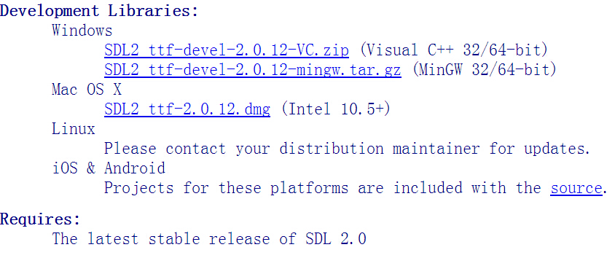
VS2010配置SDL_ttf
1) 点击网页链接下载SDL_ttf扩展包
2) 配置过程与SDL_image相同，请参考课程03

Slide 3
相关变量与函数
#include <SDL_ttf.h>
//Globally used font
TTF_Font *gFont = NULL;
//Rendered texture
LTexture gTextTexture
//Loads text as texture
LTexture loadFromRenderedText( char *text, SDL_Color textColor );
定义字体变量与字符的纹理
另外，我们声明函数，用来从字体，颜色，字符串中创建纹理

Slide 4
init()
//Initialize PNG loading
if( !( IMG_Init( imgFlags ) & imgFlags ) )
{
printf( “SDL_image could not initialize!”);
success = FALSE;
}
//Initialize SDL_ttf
if( TTF_Init() == -1 )
{
printf(“SDL_ttf could not initialize!”);
success = FALSE;
}
与SDL_image相似，加载和绘制字符之前需先初始化SDL_ttf

Slide 5
loadFromRenderedText()
//函数入参依次为：待显示的字符串，绘制字符串所用的颜色
LTexture loadFromRenderedText( char *text, SDL_Color textColor )
{
Ltexture textTexture= NULL;
//Render text surface
SDL_Surface* loadedSurface = TTF_RenderText_Solid( gFont, text, textColor );
if(loadedSurface== NULL ){ ... }
else
{ //Create texture from surface pixels
textTexture.mTexture=SDL_CreateTextureFromSurface( gRenderer, loadedSurface );
if(textTexture.mTexture== NULL ){ printf(...); }
else
{//Get image dimensions
textTexture.mWidth=loadedSurface->w;
textTexture.mHeight=loadedSurface->h;
}
SDL_FreeSurface( loadedSurface );
}
return textTexture;
}
TTF_RenderText_Solid接收字体，颜色，字符串参数来创建surface
loadFromRenderedText()与loadTexture()十分相似。前者通过SDL_ttf创建surface，后者通过文件。

Slide 6
loadMedia()
BOOL loadMedia(){
BOOL success = TRUE; //Loading success flag
//Open the font, TTF_OpenFont入参为：ttf字体文件路径，字体大小
gFont = TTF_OpenFont (“05_true_type_fonts/myFont.ttf” , 28);
if( gFont == NULL )
{
printf( "SDL_ttf Error: %s\n", TTF_GetError() );
success = FALSE;
}
else
{
SDL_Color textColor = { 255, 255, 255 };
gTextTexture=loadFromRenderedText( "The quick brown fox jumps over the lazy dog", textColor ); //Render text
if( gTextTexture.mTexture == NULL )
{
printf( "Failed to render text texture!\n" );
success = FALSE;
}
}
return success;
}
使用TTF_OpenFont加载字体
使用loadFromRenderedText加载字符纹理

Slide 7
close ()
void close()
{
//Free loaded image
freeLTexture(gTextTexture);
//Free global font
TTF_CloseFont( gFont );
gFont = NULL;
//Destroy window
SDL_DestroyRenderer( gRenderer );
SDL_DestroyWindow( gWindow );
gWindow = NULL;
gRenderer = NULL;
//Quit SDL subsystems
TTF_Quit(); //退出SDL_ttf库
IMG_Quit();
SDL_Quit();
}

Slide 8
main loop
while( !quit )
{
while( SDL_PollEvent( &e ) != 0 )
{
if( e.type == SDL_QUIT )
{
quit = TRUE;
}
}
//清楚屏幕原有内容
SDL_SetRenderDrawColor( gRenderer, 0xFF, 0xFF, 0xFF, 0xFF );
SDL_RenderClear( gRenderer );
//在屏幕中心绘制字符串纹理（与图片绘制采用同一函数）
renderTexture(gTextTexture,(SCREEN_WIDTH-gTextTexture.mWidth)/2,
(SCREEN_HEIGHT-gTextTexture.mHeight)/2,NULL,0,NULL);
//更新屏幕内容
SDL_RenderPresent( gRenderer );
}

Slide 9
小结
SDL_ttf扩展库与SDL_image库配置方法相同
与SDL_image同理，使用SDL_ttf库前先TTF_Init
使用TTF_OpenFont加载字体
加载字符串纹理与图片纹理，过程相似
程序关闭时，释放字体，退出SDL_ttf库

