Slide 1

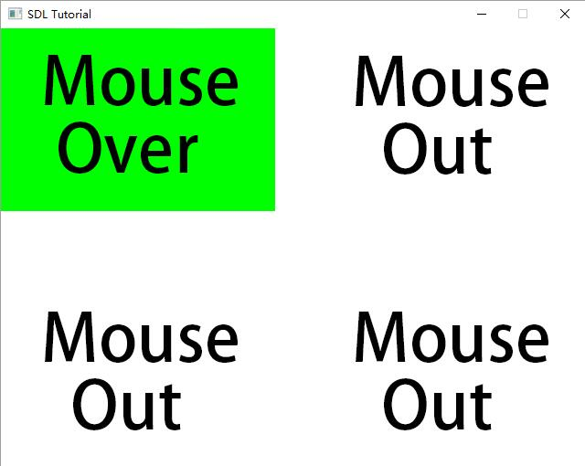
Mouse Events
响应鼠标事件
主讲教师： 刘新国
点击这里下载本节课程源码与相关资源

Slide 2
相关变量与函数
//Button constants
const int BUTTON_WIDTH = 300;
const int BUTTON_HEIGHT = 200;
const int TOTAL_BUTTONS = 4;
typedef enum LButtonSprite
{
BUTTON_SPRITE_MOUSE_OUT = 0,
BUTTON_SPRITE_MOUSE_OVER_MOTION = 1,
BUTTON_SPRITE_MOUSE_DOWN = 2,
BUTTON_SPRITE_MOUSE_UP = 3,
BUTTON_SPRITE_TOTAL = 4
} LButtonSprite;
程序将展示4个按钮，依据鼠标按下，移动，释放及移出按钮的不同状态显示相应图案

Slide 3
LButton
typedef struct {
int x;
int y;
//Currently used global sprite
LButtonSprite mCurrentSprite;
} LButton;
//Displayed texture
LTexture gButtonSpriteTexture;
SDL_Rect gSpriteClips[BUTTON_SPRITE_TOTAL];
//Buttons objects
LButton gButtons[TOTAL_BUTTONS];
//Handle mouse event
void handleMouseEvent(LButton *button, SDL_Event* e);
//Shows button sprite
void renderButton(LButton button);
定义Lbutton结构
声明鼠标事件处理函数
声明按钮绘制函数

Slide 4
loadMedia()
BOOL loadMedia(){
BOOL success = TRUE;
gButtonSpriteTexture = loadTexture("07_mouse_events/button.png");
if( gButtonSpriteTexture.mTexture == NULL ){…}
else{
//设置按钮纹理的裁剪框
for (i = 0; i < BUTTON_SPRITE_TOTAL; ++i){ gSpriteClips[i].x = 0;
gSpriteClips[i].y = i * 200;
gSpriteClips[i].w = BUTTON_WIDTH;
gSpriteClips[i].h = BUTTON_HEIGHT;
}
//设置按钮的初始图案
for (i = 0; i < TOTAL_BUTTONS; ++i)
gButtons[i].mCurrentSprite = BUTTON_SPRITE_MOUSE_OUT;
//设置按钮的默认位置
setPosition(gButtons, 0, 0);
setPosition(gButtons + 1, SCREEN_WIDTH - BUTTON_WIDTH, 0);
setPosition(gButtons + 2, 0, SCREEN_HEIGHT - BUTTON_HEIGHT);
setPosition(gButtons + 3, SCREEN_WIDTH - BUTTON_WIDTH,
SCREEN_HEIGHT - BUTTON_HEIGHT);
}
return success;
}
初始化按钮相关信息

Slide 5
main loop
while( !quit )
{
while( SDL_PollEvent( &e ) != 0 )
{
if( e.type == SDL_QUIT )
quit = TRUE;
//Handle mouse events
for( int i = 0; i < TOTAL_BUTTONS; ++i )
gButtons[ i ].handleEvent( &e );
}
//Clear screen
SDL_SetRenderDrawColor( gRenderer, 0xFF, 0xFF, 0xFF, 0xFF );
SDL_RenderClear( gRenderer );
//Render buttons
for (i = 0; i < TOTAL_BUTTONS; ++i)
renderButton(gButtons+i );
//Update screen
SDL_RenderPresent( gRenderer );
}
处理鼠标事件
逐个绘制按钮纹理

Slide 6
handleMouseEvent ( )
void handleMouseEvent(LButton *button, SDL_Event* e)
{
//Check if mouse is in button
BOOL inside = true;
int x, y;
//If mouse event happened
if( e->type == SDL_MOUSEMOTION || e->type == SDL_MOUSEBUTTONDOWN ||
e->type == SDL_MOUSEBUTTONUP )
{
//Get mouse position
SDL_GetMouseState( &x, &y );
如果发生鼠标移动，按下按钮，放开按钮事件，则使用SDL_GetMouseState()函数获取当前鼠标位置。

Slide 7
handleMouseEvent ( )
//Mouse is left of the button
if( x < button->x ) { inside = FALSE; }
//Mouse is right of the button
else if( x > button->x + BUTTON_WIDTH ){ inside = FALSE; }
//Mouse above the button
else if( y < button->y ){ inside = FALSE; }
//Mouse below the button
else if (y > button->y + BUTTON_HEIGHT){ inside = FALSE; }
//Mouse is outside button
if (!inside)
{
button->mCurrentSprite = BUTTON_SPRITE_MOUSE_OUT;
}
判断鼠标是否在界外
如果鼠标在本按钮界限之外，则设置纹理id为BUTTON_SPRITE_MOUSE_OUT

Slide 8
handleMouseEvent ( )
//Mouse is inside button
else{
//Set mouse over sprite
switch( e->type )
{
case SDL_MOUSEMOTION:
mCurrentSprite = BUTTON_SPRITE_MOUSE_OVER_MOTION;
break;
case SDL_MOUSEBUTTONDOWN:
mCurrentSprite = BUTTON_SPRITE_MOUSE_DOWN;
break;
case SDL_MOUSEBUTTONUP:
mCurrentSprite = BUTTON_SPRITE_MOUSE_UP;
break;
}
}
}
}
根据鼠标状态设置按钮纹理

Slide 9
renderButton ( )
void renderButton(LButton *button)
{
//Show current button sprite
renderTexture(gButtonSpriteTexture, button.x, button.y,
&gSpriteClips[button.mCurrentSprite], 0,
NULL, SDL_FLIP_NONE);
}

Slide 10
小结
SDL_MOUSEMOTION, SDL_MOUSEBUTTONDOWN与SDL_MOUSEBUTTONUP是常见的鼠标事件类型
通过SDL_GetMouseState函数获取鼠标位置

