Slide 1

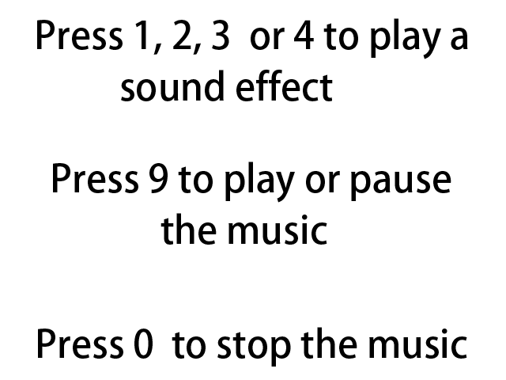
Sound Effects and Music
音频播放
主讲教师： 刘新国
点击这里下载本节课程源码与相关资源

Slide 2
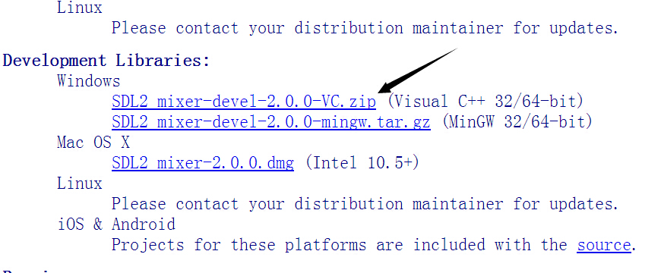
VS2010配置SDL_mixer
1) 点击网页链接下载SDL_mixer扩展包
2) 配置过程与SDL_image相同，请参考课程03

Slide 3
音频数据类型
#include <SDL_mixer.h>
//The music that will be played
Mix_Music *gMusic = NULL;
//The sound effects that will be used
Mix_Chunk *gScratch = NULL;
Mix_Chunk *gHigh = NULL;
Mix_Chunk *gMedium = NULL;
Mix_Chunk *gLow = NULL;
SDL_mixer 库中关于music的数据类型为Mix_Music, Mix_Chunk为短音频数据类型(sound)

Slide 4
init()
//Initialize SDL
if (SDL_Init(SDL_INIT_VIDEO | SDL_INIT_AUDIO) < 0 )
{
printf( “SDL could not initialize!”);
success = FALSE;
}
初始化SDL音频子系统
//Initialize PNG loading
if( !( IMG_Init( imgFlags ) & imgFlags ) )
{
printf( “SDL_image could not initialize!”);
success = FALSE;
}
//Initialize SDL_mixer
if(Mix_OpenAudio( 44100, MIX_DEFAULT_FORMAT, 2, 2048 ) < 0)
{
printf(“SDL_mixer could not initialize!”);
success = FALSE;
}
初始化SDL_Mixer,Mix_OpenAudio参数依次为
声音频率，示例格式，硬件频道数及示例大小

Slide 5
loadMedia()
…
//Load music
gMusic = Mix_LoadMUS("21_sound_effects_and_music/beat.wav");;
if( gMusic== NULL ) {
printf("Failed to load music! SDL_mixer Error: %s\n", Mix_GetError());
success = FALSE;
}
//Load sound effects
gScratch = Mix_LoadWAV("21_sound_effects_and_music/scratch.wav");
if (gScratch == NULL)
{
printf("Failed to load sound!SDL_mixer Error: %s\n", Mix_GetError());
success = FALSE;
}
gHigh = …
gMedium = …
gLow = …
return success;
}
使用Mix_LoadMUS()加载music
使用Mix_LoadWAV()加载sound

Slide 6
close ()
void close()
{
//Free loaded image
freeLTexture( gbackgroundTexture );
//Free the sound effects
Mix_FreeChunk(gScratch); gScratch = NULL;
Mix_FreeChunk(gHigh); gHigh = NULL;
Mix_FreeChunk(gMedium); gMedium = NULL;
Mix_FreeChunk(gLow); gLow = NULL;
//Free the music
Mix_FreeMusic(gMusic);
gMusic = NULL;
…
Mix_Quit();
IMG_Quit();
SDL_Quit();
释放音频文件
退出音频子系统

Slide 7
event loop (key press)
//Handle key press
else if (e.type == SDL_KEYDOWN)
{
switch (e.key.keysym.sym){
//Play high sound effect
case SDLK_1:
Mix_PlayChannel(-1, gHigh, 0);
break;
//Play medium sound effect
case SDLK_2:
Mix_PlayChannel(-1, gMedium, 0);
break;
//Play low medium effect
case SDLK_3:
Mix_PlayChannel(-1, gLow, 0);
break;
//Play scratch medium effect
case SDLK_4:
Mix_PlayChannel(-1, gScratch , 0);
break;
使用Mix_PlayChannel函数播放Mix_Chunk，参数依次为，播放频道，Mix_Chunk音频，播放次数。第一个参数取-1表示用最临近的频道播放。这里的频道是指立体声中的左右声道，与前文不同。

Slide 8
event loop (key press)
case SDLK_9:
//If there is no music playing
if( Mix_PlayingMusic()==0 )
{
Mix_PlayMusic( gMusic, -1 );
}
//If music is being played
else {
//If the music is paused
if( Mix_PausedMusic() == 1 )
{ //Resume the music
Mix_ResumeMusic();
}
//If the music is playing
else
//Pause the music
Mix_PauseMusic();
}
break;
case SDLK_0:
//Stop the music
Mix_HaltMusic();
break;
}
Mix_PlayMusic:尝试播放音乐
Mix_PauseMusic:尝试暂停音乐
Mix_ResumeMusic:尝试重启音乐
Mix_HaltMusic:结束音乐

