Slide 1

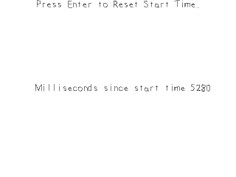
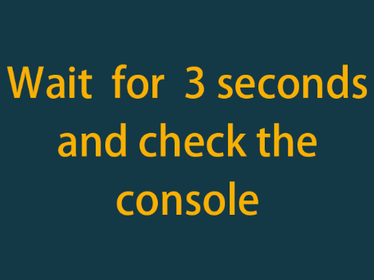
Timing Mechanism
获取时间，定时调用函数
主讲教师： 刘新国
点击这里下载本节课程源码与相关资源

Slide 2
Handle Time

Slide 3
定义全局变量
//Set text color as black
SDL_Color textColor = { 0, 0, 0, 255 };
//Current time start time
Uint32 startTime = 0;
//Start time string
char startTimestr[100];
char timeText[100] ;
//Scene textures
LTexture gPromptTextTexture;
LTexture gTimeTextTexture;
定义文字颜色，Uint32类型时间计时变量，及相应字符数组与文字纹理

Slide 4
loadMedia()
BOOL loadMedia(){
BOOL success = TRUE;
gFont = TTF_OpenFont("09_timing mechanism/myFont.ttf", 28);
if( gFont == NULL )
{
printf(“Failed to load myFont font!”);
success = FALSE;
}
else
{
//Render text
gPromptTextTexture = loadFromRenderedText
("Press Enter to Reset Start Time.", textColor);
printf("Failed to render text texture!\n");
success = FALSE;
}
return success;
}
本例中，文本纹理包括内容不变的提示信息与不断变化的时间信息，loadMedia预加载前一纹理

Slide 5
mian ()
while( !quit )
{
//Handle events on queue
while( SDL_PollEvent( &e ) != 0 )
{
//User requests quit
if( e.type == SDL_QUIT ) {
quit = true;
}
//Reset start time on return keypress
else if( e.type == SDL_KEYDOWN && e.key.keysym.sym == SDLK_RETURN){
startTime = SDL_GetTicks();
}
}
//将时间间隔转为字符数组，用于加载文本纹理
strcpy(timeText, "Milliseconds since start time ");
sprintf(startTimestr, "%d", SDL_GetTicks() - startTime);
strcat(timeText, startTimestr);
SDL_GetTicks()返回从程序启动到目前所经过的时间（单位:毫秒）

Slide 6
mian ()
//重新加载时间纹理
freeLTexture(gTimeTextTexture);
gTimeTextTexture = loadFromRenderedText(timeText, textColor);
if (gTimeTextTexture.mTexture == NULL){
printf("Unable to render time texture!\n");
}
//Clear screen
SDL_SetRenderDrawColor(gRenderer, 19, 57, 70, 0xFF);
SDL_RenderClear(gRenderer);
//Render text
renderTexture(gPromptTextTexture,
(SCREEN_WIDTH - gPromptTextTexture.mWidth) / 2,
0,NULL,0,NULL);
renderTexture(gTimeTextTexture,
(SCREEN_WIDTH –gPromptTextTexture.mWidth)/ 2,
(SCREEN_HEIGHT - gPromptTextTexture.mHeight)/ 2,
NULL, 0, NULL);
//Update screen
SDL_RenderPresent(gRenderer);

Slide 7
Timer Callbacks

Slide 8
init()
//Initialize SDL
if (SDL_Init(SDL_INIT_VIDEO | SDL_INIT_TIMER ) < 0 )
{
printf( “SDL could not initialize!”);
success = FALSE;
}
使用timer callbacks前先初始化SDL_INIT_TIMER

Slide 9
callback()
//Our test callback function
Uint32 callback( Uint32 interval, void* param );
声明回调函数必须遵循特定格式，包括参数个数，参数类型及返回值类型
//Our test callback function
Uint32 callback( Uint32 interval, void* param )
{
//Print callback message
printf( "Callback called back with message: %s\n", (char*)param );
return 0;
}
定义回调函数：在一段时间间隔后在控制台打印一段文字，interval通常用于重复调用自身 函数的情况。
void 类型指针能指向任何数据类型，此处指向字符串

Slide 10
mian ()
SDL_TimerID timerID;
...
//Set callback
timerID = SDL_AddTimer(3 * 1000, callback, "3 seconds waited!");
//While application is running
while( !quit )
{
//Handle events on queue
while( SDL_PollEvent( &e ) != 0 )
{
//User requests quit
if( e.type == SDL_QUIT ) { quit = true; }
//Clear screen
SDL_SetRenderDrawColor( gRenderer, 0xFF, 0xFF, 0xFF, 0xFF );
SDL_RenderClear( gRenderer );
//Render splash
renderTexture(gSplashTexture,0,0,NULL,0,NULL);
//Update screen
SDL_RenderPresent( gRenderer );
}
//Remove timer in case the call back was not called
SDL_RemoveTimer( timerID );
通过SDL_AddTimer()启动回调函数，参数依次为时间间隔（单位毫秒），回调函数名，数据指针。即3秒后调用callback函数，且传入指定内容
启动callback后，该函数将异步执行。若main函数执行完毕还未回调callback，则移除计时器
（SDL_RemoveTimer）

Slide 11
小结
SDL_GetTicks返回程序执行至当前所经历的时间，单位毫秒
重新加载纹理前先释放原纹理内存
使用callBack前需初始化SDL_INIT_TIMER
回调函数具有特定的格式
使用SDL_AddTimer启动回调函数

