Slide 1
FPGA Project Process report
Xingxing Geng
August 23, 2019

Slide 2
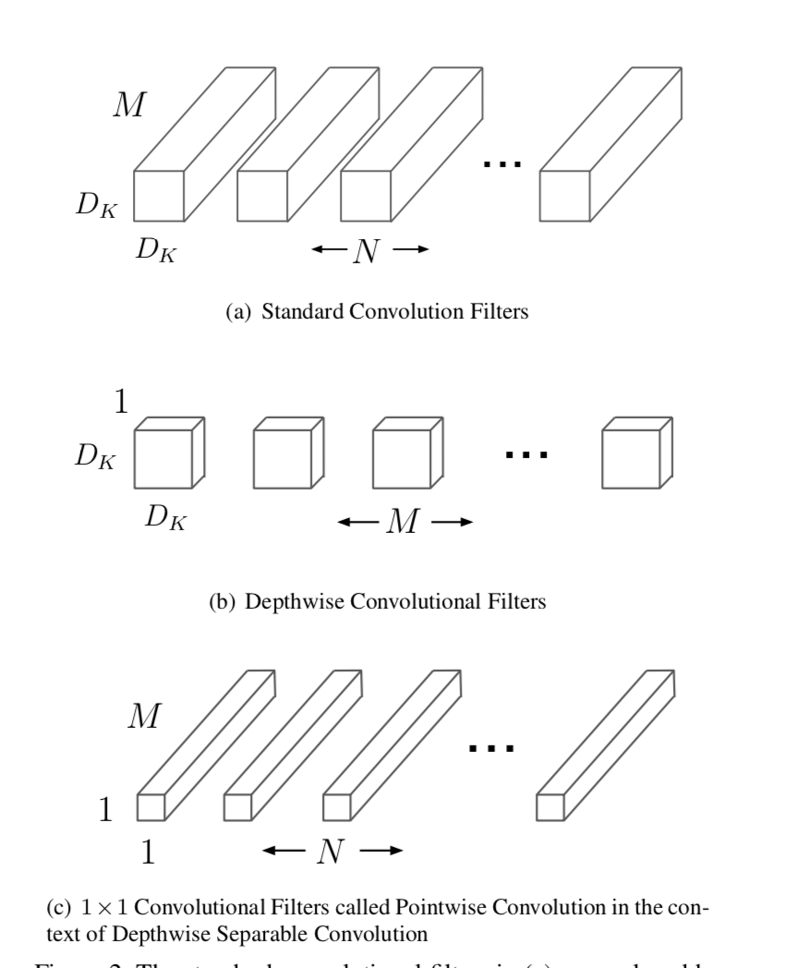
Depthwise separable convolution
#Depthwise convolutional filters = #input channels
#Separable convolutional filters = #output channels = #standard convolution filters
Benefits
have lesser number of parameters to adjust as compared to the standard CNN’s, which reduces overfitting
computationally cheaper because of fewer computations which makes them suitable for mobile vision applications

Slide 3
Current Work
Implementation of Depthwise separable convolution in c++
Only contain depthwise separable convolution layer(Goal is given a picture, perform convolution on it and get the output or display the new picture.
Derived from MobileNet
https://github.com/xingxinggeng/summer_research_weeklyProgress/tree/master/depthwise_sep_conv
Problem so far
Dealing with pictures in c++ which basically depend on OpenCV.
Pre-trained model(weights, bias, means) not handy.

Slide 4
Future study plan
Solve picture loading with OpenCV in c++
Try to write a complete neural network including back propagation training method(since current version only contains a simple forward propagation)
Get pre-trained models for MobileNet, train by self if necessary(caffe)
Transfer c++ code to OpenCL
Mainly write kernel convolution functions
……

Slide 5
References
1. very tiny CNN: https://github.com/sunziping2016/VeryTinyCnn
2. MobileNet : https://github.com/universecool/mobilenet
3. OpenCV: https://docs.opencv.org/2.4/modules/core/doc/intro.html
https://docs.opencv.org/master/d7/d9f/tutorial_linux_install.html
4. cmake document:https: //cmake.org/cmake/help/latest/#

Slide 6
Thank you for listening

