Slide 1


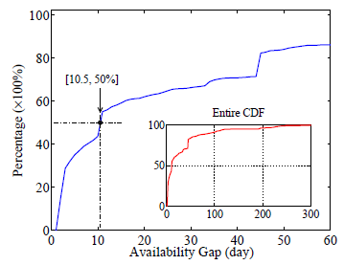
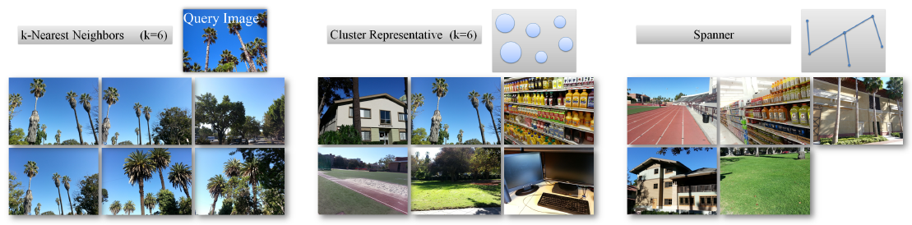
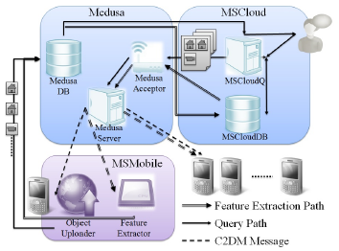
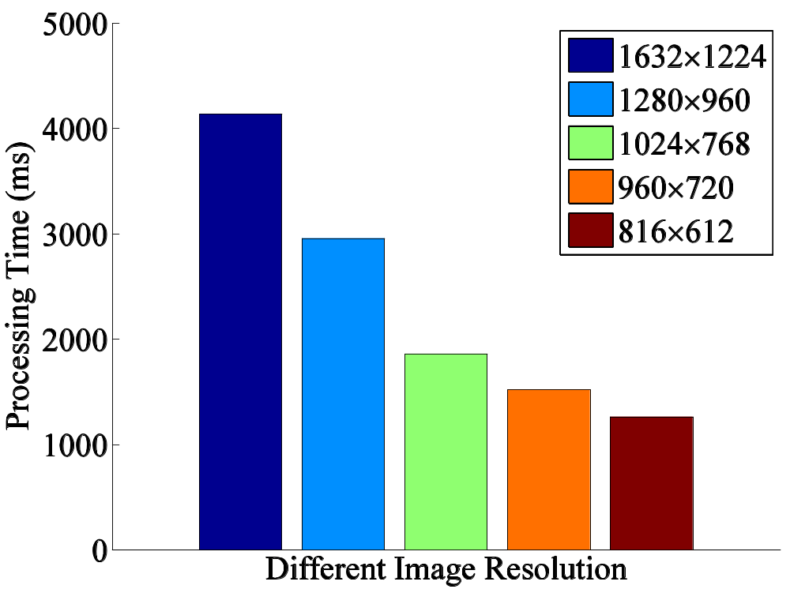
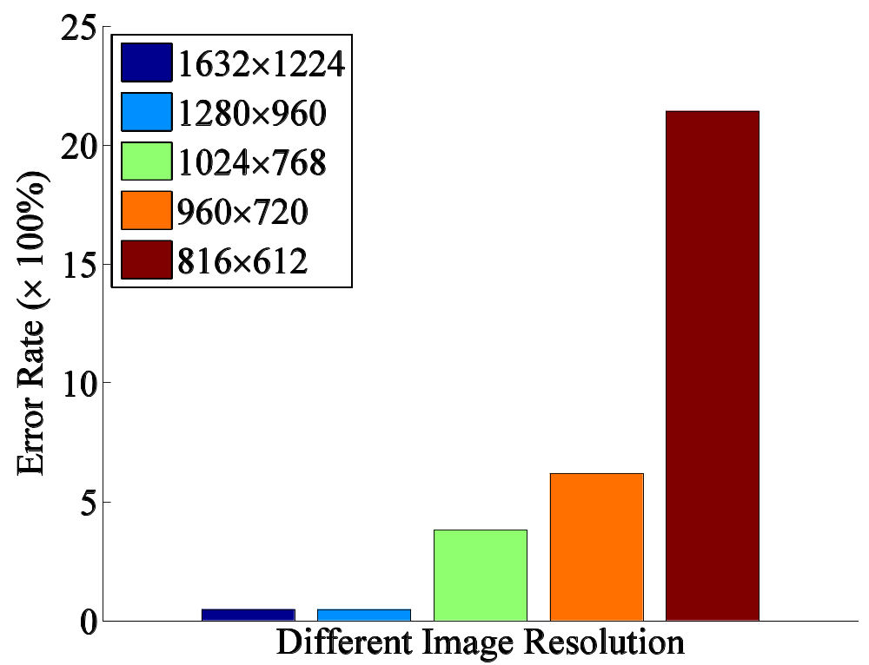
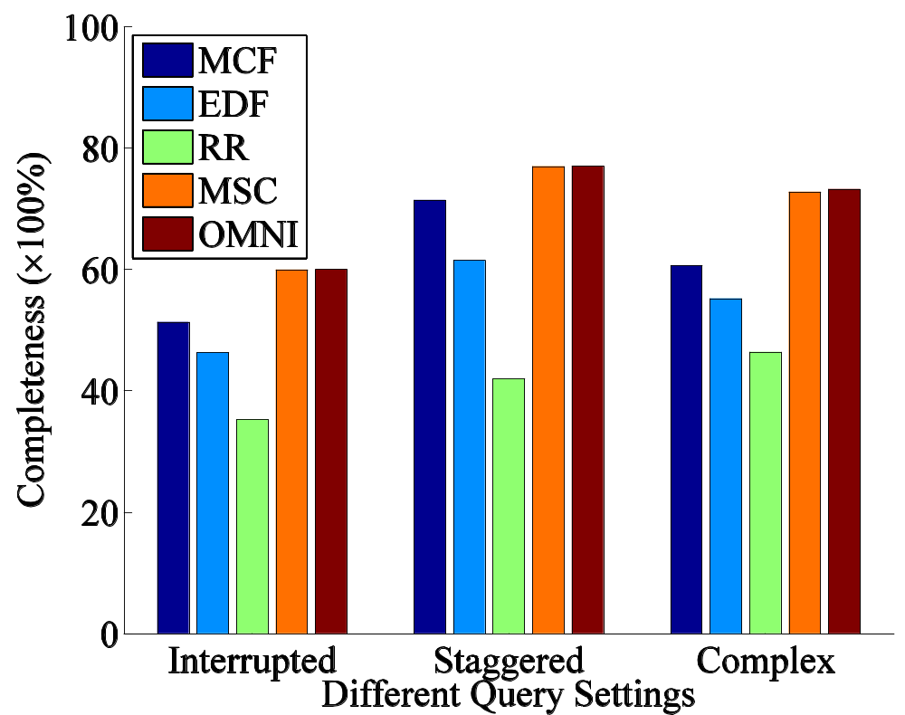
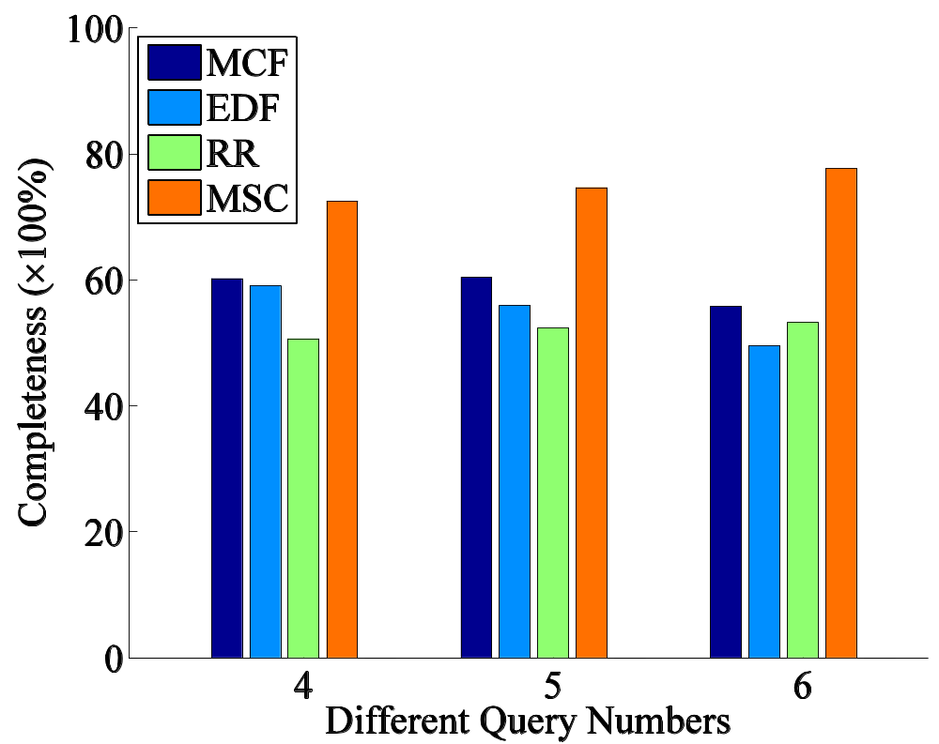
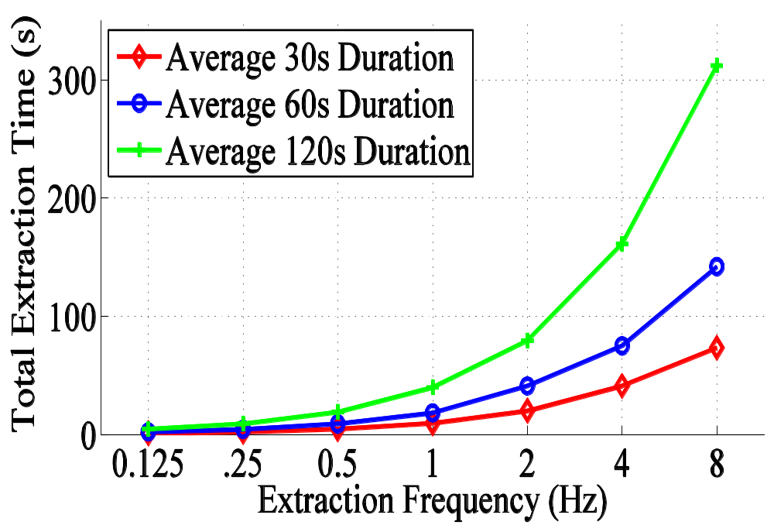
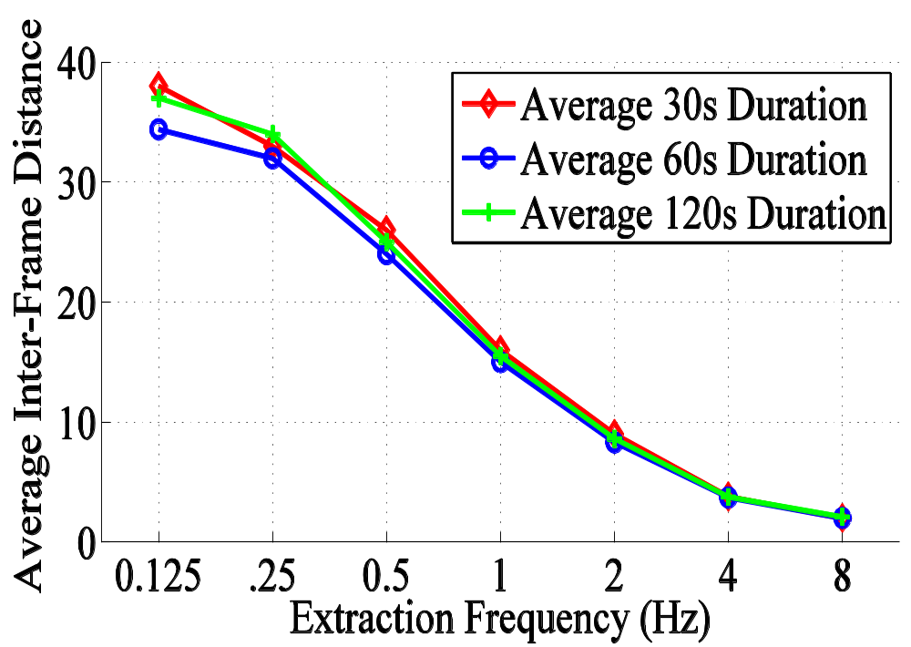
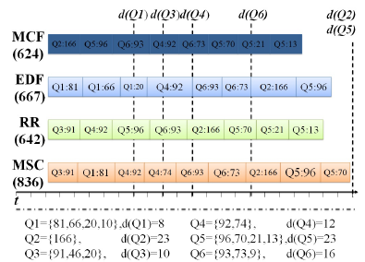
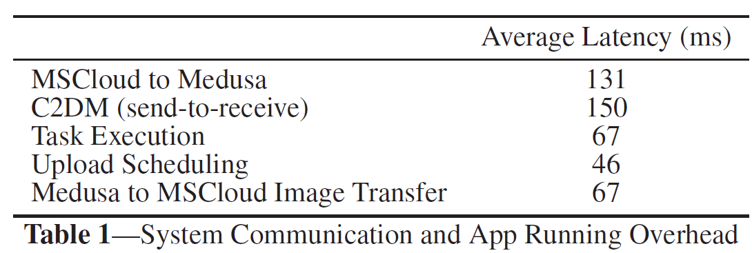
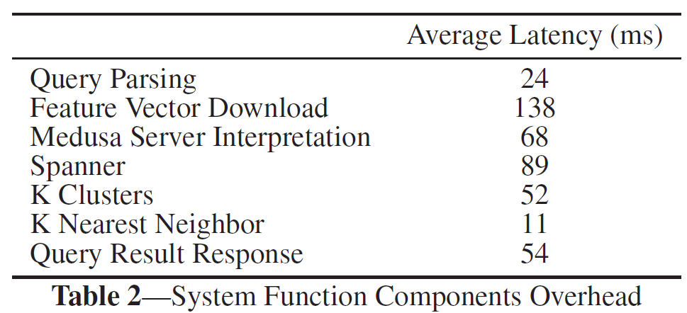
MediaScope: Selective On-Demand Media Retrieval from Mobile Devices
Yurong Jiang, Xing Xu, Peter Terlecky, Tarek Abdelzaher, Amotz Bar-Noy, Ramesh Govindan
  USC NSL, City University of New York, University of Illinois at Urbana-Champaign
Introduction
Media Retrieval from Mobile Devices
Requirements and Challenges
Capability of Mobile Devices
  Capturing tons of good media objects
Wireless Bandwidth is Scarce
  Cannot upload everything immediately
→ Availability Gap!
  We are viewing images of 10 days old!
How to bridge Availability Gap?
  On-demand media retrieval
Retrieval Accuracy
  Features of media files
    Accurate on semantic meaning
    Easy to calculate
    Easy to upload
Timeliness Bound (Retrieval Deadline)
  Upload “best” results for query
Multiple Concurrent Queries
  Upload “good” results for each query
Feature Space Similarity Query on Mobile Devices
Extract Features from Media Files
  Upload (Aggregated) Features
Accept Queries on Feature Space
  k-Nearest Neighbors
  Spanners
  Clusters
Find Media Files to Answer Each Query
On-Demand Media Files Uploading
MediaScope: Selective On-Demand Media Retrieval from Mobile Devices
MSMobile-Feature Extractor
MSCloud-MSCloudQ
CEDD
  Color and Edge Directivity Descriptor
Credit Assignment Mechanism
  Assign a total credit for each query
    proportional to its payment
  Calculate best answers to get selected files
    e.g., run k-NN
  Assign each selected media file a credit
MSMobile-Object Uploader
Credit-Based Scheduling
  Single Query Case
    maximum credit first uploading
      Consider credit only
  Multiple Concurrent Queries Case
    MediaScope Scheduling Algorithm
      Consider credit and timeliness
MSCloud-MSCloudDB
Indexing Collected Features
  Features
  Mobile Device ID
  Media File ID
Evaluation
Feature Extraction
Query Completeness
Video Sampling
System Overhead
Y.Jiang, X.Xu, P. Terlecky, T. Abdelzaher, A. Bar-Noy, R.Govindan, “MediaScope: Selective On-Demand Media Retrieval from Mobile Devices”, ACM IPSN’13, to appear
Computer Science - University of Southern California

