Slide 1
MediaScope: Selective On-Demand Media Retrieval from Mobile Devices
Yurong / Xing

Slide 2
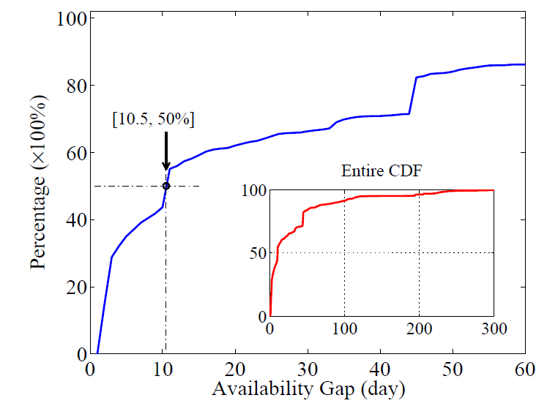
Availability Gap

Slide 3
Motivating Examples
Consider a robbery in a mall in an area uncovered by security cameras. The mall’s security staff would like to be able to access and retrieve images from mobile devices of users who happen to be in the mall on that day in order to be able to establish the identity of the thief.
A sportswriter is writing a report on a sporting event and would like to be able to include a perfect picture of a play (e.g., a catch or a dunk). The newspaper’s staff photographer happened to have been obscured when the play happened, so the sportswriter would like to be able to retrieve images from mobile devices of users who happened to be attending the event.
A talent scout [5] is looking for the next musical sensation and would like to be able to retrieve clips of budding stars. The ability to retrieve video clips, of people singing, taken at parties and other events, can accelerate this search.

Slide 4
On-Demand Retrieval
Image search on feature space
CEDD: texture feature + color feature
144 * 3 bits for each image
Feature defines similarity
Support similarity search context
Top-k, Spanners, Clusters
Examples..

Slide 5
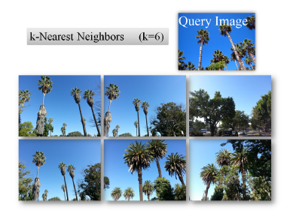

Slide 6
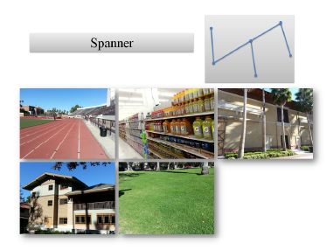

Slide 7
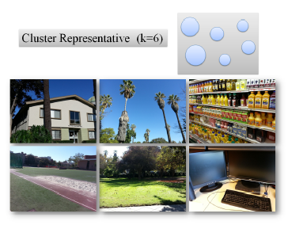

Slide 8
Challenges
1. Feature extraction
For large images …. (yurong)
2. Timeliness constraints
Query result needs to be returned in [D] seconds
User specify
More challenging: concurrent query cases
Queries are “competing”…

Slide 9
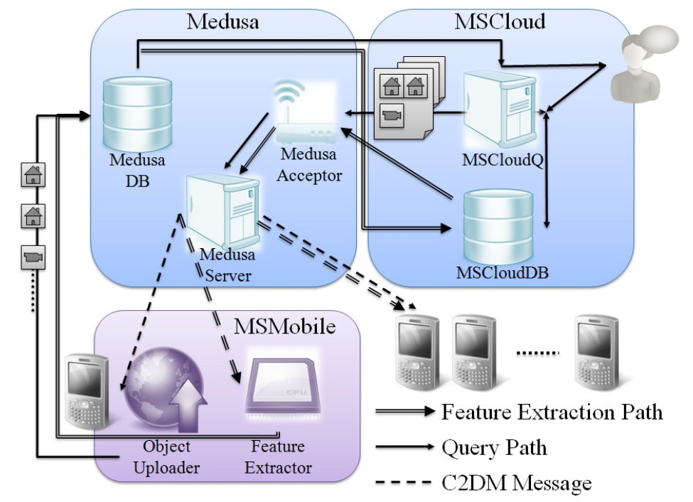
MediaScope

Slide 10
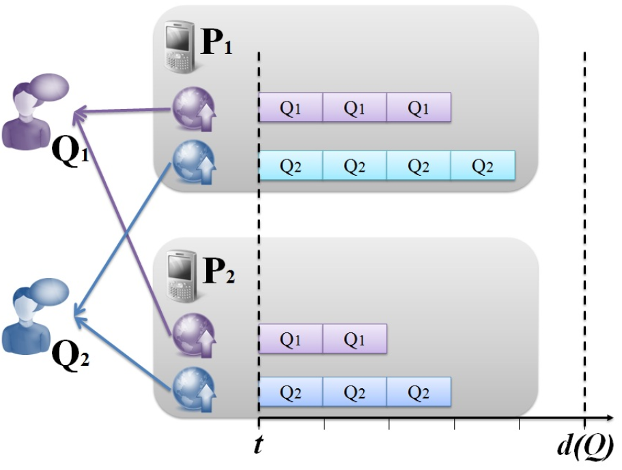
Query completeness vs. timeliness
Single query
Not accurately estimate the retrieval time?
Concurrent queries

Slide 11
Credit Assignment Mechanism
Upload most relevant results
Maximize retrieved information
C(Q) is the importance of query Q
E.g., pay more money, higher C(Q)
In query Q, ∑C(o)=C(Q)
C(o) is the importance of object o
Feature space geometry determines C(o)
Top 2 query, a “very” similar one got 80% of C(Q)
a “not-very” similar one got 20% of C(Q)

Slide 12
Queries and Credit Assignment
Yurong

Slide 13
Extensibility of MSCloudQ
1. Propose query semantics;
2. Implement query algorithm (selection);
3. Assign credits to selected objects;
Notes:
Before we go into detailed implementation of each components…

Slide 14
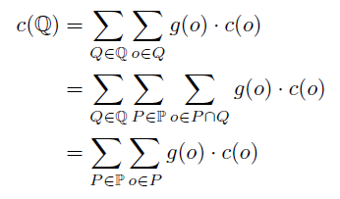
Object Uploader Credit-based Scheduling
Maximizing credits of a series of queries
= Maximizing per device’s credits
→ per device credit maximization uploading

Slide 15
Object Uploader Per Device Scheduling Problem
Input
Objects, with deadlines and credits
Uploading time (estimated) of each object
Output
Upload which object?

Slide 16
Object Uploader Scheduler
Optimal Scheduler (same uploading time)
Arrange object according their deadline
Once there is object cannot uploaded on time, throw away the one with minimum credit
General case (different uploading time)
NP-Hard (Knapsack)
Dynamic programming O(n d(o))
Practical consideration
Estimate t(o) after each object’s uploading
t(o) varies
Incoming new queries

Slide 17
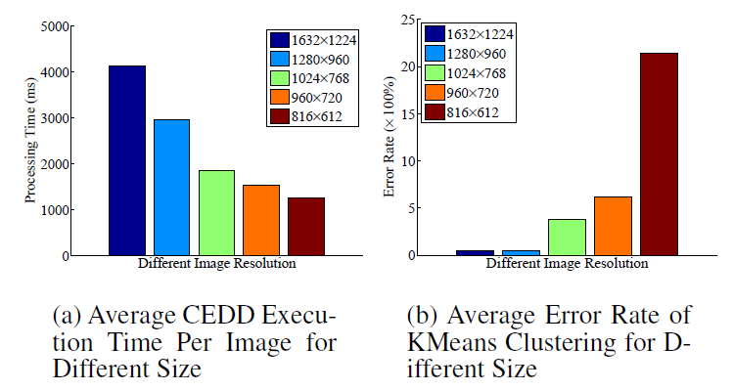
Feature Extractor image

Slide 18
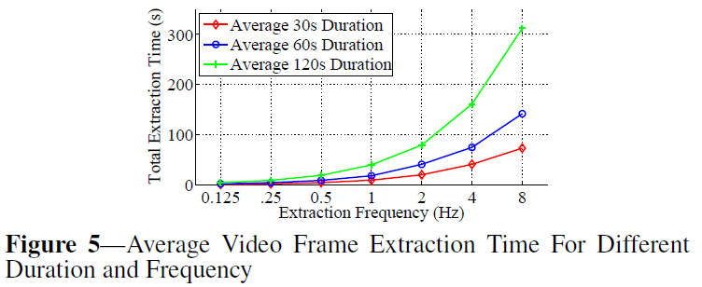
Feature Extractor video

Slide 19
Evaluation Query completeness
Evaluate different “query mixes” on 8 phones with 320 images
Participated schemes:
Max Credit First (MCF)
Earliest Deadline First (EDF)
Round Robin (RR)
Media Scope Credit-based (MSC)

Slide 20
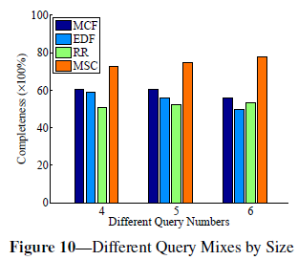
Evaluation Query completeness
Query mixes by query numbers

Slide 21
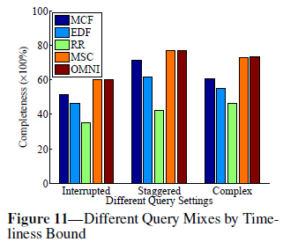
Evaluation Query completeness
Query mixes by timeliness bound
OMNI:

Slide 22
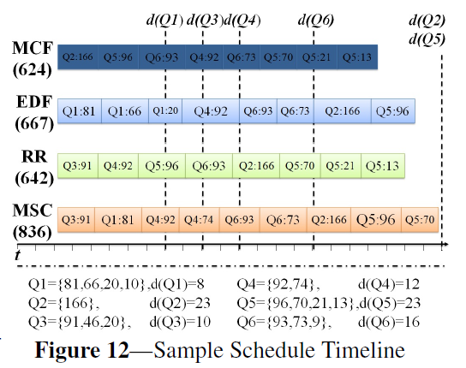
Evaluation One Device Uploading Timeline

Slide 23
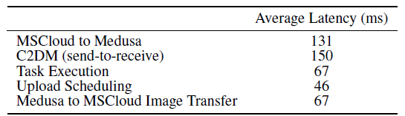
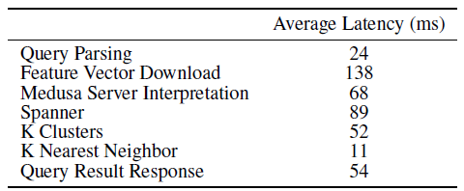
Evaluation System Overhead (delay)

Slide 24
Evaluation System Overhead (energy)
Feature extraction energy cost
On Motorola Droid
Frame extraction: 57uAh
Feature extraction: 331uAh
→ 400+ images consumes 10% droid battery

