Slide 1

Chapter 11
Separate Compilation and Namespaces
Copyright © 2017 Pearson Education, Ltd. All rights reserved.

Slide 2
Learning Objectives
Separate Compilation
Encapsulation reviewed
Header and implementation files
Namespaces
using directives
Qualifying names
Unnamed namespaces
Hiding helping functions
Nested namespaces

Slide 3
Separate Compilation
Program Parts
Kept in separate files
Compiled separately
Linked together before program runs
Class definitions
Separate from programs that use the class
Build library of classes
Re-used by many different programs
Just like predefined libraries
Notes:
程式可以分成很多個檔案，個別編譯，然後要使用再把他們 link 起來
Class 可以只編譯一次，不需重新編譯，所有使用這個 class 的程式都可以 link 到編譯好的 lib

Slide 4
Class Separation
Class Independence
Separate class definition/specification
Called "interface"
Separate class implementation
Place in two files
If implementation changes → only that file need be changed
Class specification need not change
"User" programs need not change
Notes:
實作和宣告 class 也能分開在兩個檔案，個別編譯
改了哪些實作的code，只需要編譯那些包含修改code的檔案

Slide 5
Encapsulation Reviewed
Encapsulation principle:
Separate how class is used by programmer from details of class’s implementation
"Complete" separation
Change to implementation → NO impact on any other programs
Basic OOP principle
Notes:
修改實作不會影響到其他使用這個 class 的 code，且不需要重編

Slide 6
Encapsulation Rules
Rules to ensure separation:
All member variables should be private
Basic class operations should be:
Public member functions
Friend or ordinary functions
Overloaded operators
Group class definition and prototypes together
Called “interface” for class
Make class implementation unavailable to users of class
Notes:
不讓使用者看見或修改實作

Slide 7
More Class Separation
Interface File
Contains class definition with function and operator declarations/prototypes
Users “see” this → specify how to use it
Separate compilation unit
Implementation File
Contains member function definitions
Separate compilation unit

Slide 8
Class Header Files
Class interface always in header file
Use .h naming convention
Programs that use class will "include" it
#include "myclass.h"
Quotes indicate you wrote header
Find it in "your" working directory
Recall library includes, e.g., <iostream>
< > indicate predefined library header file
Find it in library directory

Slide 9
Class Implementation Files
Class implementation in .cpp file
Typically give interface file and implementation file same name
myclass.h and myclass.cpp
All class’s member function defined here
Implementation file must #include class’s header file
.cpp files in general, typically contain executable code
e.g., Function definitions, including main()

Slide 10
Class Files
Class header file #included by:
Implementation file
Program file
Often called "application file" or "driver file"
Organization of files is system dependent
Typical IDE has "project" or "workspace"
Implementation files "combined" here
Header files still "#included"
Notes:
Project 等於是自動幫你把 makefile 寫好，可以編出你要的 program

Slide 11
Multiple Compiles of Header Files
Header files
Typically included multiple times
e.g., class interface included by class implementation and program file
Must only be compiled once!
No guarantee "which #include" in which file, compiler might see first
Use preprocessor
Tell compiler to include header only once
Notes:
其實一個 header 檔案裡的內容 像是 class 宣告，只能被編譯一次
那要如何保證呢？
我們需要使用 #ifndef

Slide 12
Using #ifndef
Header file structure:
#ifndef FNAME_H #define FNAME_H … //Contents of header file … #endif
FNAME typically name of file for consistency, readability
This syntax avoids multiple definitions of header file

Slide 13
Other Library Files
Libraries not just for classes
Related functions
Prototypes → header file
Definitions → implementation file
Other type definitions
structs, simple typedefs → header file
Constant declarations → header file
Notes:
Library 裡面也會有一些 function，不一定只有 class
這部分也一樣，把宣告放在 header，把 implement 放在 cpp

Slide 15
Namespaces
Namespace defined: A collection of name definitions
Class definitions
Variable declarations
Programs use many classes, functions
Commonly have same names
Namespaces deal with this
Can be "on" or "off"
If names might conflict → turn off
Notes:
Namespace 定義底下可以有 class 和變數，例如 cin cout 就在 std 底下，也就是說，其實你也可以自己命名另一個變數是 cin 在其他 namespace 底下，只要前面的 namespace 有掛上去，就不會混亂

Slide 16
using Directive
using namespace std;
Makes all definitions in std namespace available
Why might you NOT want this?
Can make cout, cin have non-standard meaning
Perhaps a need to redefine cout, cin
Can redefine any others
Use lemon::Node or define your own Node in your own namespace
Notes:
Lemon 是一個開放的 graph library，裡面幫你寫好了很多種 class 和 function
例如，你可以用它產生一個 graph 的 object，然後在裡面做 Dijkstra algorithm, BFS, DFS 等等
當然，你也可以定義自己的 graph 和自己的 Node

Slide 17
Namespace std
We’ve used namespace std
Contains all names defined in many standard library files
Example: #include <iostream>
Places all name definitions (cin, cout, etc.) into std namespace
Program doesn’t know names (i.e., use cin without std → error)
Must specify this namespace for program to access names (using namespace xxx or xxx::yyy)

Slide 18
Global Namespace
All code goes in some namespace
Unless specified → global namespace
No need for using directive
Global namespace always available
Implied "automatic" using directive
Notes:
Code 一定在某個 namespace，當你沒指定，則在 global namespace
可以想像成自動幫你安排在 global namespace

Slide 19
Multiple Names
Multiple namespaces
e.g., global, and std typically used
e.g., global, std, and lemon
What if name defined in both?
Error
Can still use both namespaces
Must specify which namespace used at what time (HOW? Next page)
Notes:
若兩個 namespace 有相同變數名稱，則可能發生錯誤
不管是 run-time error or compiler error，總之是危險的
但我們仍然可以在同一個 file 中，用兩個有重複定義的 namespace，怎麼弄呢？看下一頁

Slide 20
Specifying Namespaces
Given namespaces NS1, NS2
Both have void function myFunction() defined differently
{ using namespace NS1; myFunction(); } { using namespace NS2; myFunction(); }
using directive has block-scope
Notes:
使用 block scope 來避免問題

Slide 21
Creating a Namespace
Use namespace grouping: namespace Name_Space_Name { Some_Code }
Places all names defined in Some_Code into namespace Name_Space_Name
Can then be made available: using namespace Name_Space_Name
Notes:
那我們如何自己定義 namespace？

Slide 22
Creating a Namespace Example
Function declaration: namespace Space1 { void greeting(); }
Function definition: namespace Space1 { void greeting() { cout << "Hello from namespace Space1.\n"; } }

Slide 23
using Declarations
Can specify individual names from namespace
Consider: Namespaces NS1, NS2 exist Each have functions fun1(), fun(2)
Declaration syntax: using Name_Space::One_Name;
Specify which name from each: using NS1::fun1; using NS2::fun2;
Another example using lemon::ListDigraph;
Notes:
我如果只想用其中一個東西，是否可以取出 namespace 的東西
答案是可以的，可以指定某個特定的東西

Slide 24
using Definitions and Declarations
Differences:
using declaration (e.g., using NS1::fun1;)
Makes ONE name in namespace available
Introduces names so no other uses of name are allowed
using directive (e.g., using namespace std;)
Makes ALL names in namespace available
Only "potentially" introduces names
If both NS1 and NS2 have the same function name using namespace NS1; using namespace NS2; → No error
Notes:
Directive 中文是前置處理指令

Slide 25
Qualifying Names
Can specify where name comes from
Use "qualifier" and scope-resolution operator
Used if only intend one use (or few)
NS1::fun1();
Specifies that fun1() comes from namespace NS1
Especially useful for parameters: int getInput(std::istream inputStream);
Parameter found in istream’s std namespace
Eliminates need for using directive or declaration
Notes:
你也可以明明確確地直接寫出namespace::function
這樣不會有問題，可以正確運作
或者說，如果你只用這麼一次，那乾脆別用 using namespace std;

Slide 26
Naming Namespaces
Include unique string
Like last name
Reduces chance of other namespaces with same name
Often multiple programmers write namespaces for same program
Must have distinct names
Without → multiple definitions of same name in same scope
Results in error
Notes:
把你的名字當作 namespace 是一種不錯的想法，因為很特別，不容易跟別人一樣，尤其在多人合作的 project 中，可以用這樣的方式來分割每個 programmer 的區域

Slide 27
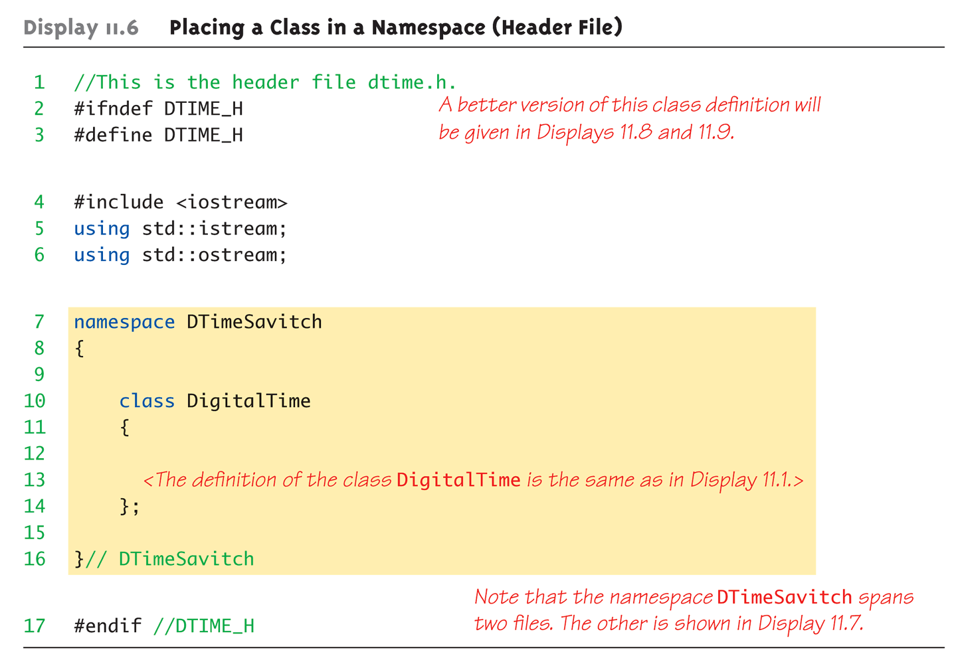
Class Namespace Example: Display 11.6 Placing a Class in a Namespace (Header File)

Slide 28
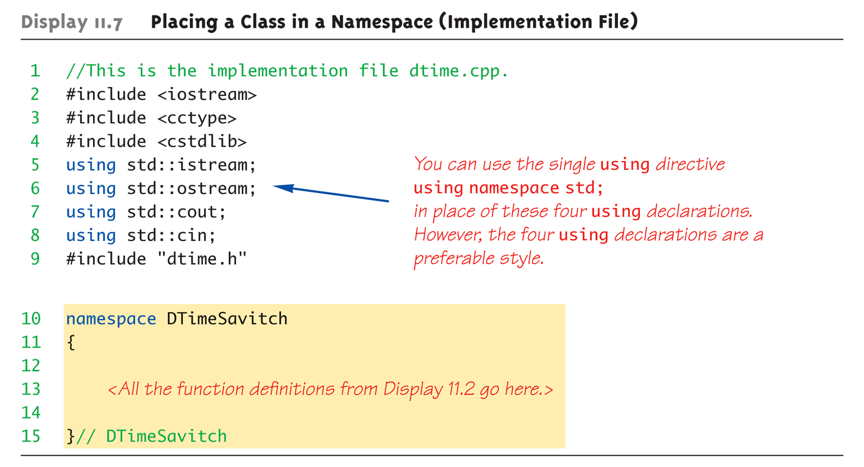
Class Namespace Example: Display 11.7 Placing a Class in a Namespace (Implementation File)

Slide 29
Unnamed Namespaces
Compilation unit defined:
A file, along with all files #included in file
Every compilation unit has unnamed namespace
Written same way, but with no name
All names are then local to compilation unit
Use unnamed namespace to keep things "local”
The names can be reused for something else outside the compilation unit
Scope of unnamed namespace is compilation unit
Notes:
編譯的單位：一個檔案和他的header

Slide 30
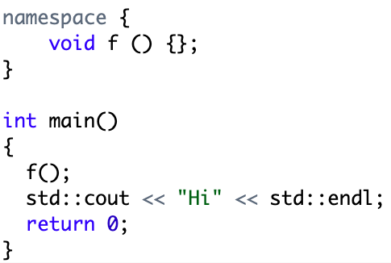
Unnamed Namespaces
Compilation unit defined:
A file, along with all files #included in file
Every compilation unit has unnamed namespace
Written same way, but with no name
All names are then local to compilation unit
Use unnamed namespace to keep things "local”
The names can be reused for something else outside the compilation unit
Scope of unnamed namespace is compilation unit
Notes:
編譯的單位：一個檔案和他的header

Slide 31
Global vs. Unnamed Namespaces
Not same
Global namespace:
No namespace grouping at all
Global scope
Unnamed namespace:
Has namespace grouping, just no name
Local scope

Slide 32
Nested Namespaces
Legal to nest namespaces namespace S1 { namespace S2 { void sample() { … } } }
Qualify names twice:
S1::S2::sample();

Slide 33
Hiding Helping Functions
Recall helping function:
Low-level utility
Not for public use
Two ways to hide:
Make private member function
If function naturally takes calling object
Place in class implementation’s unnamed namespace!
If function needs no calling object
e.g., read input from standard input
Makes cleaner code (no qualifiers)

Slide 34
Summary 1
Can separate class definition and implementation → separate files
Separate compilation units
Namespace is a collection of name definitions
Three ways to use name from namespace:
Using directive
Using declaration
Qualifying

Slide 35
Summary 2
Namespace definitions are placed inside namespace groupings
Unnamed namespace
Used for local name definitions
Scope is compilation unit
Global namespace
Items not in a namespace grouping at all
Global scope

