Slide 1
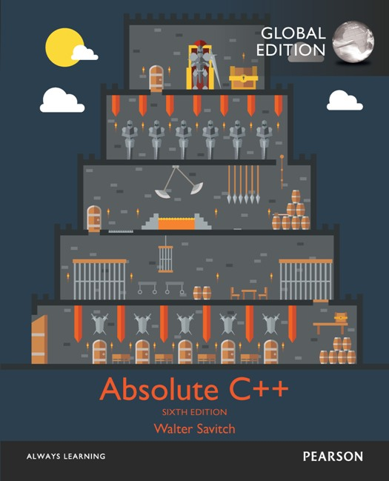
Chapter 15
Polymorphism and Virtual Functions
Copyright © 2017 Pearson Education, Ltd. All rights reserved.

Slide 2
Learning Objectives
Virtual Function Basics
Late binding
Implementing virtual functions
When to use a virtual function
Abstract classes and pure virtual functions
Pointers and Virtual Functions
Extended type compatibility
Downcasting and upcasting
C++ "under the hood" with virtual functions

Slide 3
Recall: Pointer Upcasting
class pokemon{ void attack(); };
class firePokemon: public pokemon{
void attack();
}
A Crisis??
firePokemon a; pokemon *p = &a; pokemon &r = a;
p->attack(); r.attack();
Cannot know that p and r actually points to a firePokemon object → Polymorphism (next chapter)

Slide 4
Figures Example
Base class class Figure{ draw(); erase(); center(); // erase the figure and call draw(); }
Derived class class Circle{ centerPoint, radius; draw(); erase(); }
pFig->draw() ???
class Rectangle{
width, height, centerPoint; draw(); erase(); }

Slide 5
Virtual Function Basics
Polymorphism
Associating many meanings to one function
Virtual functions provide this capability
Fundamental principle of object-oriented programming!
Virtual
Existing in "essence" though not in fact
Virtual Function
Can be "used" before it’s "defined”
Notes:
通常在 derived 會有的 function，先在 base 中宣告成 virtual，但在 base 可以不用定義完整（也沒太大意義），因為 base 通常是概念性
Virtual function 允許先宣告 function 名稱，並使用它，之後需要擴充新的 class，可以直接擴張套用到新的 class
要呼叫這個 function 的話，要先在 derived 裡面定義清楚 virtual function 要做哪些事情
盡量要在每個 derived class 裡面把 virtual function 定義清楚

Slide 6
Figures Example (Cont’d)
Best explained by example:
Classes for several kinds of figures
Rectangles, circles, ovals, etc.
Each figure an object of different class
Rectangle data: height, width, center point
Circle data: center point, radius
All derived from one parent-class: Figure
Require function: draw()
Different instructions for each figure
Notes:
Oval 橢圓

Slide 7
Figures Example 2
Each class needs different draw function
Can be called "draw" in each class, so: Rectangle r; Circle c; r.draw(); //Calls Rectangle class’s draw c.draw(); //Calls Circle class’s draw
Nothing new here yet…

Slide 8
Figures Example: center()
Parent class Figure contains functions that apply to "all" figures; consider: center(): moves a figure to center of screen
Erases 1st, then re-draws
So Figure::center() would use function draw() to re-draw
Complications!
Which draw() function? From which class?
You actually want to use the derived one’s draw()

Slide 9
Figures Example: center()
class Figure{ public: void center() { cout << ”Fig center" << endl; draw();} void draw () { cout << ”Fig draw" << endl;} }; class Circle: public Figure { public: void draw () { cout << ”Cir draw" << endl;} };
void fun(Figure *tmp) { tmp->center(); }
int main(){ Circle obj; obj.center(); return 0; }
int main(){ Circle obj; fun(&obj); // what will happen? return 0; }
Notes:
兩邊都會錯喔，因為 obj,center() 執行的 draw() 可能是 Figure 的
所以在這種情況下（還沒有 virtual 概念前），你可能會把 center 寫得很配合 Circle

Slide 10
Figures Example: New Figure
Consider new kind of figure comes along: Triangle class derived from Figure class
Function center() inherited from Figure
Will it work for triangles?
obj.center() -> It will use Figure::draw() → won’t work for triangles
tmp.center() -> It will use Figure::draw() → won’t work for triangles
Want inherited function center() to use function Triangle::draw() NOT function Figure::draw()
But class Triangle wasn’t even WRITTEN when Figure::center() was! Doesn’t know "triangles"!
The two parts, Figure and Triangle can be compiled separately

Slide 11
Figures Example: Virtual!
Virtual functions are the answer
Tells compiler:
"Don’t know how function is implemented"
"Wait until used in program"
"Then get implementation from object instance"
Called late binding or dynamic binding
Virtual functions implement late binding
Wait until the run time to determine the implementation of a procedure

Slide 12
Figures Example: center() (Cont’d)
class Figure{ public: void center() { cout << ”Fig center" << endl; draw();} virtual void draw () {} }; class Circle: public Figure { public: void draw () { cout << ”Cir draw" << endl;} };
void fun(Figure *tmp) { tmp->center(); }
int main(){ Circle obj; obj.center(); return 0; }
int main(){ Circle obj; fun(&obj); // what will happen? return 0; }
Notes:
這一次就對了，神奇，一切歸功於 virtual

Slide 14
Virtual Functions: Another Example
Bigger example best to demonstrate
Record-keeping program for automotive parts store （汽車零件商紀錄保存程式）
Track sales. We don’t know all sale types yet
1st only regular retail sales
Later, new types of sales are added: Discount sales Mail-order (with a shipping charge)
Depend on other factors besides just price, tax
Notes:
假設我們要做一個汽車零件商的紀錄保存程式，但是我們一開始不知道有哪些販售模式，之後可能會擴充，所以要寫得有彈性

Slide 15
Virtual Functions: Auto Parts
Program must:
Compute daily gross sales （銷售總額）
Calculate largest/smallest sales of day
Perhaps average sale for day
All come from individual bills
But many functions for computing bills will be added "later"!
When different types of sales added!
So function for “computing a bill” will be virtual!
Similar to draw() in the previous example
Notes:
要知道上述那些資訊，你必須要蒐集到每一筆個別的交易金額

Slide 16
Class Sale Definition
class Sale // base class { public: Sale(); Sale(double thePrice); double getPrice() const; virtual double bill() const; // return the price double savings(const Sale& other) const; // return the savings if you buy other private: double price; };

Slide 17
Member Functions savings and operator <
double Sale::savings(const Sale& other) const { return (bill() – other.bill()); }
bool operator < ( const Sale& first, const Sale& second) { return (first.bill() < second.bill()); }
Notice that BOTH use member function bill()! Similar to Figure::center() using draw()

Slide 18
Class Sale
Represents sales of single item with no added discounts or shipping charges.
Notice reserved word "virtual" in declaration of member function bill
Impact: Later, derived classes of Sale can define THEIR versions of function bill
Other member functions of Sale will use version based on object of derived class!
They won’t automatically use Sale’s version!
Notes:
沒考慮打折和運費

Slide 19
Derived Class DiscountSale Defined
class DiscountSale : public Sale { public: DiscountSale(); DiscountSale( double thePrice, double the Discount); double getDiscount() const; void setDiscount(double newDiscount); double bill() const; private: double discount; };

Slide 20
DiscountSale’s Implementation of bill()
double DiscountSale::bill() const { double fraction = discount/100; // get the discount return (1 – fraction)*getPrice(); }
Qualifier "virtual" does not go in actual function definition → wait until the run time
"Automatically" virtual in derived class
Declaration (in interface) not required to have "virtual" keyword either (but usually does)

Slide 21
DiscountSale’s Implementation of bill()
Virtual function in base class:
"Automatically" virtual in derived class
Derived class declaration (in interface)
Not required to have "virtual" keyword
But typically included anyway, for readability

Slide 22
Derived Class DiscountSale
DiscountSale’s member function bill() implemented differently than Sale’s
Particular to "discounts"
Member functions savings and "<"
Will use this definition of bill() for all objects of DiscountSale class!
Instead of "defaulting" to version defined in Sales class!

Slide 23
Virtual: Wow!
Recall class Sale written long before derived class DiscountSale
Members savings and "<" compiled before even had ideas of a DiscountSale class
Yet in a call like: DiscountSale d1, d2; d1.savings(d2);
Call in savings() to function bill() knows to use definition of bill() from DiscountSale class
Powerful and magic!

Slide 24
Virtual: How?
To write C++ programs:
Assume it happens by "magic"!
But explanation involves late binding
Virtual functions implement late binding
Tells compiler to "wait" until function is used in program
Decide which definition to use based on calling object
Very important OOP principle!

Slide 26
Overriding
Virtual function definition changed in a derived class
We say it’s been "overidden"
Similar to redefined
Recall: for standard functions
So:
Virtual functions changed: overridden
Non-virtual functions changed: redefined

Slide 27
C++11 override keyword
C++11 includes the override keyword to make it clear if a function is overridden or redefined
class Sale
{
public:
…
virtual double bill() const;
…
};
Makes it explicit that this function overrides bill() in the Sale class
class DiscountSale : public Sale
{
public:
…
double bill() const override;
…
};
Notes:
如果那個 function bill() 不是 virtual，但我們加上 override 則會發生 compiler error

Slide 28
C++11 final keyword
C++11 includes the final keyword to prevent a function from being overridden. Useful if a function is overridden but don’t want a derived classes to override it again.
Cannot override
class Sale
{
public:
…
virtual double bill() const final;
…
};
Results in compiler error
class DiscountSale : public Sale
{
public:
…
double bill() const;
…
};

Slide 29
Virtual Functions: Why Not All?
Clear advantages to virtual functions as we’ve seen
One major disadvantage: overhead!
Uses more storage
Late binding is "on the fly", so programs run slower
So if virtual functions not needed, should not be used
Notes:
他強大，但是也耗費資源，沒必要的情況下，可以不要使用它

Slide 30
Pure Virtual Functions
Base class might not have "meaningful" definition for some of it’s members!
It’s purpose solely for others to derive from
Recall class Figure
All figures are objects of derived classes
Rectangles, circles, triangles, etc.
Class Figure has no idea how to draw!
Make it a pure virtual function: virtual void draw() = 0;

Slide 31
Abstract Base Classes
Pure virtual functions require no definition
Forces all derived classes to define "their own" version
Class with one or more pure virtual functions is: abstract base class
Can only be used as base class
No objects can ever be created from it
Since it doesn’t have complete "definitions" of all it’s members!
Is still a type → can be parameters of functions
If derived class fails to define all pure’s:
It’s an abstract base class too
Notes:
如果一個 derived 也沒把所有 pure virtual 定義完，那他也是 abstract

Slide 33
Extended Type Compatibility
Given: Derived is derived class of Base
Derived objects can be assigned to objects of type Base
But NOT the other way!
Consider previous example:
A DiscountSale "is a" Sale, but reverse not true
i.e., A Sale is not a discountSale

Slide 34
Extended Type Compatibility Example
class Pet { public: string name; virtual void print() const; // not pure virtual here }; class Dog : public Pet { public: string breed; //品種 virtual void print() const; };

Slide 35
Classes Pet and Dog
Now given declarations: Dog vdog; Pet vpet;
Notice member variables name and breed are public!
For example purposes only! Not typical!

Slide 36
Using Classes Pet and Dog
Anything that "is a" dog "is a" pet:
vdog.name = "Tiny"; vdog.breed = "Great Dane"; vpet = vdog;
These are allowable
Can assign values to parent-types, but not reverse
A pet "is not a" dog (not necessarily)
Lose the breed field (i.e., slicing problem)
Notes:
Breed 品種，Great Dane 大丹犬

Slide 37
Slicing Problem
Notice value assigned to vpet "loses" it’s breed field!
cout << vpet.breed;
Produces ERROR msg!
Called slicing problem
The object is “sliced” → the remains = destination type
Might seem appropriate
Dog was moved to Pet variable, so it should be treated like a Pet
And therefore not have "dog" properties
Makes for interesting philosphical debate

Slide 38
Slicing Problem Fix
In C++, slicing problem is nuisance
It still "is a" Great Dane named Tiny
We’d like to refer to it’s breed even if it’s been treated as a Pet
Can do so with pointers to dynamic variables
Notes:
Nuisance 滋擾的、煩的

Slide 39
Slicing Problem Example
Pet *ppet; Dog *pdog; pdog = new Dog; pdog->name = "Tiny"; pdog->breed = "Great Dane"; ppet = pdog;
Cannot access breed field of object pointed to by ppet: cout << ppet->breed; //ILLEGAL!
How to access breed?

Slide 40
Slicing Problem Example
Must use virtual member function: ppet->print();
Calls print member function in Dog class!
Because it’s virtual
C++ "waits" to see what object pointer ppet is actually pointing to before "binding" call
Obtain the breed field

Slide 42
Virtual Destructors
Recall: destructors needed to de-allocate dynamically allocated data
Consider: Base *pBase = new Derived; … delete pBase;
Would call base class destructor even though pointing to Derived class object!
Making destructor virtual fixes this!
Good policy for all destructors to be virtual
Notes:
以前我在模擬的時候曾經發生記憶體不夠，可是明明就砍掉 node 了，為什麼還會沒全部砍掉

Slide 43
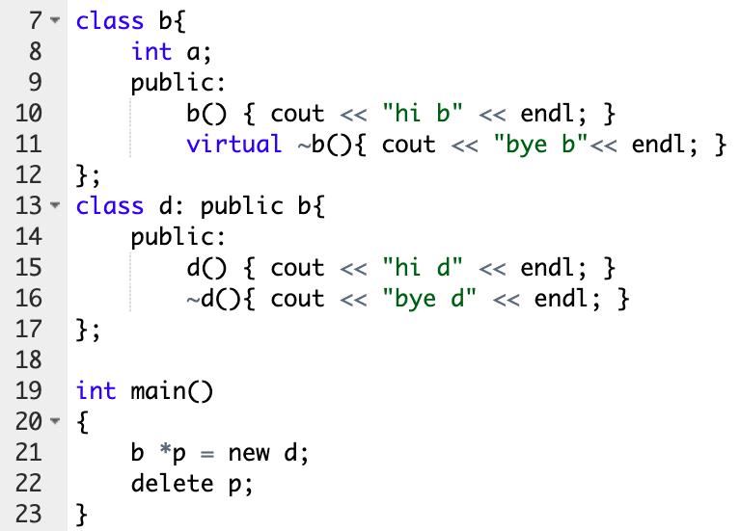
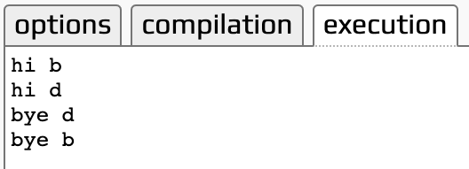
Virtual Destructors
Good policy for all destructors to be virtual
Notes:
以前我在模擬的時候曾經發生記憶體不夠，可是明明就砍掉 node 了，為什麼還會沒全部砍掉

Slide 44
Casting
Consider: Pet vpet; Dog vdog; … vdog = static_cast<Dog>(vpet); //ILLEGAL!
Can’t cast a pet to be a dog, but: vpet = vdog; // Legal! vpet = static_cast<Pet>(vdog); //Also legal!
Upcasting is OK
From descendant type to ancestor type

Slide 45
Downcasting
Downcasting dangerous!
Casting from ancestor type to descended type
Assumes information is "added"
Can be done with dynamic_cast: (Only for pointers) Pet *ppet; ppet = new Dog; Dog *pdog = dynamic_cast<Dog*>(ppet);
Legal, but dangerous!
Downcasting rarely done due to pitfalls
Must track all information to be added
The member functions must be virtual

Slide 46
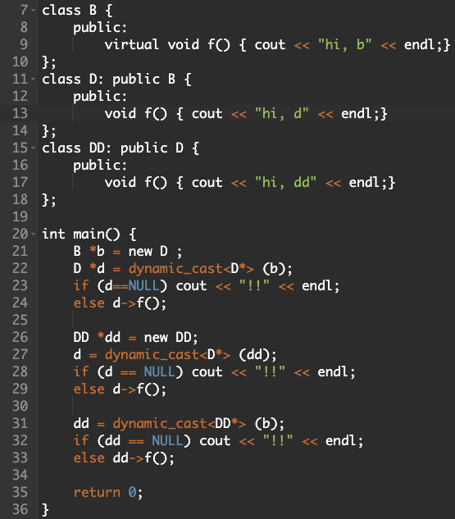


Slide 47
Inner Workings of Virtual Functions
Don’t need to know how to use it!
Principle of information hiding
Virtual function table
Compiler creates it
Has pointers for each virtual member function
Points to location of correct code for that function
Objects of such classes also have pointer
Points to virtual function table
Notes:
每個 class 都有一組由 function pointer 組成的 table

Slide 48
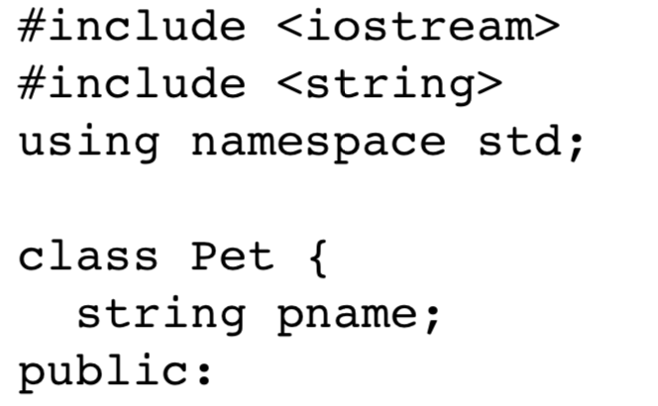
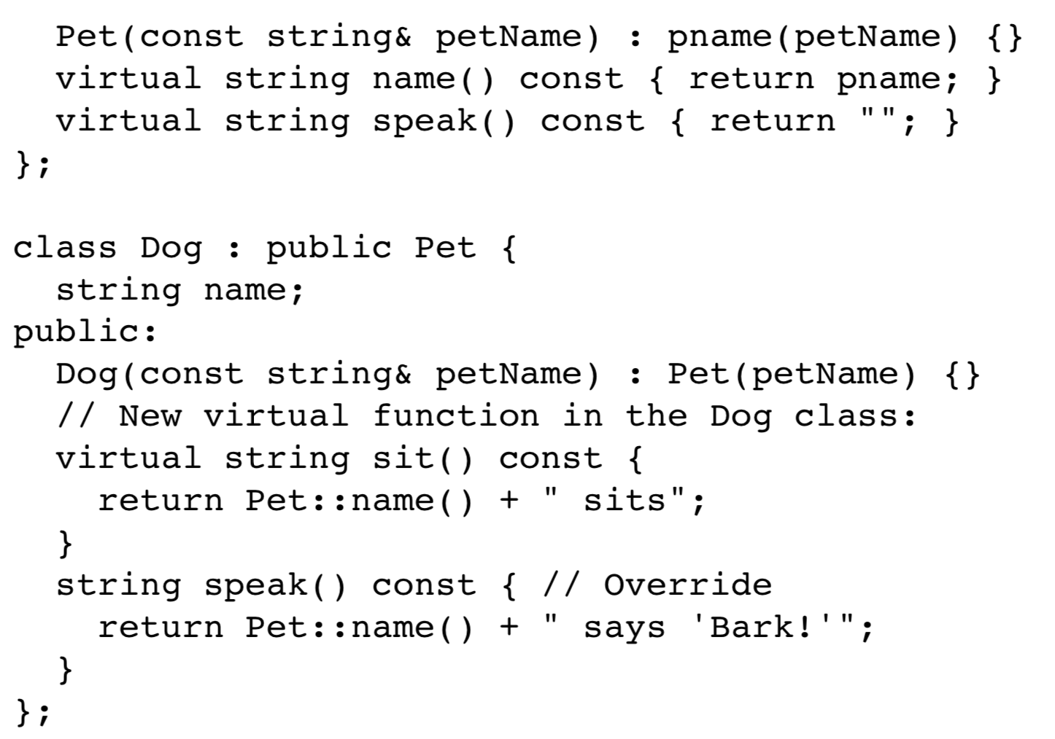
Inner Workings of Virtual Functions
Let’s see the VTABLE
Example: Dog is derived from Pet

Slide 49
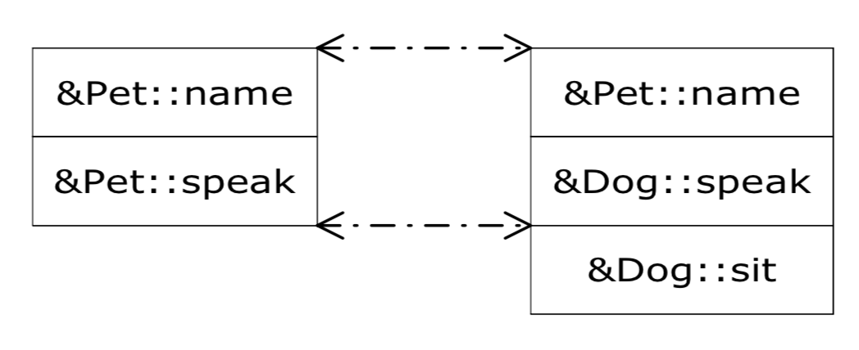
Inner Workings of Virtual Functions
Note we add sit()
Note we only override speak()

Slide 50
Inner Workings of Virtual Functions
Inheritance relation
Base class: Instrument (樂器)
Derived class: Wind (管), Percussion (打擊), Stringed (弦), Brass (銅管)
Notes:
每個 class 都有一組由 function pointer 組成的 table

Slide 51
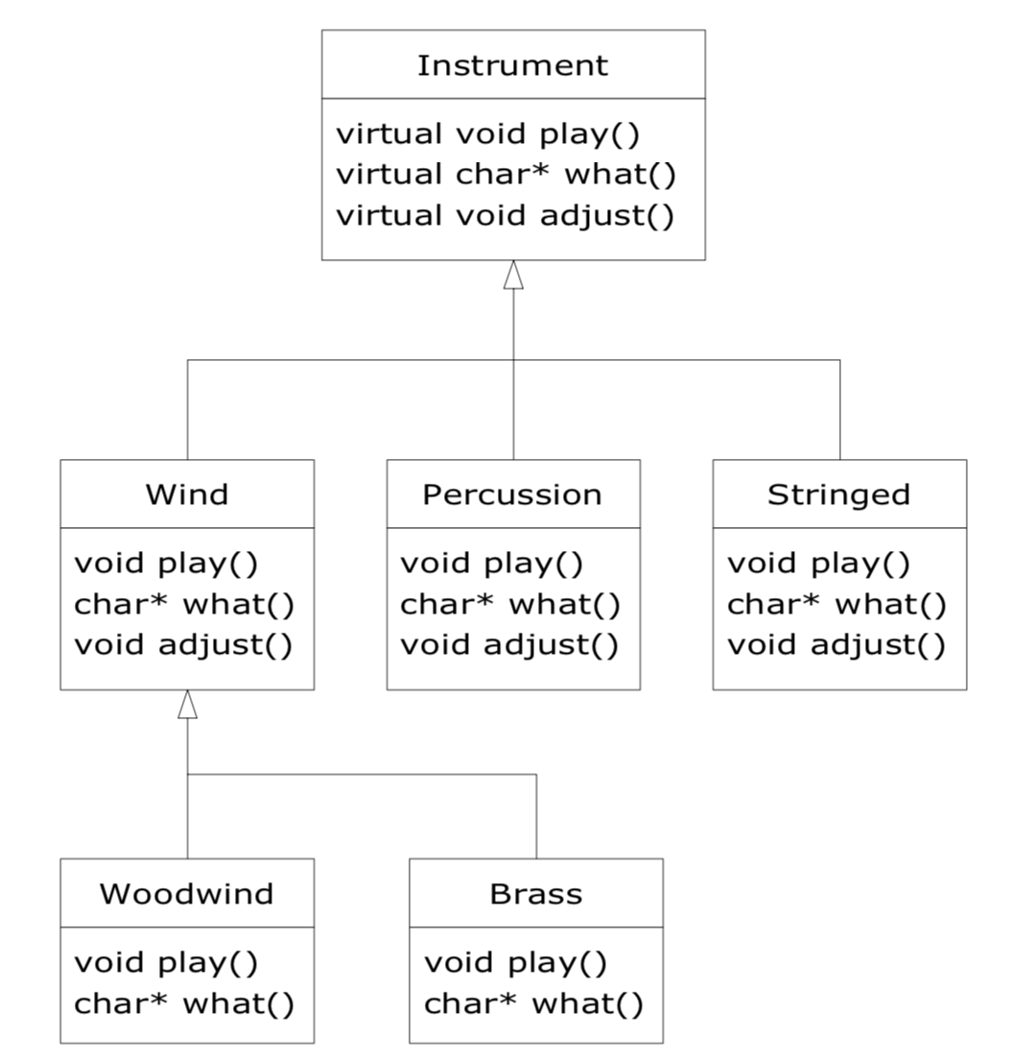
Inner Workings of Virtual Functions
Notes:
每個 class 都有一組由 function pointer 組成的 table

Slide 52
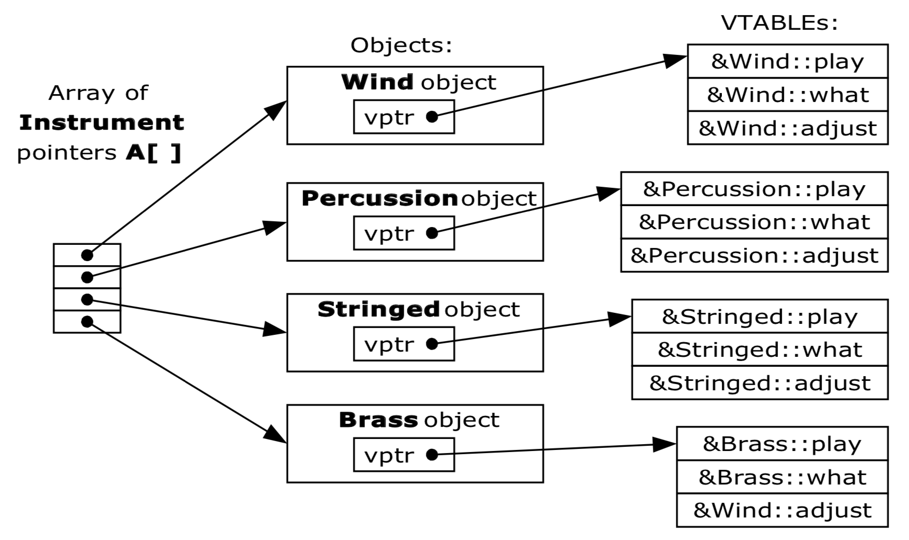
Inner Workings of Virtual Functions
Inheritance relation
Base class: Instrument (樂器)
Derived class: Wind (管), Percussion (打擊), Stringed (弦), Brass (銅管)
Notes:
每個 class 都有一組由 function pointer 組成的 table

Slide 53
Summary 1
Late binding delays decision of which member function is called until runtime
In C++, virtual functions use late binding
Pure virtual functions have no definition
Classes with at least one are abstract
No objects can be created from abstract class
Used strictly as base for others to derive

Slide 54
Summary 2
Derived class objects can be assigned to base class objects
Base class members are lost; slicing problem
Pointer assignments and dynamic objects
Allow "fix" to slicing problem
Make all destructors virtual
Good programming practice
Ensures memory correctly de-allocated

