Slide 1
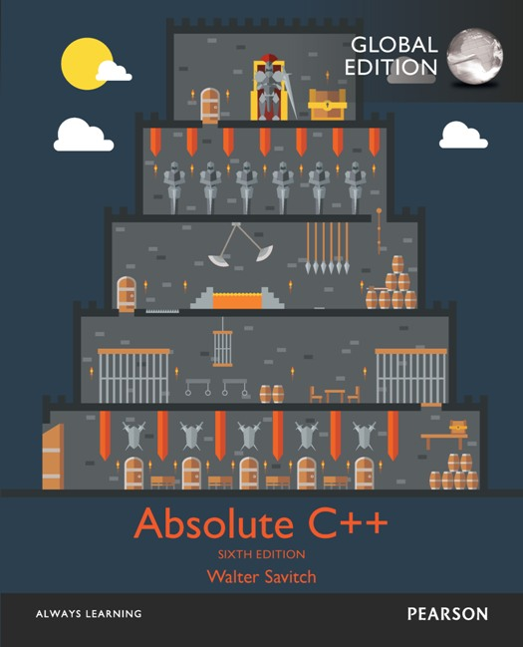
Chapter 16
Templates
Copyright © 2017 Pearson Education, Ltd. All rights reserved.

Slide 2
Learning Objectives
Function Templates
Syntax, defining
Compiler complications
Class Templates
Syntax
Example: array template class
Templates and Inheritance
Example: partially-filled array template class

Slide 3
Recall the Stash
We want to write code that
Does not know the type of object, and
Easily instantiate a new version for every type that we want to contain
We use unsigned character array to store data of any type to implement Stash

Slide 4
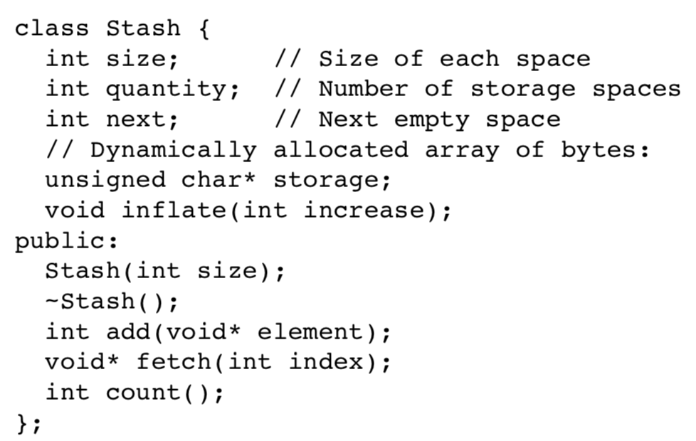
Recall the Stash
We use unsigned character array to store data of any type to implement Stash

Slide 5
Recall the Stash
We use unsigned character array to store data of any type to implement Stash
The users have to exactly know the data type
Otherwise, users may convert the data to the wrong type
The class has to know the type of the object to remove the data
Hard to support various classes; the objects may be created or removed incompletely
e.g., class consisting of a dynamic array

Slide 6
Recall the Stash
Can we make the type name as an parameter? unsigned character → any type that we want

Slide 7
Recall the Stash
Can we make the type name as an parameter? unsigned character → any type that we want
But, how?
The first answer is polymorphism
All classes are derived from a base class for some languages
e.g., Smalltalk has only one inheritance tree rooted at Object
But C++ allows multiple inheritance tree roots
See the example of class Stash with data type string
In Smalltalk
object
string

Slide 8
Use Polymorphism
…
string
object
myString
object **storage;
class object{
virtual ~object() = 0;
};
inline object::object() {}
class myString: public string, public object {
myString(string s): string(s){}
};

Slide 9
Recall the Stash
Can we make the type name as an parameter? unsigned character → any type that we want
However,
We only store uniform-type in the Stash in most cases
Polymorphism requires additional overhead
Multiple-inheritance is dangerous
Another answer is Template: type is a parameter
Reuse source code; More elegant and simpler

Slide 11
Introduction
C++ templates
Allow very "general" definitions for functions and classes
Type names are "parameters" instead of actual types
Precise definition determined at compile time

Slide 12
Function Templates
Recall function swapValues: void swapValues(int& var1, int& var2) { int temp; temp = var1; var1 = var2; var2 = temp; }
Applies only to variables of type int
But users may want code to work for any types!

Slide 13
Function Templates vs. Overloading
Could overload function for chars: void swapValues(char& var1, char& var2) { char temp; temp = var1; var1 = var2; var2 = temp; }
But notice: code is nearly identical!
Only difference is type used in 3 places
i.e., temp, var1, var2

Slide 14
Function Template Syntax
Allow "swap values" of any type variables: template<class T> void swapValues(T& var1, T& var2) { T temp; temp = var1; var1 = var2; var2 = temp; }
First line called "template prefix"
Tells compiler what’s coming is "template"
And that T is a type parameter

Slide 15
Template Prefix
Recall: template<class T>
In this usage, "class" means "type", or "classification”
T can be replaced by any type (class or not class)
Can be confused with other "known" use of word "class"!
C++ allows keyword "typename" in place of keyword "class" here
But most use "class" anyway
Notes:
你可以用 typename or class 來當作 T 的前行字

Slide 16
Template Prefix 2
Again: template<class T>
T can be replaced by any type
Predefined or user-defined (like a C++ class type)
In function definition body:
T used like any other type
Note: can use other than "T", but T is "traditional" usage
e.g., T1, T2, …

Slide 17
Function Template Definition
swapValues() function template is actually large "collection" of definitions!
A definition for each possible type!
Compiler only generates definitions when required
But it’s "as if" you’d defined for all types
Write one definition → works for all types that might be needed

Slide 18
Example
template<class T> void swapValues(T& var1, T& var2) { T temp; temp = var1; var1 = var2; var2 = temp; }
int main()
{
int integer1 = 1, integer2 = 2;
swapValues(integer1, integer2);
char symbol1 = 'A', symbol2 = 'B’;
swapValues(symbol1, symbol2);
}

Slide 19
Calling a Function Template
Consider following call: swapValues(int1, int2);
C++ compiler "generates" function definition for two int parameters using template
Likewise for all other types
Needn’t do anything "special" in call
Required definition automatically generated

Slide 20
Another Function Template
Declaration/prototype: Template<class T> void showStuff(int v1, T v2, T v3);
Definition: template<class T> void showStuff(int v1, T v2, T v3) { cout << v1 << endl << v2 << endl << v3 << endl; }

Slide 21
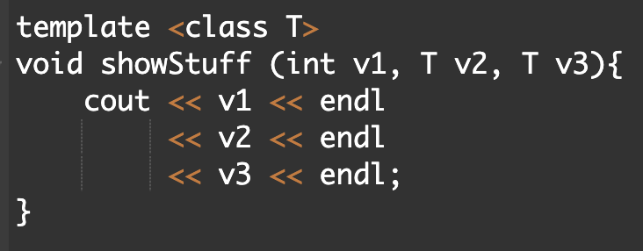
showStuff Call
Consider function call: showStuff(2, 3.3, 4.4);
Compiler generates function definition
Replaces T with double
Since second parameter is type double
Displays: 2 3.3 4.4

Slide 23
Compiler Complications
Function declarations and definitions
Typically we have them separately
For templates → not supported on most compilers!
Safest to place template function definition in file where invoked
Many compilers require it appear before using it
Often we #include all template definitions
Notes:
他在很多 compiler 底下是不能分開成兩個檔案，然後編譯，要用這個 template 的 file 要跟他一起編

Slide 24
More Compiler Complications
Check your compiler’s specific requirements
Some need to set special options
Some require special order of arrangement of template definitions vs. other file items
Most usable template program layout:
Template definition in same file it’s used
Ensure template definition precedes all uses
Can #include it

Slide 25
header.h | header.cpp | main.cpp | compile success
template declaration | include header.h template definition | include header.h Use showStuff (int, char, char) | X
template declaration | include header.h template definition Use showStuff (int, char, char) | include header.h Use showStuff (int, char, char) | O
template declaration | include header.h template definition Use showStuff (int, char, char) | include header.h Use showStuff (int, int, int) | X
template declaration | include header.h template definition | include header.h include header.cpp Use showStuff (int, int, int) | O
template declaration and definition |  | include header.h Use showStuff (int, char, char) | O

Slide 27
Multiple Type Parameters
Can have: template<class T1, class T2>
Not typical
Usually only need one "replaceable" type
Cannot have "unused" template parameters
Each must be "used" in definition
Error otherwise!
Notes:
有寫就要用，不能只用T1

Slide 28
Algorithm Abstraction
Refers to implementing templates
Express algorithms in "general" way:
Algorithm applies to variables of any type
Ignore incidental detail
Concentrate on substantive parts of algorithm
Function templates are one way C++ supports algorithm abstraction
Notes:
在寫 template 的時候會更注重 algorithm 本身，而非 data 的儲存方式等等細節

Slide 29
Defining Templates Strategies
Develop function normally
Using actual data types (base types such as int)
Completely debug "ordinary" function
Then convert to template
Replace type names with type parameter as needed
Advantages:
Easier to solve "concrete" case
Deal with algorithm, not template syntax

Slide 30
Inappropriate Types in Templates
Can use any type in template for which code makes "sense"
Code must behave in appropriate way
e.g., swapValues() template function
Cannot use type for which assignment operator isn’t defined
Example: an array: int a[10], b[10]; swapValues(a, b);
Arrays cannot be "assigned"!

Slide 32
Class Templates
Can also "generalize" classes template<class T>
Can also apply to class definition
All instances of "T" in class definition replaced by type parameter
Just like for function templates!
Once template defined, can declare objects of the class

Slide 33
Class Template Definition
template<class T> class Pair { public: Pair(); Pair(T firstVal, T secondVal); void setFirst(T newVal); void setSecond(T newVal); T getFirst() const; T getSecond() const; private: T first; T second; };

Slide 34
Template Class Pair Members
template<class T> Pair<T>::Pair(T firstVal, T secondVal) { first = firstVal; second = secondVal; } template<class T> void Pair<T>::setFirst(T newVal) { first = newVal; }

Slide 35
Template Class Pair
Objects of class have "pair" of values of type T
Can then declare objects: Pair<int> score; Pair<char> seats;
Objects then used like any other objects
Example uses: score.setFirst(3); score.setSecond(0);

Slide 36
Pair Member Function Definitions
Notice in member function definitions:
Each definition is itself a "template"
Requires template prefix before each definition
Class name before :: is "Pair<T>"
Not just "Pair”
Pair<T>::Pair (T firstVal, T secondVal)
void Pair<T>::setFirst (T newVal)
But function names are just
"Pair”, "~Pair”, “setFirst”, “setSecond”, …

Slide 37
Class Templates as Parameters
Consider: int addUP(const Pair<int>& thePair);
The type (int) is supplied to be used for T in defining this class type parameter
It "happens" to be call-by-reference here
Again: template types can be used anywhere standard types can
Notes:
Pair<int> 可視為一個 type

Slide 38
Class Templates Within Function Templates
Rather than defining new overload: template<class T> T addUp(const Pair<T>& the Pair); //Precondition: Operator + is defined for values of type T //Returns sum of two values in thePair
Function now applies to all kinds of numbers
Notes:
Operator + 有定義清楚的 data type 就能使用 addUp
舉例來說：int, double → ok, 但是你可能自己設定了 IP 這個形態，對於網路來說，IP 相加就沒意義了

Slide 39
Restrictions on Type Parameter
Only "reasonable" types can be substituted for T
Consider:
Assignment operator must be "well-behaved"
Copy constructor must also work
If T involves pointers, then destructor must be suitable!
Similar issues as function templates

Slide 40
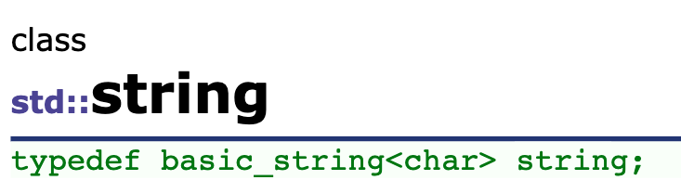
Type Definitions
Can define new "class type name"
To represent specialized class template name
Example: typedef Pair<int> PairOfInt;
Name "PairOfInt" now used to declare objects of type Pair<int>: PairOfInt pair1, pair2;
Name can also be used as parameter, or anywhere else type name allowed
Notes:
可以把某個 template type 重新命名

Slide 41
Friends and Templates
Friend functions can be used with template classes
Same as with ordinary classes
Simply requires type parameter where appropriate
Very common to have friends of template classes
Especially for operator overloads (as we’ve seen)

Slide 43
Predefined Template Classes
Recall vector class
It’s a template class!
Another: basic_string template class
Deals with strings of "any-type" elements
e.g.,
basic_string<char> works for char’s basic_string<double> works for doubles basic_string<YourClass> works for YourClass objects

Slide 44
basic_string Template Class
Already used it!
Recall "string"
It’s an alternate name for basic_string<char>
All member functions behave similarly for basic_string<T>
basic_string defined in library <string>
Definition is in std namespace

Slide 45
Templates and Inheritance
Nothing new here
Derived template classes
Can derive from template or nontemplate class
Derived class is then naturally a template class
Syntax same as ordinary class derived from ordinary class

Slide 46
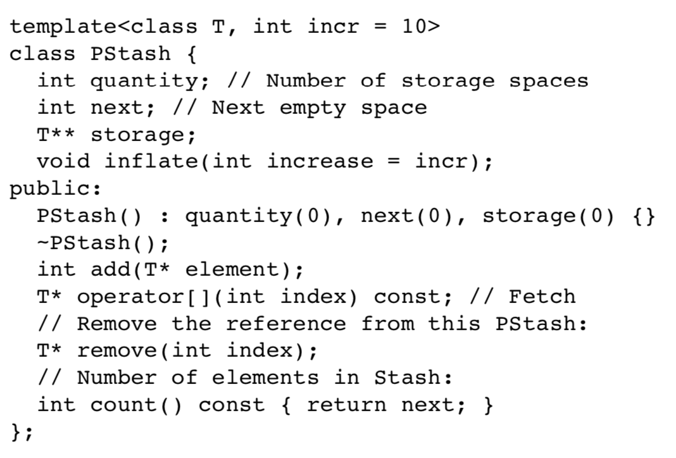
Use Template
Parameterized type

Slide 47
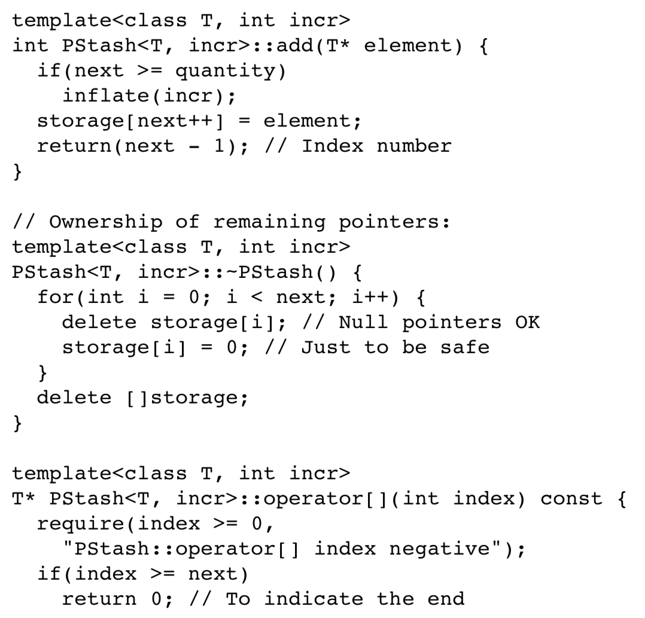
Use Template
Parameterized type

Slide 48
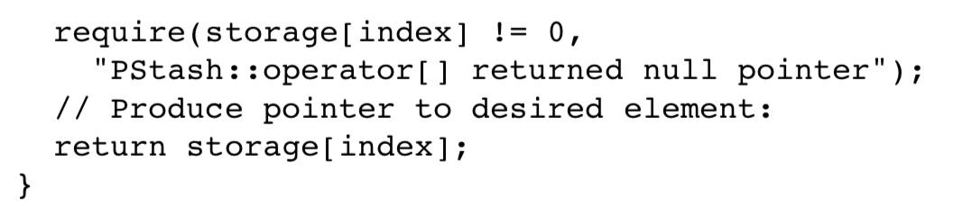
Use Template
Parameterized type

Slide 49
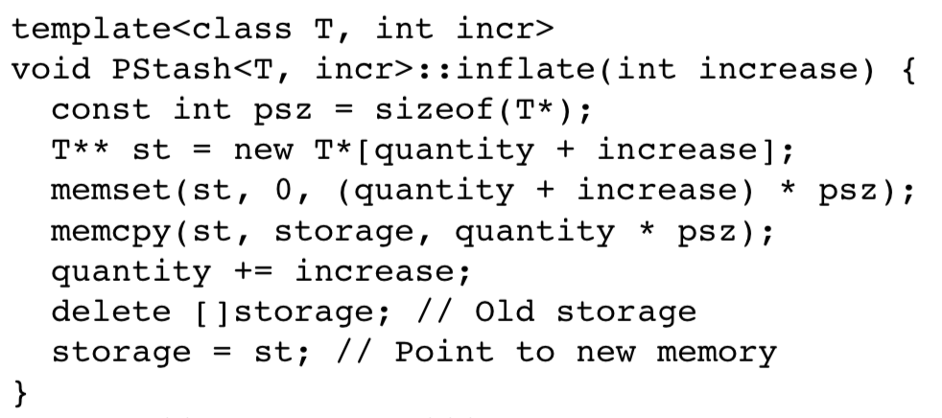
Use Template
Parameterized type

Slide 50
Summary
Function templates
Define functions with parameter for a type
Class templates
Define class with parameter for subparts of class
Predefined vector and basic_string classes are template classes
Can define template class derived from a template base class

