Slide 1

Chapter 17
Linked Data Structures
Copyright © 2017 Pearson Education, Ltd. All rights reserved.

Slide 2
Learning Objectives
Nodes and Linked Lists
Creating, searching
Linked List Applications
Stacks, queues, sets, hash tables
Friend classes, alternatives
Iterators
Pointers as iterators
Trees

Slide 3
Introduction
Linked list
Constructed using pointers
Grows and shrinks during run-time
Doubly Linked List : A variation with pointers in both directions
Trees also use pointers
Pointers backbone of such structures
Use dynamic variables
Standard Template Library
Has predefined versions of some structures

Slide 4
Approaches
Three ways to handle such data structures:
C-style approach: global functions and structs with everything public
Classes with private member variables and accessor and mutator functions
Friend classes
Linked lists will use method 1
Stacks, queues, sets, and hash tables will use method 2
Trees will use method 3

Slide 5
Nodes and Linked Lists
Linked list
Simple example of "dynamic data structure"
Composed of nodes
Each "node" is variable of struct or class type that’s dynamically created with new
Nodes also contain pointers to other nodes
Provide "links"

Slide 6
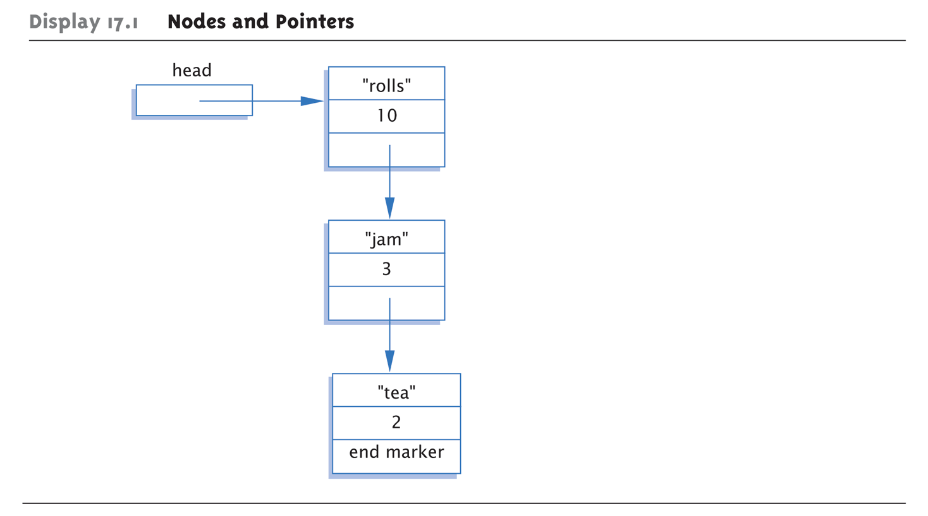
Display 17.1 Nodes and Pointers

Slide 7
Node Definition
struct ListNode { string item; int count; ListNode *link; }; typedef ListNode* ListNodePtr;
Order here is important!
Listnode defined 1st, since used in typedef
Also notice "circularity"

Slide 8
Head Pointer
Box labeled "head" not a node: ListNodePtr head;
A simple pointer to a node
Set to point to 1st node in list
Head used to "maintain" start of list
Also used as argument to functions

Slide 9
Example Node Access
(*head).count = 12;
Sets count member of node pointed to by head equal to 12
Alternate operator, ->
Called "arrow operator"
Shorthand notation that combines * and .
head->count = 12;
Identical to above
cin >> head->item
Assigns entered string to item member

Slide 10
End Markers
Use NULL or nullptr (in C++11) for node pointer
Considered "sentinel" for nodes
Indicates no further "links" after this node
Provides end marker similar to how we use partially-filled arrays

Slide 11
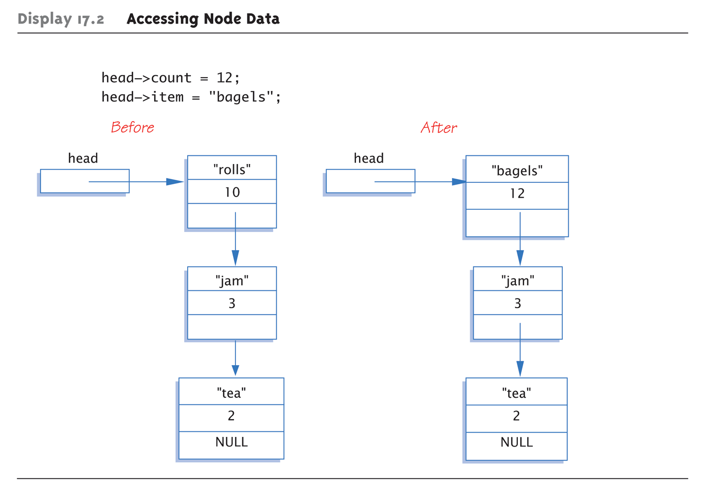
Display 17.2 Accessing Node Data

Slide 12
Linked List
Lists as illustrated called linked lists
First node called head
Pointed to by pointer named head
Last node special also
It’s member pointer variable is NULL (or nullptr in C++11)
Easy test for "end" of linked list

Slide 13
Linked List Class Definition
class IntNode { public: IntNode() { } IntNode(int theData, IntNode* theLink) : data(theData), link(theLink) { } IntNode* getLink() const {return link;} int getData() const {return data;} void setData(int theData) {data = theData;} void setLink(IntNode* pointer) {link=pointer;} private: int data; IntNode *link; }; typedef IntNode* IntNodePtr;

Slide 14
Linked List Class
Notice all member function definitions are inline
Small and simple enough
Notice two-parameter constructor
Allows creation of nodes with specific data value and specified link member
Example: IntNodePtr p2 = new IntNode(42, p1);

Slide 15
Create 1st Node
IntNodePtr head;
Declares pointer variable head
head = new IntNode;
Dynamically allocates new node
Our 1st node in list, so assigned to head
head->setData(3); head->setLink(NULL);
Sets head node data
Link set to NULL since it’s the only node!

Slide 16
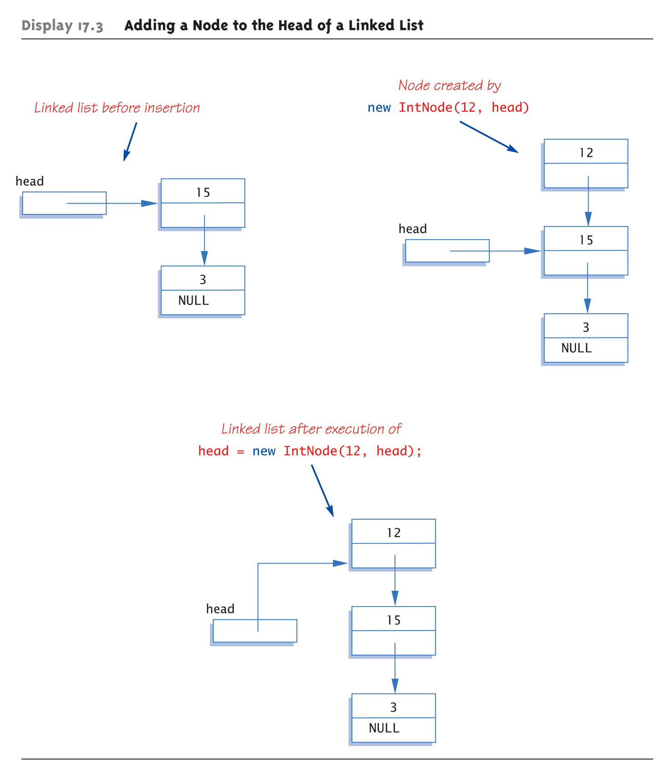
Display 17.3 Adding a Node to the Head of a Linked List

Slide 17
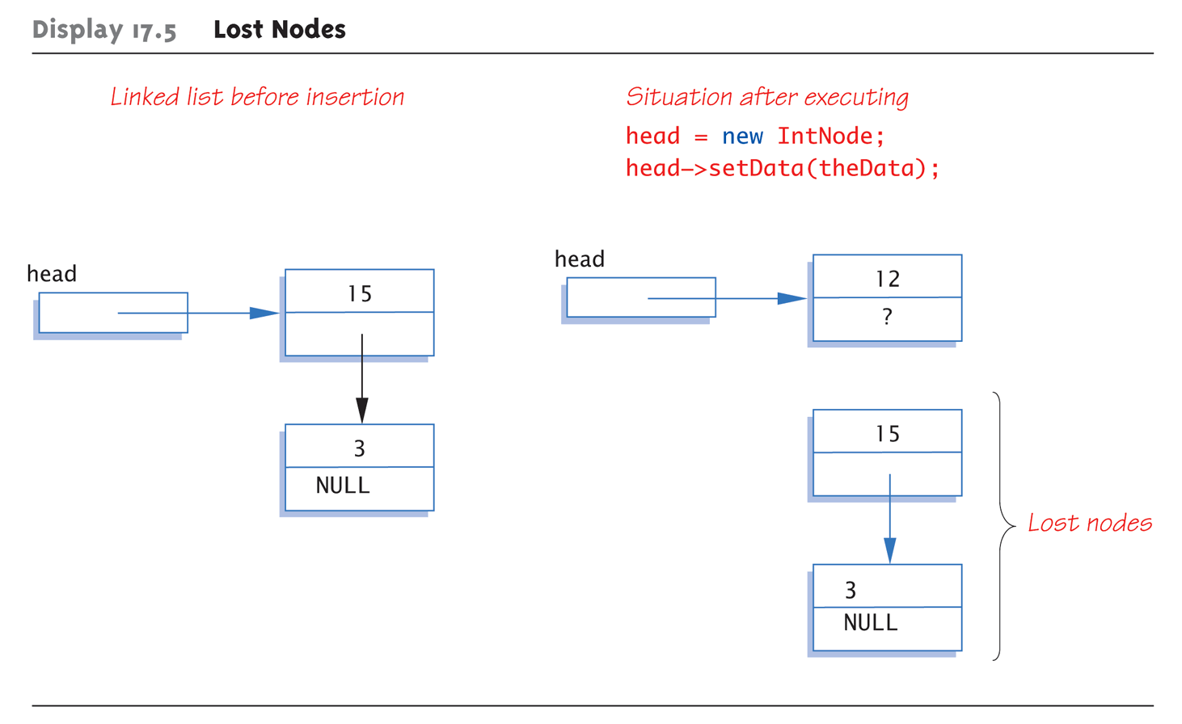
Lost Nodes Pitfall: Display 17.5 Lost Nodes

Slide 18
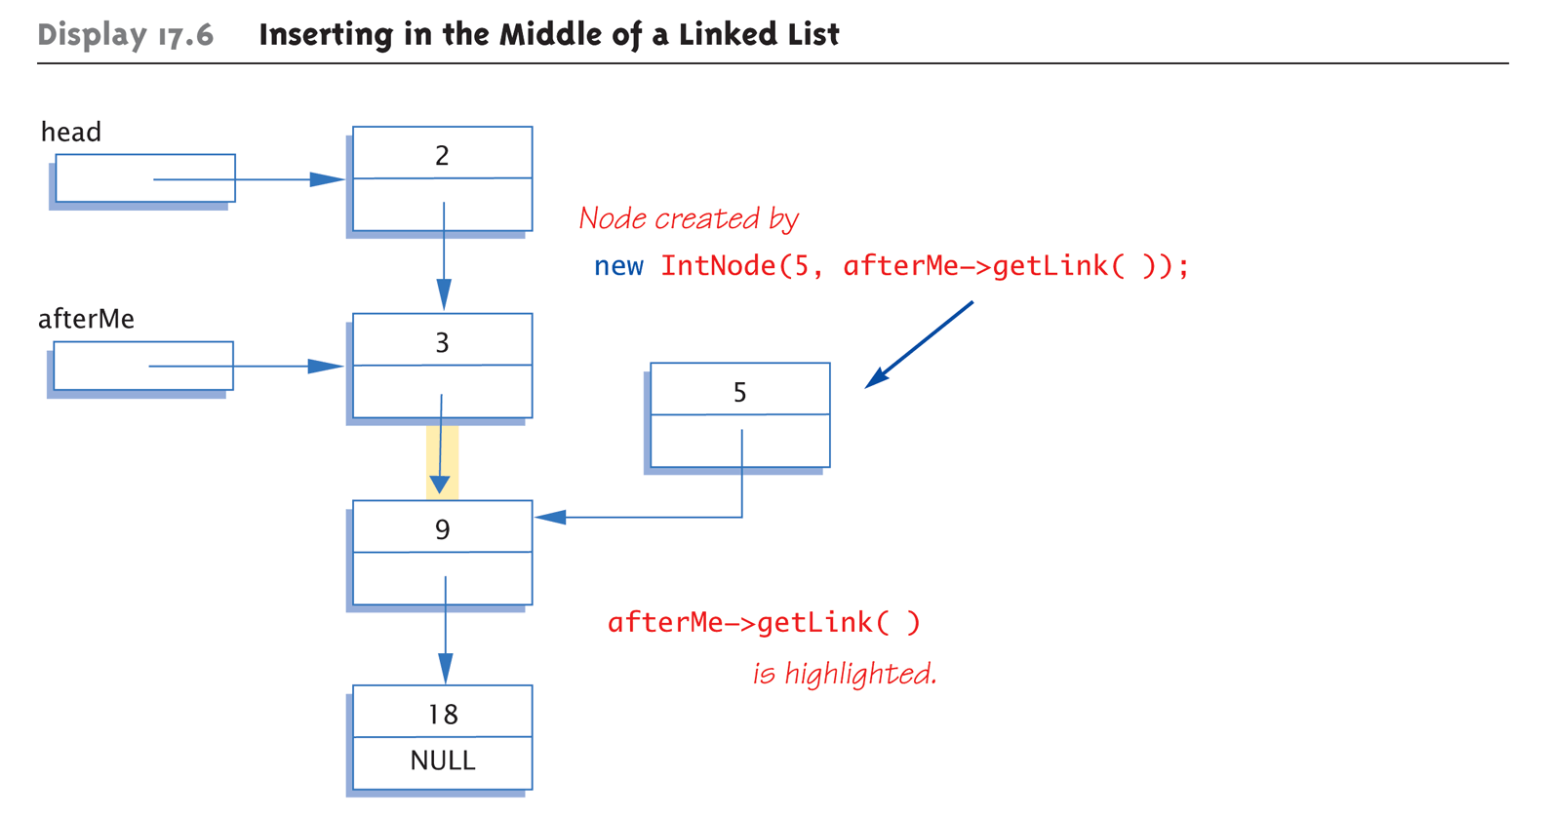
Display 17.6 Inserting in the Middle of a Linked List (1 of 2)

Slide 19
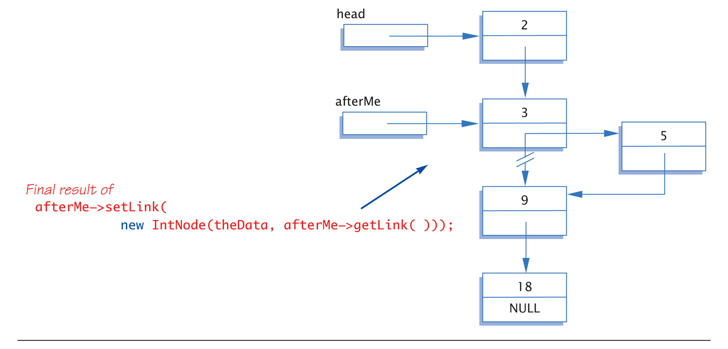
Display 17.6 Inserting in the Middle of a Linked List (2 of 2)

Slide 20
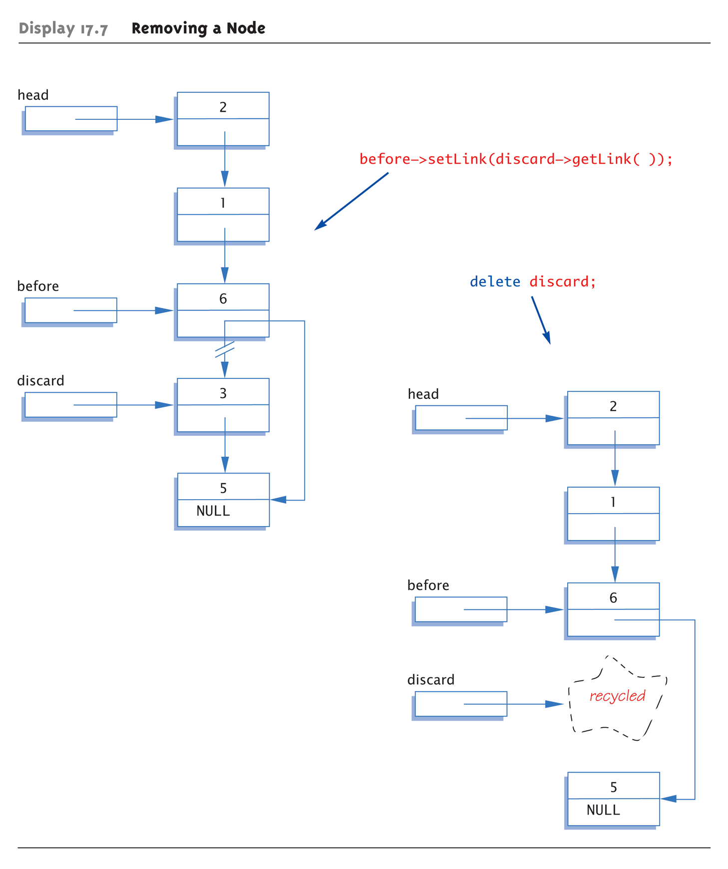
Display 17.7 Removing a Node

Slide 21
Searching a Linked List
Function with two arguments: IntNodePtr search(IntNodePtr head, int target); //Precondition: pointer head points to head of //linked list. Pointer in last node is NULL. //If list is empty, head is NULL //Returns pointer to 1st node containing target //If not found, returns NULL
Simple "traversal" of list
Similar to array traversal

Slide 22
Pseudocode for search Function
while (here doesn’t point to target node or last node) { Make here point to next node in list } if (here node points to target) return here; else return NULL;

Slide 23
Algorithm for search Function
while (here->getData() != target && here->getLink() != NULL) here = here->getLink(); if (here != NULL && here->getData() == target) return here; else return NULL;
Must make "special" case for empty list
Not done here

Slide 24
Doubly Linked Lists
What we just described is a singly linked list
Can only follow links in one direction
Doubly Linked List
Links to the next node and another link to the previous node
Can follow links in either direction
NULL signifies the beginning and end of the list
Can make some operations easier, e.g. deletion since we don’t need to search the list to find the node before the one we want to remove

Slide 25
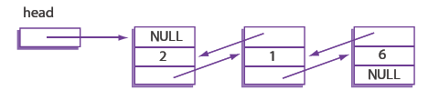
Doubly Linked Lists
class DoublyLinkedIntNode
{
public:
DoublyLinkedIntNode ( ){}
DoublyLinkedIntNode (int theData, DoublyLinkedIntNode* previous,
DoublyLinkedIntNode* next)
: data(theData), nextLink(next), previousLink(previous) {}
DoublyLinkedIntNode* getNextLink( ) const { return nextLink; }
DoublyLinkedIntNode* getPreviousLink( ) const { return previousLink; }
int getData( ) const { return data; }
void setData(int theData) { data = theData; }
void setNextLink(DoublyLinkedIntNode* pointer) { nextLink = pointer; }
void setPreviousLink(DoublyLinkedIntNode* pointer)
{ previousLink = pointer; }
private:
int data;
DoublyLinkedIntNode *nextLink;
DoublyLinkedIntNode *previousLink;
};
typedef DoublyLinkedIntNode* DoublyLinkedIntNodePtr;

Slide 26
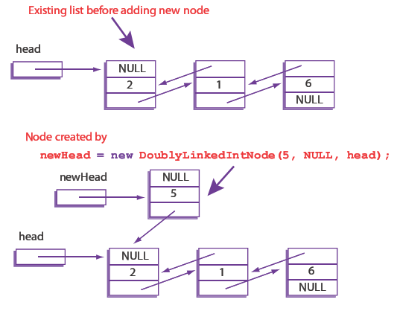
Adding a Node to the Front of a Doubly Linked List (1 of 2)

Slide 27
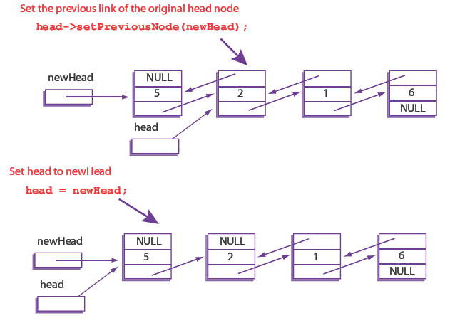
Adding a Node to the Front of a Doubly Linked List (2 of 2)

Slide 28
Deleting a Node from a Doubly Linked List
Removing a node requires updating references on both sides of the node we wish to delete
Thanks to the backward link we do not need a separate variable to keep track of the previous node in the list like we did for the singly linked list
Can access via node->previous

Slide 29
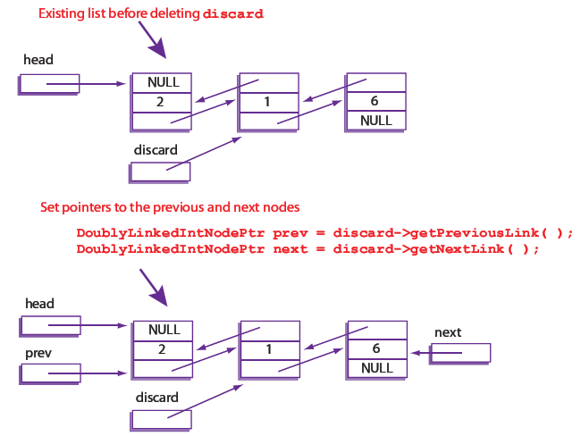
Deleting a Node from a Doubly Linked List (1 of 2)

Slide 30
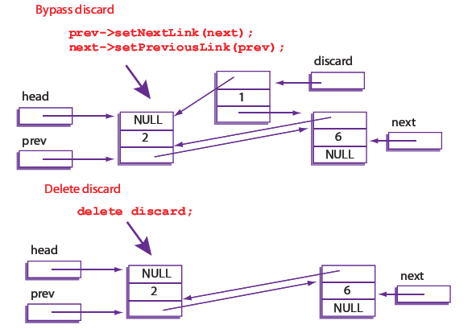
Deleting a Node from a Doubly Linked List (2 of 2)

Slide 31
Stacks
Stack data structure:
Retrieves data in reverse order of how stored
LIFO – last-in/first-out
Think of like "hole in ground"
Stacks used for many tasks:
Track C++ function calls
Memory management
Our use:
Use linked lists to implement stacks

Slide 32
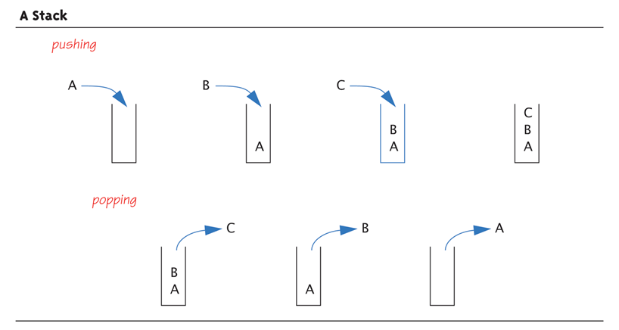
A Stack—Graphic: Display 17.12 A Stack

Slide 33
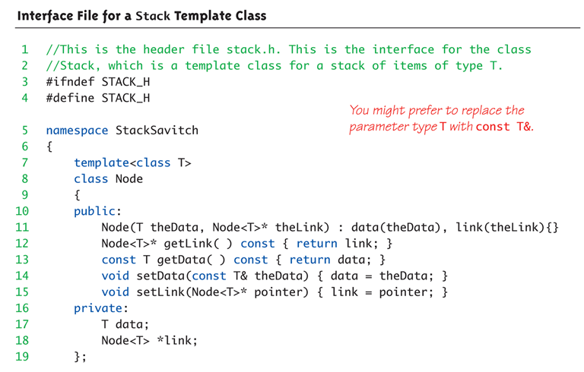
Display 17.17 Interface File for a Stack Template Class (1 of 2)

Slide 34
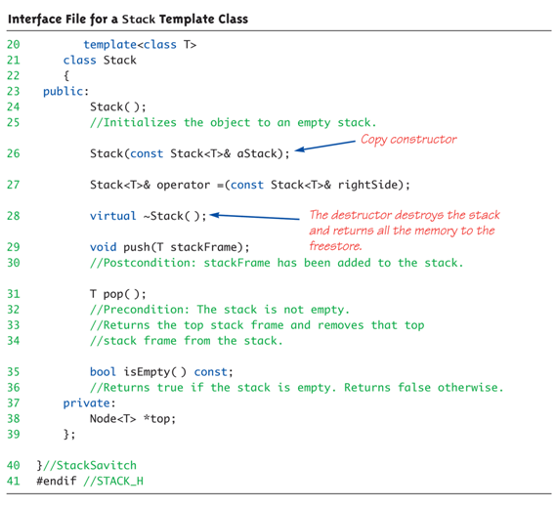
Display 17.17 Interface File for a Stack Template Class (2 of 2)

Slide 35
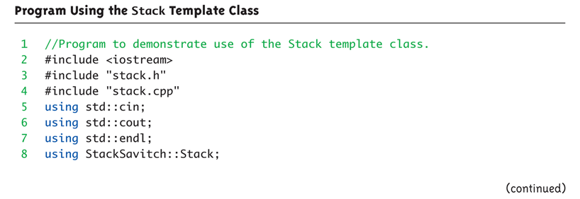
Stack Template Class Driver: Display 17.18 Program Using the Stack Template Class (1 of 3)

Slide 36
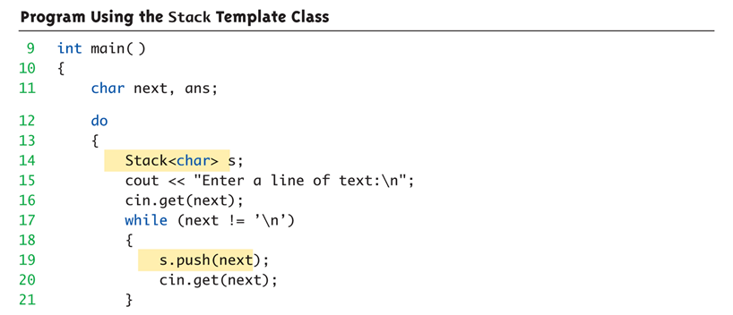
Stack Template Class Driver: Display 17.18 Program Using the Stack Template Class (2 of 3)

Slide 37
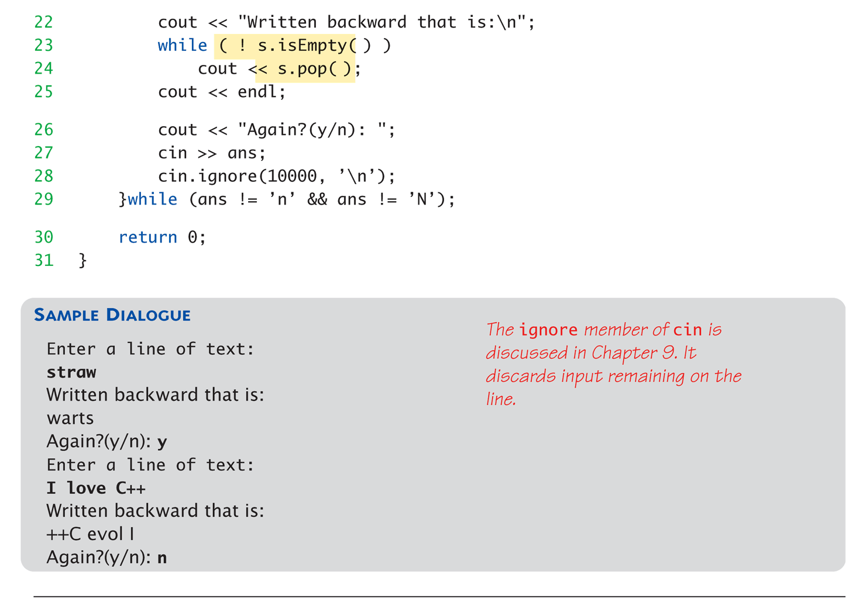
Stack Template Class Driver: Display 17.18 Program Using the Stack Template Class (3 of 3)

Slide 38
Stack Push and Pop
Adding data item to stack → push
Considered "pushing" data onto stack
Recall: goes to "top" of stack
Removing data item from stack → pop
Considered "popping" item off stack
Recall: removed from "top" of stack

Slide 39
Queues
Another common data structure:
Handles data in first-in/first-out manner (FIFO)
Items inserted to end of list
Items removed from front
Representation of typical "line" forming
Like bank teller lines, movie theatre lines, etc.

Slide 40
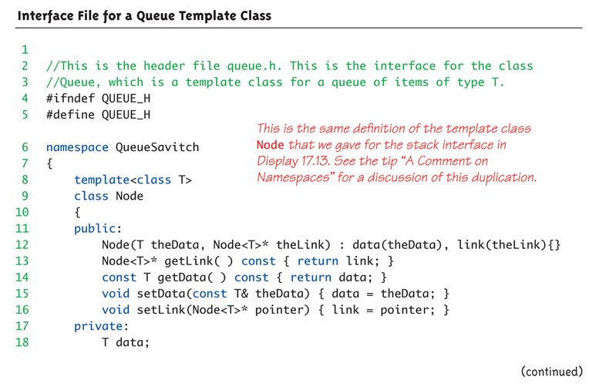
Display 17.20 Interface File for a Queue Template Class (1 of 3)

Slide 41
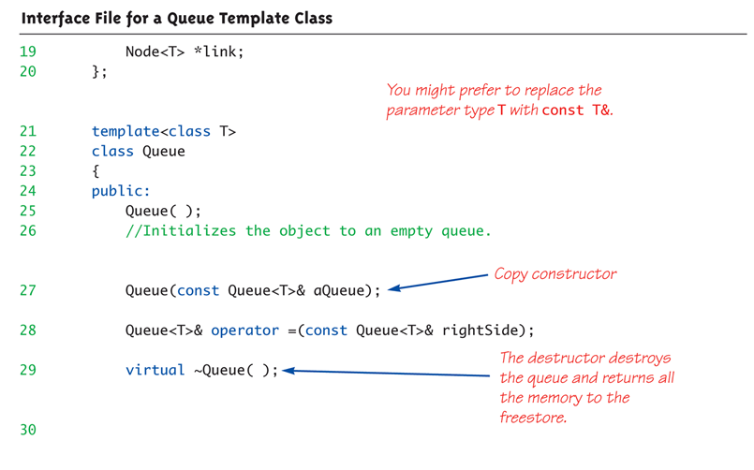
Display 17.20 Interface File for a Queue Template Class (2 of 3)

Slide 42
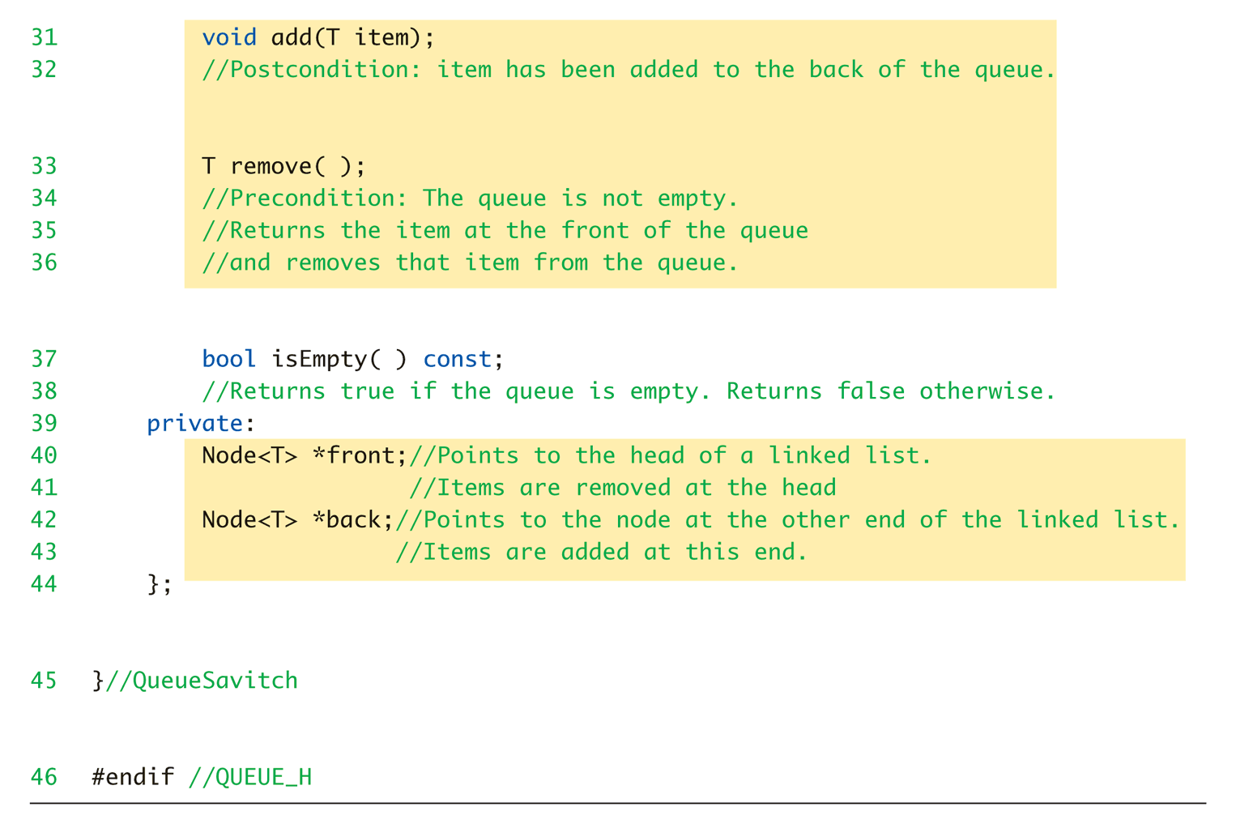
Display 17.20 Interface File for a Queue Template Class (3 of 3)

Slide 43
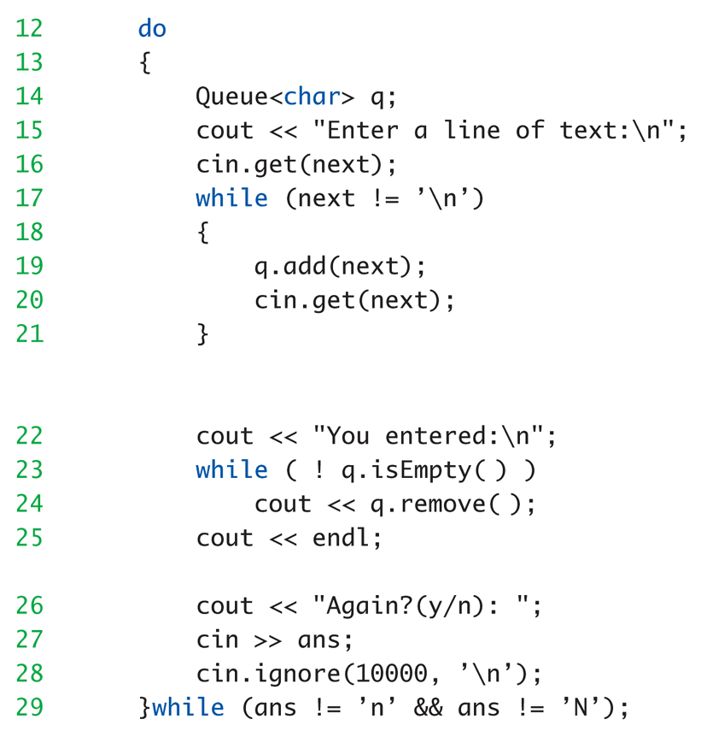
Queue Template Class Driver: Display 17.21 Program Using the Queue Template Class

Slide 44
Hash Tables
A hash table or hash map is a data structure that efficiently stores and retrieves data from memory
Here we discuss a hash table that uses an array in combination with singly linked lists
Uses a hash function
Maps an object to a key
In our example, a string to an integer

Slide 45
Simple Hash Function for Strings
Sum the ASCII value of every character in the string and then compute the modulus of the sum using the size of the fixed array.
int computeHash(string s)
{
int hash = 0;
for (int i = 0; i < s.length( ); i++)
{
hash = hash + s[i];
}
return hash % SIZE; // SIZE = 10 in example
}
Example: "dog" = ASCII 100, 111, 103
Hash = (100 + 111 + 103) % 10 = 4

Slide 46
Hash Table Idea
Storage
Make an array of fixed size, say 10
In each array element store a linked list
To add an item, map (i.e. hash) it to one of the 10 array elements, then add it to the linked list at that location
Retrieval
To look up an item, determine its hash code then search the linked list at the corresponding array slot for the item

Slide 47
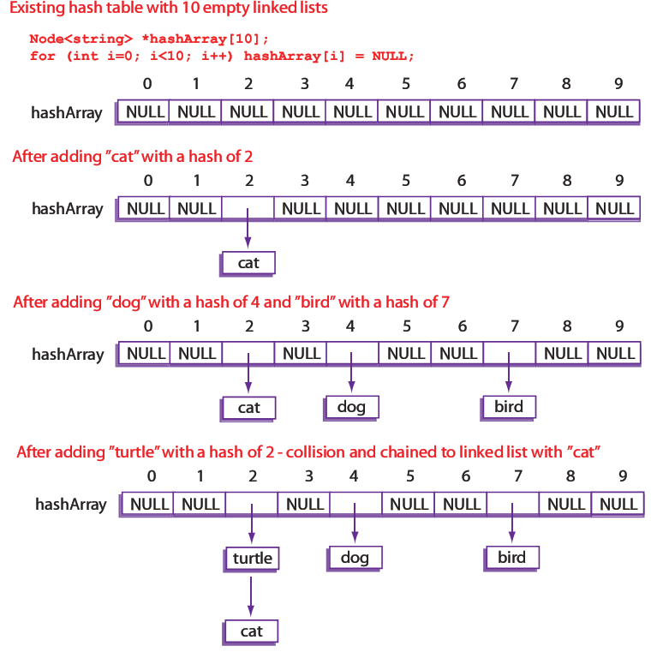
Constructing a Hash Table

Slide 48
Interface File for a HashTable Class (1 of 2)
1 // This is the header file hashtable.h. This is the interface
2 // for the class HashTable, which is a class for a hash table
3 // of strings.
4 #ifndef HASHTABLE_H
5 #define HASHTABLE_H
6 #include <string>
7 #include "listtools.h"
The library "listtools.h" is the linked list library
interface from Display 17.14.
8 using LinkedListSavitch::Node;
9 using std::string;
10 namespace HashTableSavitch
11 {
12 const int SIZE = 10; // Maximum size of the hash table array

Slide 49
Interface File for a HashTable Class (2 of 2)
13 class HashTable
14 {
15 public:
16 HashTable(); // Initialize empty hash table
17 // Normally a copy constructor and overloaded assignment
18 // operator would be included. They have been omitted
19 // to save space.
20 virtual ~HashTable(); // Destructor destroys hash table
21 bool containsString(string target) const;
22 // Returns true if target is in the hash table,
23 // false otherwise
24 void put(string s);
25 // Adds a new string to the hash table
26 private:
27 Node<string> *hashArray[SIZE]; // The actual hash table
28 static int computeHash(string s); // Compute a hash value
29 }; // HashTable
30 } // HashTableSavitch
31 #endif // HASHTABLE_H

Slide 50
Implementation File for Hash Table Class (1 of 3)
1 // This is the implementation file hashtable.cpp.
2 // This is the implementation of the class HashTable.
3 #include <string>
4 #include "listtools.h"
5 #include "hashtable.h"
6 using LinkedListSavitch::Node;
7 using LinkedListSavitch::search;
8 using LinkedListSavitch::headInsert;
9 using std::string;
10 namespace HashTableSavitch
11 {
12 HashTable::HashTable()
13 {
14 for (int i = 0; i < SIZE; i++)
15 {
16 hashArray[i] = NULL;
17 }
}

Slide 51
Implementation File for Hash Table Class (2 of 3)
19 HashTable::~HashTable()
20 {
21 for (int i=0; i<SIZE; i++)
22 {
23 Node<string> *next = hashArray[i];
24 while (next != NULL)
25 {
26 Node<string> *discard = next;
27 next = next->getLink( );
28 delete discard;
29 }
30 }
31 }
32 int HashTable::computeHash(string s)
33 {
34 int hash = 0;
35 for (int i = 0; i < s.length( ); i++)
36 {
37 hash = hash + s[i];
38 }
39 return hash % SIZE;
40 }

Slide 52
Implementation File for Hash Table Class (3 of 3)
41 void HashTable::put(string s)
42 {
43 int hash = computeHash(s);
44 if (search(hashArray[hash], s)==NULL)
45 {
46 // Only add the target if it's not in the list
47 headInsert(hashArray[hash], s);
48 }
49 }
50 } // HashTableSavitch

Slide 53
Hash Table Demonstration
1 // Program to demonstrate use of the HashTable class
2 #include <string>
3 #include <iostream>
4 #include "hashtable.h"
5 #include "listtools.cpp"
6 #include "hashtable.cpp"
7 using std::string;
8 using std::cout;
9 using std::endl;
10 using HashTableSavitch::HashTable;
11 int main()
12 {
13 HashTable h;
14 cout << "Adding dog, cat, turtle, bird" << endl;
15 h.put("dog");
16 h.put("cat");
17 h.put("turtle");
18 h.put("bird");
19 cout << "Contains dog? " << h.containsString("dog") << endl;
20 cout << "Contains cat? " << h.containsString("cat") << endl;
21 cout << "Contains turtle? " << h.containsString("turtle") << endl;
22 cout << "Contains bird? " << h.containsString("bird") << endl;
23 cout << "Contains fish? " << h.containsString("fish") << endl;
24 cout << "Contains cow? " << h.containsString("cow") << endl;
25 return 0;
26 }
Sample Dialogue
Adding dog, cat, turtle, bird
Contains dog? 1
Contains cat? 1
Contains turtle? 1
Contains bird? 1
Contains fish? 0
Contains cow? 0

Slide 54
Hash Table Efficiency
Worst Case
Every item inserted into the table has the same hash key, the find operation may have to search through all items every time (same performance as a linked list)
Best Case
Every item inserted into the table has a different hash key, the find operation will only have to search a list of size 1, very fast
Can decrease the chance of collisions with a better hash function
Tradeoff: Lower chance of collision with bigger hash table, but more wasted memory space

Slide 55
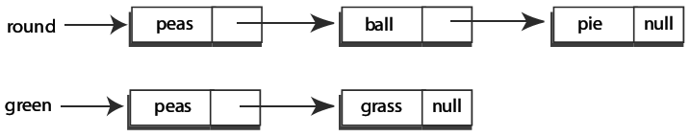
Set Template Class
A set is a collection of elements in which no element occurs more than once
We can implement a simple set that uses a linked list to store the items in the set
Fundamental set operations we will support:
Add
Contains
Union
Intersection
Example

Slide 56
Interface File for a Set Template Class (1 of 2)
1 // This is the header file set.h. This is the interface
2 // for the class Set, which is a class for a generic set.
3 #ifndef SET_H
4 #define SET_H
5 #include "listtools.h"
"listtools.h" is the linked list library interface from Display 17.14.
6 using LinkedListSavitch::Node;
7 namespace SetSavitch
8 {
9 template<class T>
10 class Set
11 {
12 public:
13 Set() { head = NULL; } // Initialize empty set
14 // Normally a copy constructor and overloaded assignment
15 // operator would be included. They have been omitted
16 // to save space.
17 virtual ~Set(); // Destructor destroys set

Slide 57
Interface File for a Set Template Class (2 of 2)
18 bool contains(T target) const;
19 // Returns true if target is in the set, false otherwise
20 void add(T item);
21 // Adds a new element to the set
22 void output();
23 // Outputs the set to the console
24 Set<T>* setUnion(const Set<T>& otherSet);
25 // Union calling object's set with otherSet
26 // and return a pointer to the new set
27 Set<T>* setIntersection(const Set<T>& otherSet);
28 // Intersect calling object's set with otherSet
29 // and return a pointer to the new set
30 private:
31 Node<T> *head;
32 }; // Set
33 } // SetSavitch
34 #endif // SET_H

Slide 58
Implementation File for a Set Template Class (1 of 4)
1 // This is the implementation file set.cpp.
2 // This is the implementation of the class Set.
3 #include <iostream>
4 #include "listtools.h"
5 #include "set.h"
6 using std::cout;
7 using std::endl;
8 using LinkedListSavitch::Node;
9 using LinkedListSavitch::search;
10 using LinkedListSavitch::headInsert;
11 namespace SetSavitch
12 {
13 template<class T>
14 Set<T>::~Set()
15 {
16 Node<T> *toDelete = head;
17 while (head != NULL)
18 {
19 head = head->getLink( );
20 delete toDelete;
21 toDelete = head;
22 }
23 }

Slide 59
Implementation File for a Set Template Class (2 of 4)
24 template<class T>
25 bool Set<T>::contains(T target) const
26 {
27 Node<T>* result = search(head, target);
28 if (result == NULL)
29 return false;
30 else
31 return true;
32 }
33 void Set<T>::output()
34 {
35 Node<T> *iterator = head;
36 while (iterator != NULL)
37 {
38 cout << iterator->getData( ) << " ";
39 iterator = iterator->getLink( );
40 }
41 cout << endl;
42 }

Slide 60
Implementation File for a Set Template Class (3 of 4)
43 template<class T>
44 void Set<T>::add(T item)
45 {
46 if (search(head, item)
==NULL)
47 {
48 // Only add the target if
it's not in the list
49 headInsert(head, item);
50 }
51 }
52 template<class T>
53 Set<T>* Set<T>::setUnion(const
Set<T>& otherSet)
54 {
55 Set<T> *unionSet = new Set<T>();
56 Node<T>* iterator = head;
57 while (iterator != NULL)
58 {
59 unionSet->add(iterator->getData( ));
60 iterator = iterator->getLink( );
61 }
62 iterator = otherSet.head;
63 while (iterator != NULL)
64 {
65 unionSet->add(iterator->getData( ));
66 iterator = iterator->getLink( );
67 }
68 return unionSet;
69 }

Slide 61
Implementation File for a Set Template Class (4 of 4)
70 template<class T>
71 Set<T>* Set<T>::setIntersection(const Set<T>& otherSet)
72 {
73 Set<T> *interSet = new Set<T>();
74 Node<T>* iterator = head;
75 while (iterator != NULL)
76 {
77 if (otherSet.contains(iterator->getData( )))
78 {
79 interSet->add(iterator->getData( ));
80 }
81 iterator = iterator->getLink( );
82 }
83 return interSet;
84 }
85 } // SetSavitch

Slide 62
Set Demonstration (1 of 3)
1 // Program to demonstrate use of the Set class
2 #include <iostream>
3 #include <string>
4 #include "set.h"
5 #include "listtools.cpp"
6 #include "set.cpp"
7 using std::cout;
8 using std::endl;
9 using std::string;
10 using namespace SetSavitch;
11 int main()
12 {
13 Set<string> round; // Round things
14 Set<string> green; // Green things
15 round.add("peas"); // Sample data for both sets
16 round.add("ball");
17 round.add("pie");
18 round.add("grapes");
19 green.add("peas");
20 green.add("grapes");
21 green.add("garden hose");
22 green.add("grass");

Slide 63
Set Demonstration (2 of 3)
23 cout << "Contents of set round: ";
24 round.output();
25 cout << "Contents of set green: ";
26 green.output();
27 cout << "ball in set round? " <<
28 round.contains("ball") << endl;
29 cout << "ball in set green? " <<
30 green.contains("ball") << endl;
31 cout << "ball and peas in same set? ";
32 if ((round.contains("ball") && round.contains("peas")) ||
33 (green.contains("ball") && green.contains("peas")))
34 cout << " true" << endl;
35 else
36 cout << " false" << endl;
37 cout << "pie and grass in same set? ";
38 if ((round.contains("pie") && round.contains("grass")) ||
39 (green.contains("pie") && green.contains("grass")))
40 cout << " true" << endl;
41 else
42 cout << " false" << endl;

Slide 64
Set Demonstration (3 of 3)
43 cout << "Union of green and round: " << endl;
44 Set<string> *unionset = round.setUnion(green);
45 unionset->output();
46 delete unionset;
47 cout << "Intersection of green and round: " << endl;
48 Set<string> *interset = round.setIntersection(green);
49 interset->output();
50 delete interset;
51 return 0;
52 }
SAMPLE DIALOGUE
Contents of set round: grapes pie ball peas
Contents of set green: grass garden hose grapes peas
ball in set round? 1
ball in set green? 0
ball and peas in same set? true
pie and grass in same set? false
Union of green and round:
garden hose grass peas ball pie grapes
Intersection of green and round:
peas grapes

Slide 65
Friend Classes
Recall constant use of getLink and setlink accessor and mutator functions
Somewhat of a nuisance
Similar to making data public?!
Public makes available to ALL!
Use friend class
Make queue template class "friend" of node template class
All private link members directly available in member functions of queue class!

Slide 66
Forward Declaration
Class friendships typically require classes reference each other
Presents problem
How can "both" be declared at same time?
Requires forward declaration
Simple class heading given inside other: class Queue; //Forward Dec.
Announces "class Queue will exist"

Slide 68
Concept of Iterators
Constructed for cycling through data
Like a "traversal"
Allows "whatever" actions required on data
Pointers typically used as iterators
Seen in linked list implementation

Slide 69
The Simplest Example: Pointers as Iterators
Recall: linked list: "prototypical" data structure
Pointer: "prototypical" example of iterator
Pointer used as iterator by moving thru linked list node by node starting at head:
Example: Node_Type *iterator; for (iterator = Head; iterator != NULL; iterator=iterator->Link) Do_Action

Slide 70
The Simplest One is Not General
Pointers as iterators is common for the data structures based on linked lists
But, how to enumerate the elements in a tree, a hash table, or more complicated data structures?
Other data structures cannot be enumerated by iterator = iterator->link anymore
If you have to enumerate the elements of different data structures, you have to know the implementation ➔ Violate hidden implementation
e.g., inorder traversal of tree

Slide 71
Why generalized as Iterator?
Moreover, we want to design a general function for every different data structure ds: const XXX_type findMax(...) XXX_type max := -infinity; for ( enumerate all elements in ds ){ if ( max < element.data ) { max = element.data; } } return max;
Every ds requires the similar implementation
But different ds has different enumeration method

Slide 72
Why generalized as Iterator?
How to reduce the implementation complexity
Define the function once with template
Enumerate all elements by the same tool (iterator)
template <class ????> const ???? findMax ( ???? ) {...}
Queue<int> intQ;
???? = findMax( ???? );
This is a toy example; some data structure can directly access the maximum such as max heap

Slide 73
Iterator Classes
More versatile than pointer
Typical overloaded operators: ++ advances iterator to next item -- retreats iterator to previous item == Compares iterators != Compare for not equal * Accesses one item
Data structure class would have members: begin(): returns iterator to 1st item in structure end(): returns iterator to test if at end
Notes:
KK[ˋvɝsət!]

Slide 74
Use of Iterator Class
Cycle through data structure named ds: for (i=ds.begin();i!=ds.end();i++) process *i //*i is current data item
i is a variable of the iterator type

Slide 75
Iterator Class Example
template <class T> class Node { public: Node(T theData, Node<T>* theLink): data(theData), link (theLink){} Node<T> *getLink() const {return link;} const T& getData() const {return data;} void setData (const T& theData) {data = theData;} void setLink (Node<T>* pointer) {link = pointer;} private: T data; // should define comparison operators Node<T> *link; };

Slide 76
Iterator Class Example (cont’d)
template <class T> class Iterator { public: Iterator(): current(NULL) {} Iterator(Node<T> *initial): current(initial) {} const T & operator *() const {return current->getData();} Iterator & operator ++ () { current = current->getLink(); return *this; } Iterator operator ++(int) { // postfix Iterator temp(current); current = current->getLink(); return temp; } ...

Slide 77
Iterator Class Example (cont’d)
template <class T> class Iterator { public: ... bool operator == (const Iterator &rhs) const { return (current == rhs.current); } bool operator != (const Iterator &rhs) const { return (current != rhs.current); } private: Node<T> *current; };

Slide 78
Iterator Class Example (cont’d)
template <class T> class Queue { public: typedef Iterator<T> It; Queue(); Queue(const Queue<T> & aQueue); Queue<T> &operator = (const Queue<T> &rhs); virtual ~Queue(); void add (T item); T remove(); bool isEmpty() const; It begin() const {return It(front);} It end() const {return It();} private: Node<T> *front; Node<T> *back; };

Slide 79
The Generalized Function
How to reduce the implementation complexity
Define the function once with template
template <class Iter> Iter findMax ( Iter start, Iter end ){ Iter max = start; while ( start != end ) { if ( *max < *start ) { max = start; } start ++; } return max;
}
Iterator<int> solIt;
Queue<int> intQ;
solIt = findMax( intQ.begin(), intQ.end());
TreeIterator<int> solIt;
Tree<int> intTree;
solIt = findMax( intTree.begin(), intTree.end());

Slide 81
Trees Introduction
Trees can be complex data structures
Only basics here:
Constructing, manipulating
Using nodes and pointers
Recall linked list: nodes have only one pointer → next node
Trees have two, & sometimes more, pointers to other nodes

Slide 82
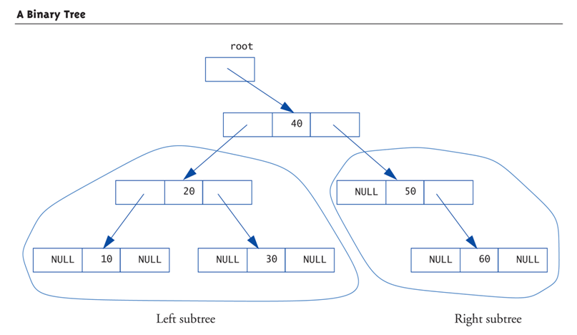
Tree Structure: Display 17.35 A Binary Tree (1 of 2)

Slide 83
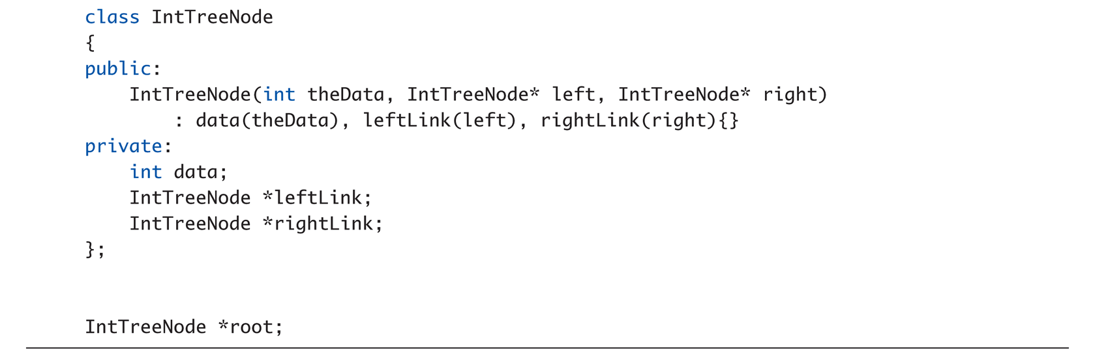
Tree Structure: Display 17.35 A Binary Tree (2 of 2)

Slide 84
Tree Properties
Notice paths
From top to any node
No "cycles" – follow pointers, will reach "end"
Notice here each node has two links
Called binary tree
Most common type of tree
Root node
Similar to linked list’s head
Leaf nodes
Both link variables are NULL (no subtrees)

Slide 85
Trees and Recursion
Note tree’s "recursive structure"
Each tree has two subtrees
Each subtree has two subtrees
Etc., etc.
Makes trees amenable to recursive algorithms
For searching especially!

Slide 86
Tree Processing
Preorder Processing:
Process data in root node
Process left subtree
Process right subtree
In-order Processing:
Process left subtree
Process data in root
Process right subtree
Postorder Processing:
Process left subtree
Process right subtree
Process data in root

Slide 87
Tree Storage
Our example stored values in special way:
Called binary search tree storage rule:
values in left subtree less than root value
values in right subtree greater than root
rule applies recursively to each subtree
Trees using this storage mechanism:
Called binary search tree (BST)
Traversals: Inorder → values "in order" Preorder → "prefix" notation Postorder → "postfix" notation

Slide 88
Summary 1
Node is struct or class object
One or more members is pointer
Nodes connected by member pointers
Produce structures that grow and shrink at runtime
Linked list
List of nodes where each node points to next
In a doubly linked lists there are pointers in both directions
End of linked list marked with NULL pointer

Slide 89
Summary 2
Stack is LIFO data structure
Queue is FIFO data structure
Hash Tables are data structures for quick storage and retrieval; can be implemented with a linked list
Sets can be implemented with linked lists
Iterator construct allows cycling through data items in given data structure
Tree data structures
Nodes have two member pointers
Each point to other nodes/subtrees
Binary search tree
Special storage rules allow rapid searches

