Slide 1

Chapter 18
Exception Handling
Copyright © 2017 Pearson Education, Ltd. All rights reserved.

Slide 2
Learning Objectives
Exception Handling Basics
Defining exception classes
Multiple throws and catches
Exception specifications
Programming Techniques for Exception Handling
When to throw exceptions
Exception class hierarchies

Slide 3
Introduction
Typical approach to development:
Write programs assuming things go as planned
Get "core" working
Then take care of "exceptional" cases
C++ exception-handling facilities
Handle "exceptional" situations
Mechanism "signals" unusual happening
Another place in code "deals" with exception

Slide 4
Exception-Handling Basics
Meant to be used sparingly
In more "involved" situations
Difficult to introduce such large examples
Approach:
Simple toy examples, that would not normally use exception-handling
Keep in mind "big picture"
Notes:
Involved --> complex

Slide 5
Toy Example
Imagine: people rarely run out of milk: cout << "Enter number of donuts:"; cin >> donuts; cout << "Enter number of glasses of milk:"; cin >> milk dpg = donuts/static_cast<double>(milk); cout << donuts << "donuts.\n"; << milk << "glasses of milk.\n"; << "You have " << dpg << "donuts for each glass of milk.\n";
Basic code assumes never run out of milk

Slide 6
Toy Example if-else
Notice: If no milk→divide by zero error!
Program should accommodate unlikely situation of running out of milk
Can use simple if-else structure: if (milk <= 0) cout << "Go buy some milk!\n"; else {…}
Notice: no exception-handling here

Slide 7
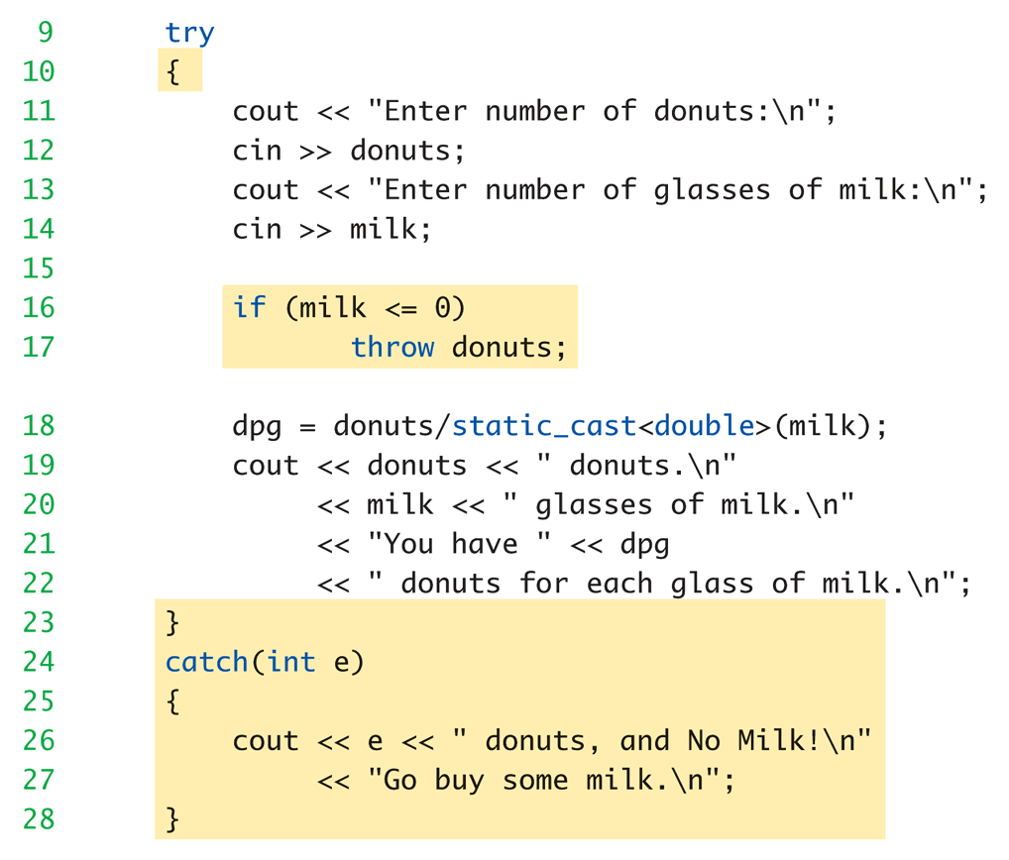
Toy Example with Exception Handling: Display 18.2 Same Thing Using Exception Handling

Slide 8
Toy Example Discussion
Code between keywords try and catch
Same code from ordinary version, except if statement simpler: if (milk <= 0) throw donuts;
Much cleaner code
If "no milk" → do something exceptional
The "something exceptional" is provided after keyword catch

Slide 9
Toy Example try-catch
Try block
Handles "normal" situation
Catch block
Handles "exceptional" situations
Provides separation of normal from exceptional
Not big deal for this simple example, but important concept

Slide 10
try block
Basic method of exception-handling is try-throw-catch
Try block: try { Some_Code; }
Contains code for basic algorithm when all goes smoothly
Notes:
You are not 100% sure that all will go without a hitch, but you want to give it a try.

Slide 11
throw
Inside try-block, when something unusual happens: try { Code_To_Try if (exceptional_happened) throw donuts; More_Code }
Keyword throw followed by exception type
Called "throwing an exception"
Notes:
You can throw a value of any type.

Slide 12
catch-block
When something thrown → goes somewhere
In C++, flow of control goes from try-block to catch-block
try-block is "exited" and control passes to catch-block
Executing catch block called "catching the exception"
Exceptions must be "handled" in some catch block

Slide 13
catch-block More
Recall: catch(int e) { cout << e << " donuts, and no milk!\n"; << " Go buy some milk.\n"; }
Looks like function definition with int parameter!
Not a function, but works similarly
Throw like "function call"

Slide 14
catch-block Parameter
Recall: catch(int e)
"e" called catch-block parameter
Each catch block can have at most ONE catch-block parameter
Does two things:
type name specifies what kind of thrown value the catch-block can catch
Provides name for thrown value caught; can "do things" with value
Notes:
告訴你這個 block 可以吃的 parameter data type
提供你這個 block 的 parameter name，以方便你在這個 block 裡面使用這個 parameter

Slide 15
Defining Exception Classes
throw statement can throw value of any type
Exception class
Contains objects with information to be thrown
Can have different types identifying each possible exceptional situation
Still just a class
An "exception class" due to how it’s used

Slide 16
Exception Class for Toy Example
Consider: class NoMilk { public: NoMilk() { } NoMilk(int howMany) : count(howMany) { } int getcount() const { return count; } private: int count; };
throw NoMilk(donuts);
Invokes constructor of NoMilk class

Slide 18
Multiple Throws and Catches
try-block typically throws any number of exception values, of differing types
Of course only one exception thrown
Since throw statement ends try-block
But different types can be thrown
Each catch block only catches "one type"
Typical to place many catch-blocks after each try-block
To catch "all-possible" exceptions to be thrown

Slide 19
Catching
Order of catch blocks important
Catch-blocks tried "in order" after try-block
First match handles it!
Consider: catch (…) { }
Called "catch-all", "default" exception handler
Catches any exception
Ensure catch-all placed AFTER more specific exceptions!
Or others will never be caught!
Typically placed at the end of a list of catch blocks
Notes:
那點點點，是真的點點點，要寫在 code 裡面，代表 default catch block
通常放在最後一個，就像是 switch 裡面的 default:

Slide 20
Trivial Exception Classes
Consider: class DivideByZero { }
No member variables
No member functions (except default constructor)
Nothing but it’s name, which is enough
Might be "nothing to do" with exception value
Used simply to "get to" catch block
Can omit catch block parameter
Notes:
除以 0 的 exception 不需要給額外的 member variable 和 member function，因為 handler 通常不需要這些資訊就能處理，比方說，只是需要印出「不得除以 0」的警語。

Slide 21
Throwing Exception in Function
Function might throw exception
Callers might have different "reactions"
Some might desire to "end program"
Some might continue, or do something else
Makes sense to "catch" exception in calling function’s try-catch-block
Place function call inside try-block
Handle in catch-block after try-block
See next page…

Slide 22
Throwing Exception in Function Example
Consider: try { quotient = safeDivide(num, den); } catch (DivideByZero) { … }
safeDivide() function throws DividebyZero exception
We don’t handle the exception in safeDivde()
Handled back in caller’s catch-block

Slide 23
Exception Specification
Functions that don’t catch exceptions
Should "warn" users that it could throw
But it won’t catch!
Should list such exceptions: double safeDivide(int top, int bottom) throw (DividebyZero);
Called "exception specification" or "throw list"
Should be in declaration and definition
All types listed handled "normally”
You can place the function in a try block followed by a catch block to catch that type of exceptions
If no throw list → all types considered there

Slide 24
Throw List
If exception thrown in function NOT in throw list:
No errors (compile or run-time)
Function unexpected() automatically called
Default behavior is to terminate
Can modify behavior
Same result if no catch-block found
Notes:
如果不在 exception list 上面，compile 和 run-time 不會有錯，但是當發生 exception 時，它會直接使用 unexpected()

Slide 25
Throw List Summary
void someFunction() throw(DividebyZero, OtherException); //Exception types DividebyZero or OtherException //treated normally. All others invoke unexpected()
void someFunction() throw (); //Empty exception list, all exceptions invoke unexpected()
void someFunction(); //All exceptions of all types treated normally

Slide 26
unexpected()
Default action: terminates program
No special includes or using directives
Normally no need to redefine unexpected()
But you can:
Use set_unexpected() to change unexpected()
Consult compiler manual or advanced text for details
Please reference further reading…

Slide 27
Derived Classes
Recall: derived class objects also objects of base class
Consider: D is derived class of B
If B is in exception specification →
The thrown objects of class D will also be treated normally, since it’s also object of class B
Note: does not do automatic type cast:
double will not account for throwing an int
Notes:
雖然允許 derived class 的 exception
但是 exception 不會自動轉型，例如：丟出 int 沒辦法用 double 去接

Slide 29
When to Throw Exceptions
Typical to separate throws and catches
In separate functions
Throwing function:
Include throw statements in definition
List exceptions in throw list
In both declaration and definition
Catching function:
Different function, perhaps even in different file
Use exception if the way that the condition is handled depends on how and where the function is used
Notes:
使用 exception 的合適時機是
當這個 condition 必須由外面的狀況而定，也就是，每個狀況會有不同處理方式的時候

Slide 30
Preferred throw-catch Triad: throw
void functionA() throw (MyException) { … throw MyException(arg); … }
Function throws exception as needed
Notes:
Triad: 三人和弦，三件一組，三元素

Slide 31
Preferred throw-catch Triad: catch
Then some other function: void functionB() { … try { … functionA(); … } catch (MyException e) { // Handle exception } … }

Slide 32
Uncaught Exceptions
Should catch every exception thrown
If not → program terminates
terminate() is called
Recall for functions
If exception not in throw list: (e.g., throw ()) unexpected() is called
It in turn calls terminate()
So same result
Notes:
沒被接到的exception，會造成terminate()
而沒在list中的exception會造成unexpected()，不過因為unexpected通常call terminate()
所以結果來說，是一樣的，就是離開程式

Slide 33
Overuse of Exceptions
Exceptions alter flow of control
Similar to old "goto" construct
"Unrestricted" flow of control
Should be used sparingly
Good rule:
If desire a "throw": consider how to write program without throw
If alternative reasonable → do it
Notes:
Exception 造成程式的 flow 突然跳到其他地方，類似 goto，對structure來說不好→少用
為了避免被濫用，如果你的程式架構可以被改變而且合理，那就不要用 exception

Slide 34
Exception Class Hierarchies
Useful to have; consider: DivideByZero class derives from: ArithmeticError exception class
All catch-blocks for ArithmeticError also catch DivideByZero
If ArithmeticError in throw list, then DividebyZero also considered there
Notes:
繼承的class可以視為自動被加入exception list

Slide 35
Testing Available Memory
new operator throws bad_alloc exception if insufficient memory: try { NodePtr pointer = new Node; } catch (bad_alloc) { cout << "Ran out of memory!"; // Can do other things here as well… }
bad_alloc is in library <new>, std namespace
Notes:
利用 exception 來處理 memory allocation 的失敗

Slide 36
Rethrowing an Exception
Legal to throw exception IN catch-block!
Typically only in rare cases
Throws to catch-block "farther up chain"
Can re-throw same or new exception
rethrow;
Throws same exception again
throw newExceptionUp;
Throws new exception to next catch-block
Notes:
很少機會再一個 catch 裡面再寫 throw，當然你可以在裡面寫，只要有 catch 可以接，就不會 terminate

Slide 38
Example – High Score
Throwing an exception in a function is especially helpful when the exception has no relation to the return value of the function.
Consider a function that scans through a text file of high scores and returns the highest score.
What should the function return if the file cannot be opened?
One strategy is to return a special value, such as a negative number.
Notes:
檔案開不起來，要怎麼處理？
回傳的數字，會是？過去通常用 -1 來表示還沒找到 max

Slide 39
High Score – No Exception Handling (1 of 4)
// Program that outputs the high score from a high scores file.
// Does not use exception handling.
#include <iostream>
#include <fstream>
#include <string>
using std::cout;
using std::endl;
using std::ifstream;
//Function prototypes
int getHighscore();
Notes:
傳統做法

Slide 40
High Score – No Exception Handling (2 of 4)
// Returns the high score in the scores.txt file
int getHighscore()
{
ifstream f;
f.open("scores.txt");
// Check if the file did not open
if (f.fail())
{
cout << "File could not be opened." << endl;
return -1;
}
...
}

Slide 41
High Score – No Exception Handling (3 of 4)
// Returns the high score in the scores.txt file
int getHighscore()
{
...
int num;
int high = -1;
// Scan through each number in the file and return the largest
f >> high;
while (f >> num)
{
if (num > high)
high = num;
}
f.close();
return high;
}

Slide 42
High Score – No Exception Handling (4 of 4)
int main()
{
int highscore = getHighscore();
cout << "The high score is " << highscore << endl;
return 0;
}
Sample Dialogue 1 (file exists with values 10, 50, 30)
The high score is 50
Sample Dialogue 2 (the file does not exist)
File could not be opened.
The high score is -1
But what if negative scores are possible? No way to distinguish high scores
from no scores!

Slide 43
High Score Solution – Throw Exception (1 of 4)
Throw an exception if there is an IO error and catch it in main
// Program that outputs the high score from a high scores file.
// Uses exception handling.
#include <iostream>
#include <fstream>
#include <string>
using std::cout;
using std::endl;
using std::ifstream;
class FileIOError
{};
//Function prototypes
int getHighscore() throw (FileIOError);
Notes:
特別定義了一個 exception class

Slide 44
High Score Solution – Throw Exception (2 of 4)
// Returns the high score in the scores.txt file
// but throws an exception if the file could not be opened.
// This eliminates possible confusion over the return value.
int getHighscore() throw (FileIOError)
{
ifstream f;
f.open("cores.txt");
// Check if the file did not open
if (f.fail())
{
throw FileIOError();
}
...
}
Notes:
注意，當 fail 發生的時候，我們丟出 exception

Slide 45
High Score Solution – Throw Exception (3 of 4)
int getHighscore() throw (FileIOError)
{
... int num; int high = -1;
// Scan through each number in the file and return the largest
f >> high;
while (f >> num)
{
if (num > high)
high = num;
}
f.close();
return high;
}
Notes:
和之前一樣

Slide 46
High Score Solution – Throw Exception (4 of 4)
int main()
{
try
{
int highscore = getHighscore();
cout << "The high score is " << highscore << endl;
}
catch (FileIOError)
{
cout << "Could not open the scores file." << endl;
}
return 0;
}
Notes:
Main 裡面就要 try 和 catch 來抓到 error

Slide 47
Summary 1
Exception handling allows separation of "normal" cases and "exceptional" cases
Exceptions thrown in try-block
Or within a function whose call is in try-block
Exceptions caught in catch-block
try-blocks typically followed by more than one catch-block
List more specific exceptions first

Slide 48
Summary 2
Best used with separate functions
Especially considering callers might handle differently
Exceptions thrown in but not caught in function, should be listed in throw list
Exceptions thrown but never caught → program terminates
Resist overuse of exceptions
Unrestricted flow of control

