Slide 1

Chapter 19
Standard Template Library
Copyright © 2017 Pearson Education, Ltd. All rights reserved.

Slide 2
Learning Objectives
Iterators
Constant and mutable iterators
Reverse iterators
Containers
Sequential containers
Container adapters stack and queue
Associative Containers set and map
Generic Algorithms
Sequence, set, and sorting algorithms
Appendix: Big-O notation

Slide 3
Introduction
Recall stack and queue data structures
We created our own
Large collection of standard data structures exists
Make sense to have standard portable implementations of them!
Standard Template Library (STL)
Includes libraries for all such data structures
Like container classes: stacks and queues

Slide 4
Iterators
Recall: generalization of a pointer
Typically even implemented with pointer!
"Abstraction" of iterators
Designed to hide details of implementation
Provide uniform interface across different container classes
Each container class has "own" iterator type
Similar to how each data type has own pointer type

Slide 5
Manipulating Iterators
Recall using overloaded operators:
++, --, ==, !=
*
So if p is an iterator variable, *p gives access to data pointed to by p
Vector template class
Has all above overloaded operators
Also has members begin() and end() c.begin(); //Returns iterator for 1st item in c c.end(); //Returns "test" value for end

Slide 6
Cycling with Iterators
Recall cycling ability: for (p=c.begin();p!=c.end();p++) process *p //*p is current data item
Big picture so far…
Keep in mind:
Each container type in STL has own iterator types
Even though they’re all used similarly

Slide 7
Vector Iterator Types
Iterators for vectors of ints are of type: std::vector<int>::iterator
Vector is in std namespace, so need: using std::vector<int>::iterator;
Iterators for lists of ints are of type: std::list<int>::iterator
Notes:
因為 vector 的 iterator 定義在 class vector 底下，所以用 :: 來使用它

Slide 8
Display 19.1 Iterators Used with a Vector (1 of 2)
1 //Program to demonstrate STL iterators.
2 #include <iostream>
3 #include <vector>
4 using std::cout;
5 using std::endl;
6 using std::vector;
7 int main( )
8 {
9 vector<int> container;
10 for (int i = 1; i <= 4; i++)
11 container.push_back(i);
12 cout << "Here is what is in the container:\n";
13 vector<int>::iterator p;
14 for (p = container.begin( ); p != container.end( ); p++)
15 cout << *p << " ";
16 cout << endl;

Slide 9
Display 19.1 Iterators Used with a Vector (2 of 2)
17 cout << "Setting entries to 0:\n";
18 for (p = container.begin( ); p != container.end( ); p++)
19 *p = 0; 20 cout << "Container now contains:\n";
21 for (p = container.begin( ); p != container.end( ); p++)
22 cout << *p << " ";
23 cout << endl;
24 return 0;
25 }
Sample Dialogue
Here is what is in the container:
1 2 3 4
Setting entries to 0:
Container now contains:
0 0 0 0

Slide 10
Kinds of Iterators
Different containers → different iterators
Vector iterators
Most "general" form
All operations work with vector iterators
Support most of overloaded operators
Vector container great for iterator examples
Notes:
Vector 的 iterator 最完整，幾乎所有操作都有
注意：有些資料結構的操作方式不見得全部功能都存在

Slide 11
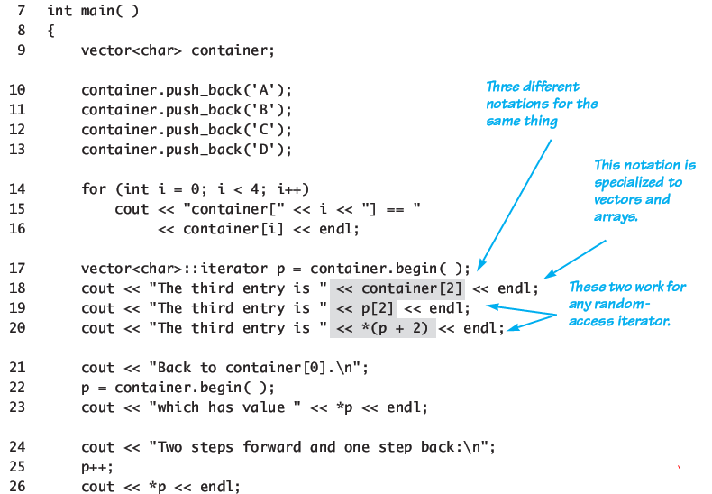
Random Access: Display 19.2 Bidirectional and Random-Access Iterator Use (1 of 2)
Notes:
宣告一個 vector container，丟進去 A B C D 四個 char，之後用各種不同方式取得成員

Slide 12
Random Access: Display 19.2 Bidirectional and Random-Access Iterator Use (2 of 2)
container[0] == A
container[1] == B
container[2] == C
container[3] == D
The third entry is C
The third entry is C
The third entry is C
Back to container[0].
Which has value A
Two steps forward and one step back:
B
C
B
27 p++;
28 cout << *p << endl;
29 p--;
30 cout << *p << endl;
31 return 0;
32 }

Slide 13
Iterator Classifications
Random-access
Forward iterators:
++ works on iterator
Bidirectional iterators:
Both ++ and -- work on iterator
Random-access iterators:
++, --, and random access all work with iterator
These are "kinds" of iterators, not types!
Bidirectional
Forward

Slide 14
Constant and Mutable Iterators
Dereferencing (*) operator’s behavior dictates
Constant iterator:
* produces read-only version of element
Can use *p to assign to variable or output, but cannot change element in container
E.g., *p = <anything>; is illegal
Mutable iterator:
*p can be assigned value
Changes corresponding element in container
i.e.: *p returns an lvalue

Slide 15
Reverse Iterators
To cycle elements in reverse order
Requires container with bidirectional iterators
Might consider: iterator p; for (p=container.end();p!=container.begin(); p--) cout << *p << " " ;
But recall: end() is just "sentinel", begin() not!
May result in run-time error
Might work on some systems, but not most
See next page for the correct usage

Slide 16
Reverse Iterators Correct
To correctly cycle elements in reverse order: reverse_iterator p; for (rp=container.rbegin();rp!=container.rend(); rp++) cout << *rp << " " ;
rbegin()
Returns iterator at last element
rend()
Returns sentinel "end" marker

Slide 17
Compiler Problems
Some compilers problematic with iterator declarations
Consider our usage: using std::vector<char>::iterator; … iterator p;
Alternatively: std::vector<char>::iterator p;
And others…
Try various forms if compiler problematic

Slide 18
Auto
The C++11 auto keyword can make your code much more readable when it comes to templates and iterators.
Instead of
vector<int>::iterator p = v.begin();
We can do the same thing much more compactly with auto
auto p = v.begin();

Slide 20
Containers
Container classes in STL
Different kinds of data structures
Like lists, queues, stacks
Each is template class with parameter for particular data type to be stored
e.g., Lists of ints, doubles or myClass types
Each has own iterators
One might have bidirectional, another might just have forward iterators
But all operators and members have same meaning
e.g., ++, begin(), and end()

Slide 21
Sequential Containers
Arranges list data
1st element, next element, … to last element
Linked list is sequential container
Earlier linked lists were "singly linked lists"
One link per node
STL has no "singly linked list"
Only "doubly linked list": template class list
Notes:
Singly linked list: 單向的串鏈

Slide 22
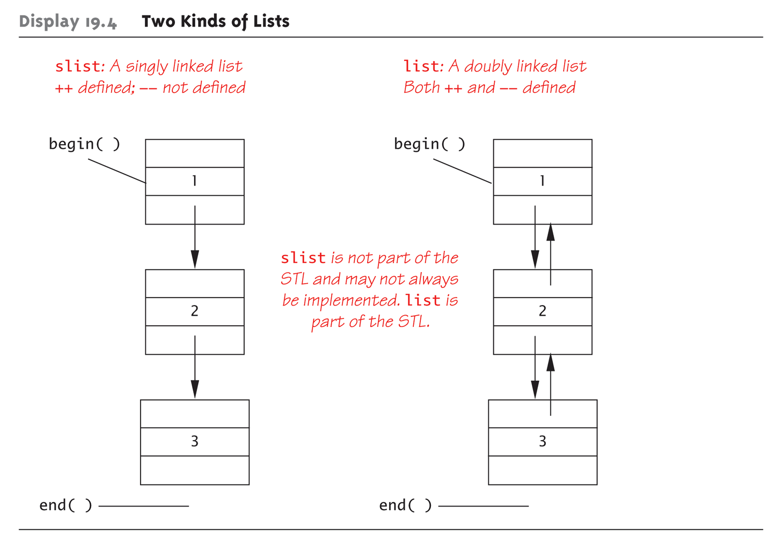
Display 19.4 Two Kinds of Lists

Slide 23
Display 19.5 Using the list Template Class(1 of 2)
1 //Program to demonstrate the STL template class list.
2 #include <iostream>
3 #include <list>
4 using std::cout;
5 using std::endl;
6 using std::list;
7 int main( )
8 {
9 list<int> listObject;
10 for (int i = 1; i <= 3; i++)
11 listObject.push_back(i);
12 cout << "List contains:\n";
13 list<int>::iterator iter;
14 for (iter = listObject.begin( ); iter != listObject.end( );
iter++)
15 cout << *iter << " ";
16 cout << endl;

Slide 24
Display 19.5 Using the list Template Class(2 of 2)
17 cout << "Setting all entries to 0:\n";
18 for (iter = listObject.begin( ); iter != listObject.end( );
iter++)
19 *iter = 0;
20 cout << "List now contains:\n";
21 for (iter = listObject.begin( ); iter != listObject.end( );
iter++)
22 cout << *iter << " ";
23 cout << endl;
24 return 0;
25 }
SAMPLE DIALOGUE
List contains:
1 2 3
Setting all entries to 0:
List now contains:
0 0 0

Slide 25
Container Adapters stack and queue
Container adapters are template classes
Implemented "on top of" other classes
Example: stack template class by default implemented on top of deque template class
Buried in stack’s implementation is deque where all data resides
Deque: doubly ended queue
Others: queue: also on top of deque priority_queue: on top of vector
Notes:
Deque 是雙向 queue，兩端都可以 add 和 remove
Stack 和 queue 都是 deque 當基底
Priority queue 則是 vector

Slide 26
Specifying Container Adapters
Adapter template classes have "default" containers underneath
But can specify different underlying container
Examples: stack template class → any sequence container priority_queue → default is vector, could be others
Implementing Example: stack<int, vector<int> >
Makes vector underlying container for stack
Note space between > > C++ 11 has corrected the issue.
Notes:
不過這一切基底，你可以換掉

Slide 27
Associative Containers
Associative container: simple database
Store data
Each data item has key
Example: data: employee’s record as struct key: employee’s SSN
Items retrieved based on key
Similar to hashing

Slide 28
set Template Class
Simplest container possible
Stores elements without repetition
1st insertion places element in set
Each element is own key
Use element as a key to retrieve the element
Capabilities:
Add elements
Delete elements
Ask if element is in set

Slide 29
More set Template Class
Designed to be efficient
Stores values in sorted order
Can specify order: set<T, Ordering> s;
Ordering is well-behaved ordering relation that returns bool
None specified: use < relational operator
Notes:
Order 可以換掉，只要你寫了 comparison object，裡面要包到 comp fucntion

Slide 30
Program Using the set Template Class (1 of 2)
1 //Program to demonstrate use of the set template class.
2 #include <iostream>
3 #include <set>
4 using std::cout;
5 using std::endl;
6 using std::set;
7 int main( )
8 {
9 set<char> s;
10 s.insert(’A’);
11 s.insert(’D’);
12 s.insert(’D’);
13 s.insert(’C’);
14 s.insert(’C’);
15 s.insert(’B’);
16 cout << "The set contains:\n";
17 set<char>::const_iterator p;
18 for (p = s.begin( ); p != s.end( ); p++)
19 cout << *p << " ";
20 cout << endl;

Slide 31
Program Using the set Template Class (2 of 2)
21 cout << "Set contains 'C': ";
22 if (s.find('C')==s.end( ))
23 cout << " no " << endl;
24 else
26 cout << " yes " << endl;
27 cout << "Removing C.\n";
28 s.erase(’C’);
29 for (p = s.begin( ); p != s.end( ); p++)
30 cout << *p << " ";
31 cout << endl;
32 cout << "Set contains 'C': ";
33 if (s.find('C')==s.end( ))
34 cout << " no " << endl;
35 else
36 cout << " yes " << endl;
37 return 0;
38 }
SAMPLE DIALOGUE
The set contains:
A B C D
Set contains 'C': yes
Removing C.
A B D
Set contains 'C': no

Slide 32
Map Template Class
A function given as set of ordered pairs
For each value first, at most one value second in map, i.e., (first, second)
Example map declaration: map<string, int> numberMap;
Can use [ ] notation to access the map
For both storage and retrieval
Stores in sorted order, like set
Second value can have no ordering impact

Slide 33
Program Using the map Template Class (1 of 3)
1 //Program to demonstrate use of the map template class.
2 #include <iostream>
3 #include <map>
4 #include <string>
5 using std::cout;
6 using std::endl;
7 using std::map;
8 using std::string;
9 int main( )
10 {
11 map<string, string> planets;
12 planets["Mercury"] = "Hot planet";
13 planets["Venus"] = "Atmosphere of sulfuric acid";
14 planets["Earth"] = "Home";
15 planets["Mars"] = "The Red Planet";
16 planets["Jupiter"] = "Largest planet in our solar system";
17 planets["Saturn"] = "Has rings";
18 planets["Uranus"] = "Tilts on its side";
19 planets["Neptune"] = "1500 mile per hour winds";
20 planets["Pluto"] = "Dwarf planet";

Slide 34
Program Using the map Template Class (2 of 3)
21 cout << "Entry for Mercury - " << planets["Mercury"]
22 << endl << endl;
23 if (planets.find("Mercury") != planets.end())
24 cout << "Mercury is in the map." << endl;
25 if (planets.find("Ceres") == planets.end())
26 cout << "Ceres is not in the map." << endl << endl;
27 cout << "Iterating through all planets: " << endl;
28 map<string, string>::const_iterator iter;
29 for (iter = planets.begin(); iter != planets.end(); iter++)
30 {
31 cout << iter->first << " - " << iter->second << endl;
32 }
The iterator will output the map in order sorted by the key. In this case the output will be listed alphabetically by planet.
33 return 0;
34 }

Slide 35
Program Using the map Template Class (3 of 3)
SAMPLE DIALOGUE
Entry for Mercury - Hot planet
Mercury is in the map.
Ceres is not in the map.
Iterating through all planets:
Earth - Home
Jupiter - Largest planet in our solar system
Mars - The Red Planet
Mercury - Hot planet
Neptune - 1500 mile per hour winds
Pluto - Dwarf planet
Saturn - Has rings
Uranus - Tilts on its side
Venus - Atmosphere of sulfuric acid

Slide 36
Use Initialization, Ranged For, and auto with Containers
C++11’s ranged for, auto, and initialization features make it easier to work with Containers
Consider:
We can easily iterate through each with:
map<int, string> personIDs = { {1,"Walt"}, {2,"Kenrick"} };
set<string> colors = {"red","green","blue"};
for (auto p : personIDs) cout << p.first << " " << p.second << endl; for (auto p : colors) cout << p << " ";

Slide 37
Efficiency
STL designed with efficiency as important consideration
Strives to be optimally efficient
Example: set, map elements stored in sorted order for fast searches
Template class member functions:
Guaranteed maximum running time
Called "Big-O" notation, an "efficiency"-rating

Slide 39
Generic Algorithms
Basic template functions
Recall algorithm definition:
Set of instructions for performing a task
Can be represented in any language
Typically thought of in "pseudocode"
Considered "abstraction" of code
Gives important details, but not find code details
STL’s algorithms in template functions:
Certain details provided only
Therefore considered "generic algorithms"

Slide 40
Nonmodifying Sequence Algorithms
Template functions operating on containers
NO modification of container contents
Generic find function
Typical example
Can be used with any STL sequence container class
Other functions such as binary_search

Slide 41
Display 19.17 The Generic find Function (1 of 3)
1 //Program to demonstrate use of the generic find function.
2 #include <iostream>
3 #include <vector>
4 #include <algorithm>
5 using std::cin;
6 using std::cout;
7 using std::endl;
8 using std::vector;
9 using std::find;
10 int main( )
11 {
12 vector<char> line;
13 cout << "Enter a line of text:\n";
14 char next;
15 cin.get(next);
16 while (next != ’\n’)
17 {
18 line.push_back(next);
19 cin.get(next);
20 }

Slide 42
Display 19.17 The Generic find Function (2 of 3)
21 vector<char>::const_iterator where;
22 where = find(line.begin( ), line.end( ), ’e’);
23 //where is located at the first occurrence of ’e’ in v.
24 vector<char>::const_iterator p;
25 cout << "You entered the following before you entered your
first e:\n";
26 for (p = line.begin( ); p != where; p++)
27 cout << *p;
28 cout << endl;
29 cout << "You entered the following after that:\n";
30 for (p = where; p != line.end( ); p++)
31 cout << *p;
32 cout << endl;
33 cout << "End of demonstration.\n";
34 return 0;
}
If find does not find what it is looking for, it returns its second argument.
i.e., line.end() in this example code

Slide 43
Display 19.17 The Generic find Function (3 of 3)
Sample Dialogue 1
Enter a line of text
A line of text.
You entered the following before you entered your first e:
A lin
You entered the following after that:
e of text.
End of demonstration.
Sample Dialogue 2
Enter a line of text
I will not!
You entered the following before you entered your first e:
I will not!
You entered the following after that:
End of demonstration.

Slide 44
Modifying Sequence Algorithms
STL functions that change container contents
Recall: adding/removing elements from containers can affect other iterators!
list, slist guarantee no iterator changes
vector, deque make NO such guarantee
Always watch which iterators are assured to be changed/unchanged

Slide 45
Set Algorithms
STL generic set operation functions
All assume containers stored in sorted order
Containers set, map, multiset, multimap
DO store in sorted order, so all set functions apply
Others, like vector, are not sorted
Should not use set functions

Slide 46
Sorting Algorithms
STL contains two template functions:
sort range of elements
merge two sorted ranges of elements
Guaranteed running time O(N log N)
No sort can be faster
Function guarantees fastest possible sort

Slide 47
Summary 1
Iterator is "generalization" of a pointer
Used to move through elements of container
Container classes with iterators have:
Member functions end() and begin() to assist cycling
Main kinds of iterators:
Forward, bi-directional, random-access
Given constant iterator p, *p is read-only version of element

Slide 48
Summary 2
Given mutable iterator p → *p can be assigned value
Bidirectional container has reverse iterators allowing reverse cycling
Main STL containers: list, vector, deque
stack, queue: container adapter classes
set, map, multiset, multimap containers store in sorted order
STL implements generic algorithms
Provide maximum running time guarantees

Slide 49
Appendix

Slide 50
Running Times
How fast is program?
"Seconds"?
Consider: large input? .. small input?
Produce "table"
Based on input size
Table called "function" in math
With arguments and return values!
Argument is input size: T(10), T(10,000), …
Function T is called "running time"

Slide 51
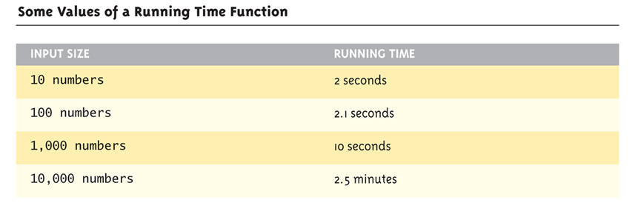
Table for Running Time Function: Display 19.15 Some Values of a Running Time Function

Slide 52
Consider Sorting Program
Faster on smaller input set?
Perhaps
Might depend on "state" of set
"Mostly" sorted already?
Consider worst-case running time
T(N) is time taken by "hardest" list
List that takes longest to sort

Slide 53
Counting Operations
T(N) given by formula, such as: T(N) = 5N + 5
"On inputs of size N program runs for 5N + 5 time units"
Must be "computer-independent"
Doesn’t matter how "fast" computers are
Can’t count "time"
Instead count "operations"

Slide 54
Counting Operations Example
int I = 0; bool found = false; while (( I < N) && !found) if (a[I] == target) found = true; else I++;
5 operations per loop iteration: <, &&, !, [ ], ==, ++
After N iterations, final three: <, &&, !
So: 6N+5 operations when target not found

Slide 55
Big-O Notation
Recall: 6N+5 operations in "worst-case"
Expressed in "Big-O" notation
Some constant "c" factor where c(6N+5) is actual running time
c different on different systems
We say code runs in time O(6N+5)
But typically only consider "highest term"
Term with highest exponent
O(N) here

Slide 56
Big-O Terminology
Linear running time:
O(N)—directly proportional to input size N
Quadratic running time:
O(N²)
Logarithmic running time:
O(log N)
Typically "log base 2"
Very fast algorithms!

Slide 57
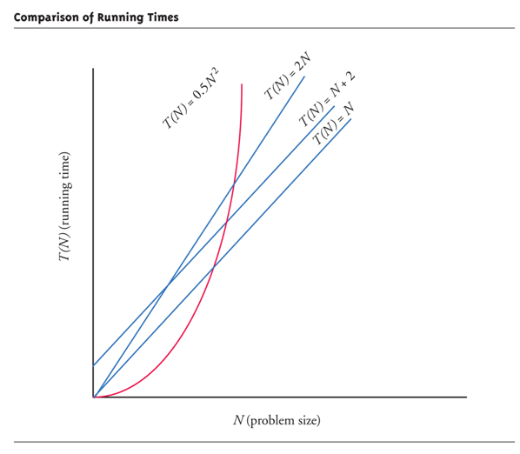
Display 19.16 Comparison of Running Times

Slide 58
Container Access Running Times
O(1) - constant operation always:
Vector inserts to front or back
deque inserts
list inserts
O(N)
Insert or delete of arbitrary element in vector or deque (N is number of elements)
O(log N)
set or map finding

