Slide 1
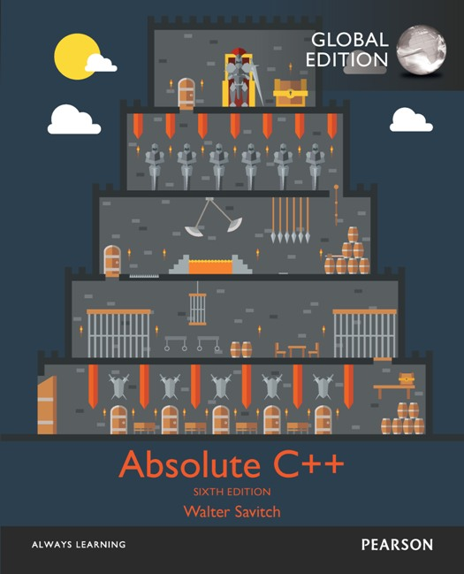
Chapter 20
Patterns and UML
Copyright © 2017 Pearson Education, Ltd. All rights reserved.

Slide 2
Learning Objectives
Patterns
Adapter pattern
Model-View-Controller pattern
Sorting pattern and it’s efficiency
Pattern formalism
UML
History of UML
UML class diagrams
Class interactions

Slide 3
Introduction
Patterns and UML
Software design tools
Programming-language independent
Assuming object-oriented-capable
Pattern
Like "ordinary" pattern in other contexts
An "outline" of software task
Can result in different code in different but similar tasks
UML
Graphical language for OOP design

Slide 4
Patterns
Patterns are design principles
Apply across variety of software applications
Must also apply across variety of situations
Must make assumptions about application domain
Example: Iterator pattern applies to containers of almost any kind

Slide 5
Pattern Example: Iterators
Recall iterators
Iterator pattern applies to containers of almost any kind
1st described as "abstract"
As ways of cycling thru any data in any container
Then gave specific applications
Such as list iterator, constant list iterator, reverse list iterator, etc.

Slide 6
Consider No Patterns
Iterators
Imagine huge amount of detail if all container iterators presented separately!
If each had different names for begin(), end()
To make "sense" of it, learners might make pattern themselves!
Until pattern developed, all were different
"Seemed" similar, but not organized
Consider containers as well
Same issues!

Slide 7
Adapter Pattern
Transforms one class into different class
With no changes to underlying class
Only "adding" to interface
Recall stack and queue template classes
Both can choose underlying class used to store data: stack<vector<int>> -- int stack under vector stack<list<int>> -- int stack underlying list
All cases underlying class not changed
Only interface is added

Slide 8
Adapter Pattern Interface
How to add interface?
Implementation detail
Not part of pattern
But… two ways:
Example: for stack adapter:
Underlying container class could be member variable of stack class
Or stack class could be derived class of underlying container class

Slide 9
Model-View-Controller Pattern
Way of dividing I/O task out
Model part: heart of application
View part: output
Displays picture of model’s state
Controller part: input
Relays commands from user to model
A divide and conquer strategy
One big task → three smaller tasks
Each with well-defined responsibilities

Slide 10
Model-View-Controller Pattern
Any application can fit
But particularly suited to GUI design projects
Where view can actually be visualization of state of model

Slide 11
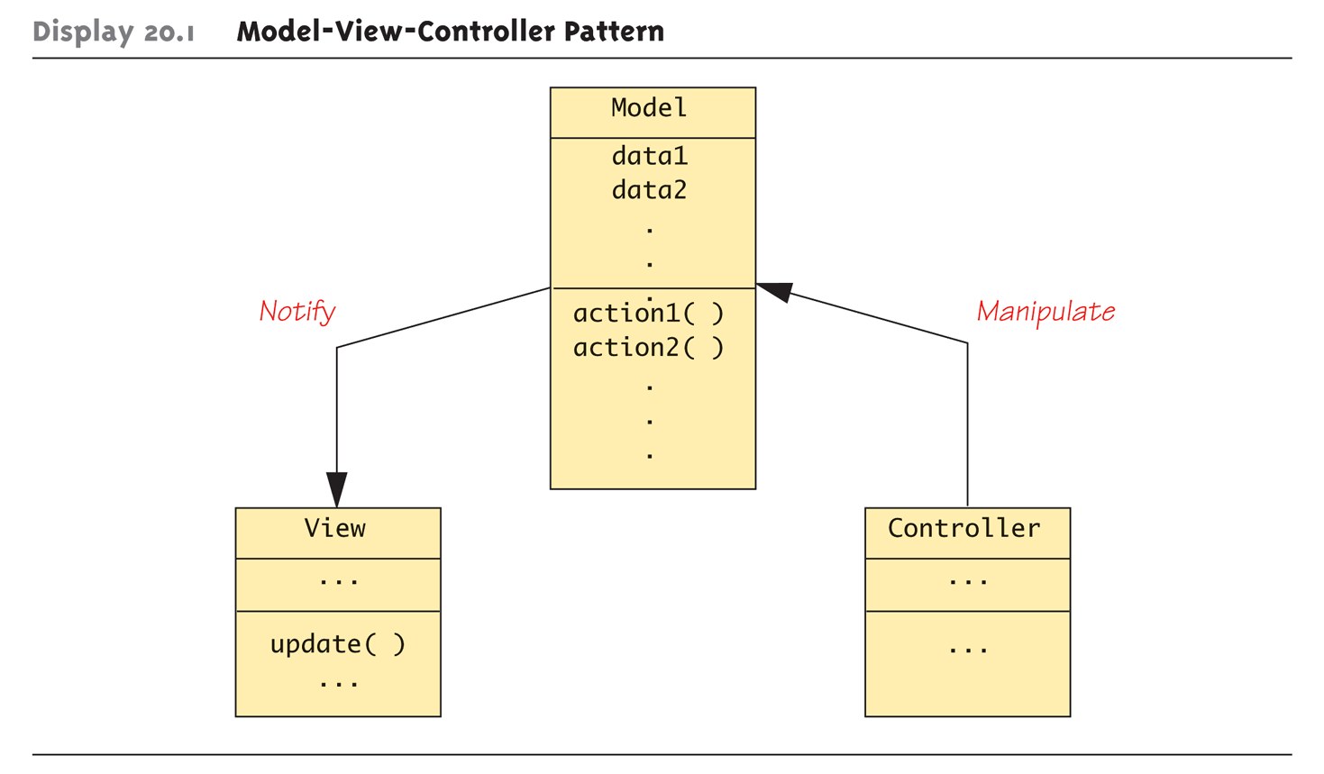
Display 20.1 Model-View-Controller Pattern

Slide 12
A Sorting Pattern Example
Similar pattern among "most-efficient" sorting algorithms:
Recursive
Divide list into smaller lists (i.e., split)
Then recursively sort smaller lists
Recombine two sorted lists obtaining one final sorted list (i.e., join)

Slide 13
Sorting Pattern
Clearly a divide-and-conquer strategy
Heart of pattern: int splitPt = split(a, begin, end); sort(a, begin, splitPt); sort(a, splitPt, end); join(a, begin, splitPt, end);
Note no details on how split and join are defined
Different definitions will yield different sorting algorithms

Slide 14
Function split
Rearranges elements
In interval [begin, end]
Divides interval at split point, splitPt
Two new intervals then sorted
[begin, splitPt) – first half
[splitPt, end) – second half
No details in pattern
Nothing about how rearrange and divide takes place

Slide 15
Function join
Combines two sorted intervals
Produces final sorted version
Again, no details
join function could perform many ways

Slide 16
Sample Realization of Sorting Pattern: Mergesort
Simplest "realization" of sorting pattern is mergesort
Definition of split very simple
Just divides array into two intervals
No rearranging of elements
Definition of join complex!
Must sort subintervals
Then merge, copying to temporary array

Slide 17
Mergesort’s join Function
Sequence:
Compare smallest elements in each interval
Smaller of two → next position in temporary array
Repeated until through both intervals
Result is final sorted array

Slide 18
Sort Pattern Complexity
Trade-off between split and join
Either can be simple at expense of other
e.g., In mergesort, split function simple at expense of complicated join function
Could vary in other algorithms
Comes down to "who does work?"
Notes:
其實做研究都是這樣，你一定要有 trade-off，才值得去做個題目。在這個題目裡面，找到最佳平衡點，也就是權衡多個 trade-off 底下最好的決定。

Slide 19
Consider Quicksort
Complexity switch
join function simple, split function complex
Library files
Include files "mergesort.cpp", "quicksort.cpp" both give two different realizations of same sort pattern
Provide same input and output!

Slide 20
Quicksort Realization
A sophisticated split function
Arbitrary value chosen, called "splitting value"
Array elements rearranged "around" splitting value
Those less than in front, greater than in back
Splitting value essentially "divides" array
Two "sides" then sorted recursively
Finally combined with join
Which does nothing!

Slide 21
Sorting Pattern Efficiency
Most efficient realizations "divide" list into two chunks
Such as half and half
Inefficient if divided into "few" and "rest"
Mergesort: O(N log N)
Quicksort:
Worst case: O(N²) (if split uneven)
Average case: O(N log N)
In practice, one of best sort algorithms

Slide 22
Pragmatics and Patterns
Patterns are guides, not requirements
Not compelled to follow all fine details
Can take "liberties" and adjust for particular needs
Like efficiency issues
Pattern formalism
Standard techniques exist for using patterns
Place of patterns in software design process not yet clear
Is clear that many basic patterns are useful

Slide 24
UML
Unified Modeling Language
Attempt to produce "human-oriented" ways of representing programs
Like pseudocode: think of problem, without details of language
Pseudocode very standard, very used
But it’s a linear, algebraic representation
Prefer "graphical" representation
Enter UML

Slide 25
UML Design
Designed to reflect/be used with object-oriented programming philosophy
A promising effort!
Many companies have adopted UML formalism in software design process

Slide 26
History of UML
Developed with OOP
Different groups developed own graphical representations for OOP design
1996:
Booch, Jacobsen, Rumbaugh released early version of UML
Intended to "bring together" various different graphical representations to produce standard for all object-oriented design

Slide 27
UML Lately
Since 1996:
Developed and revised with feedback from OOP community
Today:
UML standard maintained and certified by Object Management Group (OMG)
Non-profit organization that promotes use of object-oriented techniques

Slide 28
UML Class Diagrams
As classes are central to OOP…
Class diagram is simplest of UML graphical representations to use
Three-sectioned box contains:
Class name
Data specifications
Actions (class member functions)

Slide 29
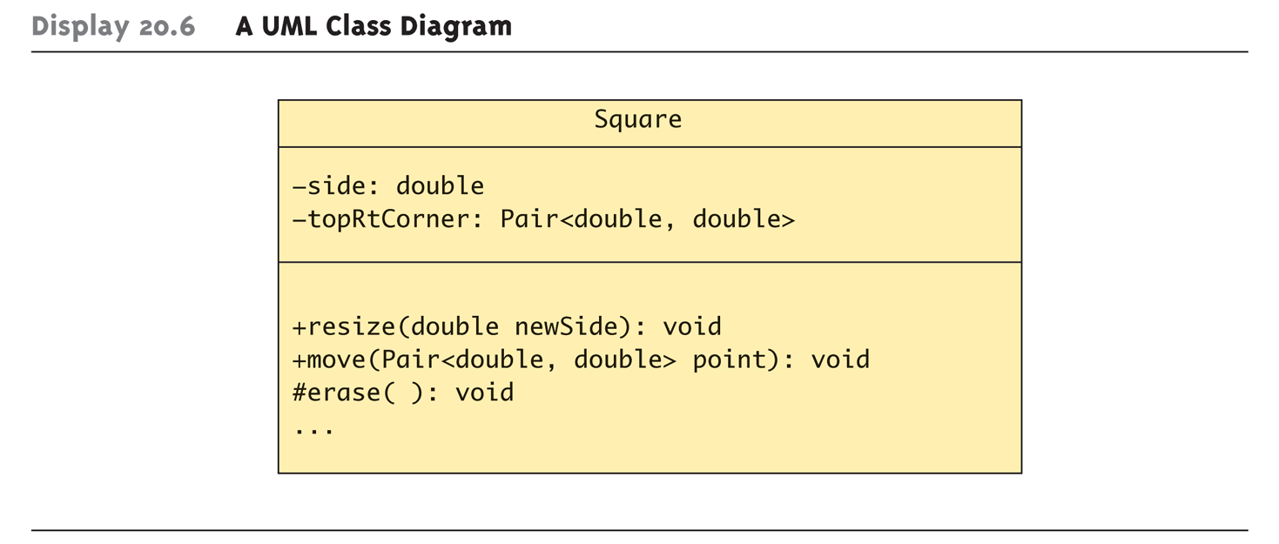
Class Diagrams Example: Display 20.6 A UML Class Diagram

Slide 30
Class Diagrams Example Notes
Data section:
+ sign indicates public member
- sign indicates private member
# indicates protected member
Our example: both private (Typical in OOP)
Actions:
Same +, -, # for public, private, protected
Need not provide all details
Missing members indicated with ellipsis (…)

Slide 31
Class Interactions
Class diagrams alone of little value
Just repeat of class interface, often "less"
Must show how objects of various classes interact
Annotated arrows show information flow between class objects
Recall Model-View-Controller Pattern
Annotations also for class groupings into library-like aggregates
Such as for inheritance

Slide 32
Display 20.1 Model-View-Controller Pattern

Slide 33
More Class Interactions
UML is extensible
If your needs not in UML, add them to UML!
Framework exists for this purpose
Prescribed standard for additions
Ensures different software developers understand each other’s UML

Slide 35
Design Patterns
Problems you have seen and solved before
But your solution may be
incomplete and incomprehensive
Pattern concept
The best solution obtained from all angles
More general, flexible solution
Book “Design Patterns” discusses 23 patterns
Notes:
我不介紹那麼多種，只是再給大家多一點感覺

Slide 36
Basic Concept of Patterns
Goal:
Cheap to maintain and simple to understand
Adding layers of abstraction
Isolates (hides) particular details
Separates things that changes from things that stay the same
Prevent changes from propagating
Program is likely to change for many reason and the changes may propagate other modifications throughout your code
Notes:
Adding layers of abstraction 你可以先想想 iterator，把最大相同的概念抓出來，形成一個 class，然後每個不同的部分，就實作在你新增的 iterator 裡面，而且修改不需要跨出新增的 class 外面（最高宗旨）

Slide 37
Singleton Pattern
Suitable scenarios: Object creation invoked client programmers
The ways you provide (O)
At most one object (O)
The other ways (X)
You will:
Make the constructors as private
Create a constructor (prevent default constructor)
Use static member variable

Slide 38

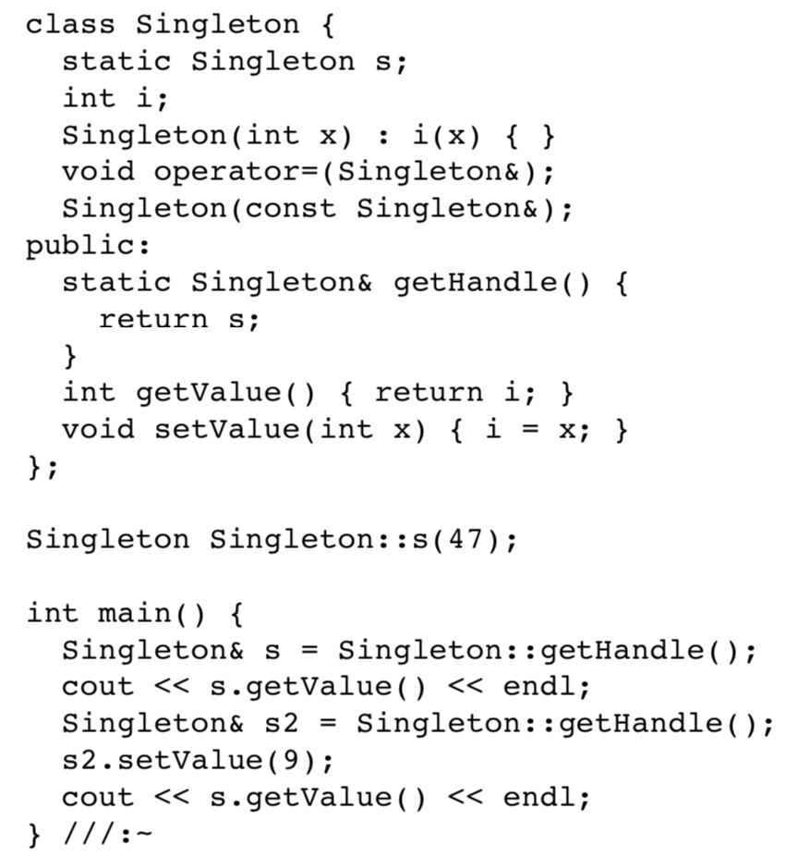
Example: Singleton Pattern
Use static member variable
Private constructor
Prevent default constructor

Slide 39
2nd Singleton Pattern
Suitable scenarios: Object creation invoked client programmers
The ways you provide (O)
At most one object created on demand (O)
The other ways (X)
You will:
Make the constructors as private
Create a constructor (prevent default constructor)
Use static member function with static variable

Slide 40
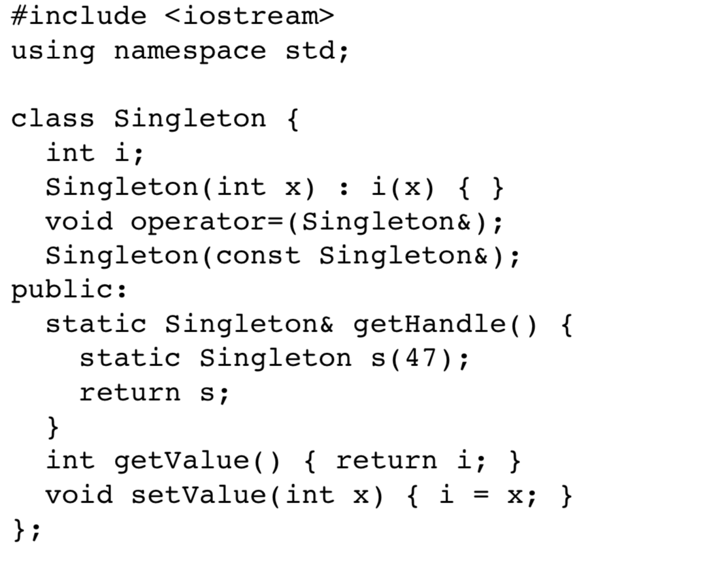
Example: 2nd Singleton Pattern
Use static member function to store static variable

Slide 41
Factory Pattern
Suitable scenarios: Inherited object creation invoked client programmers
The ways you provide (O)
The other ways (X)
You will:
Make the constructors as private
Create a constructor (prevent default constructor)
Build factory member function in the base class

Slide 42
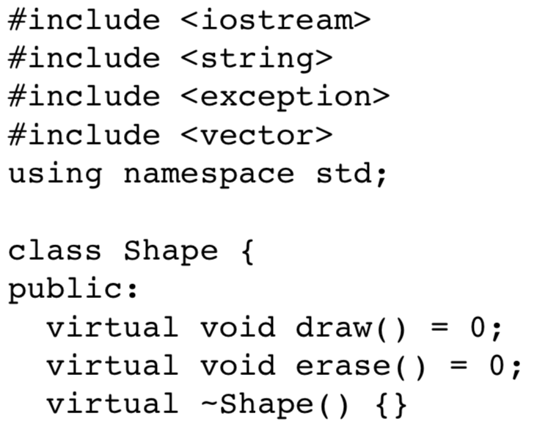
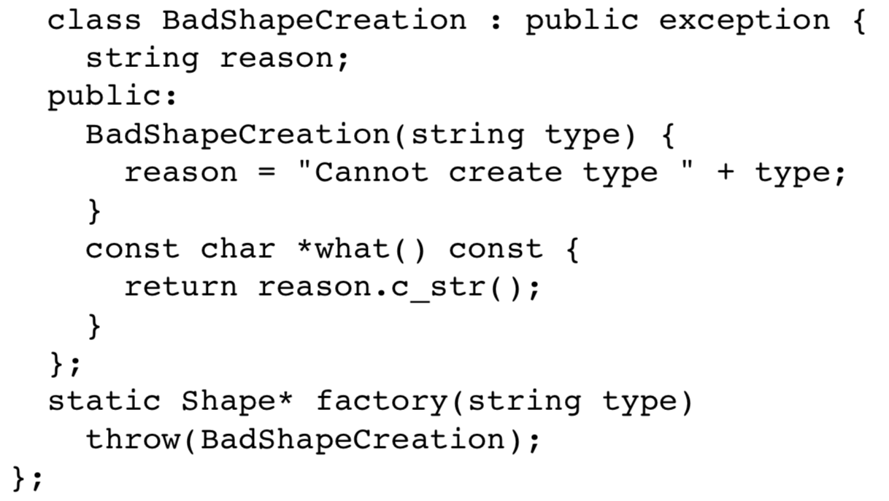
Example: Factory Pattern (1/2)
Build a factory

Slide 43
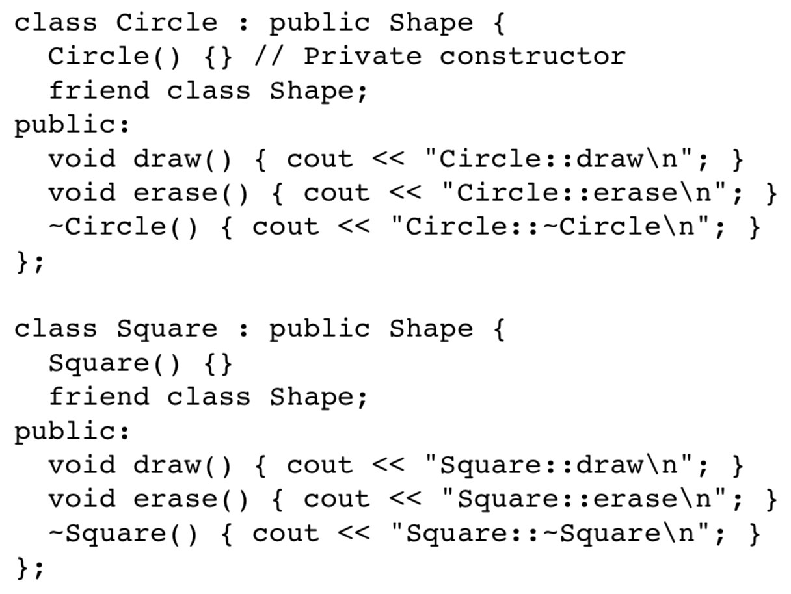
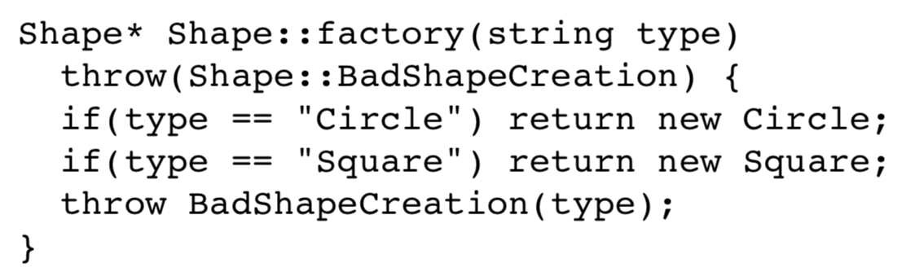
Example: Factory Pattern (2/2)
The details of factory

Slide 44
Example: Factory Pattern (2/2)
Adding a new shape, you have to define a new class
And add an if-else statement, which is cumbersome
The details of factory

Slide 45
Polymorphic Factory Pattern
Suitable scenarios: Inherited object creation invoked client programmers
The ways you provide (O)
You don’t want a factory that requires modification after adding a new type
The other ways (X)
You will:
Make the constructors as private
Create a constructor (prevent default constructor)
Move and modify the factory function

Slide 46
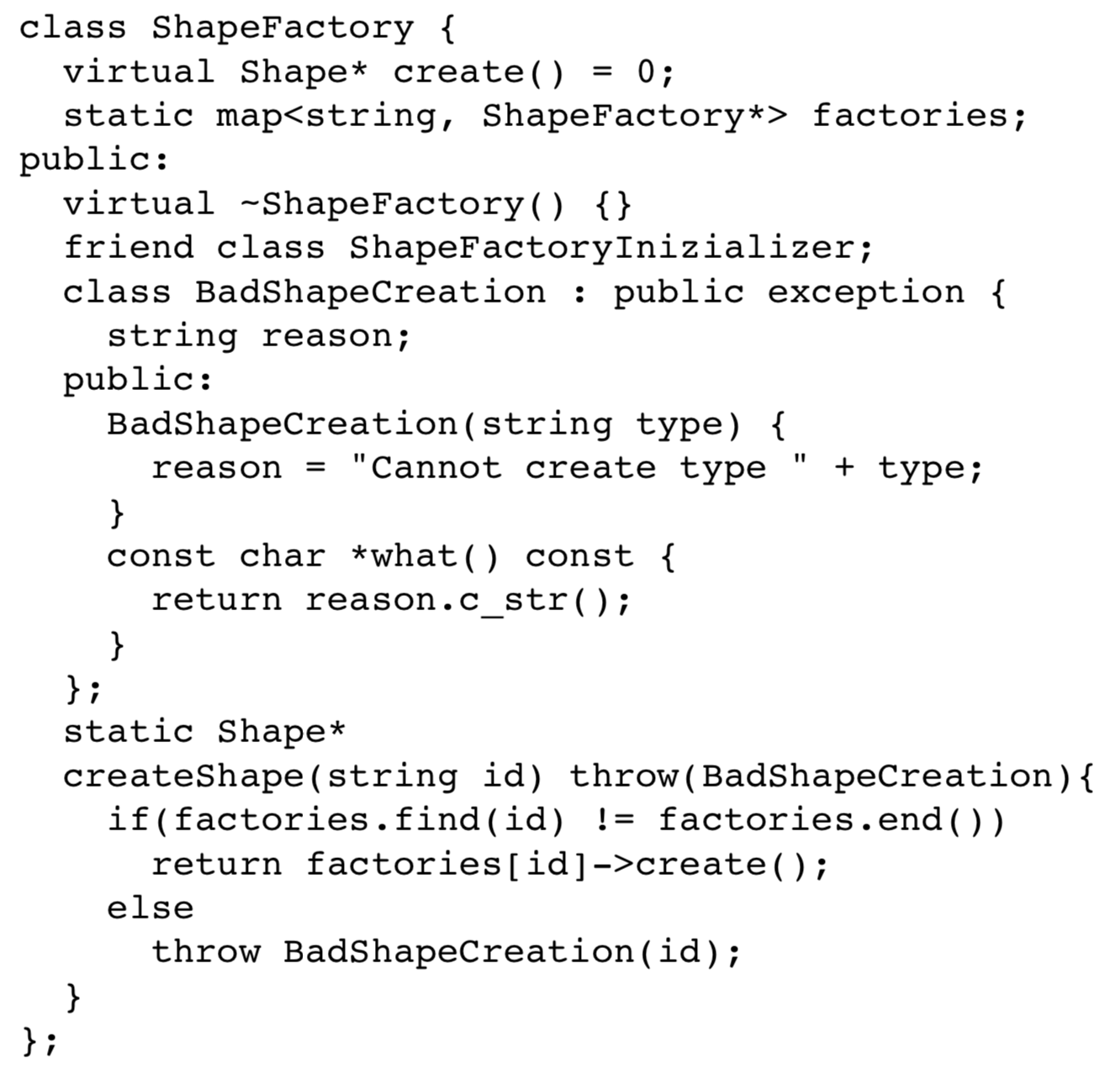
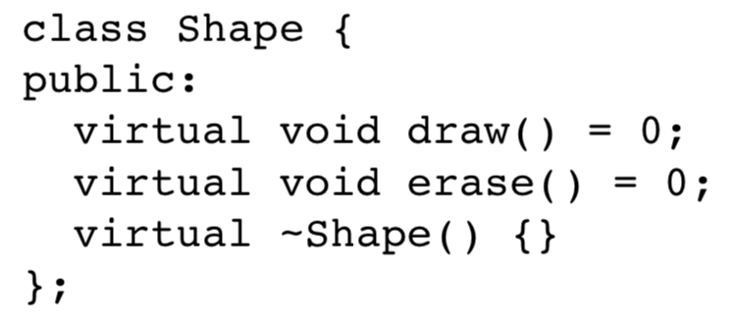
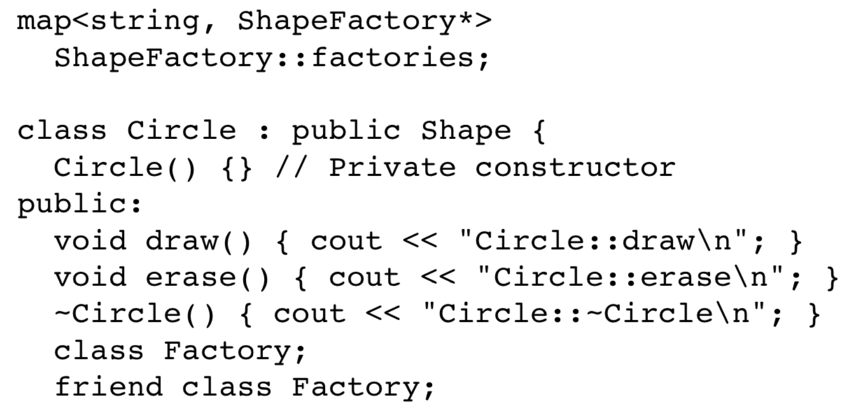
Example: Polymorphic Factory Pattern (1/3)
Isolate the factory
The derived factory should implement “create”
Use a map to store all derived shapes

Slide 47
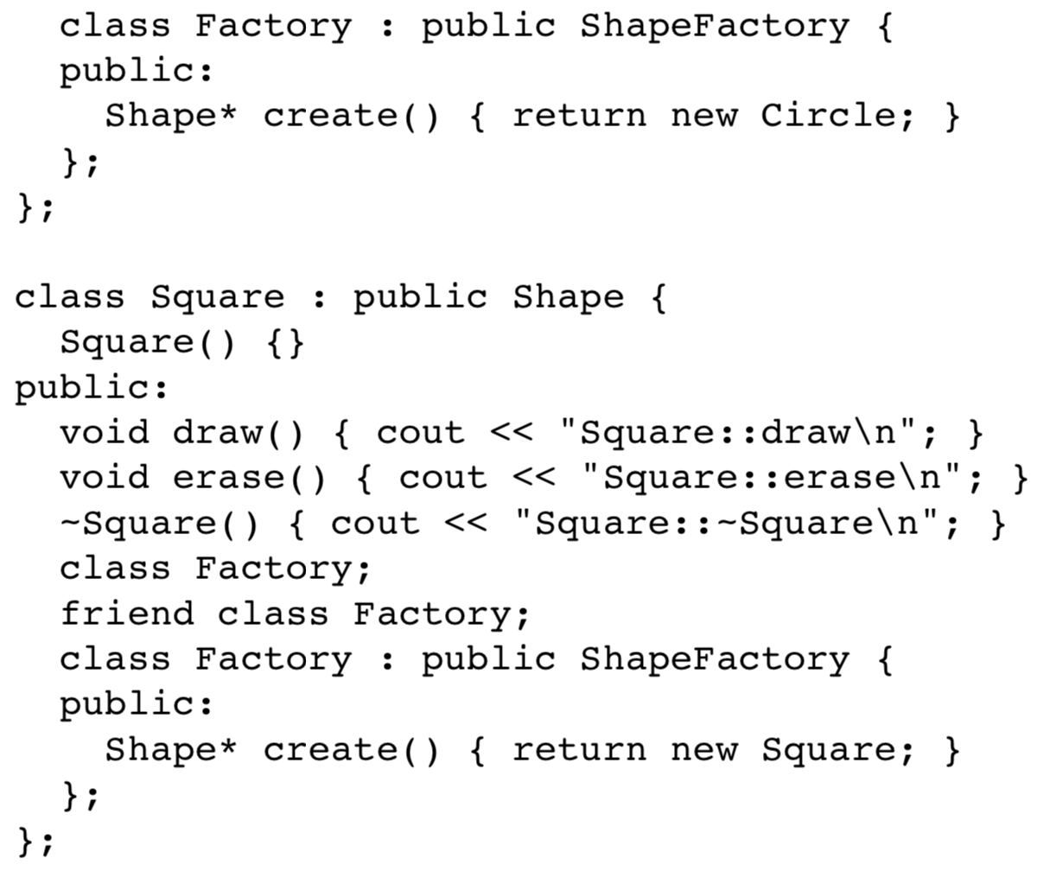
Example: Polymorphic Factory Pattern (2/3)
Allow its Factory can access private constructor
Overriding create function

Slide 48
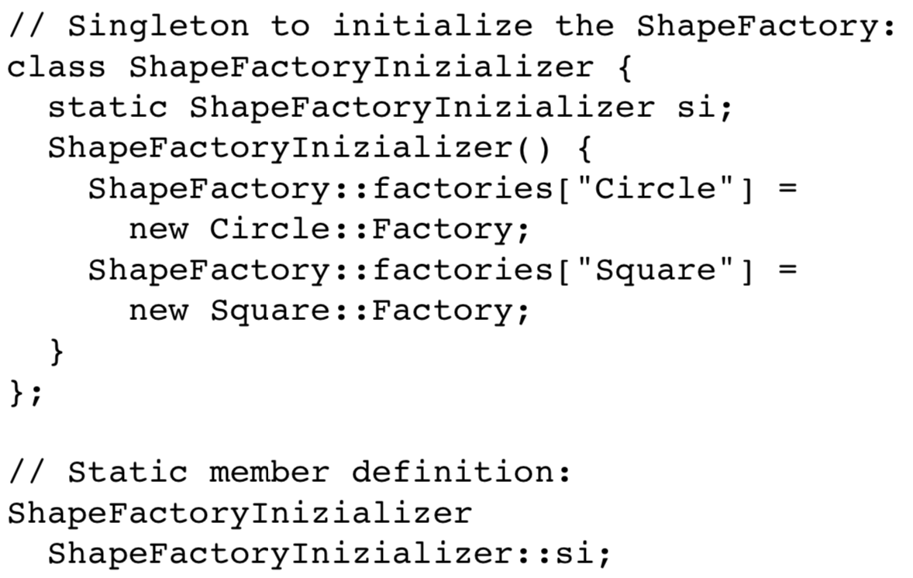
Example: Polymorphic Factory Pattern (3/3)
Initialize the map

Slide 49
Example: Polymorphic Factory Pattern (3/3)
Initialize the map
Changes propagates…

Slide 50
2nd Polymorphic Factory Pattern
Suitable scenarios: Inherited object creation invoked client programmers
The ways you provide (O)
You don’t want the changes propagate
The other ways (X)
See my code…

Slide 52
Summary
Patterns are design principles
Apply across variety of software applications
Pattern can provide framework for comparing related algorithms" efficiency
Unified Modeling Language (UML)
Graphical representation language
Designed for object-oriented software design
UML is one formalism used to express patterns

