Slide 1
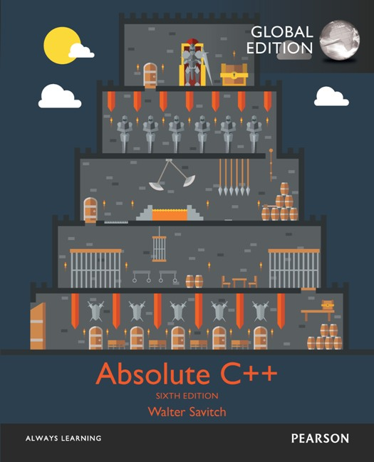
Chapter 2
Flow of Control
Copyright © 2017 Pearson Education, Ltd. All rights reserved.

Slide 2
Learning Objectives
Boolean Expressions
Building, Evaluating & Precedence Rules
Branching Mechanisms
if-else
switch
Nesting if-else
Loops
While, do-while, for
Nesting loops
Introduction to File Input

Slide 3
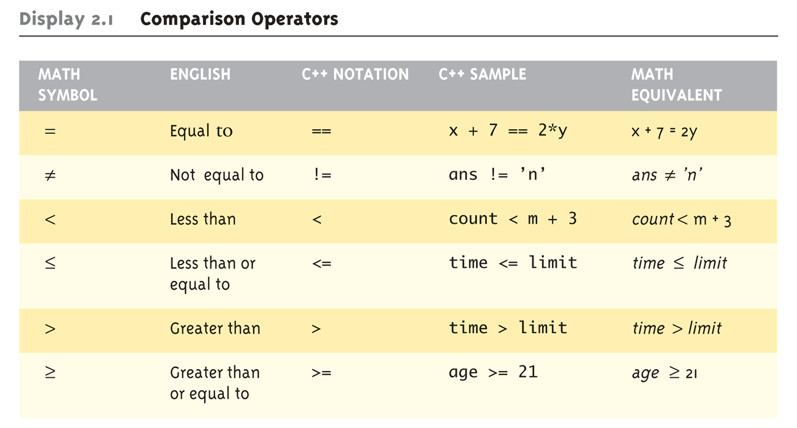
Boolean Expressions: Display 2.1 Comparison Operators
Logical Operators
Logical AND (&&)
Logical OR (||)

Slide 4
Evaluating Boolean Expressions
Data type bool
Returns true or false
true, false are predefined library consts
Truth tables
Display 2.2 next slide

Slide 5
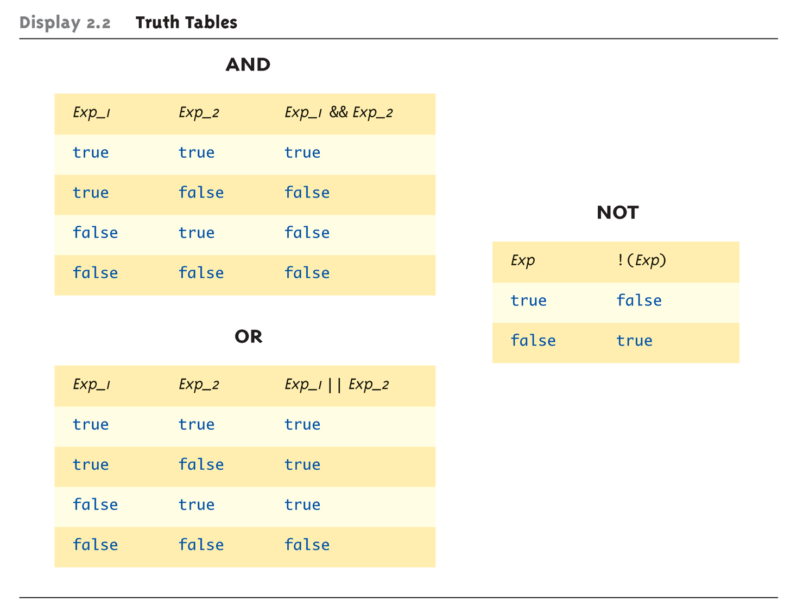
Evaluating Boolean Expressions: Display 2.2 Truth Tables

Slide 6
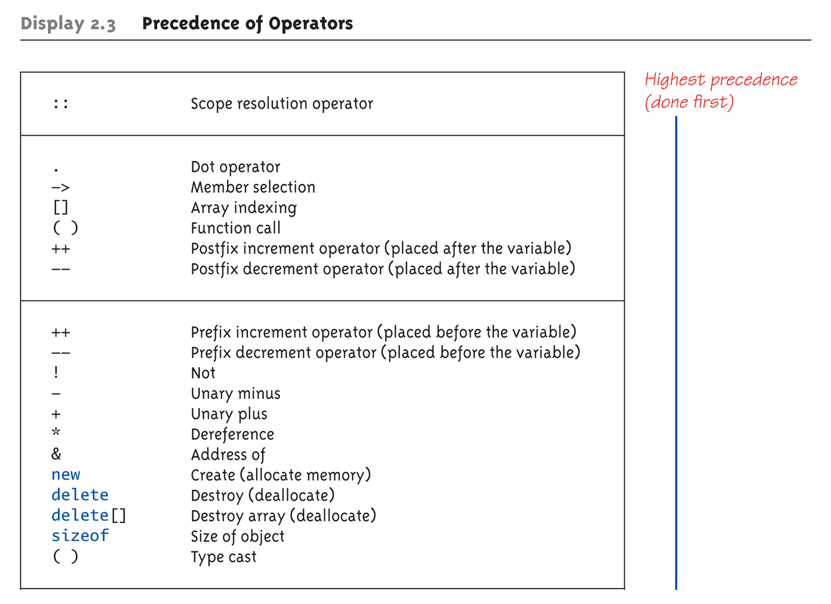
Display 2.3 Precedence of Operators (1 of 4)

Slide 7
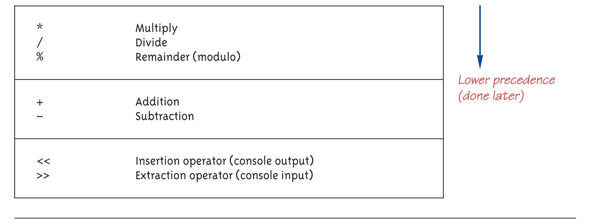
Display 2.3 Precedence of Operators (2 of 4)

Slide 8
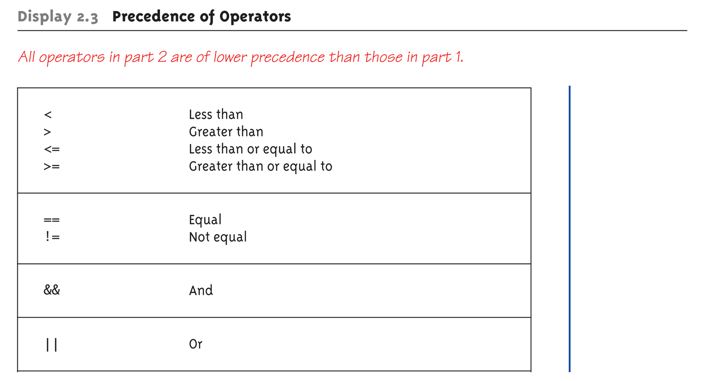
Display 2.3 Precedence of Operators (3 of 4)

Slide 9
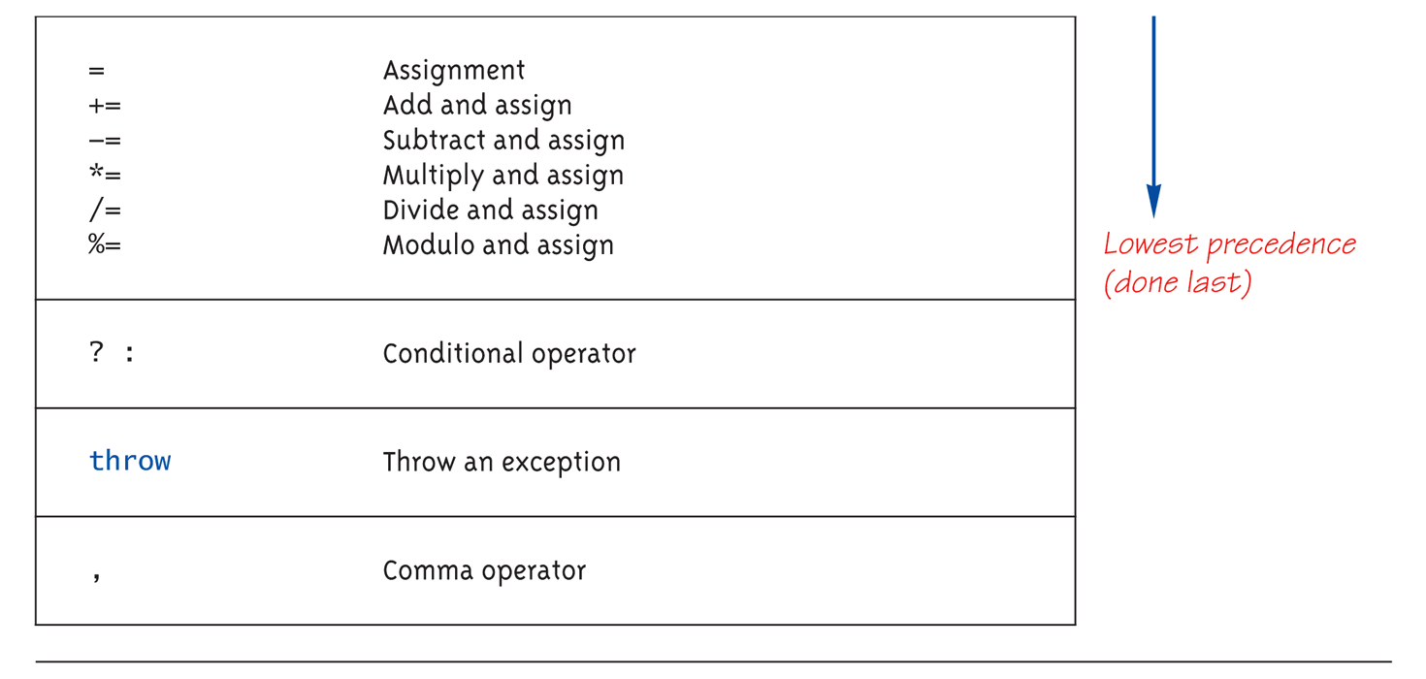
Display 2.3 Precedence of Operators (4 of 4)

Slide 10
Precedence Examples
Arithmetic before logical
x + 1 > 2 || x + 1 < -3 means:
(x + 1) > 2 || (x + 1) < -3
Short-circuit evaluation:
(x >= 0) && (y > 1)
Be careful with increment operators!
(x > 1) && (y++): what will happen if x <= 1
Integers as boolean values
All non-zero values → true
Zero value → false
! time > limit vs ! (time > limit)
Notes:
注意 short-circuit 那邊，如果 x 沒有 > 1 則 y ++ 不會做
What will happen ! time > limit → avoid using !

Slide 11
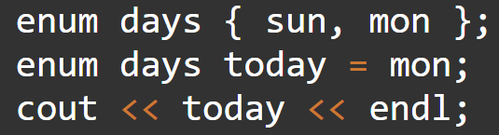
Strong Enum
C++11 introduces strong enums or enum classes
Does not act like an integer
Examples
Illegal: if (d == 0)
Legal: if (d == Days::Wed)
enum class Days { Sun, Mon, Tue, Wed, Thu, Fri, Sat };
enum class Weather { Rain, Sun };
Days d = Days::Tue;
Weather w = Weather::Sun;

Slide 12
Branching Mechanisms
if-else statements
Choice of two alternate statements based on condition expression
Example: if (hrs > 40) grossPay = rate*40 + 1.5*rate*(hrs-40); else grossPay = rate*hrs;

Slide 13
if-else Statement Syntax
Formal syntax: if (<boolean_expression>) <yes_statement> else <no_statement>
Note each alternative is only ONE statement!
To have multiple statements execute in either branch → use compound statement

Slide 14
Compound/Block Statement
Only "get" one statement per branch
Must use compound statement { } for multiples
Also called a "block" stmt
Each block should have block statement
Even if just one statement
Enhances readability

Slide 15
Compound Statement in Action
Note indenting in this example: if (myScore > yourScore) { cout << "I win!\n"; wager = wager + 100; } else { cout << "I wish these were golf scores.\n"; wager = 0; }

Slide 16
Common Pitfalls
Operator "=" vs. operator "=="
One means "assignment" (=)
One means "equality" (==)
VERY different in C++!
Example: if (x = 12) ← Note operator used! Do_Something else Do_Something_Else
Notes:
盡量寫成 12 == x
就算寫錯變成 12 = x，compiler 會報錯

Slide 17
The Optional else
else clause is optional
If, in the false branch (else), you want "nothing" to happen, leave it out
Example: if (sales >= minimum) salary = salary + bonus; cout << "Salary = %" << salary;
Note: nothing to do for false condition, so there is no else clause!
Execution continues with cout statement

Slide 18
Nested Statements
if-else statements contain smaller statements
Compound or simple statements (we’ve seen)
Can also contain any statement at all, including another if-else stmt!
Example: if (speed > 55) if (speed > 80) cout << "You’re really speeding!"; else cout << "You’re speeding.";
Note proper indenting (縮排)! → Better program style
Notes:
提一下 python

Slide 19
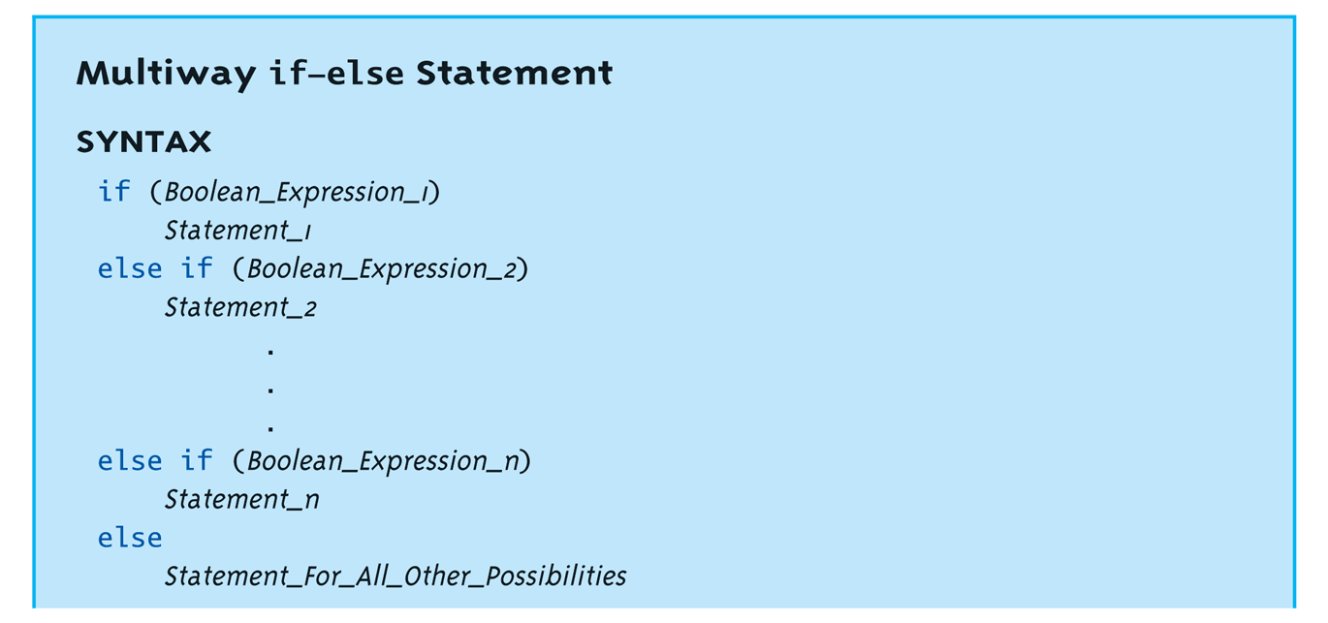
Multiway if-else
Not new, just different indenting
Avoids "excessive" indenting
Syntax:

Slide 20
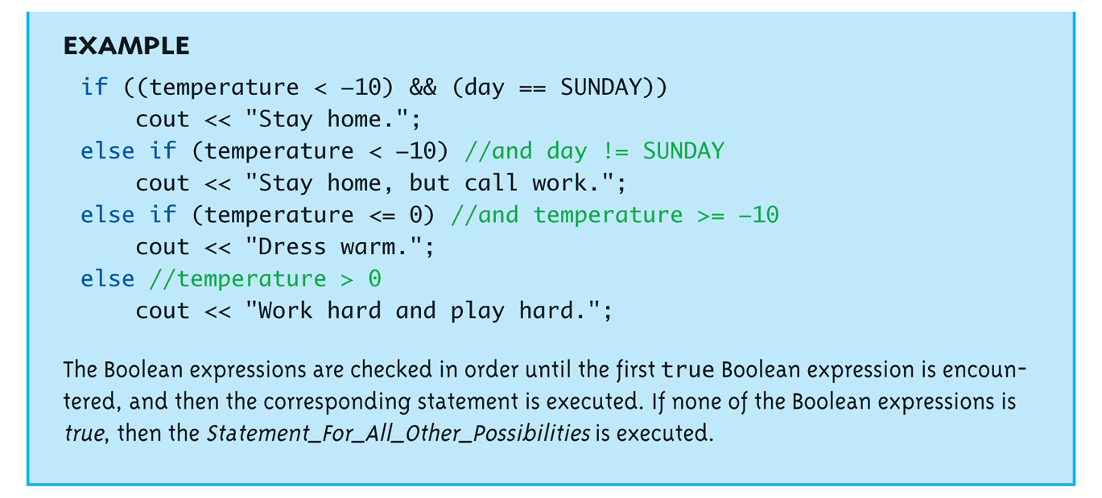
Multiway if-else Example
Notes:
提一下明尼蘇達

Slide 22
The switch Statement
A statement for controlling multiple branches
Can do the similar thing with if statements but sometimes switch is more convenient
Uses controlling expression which returns bool data type (true or false)
Syntax:
Next slide

Slide 23
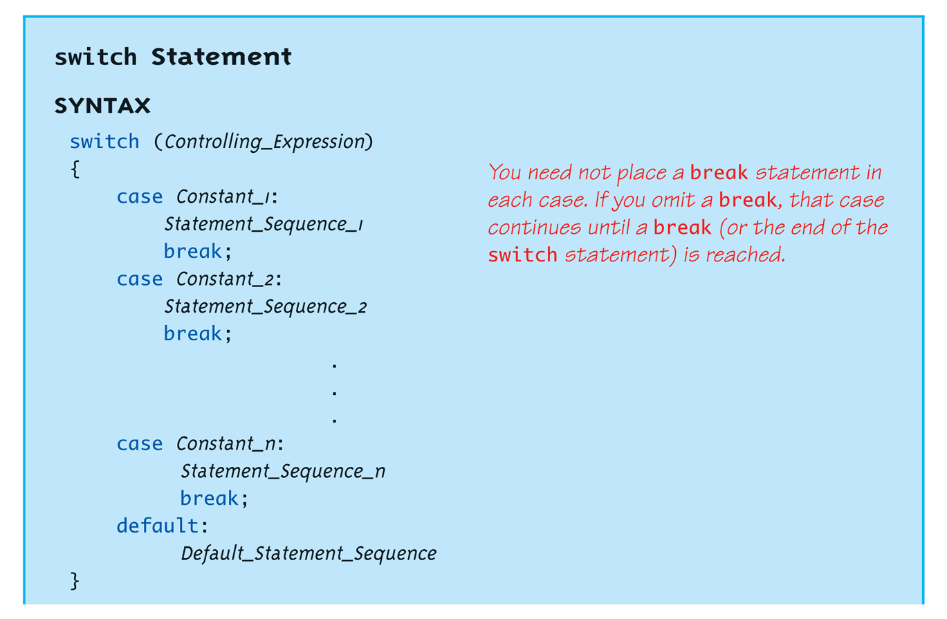
switch Statement Syntax
The controlling expression must be integral! This includes char.

Slide 24
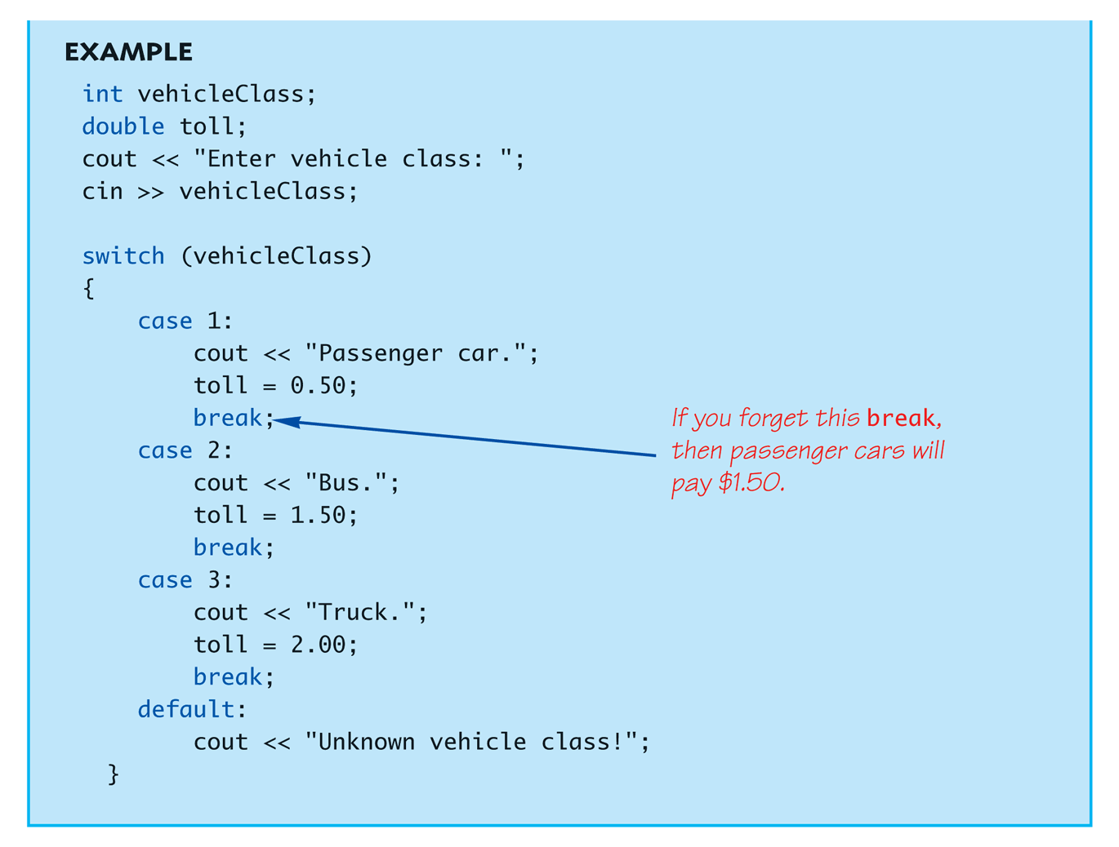
The switch Statement in Action

Slide 25
The switch: multiple case labels
Execution "falls thru" until break
switch provides a "point of entry"
Example: case 'A': case 'a': cout << "Excellent: you got an "A"!\n"; break; case 'B': case 'b': cout << "Good: you got a "B"!\n"; break;
Note multiple labels provide same "entry"
Notes:
講一下以前寫小遊戲的時候，發生大小寫的笑劇

Slide 26
switch Pitfalls/Tip
Forgetting the break;
No compiler error
Execution simply "falls thru" other cases until break;
Biggest use: MENUs
Provides clearer "big-picture" view
Shows menu structure effectively
Each branch is one menu choice

Slide 27
switch Menu Example
Switch stmt "perfect" for menus: switch (response) { case 1: // Execute menu option 1 break; case 2: // Execute menu option 2 break; case 3: // Execute menu option 3 break; default: cout << "Please enter valid response."; }

Slide 28
Conditional Operator
Also called "ternary operator"
Allows embedded conditional in expression
Essentially "shorthand if-else" operator
Example: if (n1 > n2) max = n1; else max = n2;
Can be written: max = (n1 > n2) ? N1 : n2;
"?" and ":" form this "ternary" operator

Slide 29
Loops
3 Types of loops in C++
while
Most flexible
No "restrictions"
do-while
Least flexible
Always executes loop body at least once
for
Natural "counting" loop

Slide 30
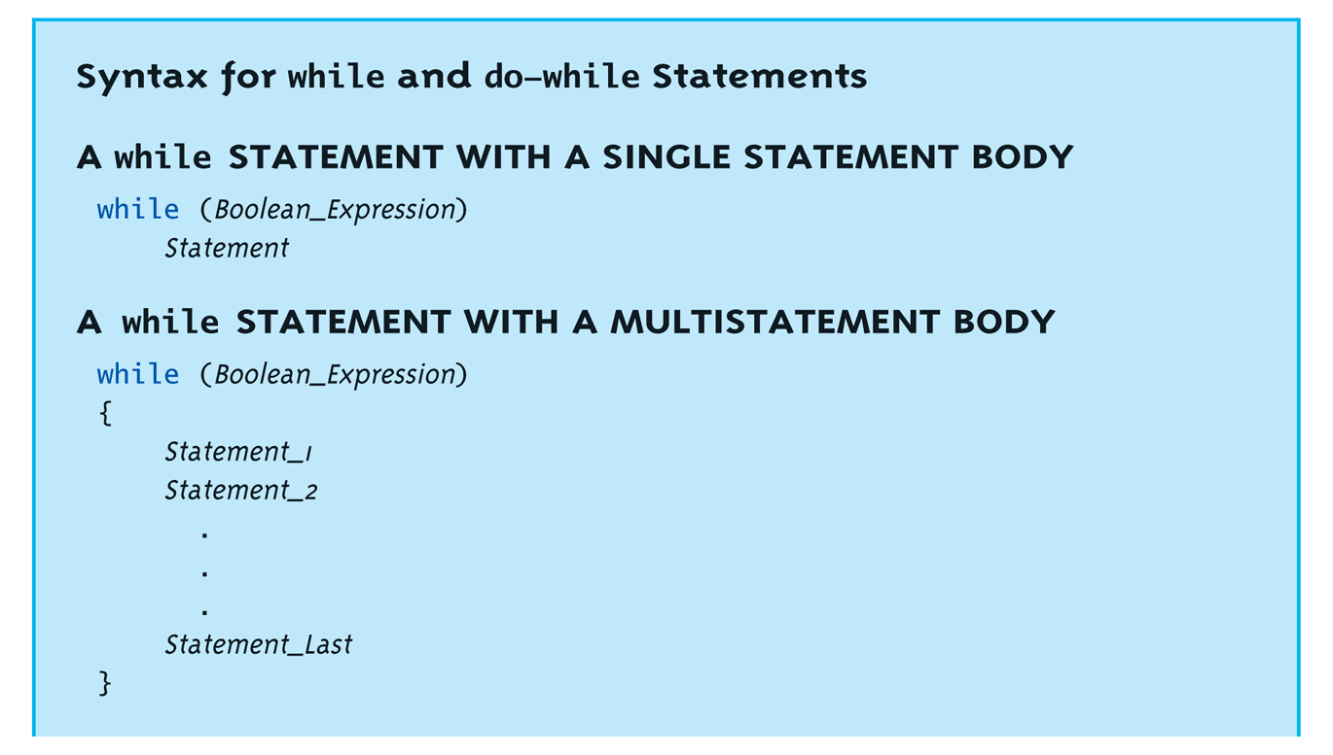
while Loops Syntax

Slide 31
while Loop Example
Consider: int count = 0; // Initialization while (count < 3) // Loop Condition { cout << "Hi "; // Loop Body count++; // Update expression }
Loop body executes how many times?

Slide 32
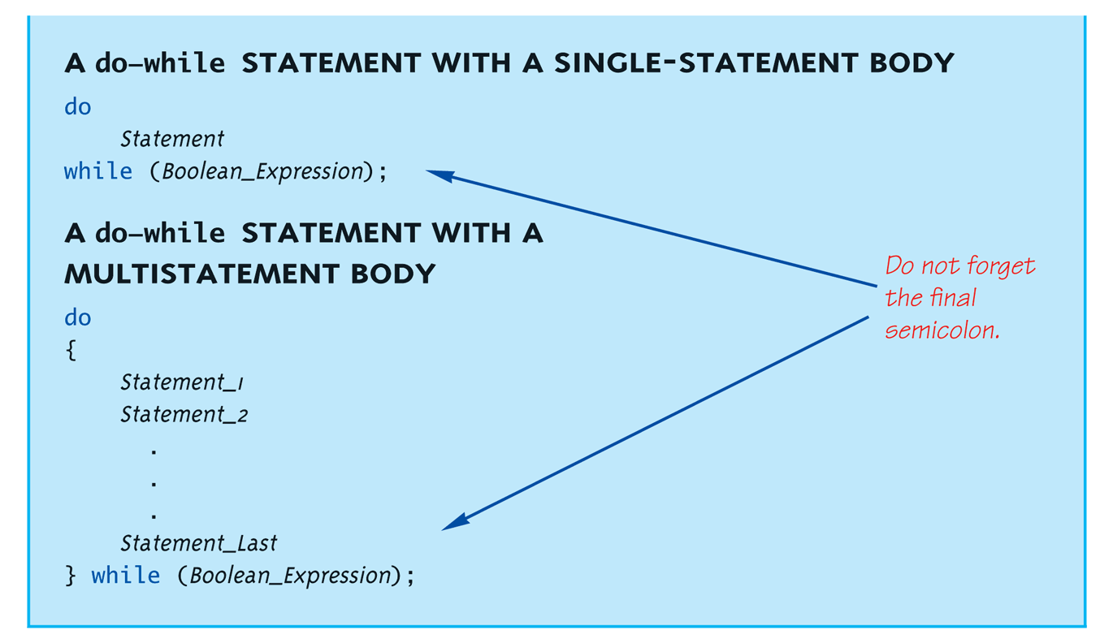
do-while Loop Syntax

Slide 33
do-while Loop Example
int count = 0; // Initialization do { cout << "Hi "; // Loop Body count++; // Update expression } while (count < 3); // Loop Condition
Loop body executes how many times?
do-while loops always execute body at least once!

Slide 34
while vs. do-while
Very similar, but…
One important difference
Issue is "WHEN" boolean expression is checked
while: checks BEFORE body is executed
do-while: checked AFTER body is executed
After this difference, they’re essentially identical!
while is more common, due to it’s ultimate "flexibility"

Slide 35
Comma Operator
Evaluate list of expressions, returning value of the last expression
Most often used in a for-loop
Example: result = (first = 2, second = first + 1);
first gets assigned the value 2
second gets assigned the value 3
result gets assigned the value 3
No guarantee what order expressions will be evaluated for some compilers.

Slide 36
for Loop Syntax
for (Init_Action; Bool_Exp; Update_Action)
Body_Statement
Like if-else, Body_Statement can be a block statement
Much more typical

Slide 37
for Loop Example
for (count=0;count<3;count++) { cout << "Hi "; // Loop Body }
How many times does loop body execute?
Initialization, loop condition and update all "built into" the for-loop structure!
A natural "counting" loop

Slide 38
Loop Issues
Loop’s condition expression can be ANY boolean expression
Examples:
while (count<3 && done!=0) { // Do something }
for (index=0;index<10 && entry!=-99;index++) { // Do something }

Slide 39
Loop Pitfalls: Misplaced ;
Watch the misplaced ; (semicolon)
Example: while (response != 0) ;← { cout << "Enter val: "; cin >> response; }
Notice the ";" after the while condition!
Result here: INFINITE LOOP!

Slide 40
Loop Pitfalls: Infinite Loops
Loop condition must evaluate to false at some iteration through loop
If not → infinite loop.
Example: while (1) { cout << "Hello "; }
A perfectly legal C++ loop → always infinite!
Infinite loops can be desirable
e.g., "Embedded Systems"

Slide 41
The break and continue Statements
Flow of Control
Recall how loops provide "graceful" and clear flow of control in and out
In RARE instances, can alter natural flow
break;
Forces loop to exit immediately.
continue;
Skips rest of loop body
These statements violate natural flow
Only used when absolutely necessary!

Slide 42
Nested Loops
Recall: ANY valid C++ statements can be inside body of loop
This includes additional loop statements!
Called "nested loops"
Requires careful indenting: for (outer=0; outer<5; outer++) for (inner=7; inner>2; inner--) cout << outer << inner;
Notice no { } since each body is one statement
Good style dictates we use { } anyway

Slide 43
Introduction to File Input
We can read from a file in a manner very similar to reading from cin (i.e., the keyboard)
Only an introduction is given here, more details are in chapter 12
Just enough so you can read from text files and process larger amounts of data that would be too much work to type in

Slide 44
Opening a Text File
Add at the top
#include <fstream> using namespace std;
You can then declare an input stream just as you would declare any other variable.
ifstream inputStream;
Next you must connect the inputStream variable to a text file on the disk.
inputStream.open("filename.txt");
The “filename.txt” is the pathname to a text file or a file in the current directory

Slide 45
Reading from a Text File
Use
inputStream >> var;
The result is the same as using cin >> var except the input is coming from the text file and not the keyboard
When done with the file close it with
inputStream.close();

Slide 46
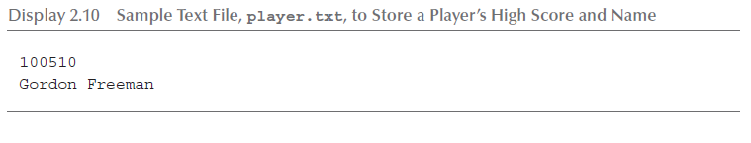
File Input Example (1 of 2)
Consider a text file named player.txt with the following text

Slide 47
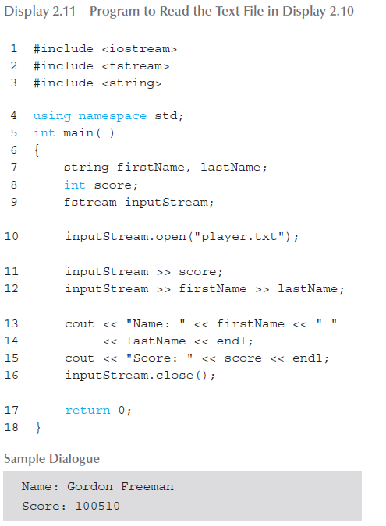
File Input Example (2 of 2)

Slide 48
Summary 1
Boolean expressions
Similar to arithmetic → results in true or false
C++ branching statements
if-else, switch
switch statement great for menus
C++ loop statements
while
do-while
for

Slide 49
Summary 2
do-while loops
Always execute their loop body at least once
for-loop
A natural "counting" loop
Loops can be exited early
break statement
continue statement
Usage restricted for style purposes
Reading from a text file is similar to reading from cin

