Slide 1
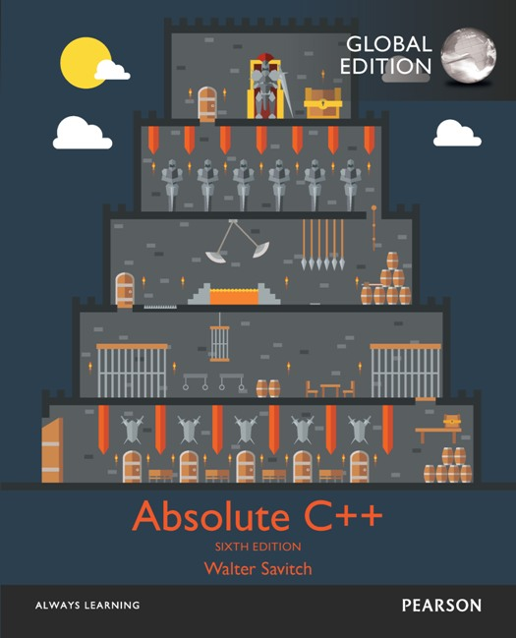
Chapter 3
Function Basics
Copyright © 2017 Pearson Education, Ltd. All rights reserved.

Slide 2
Learning Objectives
Predefined Functions
Those that return a value and those that don’t
Programmer-defined Functions
Defining, Declaring, Calling
Recursive Functions
Scope Rules
Local variables
Global constants and global variables
Blocks, nested scopes

Slide 3
Introduction to Functions
Building Blocks of Programs
Other terminology in other languages:
Procedures, subprograms, methods
In C++: functions
I-P-O
Input – Process – Output
Basic subparts to any program
Use functions for these "pieces"

Slide 4
Predefined Functions
Libraries full of functions for our use!
Two types:
Those that return a value
Those that do not (void)
Must "#include" appropriate library
e.g.,
<cmath>, <cstdlib> (Original "C" libraries)
<iostream> (for cout, cin)

Slide 5
Using Predefined Functions
Math functions very plentiful
Found in library <cmath.h>
Most return a value (the "answer")
Example: theRoot = sqrt(9.0);
Components: sqrt = name of library function theRoot = variable used to assign "answer" to 9.0 = argument or "starting input" for function
In I-P-O:
I = 9.0
P = "compute the square root"
O = 3, which is returned & assigned to theRoot

Slide 6
The Function Call
Back to this assignment: theRoot = sqrt(9.0);
The expression "sqrt(9.0)" is known as a function call, or function invocation
The argument in a function call (9.0) can be a literal, a variable, or an expression
The call itself can be part of an expression:
bonus = sqrt(sales)/10;
A function call is allowed wherever it’s legal to use an expression of the function’s return type

Slide 7
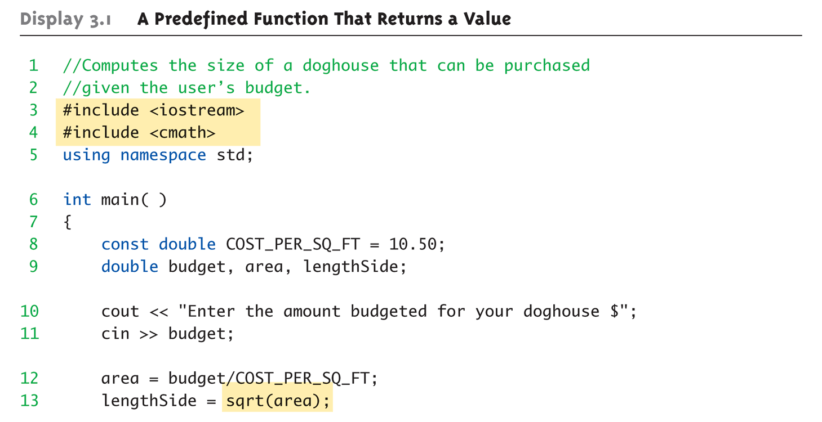
A Larger Example: Display 3.1 A Predefined Function That Returns a Value (1 of 2)

Slide 8
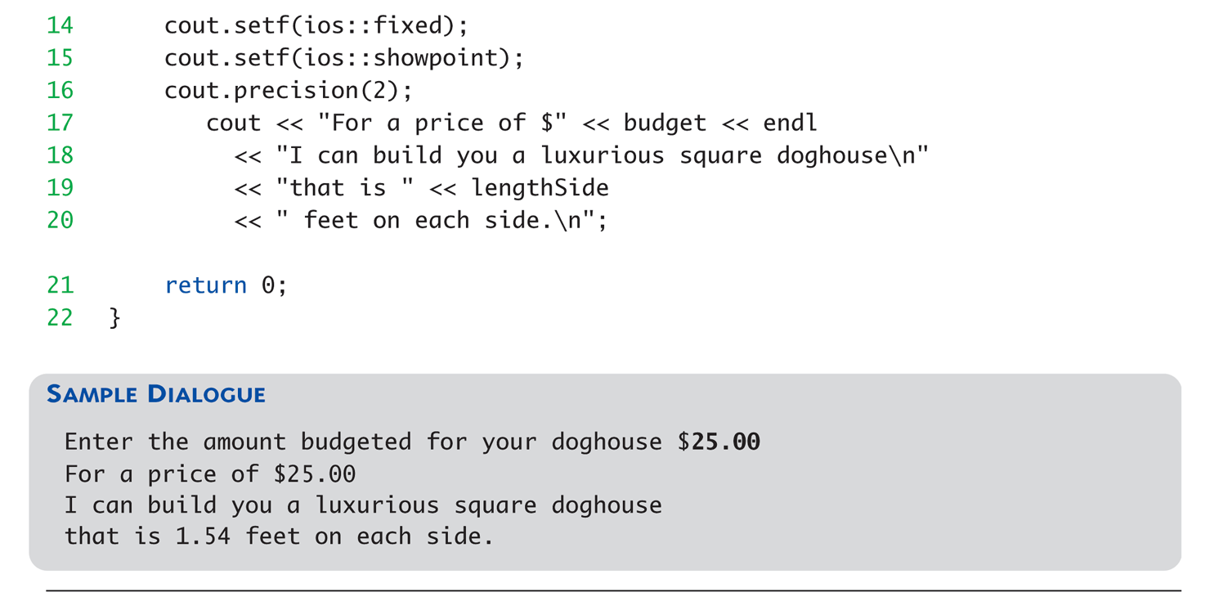
A Larger Example: Display 3.1 A Predefined Function That Returns a Value (2 of 2)

Slide 9
More Predefined Functions
#include <cstdlib>
Library contains functions like:
abs() // Returns absolute value of an int
labs() // Returns absolute value of a long int
*fabs() // Returns absolute value of a float
*fabs() is actually in library <cmath>! (not in <cstdlib>)
Can be confusing
Remember: libraries were added after C++ was "born," in incremental phases
Refer to appendices/manuals for details
Notes:
fabs 不在 cstdlib

Slide 10
More Math Functions
pow(x, y)
Returns x to the power y double result, x = 3.0, y = 2.0; result = pow(x, y); cout << result;
Here 9.0 is displayed since 3.0^{2.0} = 9.0
Notice this function receives two arguments
A function can have any number of arguments, of varying data types

Slide 11
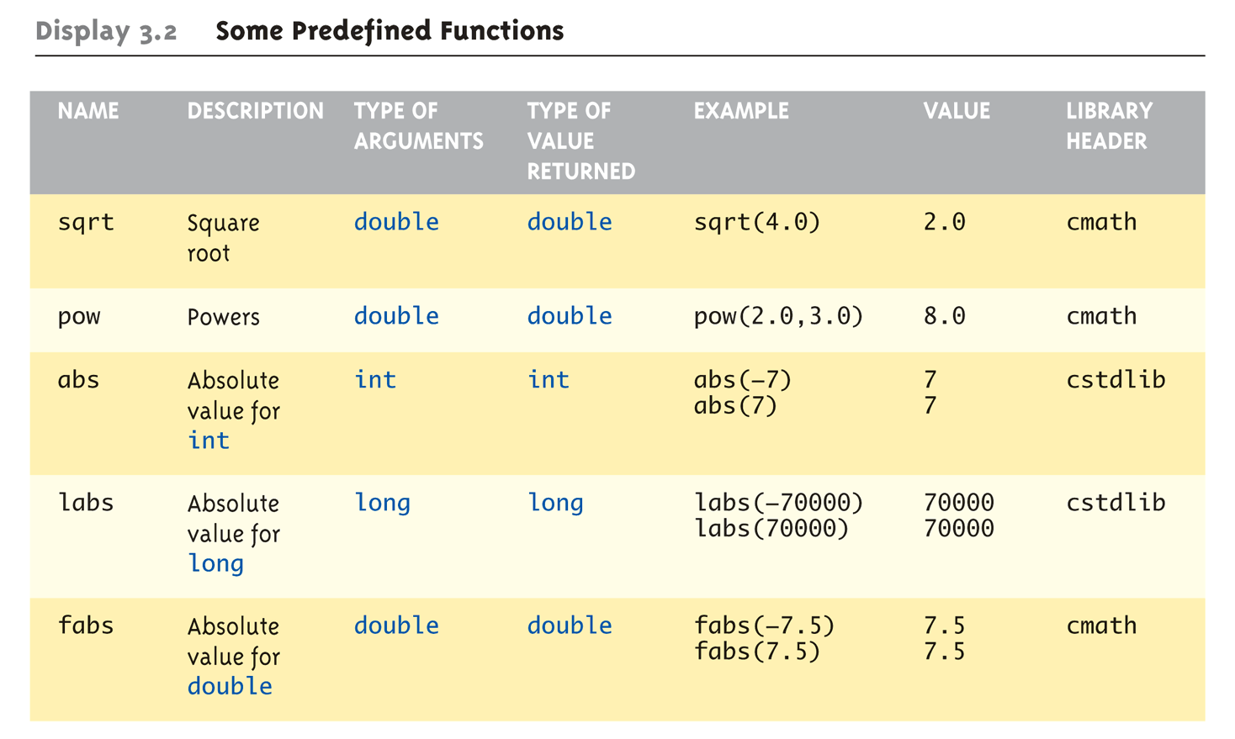
Even More Math Functions: Display 3.2 Some Predefined Functions (1 of 2)

Slide 12
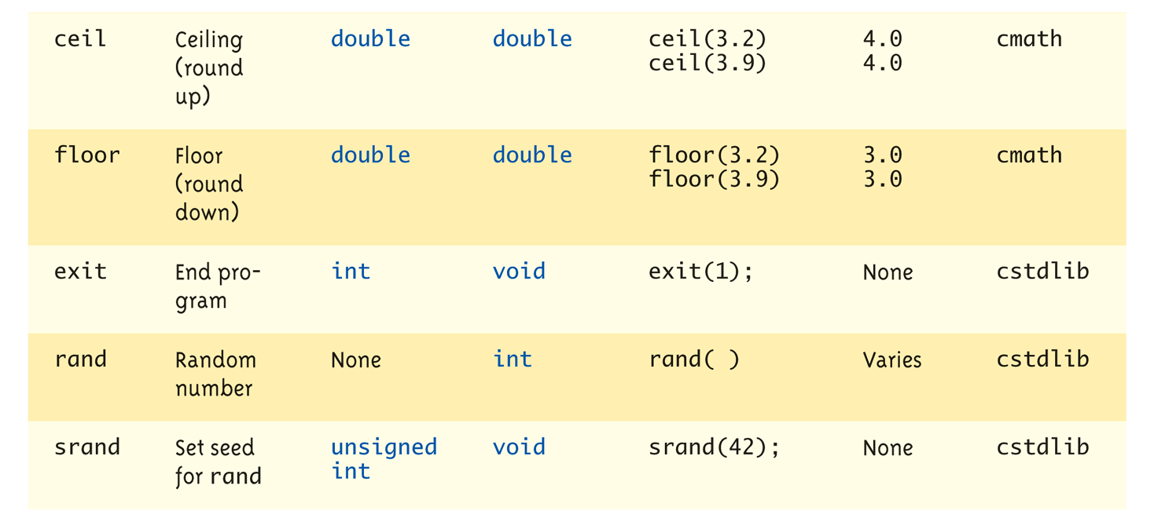
Even More Math Functions: Display 3.2 Some Predefined Functions (2 of 2)
Notes:
提一下rand()在寫實驗的程式要手動設定seed比較好，別用time

Slide 13
Predefined Void Functions
No returned value
Performs an action, but sends no "answer"
When called, it’s a statement itself
exit(1); // No return value, so not assigned
This call terminates program
void functions can still have arguments
All aspects same as functions that "return a value"
They just don’t return a value!
Notes:
基本上void function和會return的function都一樣，只差在不會return

Slide 14
Random Number Generator
Return "randomly chosen" number
Used for simulations, games
rand()
Takes no arguments
Returns value between 0 & RAND_MAX
Scaling
Squeezes random number into smaller range rand() % 6
Returns random value between 0 & 5
Shifting rand() % 6 + 1
Shifts range between 1 & 6 (e.g., die roll)

Slide 15
Random Number Seed
Pseudorandom numbers
Calls to rand() produce given "sequence" of random numbers
Use "seed" to alter sequence srand(seed_value);
void function
Receives one argument, the "seed"
Can use any seed value, including system time: srand(time(0));
time() returns system time as numeric value
Library <time> contains time() functions

Slide 16
Random Examples
Random double between 0.0 & 1.0: (RAND_MAX – rand())/static_cast<double>(RAND_MAX)
Type cast used to force double-precision division
Random int between 1 & 6: rand() % 6 + 1
"%" is modulus operator (remainder)
Random int between 10 & 20: rand() % 11 + 10

Slide 17
Programmer-Defined Functions
Write your own functions!
Building blocks of programs
Divide & Conquer
Readability
Re-use
Your "definition" can go in either:
Same file as main()
Separate file so others can use it, too
Notes:
user-defined functions 可以在 main.cpp 也可以在其他的 included cpp

Slide 18
Components of Function Use
3 Pieces to using functions:
Function Declaration/prototype
Information for compiler
To properly interpret calls
Function Definition
Actual implementation/code for what function does
Function Call
Transfer control to function

Slide 19
Function Declaration
Also called function prototype
An "informational" declaration for compiler
Tells compiler how to interpret calls
Syntax: <return_type> FnName(<formal-parameter-list>);
Example: double totalCost( int numberParameter, double priceParameter);
Placed before any calls
In declaration space of main()
Or above main() in global space

Slide 20
Function Definition
Implementation of function
Just like implementing function main()
Example: double totalCost( int numberParameter, double priceParameter) { const double TAXRATE = 0.05; double subTotal; subtotal = priceParameter * numberParameter; return (subtotal + subtotal * TAXRATE); }
Notice proper indenting

Slide 21
Function Definition Placement
Placed after function main()
NOT "inside" function main()!
Functions are "equals"; no function is ever "part" of another
Formal parameters in definition
"Placeholders" for data sent in
"Variable name" used to refer to data in definition
Cannot be double totalCost(int, double);
return statement
Sends data back to caller

Slide 22
Function Call
Just like calling predefined function bill = totalCost(number, price);
Recall: totalCost returns double value
Assigned to variable named "bill"
Arguments here: number, price
Recall arguments can be literals, variables, expressions, or combination
In function call, arguments often called "actual arguments"
Because they contain the "actual data" being sent

Slide 23
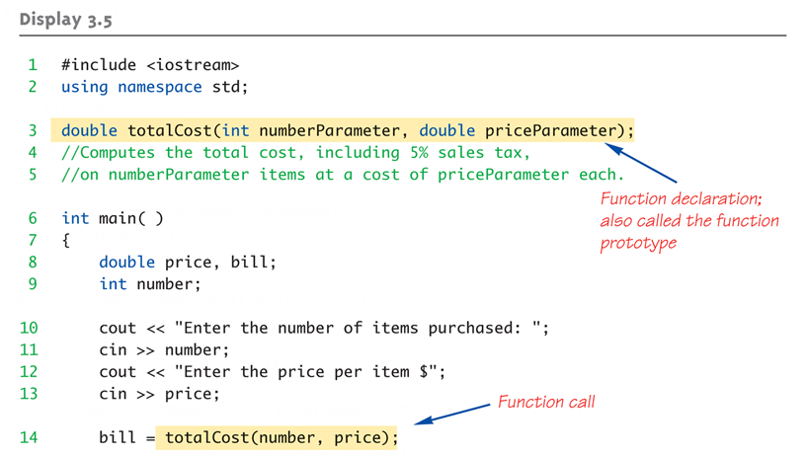
Function Example: Display 3.5 A Function to Calculate Total Cost (1 of 2)

Slide 24
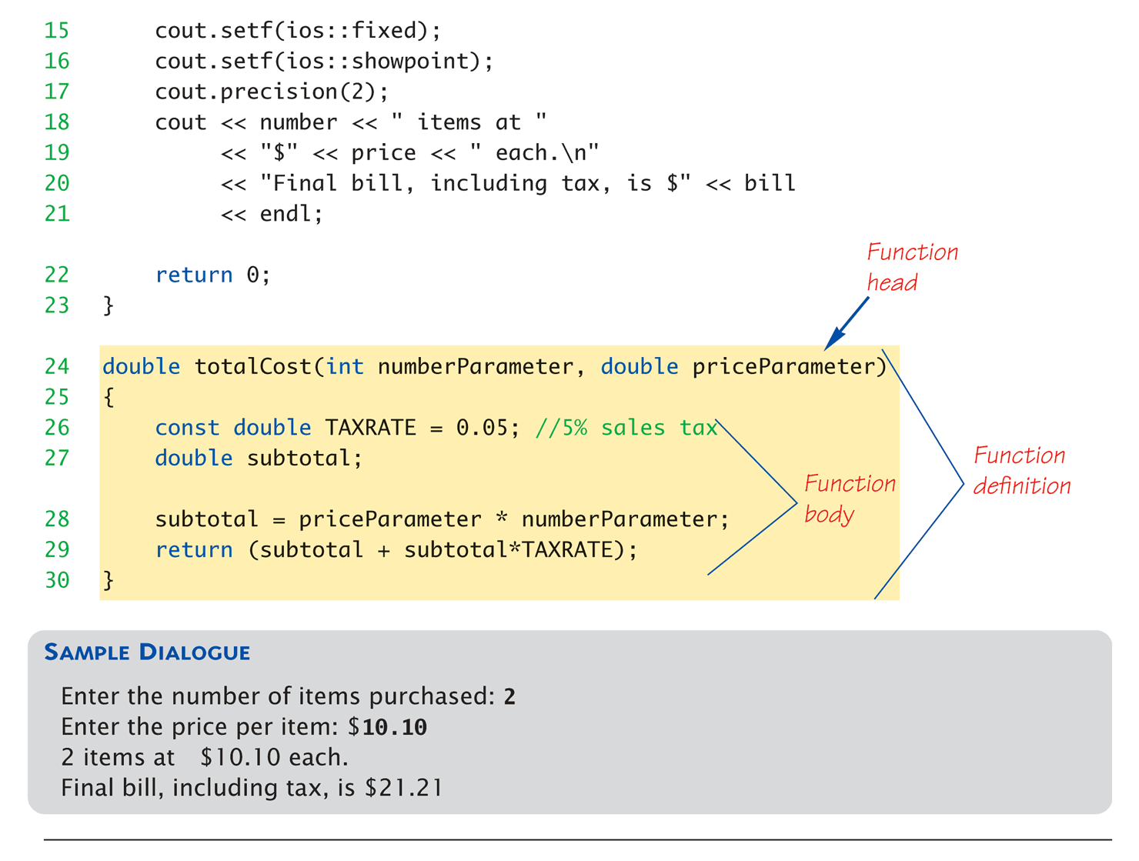
Function Example: Display 3.5 A Function to Calculate Total Cost (2 of 2)

Slide 25
Alternative Function Declaration
Recall: Function declaration is "information" for compiler
Compiler only needs to know:
Return type
Function name
Parameter list
Formal parameter names not needed: double totalCost(int, double);
Still "should" put in formal parameter names
Improves readability

Slide 26
Parameter vs. Argument
Terms often used interchangeably
Formal parameters/arguments
In function declaration
In function definition’s header
Actual parameters/arguments
In function call
Technically parameter is "formal" piece while argument is "actual" piece*
*Terms not always used this way
Notes:
有人會這麼說
parameter 在 declaration 和 definition
argument 在 call function

Slide 27
Functions Calling Functions
We’re already doing this!
main() IS a function!
Only requirement:
Function’s declaration must appear first
Function’s definition typically elsewhere
After main()"s definition
Or in separate file
Common for functions to call many other functions
Function can even call itself → "Recursion"

Slide 28
Boolean Return-Type Functions
Return-type can be any valid type
Given function declaration/prototype: bool appropriate(int rate);
And function’s definition: bool appropriate (int rate) { return (((rate>=10)&&(rate<20))||(rate==0); }
Returns "true" or "false"
Function call, from some other function: if (appropriate(entered_rate)) cout << "Rate is valid\n";

Slide 29
Declaring Void Functions
Similar to functions returning a value
Return type specified as "void"
Example:
Function declaration/prototype: void showResults( double fDegrees, double cDegrees);
Return-type is "void"
Nothing is returned

Slide 30
Declaring Void Functions
Function definition: void showResults(double fDegrees, double cDegrees) { cout.setf(ios::fixed); cout.setf(ios::showpoint); cout.precision(1); cout << fDegrees << " degrees fahrenheit equals \n" << cDegrees << " degrees celsius.\n"; }
Notice: no return statement
Optional for void functions
Notes:
列印華氏轉攝氏，不做計算

Slide 31
Calling Void Functions
Same as calling predefined void functions
From some other function, like main():
showResults(degreesF, degreesC);
showResults(32.5, 0.3);
Notice no assignment, since no value returned
Actual arguments (degreesF, degreesC)
Passed to function
Function is called to "do it’s job" with the data passed in

Slide 32
More on Return Statements
Transfers control back to "calling" function
For return type other than void, MUST have return statement
Typically the LAST statement in function definition
return statement optional for void functions
Closing } would implicitly return control from void function
Notes:
void function 就等於最後有加 return;

Slide 33
Preconditions and Postconditions
Write the comments please
Similar to "I-P-O" discussion
Comment function declaration: void showInterest(double balance, double rate); //Precondition: balance is nonnegative account balance // rate is interest rate as percentage //Postcondition: amount of interest on given balance, // at given rate …
Often called Inputs & Outputs

Slide 34
main(): "Special"
Recall: main() IS a function
"Special" in that:
One and only one function called main() will exist in a program
Who calls main()?
Operating system
Tradition holds it should have return statement
Value returned to "caller" → Here: operating system
Should return "int" or "void"

Slide 35
Scope Rules
Local variables
Declared inside body of given function
Available only within that function
Can have variables with same names declared in different functions
Scope is local: "that function is it’s scope"
Local variables preferred
Maintain individual control over data
Need to know basis
Functions should declare whatever local data needed to "do their job"

Slide 36
Procedural Abstraction
Need to know "what" function does, not "how" it does it!
Think "black box"
Device you know how to use, but not it’s method of operation
Implement functions like black box
User of function only needs: declaration
Does NOT need function definition
Called Information Hiding
Hide details of "how" function does it’s job
Notes:
通常我們會把實作的部分藏到其他的file

Slide 37
Global Constants and Global Variables
Declared "outside" function body
Global to all functions in that file
Declared "inside" function body
Local to that function
Global declarations typical for constants:
const double TAXRATE = 0.05;
Declare globally so all functions have scope
Global variables?
Possible, but SELDOM-USED
Dangerous: no control over usage!
Notes:
多執行緒可能會出問題

Slide 38
Blocks
Declare data inside compound statement
Called a "block"
Has "block-scope"
Note: all function definitions are blocks!
This provides local "function-scope"
Loop blocks: for (int counter=0;counter<10;counter++) { sum+=counter; }
Variable counter has scope in loop body block only

Slide 39
Nested Scope
Same name variables declared in multiple blocks
Very legal; scope is "block-scope"
No ambiguity
Each name is distinct within its scope
One block nested inside another block
The variable in the inner/outer block can only accessed in the inner/outer block

Slide 40
Summary 1
Two kinds of functions:
"Return-a-value" and void functions
Functions should be "black boxes"
Hide "how" details
Declare own local data
Function declarations should self-document
Provide pre- & post-conditions in comments
Provide all "caller" needs for use

Slide 41
Summary 2
Local data
Declared in function definition
Global data
Declared above function definitions
OK for constants, not for variables
Parameters/Arguments
Formal: In function declaration and definition
Placeholder for incoming data
Actual: In function call
Actual data passed to function

