Slide 1

Chapter 4
Parameters and Overloading
Copyright © 2017 Pearson Education, Ltd. All rights reserved.

Slide 2
Learning Objectives
Parameters
Call-by-value
Call-by-reference
Mixed parameter-lists
Overloading and Default Arguments
Examples, Rules
Testing and Debugging Functions
assert Macro
Stubs, Drivers

Slide 3
Parameters
Two methods of passing arguments as parameters
Call-by-value
"copy" of value is passed
Call-by-reference
"address of" actual argument is passed

Slide 4
Call-by-Value Parameters
Copy of actual argument passed
Considered "local variable" inside function
If modified, only "local copy" changes
Function has no access to "actual argument" from caller
This is the default method
Used in all examples thus far

Slide 5
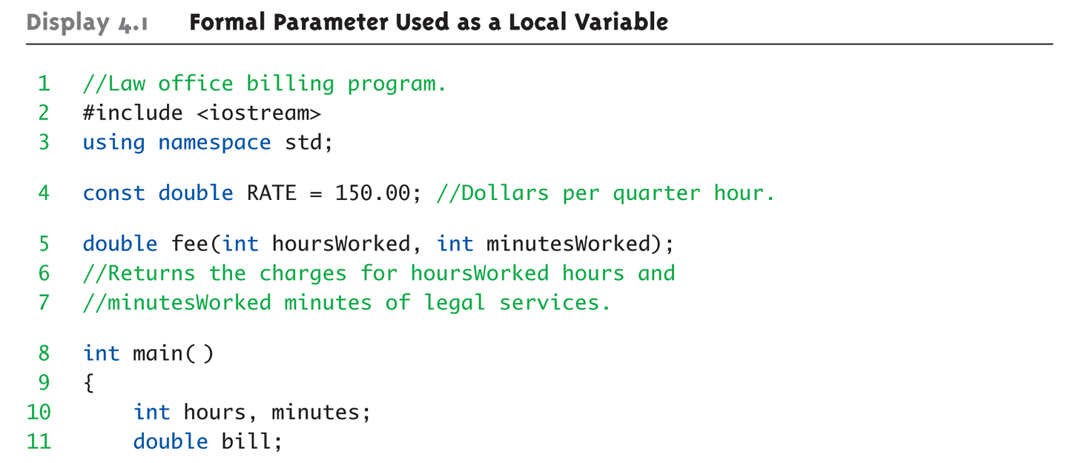
Call-by-Value Example: Display 4.1 Formal Parameter Used as a Local Variable (1 of 3)

Slide 6
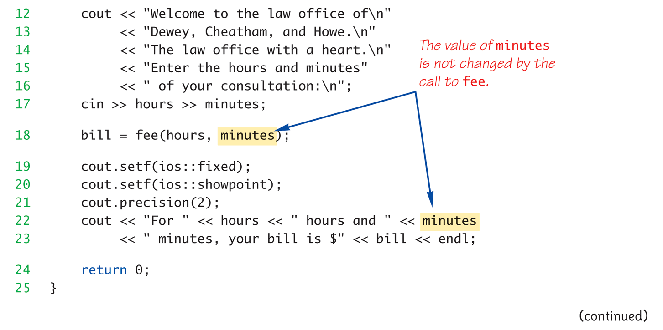
Call-by-Value Example: Display 4.1 Formal Parameter Used as a Local Variable (2 of 3)

Slide 7
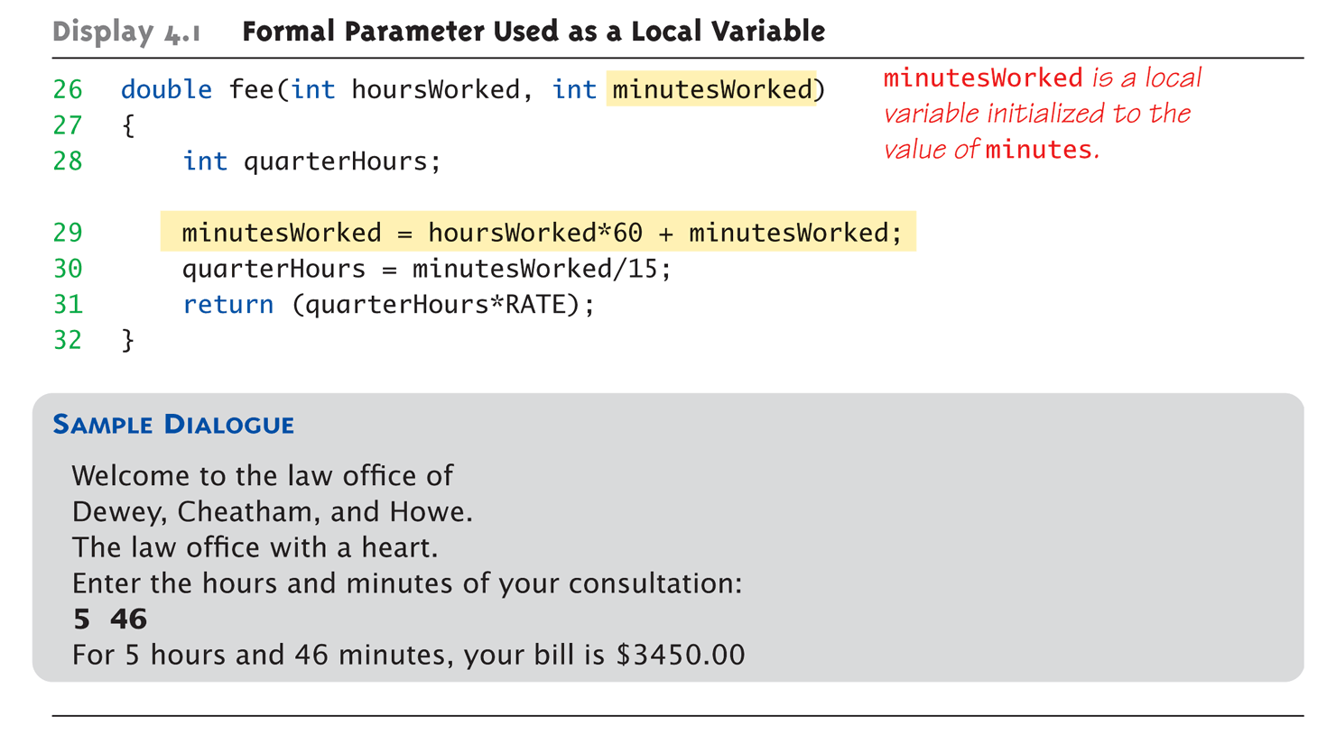
Call-by-Value Example: Display 4.1 Formal Parameter Used as a Local Variable (3 of 3)

Slide 8
Call-by-Value Pitfall
Common Mistake:
Declaring parameter "again" inside function: double fee(int hoursWorked, int minutesWorked) { int quarterHours; // local variable int minutesWorked; // NO! }
Compiler error results
"Redefinition error…"
Value arguments ARE like "local variables"
But function gets them "automatically"

Slide 9
Call-By-Reference Parameters
Used to provide access to caller’s actual argument
Caller’s data can be modified by called function!
Typically used for input function
To retrieve data for caller
Data is then "given" to caller
Specified by ampersand, &, after type in formal parameter list
Notes:
一定會有人想問，那 C 裡面的 pointer 算不算 call by reference → no

Slide 10
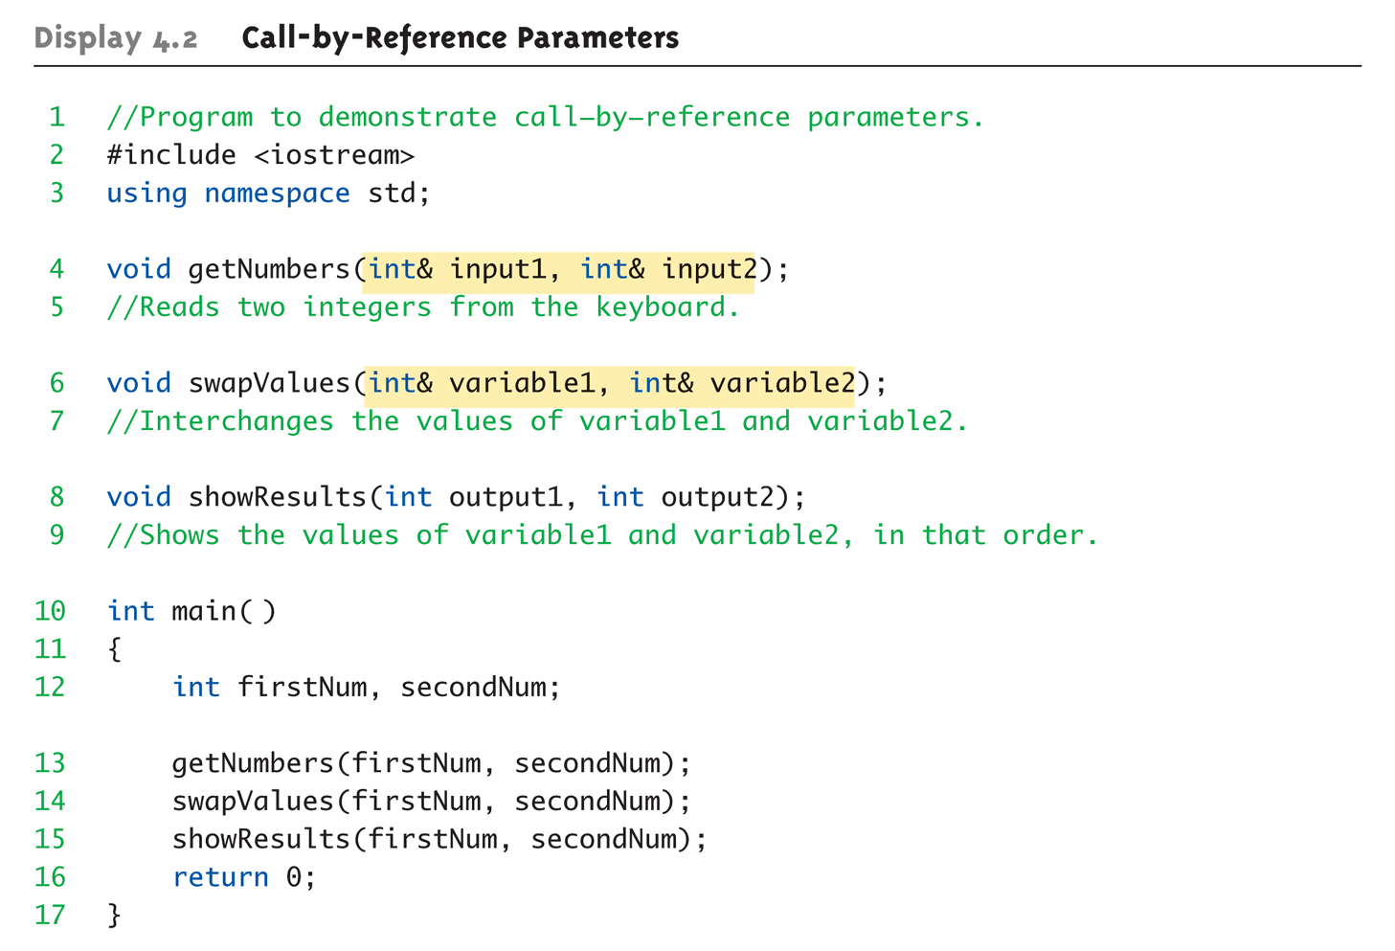
Call-By-Reference Example: Display 4.1 Call-by-Reference Parameters (1 of 3)

Slide 11
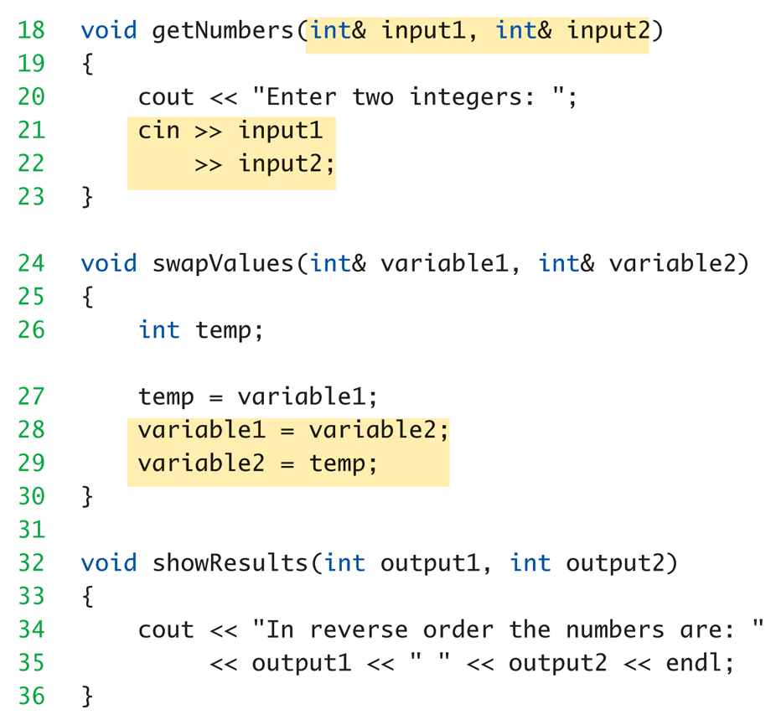
Call-By-Reference Example: Display 4.1 Call-by-Reference Parameters (2 of 3)

Slide 12
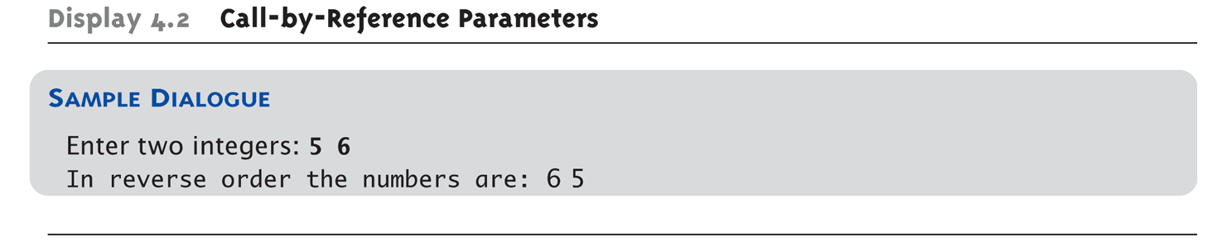
Call-By-Reference Example: Display 4.1 Call-by-Reference Parameters (3 of 3)

Slide 13
Call-By-Reference Details
What’s really passed in?
A "reference" back to caller’s actual argument!
Refers to memory location of actual argument
Called "address", which is a unique number referring to distinct place in memory

Slide 14
Constant Reference Parameters
Reference arguments inherently "dangerous"
Caller’s data can be changed
Often this is desired, sometimes not
To "protect" data, & still pass by reference:
Use const keyword
void sendConstRef( const int &par1, const int &par2);
Makes arguments "read-only" by function
No changes allowed inside function body

Slide 15
Parameters and Arguments
Confusing terms, often used interchangeably
True meanings:
Formal parameters
In function declaration and function definition
Arguments
Used to "fill-in" a formal parameter
In function call (argument list)
Call-by-value & Call-by-reference
Simply the "mechanism" used in plug-in process

Slide 16
Mixed Parameter Lists
Can combine passing mechanisms
Parameter lists can include pass-by-value and pass-by-reference parameters
Order of arguments in list is critical: void mixedCall(int & par1, int par2, double & par3);
Function call: mixedCall(arg1, arg2, arg3);
arg1 must be integer type, is passed by reference
arg2 must be integer type, is passed by value
arg3 must be double type, is passed by reference

Slide 17
Choosing Formal Parameter Names
Same rule as naming any identifier:
Meaningful names!
Functions as "self-contained modules"
Designed separately from rest of program
Assigned to teams of programmers
All must "understand" proper function use
OK if formal parameter names are same as argument names
Choose function names with same rules
Notes:
Classes use nouns and functions use verbs
有人提過Hungarian notation，在變數前面加上他的型態，在函式前面加上回傳的型態，但有人建議不要使用這種命名，因為現在IDE已經很先進了

Slide 19
Overloading
Similar functionalities with different names → tedious
double averageOfTwo(double n1, double n2) { return ((n1 + n2) / 2.0); }
double averageOfThree(double n1, double n2, double n3) { return ((n1 + n2 + n3) / 3.0); }
Notes:
Why not overloading on return values → int function(); void function(); readability

Slide 20
Overloading
Same function name
Different parameter lists
Two separate function definitions
Function "signature"
Function name & parameter list
Must be "unique" for each function definition
Allows same task performed on different data
Notes:
Why not overloading on return values → int function(); void function(); readability 避免到function開始執行才發現錯誤

Slide 21
Overloading Example: Average
Function computes average of 2 numbers: double average(double n1, double n2) { return ((n1 + n2) / 2.0); }
Now compute average of 3 numbers: double average(double n1, double n2, double n3) { return ((n1 + n2 + n3) / 3.0); }
Same name, two functions

Slide 22
Overloaded Average() Cont’d
Which function gets called?
Depends on function call itself:
avg = average(5.2, 6.7);
Calls "two-parameter average()"
avg = average(6.5, 8.5, 4.2);
Calls "three-parameter average()"
Compiler resolves invocation based on signature of function call
"Matches" call with appropriate function
Each considered separate function

Slide 23
Overloading Pitfall
Only overload "same-task" functions
A average() function should always perform same task, in all overloads
Otherwise, unpredictable results
C++ function call resolution:
1st: looks for exact signature
2nd: looks for "compatible" signature

Slide 24
Overloading Resolution
1st: Exact Match
Looks for exact signature
Where no argument conversion required
2nd: Compatible Match
Looks for "compatible" signature where automatic type conversion is possible:
1st with promotion (e.g., int→double)
No loss of data
2nd with demotion (e.g., double→int)
Possible loss of data

Slide 25
Overloading Resolution Example
Given following functions:
1. void f(int n, double m); 2. void f(double n, int m); 3. void f(int n, int m);
These calls: f(98, 99); → Calls #3 f(5.3, 4); → Calls #2 f(4.3, 5.2); → Calls ???
Avoid such confusing overloading
Source: https://www.niusnews.com/=P2equij5

Slide 26
Overloading Resolution Example
Which function gets called?
void function(int a, int b);
int main(){
int a, b; // or double a, b
function(a, b);
}
int main(){
int a; double b;
function(a, b);
}
Notes:
(double, double) 和 (int, int)

Slide 27
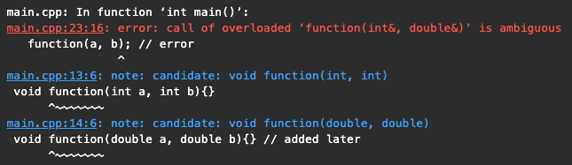
Overloading Resolution Example
Which function gets called?
void function(int a, int b);
void function(double a, double b); // added later
int main(){
int a, b; // or double a, b
function(a, b);
}
int main(){
int a; double b;
function(a, b); // error
}
Notes:
(double, double) 和 (int, int)

Slide 28
Automatic Type Conversion and Overloading
Numeric formal parameters typically made "double" type
Allows for "any" numeric type
Any "subordinate" data automatically promoted
int → double
float → double
char → double *More on this later!
Avoids overloading for different numeric types

Slide 29
Automatic Type Conversion and Overloading Example
double mpg(double miles, double gallons) { return (miles/gallons); }
Example function calls:
mpgComputed = mpg(5, 20);
Converts 5 & 20 to doubles, then passes
mpgComputed = mpg(5.8, 20.2);
No conversion necessary
mpgComputed = mpg(5, 2.4);
Converts 5 to 5.0, then passes values to function

Slide 31
Default Arguments
Allows omitting some arguments
Specified in function declaration/prototype
void showVolume( int length, int width = 1, int height = 1);
Last 2 arguments are defaulted
Possible calls:
showVolume(2, 4, 6); //All arguments supplied
showVolume(3, 5); //height defaulted to 1
showVolume(7); //width & height defaulted to 1
Notes:
避免為了單純為了有default parameter，而要重複寫相同功能的function

Slide 32
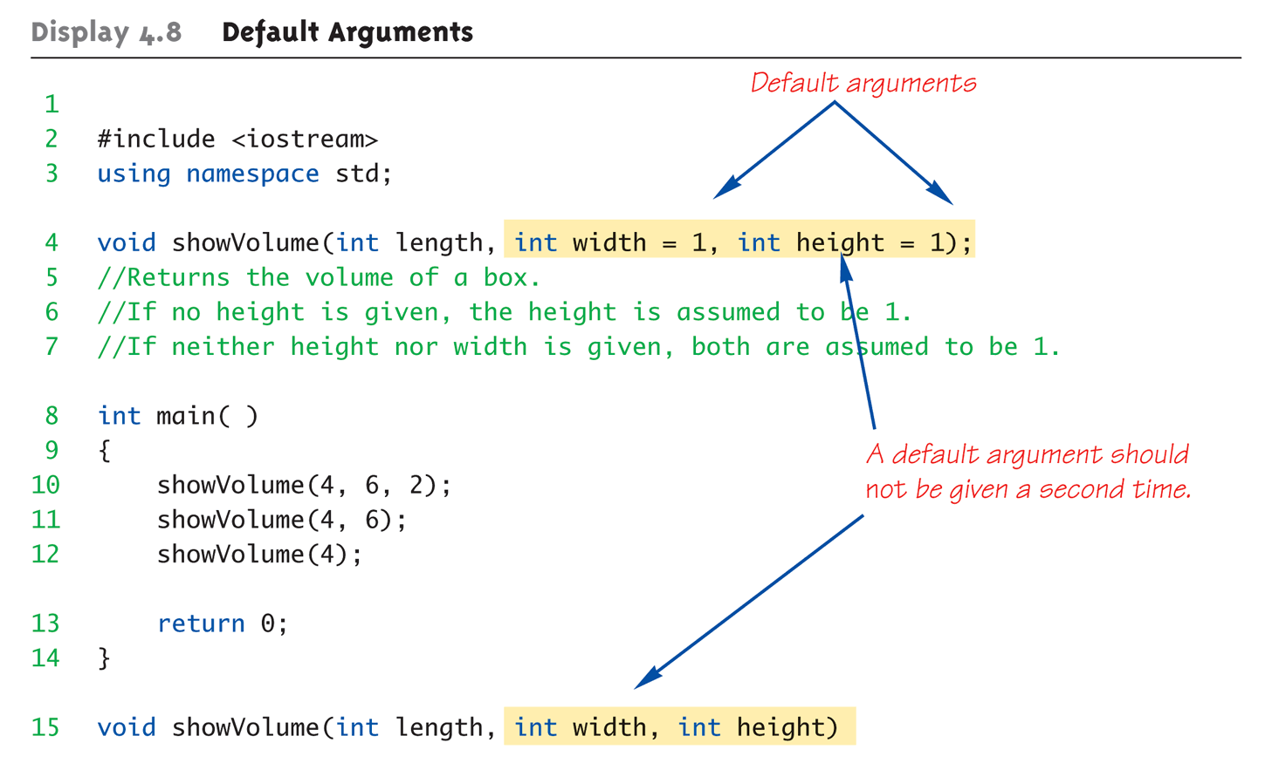
Default Arguments Example: Display 4.1 Default Arguments (1 of 2)

Slide 33
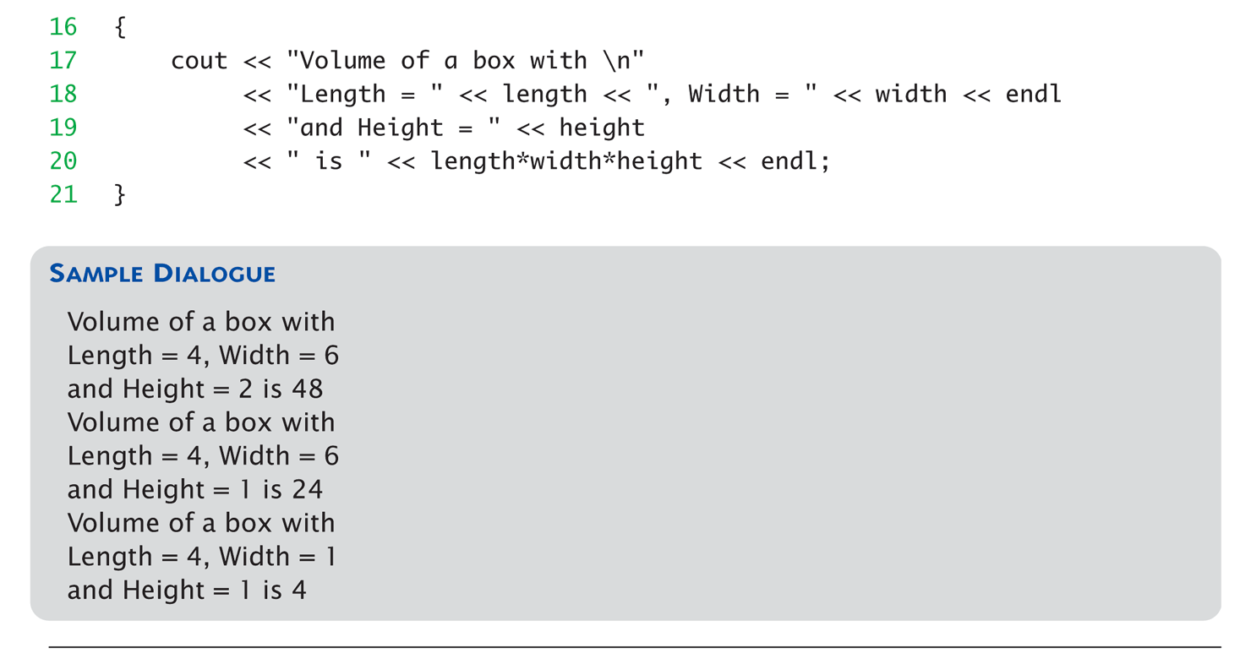
Default Arguments Example: Display 4.1 Default Arguments (2 of 2)

Slide 35
Testing and Debugging Functions
Many methods:
Lots of cout statements (常見)
In calls and definitions
Used to "trace" execution
Compiler Debugger
Environment-dependent
assert Macro
Early termination as needed
Stubs and drivers
Incremental development

Slide 36
The assert Macro
Assertion: a true or false statement
Used to document and check correctness
Preconditions & Postconditions
Typical assert use: confirm their validity
Syntax: assert(<assert_condition>);
No return value
Evaluates assert_condition
Terminates if false, continues if true
Predefined in library <cassert>
Macros used similarly as functions

Slide 37
An assert Macro Example
Given Function Declaration: void computeCoin( int coinValue, int& number, int& amountLeft); //Precondition: 0 < coinValue < 100 0 <= amountLeft <100 //Postcondition: number set to max. number of coins
Check precondition:
assert ((0 < currentCoin) && (currentCoin < 100) && (0 <= currentAmountLeft) && (currentAmountLeft < 100));
If precondition not satisfied → condition is false → program execution terminates!

Slide 38
An assert Macro Example Cont’d
Useful in debugging
Stops execution so problem can be investigated

Slide 39
assert On/Off
Preprocessor provides means
#define NDEBUG #include <cassert>
Add "#define" line before #include line
Turns OFF all assertions throughout program
Remove "#define" line (or comment out)
Turns assertions back on

Slide 40
Stubs and Drivers
Separate compilation units
Design, code, and test each function separately
Ensures validity of each unit
Divide & Conquer
Transforms one big task → smaller, manageable tasks
But how to test independently?
Driver programs
Temporary tools; quite minimal
Notes:
Driver program 寫一個 main 專門用來測試寫好的 function

Slide 41
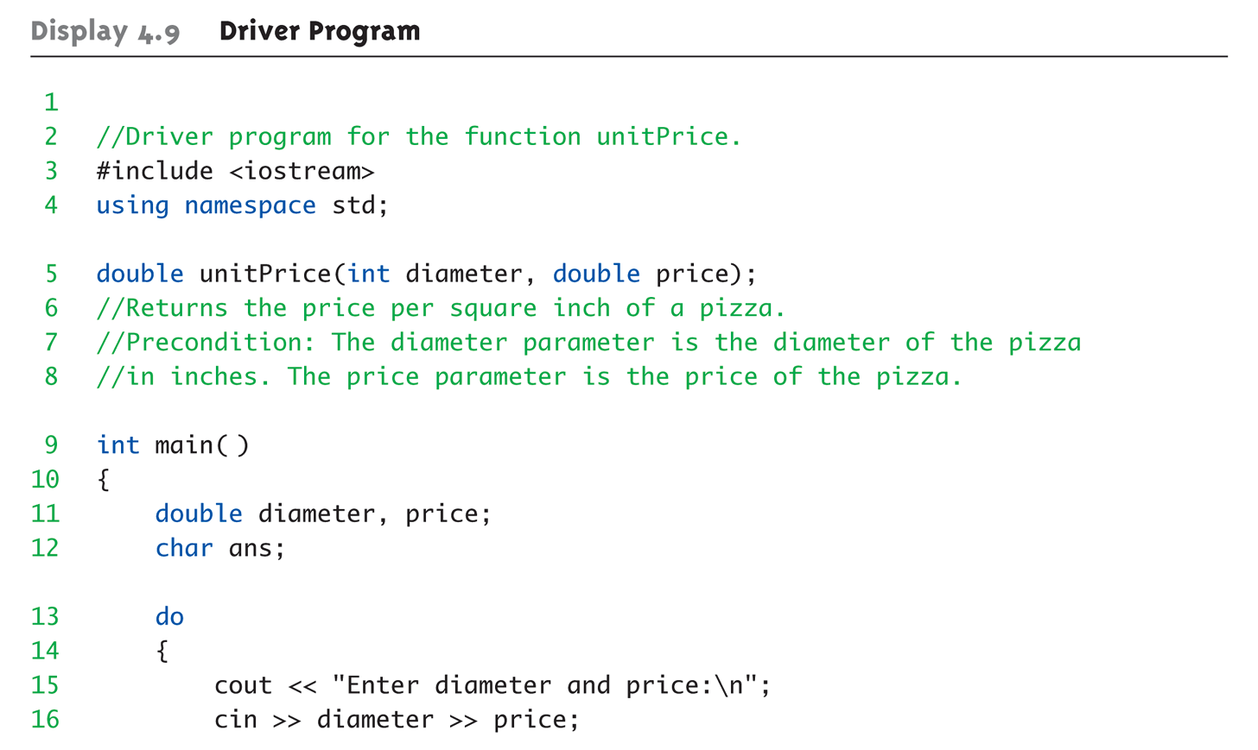
Driver Program Example: Display 4.9 Driver Program (1 of 3)

Slide 42
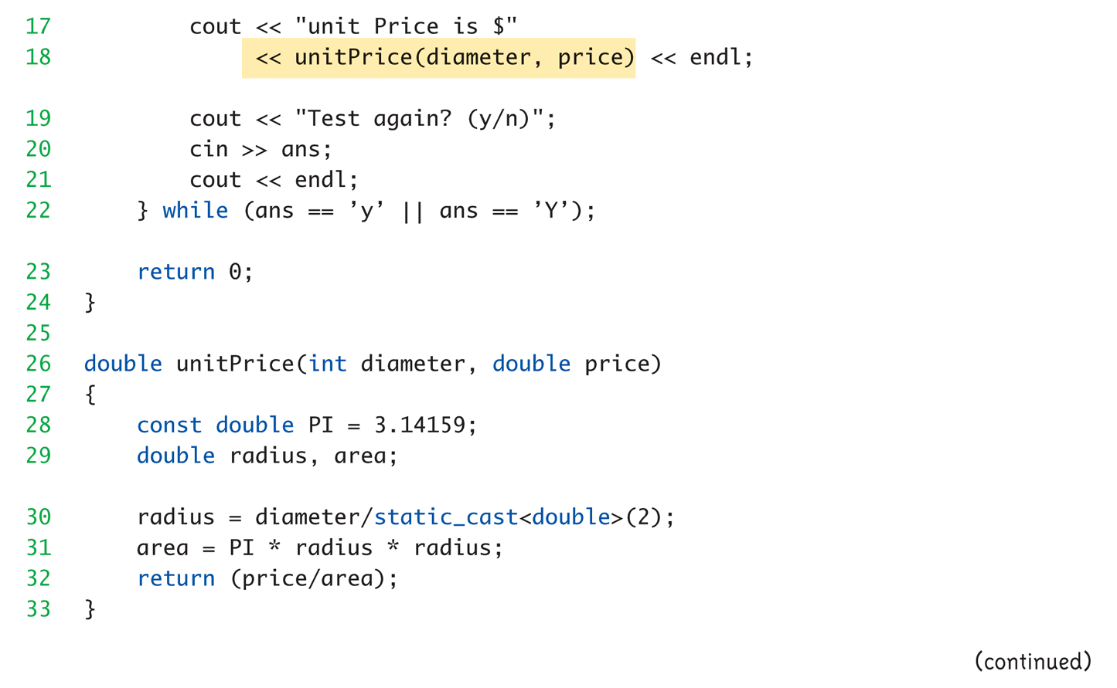
Driver Program Example: Display 4.9 Driver Program (2 of 3)

Slide 43
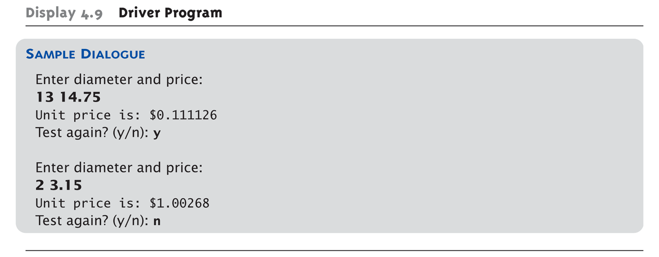
Driver Program Example: Display 4.9 Driver Program (3 of 3)

Slide 44
Stubs (模擬函式)
Develop incrementally
Write "big-picture" functions first
Low-level functions last
"Stub-out" functions until implementation
Example: double unitPrice(int diameter, double price) { return (9.99); // not valid, but noticeably // a "temporary" value }
Calls to function will still "work"
Notes:
模擬函式：部分功能還沒完成，先讓他產生假的output，能夠讓整個程式運作 → big picture 可運作
閉上眼睛，告訴自己，這只是暫時的，假的

Slide 45
Fundamental Testing Rule
To write "correct" programs
Minimize errors, "bugs"
Ensure validity of data
Test every function in a program where every other function has already been fully tested and debugged
Avoids "error-cascading" & conflicting results

Slide 46
Summary 1
Formal parameter is placeholder, filled in with actual argument in function call
Call-by-value parameters are "local copies" in receiving function body
Actual argument cannot be modified
Call-by-reference passes memory address of actual argument
Actual argument can be modified
Argument MUST be variable, not constant

Slide 47
Summary 2
Multiple definitions of same function name possible: called overloading
Default arguments allow function call to "omit" some or all arguments in list
If not provided → default values assigned
assert macro initiates program termination if assertions fail
Functions should be tested independently
As separate compilation units, with drivers

