Slide 1
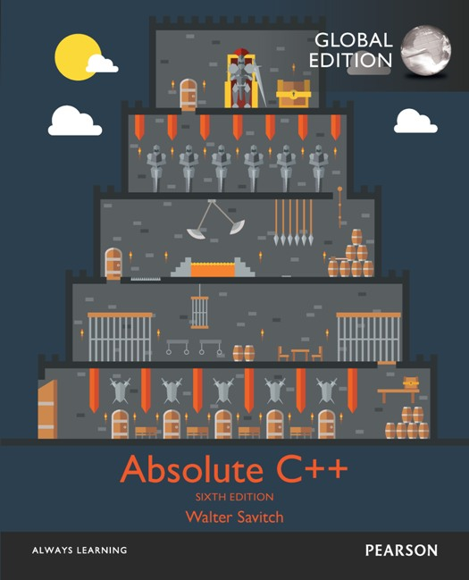
Chapter 5
Arrays
Copyright © 2017 Pearson Education, Ltd. All rights reserved.

Slide 2
Learning Objectives
Introduction to Arrays
Declaring and referencing arrays
For-loops and arrays
Arrays in memory
Arrays in Functions
Arrays as function arguments, return values
Programming with Arrays
Partially Filled Arrays, searching, sorting
Multidimensional Arrays

Slide 3
Introduction to Arrays
Array definition:
A collection of data of same type
First "aggregate" data type
Means "grouping"
int, float, double, char are simple data types
Used for lists of like items
Test scores, temperatures, names, etc.
Avoids declaring multiple simple variables
Can manipulate "list" as one entity

Slide 4
Declaring Arrays
Declare the array → allocates memory int score[5];
Declares array of 5 integers named "score"
Similar to declaring five variables: int score[0], score[1], score[2], score[3], score[4]
Individual parts called many things:
Indexed or subscripted variables
"Elements" of the array
Value in brackets called index or subscript
Numbered from 0 to (size – 1)
Notes:
有人稱呼array裡存的東西為 indexed variable, subscripted variable, or element

Slide 5
Declaring Arrays
You can try this:
int a, b, c;
a = 1; b = 2; c = 3;
cout << &a << ": " << a << endl;
cout << &b << ": " << b << endl;
cout << &c << ": " << c << endl;
int *p = &a;
for (int count = 0; count < 3; count += 1, p++){
cout << p << ": " << *p << endl;
}
Notes:
有人稱呼array裡存的東西為 indexed variable, subscripted variable, or element

Slide 6
Accessing Arrays
Access using index/subscript
cout << score[3];
Note two uses of brackets:
In declaration, specifies SIZE of array
Anywhere else, specifies a subscript
Size, subscript need not be literal
int score[MAX_SCORES];
score[n+1] = 99;
If n is 2, identical to: score[3]
Notes:
Subscript: 標號

Slide 7
Array Usage
Powerful storage mechanism
Can issue command like:
"Do this to i^{th} indexed variable" where i is computed by program
"Display all elements of array score"
"Fill elements of array score from user input"
"Find highest value in array score"
"Find lowest value in array score”
…

Slide 8
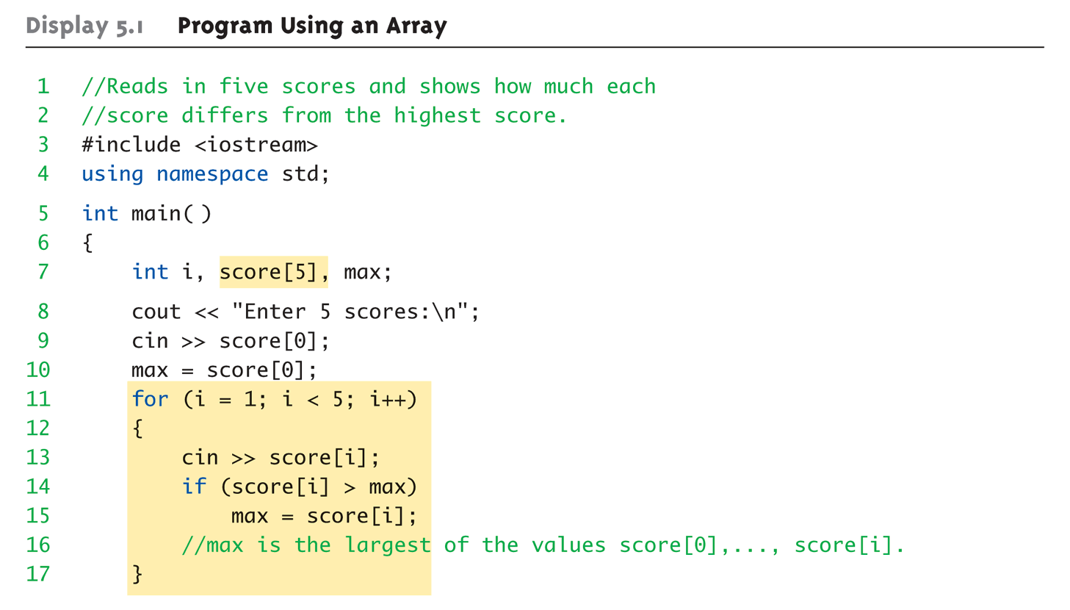
Array Program Example: Display 5.1 Program Using an Array (1 of 2)
Notes:
輸入五個分數

Slide 9
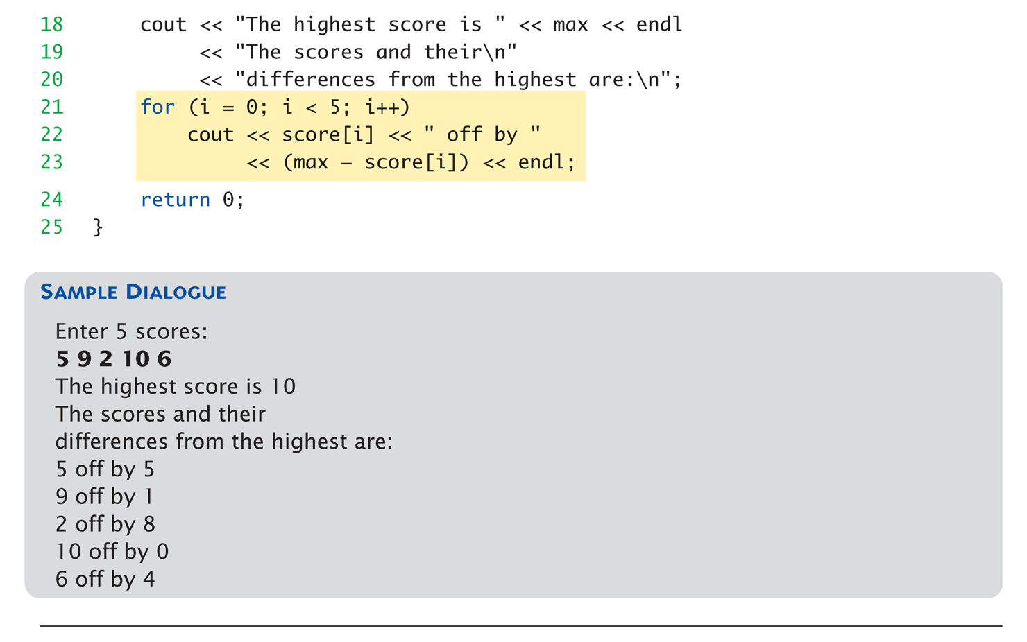
Array Program Example: Display 5.1 Program Using an Array (2 of 2)
Notes:
找到最高分，和每個分數與最高分的差距

Slide 10
for-loops with Arrays
Natural counting loop
Naturally works well "counting through" elements of an array
Example: for (idx = 0; idx<5; idx++) { cout << score[idx] << "off by " << max – score[idx] << endl; }
Loop control variable (idx) counts from 0 – 5
Notes:
因為從0開始算，我們寫<就可以剛好直接執行完5個，然後結束的idx剛好也是5，可以看成剛好執行完5個

Slide 11
Major Array Pitfall
Array indexes always start with zero!
Zero is "first" number to computer scientists
C++ will "let" you go beyond range
Unpredictable results
Compiler will not detect these errors!
Up to programmer to "stay in range"
Notes:
當範圍超過，不會給error，要小心

Slide 12
Major Array Pitfall Example
Indexes range from 0 to (array_size – 1)
Example: double temperature[24]; // 24 is array size // Declares array of 24 double values called temperature
They are indexed as: temperature[0], temperature[1] … temperature[23]
Common mistake: temperature[24] = 5;
Index 24 is "out of range"!
No warning, possibly disastrous results
Notes:
如果寫錯index導致每次錯，還比較好修改，但是，有時候還會沒問題呢

Slide 13
Defined Constant as Array Size
Always use defined/named constant for array size
Example: const int NUMBER_OF_STUDENTS = 5; int score[NUMBER_OF_STUDENTS];
Improves readability
Improves maintainability
Notes:
可以盡量使用 const int 來定義 array size

Slide 14
Uses of Defined Constant
Use everywhere size of array is needed
In for-loop for traversal: for (idx = 0; idx < NUMBER_OF_STUDENTS; idx++) { // Manipulate array }
In calculations involving size: lastIndex = (NUMBER_OF_STUDENTS – 1);
When passing array to functions (later)
If size changes → requires only ONE change in program!
Notes:
不要每惡loop寫literal，你可以只改一個地方來避免麻煩

Slide 15
Ranged-Based For Loop
The C++11 ranged-based for loop makes it easy to iterate over each element in a loop
Format
Example
for (datatype varname : array) { // varname is set to each successive
// element in the array }
int arr[] = {20, 30, 40, 50};
for (int x : arr) cout << x << " "; cout << endl;
Output: 20 30 40 50

Slide 16
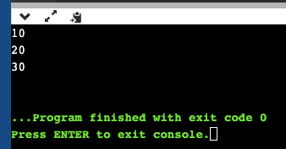
Ranged-Based For Loop
The C++11 ranged-based for loop makes it easy to iterate over each element in a loop
What will happen?
int arr[] = {10,20,30}; int counter = 0;
for(int data : arr){
data = (counter ++);
}
for(int data : arr){
cout << data << endl;
}
Notes:
但是，要注意一件事情，在下面這種case，如果修改x，並不會修改到上面的arr真實位置

Slide 17
Arrays in Memory
Recall simple variables:
Allocated memory in an "address"
Array declarations allocate memory for entire array
Sequentially-allocated
Means addresses allocated "back-to-back"
Allows indexing calculations
Simple "addition" from array beginning (index 0)

Slide 18
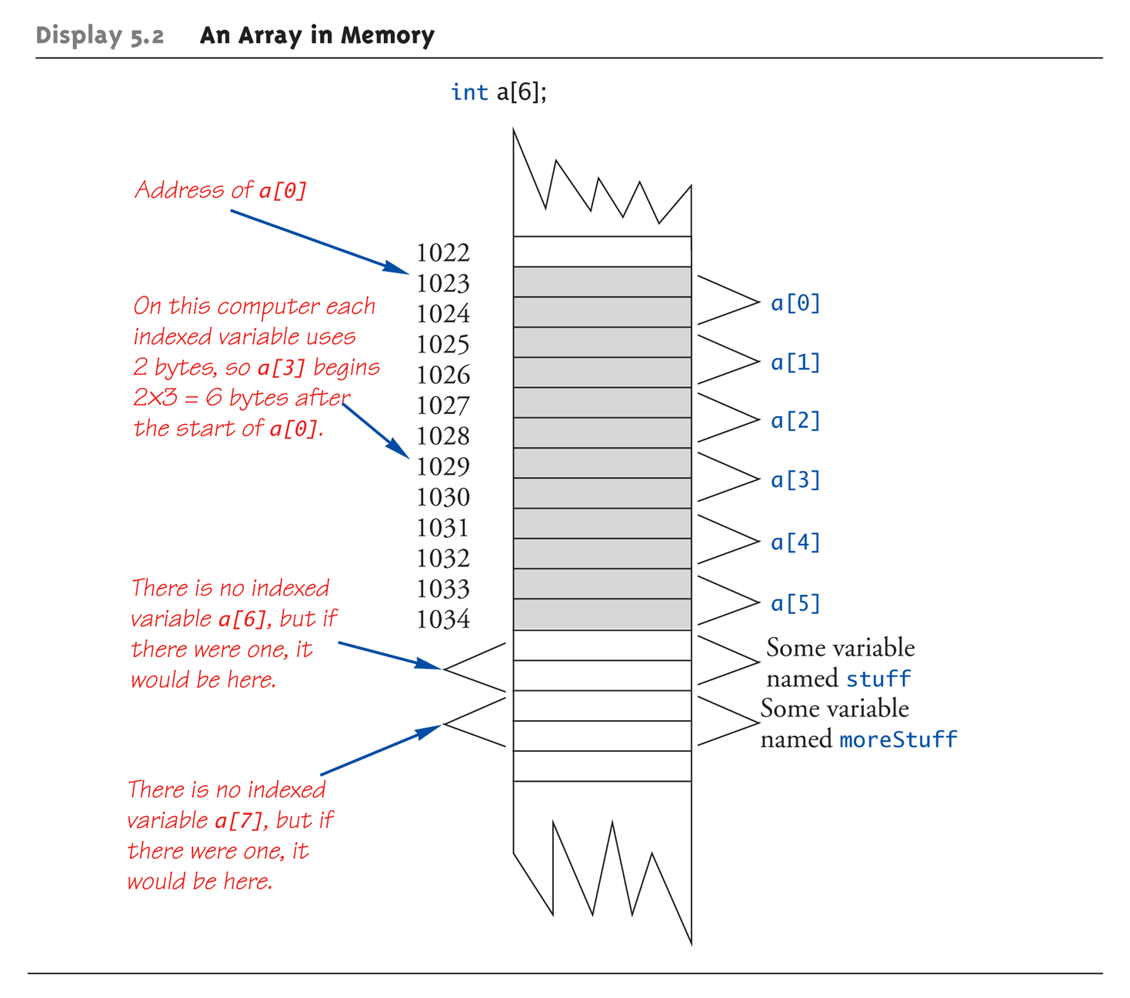
An Array in Memory
Notes:
假設每個int是2 bytes，則a[3]會出現在a[0]的2*3=6 bytes後面

Slide 19
Initializing Arrays
As simple variables can be initialized at declaration: int price = 0; // 0 is initial value
Arrays can as well: int children[3] = {2, 12, 1};
Equivalent to following: int children[3]; children[0] = 2; children[1] = 12; children[2] = 1;

Slide 20
Auto-Initializing Arrays
If fewer values than size supplied:
Fills from beginning
Fills "rest" with zero of array base type
If array-size is left out
Declares array with size required based on number of initialization values
Example: int b[] = {5, 12, 11};
Allocates array b to size 3
Notes:
如果你填入的預設值個數比array size小，則優先餵給前面的element，之後的element則設為0，不過有些compiler不會這樣做

Slide 21
Arrays in Functions
As arguments to functions
Indexed variables
An individual "element" of an array can be function parameter
Entire arrays
All array elements can be passed as "one entity"
As return value from function
Can be done → chapter 10
Return a pointer to the array
Notes:
可以把 array 當作 argument，單一element或整個都行
Array 當 return output，比較麻煩要用 pointer，之後會提到

Slide 22
Indexed Variables as Arguments
Indexed variable handled same as simple variable of array base type
Given this function declaration: void myFunction(double par1);
And these declarations: int i; double n, a[10];
Can make these function calls: myFunction(i); // i is converted to double myFunction(a[3]); // a[3] is double myFunction(n); // n is double

Slide 23
Subtlety of Indexing
Consider: myFunction(a[i]);
Value of i is determined first
It determines which indexed variable is sent
myFunction(a[i*5]);
Perfectly legal, from compiler’s view
Programmer responsible for staying "in-bounds" of array
Notes:
In-bounds: 別算到超過範圍

Slide 24
Entire Arrays as Arguments
Formal parameter can be entire array
Argument then passed in function call is array name
Called "array parameter"
Send size of array as well
Typically done as second parameter
Simple int type formal parameter

Slide 25
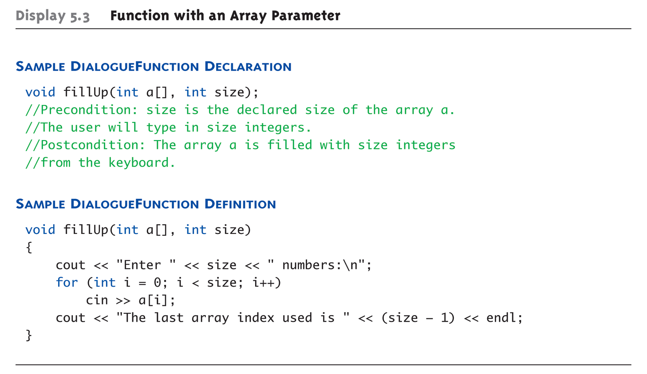
Entire Array as Argument Example: Display 5.3 Function with an Array Parameter

Slide 26
Entire Array as Argument Example
Given previous example:
In some main() function definition, consider this calls: int score[5], numberOfScores = 5; fillup(score, numberOfScores);
1st argument is entire array
2nd argument is integer value
Note no brackets in array argument!

Slide 27
Array as Argument: How?
What’s really passed?
Think of array as 3 "pieces"
Address of first indexed variable (arrName[0])
Array base type
Size of array

Slide 28
Array as Argument: How?
What’s really passed?
Think of array as 3 "pieces"
Address of first indexed variable (arrName[0])
Array base type
Size of array
Only 1st piece is passed!
Just the beginning address of array
Very similar to "pass-by-reference”, but is not quite a pass-by-reference

Slide 29
Array Parameters
May seem strange
No brackets in array argument
Must send size separately
One nice property:
Can use SAME function to fill any size array!
Exemplifies "re-use" properties of functions
Example: int score[5], time[10]; fillUp(score, 5); fillUp(time, 10);

Slide 30
The const Parameter Modifier
Recall: array parameter actually passes address of 1st element
Similar to pass-by-reference
Function can then modify array!
Often desirable, sometimes not!
Protect array contents from modification
Use "const" modifier before array parameter
Called "constant array parameter"
Tells compiler to "not allow" modifications

Slide 31
Functions that Return an Array
Functions cannot return arrays same way simple types are returned
Requires use of a "pointer"
Will be discussed in chapter 10…

Slide 32
Programming with Arrays
Plenty of uses
Partially-filled arrays
Must be declared some "max size"
Sorting
Searching

Slide 33
Partially-filled Arrays
Difficult to know exact array size needed
Must declare to be largest possible size
Must then keep "track" of valid data in array
Additional "tracking" variable needed
int numberUsed;
Tracks current number of elements in array

Slide 34
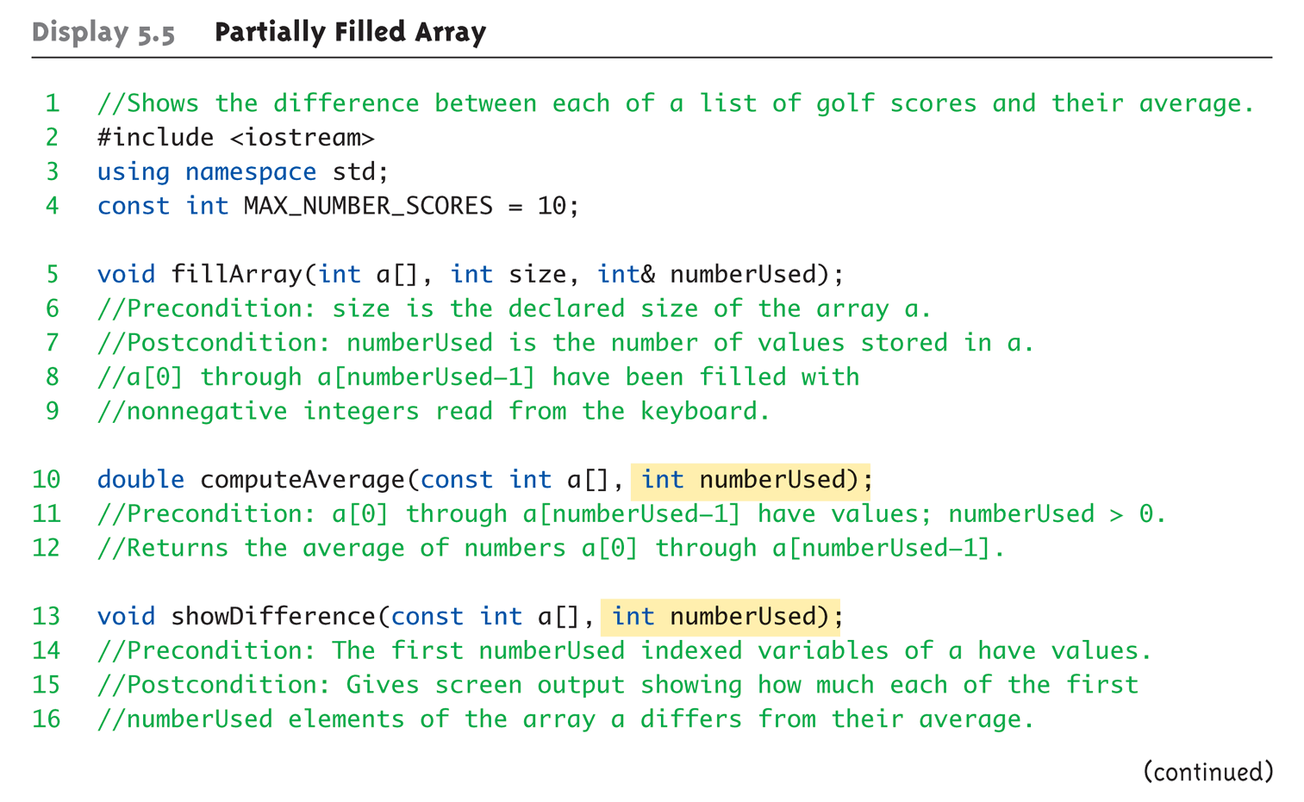
Partially-filled Arrays Example: Display 5.5 Partially Filled Array (1 of 5)

Slide 35
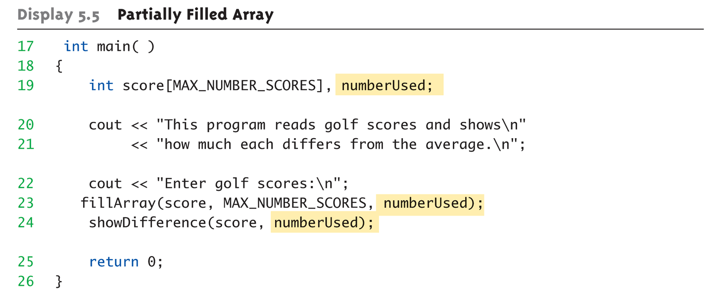
Partially-filled Arrays Example: Display 5.5 Partially Filled Array (2 of 5)

Slide 36
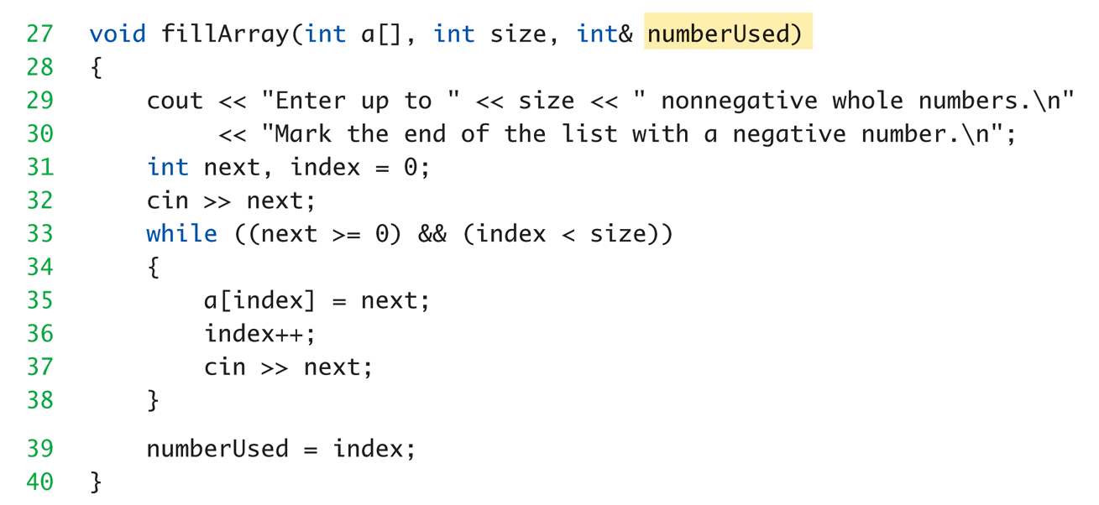
Partially-filled Arrays Example: Display 5.5 Partially Filled Array (3 of 5)
Notes:
不要負數

Slide 37
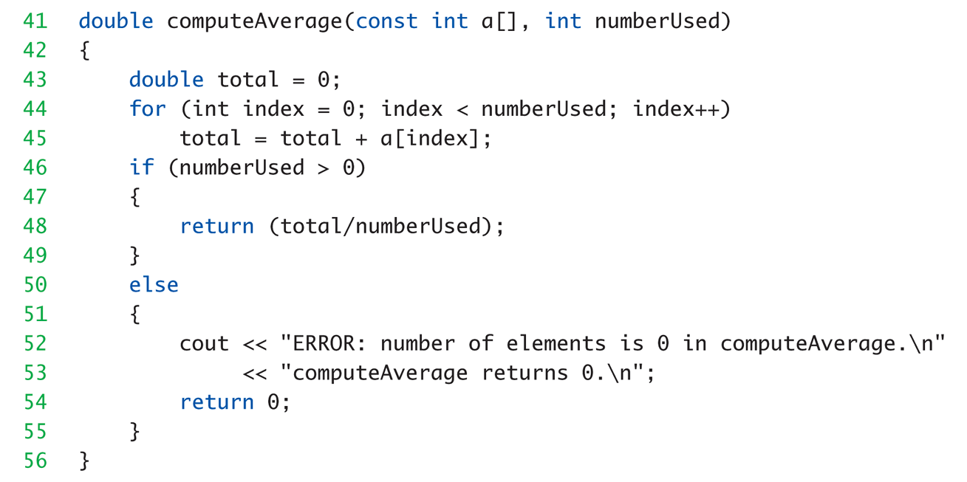
Partially-filled Arrays Example: Display 5.5 Partially Filled Array (4 of 5)

Slide 38
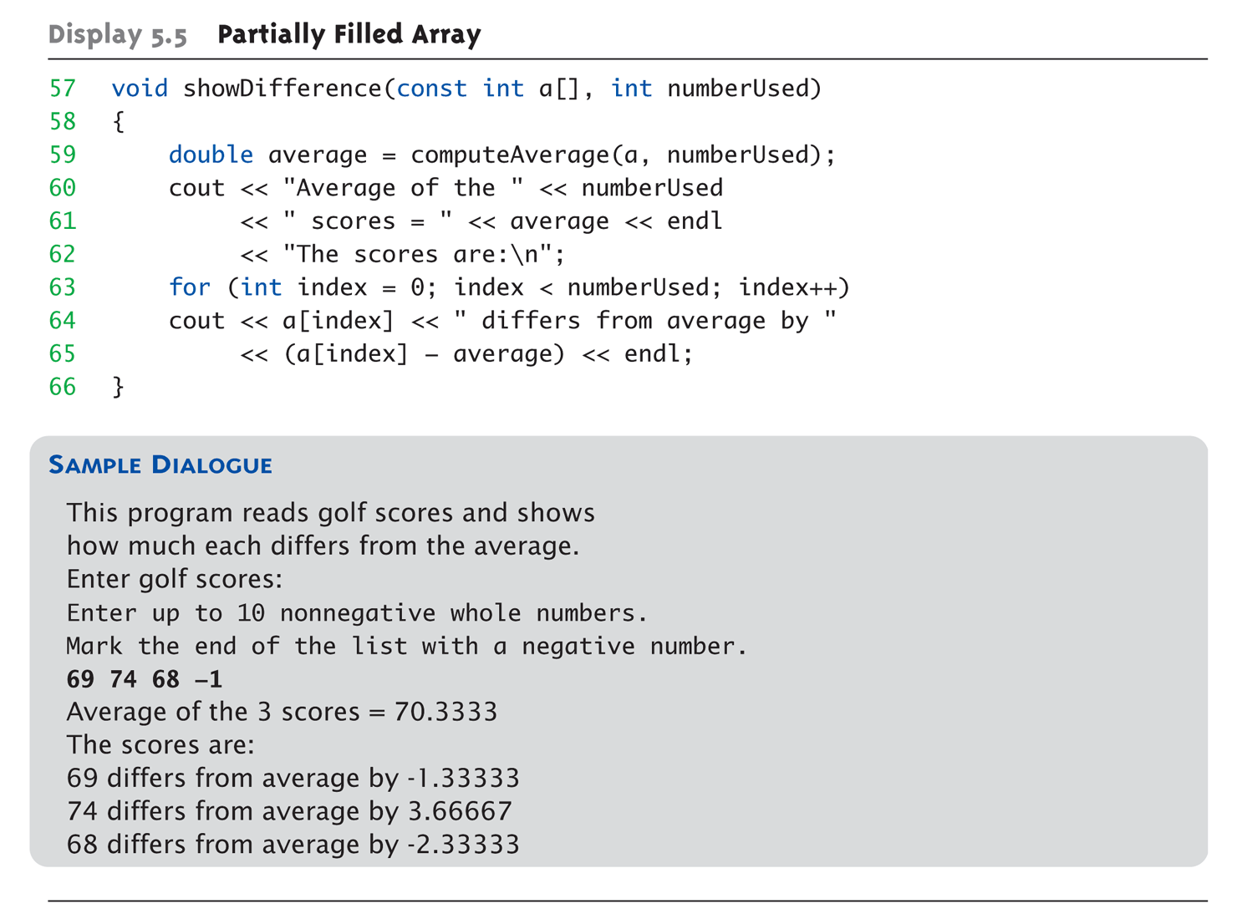
Partially-filled Arrays Example: Display 5.5 Partially Filled Array (5 of 5)

Slide 39
Global Constants vs. Parameters
Constants typically made "global"
Declared above main()
Functions then have scope to array size constant
No need to send as parameter then?
Technically yes
Why should we anyway? (For reuse)
Function definition might be in separate file
Function might be used by other programs!
Notes:
Global 看起來大家都能直接access，為什麼要多此一舉？

Slide 41
Searching an Array
Very typical use of arrays
Find a specific element in an array
Display 5.6 next slide

Slide 42
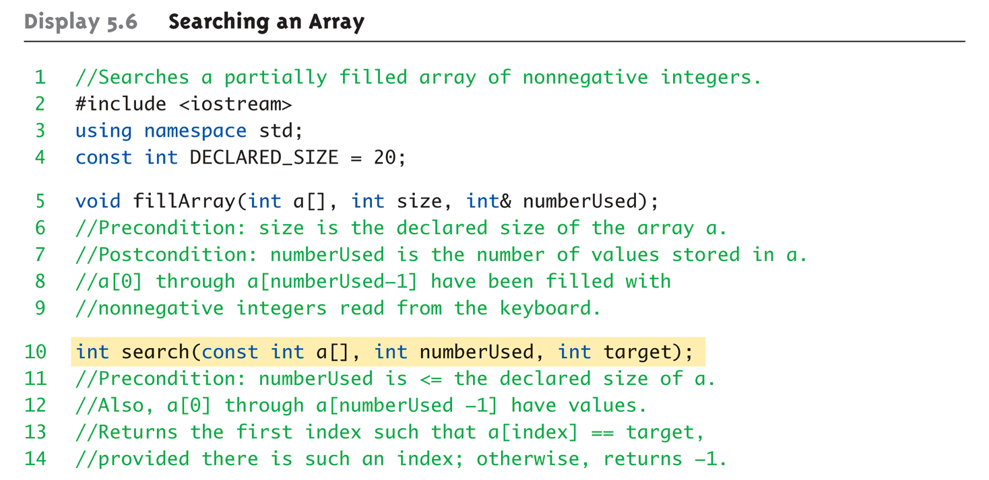
Display 5.6 Searching an Array (1 of 4)

Slide 43
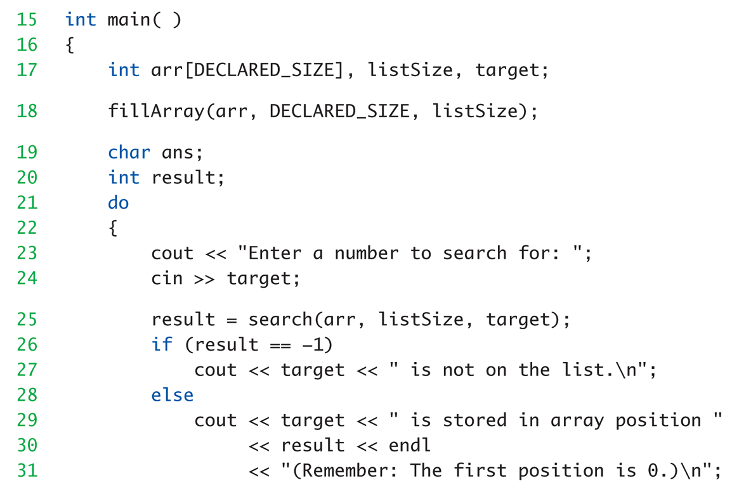
Display 5.6 Searching an Array (2 of 4)

Slide 44
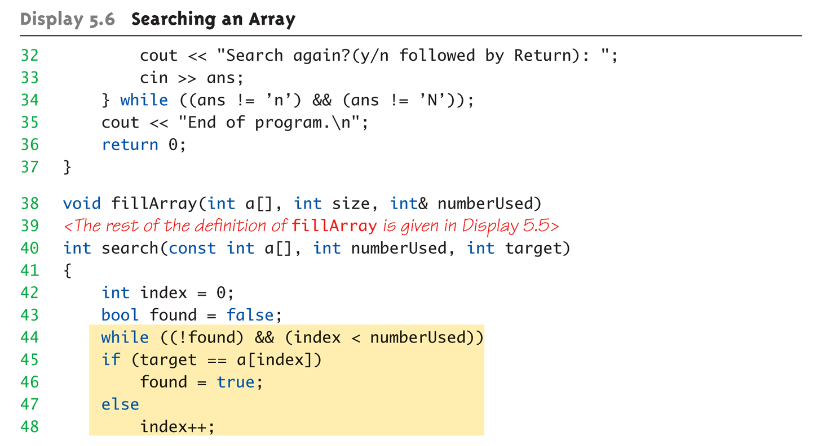
Display 5.6 Searching an Array (3 of 4)

Slide 45
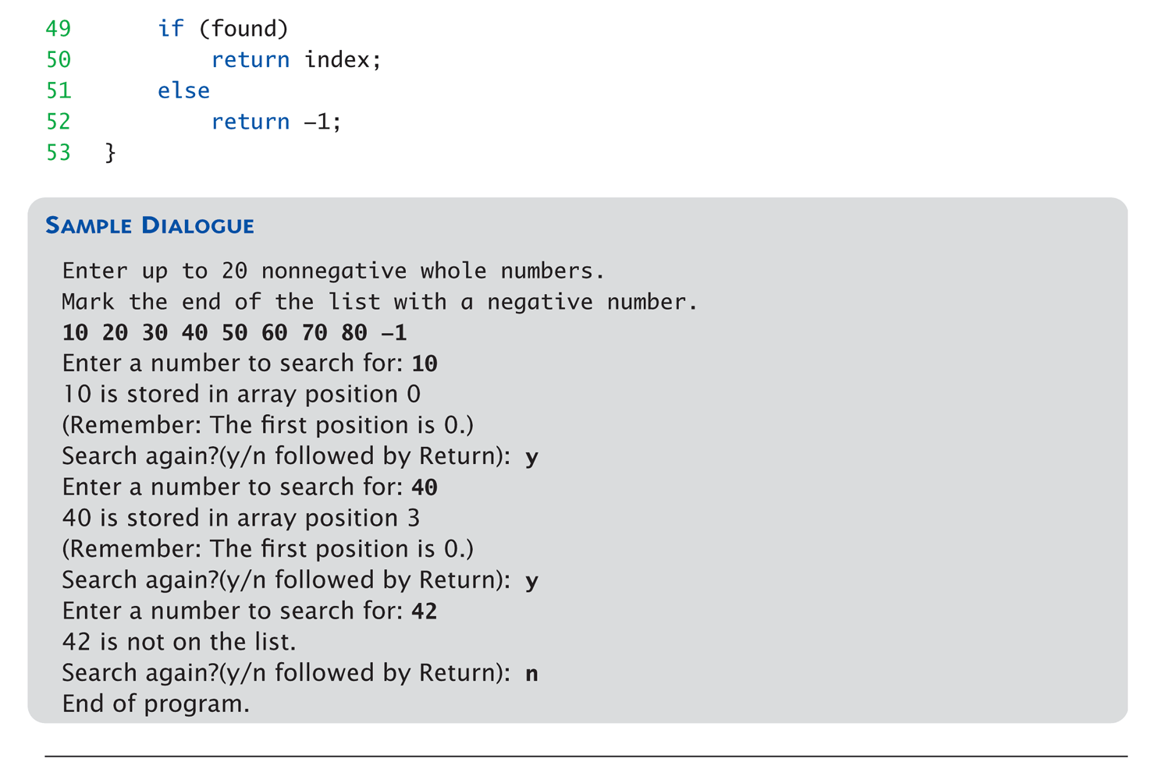
Display 5.6 Searching an Array (4 of 4)

Slide 46
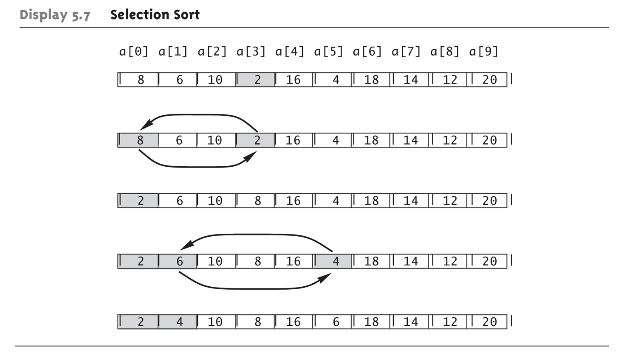
Sorting an Array: Display 5.7 Selection Short
Selection Sort Algorithm

Slide 47
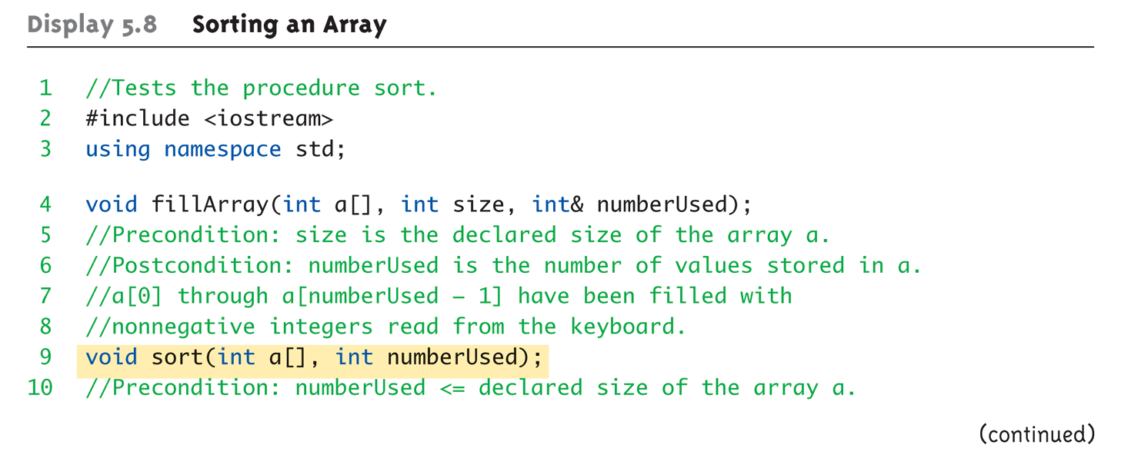
Sorting an Array Example: Display 5.8 Sorting an Array (1 of 4)

Slide 48
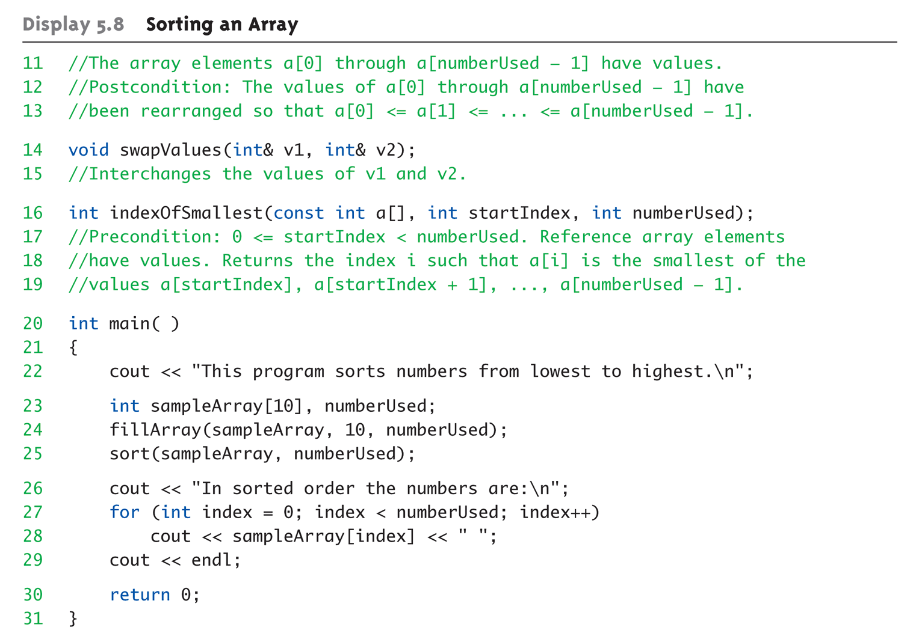
Sorting an Array Example: Display 5.8 Sorting an Array (2 of 4)

Slide 49
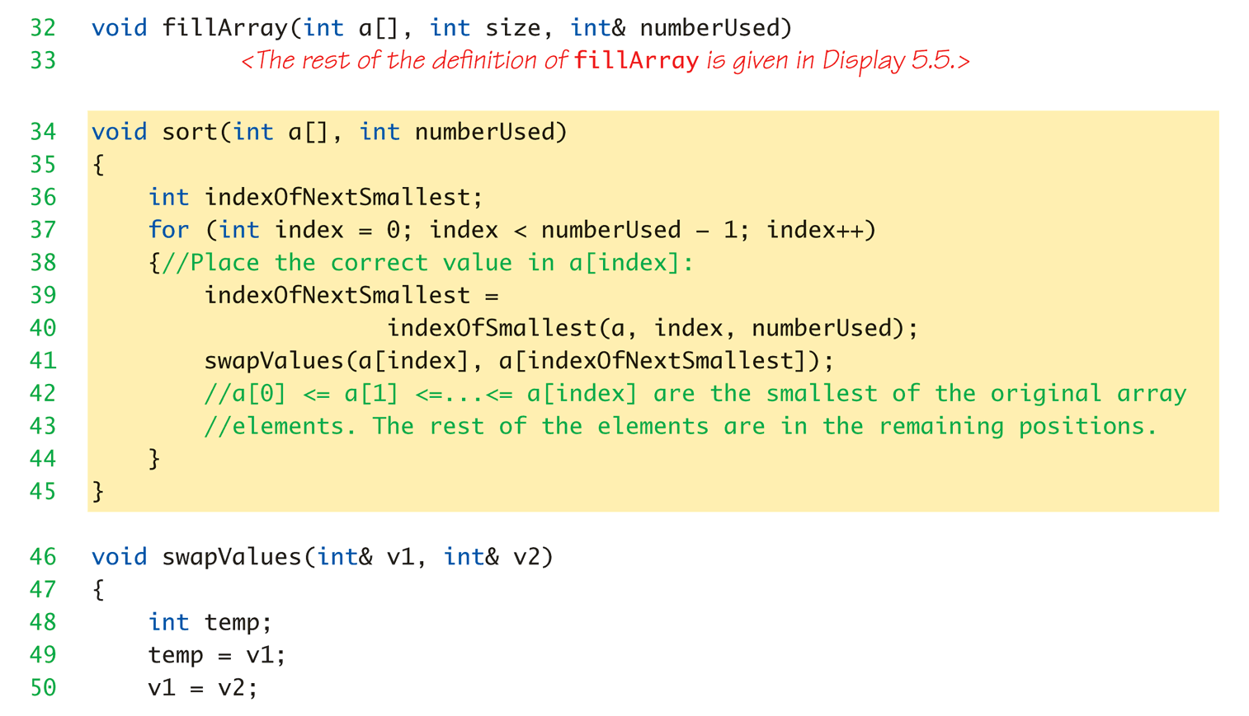
Sorting an Array Example: Display 5.8 Sorting an Array (3 of 4)

Slide 50
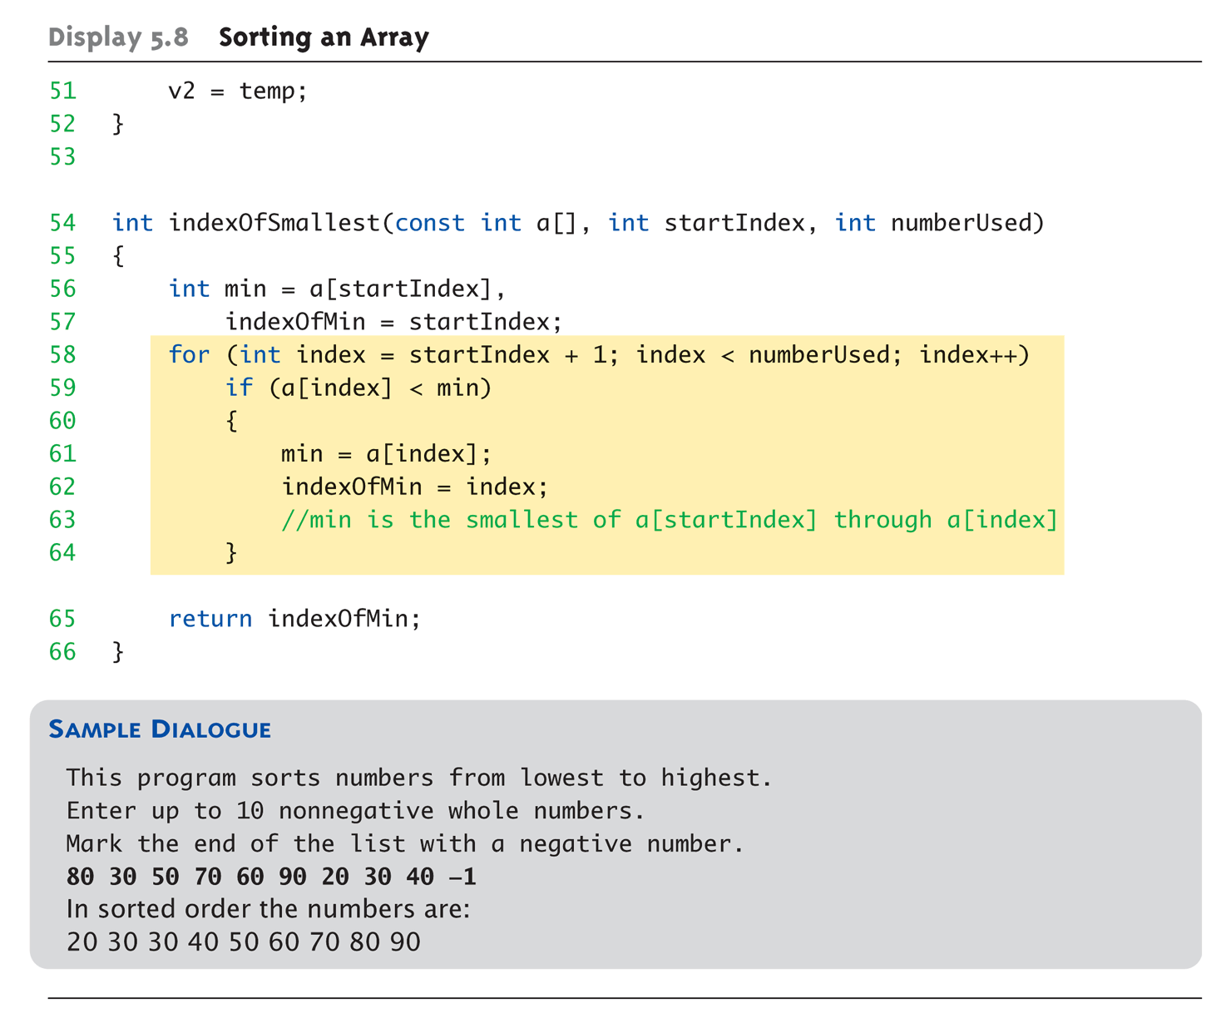
Sorting an Array Example: Display 5.8 Sorting an Array (4 of 4)

Slide 51
Multidimensional Arrays
Arrays with more than one index
char page[30][100];
Two indexes: An "array of arrays"
Visualize as: page[0][0], page[0][1], …, page[0][99] page[1][0], page[1][1], …, page[1][99] … page[29][0], page[29][1], …, page[29][99]
C++ allows any number of indexes
Typically no more than two

Slide 52
Multidimensional Array Parameters
Similar to one-dimensional array
1st dimension size not given
Provided as second parameter
2nd dimension size IS given
Example: void DisplayPage(const char p[][100], int sizeDimension1) { for (int index1=0; index1<sizeDimension1; index1++) { for (int index2=0; index2 < 100; index2++) cout << p[index1][index2]; cout << endl; } }

Slide 53
Summary 1
Array is collection of "same type" data
Indexed variables of array used just like any other simple variables
for-loop "natural" way to traverse arrays
Programmer responsible for staying "in bounds" of array
Array parameter is "new" kind
Similar to call-by-reference

Slide 54
Summary 2
Array elements stored sequentially
"Contiguous" portion of memory
Only address of 1st element is passed to functions
Partially-filled arrays → more tracking
Constant array parameters
Prevent modification of array contents
Multidimensional arrays
Create "array of arrays"

