Slide 1

Chapter 6
Structures and Classes
Copyright © 2017 Pearson Education, Ltd. All rights reserved.

Slide 2
Learning Objectives
Structures
Structure types
Structures as function arguments
Initializing structures
Classes
Defining, member functions
Public and private members
Accessor and mutator functions
Structures vs. classes

Slide 3
Structures
2nd aggregate data type: struct
Recall: aggregate meaning "grouping"
Recall array: collection of values of same type; 1st is array
Structure: collection of values of different types
Treated as a single item, like arrays
Major difference: Must first "define" struct
Prior to declaring any variables

Slide 4
Structure Types
Define struct globally (typically)
No memory is allocated
Just a "placeholder" for what our struct will "look like"
Definition: struct CDAccountV1 ← Name of new struct "type" { double balance; ← member names double interestRate; int term; };

Slide 5
Declare Structure Variable
With structure type defined, now declare variables of this new type: CDAccountV1 account;
Just like declaring simple types (e.g., int)
Variable account now of type CDAccountV1
It contains "member values"
Each of the struct "parts"

Slide 6
Accessing Structure Members
Dot Operator to access members
account.balance
account.interestRate
account.term
Called "member variables"
The "parts" of the structure variable
Different structs can have same name member variables
No conflicts

Slide 7
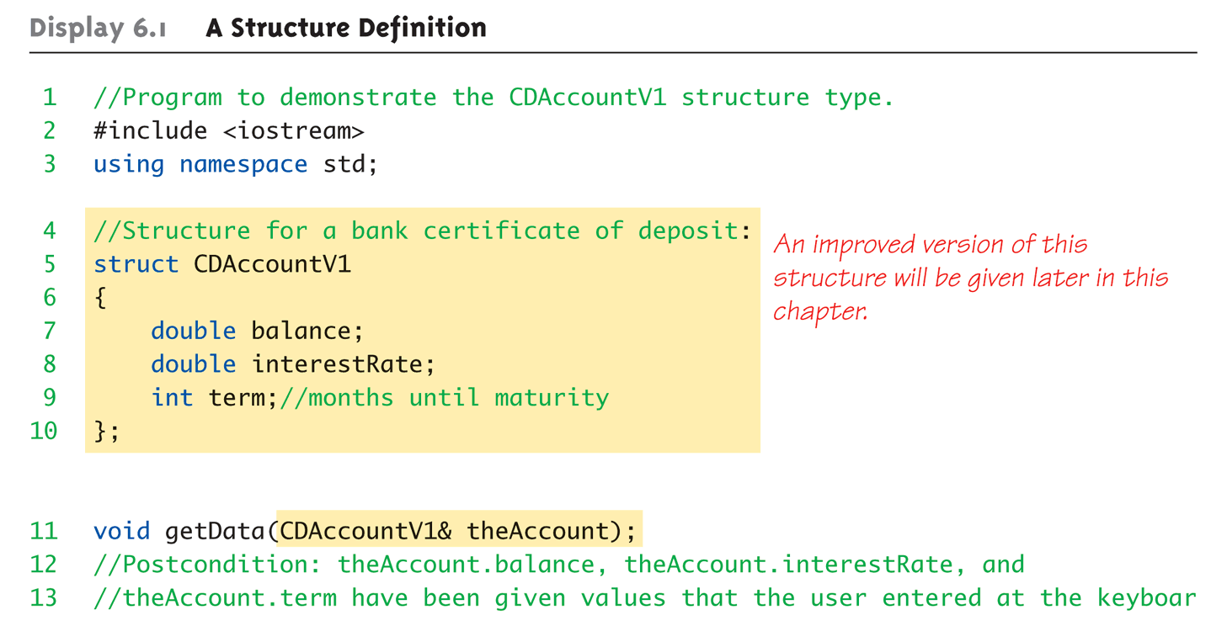
Structure Example: Display 6.1 A Structure Definition (1 of 3)

Slide 8
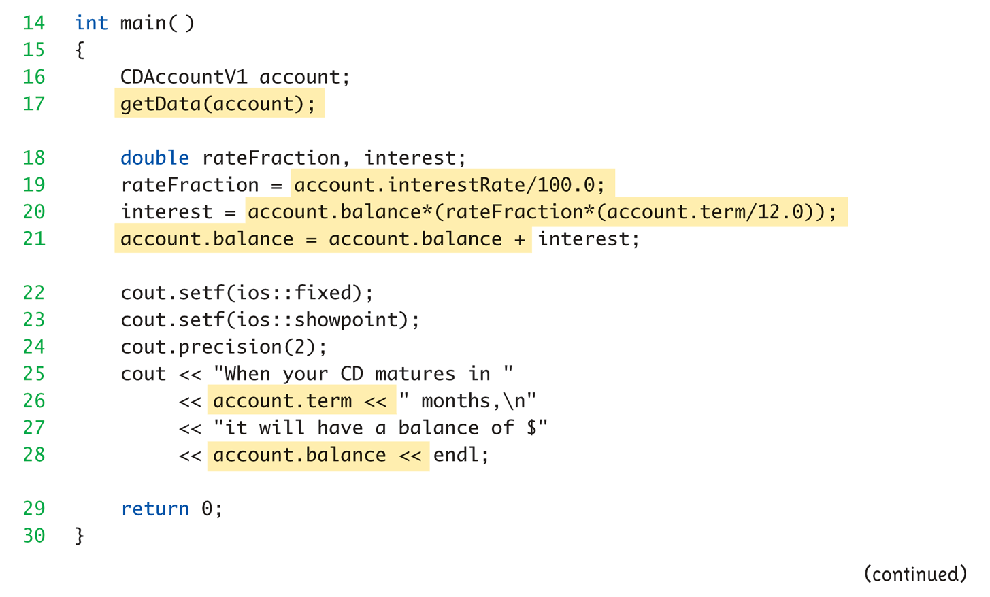
Structure Example: Display 6.1 A Structure Definition (2 of 3)

Slide 9
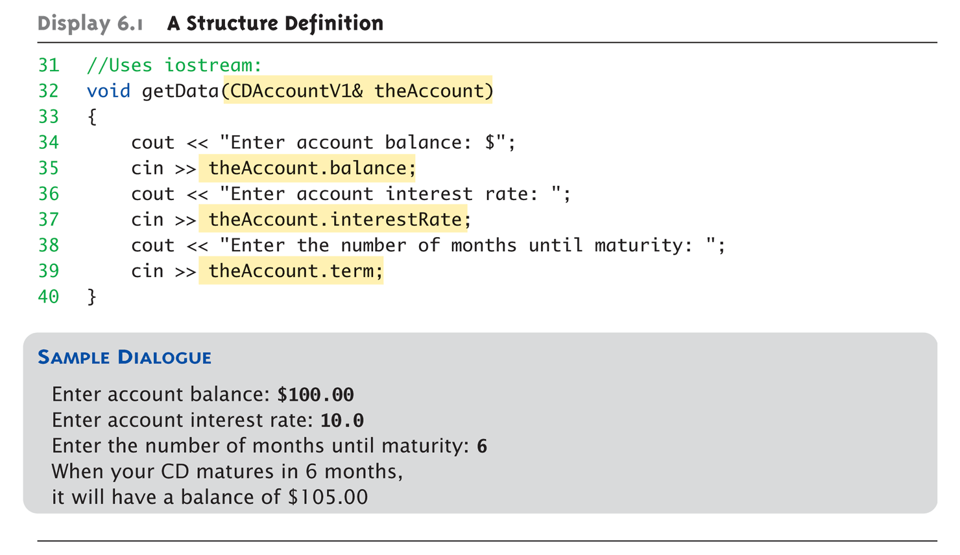
Structure Example: Display 6.1 A Structure Definition (3 of 3)

Slide 10
Structure Pitfall
Semicolon after structure definition
; MUST exist: struct WeatherData { double temperature; double windVelocity; }; ← REQUIRED semicolon!
Required since you "can" declare structure variables in this location
Notes:
struct WeatherData {…} variable1, variable2;

Slide 11
Structure Assignments
Define structure named CropYield
Declare two structure variables: CropYield apples, oranges;
Both are variables of "struct type CropYield"
Simple assignments are legal: apples = oranges;
Simply copies each member variable from apples into member variables from oranges

Slide 12
Pitfall: Structure Assignments
Usually, the simple data type assignment seems to create two independent entities
But, if you use pointer (i.e., address), the assignment only pass the value and does not creates another entity
We will introduce pointer and operator overloading in Chapters 10 & 8
struct A{
int *a;
};
int main()
{
A v1,v2;
v1.a = new int;
*(v1.a) = 50;
v2 = v1;
*(v2.a) = 100;
cout << *(v1.a) << endl;
return 0;
}

Slide 13
Structures as Function Arguments
Passed like any simple data type
Pass-by-value
Pass-by-reference
Or combination
Can also be returned by function
Return-type is structure type
Return statement in function definition sends structure variable back to caller

Slide 14
Initializing Structures
Can initialize at declaration
Example: struct Date { int month; int day; int year; }; Date dueDate = {3, 12, 2019};
Declaration provides initial data to all three member variables

Slide 15
Before Introducing Class
Review how to implement a data structure
Using C-like implementation
An array for any data type with a dynamic size

Slide 16
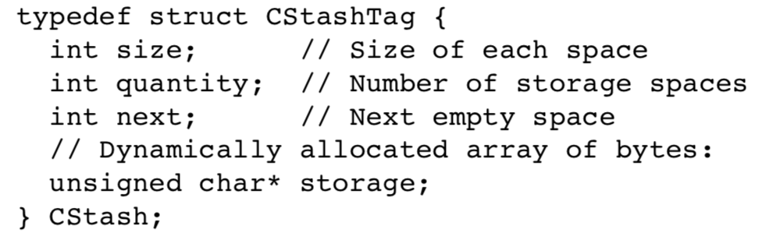
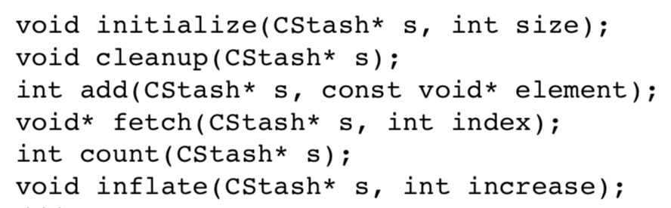
Build Libraries in C
CStash: acts like an array with a dynamic size
Notes:
Although it’s written in C++, it has the style of what you would write in C

Slide 17
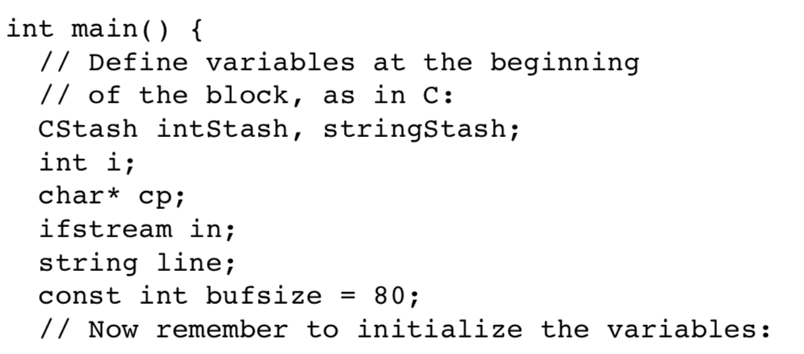
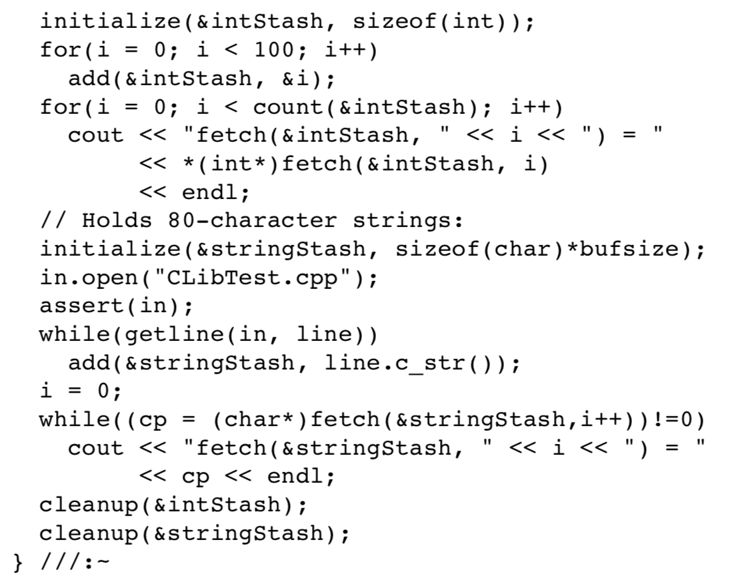
Use Libraries in C
Use CStash to generate an array of integers
Since the function returns void*
Notes:
Remark that a cast is always required to tell the compiler that you really want to treat it as the destination type

Slide 18
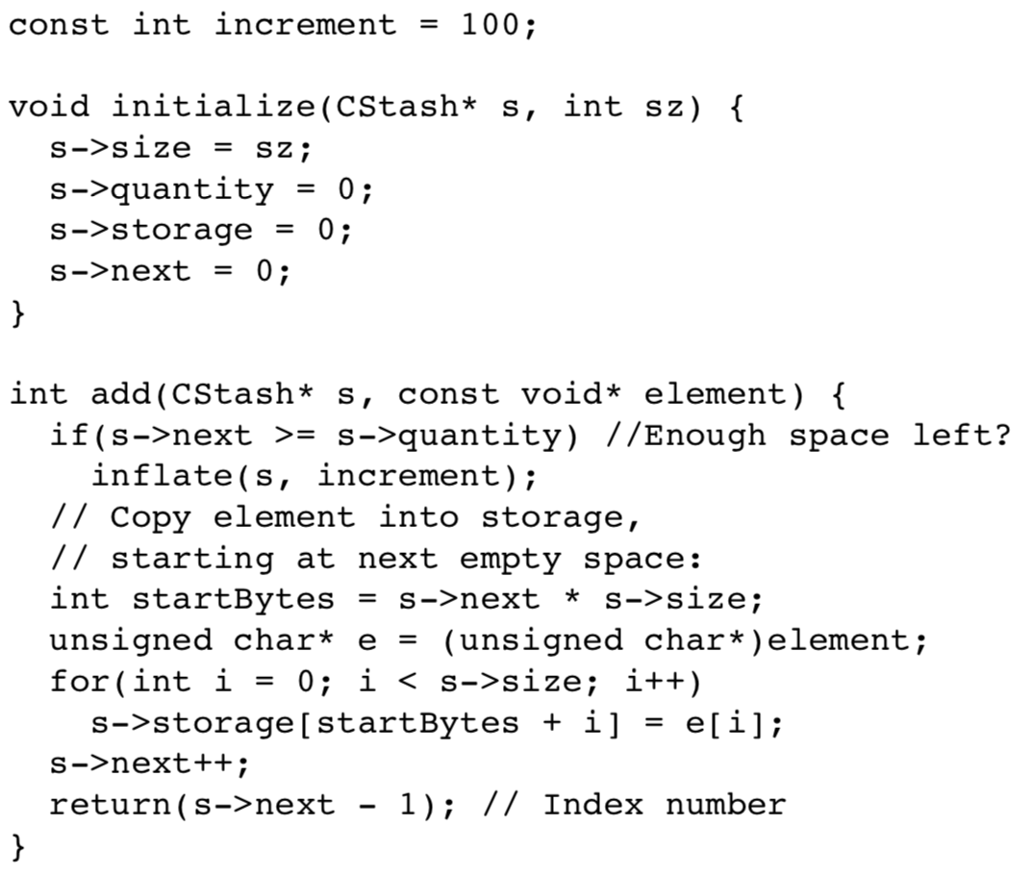
Implement Libraries in C
Function initialize: to initialize the storage of CStash

Slide 19
Implement Libraries in C
Function add: to add an element in the storage

Slide 20
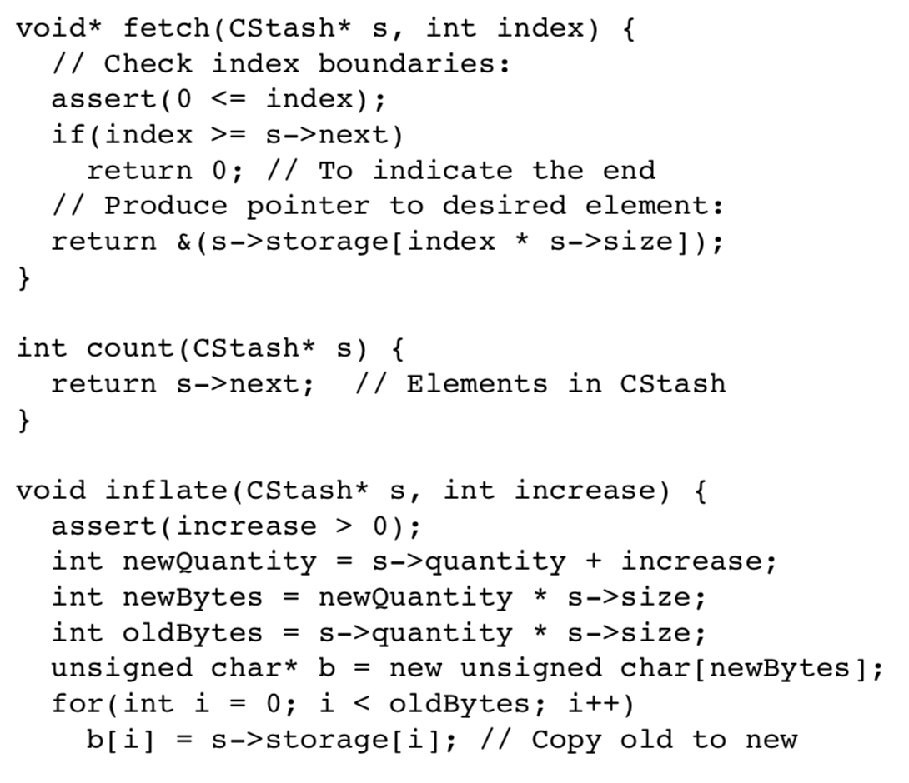
Implement Libraries in C
Function fetch: to retrieve an element in the storage
Function count: to obtain the number of elements

Slide 21
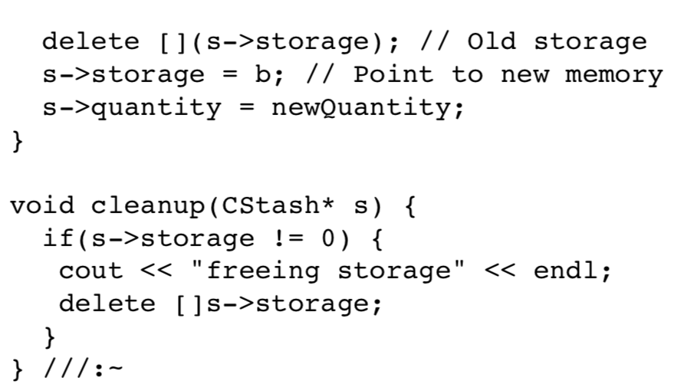
Implement Libraries in C
Function inflate: to resize the storage

Slide 22
Implement Libraries in C
Function cleanup: to delete all elements

Slide 23
What’s Wrong?
The style of CStash library has been staple for C programmers
But it is awkward…
Pass the address of the structure to every single function → Confusing the readers
Only a single namespace for functions → Name clashes
initialize → CStash_initialize
cleanup → CStash_cleanup
That is tedious!!!!!

Slide 24
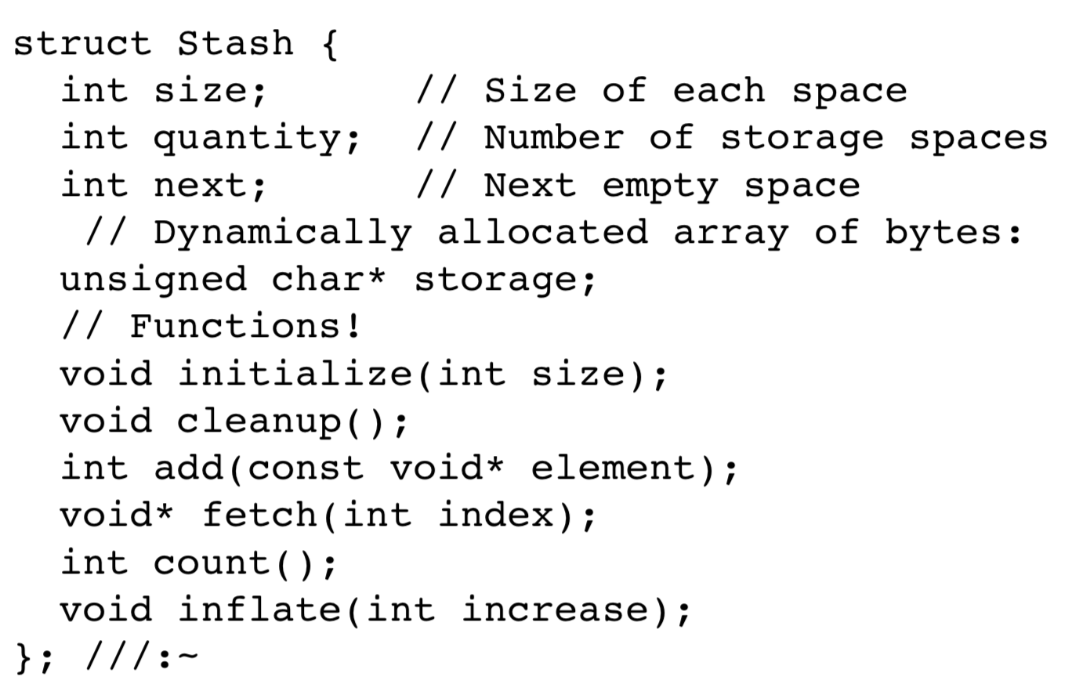
Towards Object-Based (not OOP yet)
C++ functions can be placed inside structs as “member functions” – towards encapsulation
Notes:
注意傳統C不能這樣寫，但C++可以

Slide 25
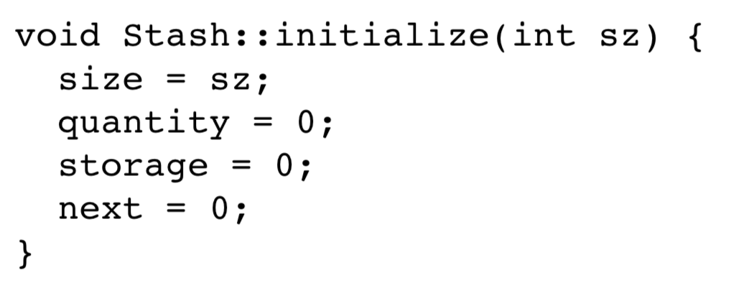
Towards Object-Based (not OOP yet)
No function inside an struct will collide with other function outside the struct → Just use “initialize”
To specify the function that belongs to Stash, use “::” (scope resolution operator) and “.”
No need of the first argument and “s->”
Secret first argument in member functions
Replace “s->” with “this->”

Slide 26
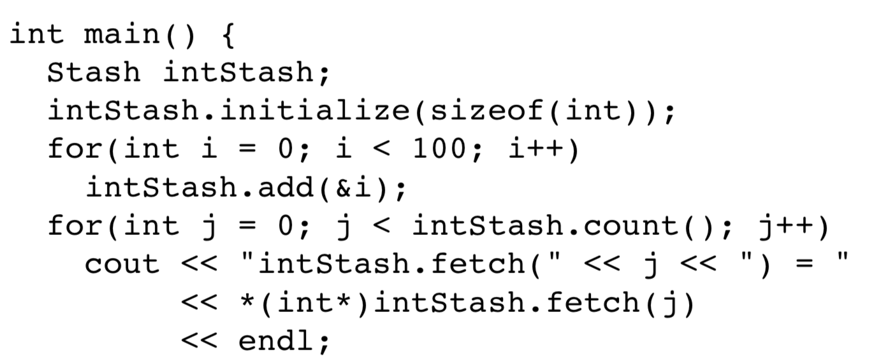
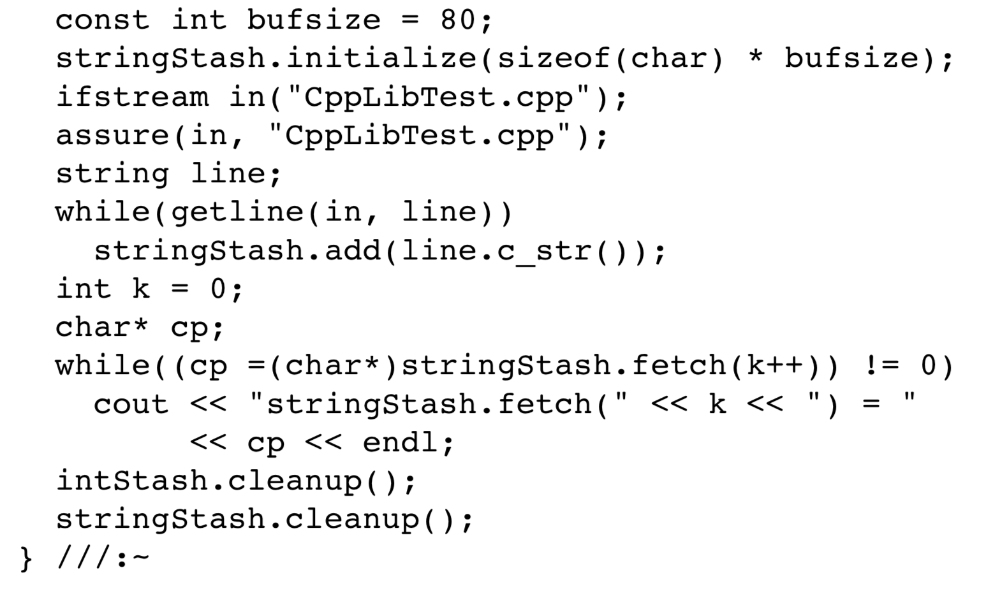
Towards Object-Based (not OOP yet)
Note that type is critical in C++
You are not allowed to assign a void pointer to any other type of pointer → Use “cast” to tell the compiler that you really do want to treat it as the destination type
Since the function returns void*

Slide 27
No Hidden Implementation
Client programmers can directly manipulate some of the members of your struct → not hidden

Slide 28
Access Control
Use keyword private to hide the members
private:
public:
Notes:
好處：讓使用者不會動到內部，隔離開發class和使用class的人，讓開發的人專心在這個class的設計，用的人就只要知道怎麼使用，別改到內部

Slide 29
Object-Based is Not Enough
What will happen if we define an integer stack to be an element added into a Stash??
struct myIntStackNode{
int data;
myIntStackNode *link;
void initialize(int dat);
};
struct myStack{
myIntStackNode *head;
void initialize();
void push(int dat);
int pop();
void cleanup();
};
Stash myIntStackStash;
myIntStackStash.initialize\
(sizeof(myIntStack));
myStack stack1;
stack1.initialize();
myIntStackStash.add(&stack1);
myIntStackStash.fetch(0);
myIntStackStash.cleanup();
Notes:
很可怕，不要問，會發生很大的問題，特別出在cleanup
Memory leak or dangling reference
Who is responsible for the memory??????
我們還需要很多東西 constructor, destructor, template…才有辦法完全做到我們要的

Slide 30
Towards OOP
Encapsulation and access control, taken together, invent something more than C struct
We’re stepping into the world of OOP
You can describe a class of pokemons (O)
Any object belonging to this class will share these characteristics and behaviors
HP, Att, Def, SP-Att, SP-Def, …
Attack(), Recover(), …
Keyword class in Simula-67 inspires Stroustrup to choose the same keyword for C++
Create new data types more than just C structs
Notes:
Stroustrup: C++之父
史特勞斯特魯普

Slide 31
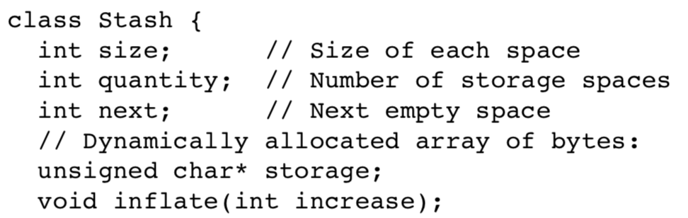
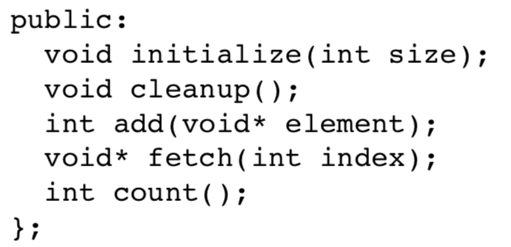
Use “class” instead of “struct”
Notes:
開始使用 class 這個字吧

Slide 32
Classes
Similar to structures
Adds member FUNCTIONS (not allowed in C struct)
Not just member data
Integral to object-oriented programming
Focus on objects
Object: Contains data and operations
In C++, variables of class type are objects

Slide 33
Class Definitions
Defined similar to structures
Example: class DayOfYear ← name of new class type { public: void output(); ← member function! int month; int day; };
Notice only member function’s prototype
Function’s implementation is elsewhere

Slide 34
Declaring Objects
Declared same as all variables
Predefined types, structure types
Example: DayOfYear today, birthday;
Declares two objects of class type DayOfYear
Objects include:
Data
Members month, day
Operations (member functions)
output()

Slide 35
Class Member Access
Members accessed same as structures
Use dot
Example: today.month today.day
And to access member function: today.output(); ← Invokes member function

Slide 36
Class Member Functions
Must define or "implement" class member functions
Like other function definitions
Can be after main() definition
Must specify class: void DayOfYear::output() {…}
:: is scope resolution operator
Instructs compiler "what class" member is from
Item before :: called type qualifier

Slide 37
Class Member Functions Definition
Notice output() member function’s definition (in next example)
Refers to member data of class
No qualifiers
Directly use “month” and “day”
Function used for all objects of the class
Will refer to "that object’s" data when invoked
Example: today.output();
Displays "today" object’s data
Notes:
在定義class 裡的 function，如果需要 access data member，可直接使用 data member，不需要在前面加東西

Slide 38
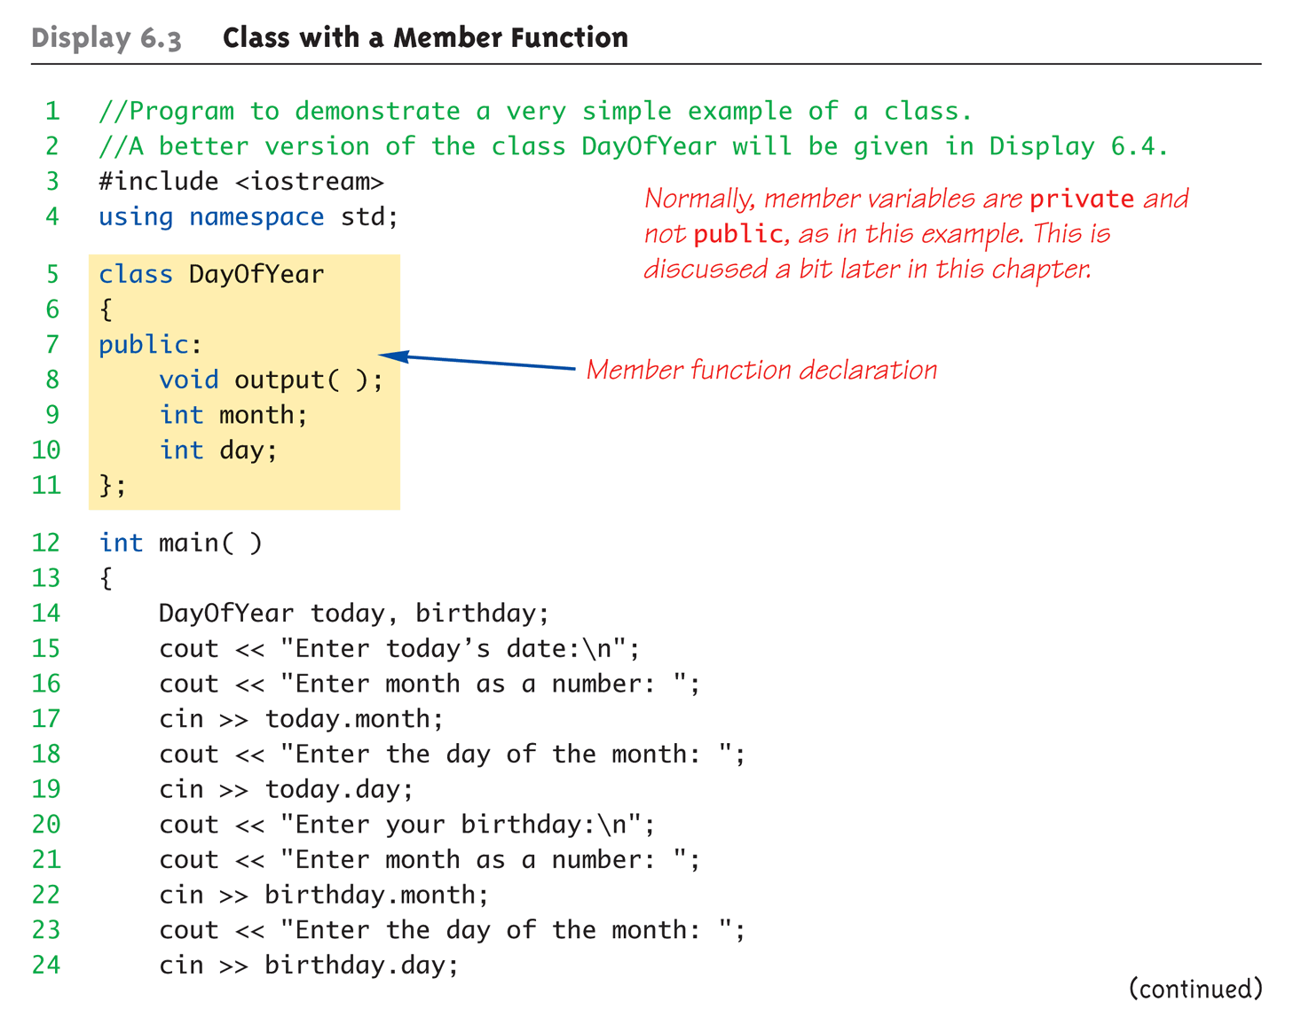
Complete Class Example: Display 6.3 Class With a Member Function (1 of 4)

Slide 39
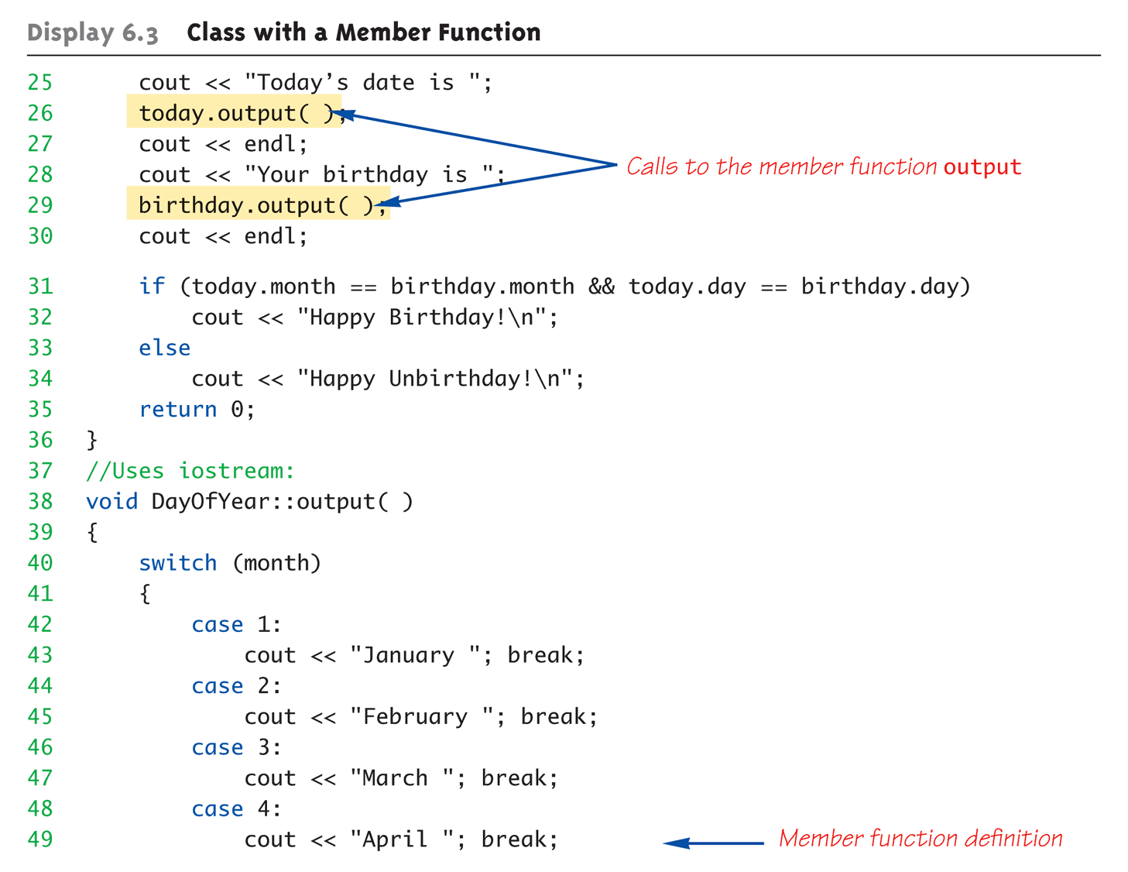
Complete Class Example: Display 6.3 Class With a Member Function (2 of 4)

Slide 40
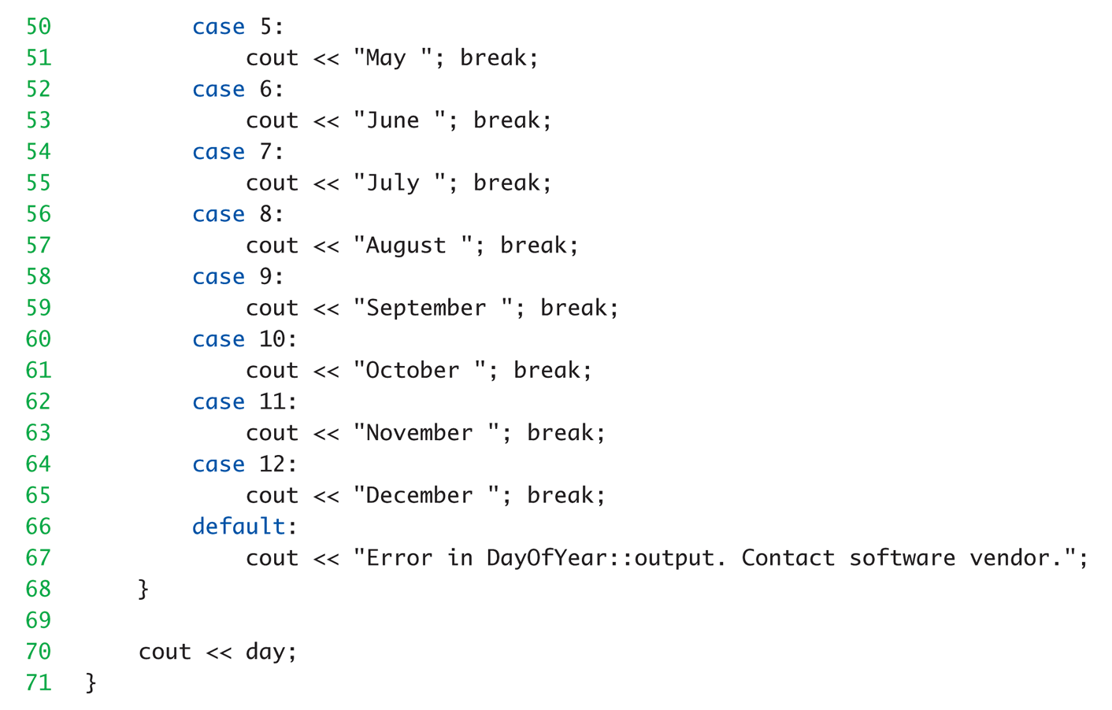
Complete Class Example: Display 6.3 Class With a Member Function (3 of 4)

Slide 41
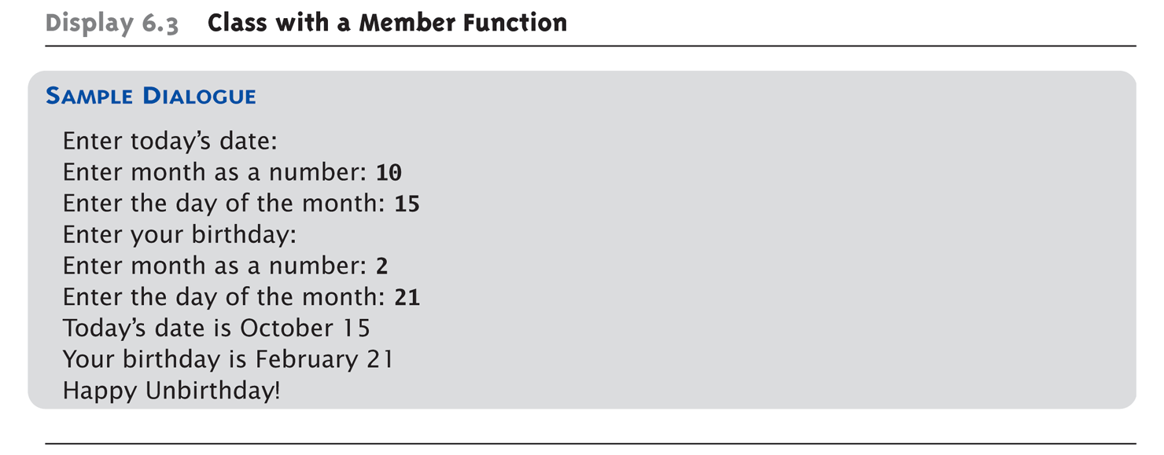
Complete Class Example: Display 6.3 Class With a Member Function (4 of 4)

Slide 42
Dot and Scope Resolution Operator
Used to specify "of what thing" they are members
Dot operator (.):
Specifies member of particular object
Scope resolution operator (::):
Specifies what class the function definition comes from

Slide 43
A Class’s Place
Class is full-fledged type!
Just like data types int, double, etc.
Can have variables of a class type
We simply call them "objects"
Can have parameters of a class type
Pass-by-value
Pass-by-reference
Can use class type like any other type!

Slide 44
Encapsulation
Any data type includes
Data (range of data)
Operations (that can be performed on data)
Example: int data type has: Data: -2147483648 to 2147483647 (for 32 bit int) Operations: +,-,*,/,%,logical,etc.
Same with classes
But WE specify data, and the operations to be allowed on our data!

Slide 45
Abstract Data Types
"Abstract"
Client programmers don’t know details
Abbreviated "ADT"
Collection of data values together with set of basic operations defined for the values
ADT’s often "language-independent"
We implement ADT’s in C++ with classes
C++ class "defines" the ADT
Other languages implement ADT’s as well

Slide 46
More Encapsulation
Encapsulation
Means "bringing together as one"
Declare a class → get an object
Object is "encapsulation" of
Data values
Operations on the data (member functions)

Slide 47
Principles of OOP
Information Hiding
Details of how operations work not known to "user" of class
Data Abstraction
Details of how data is manipulated within ADT/class not known to user
Encapsulation
Bring together data and operations, but keep "details" hidden

Slide 48
Public and Private Members
Data in class almost always designated private in definition!
Upholds principles of OOP
Hide data from user
Allow manipulation only via operations
Which are member functions
Public items (usually member functions) are "user-accessible"

Slide 49
Public and Private Example
Modify previous example: class DayOfYear { public: void input(); void output(); private: int month; int day; };
Data now private
Objects have no direct access

Slide 50
Public and Private Example 2
Given previous example
Declare object: DayOfYear today;
Object today can ONLY access public members
cin >> today.month; // NOT ALLOWED outside the class!
cout << today.day; // NOT ALLOWED outside the class!
Must instead call public operations:
today.input();
today.output();

Slide 51
Public and Private Style
Can mix & match public & private
More typically place public first
Allows easy viewing of portions that can be USED by programmers using the class
Private data is "hidden", so irrelevant to users
Outside of class definition, cannot change (or even access) private data

Slide 52
Accessor and Mutator Functions
Object needs to "do something" with its data
Call accessor member functions
Allow object to read data
Also called "get member functions"
Simple retrieval of member data
Mutator member functions
Allow object to change data
Manipulated based on application

Slide 53
Separate Interface and Implementation
User of class need not see details of how class is implemented
Principle of OOP → encapsulation
User only needs "rules"
Called "interface" for the class
In C++ → public member functions and associated comments
Implementation of class hidden
Member function definitions elsewhere
User need not see them

Slide 54
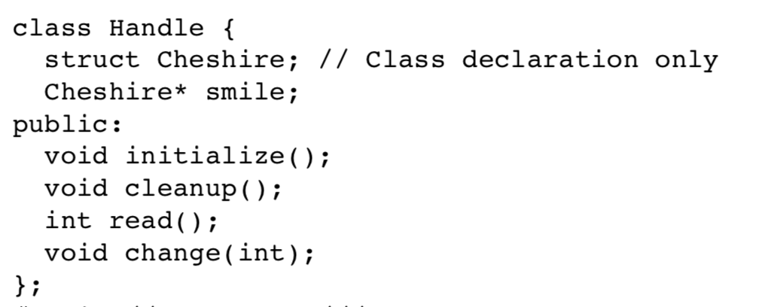
More Hidden
The implementation hiding is only partial in C++
You still see the declaration for all parts even if you cannot access it easily
Solution: hide the data by declaring an object of Handler::Cheshire and defining it in other file

Slide 55
Structures versus Classes
Structures
Typically all members public
No member functions
Classes
Typically all data members private
Interface member functions public
Technically, same
Perceptionally, very different mechanisms

Slide 56
Thinking Objects
Focus for programming changes
Before → algorithms center stage
OOP → data is focus
Algorithms still exist
They simply focus on their data
Are "made" to "fit" the data
Designing software solution
Define variety of objects and how they interact

Slide 57
Summary 1
Structure is collection of different types
Class used to combine data and functions into single unit -> object
Member variables and member functions
Can be public → accessed outside class
Can be private → accessed only in a member function’s definition
Class and structure types can be formal parameters to functions

Slide 58
Summary 2
C++ class definition
Should separate two key parts
Interface: what user needs
Implementation: details of how class works

