Slide 1

Chapter 8
Operator Overloading, Friends, and References
Copyright © 2017 Pearson Education, Ltd. All rights reserved.

Slide 2
Learning Objectives
Basic Operator Overloading
Unary operators
As member functions
Friends and Automatic Type Conversion
Friend functions, friend classes
Constructors for automatic type conversion
References and More Overloading
<< and >>
Operators: = , [], ++, --

Slide 3
Operator Overloading Introduction
Operators +, -, %, ==, etc.
Really just functions!
Simply "called" with different syntax: x + 7
"+" is binary operator with x & 7 as operands
We "like" this notation as humans
Think of it as: +(x, 7)
"+" is the function name
x, 7 are the arguments
Function "+" returns "sum" of it’s arguments
Notes:
這些符號，就真的是代表了某個function
不過這些符號是人慣用的，所以比較熟悉、直覺

Slide 4
Operator Overloading Perspective
Built-in operators
e.g., +, -, = , %, ==, /, *
Already work for C++ built-in types
In standard "binary" notation
We can overload them!
To work with OUR types!
To add "Chair types", or "Money types"
As appropriate for our needs
In "notation" we’re comfortable with
Always overload with similar "actions"!

Slide 5
Overloading Basics
Overloading operators
VERY similar to overloading functions
Operator itself is "name" of function
Example Declaration: const Money operator +( const Money& amount1, const Money& amount2);
Overloads + for operands of type Money
Uses constant reference parameters for efficiency
Returned value is type Money
Allows addition of "Money" objects
Notes:
int x = 5, y = 10;
(x+y)++; 會錯，因為(x+y)是一個const，也沒必要讓使用修改他 lvalue required as left operand of assignment
後面會再一次講到

Slide 6
Overloading Basics
Overloading operators
VERY similar to overloading functions
Operator itself is "name" of function
Example Declaration: const Money operator +( const Money& amount1, const Money& amount2);
Overloads + for operands of type Money
Uses constant reference parameters for efficiency
Returned value is type Money
Allows addition of "Money" objects
Notes:
int x = 5, y = 10;
(x+y)++; 會錯，因為(x+y)是一個const，也沒必要讓使用修改他 lvalue required as left operand of assignment
後面會再一次講到

Slide 7
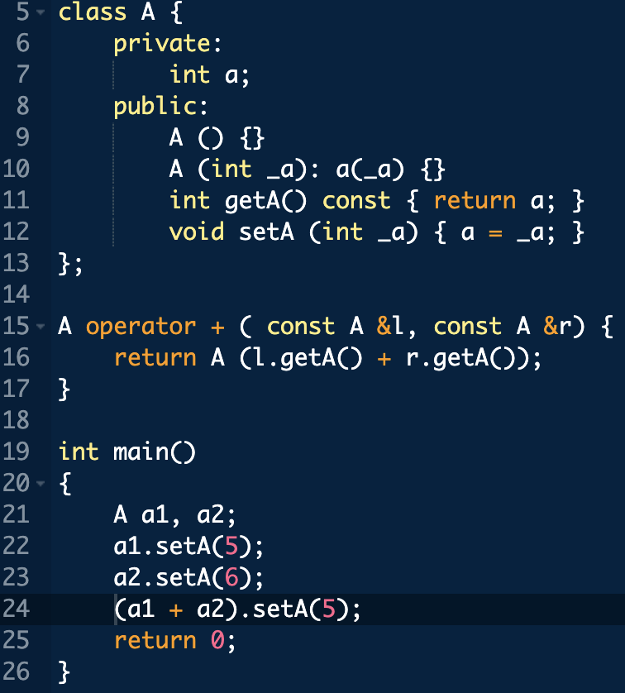
Notes:
Line 24 會給過，因為沒有把 line 15 設定成 constant

Slide 8
Overloaded "+"
Given previous example:
Note: overloaded "+" NOT member function
Definition is "more involved" than simple "add"
Requires issues of money type addition
Must handle negative/positive values
Operator overload definitions generally very simple
Just perform "addition" particular to "your" type

Slide 9
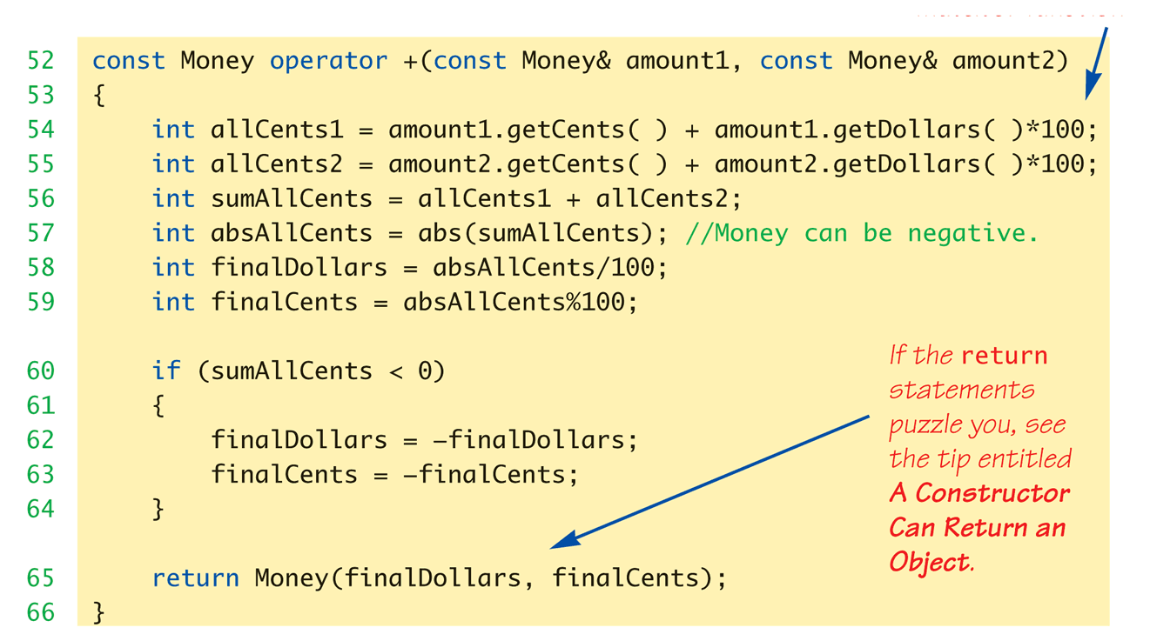
Money "+" Definition: Display 8.1 Operator Overloading
Note that we need to use accessor and mutator functions
Definition of "+" operator for Money class:
Notes:
因為不是member function，所以可以看到要取得裡面的value要透過getCents()和getDollars()
Binary operator + 和 – 差不多

Slide 10
Constructors Returning Objects
Constructor a "void" function?
We "think" that way, but no
A "special" function
With special properties
CAN return a value!
Recall return statement in "+" overload for Money type:
return Money(finalDollars, finalCents);
Returns an "invocation" of Money class!
So constructor actually "returns" an object!
Called an "anonymous object"

Slide 11
Overloaded "=="
Equality operator, ==
Enables comparison of Money objects
Declaration: bool operator ==( const Money& amount1, const Money& amount2);
Returns bool type for true/false equality
Again, it’s a non-member function (like "+" overload)
Notes:
Bool 其實是 constant，基本上 simple type 當作 return type 時候，C++ 會自動把它當成 constant，避免使用者把重要的資訊存到裡面，然後

Slide 12
Overloaded "=="
Equality operator, ==
Enables comparison of Money objects
Declaration: const?? bool operator ==( const Money& amount1, const Money& amount2);
Returns bool type for true/false equality
Again, it’s a non-member function (like "+" overload)
Notes:
Bool 其實是 constant，基本上 simple type 當作 return type 時候，C++ 會自動把它當成 constant，避免使用者把重要的資訊存到裡面，然後

Slide 13
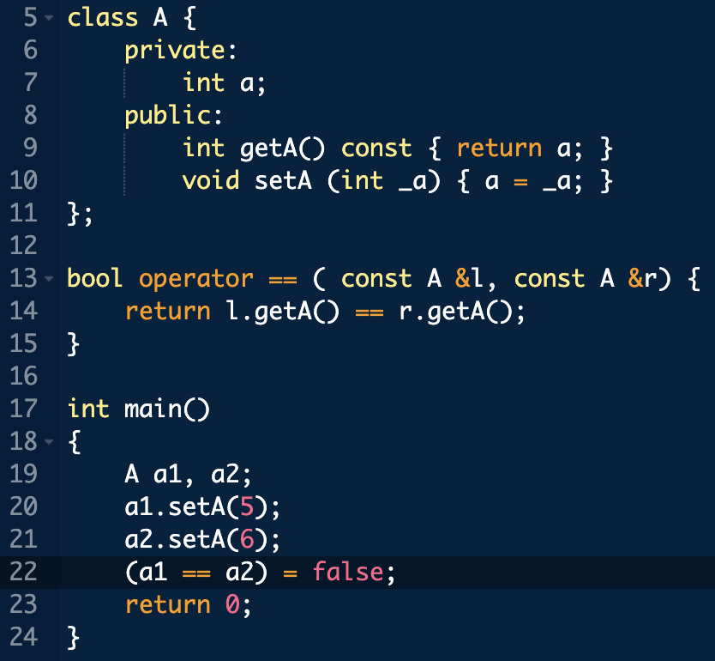
Notes:
Error, 因為 a1 == a2 return an anonymous variable 不能改成 false

Slide 14
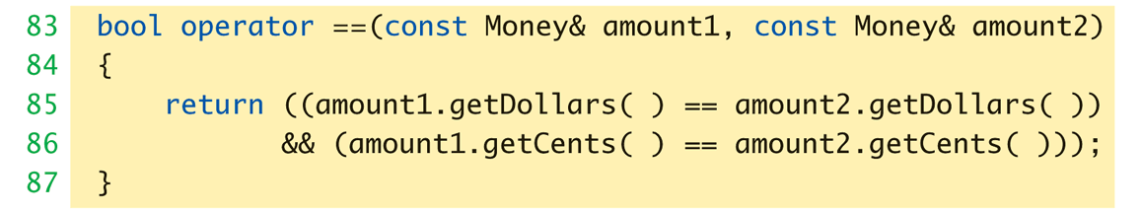
Overloaded "==" for Money: Display 8.1 Operator Overloading
Definition of "==" operator for Money class:

Slide 15
Returning by const Value
Consider "+" operator overload again: const Money operator +( const Money& amount1, const Money& amount2);
Returns a "constant object"?
Why?
Consider impact of returning "non-const" object to see… → (next page)

Slide 16
Returning by non-const Value
Consider "no const" in declaration: Money operator +( const Money& amount1, const Money& amount2);
Consider expression that calls: m1 + m2
Where m1 & m2 are Money objects
Object returned is Money object
We can "do things" with objects!
Like call member functions…

Slide 17
What to do with Non-const Object
Can call member functions:
We could invoke member functions on object returned by expression m1+m2:
(m1+m2).output(); //Legal, right?
Not a problem: doesn’t change anything
(m1+m2).input(); //Legal!
PROBLEM! //Legal, but MODIFIES!
Allows modification of "anonymous" object!
Can’t allow that here!
Prevent users from storing valuable information in an object that will most likely be lost ➔ So define the return object as const

Slide 19
Overloading Unary Operators
C++ has unary operators:
Defined as taking one operand
e.g., - (negation)
x = -y; // Sets x equal to negative of y
Other unary operators:
++, --
Unary operators can also be overloaded

Slide 20
Overload "-" for Money
Overloaded "-" function declaration
Placed outside class definition: const Money operator –(const Money& amount);
Notice: only one argument
Since only 1 operand (unary)
"-" operator is overloaded twice!
For two operands/arguments (binary)
For one operand/argument (unary)
Definitions must exist for both

Slide 21
Overloaded "-" Definition
Overloaded "-" function definition: const Money operator –(const Money& amount) { return Money(-amount.getDollars(), -amount.getCents()); }
Applies "-" unary operator to built-in type
Operation is "known" for built-in types
Returns anonymous object again

Slide 22
Overloaded "-" Usage
Consider: Money amount1(10), amount2(6), amount3; amount3 = amount1 – amount2;
Calls binary "-" overload
amount3.output(); //Displays $4.00 amount3 = -amount1;
Calls unary "-" overload
amount3.output() //Displays -$10.00

Slide 24
Overloading as Member Functions
Previous examples: standalone functions
Defined outside a class
Can overload as "member operator"
Considered "member function" like others
When operator is member function:
Only ONE parameter, not two! (for a binary operator)
Calling object serves as 1st parameter
Notes:
Call function 的那個是 first parameter，這很直覺，跟我們當初要做封裝是一樣概念

Slide 25
Member Operator in Action
Money cost(1, 50), tax(0, 15), total; total = cost + tax;
If "+" overloaded as member operator:
Variable/object cost is calling object
Object tax is single argument
Think of as: total = cost.+(tax);
Declaration of "+" in class definition:
const Money operator +(const Money& amount);
Notice only ONE argument
To define “+”: const Money Money::operator +(const Money& amount)

Slide 26
Member Operator in Action
But!
const Money operator +(const Money& amount);
It does not protect the calling object
Use
const Money operator +(const Money& amount) const;

Slide 27
const Functions
When to make function const?
Constant functions not allowed to alter class member data
Constant objects can ONLY call constant member functions
Good style dictates:
Any member function that will NOT modify data should be made const
Use keyword const after function declaration and heading in class definition
int function(obj & a, obj & b) const;
Notes:
const 加在 function 名稱後面，表示這個 function 部會改到這個 object 底下的 variable，但是別的 object 可以，同時也不能呼叫非 const 的 member function

Slide 28
Overloading Operators: Which Method? Non-member vs Member
Object-Oriented-Programming
Principles suggest member operators
Many agree, to maintain "spirit" of OOP
Member operators more efficient
No need to call accessor & mutator functions
At least one significant disadvantage
(Later in chapter…)

Slide 30
Overloading Function Application ()
Function call operator, ( )
Must be overloaded as member function
Allows use of class object like a function
Can overload for all possible numbers of arguments
Example: void Aclass::operator () (int a) {…} Aclass anObject; anObject(42);
If ( ) overloaded → calls overload

Slide 31
Other Overloads
&&, ||, and comma operator
Predefined versions work for bool types
Recall: use "short-circuit evaluation"
When overloaded no longer uses short-circuit
Uses "complete evaluation" instead
Contrary to expectations
Generally should not overload these operators

Slide 33
Pitfall: Automatic Type Conversion
class Money {int dollars; int cents;…};
Money baseAmount (100, 60), fullAmount;
fullAmount = baseAmount + 25;
If we have defined binary operator + and constructor Money (int theDollars)
25 will be automatically converted to an object of Money
Compiler uses Money(25) to generate such an object
But how about the following one???
fullAmount = 25 + baseAmount;
Notes:
在function後面加上const字眼

Slide 34
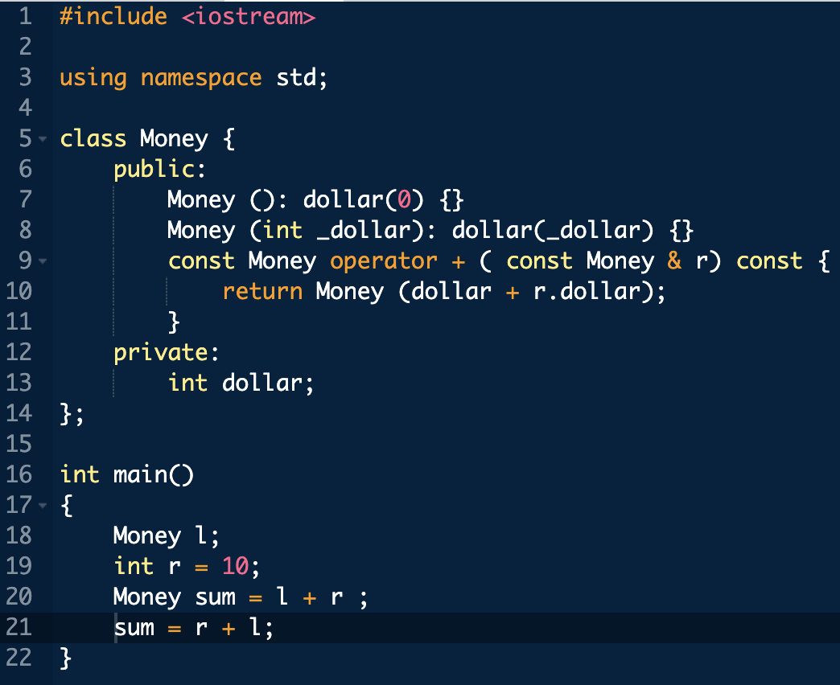
Notes:
sum = r + l ; 那行會錯

Slide 35
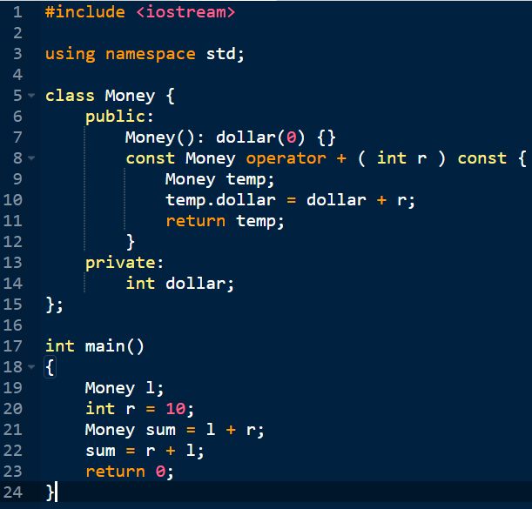
Notes:
sum = r + l ; 那行會錯

Slide 36
Friend Functions
Nonmember functions
Recall: operator overloads as nonmembers
They access data through accessor and mutator functions
Very inefficient (overhead of calls)
Friends can directly access private class data
No overhead, more efficient
So: best to make nonmember operator overloads friends!

Slide 37
Friend Functions
Friend function of a class
Not a member function
Has direct access to private members
Just as member functions do
Use keyword friend in front of function declaration
Specified IN class definition
But they’re NOT member functions!

Slide 38
Friend Function Uses
Operator Overloads
Most common use of friends
Improves efficiency
Avoids need to call accessor/mutator member functions
Operator must have access anyway
Might as well give full access as friend
Friends can be any function

Slide 39
Friend Function Purity
Friends not pure?
"Spirit" of OOP dictates all operators and functions be member functions
Many believe friends violate basic OOP principles
Advantageous?
For operators: very!
Allows automatic type conversion
Still encapsulates: friend is in class definition
Improves efficiency
Notes:
自動轉換
class myInt {int value;}; 假設有 constructor 是 myInt (int _a): value(_a) {} 和 operator + (const myInt &a)
Compiler 可以自動幫忙把 int 轉成 myInt (透過constrcutor)，就能使用 operator + 來把 myInt 和 int 加起來了

Slide 40
Automatic Type Conversion
class Money {int dollars; int cents;…
friend const Money operator+ (const Money &amount1,
const Money &amount2);
…};
Money baseAmount (100, 60), fullAmount;
fullAmount = baseAmount + 25;
fullAmount = 25 + baseAmount;
Now, 25 will be automatically converted to Money type
Note that two class can have the same friend function
Notes:
在function前面加上friend字眼，但注意define的時候，不用再放friend

Slide 41
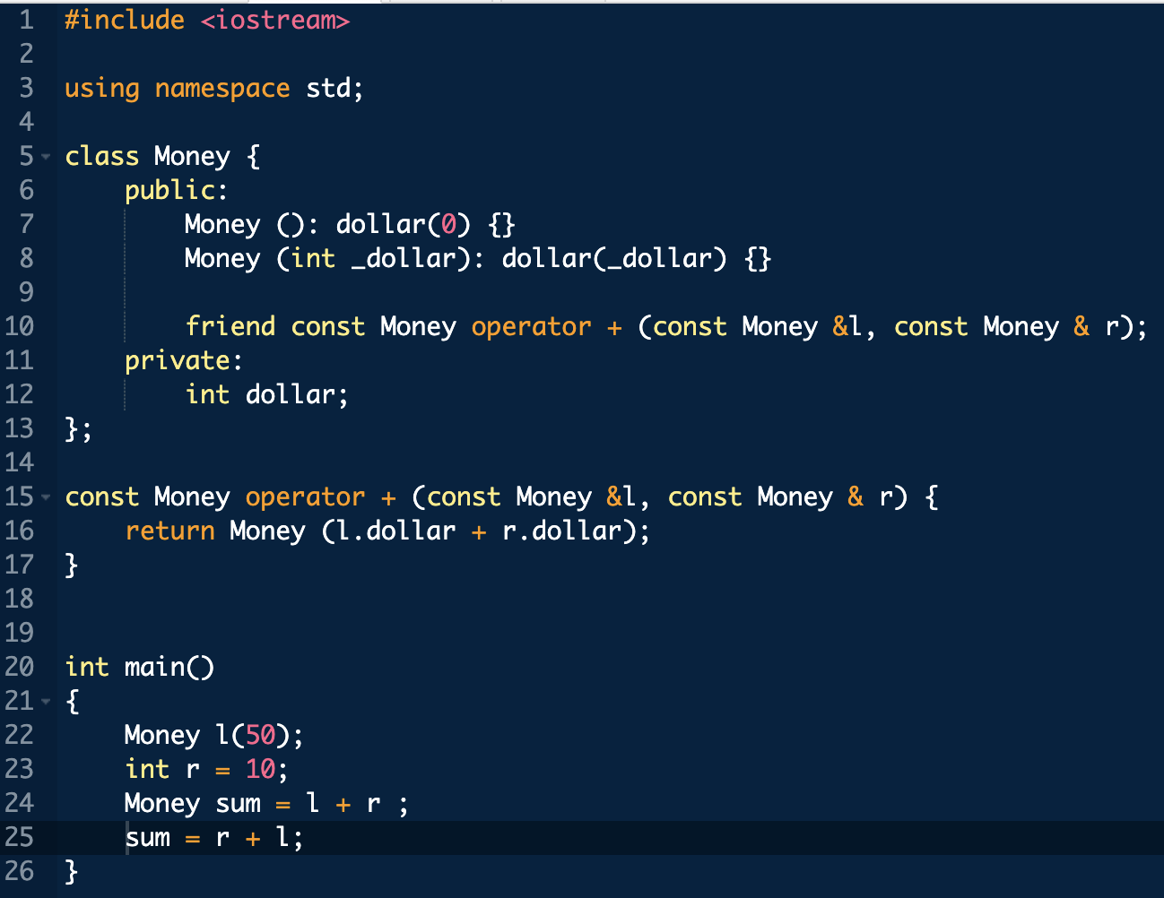

Slide 43
Friend Classes
Entire classes can be friends
Similar to function being friend to class
Example: class F is friend of class C
All class F member functions are friends of C
NOT reciprocated
Friendship granted, not taken
Syntax: friend class F
Goes inside class definition of "authorizing" class
i.e., friend class F inside the definition of class C
Notes:
Reciprocate (v) 互換

Slide 44
Friend Classes
friend class F inside the definition of class C
class F;
class C
{
public:
…
friend class F;
…
}
class F {…}
Notes:
Reciprocate (v) 互換

Slide 45
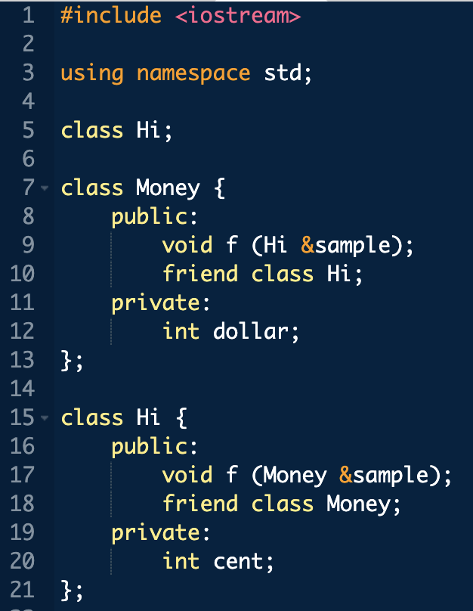
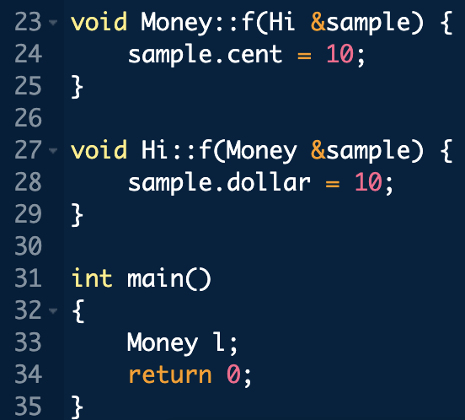
Notes:
Reciprocate (v) 互換

Slide 46
References (Alias)
Reference defined:
Name of a storage location
Similar to "pointer"
Example of stand alone reference:
int robert; int& bob = robert;
bob is reference to storage location for robert
Changes made to bob will affect robert
Confusing?
Notes:
別名，但是單獨用有點危險，通常我們不太這樣使用

Slide 47
References Usage
Seemingly dangerous
Useful in several cases:
Call-by-reference for parameters
Often used to implement this mechanism
Returning a reference
Allows operator overload implementations to be written more naturally
Think of as returning an "alias" to a variable
(Next page…)

Slide 48
Returning Reference
Syntax: double& sampleFunction(double& variable);
double& and double are different
Must match in function declaration and heading
Returned item must "have" a reference
Like a variable of that type
Cannot be expression like "x+5"
Has no place in memory to "refer to"
Notes:
你一定要「很小心」不要把 local variable 使用 reference 的方式 return 回來，像下面這個例子，有機會讓你的code發生segmentation fault int & f( int _a ){
int a = _a ;
return a;
}

Slide 49
Returning Reference in Definition
Example function definition: double& sampleFunction(double& variable) { return variable; } double m = 99; cout << sampleFunction(m) << endl; sampleFunction(m) = 42; cout << m << endl;
Trivial, useless example
Shows concept only
Major use:
Certain overloaded operators: e.g., [], cascading

Slide 50
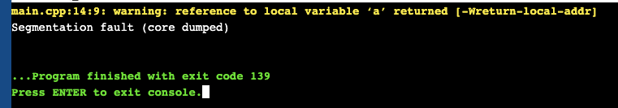
Returning Reference in Definition
#include <iostream>
using namespace std;
int & f( int _a ){
int a = _a ;
return a;
}
int main()
{
int a = 5, &b = f(a);
cout << b << endl;
return 0;
}

Slide 52
Overloading “<<“ and “>>”
Enables input and output of our objects (e.g., cout)
Similar to other operator overloads
New subtleties
Improves readability
Like all operator overloads do
Enables: cout << myObject; cin >> myObject;
Instead of need for: myObject.output(); …

Slide 53
Overloading <<
Insertion operator <<
Used with cout
A binary operator
Example: cout << "Hello";
Operator is <<
1st operand is predefined object cout
From library iostream
2nd operand is literal string "Hello"

Slide 54
Overloading <<
Operands of <<
cout object, of class type ostream
Our class type
Recall Money class
Used member function output()
Nicer if we can use << operator: Money amount(100); cout << "I have " << amount << endl; instead of: cout << "I have "; amount.output()

Slide 55
What does cout << amount return?
To obtain the answer, look at a more complicated example: Money amount(100); cout << "I have " << amount << endl;
Analogous to other operators such as + ((cout << "I have ”) << amount) << endl;
The first thing evaluated is (cout << "I have ”)
If things are to work out (cout << amount) << endl;
That is, it should return the first argument

Slide 56
Overloaded << Return Value
Money amount(100); cout << amount;
<< should return some value
To allow cascades: cout << "I have " << amount; (cout << "I have ") << amount;
Two are equivalent
What to return?
cout object!
cout is an object of type ostream
Returns its first argument type, ostream

Slide 57
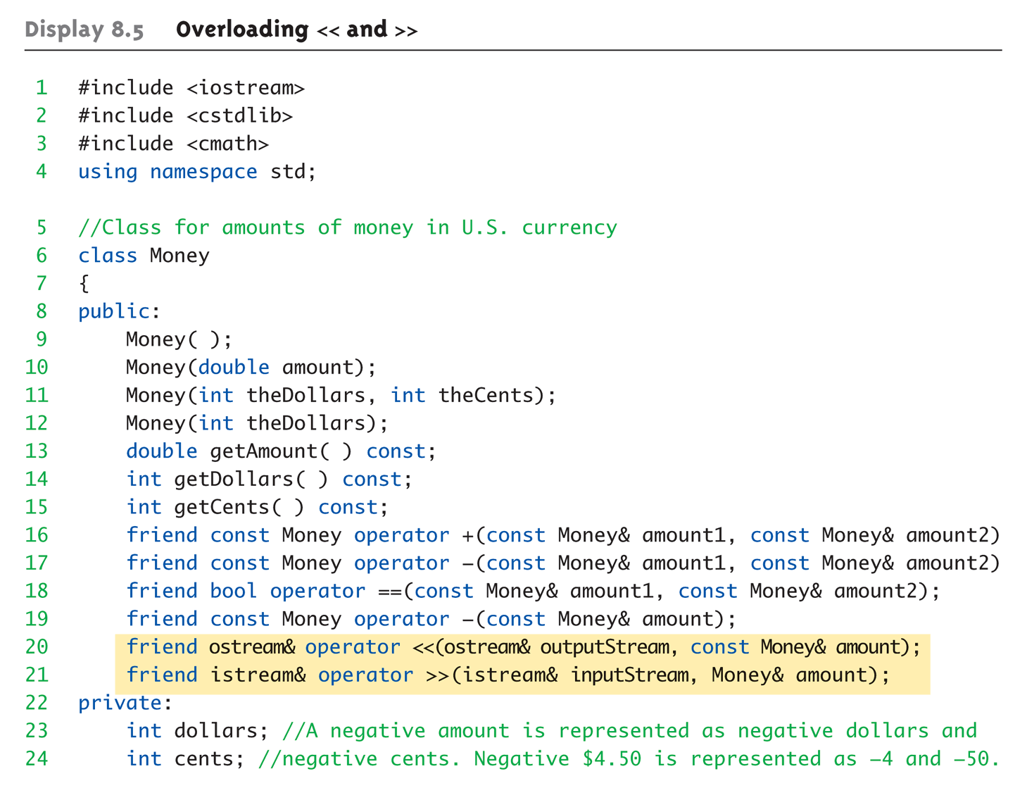
Overloaded Example: Display 8.5 Overloading << and >> (1 of 5)

Slide 58
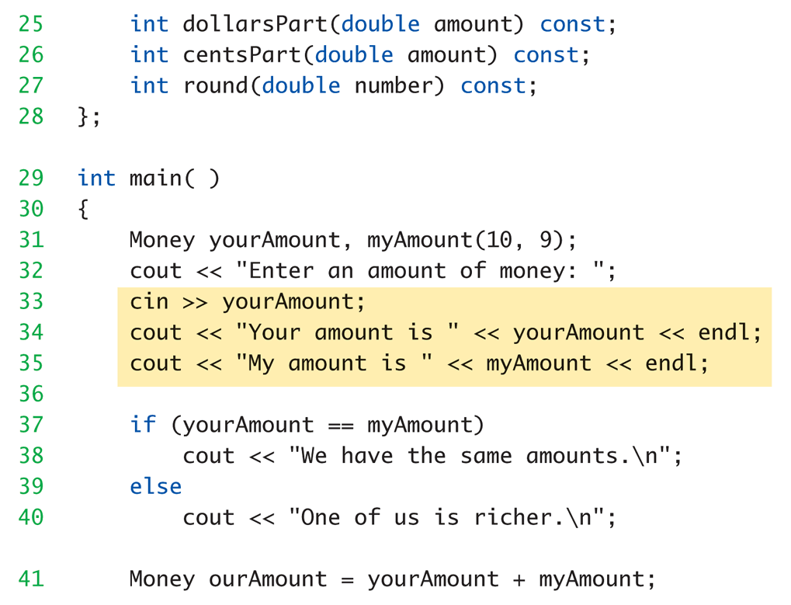
Overloaded Example: Display 8.5 Overloading << and >> (2 of 5)

Slide 59
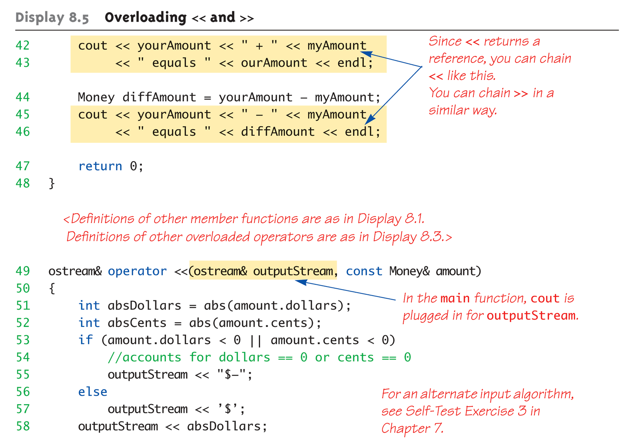
Overloaded Example: Display 8.5 Overloading << and >> (3 of 5)

Slide 60
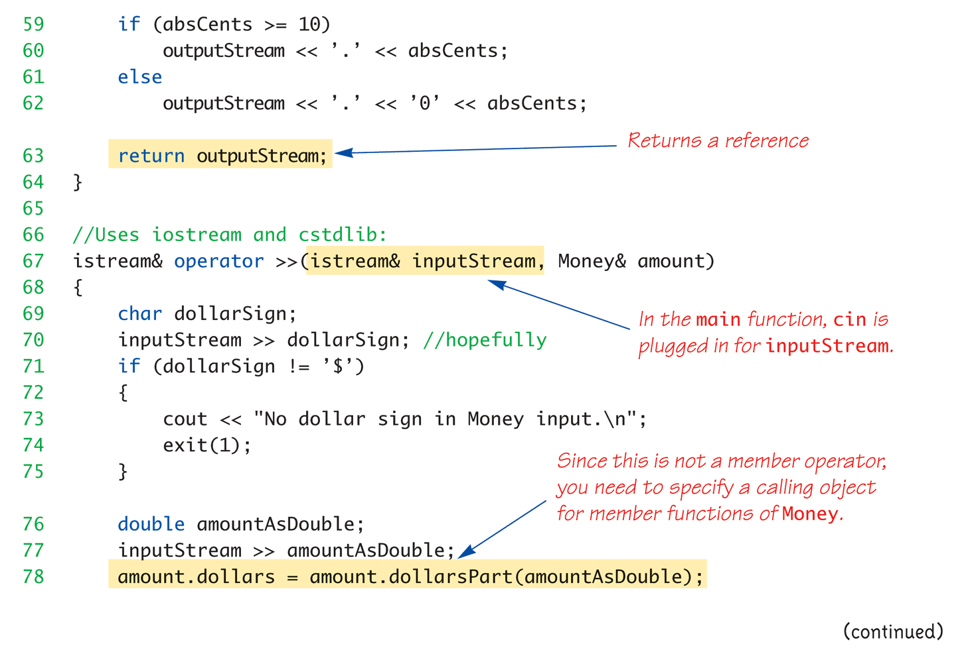
Overloaded Example: Display 8.5 Overloading << and >> (4 of 5)

Slide 61
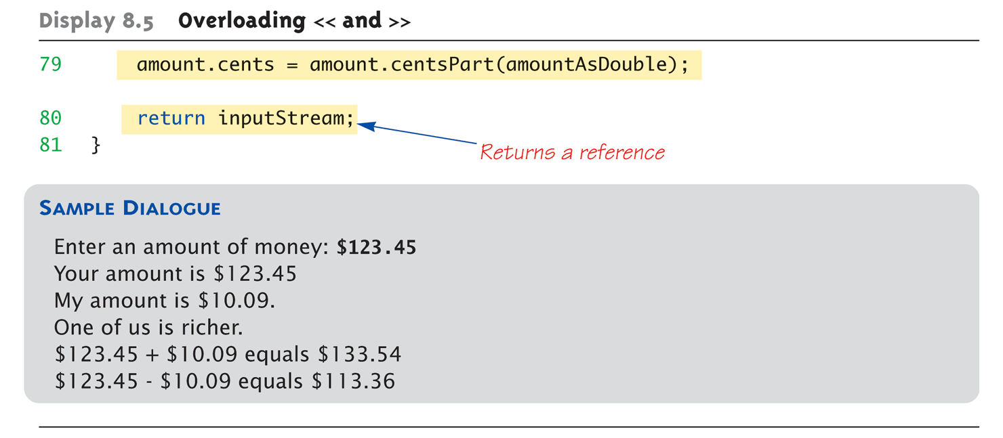
Overloaded Example: Display 8.5 Overloading << and >> (5 of 5)

Slide 63
Assignment Operator =
Must be overloaded as member operator
Automatically overloaded
Default assignment operator:
Member-wise copy
Member variables from one object → corresponding member variables from other
Default OK for simple classes
But with pointers → must write our own!
The reason is similar to that of copy-constructor

Slide 64
Increment and Decrement
Each operator has two versions
Prefix notation: ++x;
Postfix notation: x++;
Must distinguish in overload
Standard overload method → Prefix
Add 2nd parameter of type int → Postfix
Just a marker for compiler!
Specifies postfix is allowed

Slide 65
Increment and Decrement
Prefix notation: ++x; class IntPair{ int first; int second; public: … IntPair operator ++(); … } IntPair IntPair::operator ++(){ first ++; second ++; return IntPair(first, second); }

Slide 66
Increment and Decrement
Postfix notation: x++; class IntPair{ int first; int second; public: … IntPair operator ++(int ignoreMe); … } IntPair IntPair::operator ++(int ignoreMe){ int temp1 = first ++; int temp2 = second ++; return IntPair(temp1, temp2); }

Slide 67
Overload Array Operator [ ]
Can overload [ ] for your class
To be used with objects of your class
Operator must return a reference!
array[10] will be assigned to 5 if we write “array[10] = 5”
Operator [ ] must be a member function!

Slide 68
Overload Array Operator [ ]
Class CharPair{ public: … char & operator[] (int index); private: char first; char second; }; char & CharPair::operator[] (int index){ if (index == 1) return first; else if (index == 2) return second; cout << “error” << endl; exit(1); }
Notes:
回傳的時候是回傳原 first 和 second 的 reference，因此從外面使用 [ index ] 可以直接修改到 object 裡的 first 和 second
CharPair temp;
temp[1] = 'c';
temp[2] = 'd';

Slide 69
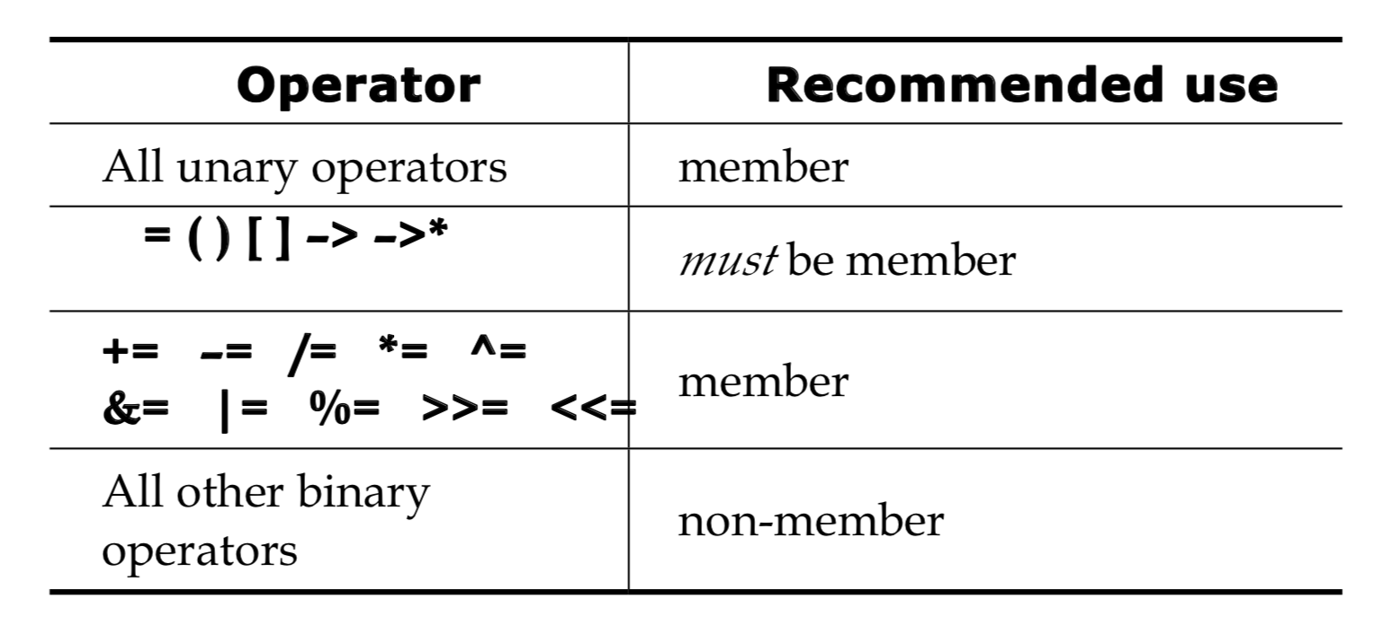
Basic Guidelines
For choosing between members and non-members
Mob Murray, C++ Strategies & Tactics, Addison-Wesley, 1993, page 47
Notes:
回傳的時候是回傳原 first 和 second 的 reference，因此從外面使用 [ index ] 可以直接修改到 object 裡的 first 和 second
CharPair temp;
temp[1] = 'c';
temp[2] = 'd';

Slide 70
Summary 1
C++ built-in operators can be overloaded
To work with objects of your class
Operators are really just functions
Friend functions have direct private member access
Operators can be overloaded as member functions
1st operand is calling object

Slide 71
Summary 2
Friend functions add efficiency only
Not required if sufficient accessors/mutators available
Reference "names" a variable with an alias
Can overload <<, >>
Return type is a reference to stream type

