Slide 1

Chapter 9
Strings
Copyright © 2017 Pearson Education, Ltd. All rights reserved.

Slide 2
Learning Objectives
An Array Type for Strings
C-Strings
Character Manipulation Tools
Character I/O
get, put member functions
putback, peek, ignore
Standard Class string
String processing

Slide 3
Introduction
Two string types:
C-strings
Array with base type char
End of string marked with null, ‘\0'
"Older" method inherited from C
String class
Uses basic_string <char> template
Specifically designed to operate with strings of single-byte characters

Slide 4
C-Strings
Array with base type char
One character per indexed variable
One extra character: "\0"
Called "null character"
End marker
We’ve used c-strings
Literal "Hello" stored as c-string

Slide 5
C-String Variable
Array of characters: char s[10];
Declares a c-string variable to hold up to 9 characters
+ one null character
Typically "partially-filled" array
Declare large enough to hold max-size string
Indicate end with null
Only difference from standard array:
Must contain null character

Slide 6
C-String Storage
A standard array: char s[10];
If s contains string "Hi Mom", stored as:

Slide 7
C-String Initialization
Can initialize c-string: char myMessage[20] = "Hi there.";
Needn’t fill entire array
Initialization places "\0" at end
Can omit array-size: char shortString[] = "abc";
Automatically makes size one more than length of quoted string
NOT same as: char shortString[] = {‘a’, ‘b’, ‘c’};
Notes:
因為沒有\0，所以不一樣

Slide 8
C-String Indexes
A c-string IS an array
Can access indexed variables of: char ourString[5] = "Hi";
ourString[0] is "H"
ourString[1] is "i"
ourString[2] is "\0"
ourString[3] is unknown
ourString[4] is unknown

Slide 9
C-String Index Manipulation
Can manipulate indexed variables char happyString[7] = "DoBeDo"; happyString[6] = ‘Z’;
Be careful!
Here, ‘\0’ (null) was overwritten by a ‘Z’!
If null overwritten, c-string no longer "acts" like c-string!
Unpredictable results!

Slide 10
Library
Declaring c-strings
Requires no C++ library
Built into standard C++
Manipulations
Require library <cstring>
Typically included when using c-strings
Normally want to do "fun" things with them

Slide 11
= and == with C-strings
C-strings not like other variables
Cannot assign or compare: char aString[10]; aString = "Hello"; // ILLEGAL!
Can ONLY use "=" at declaration of c-string! Only for initialization
Must use library function for assignment: strcpy(aString, "Hello");
Built-in function (in <cstring>)
Sets value of aString equal to "Hello"
NO checks for size!
Up to programmer, just like other arrays!

Slide 12
Comparing C-strings
Also cannot use operator == char aString[10] = "Hello"; char anotherString[10] = "Goodbye";
aString == anotherString; // incorrect result, but no error msg!
Must use library function again: if (strcmp(aString, anotherString)) cout << "Strings NOT same."; else cout << "Strings are same.";
Notes:
比對numeric encoding，如果都相同就會是0，如果比到一個位置不一樣了，回傳 positive 則表示 aString 比 anotherString 在那個位置上的 encoding，aString 的數值比較大，反之則比較小。

Slide 13
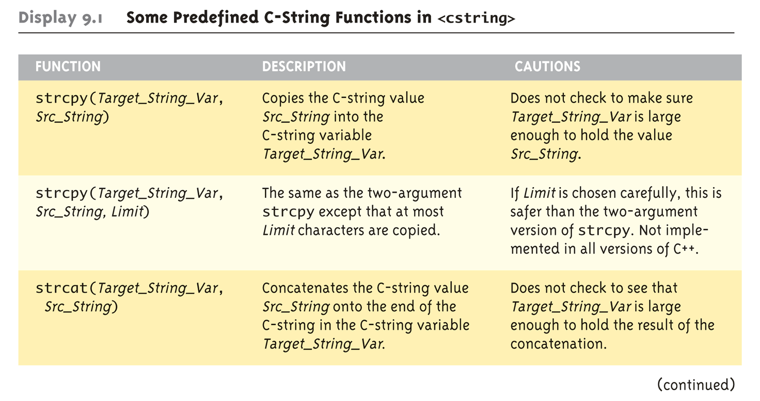

The <cstring> Library: Display 9.1 Some Predefined C-String Functions in <cstring> (1 of 2)
Full of string manipulation functions
strncpy

Slide 14
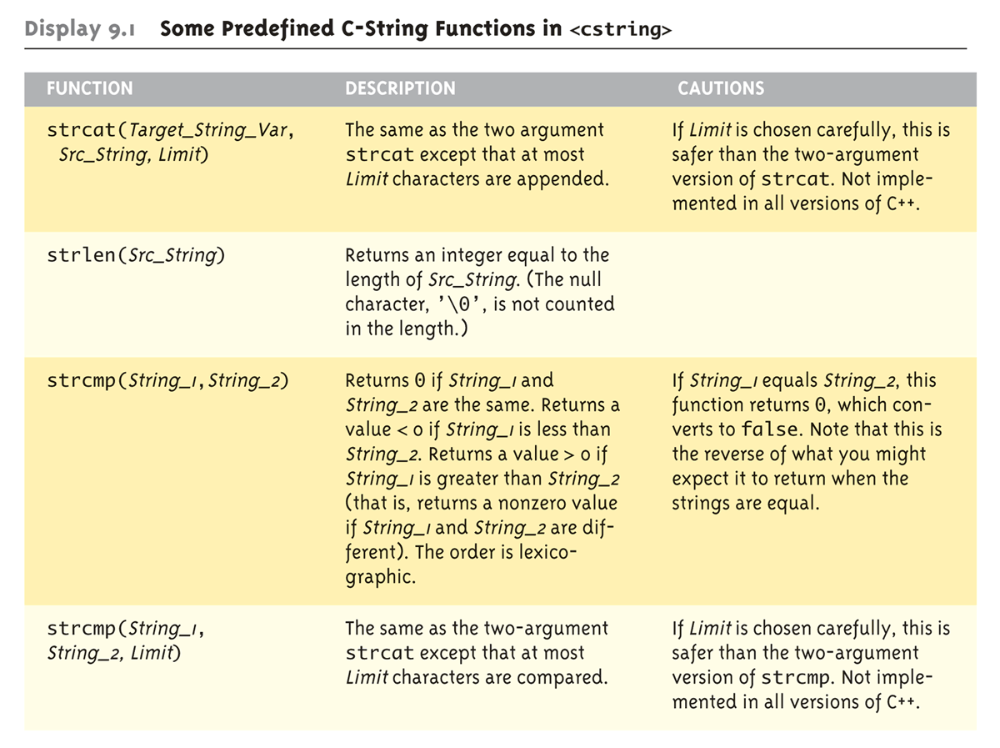

The <cstring> Library: Display 9.1 Some Predefined C-String Functions in <cstring> (2 of 2)
strncat
strncmp

Slide 15
C-string Functions: strlen()
"String length"
Often useful to know string length: char myString[10] = "dobedo"; cout << strlen(myString);
Returns number of characters
Not including null
Result here: 6

Slide 16
C-string Functions: strcat()
strcat()
"String concatenate": char stringVar[20] = "The rain"; strcat(stringVar, "in Spain");
Note result: stringVar now contains "The rainin Spain"
Be careful!
Incorporate spaces as needed!

Slide 17
C-string Arguments and Parameters
Recall: c-string is array
So c-string parameter is array parameter
C-strings passed to functions can be changed by receiving function!
Like all arrays, typical to send size as well
Function "could" also use "\0" to find end
So size not necessary if function won’t change c-string parameter
Use "const" modifier to protect c-string arguments

Slide 18
C-String Output
Can output with insertion operator <<
As we’ve been doing already: cout << news << " Wow.\n";
Where news is a c-string variable
Possible because << operator is overloaded for c-strings!

Slide 19
C-String Input
Can input with extraction operator >>
Issues exist, however
Whitespace is "delimiter"
Tab, space, line breaks are "skipped"
Input reading "stops" at delimiter
Watch size of c-string
Must be large enough to hold entered string!
C++ gives no warnings of such issues!
Notes:
用空格分開數字

Slide 20
C-String Input Example
char a[80], b[80]; cout << "Enter input: "; cin >> a >> b; cout << a << b << "END OF OUTPUT\n";
Dialogue offered: Enter input: Do be do to you! DobeEND OF OUTPUT
Note: Underlined portion typed at keyboard
C-string a receives: "do"
C-string b receives: "be"

Slide 21
C-String Line Input
Can receive entire line into c-string
Use getline(), a predefined member function: char a[80]; cout << "Enter input: "; cin.getline(a, 80); cout << a << "END OF OUTPUT\n";
Dialogue: Enter input: Do be do to you! Do be do to you!END OF INPUT

Slide 23
Example: Command Line Arguments
Programs invoked from the command line (e.g. a UNIX shell, DOS command prompt) can receive arguments (i.e., input parameters)
Example: COPY C:\FOO.TXT D:\FOO2.TXT
This runs the program named “COPY” and sends in two C-String parameters, “C:\FOO.TXT” and “D:\FOO2.TXT”
It is up to the COPY program to process the inputs presented to it; i.e. actually copy the files
Arguments are passed as an array of C-Strings to the main function

Slide 24
Example: Command Line Arguments
Header for main
int main(int argc, char *argv[])
argc specifies how many arguments are supplied. The name of the program counts, so argc will be at least 1.
argv is an array of C-Strings.
argv[0] holds the name of the program that is invoked
argv[1] holds the name of the first parameter
argv[2] holds the name of the second parameter
Etc.

Slide 25
Example: Command Line Arguments
// Echo back the input arguments
int main(int argc, char *argv[])
{
for (int i=0; i<argc; i++)
{
cout << "Argument " << i << " " << argv[i] << endl;
}
return 0;
}
Sample Execution
> Test hello world
Argument 0 Test
Argument 1 hello
Argument 2 world
Sample Execution
> Test
Argument 0 Test
Invoking Test
from command
prompt

Slide 26
More getline()
Can explicitly tell length to receive: char shortString[5]; cout << "Enter input: "; cin.getline(shortString, 5); cout << shortString << "END OF OUTPUT\n";
Results: Enter input: dobedowap dobeEND OF OUTPUT
Forces FOUR characters only be read
Recall need for null character!

Slide 27
Character I/O
Input and output data
ALL treated as character data
e.g., number 10 outputted as ‘1’ and ‘0’
Conversion done automatically
Uses low-level utilities
Can also use same low-level utilities ourselves
Read and write int values in Roman numeral notation

Slide 28
Member Function get()
Reads one char at a time
Member function of cin object: char nextSymbol; cin.get(nextSymbol);
Reads next char & puts in variable nextSymbol
Argument must be char type
Not "string"!

Slide 29
Member Function put()
Outputs one character at a time
Member function of cout object:
Examples: cout.put(‘a’);
Outputs letter ‘a’ to screen
char myString[10] = "Hello"; cout.put(myString[1]);
Outputs letter "e" to screen

Slide 30
More Member Functions
putback()
Once read, might need to "put back"
cin.putback(lastChar); //put the char back to the stream
peek()
Returns next char, but leaves it there
peekChar = cin.peek();
ignore()
Skip input, up to designated character
cin.ignore(1000, "\n");
Skips at most 1000 characters until "\n"
Notes:
把char放回cin，偷看一個char，忽略x個char直到遇到\n

Slide 31
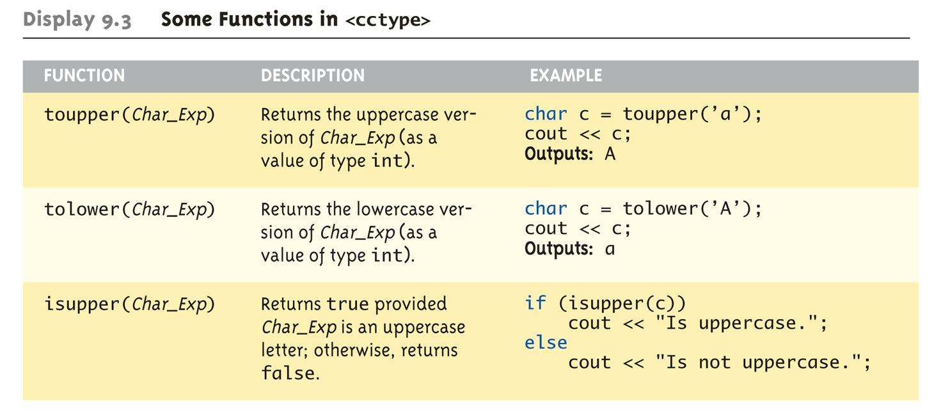
Character-Manipulating Functions: Display 9.3 Some Functions in <cctype> (1 of 3)

Slide 32
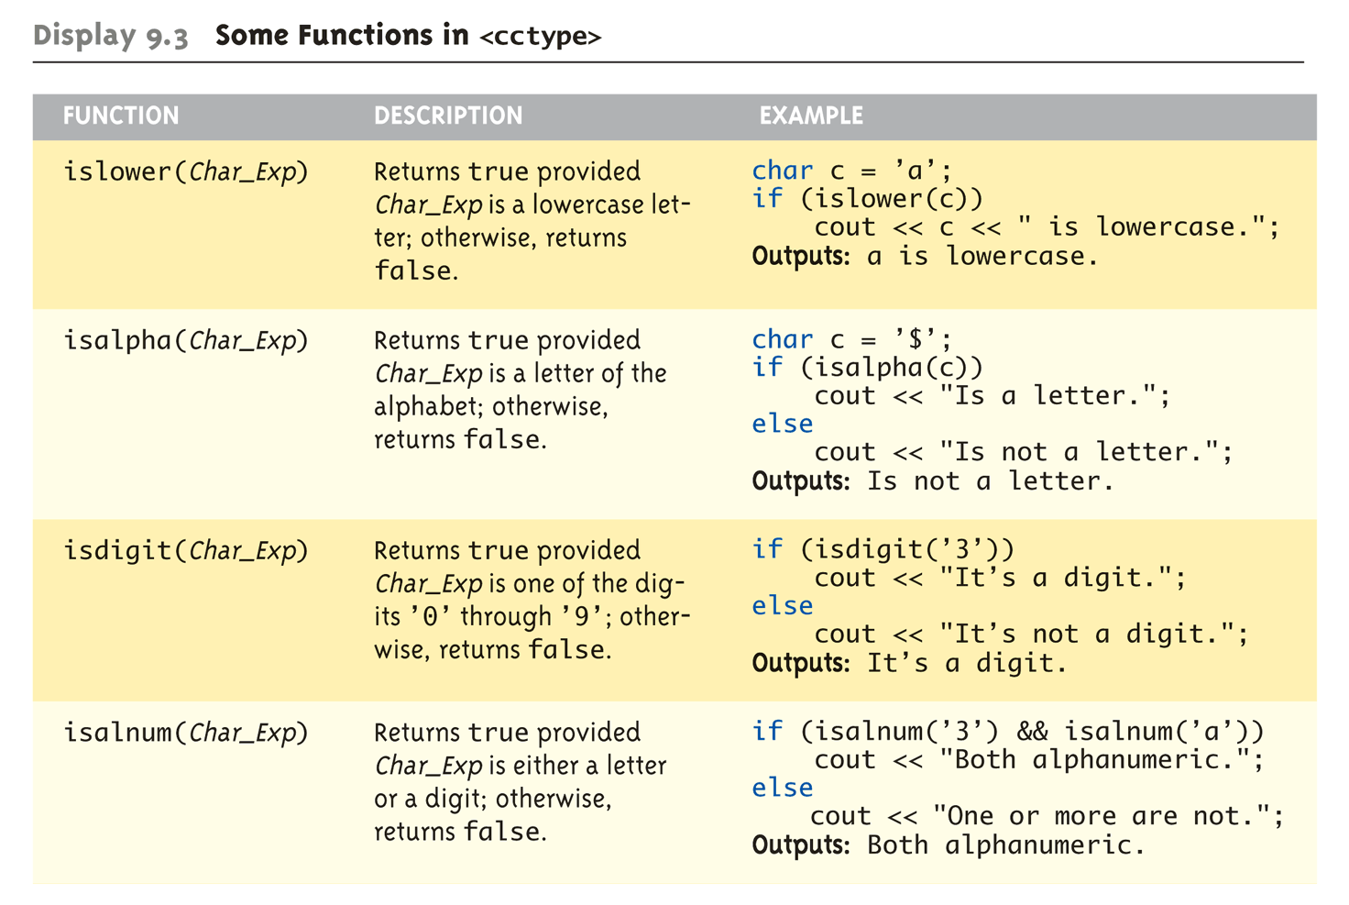
Character-Manipulating Functions: Display 9.3 Some Functions in <cctype> (2 of 3)

Slide 33
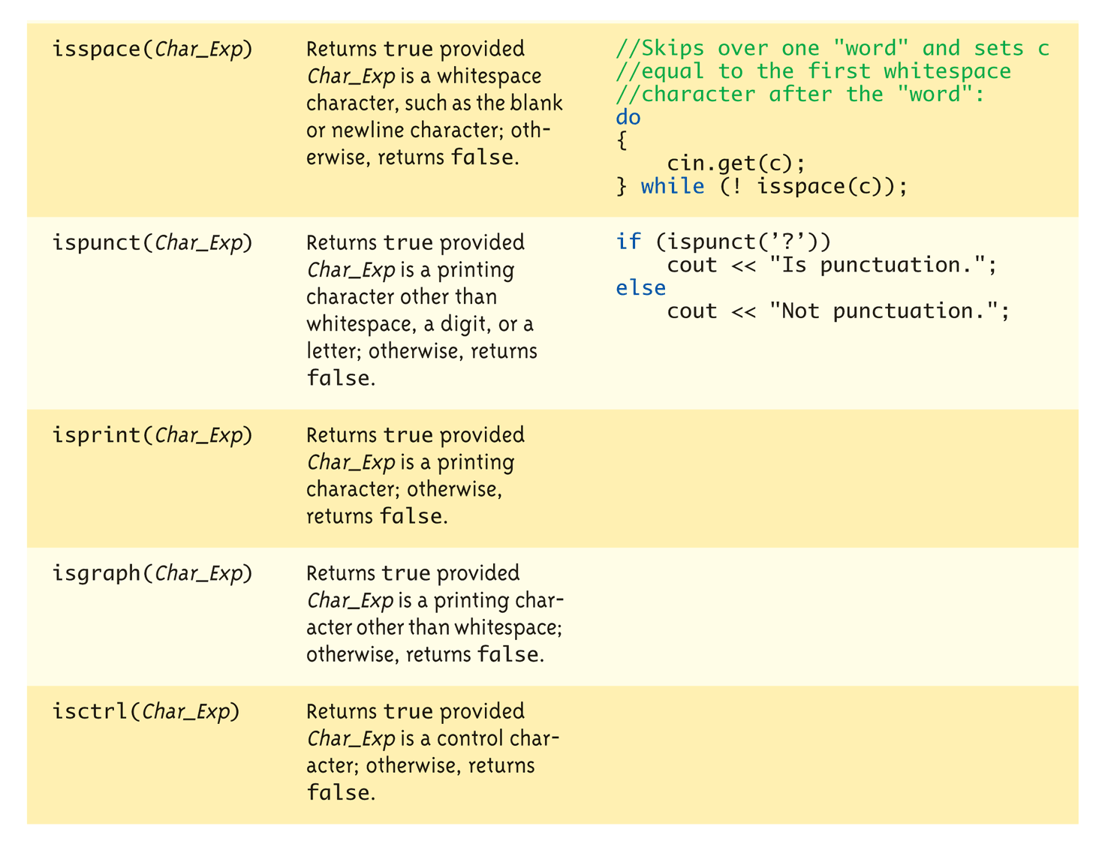
Character-Manipulating Functions: Display 9.3 Some Functions in <cctype> (3 of 3)

Slide 35
Standard Class string
Defined in library: #include <string> using namespace std;
String variables and expressions
Treated much like simple types
Can assign, compare, add: string s1, s2, s3; s3 = s1 + s2; //Concatenation s3 = "Hello Mom!" //Assignment
Note c-string "Hello Mom!" automatically converted to string type!
Notes:
Operator overloading 的 + 和 = 都定義好了

Slide 36
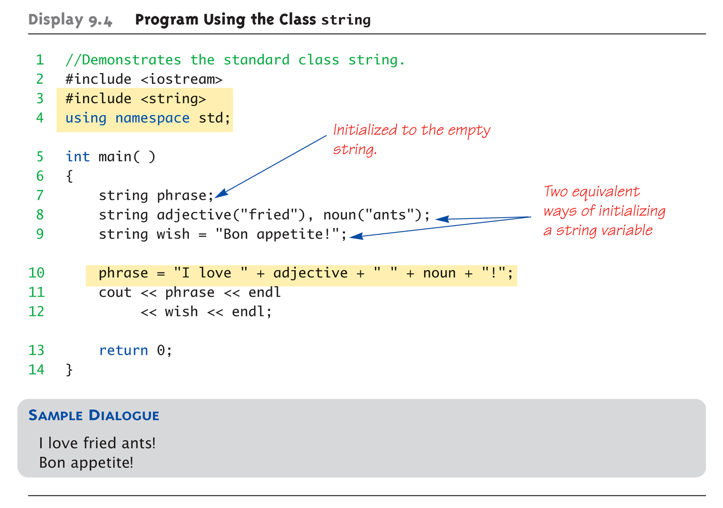
Display 9.4 Program Using the Class string

Slide 37
I/O with Class string
Just like other types!
string s1, s2; cin >> s1; cin >> s2;
Results: User types in: May the hair on your toes grow long and curly!
Extraction still ignores whitespace: s1 receives value "May" s2 receives value "the"
Notes:
他已經幫你寫好 operator overloading >> 所以可以配合 cin cout，注意對他來說空白是切斷

Slide 38
getline() with Class string
For complete lines: string line; cout << "Enter a line of input: "; getline(cin, line); cout << line << "END OF OUTPUT";
Dialogue produced: Enter a line of input: Do be do to you! Do be do to you!END OF INPUT
Similar to c-string’s usage of getline()
Is it a member function?
Notes:
getline 是一個 function 可以接 string，可參見 http://www.cplusplus.com/reference/string/string/getline/
同時 istream (such as cin) 有一個 getline 是 member function 用來接 char *，參見 http://www.cplusplus.com/reference/istream/istream/getline/

Slide 39
Other getline() Versions
Can specify "delimiter" character: string line; cout << "Enter input: "; getline(cin, line, "?");
Receives input until "?" encountered
getline() actually returns reference
string s1, s2; getline(cin, s1) >> s2;
Results in: (cin) >> s2;

Slide 40
Pitfall: Mixing Input Methods
Be careful mixing cin >> var and getline
int n; string line; cin >> n; getline(cin, line);
If input is: 42 Hello hitchhiker.
Variable n set to 42
line set to empty string!
cin >> n skipped leading whitespace, leaving "\n" on stream for getline()!
You can use cin.ignore (1000, '\n’);
Notes:
Read and discard the entire rest of the line up to and including the '\n’
Or until it dicards 1000 characters if it does not find the end of the line after 1000 characters

Slide 41
Class string Processing
Same operations available as c-strings
And more!
Over 100 members of standard string class
Some member functions:
.length()
Returns length of string variable
.at(i)
Returns reference to char at position i

Slide 42
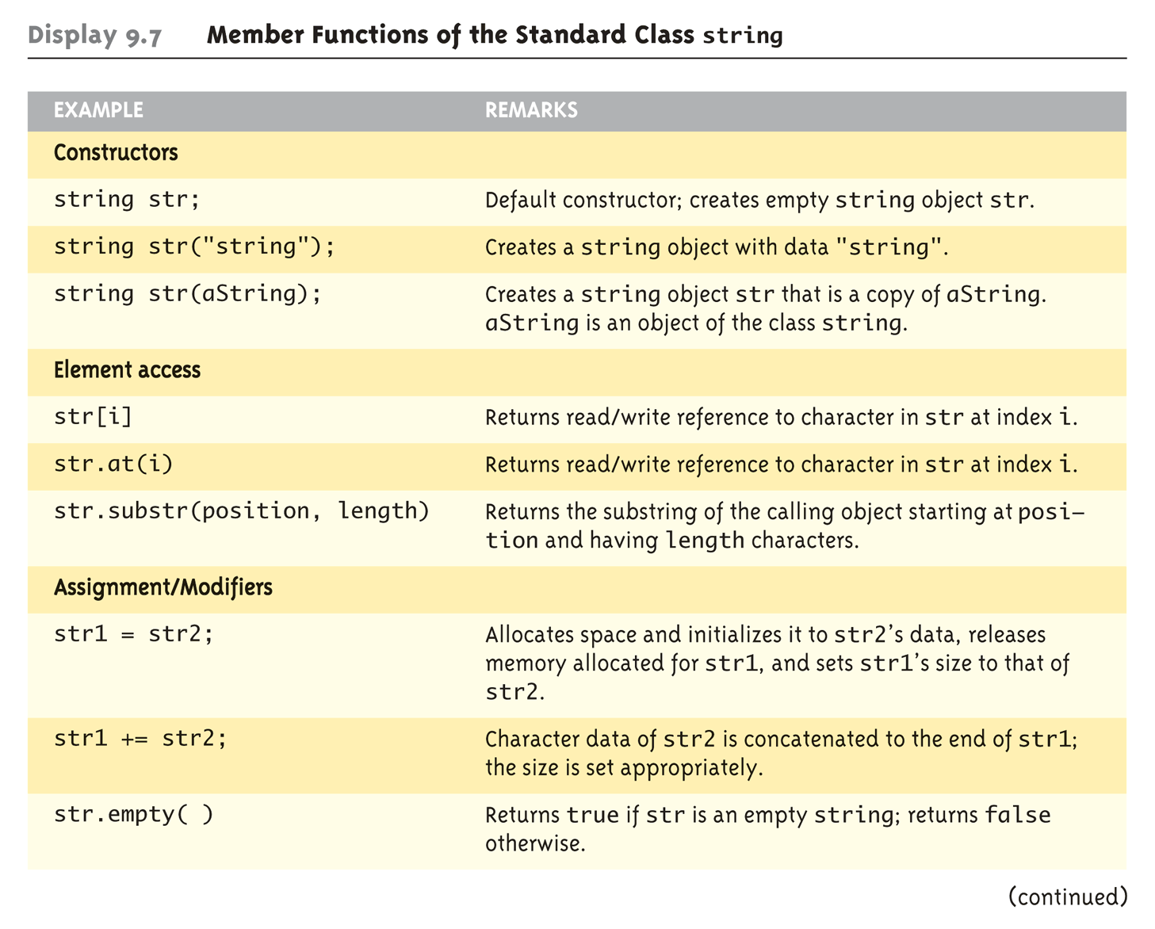
Display 9.7 Member Functions of the Standard Class string (1 of 2)

Slide 43
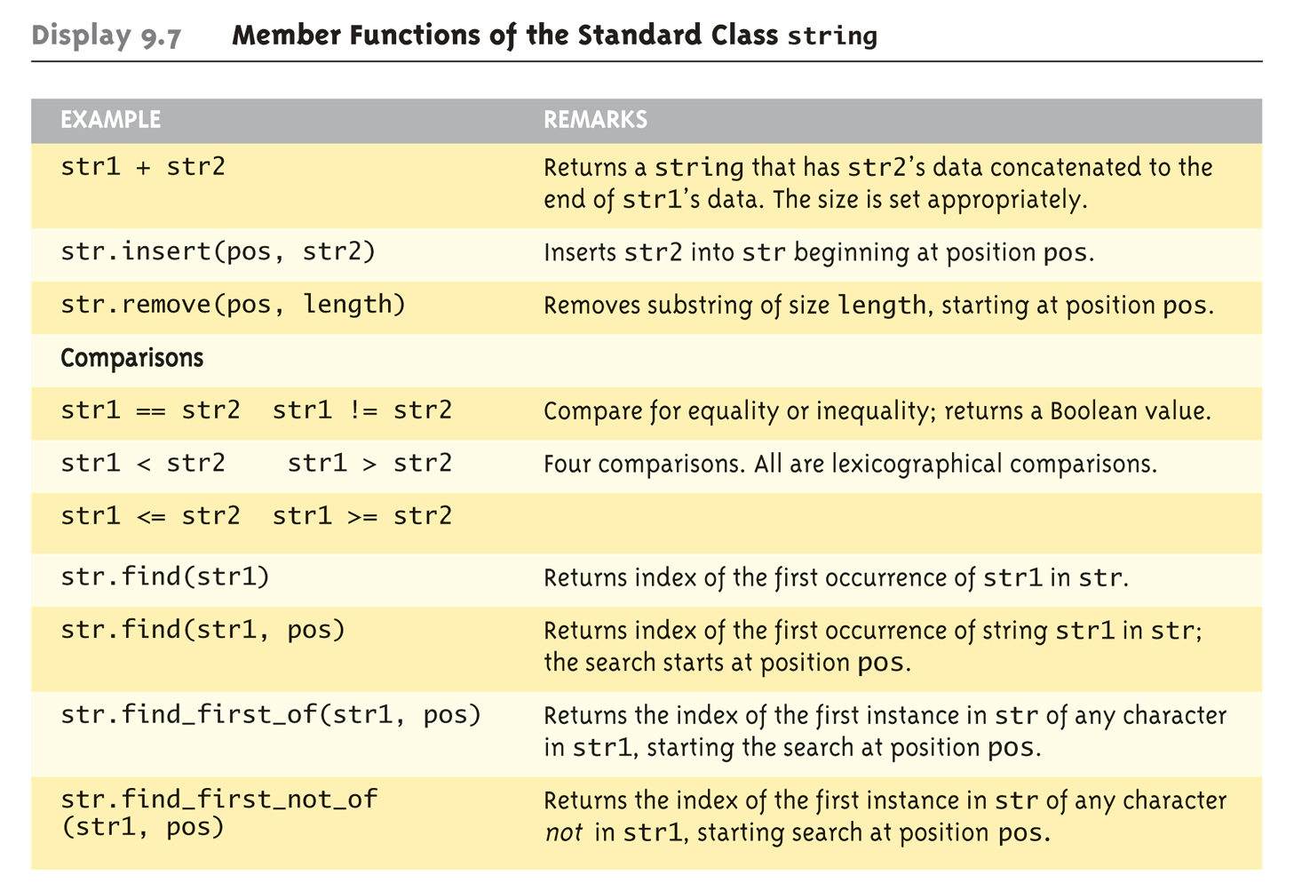
Display 9.7 Member Functions of the Standard Class string (2 of 2)

Slide 44
C-string and string Object Conversions
Automatic type conversions
From c-string to string object: char aCString[] = "My C-string"; string stringVar; stringVar = aCstring;
Perfectly legal and appropriate!
aCString = stringVar;
ILLEGAL!
Cannot auto-convert to c-string
Must use explicit conversion: strcpy(aCString, stringVar.c_str()); (using strncpy is better)
Notes:
最好使用strncpy

Slide 45
Converting between string and numbers
In C++11 it is simply a matter of calling stof, stod, stoi, or stol to convert a string to a float, double, int, or long, respectively.
int i; double d; i = stoi("35"); // Converts the string "35" to an integer 35 d = stod("2.5"); // Converts the string "2.5" to the double 2.5

Slide 46
Converting between numbers and string objects
In C++11 use to_string to convert a numeric type to a string
double d = 2.5;
string s;
s = to_string(d); // Converts the double 5.0 to a
// string "5.0000"

Slide 47
Summary
C-string variable is "array of characters"
With addition of null character, "\0"
C-strings act like arrays
Cannot assign, compare like simple variables
Libraries <cctype> & <string> have useful manipulating functions
cin.get() reads next single character
getline() versions allow full line reading
Class string objects are better-behaved than c-strings

