Slide 1
Object-Oriented Programming
Programming Project #1
郭建志

Slide 2
Background
Large-scale geographic routing
Every node only has the local information (i.e., its neighbors’ information) and the destination’s information
destination
source

Slide 3
Background
Large-scale geographic routing
Every node only has the local information (i.e., its neighbors’ information) and the destination’s information
So, how should a source route a packet to a specific destination?
destination
source

Slide 4
Naïve Routing Scheme: Greedy
Forward the packet towards the neighboring node that is closer to the destination
destination
source

Slide 5
Naïve Routing Scheme: Greedy
Forward the packet towards the neighboring node that is closer to the destination
However, the packet may be stuck at the dead end
(Out of the scope of this homework)
dead end
destination
source

Slide 6
Note
Every node only knows its neighbors
Define you own node class
(i.e., just use class instead of struct)
Each node public stores it location
Use an dynamic array of vector<node> to store the neighbors in each node
You can regard it as an array
Notes:
在這個圖中，每個點每個點只有自己的 neighbor 資訊，且必須各自決定哪些 edge 應該要砍掉，哪些 edge 應該要留著
vector<node> vector 裡面要求要存的東西是 node。實際上要存哪一種type都可以，它很好用

Slide 7
Programming Project #1: Greedy Routing
Input:
Number of nodes
Nodes with non-negative coordinates (x, y) (the input graph is connected after adding links)
Source-destination pairs
Procedure:
Add a link between any two nodes u, v if dist(u,v) ≤ 1
Get the path of greedy routing for each pair
Output:
The routing paths for each pair

Slide 8
Note
Each node can send and receive the packet to and from others
Define your own packet class to privately store
the locations of the source and destination
the last hop and next hop
Use a queue<packet> to store the packet in each node
Write a member function “checkQueue ()”
Check whether the queue is empty
If not, pop the packet in the queue (use pop_front) to receive the packet
If the next hop is me, use getNextHop() to update the last hop and next hop, and then use send to forward the packet
If the next hop is not me, drop the packet
Write a function “getNextHop ()”
Use greedy routing to compute the next hop node; return nullptr (i.e., NULL) if no next hop
Write a function “send ()”
Push the packet back to all neighbors’ queue (use push_back)
Notes:
node getNextHop() 可以讓他回傳 pointer 或 node ID 皆可，要怎麼實作可以依當下你最適合的方式來處理，但必須要回傳一個下一步應該送往哪一個 node 的辨識資訊
封包裡面會存 source, destination, last hop, next hop, previous intersection point
其中，previous intersection point 就是上次遇到和 source-destination 間的直線之交叉點

Slide 9
Programming Project #1: Greedy Routing
Program sketch:
Read data and generate nodes
For each node, add its neighbor to its neighbor list (centralized)
Read data and get a source-destination pair
Generate a packet and initialize the packet (filling the columns of the source, destination, …)
Add the packet to the queue of the source
For each round, every node check its queue (i.e., checkQueue())
If the queue is not empty and the packet is mine, it uses Greedy Routing to get the next hop (i.e., getNextHop()), and then add the packet to all neighbors’ queues (i.e., send())
Otherwise, it drops the packet
Repeat get the next hop until the packet reaches the destination or getNextHop() return nullptr
Compute all the source-destination pair
Notes:
For each round, every node check its queue (i.e., checkQueue())
這個可以用 for loop 來執行，把每個節點都掃過，每個節點都檢查他的queue

Slide 10
Input Sample: node.txt
11
0 1.4142 1.1534
1 1.97 1.85
2 0.8823 1.3926
3 1.9996 1.9484
4 0.6301 1.9145
5 0.3329 1.1756
6 1.952 0.5866
7 1.8181 0.4043
8 0.4949 1.946
9 0.2079 1.4758
10 0.1364 1.4084
3
0 1
2 8
9 3

Slide 11
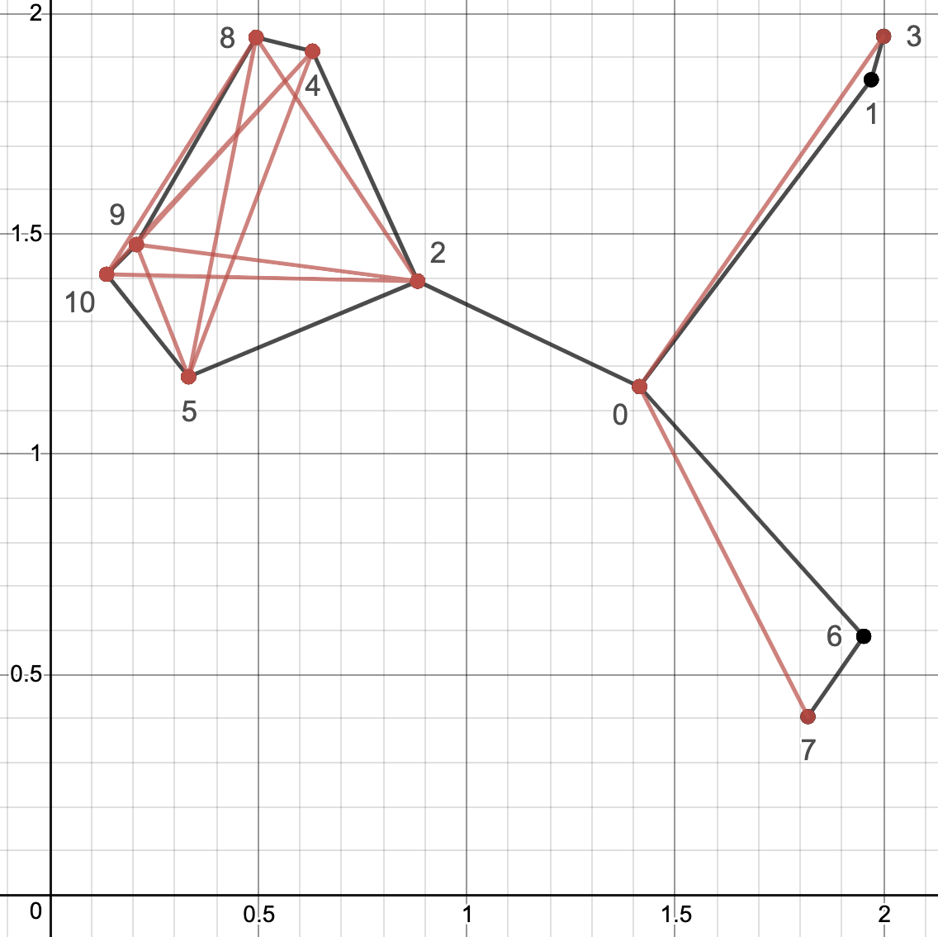
Output Sample:
3
0 1
2 8
9 2 0 3

Slide 12
Note
Deadline: 3/16 Tue (小老師) 3/23 Tue (所有同學)
E-course2
No stdio.h
Use iostream
C++ Source code

Slide 13
Remark
Know how to use vector and queue in C++
Use nullptr
Design your first class (i.e., node, packet)
Implement an easy routing algorithm

Slide 14
Further Reading
Routing with Guaranteed Delivery in Ad Hoc Wireless Networks, Wireless Networks 2001
On Delivery Guarantees of Face and Combined Greedy-Face Routing in Ad Hoc and Sensor Network, ACM MobiCom 2006
…
Long story

