Slide 1
Object-Oriented Programming
Programming Project #2
郭建志

Slide 2
Background
Large-scale geographic routing
Every node only has the local information (i.e., its neighbors’ information) and the destination’s information
destination
source

Slide 3
Background
Large-scale geographic routing
Every node only has the local information (i.e., its neighbors’ information) and the destination’s information
So, how should a source route a packet to a specific destination?
destination
source

Slide 4
Naïve Routing Scheme: Greedy
Forward the packet towards the neighboring node that is closer to the destination
destination
source

Slide 5
Naïve Routing Scheme: Greedy
Forward the packet towards the neighboring node that is closer to the destination
However, the packet may be stuck at the dead end
(Out of the scope of this homework)
dead end
destination
source

Slide 6
Programming Project #2: Greedy Routing (Distributed Computing)
Input:
Number of nodes
Nodes with non-negative coordinates (x, y) (the input graph is connected after adding links)
Source-destination pairs
Simulation duration
Procedure:
Add a link between any two nodes u, v if dist(u,v) ≤ 1
Compute the next hop by greedy routing for each node
Output:
All packets transmitted in the network (automatically generated by my code)

Slide 7
Note
Implement recv_handler in class GR_node void GR_node ::recv_handler (packet *p)
Use getHeader and getPaylod to access more packet information header *GR_packet::getHeader () payload *GR_packet::getPayload ()
Employ send_handler in class node to send the packet void node::send_handler (packet *p)
Each node privately stores phy_neighbors (i.e., neighbor list) and you can access it by getPhyNeighbors const map<unsigned int, bool> & getPhyNeighbors()
The implementation must be distributed You are not allowed to access the neighbor list of the other node directly

Slide 8
Programming Project #2: Greedy Routing (Distributed Computing)
Program sketch:
Read input by cin and generate nodes
For each node, add its neighbor to its neighbor list (centralized)
Read input by cin and get a source-destination pair
Generate a packet and initialize the packet (filling the columns of the source, destination, …)
Add the packet to the source node by add_initial_event
Implement: once a node receives a packet, the node computes the next hop and sends it to the next node

Slide 9
Input Sample: cin
11
0 1.4142 1.1534
1 1.97 1.85
2 0.8823 1.3926
3 1.9996 1.9484
4 0.6301 1.9145
5 0.3329 1.1756
6 1.952 0.5866
7 1.8181 0.4043
8 0.4949 1.946
9 0.2079 1.4758
10 0.1364 1.4084
3
0 1
2 8
9 3

Slide 10
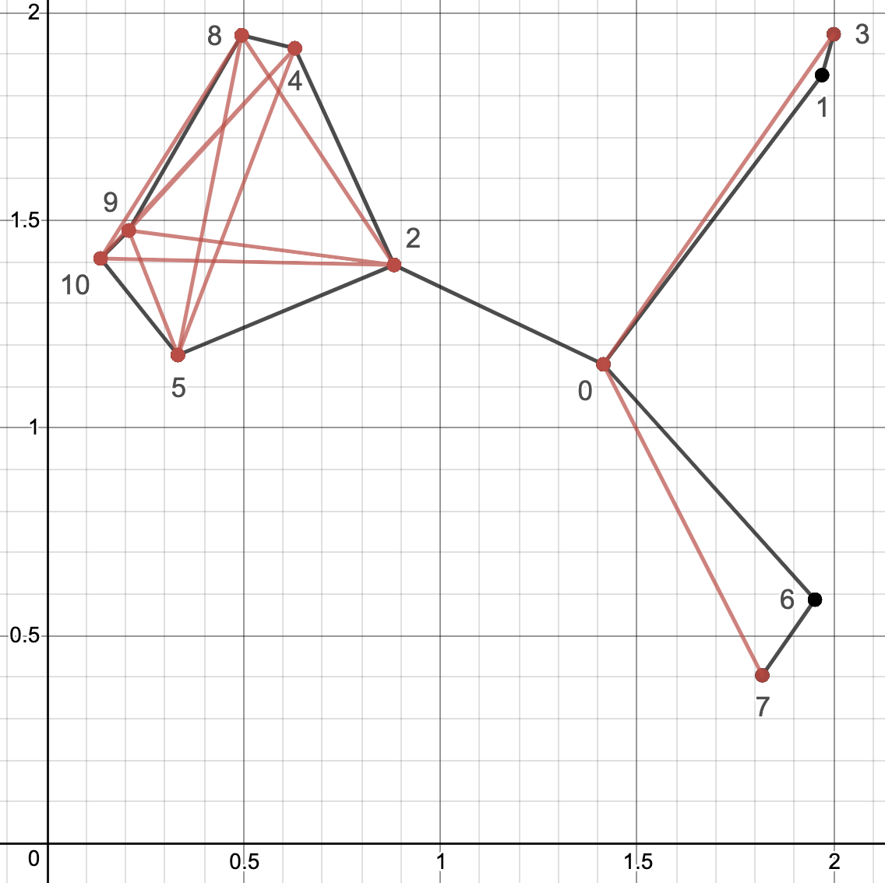
Output Sample: cout
You just implement recv_handler and the output will be automatically generated

Slide 11
Note
Deadline: 4/6 Tue (小老師) 4/13 Tue (所有同學)
E-course2
No stdio.h
Use iostream
C++ Source code

Slide 12
Remark
Know how to implement the functions in a more OOP way
Use nullptr

Slide 13
Further Reading
Routing with Guaranteed Delivery in Ad Hoc Wireless Networks, Wireless Networks 2001
On Delivery Guarantees of Face and Combined Greedy-Face Routing in Ad Hoc and Sensor Network, ACM MobiCom 2006
…
Long story

