Slide 1
Object-Oriented Programming
Programming Project #3
郭建志

Slide 2
Background
Large-scale geographic routing
Every node only has the local information (i.e., its neighbors’ information) and the destination’s information
destination
source

Slide 3
Background
Large-scale geographic routing
Every node only has the local information (i.e., its neighbors’ information) and the destination’s information
So, how should a source route a packet to a specific destination?
destination
source

Slide 4
Naïve Routing Scheme: Greedy
Forward the packet towards the neighboring node that is closer to the destination
destination
source

Slide 5
Naïve Routing Scheme: Greedy
Forward the packet towards the neighboring node that is closer to the destination
However, the packet may be stuck at the dead end
(Out of the scope of this homework)
dead end
destination
source

Slide 6
Hello Message – Explore the Neighbors
Broadcast a hello message to the neighbors
Receive the message → get the neighbor information
Each node maintains a neighbor list

Slide 7
Programming Project #3: Greedy Routing (Distributed Computing)
Input:
Number of nodes
Nodes with non-negative coordinates (x, y) (the input graph is connected after adding links)
Each node broadcast “hello message” at different time
Source-destination pairs with start time
Simulation duration
Procedure:
Add a link between any two nodes u, v if dist(u,v) ≤ 1
Receive hello message and add the sender to the nb list
Compute the next hop by greedy routing for each node
Output:
All packets transmitted in the network (automatically generated by my code)

Slide 8
Note 1
Create a new class Hello_packet, Hello_header, and Hello_payload which inherit class packet, header, payload
Follow the class GR_packet, GR_header, and GR_payload to define the Hello_packet, Hello_header, and Hello_payload
Implement class Hello_packet, Hello_header, and Hello_payload
Implement recv_handler in class GR_node
void GR_node ::recv_handler (packet *p)
Use p->type() to recognize the packet type
Use dynamic_cast<GR_packet*> (p) to cast the type
Use dynamic_cast<Hello_packet*> (p) to cast the type

Slide 9
Note 2
Use getHeader to access more packet information header *packet::getHeader () with dynamic_cast
Employ send_handler in class node to send the packet void node::send_handler (packet *p)
Maintain the neighbors (i.e., neighbor list) in class GR_node by yourself
Please use map<unsigned int, bool>
to store each node’s neighbors in class GR_node
You cannot access the neighbors by getPhyNeighbors const map<unsigned int, bool> & getPhyNeighbors()

Slide 10
Note 3
The implementation must be distributed
You cannot access the other nodes in class GR_node
Again, you cannot use getPhyNeighbors() in class node

Slide 11
Programming Project #3: Greedy Routing and Hello Message
Program sketch:
Read input by cin and generate nodes
For each node, add its neighbor to its neighbor list (centralized)
Read input by cin and get each node’s time for broadcasting the hello message
Generate a Hello_packet and initialize the packet (filling the columns of the source, destination, …)
Add the packet to the source node by yourself
Implement: once a node receives the Hello_packet, the node stores the sender of this packet in its neighbor lists
Read input by cin and get a source-destination pair
Generate a GR_packet and initialize the packet (filling the columns of the source, destination, …)
Add the packet to the source node by add_initial_event
Implement: once a node receives a GR_packet, the node computes the next hop and sends it to the next node

Slide 12
Input Sample: cin
11
0 1.4142 1.1534 50
1 1.97 1.85 50
2 0.8823 1.3926 50
3 1.9996 1.9484 50
4 0.6301 1.9145 50
5 0.3329 1.1756 50
6 1.952 0.5866 50
7 1.8181 0.4043 50
8 0.4949 1.946 50
9 0.2079 1.4758 50
10 0.1364 1.4084 50
3 300
100 0 1
150 2 8
200 9 3
#nodes
ID x y BR_time
…
#pairs duration
time source destination
…

Slide 13
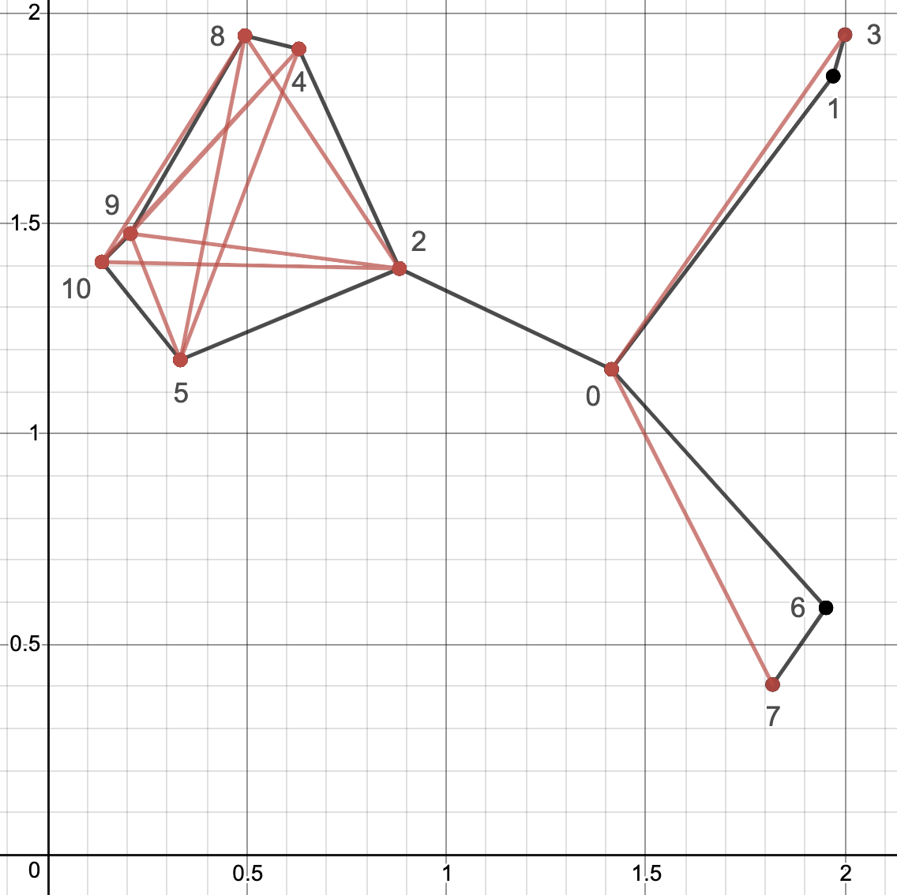
Output Sample: cout
You have implement Hello_packet, Hello_header, Hello_paylod, and GR_node::recv_handler and the output will be automatically generated

Slide 14
Note
Deadline: 5/4 Tue (小老師) 5/11 Tue (所有同學)
E-course2
No stdio.h
Use iostream
C++ Source code

Slide 15
Remark
Know how to implement the functions in a more OOP way
Use nullptr
Know how create a derived class that inherit a base class

Slide 16
Further Reading
Routing with Guaranteed Delivery in Ad Hoc Wireless Networks, Wireless Networks 2001
On Delivery Guarantees of Face and Combined Greedy-Face Routing in Ad Hoc and Sensor Network, ACM MobiCom 2006
…
Long story

