Slide 1
Object-Oriented Programming
Programming Project #4
郭建志

Slide 2
Background
Large-scale geographic routing
Every node only has the local information (i.e., its neighbors’ information) and the destination’s information
destination
source

Slide 3
Background
Large-scale geographic routing
Every node only has the local information (i.e., its neighbors’ information) and the destination’s information
So, how should a source route a packet to a specific destination?
destination
source

Slide 4
Naïve Routing Scheme: Greedy
Forward the packet towards the neighboring node that is closer to the destination
destination
source

Slide 5
Naïve Routing Scheme: Greedy
Forward the packet towards the neighboring node that is closer to the destination
However, the packet may be stuck at the dead end
(Out of the scope of this homework)
dead end
destination
source

Slide 6
Hello Message – Explore the Neighbors
Broadcast a hello message to the neighbors
Receive the message → get the neighbor information
Each node maintains a neighbor list

Slide 7
How to Know the Destination’s Coordination?
You may want to ask this question…
If the dst is a neighbor of the src → OK
Otherwise → Who can tell the src?
Information brokerage, location service
destination
source

Slide 8
Replicate Message – Publish
Every node use its ID to hash and get a coordination
Send a Rep_packet toward the coordination by greedy routing
The information will be stored in the dead end (i.e., the closest node to the coordination)
hash result
destination
source

Slide 9
Retrieve Message – Subscribe
Use the same hash function with dstID to get the coordination
Send a Ret_packet toward the coordination by greedy routing
hash result
destination
source

Slide 10
Response Message – Reply
If the dead end (i.e., the closest node to the coordination) knows the coordination, then the dead end sends a Res_message back to the source by greedy routing; Otherwise, no one sends back
Source records the destination’s coordination
hash result
destination
source

Slide 11
After Receive the Response Message
Use greedy algorithm to forward the GR_packet towards the neighboring node that is closer to the destination
dead end
destination
source

Slide 12
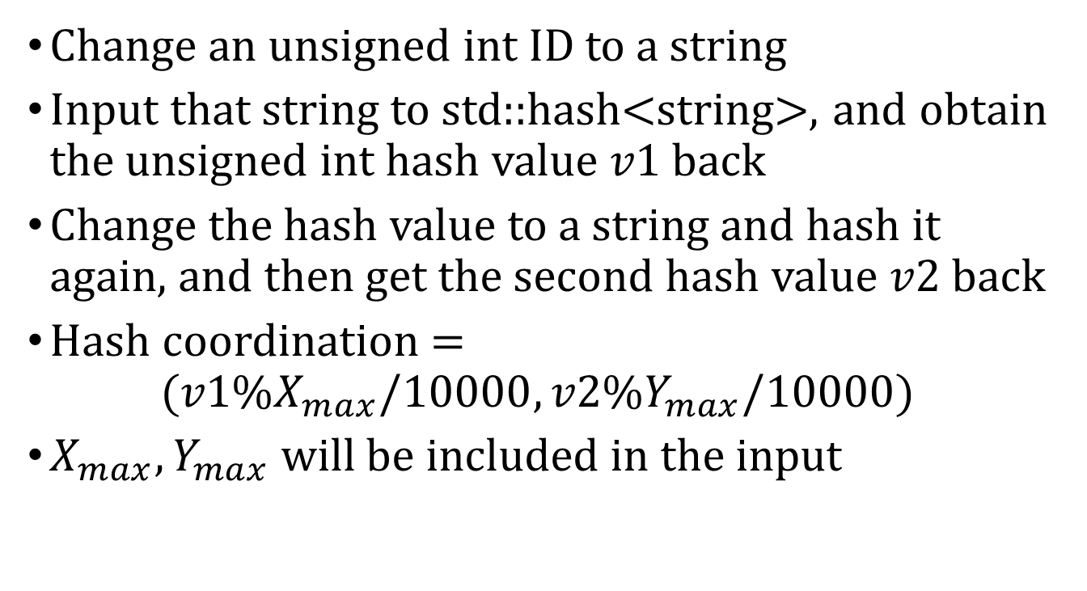
The Hash Function
Change an unsigned int ID to a string
Input that string to std::hash<string>, and obtain the unsigned int hash value $v1$ back
Change the hash value to a string and hash it again, and then get the second hash value $v2$back
Hash coordination = $(v1\%X_{max}/10000,v2\%Y_{max}/10000)$
$X_{max},Y_{max}$ will be included in the input

Slide 13
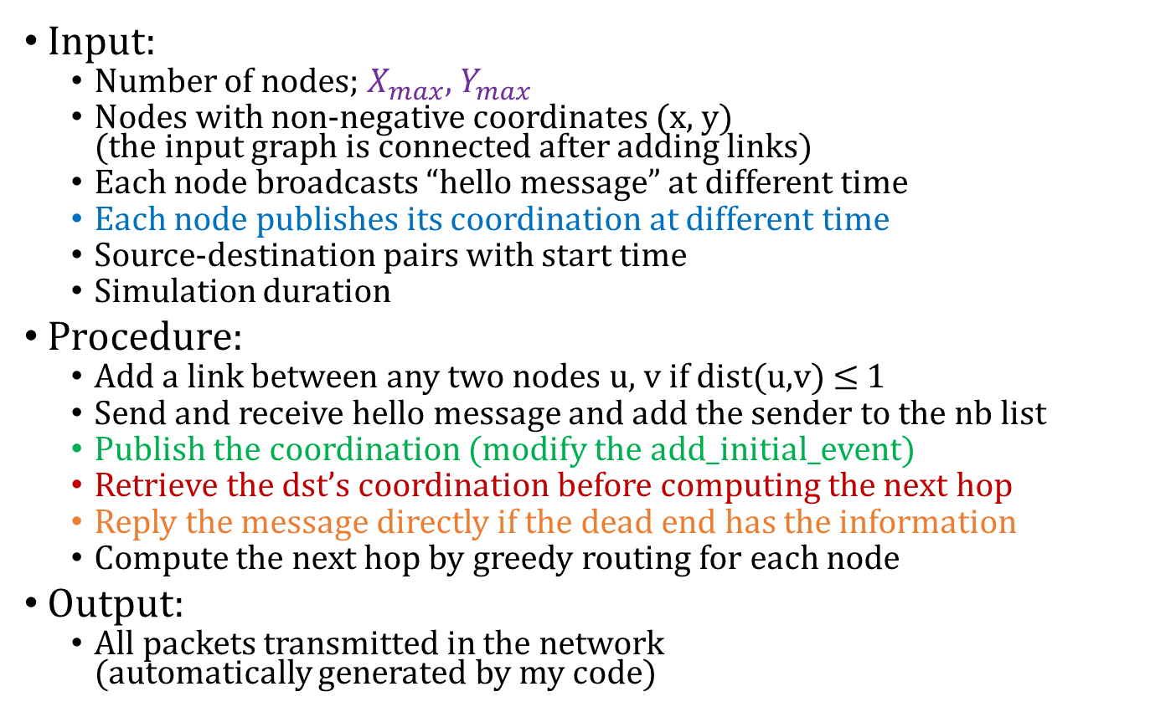
Programming Project #4: Location Service (Distributed Computing)
Input:
Number of nodes; $X_{max}$, $Y_{max}$
Nodes with non-negative coordinates (x, y) (the input graph is connected after adding links)
Each node broadcasts “hello message” at different time
Each node publishes its coordination at different time
Source-destination pairs with start time
Simulation duration
Procedure:
Add a link between any two nodes u, v if dist(u,v) ≤ 1
Send and receive hello message and add the sender to the nb list
Publish the coordination (modify the add_initial_event)
Retrieve the dst’s coordination before computing the next hop
Reply the message directly if the dead end has the information
Compute the next hop by greedy routing for each node
Output:
All packets transmitted in the network (automatically generated by my code)

Slide 14
Note 1
Define the class Rep_packet, Rep_header, Rep_payload, Ret_packet, Ret_header, Ret_payload, Res_packet, Res_header, Res_paylod
Implement recv_handler in class GR_node
void GR_node ::recv_handler (packet *p)
Use p->type() to recognize the packet type
Use dynamic_cast<Rep_packet*> (p) to cast the type
Use dynamic_cast<Ret_packet*> (p) to cast the type
Use dynamic_cast<Res_packet*> (p) to cast the type

Slide 15
Note 2
Use getHeader to access more packet information header *packet::getHeader () with dynamic_cast
Employ send_handler in class node to send the packet void node::send_handler (packet *p)
Maintain the destinations’ coordinations (i.e., coordination table) in class GR_node by yourself
Please use map<unsigned int, pair<double,double>>
to store each node’s coordination in class GR_node
You cannot access the neighbors by getPhyNeighbors const map<unsigned int, bool> & getPhyNeighbors()

Slide 16
Note 3
The implementation must be distributed
You cannot access the other nodes in class GR_node
Again, you cannot use getPhyNeighbors() in class node
The dead-end node directly generates and sends the Res_packet back to src after receiving the Ret_packet
You don’t need to use add_initial_event() for the reply
You can use add_phy_neighbor() for network initialization

Slide 17
Note 4
Use add_initial_event or design you own add_initial_event
→ generate a packet to a node manually
Hello_packet: get the event time by cin
GR_packet: get the event time by cin
Rep_packet: get the event time by cin
Don’t use add_initial_event (i.e., no new event generated)
→ the node should generate the packet by itself
Ret_packet: if the src cannot find the destination
Res_packet: if the dead end receives the Ret_packet
Cached GR_packet: if the src receives the Res_Packet
Remember to discard (delete) the generated packet

Slide 18
Programming Project #4: Location Service
Program sketch:
Read input by cin and generate nodes
For each node, add its neighbor to its neighbor list (centralized)
Read input by cin and get each node’s time for broadcasting the hello message
Generate a Hello_packet and initialize the packet (filling the columns of the source, destination, …)
Add the packet to the source node by yourself
Generate a Rep_packet and send it for every node
Read input by cin and get a source-destination pair
Generate a GR_packet and initialize the packet (filling the columns of the source, destination, …)
Add the packet to the source node by add_initial_event
If you cannot find the destination in the coordination table:
Cache GR_packet in the node (use a easy linked list or any data struct)
Generate a Ret_packet to ask the destination’s coordination
Generate a Res_packet to reply the coordination back
If get the reply, maintain a table to store the coordination
GR routing: once a node receives a GR_packet, the node computes the next hop and sends it to the next node

Slide 19
Input Sample: cin
#nodes X_max Y_max
ID x y BR_time Rep_time
…
#pairs duration
time source destination
…
11 20000 20000
0 1.4142 1.1534 50 70
1 1.97 1.85 50 70
2 0.8823 1.3926 50 70
3 1.9996 1.9484 50 70
4 0.6301 1.9145 50 70
5 0.3329 1.1756 50 70
6 1.952 0.5866 50 70
7 1.8181 0.4043 50 70
8 0.4949 1.946 50 70
9 0.2079 1.4758 50 70
10 0.1364 1.4084 50 70
3 300
150 0 1
200 2 8
250 9 3

Slide 20
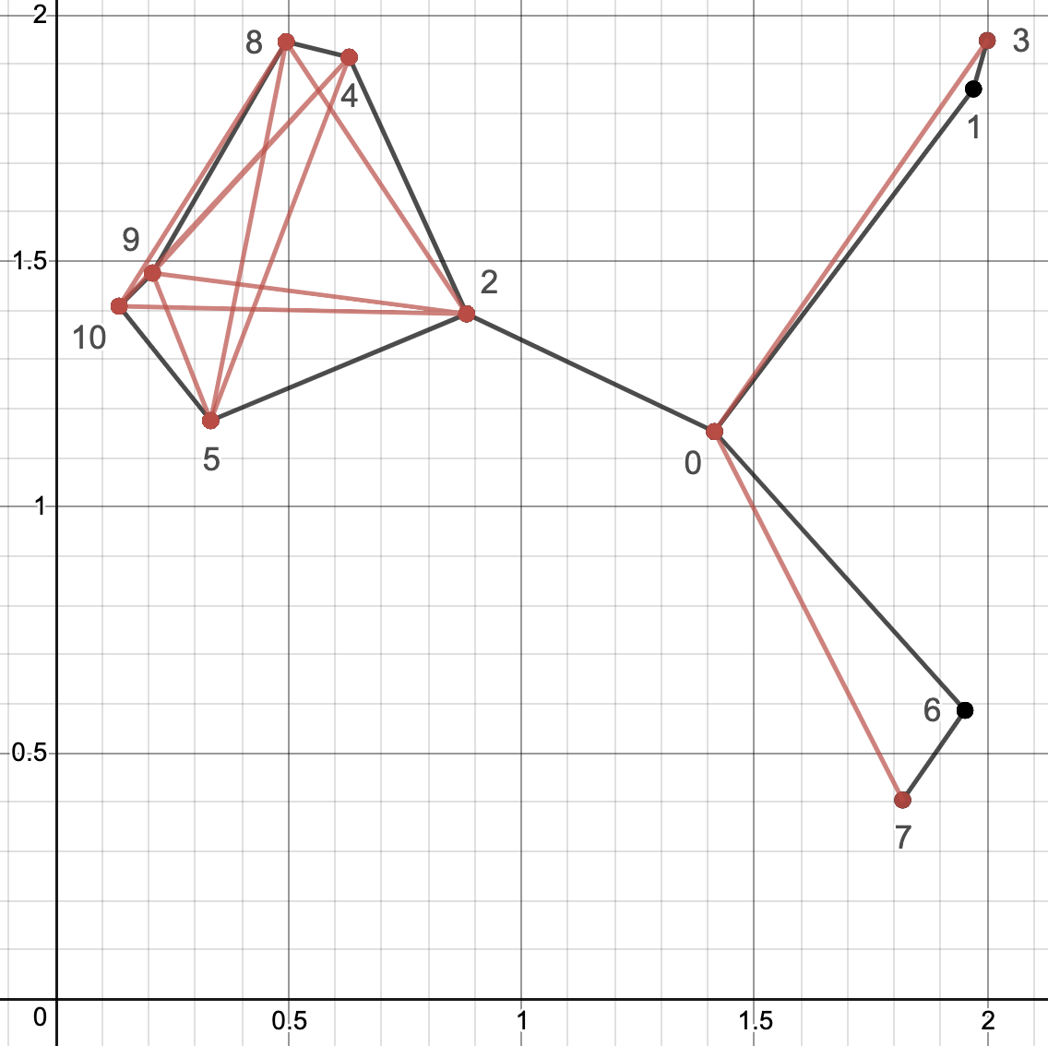
Output Sample: cout
You have implement Rep_packet, Rep_header, Ret_paylod,…, and GR_node::recv_handler and the output will be automatically generated

Slide 21
Note
Deadline: 6/15 Tue (小老師) 6/22 Tue (所有同學)
E-course2
No stdio.h
Use iostream
C++ Source code

Slide 22
Remark
Know how to implement the functions in a more OOP way
Use nullptr
Know how create a derived class that inherit a base class

Slide 23
Further Reading
Routing with Guaranteed Delivery in Ad Hoc Wireless Networks, Wireless Networks 2001
On Delivery Guarantees of Face and Combined Greedy-Face Routing in Ad Hoc and Sensor Network, ACM MobiCom 2006
…
Long story

