Slide 1
Fractal Dimension of the
One Dimensional Case
LI Xingyao

Slide 2
Review
Analysis
Summary

Slide 3
01
Review

Slide 4
Review
Let's recall the basic process
Data Loading --> Data Imputation --> Metrics on Sample Data --> Vector Selection --> Matrix Selection --> Fractal Dimension Modelling Analysis on Sampled Column Vectors
Fractal Dimension Modelling Analysis：
1. fractal dimension distribution model
2. regression model (negligible)
3. log-log model
4. distribution fitter model

Slide 5
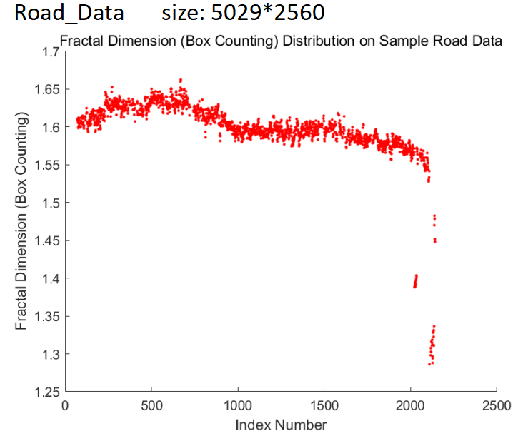
Review
The fractal dimension of a road is about 1.55 to 1.65.

Slide 6
02
Analysis

Slide 7
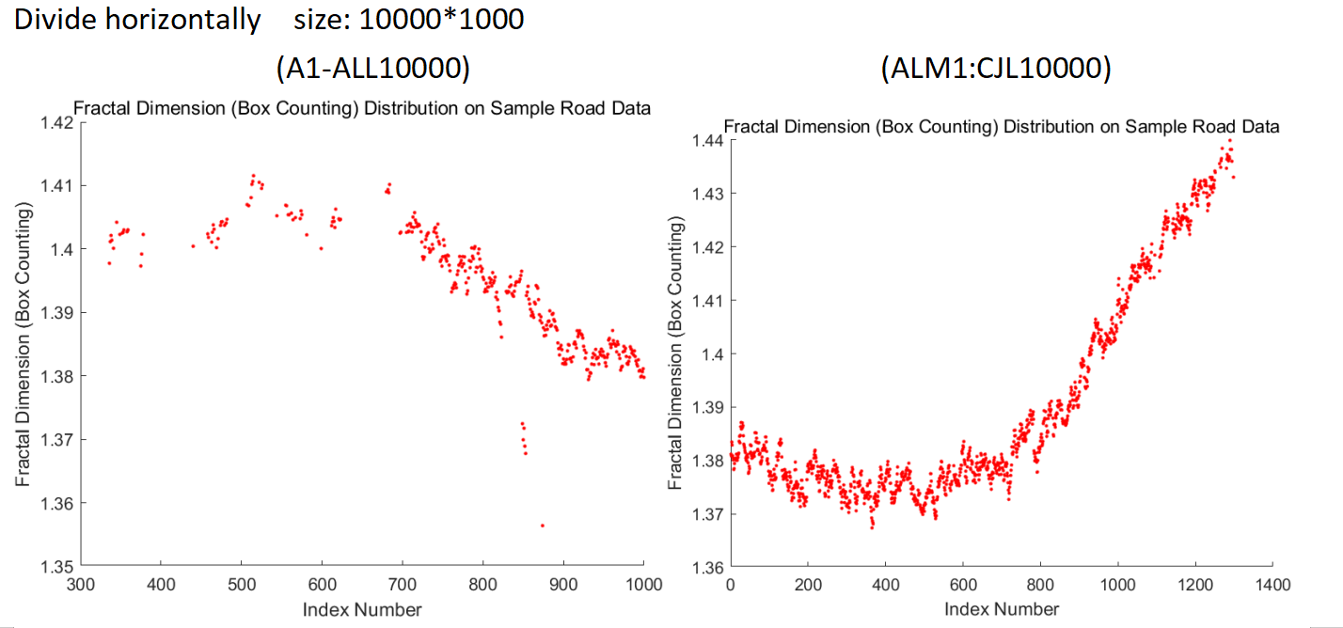
Analysis
missing data
1000
2000
left
right
10000
LRawData3

Slide 8
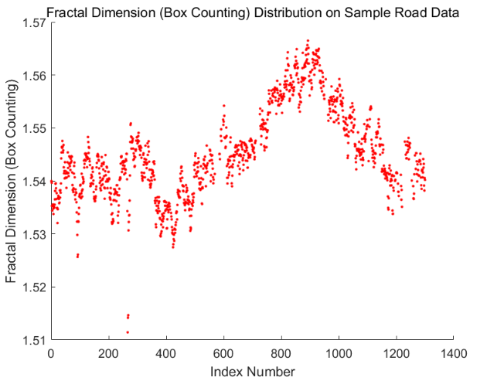
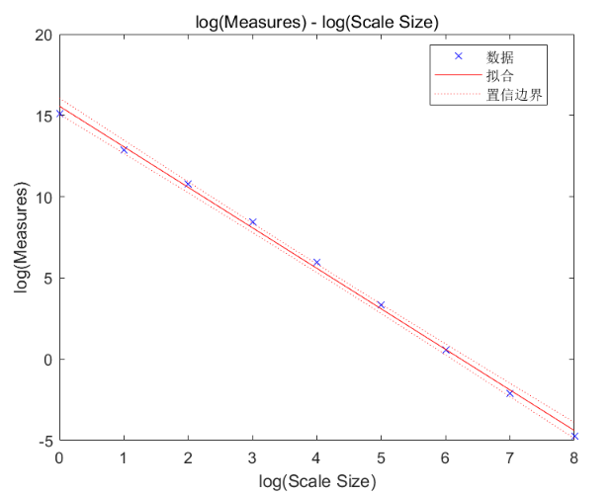
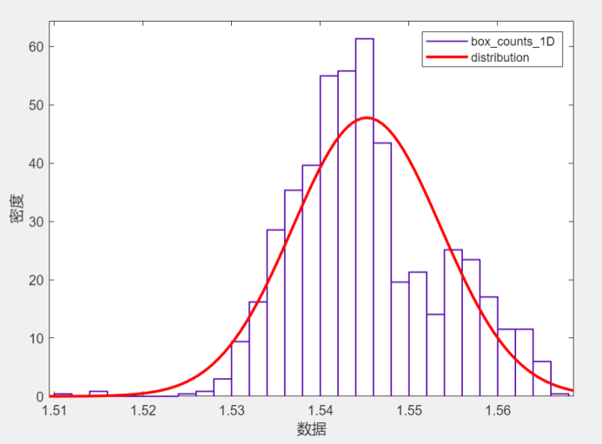
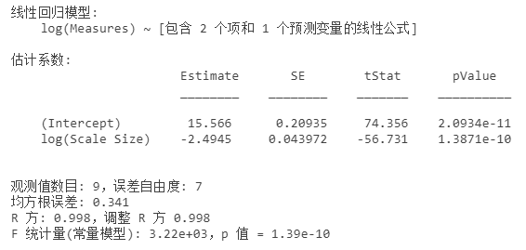
Rough
LRawData5(right) The number of data columns without bad data points: 1253
distribution fitter
fractal dimension distribution
log-log model

Slide 9
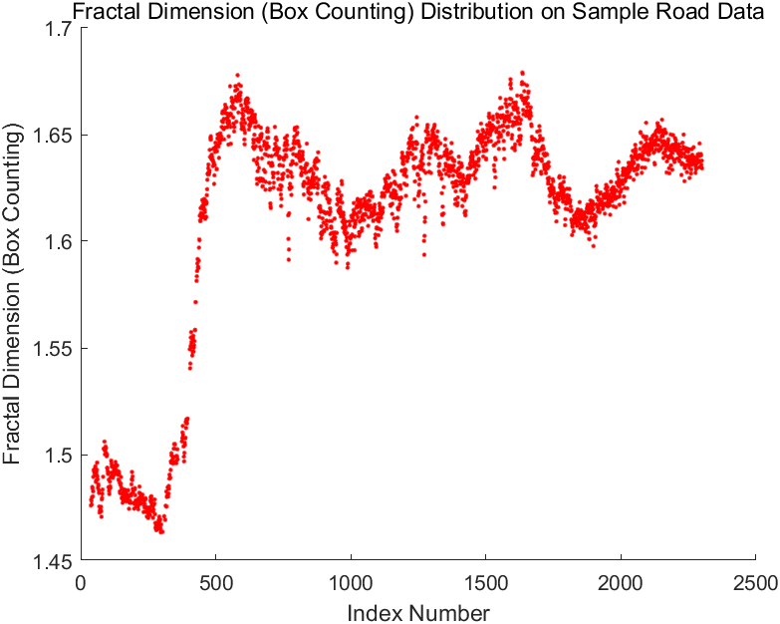
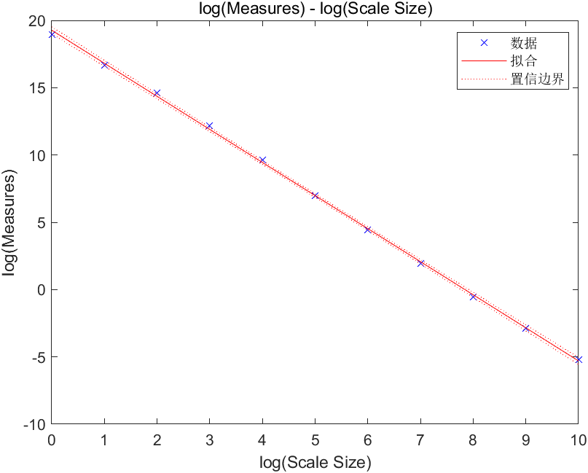
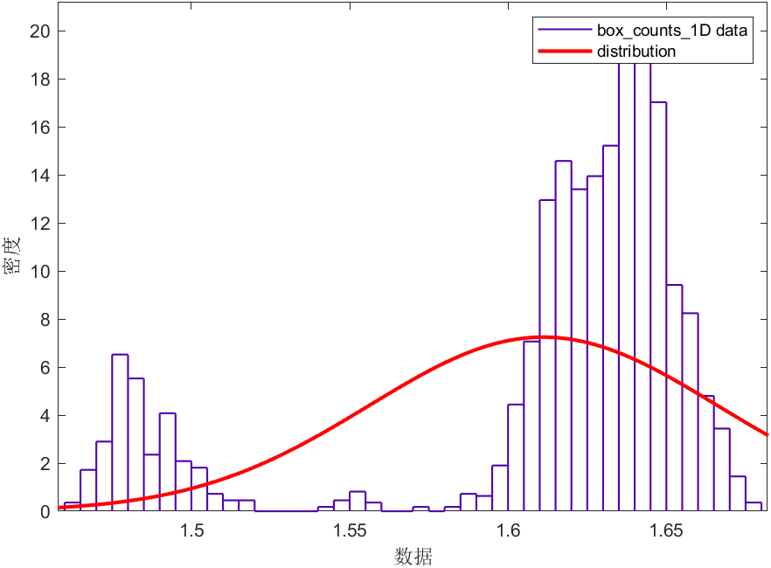
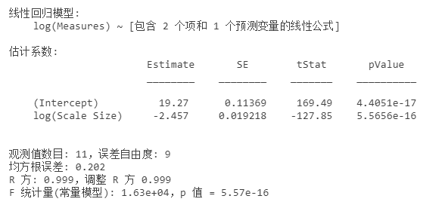
Smooth
LeftRawData1
The number of data columns without bad data points: 2247
fractal dimension distribution
distribution fitter
log-log model

Slide 10
03
Summary

Slide 11
Summary
The fractal dimension of a rough road is basically between 1.45 and 1.55, while that of a smooth road is between 1.4 and 1.7.
The fluctuation range of the fractal dimension of a smooth road is larger, and it is not around 1 as expected.
On the whole, the log-log models have good fitting.

Slide 12
Thanks
Q&A

