Slide 1
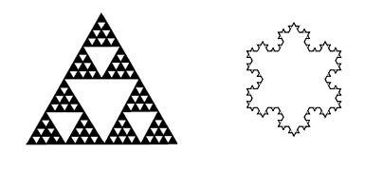
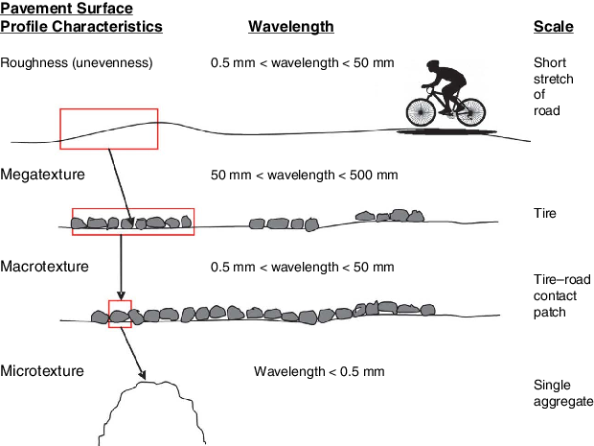
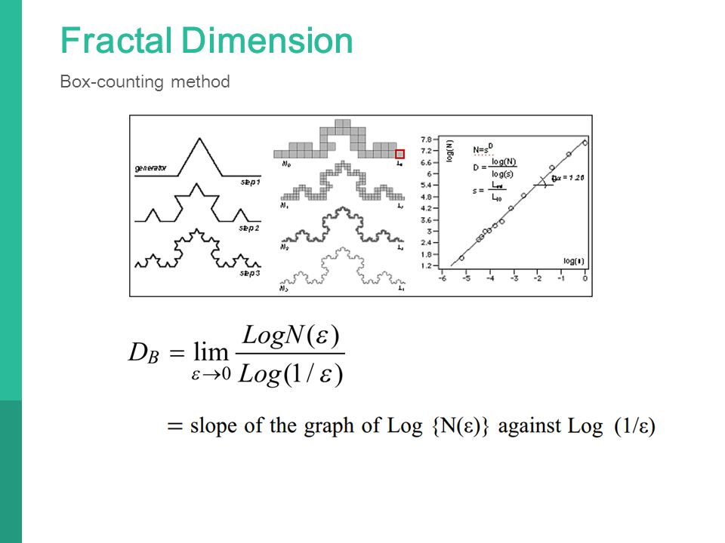
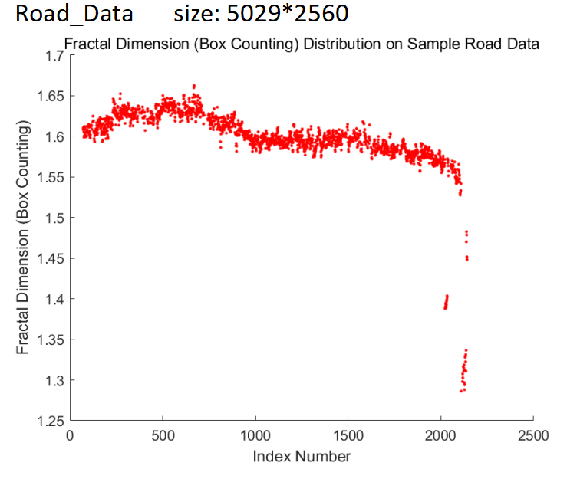
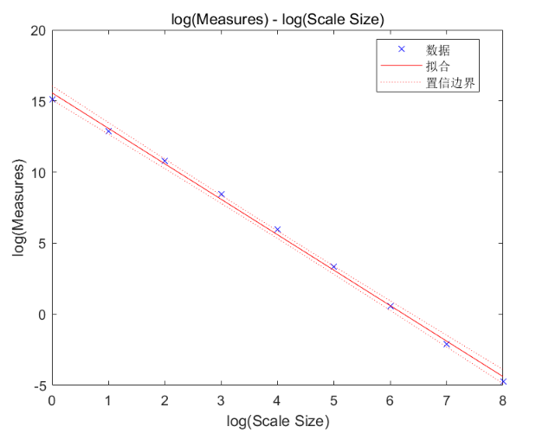
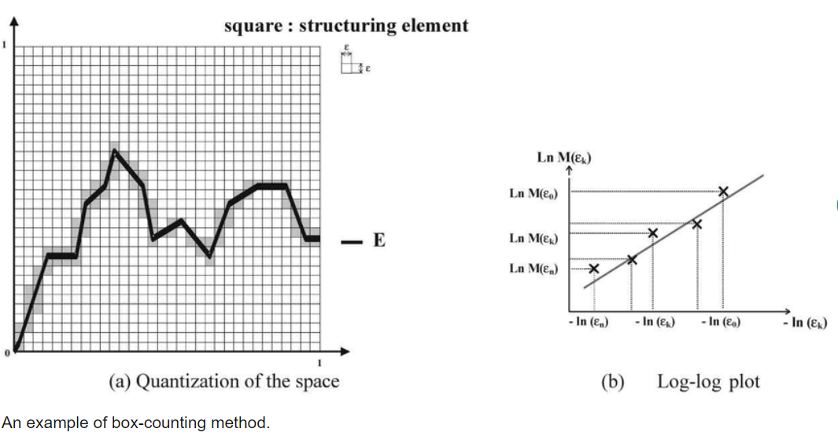
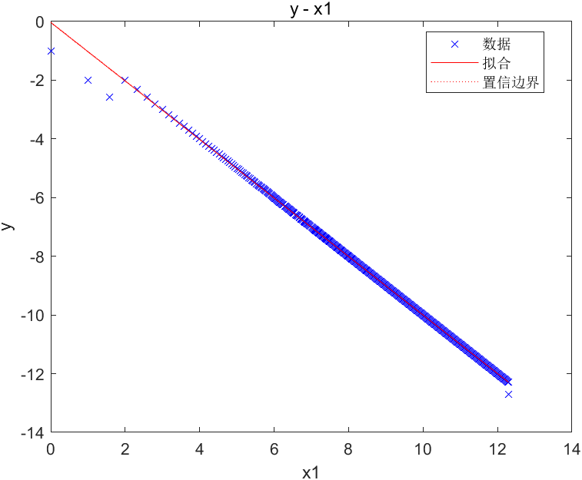
Fractal Dimension of the One Dimensional Case
LI Xingyao
Introduction & Objective
Methods
Results & Interpretation
Conclusions
Under the grand challenge topic “Enhance Virtual Reality”, the research title for the summer research is “The fractal dimension of the one dimensional case”. The research project set out to determine the fractal dimension of a road profile.
MATLAB is used to process and model the road sample data. After imputing missing values and reshaping the matrix, we extract the largest centered submatrix of size 2^{K}. Each column vector is analyzed using three models: fractal dimension distribution, log–log linear regression, and distribution fitting. R² of the log-log model quantifies self-similarity.
The fractal dimension of a road surface that looks smooth may be even larger than that of the road surface that looks rough. Besides, the fluctuation range of the fractal dimension of a smooth data set is larger, and it is not around 1 as expected. In addition, the log-log models basically present a smooth straight line, reflecting good self-similarity property.
Visual roughness does not reliably indicate true fractal complexity. This study finds that road profiles exhibit fractal dimensions between 1.4 and 1.7, with strong self-similarity confirmed by regression results.
Figure 1. Classic fractal patterns with self-similarity.
The purpose is to find the fractal dimension of a longitudinal profile. Using the box counting algorithm, the measures under different scales can be calculated. Through the relationship between the scales and measures, the self-similar property can be recognized, and the fractal dimension would also be got through the gradient of the log(scale)-log(measure) graph.
Figure 4. Fractal Dimension Distribution Plot.
Figure 7. Pavement Texture and Wavelength.
Figure 3. The Principle and Formula of Fractal Dimension by Box Counting Method.
References
Zeng, Xianyi & Koehl, Ludovic & Vasseur, Christian. (2001). Design and implementation of an estimator of fractal dimension using fuzzy techniques. Pattern Recognition. 34. 151-169. 10.1016/S0031-3203(99)00202-2.
Son, H. J. (n.d.). Fractals in neuroscience bio and brain engineering in KAIST. SlidePlayer. https://slideplayer.com/slide/6237958/
Data Analysis
The fractal dimension of rough profiles typically ranges from 1.45 to 1.55, while that of smooth profiles varies between 1.4 and 1.7. The log–log models show high linearity with R² close to 1, confirming strong self-similarity. For periodic data, the estimated dimension is close to 1.
Figure 5. Log-log Plot for a Road Data Set.
Acknowledgement
We thank Dr. CHUNG for his guidance, and Alvin for his support with code implementation. We also appreciate the feedback from Dr. Hon and Mr. Chan during project meetings.
Figure 2. Box Counting Principle and Log-log Plot.
Figure 6. Log-Log Plot for a Periodic Profile.

