Slide 1
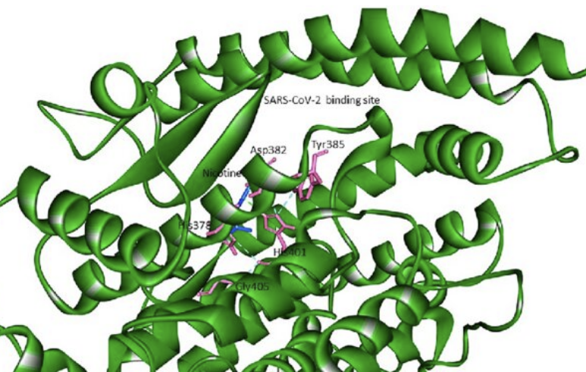
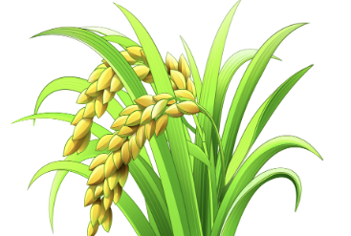
Step 1: Cultivate transformed strains
Aim: Express receptor-binding domain (RBD) in stably transformed rice cell for developing country applications
Transform RBD gene into mature embryo-derived rice callus using a vector construct.
1. Isolate mature embryos from rice seeds.
2. Prepare vector construct containing RBD gene.
3. Deliver construct into callus via Agrobacterium-mediated transformation.
4. Culture callus on selection medium
Under the control ubiquitin promoter and first intron (Ubi-1)
as housekeeping gene
Test: Callus, Roots, Flag Leaf, Leaf，Seed coat, Seed
Regenerated 15 independent T0 transgenic rice plants containing pUbi-RBD
Mature: 9, 19, 26
Regenerated 14 independent T0 transgenic rice plants containing Hord-RBD
Mature: 8, 12, 14
Under control of endosperm-specific barley D-hordein promoter (Hord) as luxury gene
Test: Callus, Seed

Slide 2
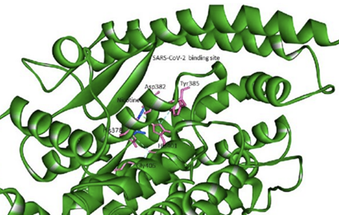

Step 2: Determine RBD level in different tissue of different plants by ELISA
Dectect that if there are protein RBD using Western Blotting in Callus
1. Sample Separation, separate them by size using SDS-PAGE gel.
2. Transfer to Membrane.
3. Treat the membrane with a protein-rich buffer to prevent non-specific antibody binding.
4. Antibody Incubation and Detection.
Continue to cultivate callus tissues that can detect RBD protein levels into plants
Determination of RBD protein concentration in different tissues of six different plants using Enzyme-Linked Immunosorbent Assay (ELISA)
1. Coating: Immobilize target antigen on a microplate well.
2. Blocking: Add a blocking agent, which is ACE2 to prevent non-specific binding.
3. Antibody Incubation: Apply a specific primary antibody that binds to the RBD.
4. Detection: Introduce an enzyme-linked secondary antibody (HRP conjugated), followed by a substrate that produces 450nm Fluorescence when it is activate.
Plant 9,19, 26
All tissue
Plant 8, 12, 14
Callus and Seed
Positive Control
C+, SARS-CoV-2 S1 protein
Negative Control
C−, 1% BSA in PBST

