Slide 1

Open a Thai Restaurant in New York
for IBM Data Science Courses Capstone Project - The Battle of Neighborhoods

Slide 2
Introduction
Thai cuisine is characterized by a balance of sour, spicy, salty, sweet and bitter flavors. The materials used are mainly seafood, fruits and vegetables. There are four major Thai cuisines, namely Northern Thai, Northern Thai, Thai Chinese, and Southern Thai, reflecting the different geography and culture of Sifang in Thailand, and the ingredients used everywhere are often the same as those in neighboring countries. Signature dishes include Tom Yum Kung (sour and sour seafood soup), coconut chicken tender chicken soup, curry fish cake, green curry chicken, mango fragrant rice and so on.
In this project, we are going to find a best place in New York for openning a Thai resturant.

Slide 3
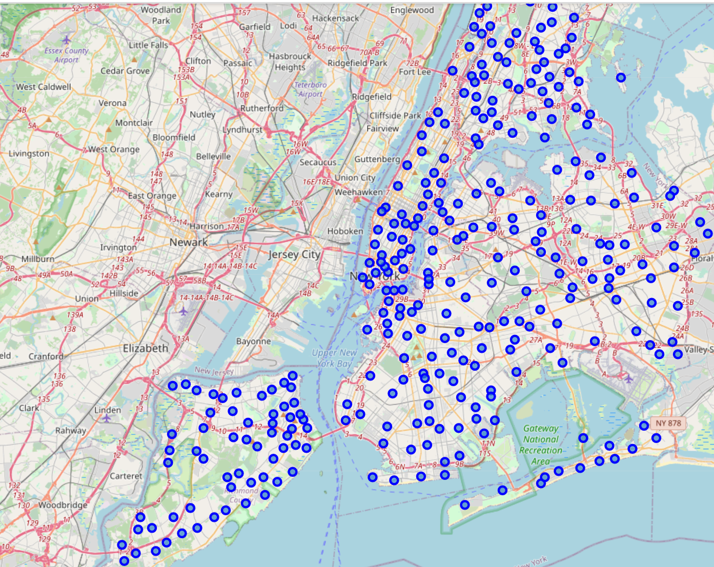
Data Source
Using FourSquare API to get the information in New York, such as venue ratings, price and others. Then running K-mean clusters to find out the best place for Thai Restaurant.

Slide 4
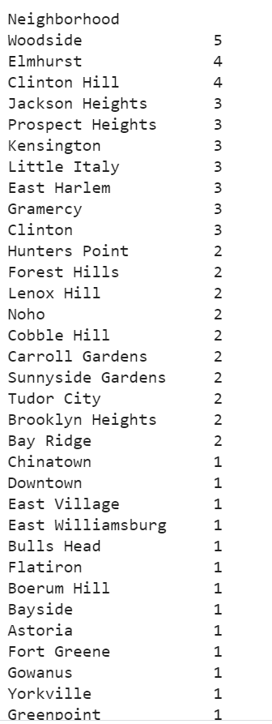
Methodology & Result
My goal is to find a neighborhood best for opening the Thai restaurant. I use Foursquare API to get the Thai restaurant information in NYC and use some statistic method to choose the best neighborhood.
Woodside is the best neighborhood in NYC because it has five Thai restaurants.

