Slide 1
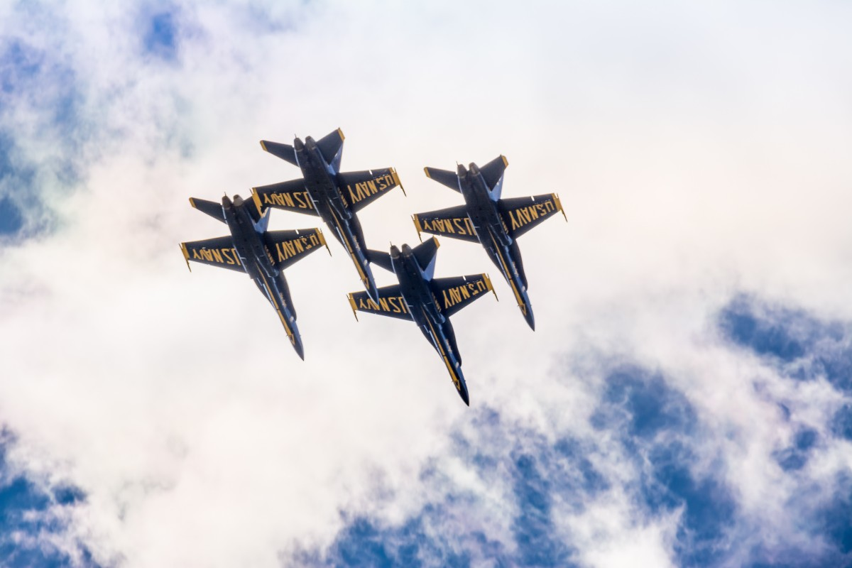
The Jet Laggers
Meeghan Gross
Kayleigh Tompkins
Samiul Haque
Md Al Hasib
"Jet Laggers fly together, penguins do not unfortunately..."​
- Unknown

Slide 2
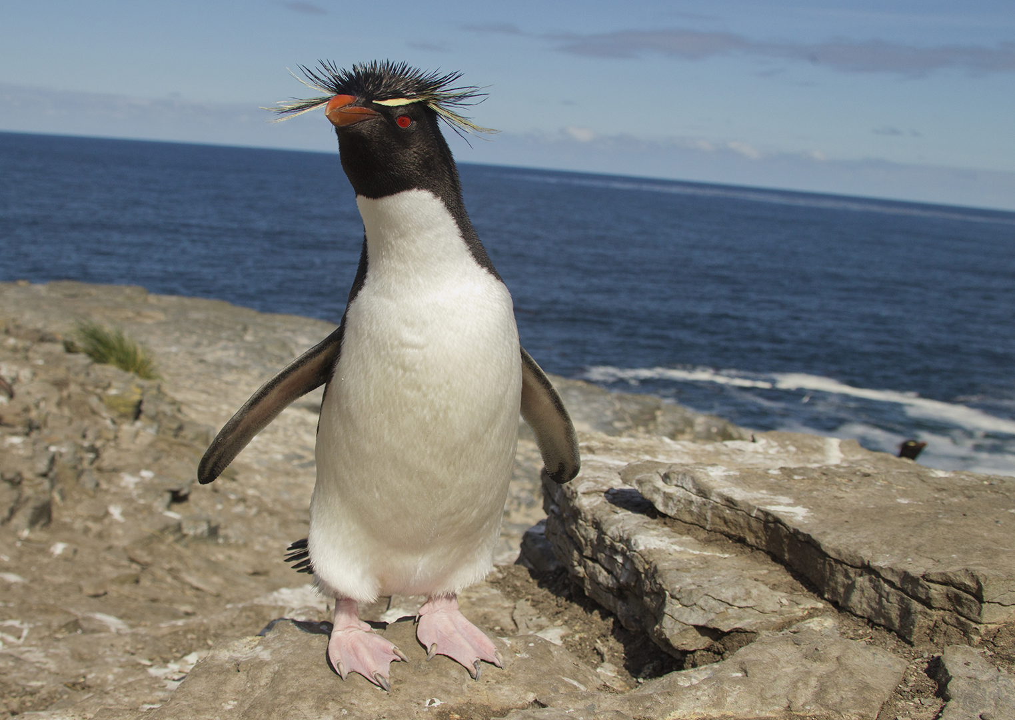
Penguin Trivia: True or False
Penguins have been around for about 10 million years.
A group of penguins together in the water are called a raft, but on land they are called a waddle.
Penguins evolved to "fly" underwater.

Slide 3
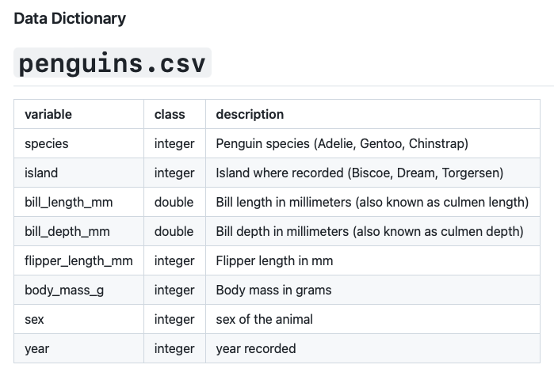
Dataset
Rfordatascience / tidytuesday

Slide 4
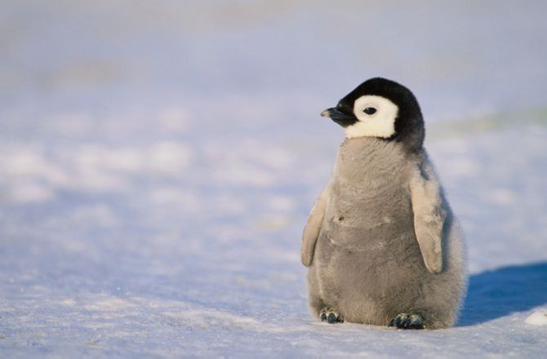
Data Content and Research Questions
I can't wait to be a researcher!
What factors affect penguin clutch completion?
What is the effect of nitrogen and carbon on body mass?
What is the impact of island, sex, and species on flipper length?

Slide 5
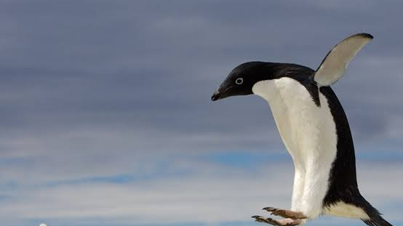
Which factors affect penguin clutch completion?
Notes:
A nest of eggs is called a clutch, and with the exception of emperor and king penguins, clutches usually contain two eggs. (Emperor and king penguins lay a single egg.)
Clutch Completion: a character string denoting if the study nest observed with a full clutch, i.e., 2 eggs
Our group was curious to determine what impacts a clutch completion to better predict if a penguin will have a better chance of a successful clutch versus an incomplete, which drastically effects the penguin population , regardless of species.
Severa

Slide 6
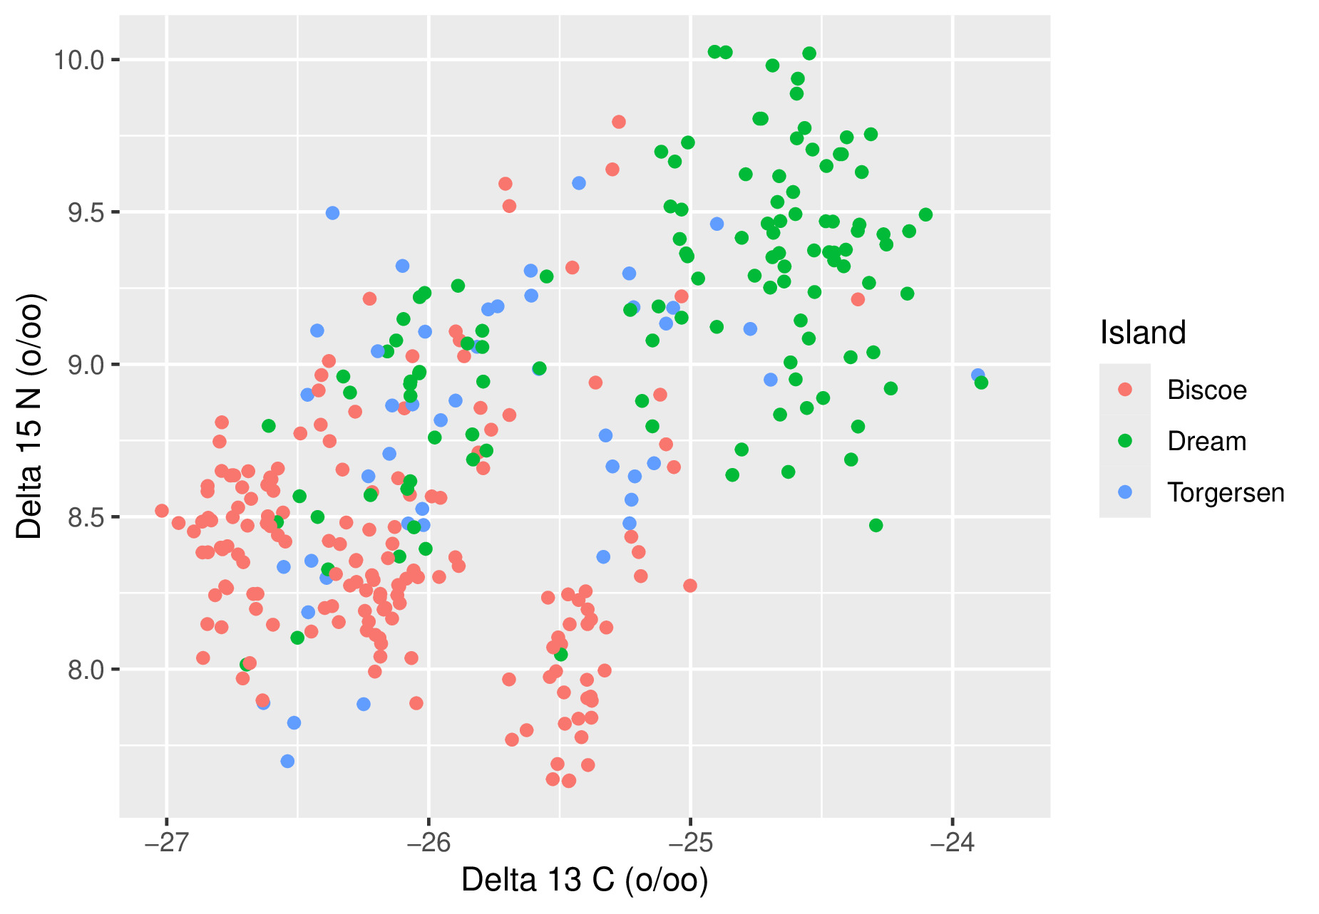
Penguin Location, Nitrogen, and Carbon

Slide 7
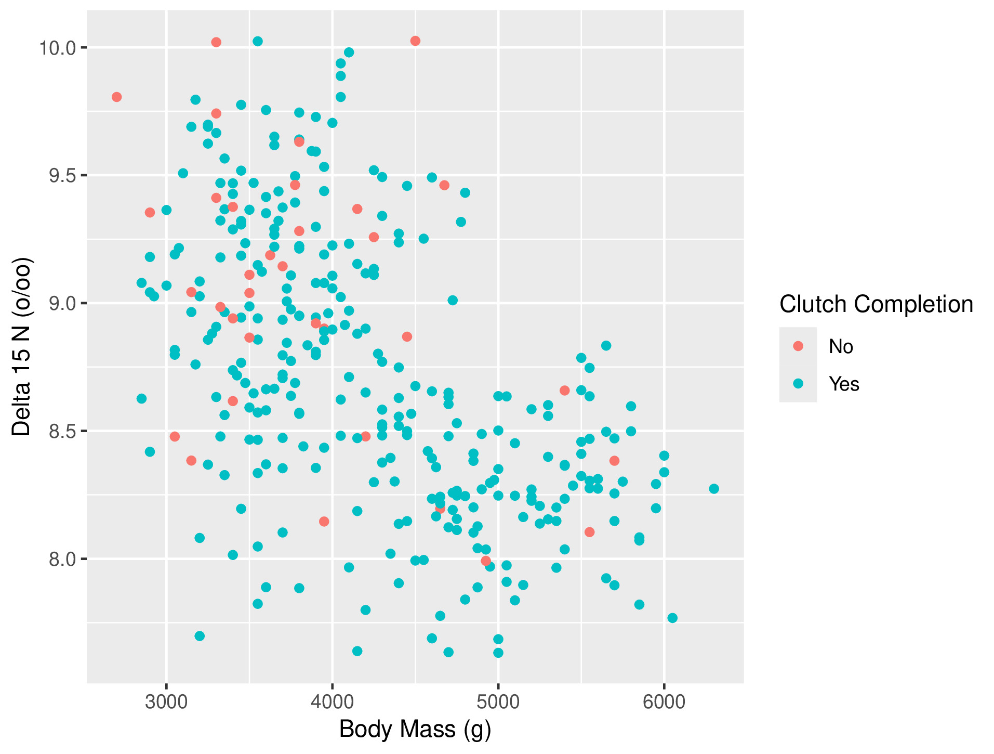
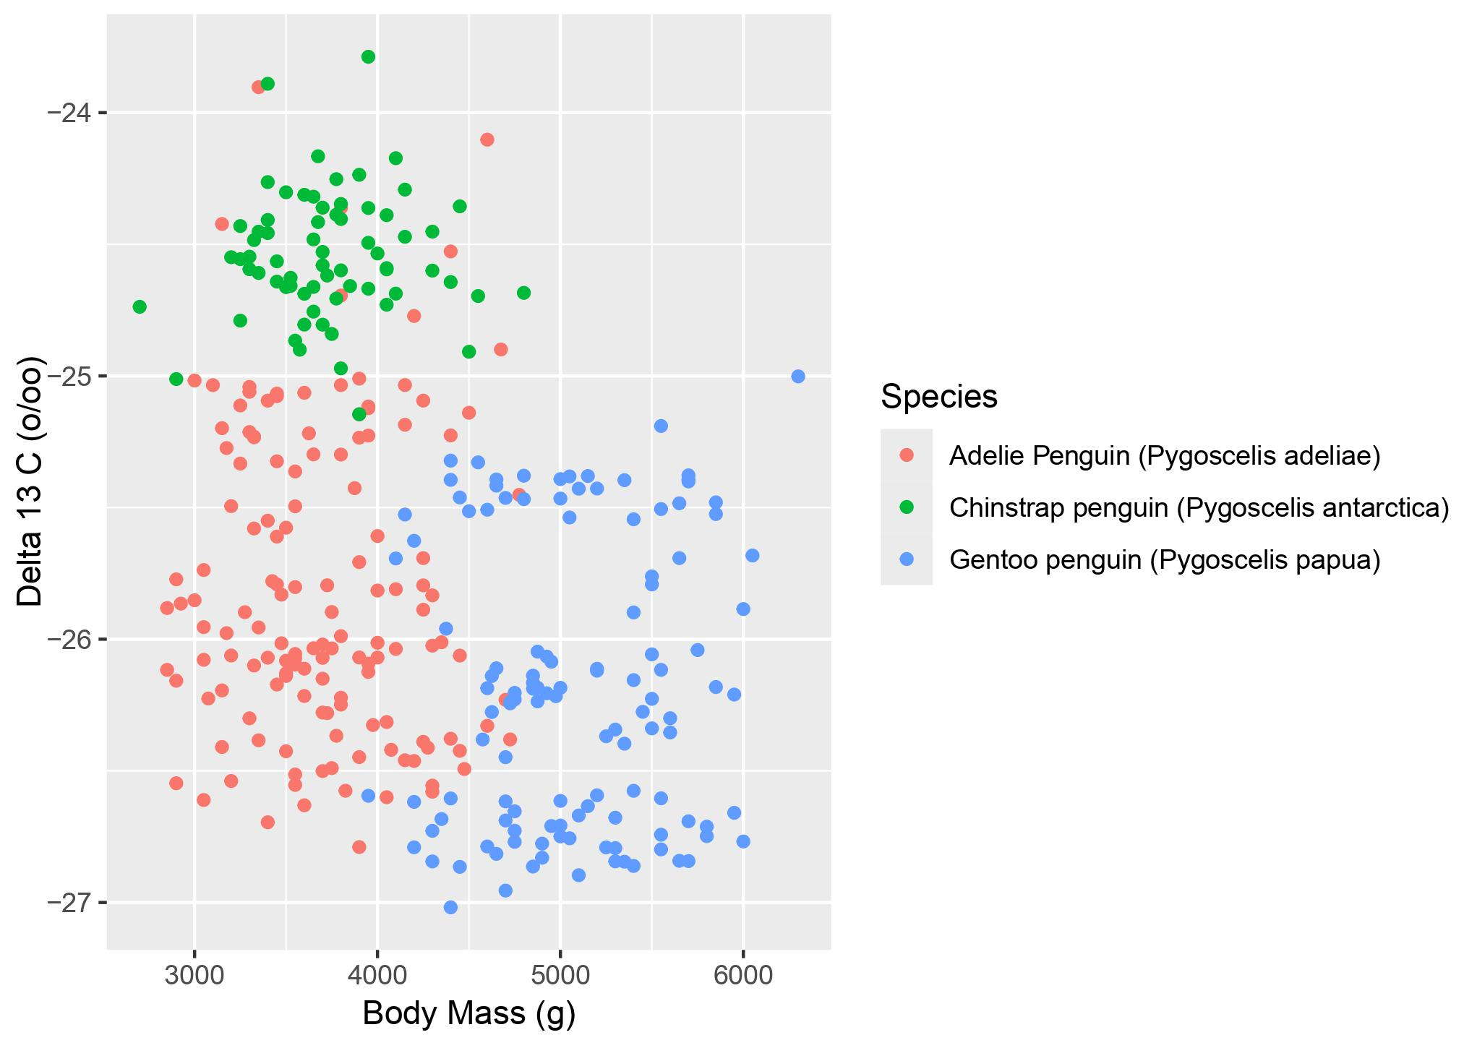

Slide 8
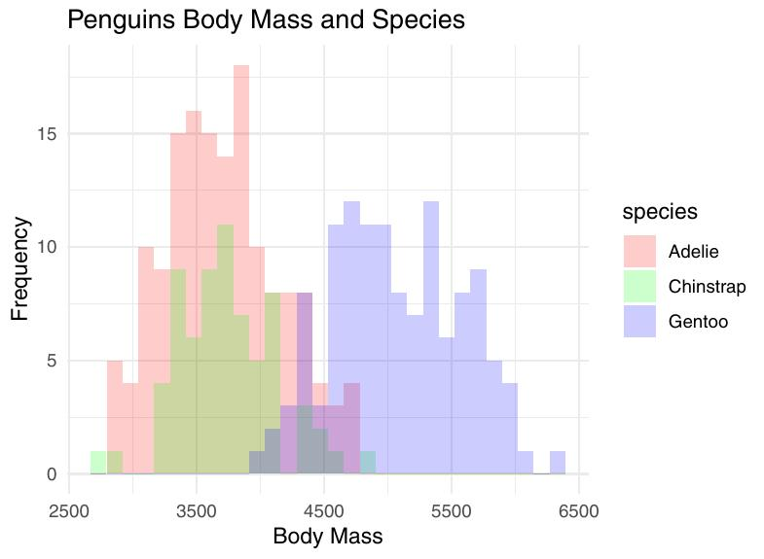

Slide 9
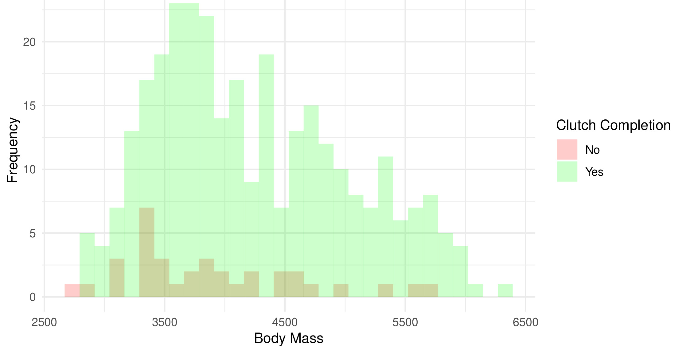
Penguins Clutch Completion Based On Body Mass

Slide 10
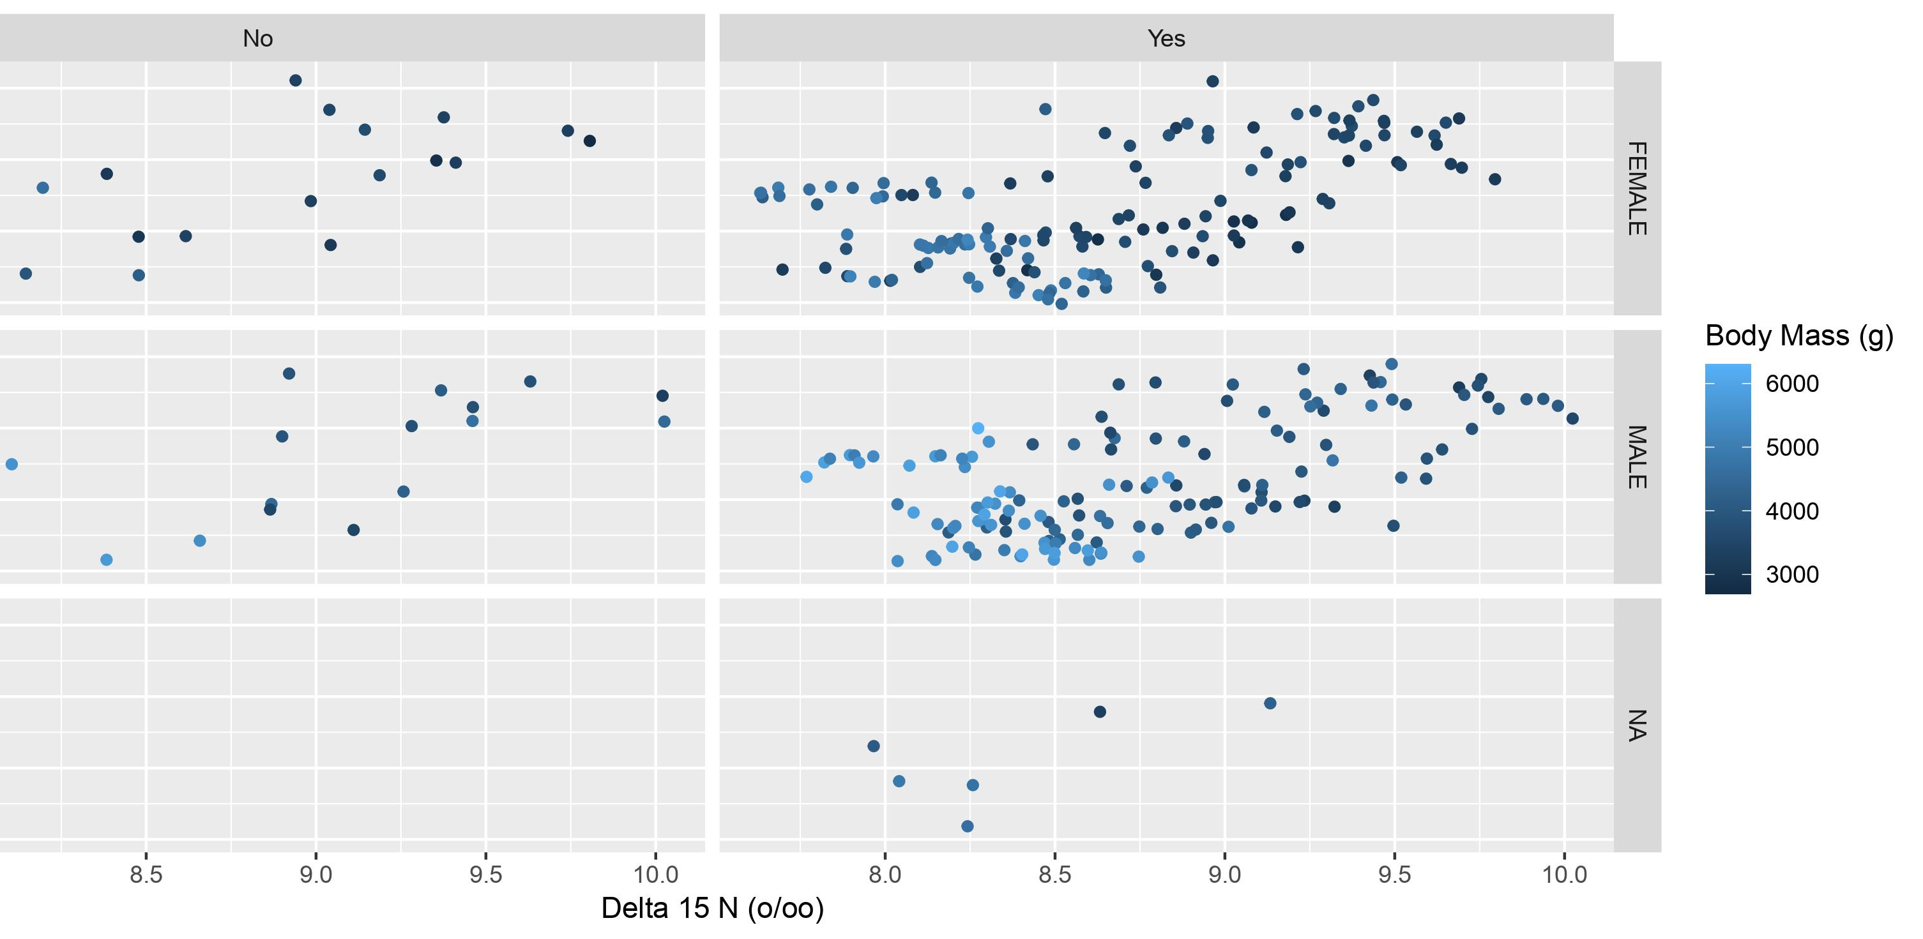

Slide 11
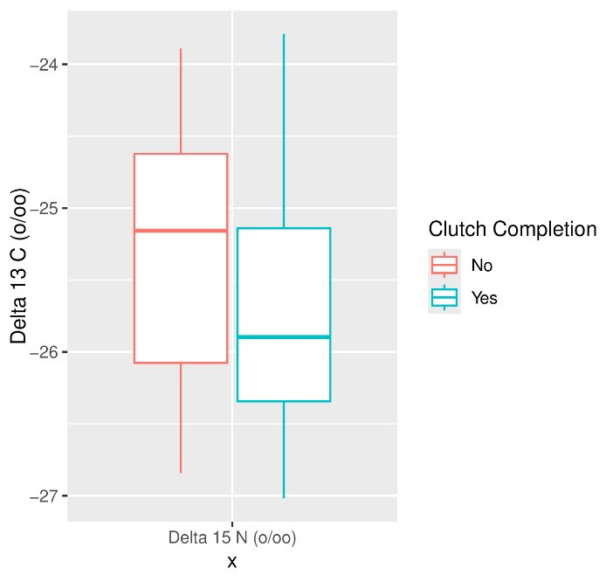
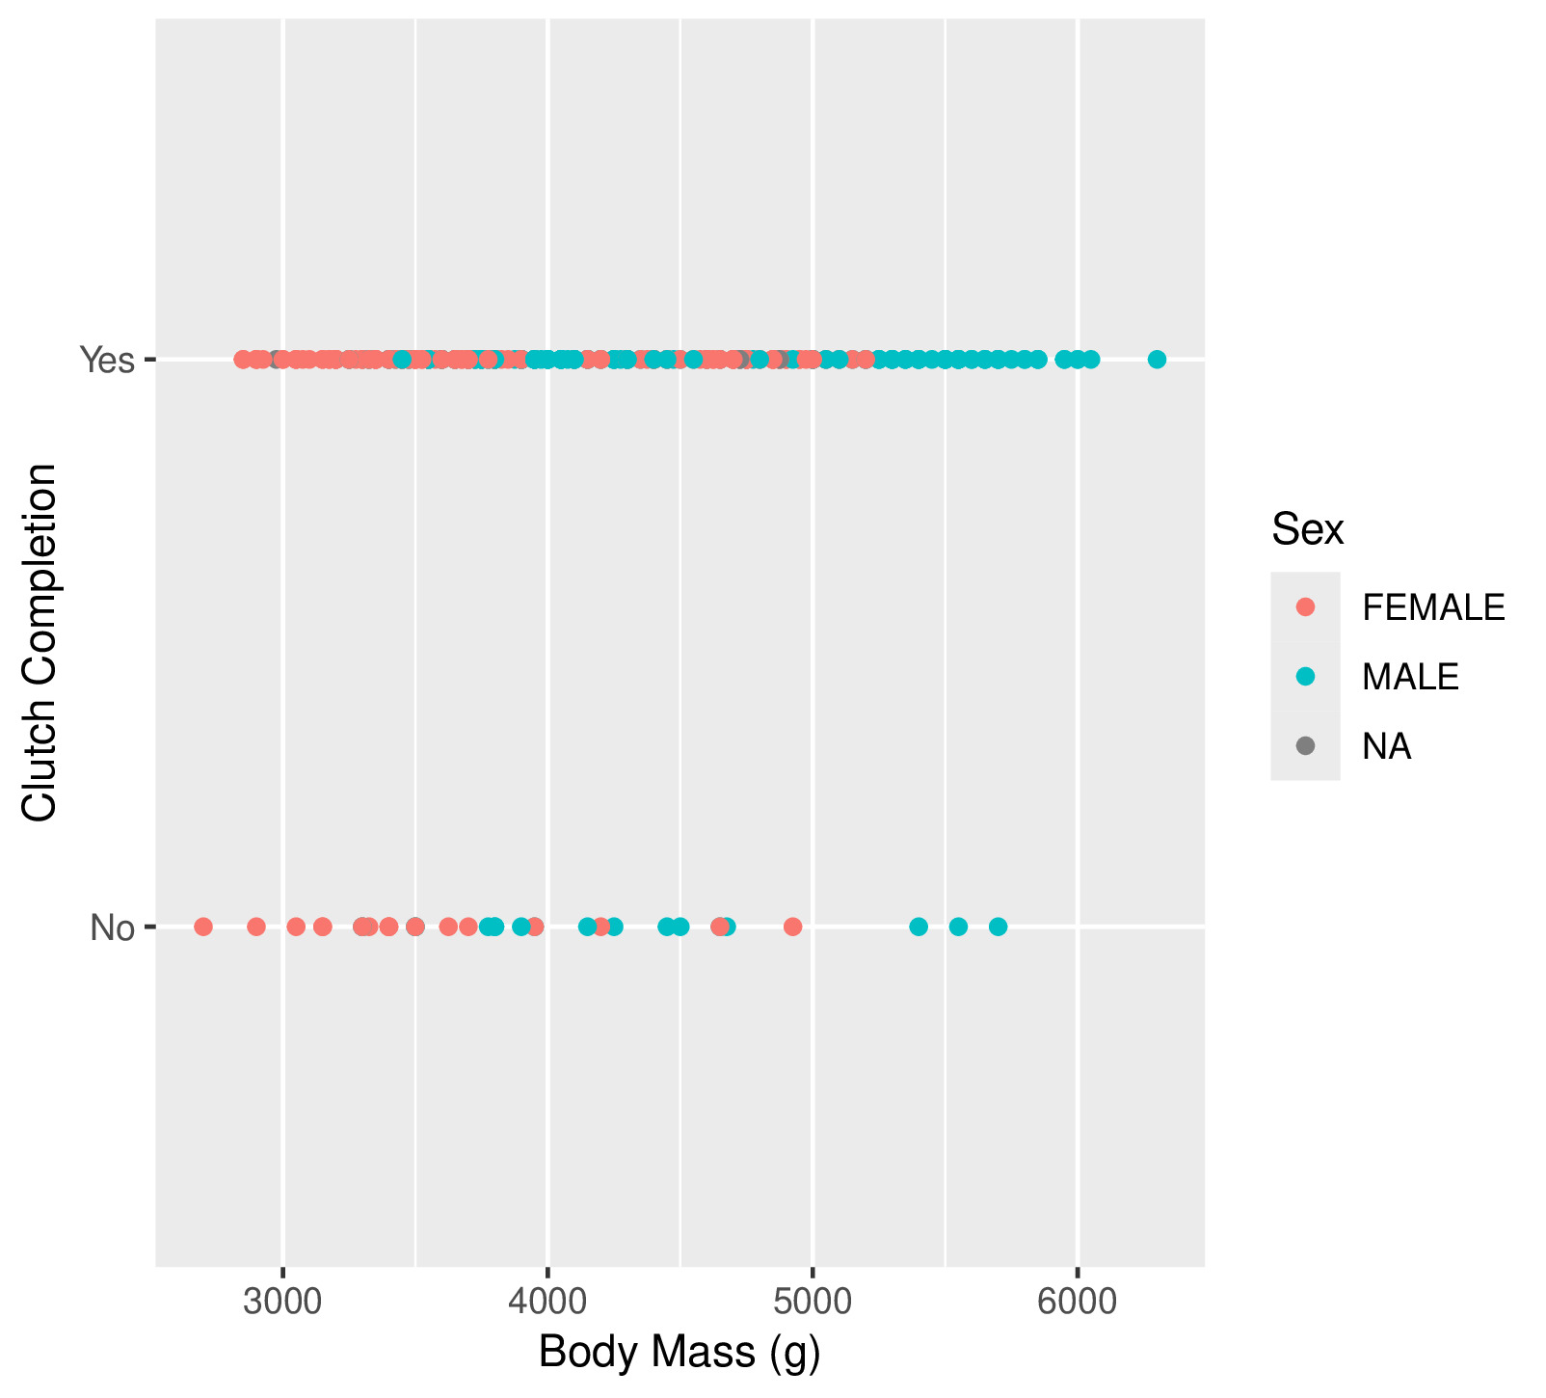

Slide 12
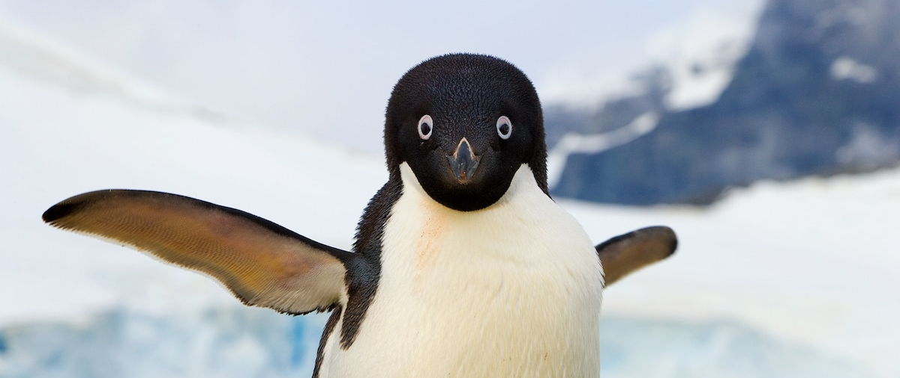
How does location, sex and species type affect flipper length?
Notes:
Does regional variation in environment affect flipper length?

Slide 13
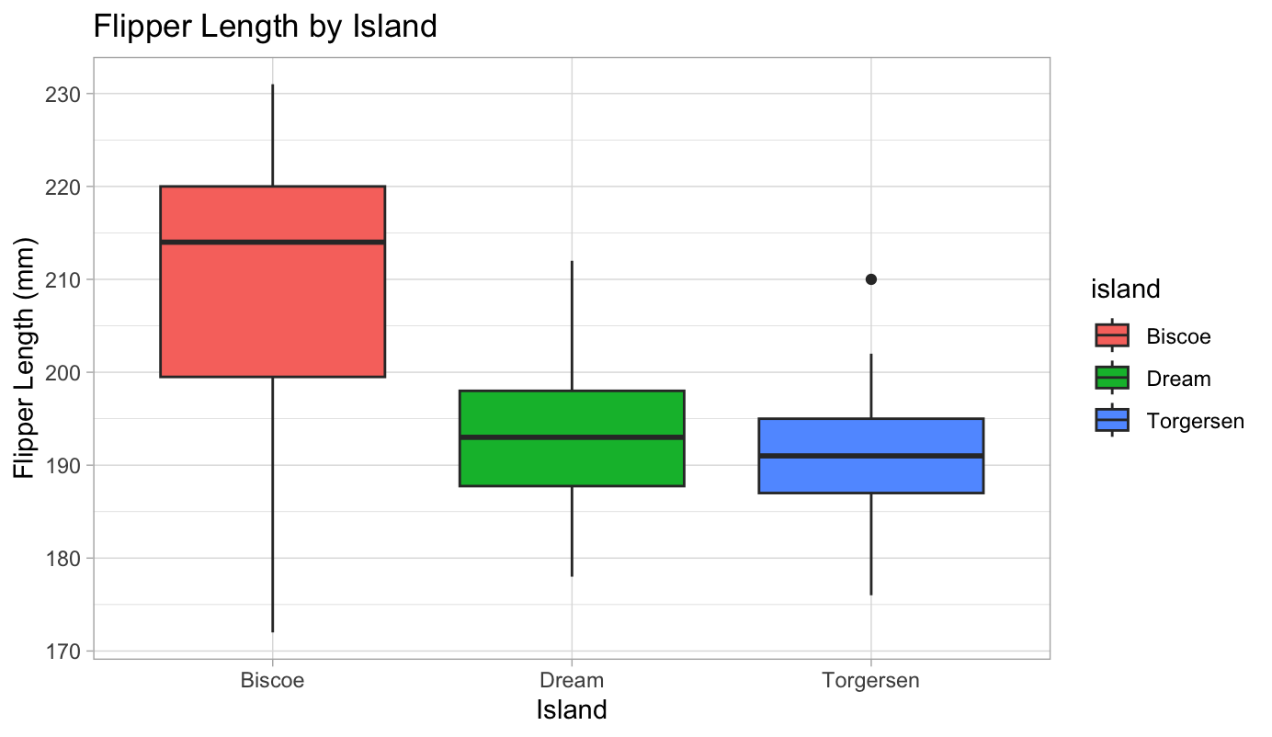
Notes:
Started looking at island and initially thought interesting – what's going on on Biscoe island that means the mean flipper size is so much longer? Are all the male and female penguins living on Biscoe?

Slide 14
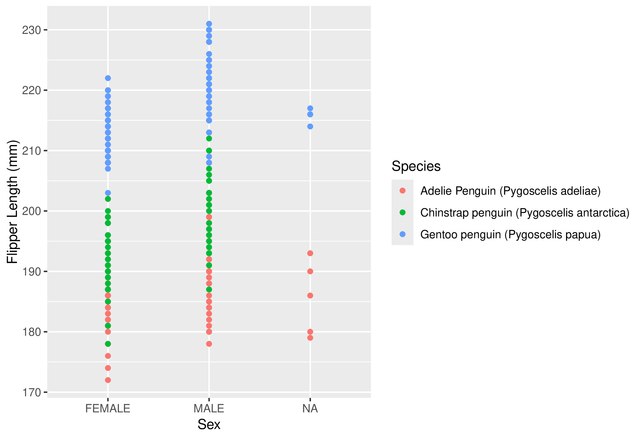

Slide 15
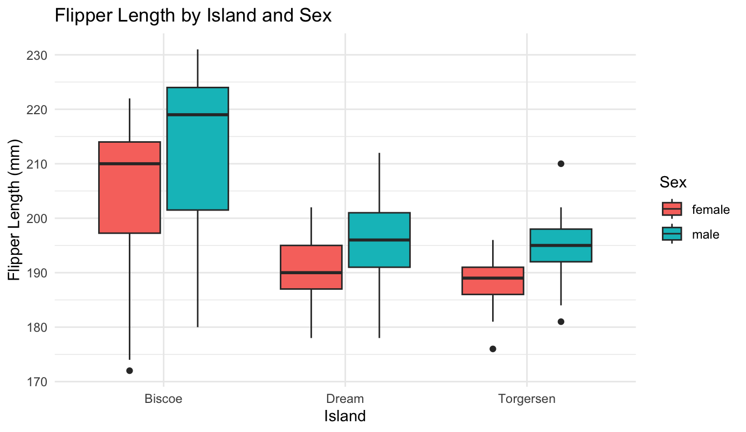
Notes:
Wanted to look at sex – does it affect flipper length, are all the male penguins living on Biscoe? Found it does seem to affect flipper length, true across all islands.

Slide 16
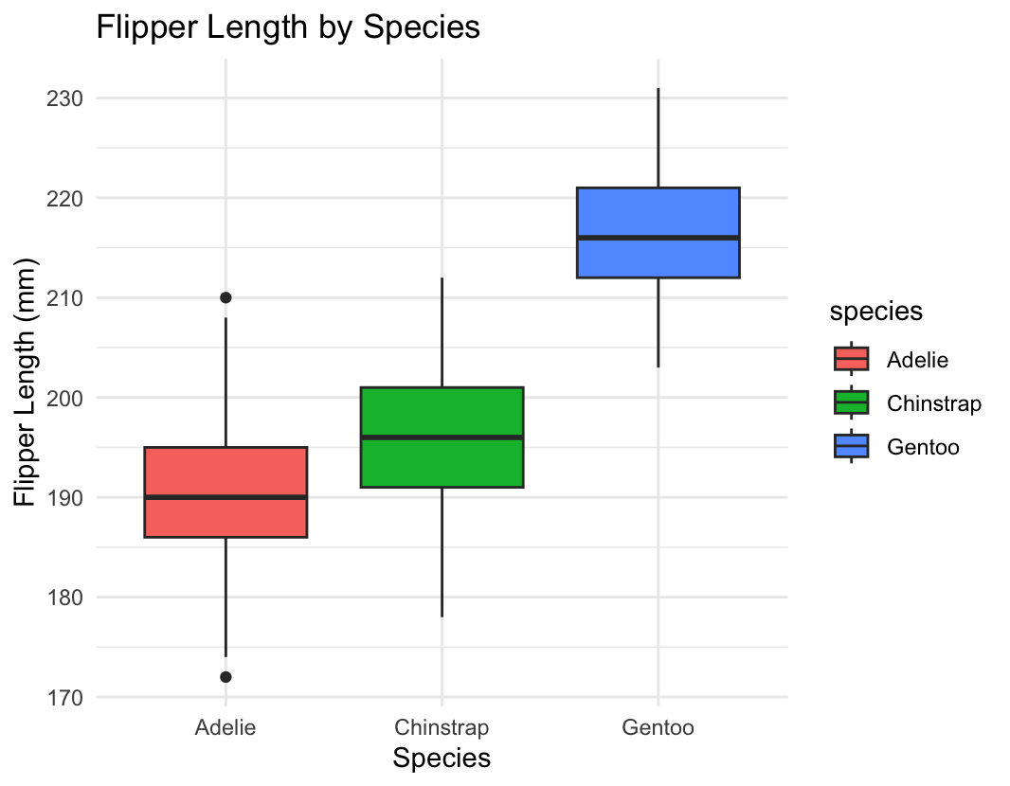
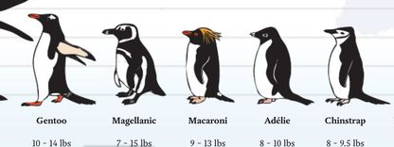
Notes:
Left species as the next variable. Does seem to significantly affect flipper length. But how does that relate to the islands? Re-looked at data and realized that species not distributed evenly across the islands, and ran box plot to confirm that species affects flipper length with Gentoo penguins having longest flippers. Gentoo penguins found on Biscoe island, explains that result.

Slide 17
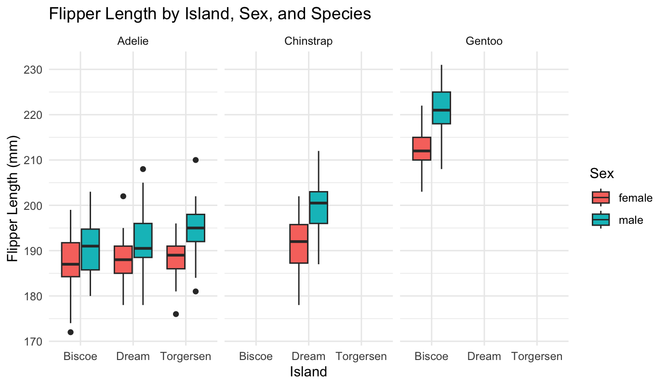
Flipper length by island, sex and species
Notes:
Plotted this all together. Adelie penguins only ones found on all three islands. Are differences in microclimates in Antartica leading tp physical differences in Adelie penguins?
Species is one thing, but environment can be the other – colder environments, need bigger flipprs to dive deeper for longer.
Does the island affect their flipper length?

Slide 18
Statistically significant for Adelie penguins?
ANOVA test:
What I'd do differently.
 | Pr(>F)
Island | 0.0985 .
Sex | 8.37e-06 ***
Island:sex | 0.3753
Notes:
Wasn't sure if I was seeing difference by island for Adelie penguins. Ran ANOVA test for flipper length , island and sex for Adelie penguins. Only statistically significant for sex.

Slide 19
Summary:
The bigger the body mass of a penguin the greater the likelihood of clutch completion
Clutch completion is greater when male penguins incubate the eggs.
Clutch completion is greater when the species is larger.
*Lower levels of nitrogen and carbon increased in body mass
Species is the only statistically significant variable that affects flipper length.

