Slide 1
Kubeflow Pipeline POC

Slide 2
KFP Pros
Repeatable experiments/results
Data preprocessing and modeling process are defined as KFP pipelines. The same results can be derived by running the same pipeline.
Retraceable artifacts
KFP keep track of all input/output artifacts(e.g., data, model file, metrics file) for each run.
Reusable components
A component, if well built and tested, can be reused easily in different pipelines. A complicated model can be wrapped in a black box for reuse by any team member.
KFP UI
KFP UI is a well adapted dashboard for ML problems.

Slide 3
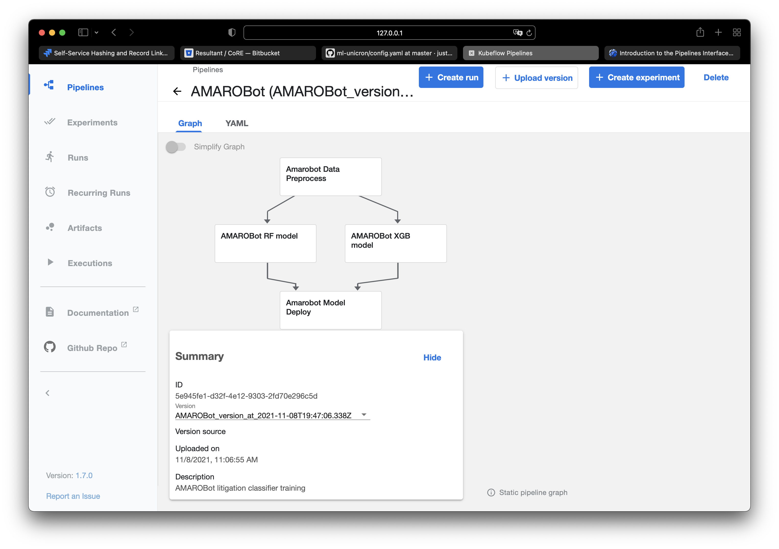
KFP Overview-Pipelines
KFP pipelines are DAG that contains the jobs to run.
Pipelines are defined in YAML or Python if using KFP SDK.
Pipelines are run on top of Kubernetes clusters.
KFP will keep track of all artifacts.
A pipeline can have different versions.
Each pipeline step is a component.
Each component is a containerized application.

Slide 4
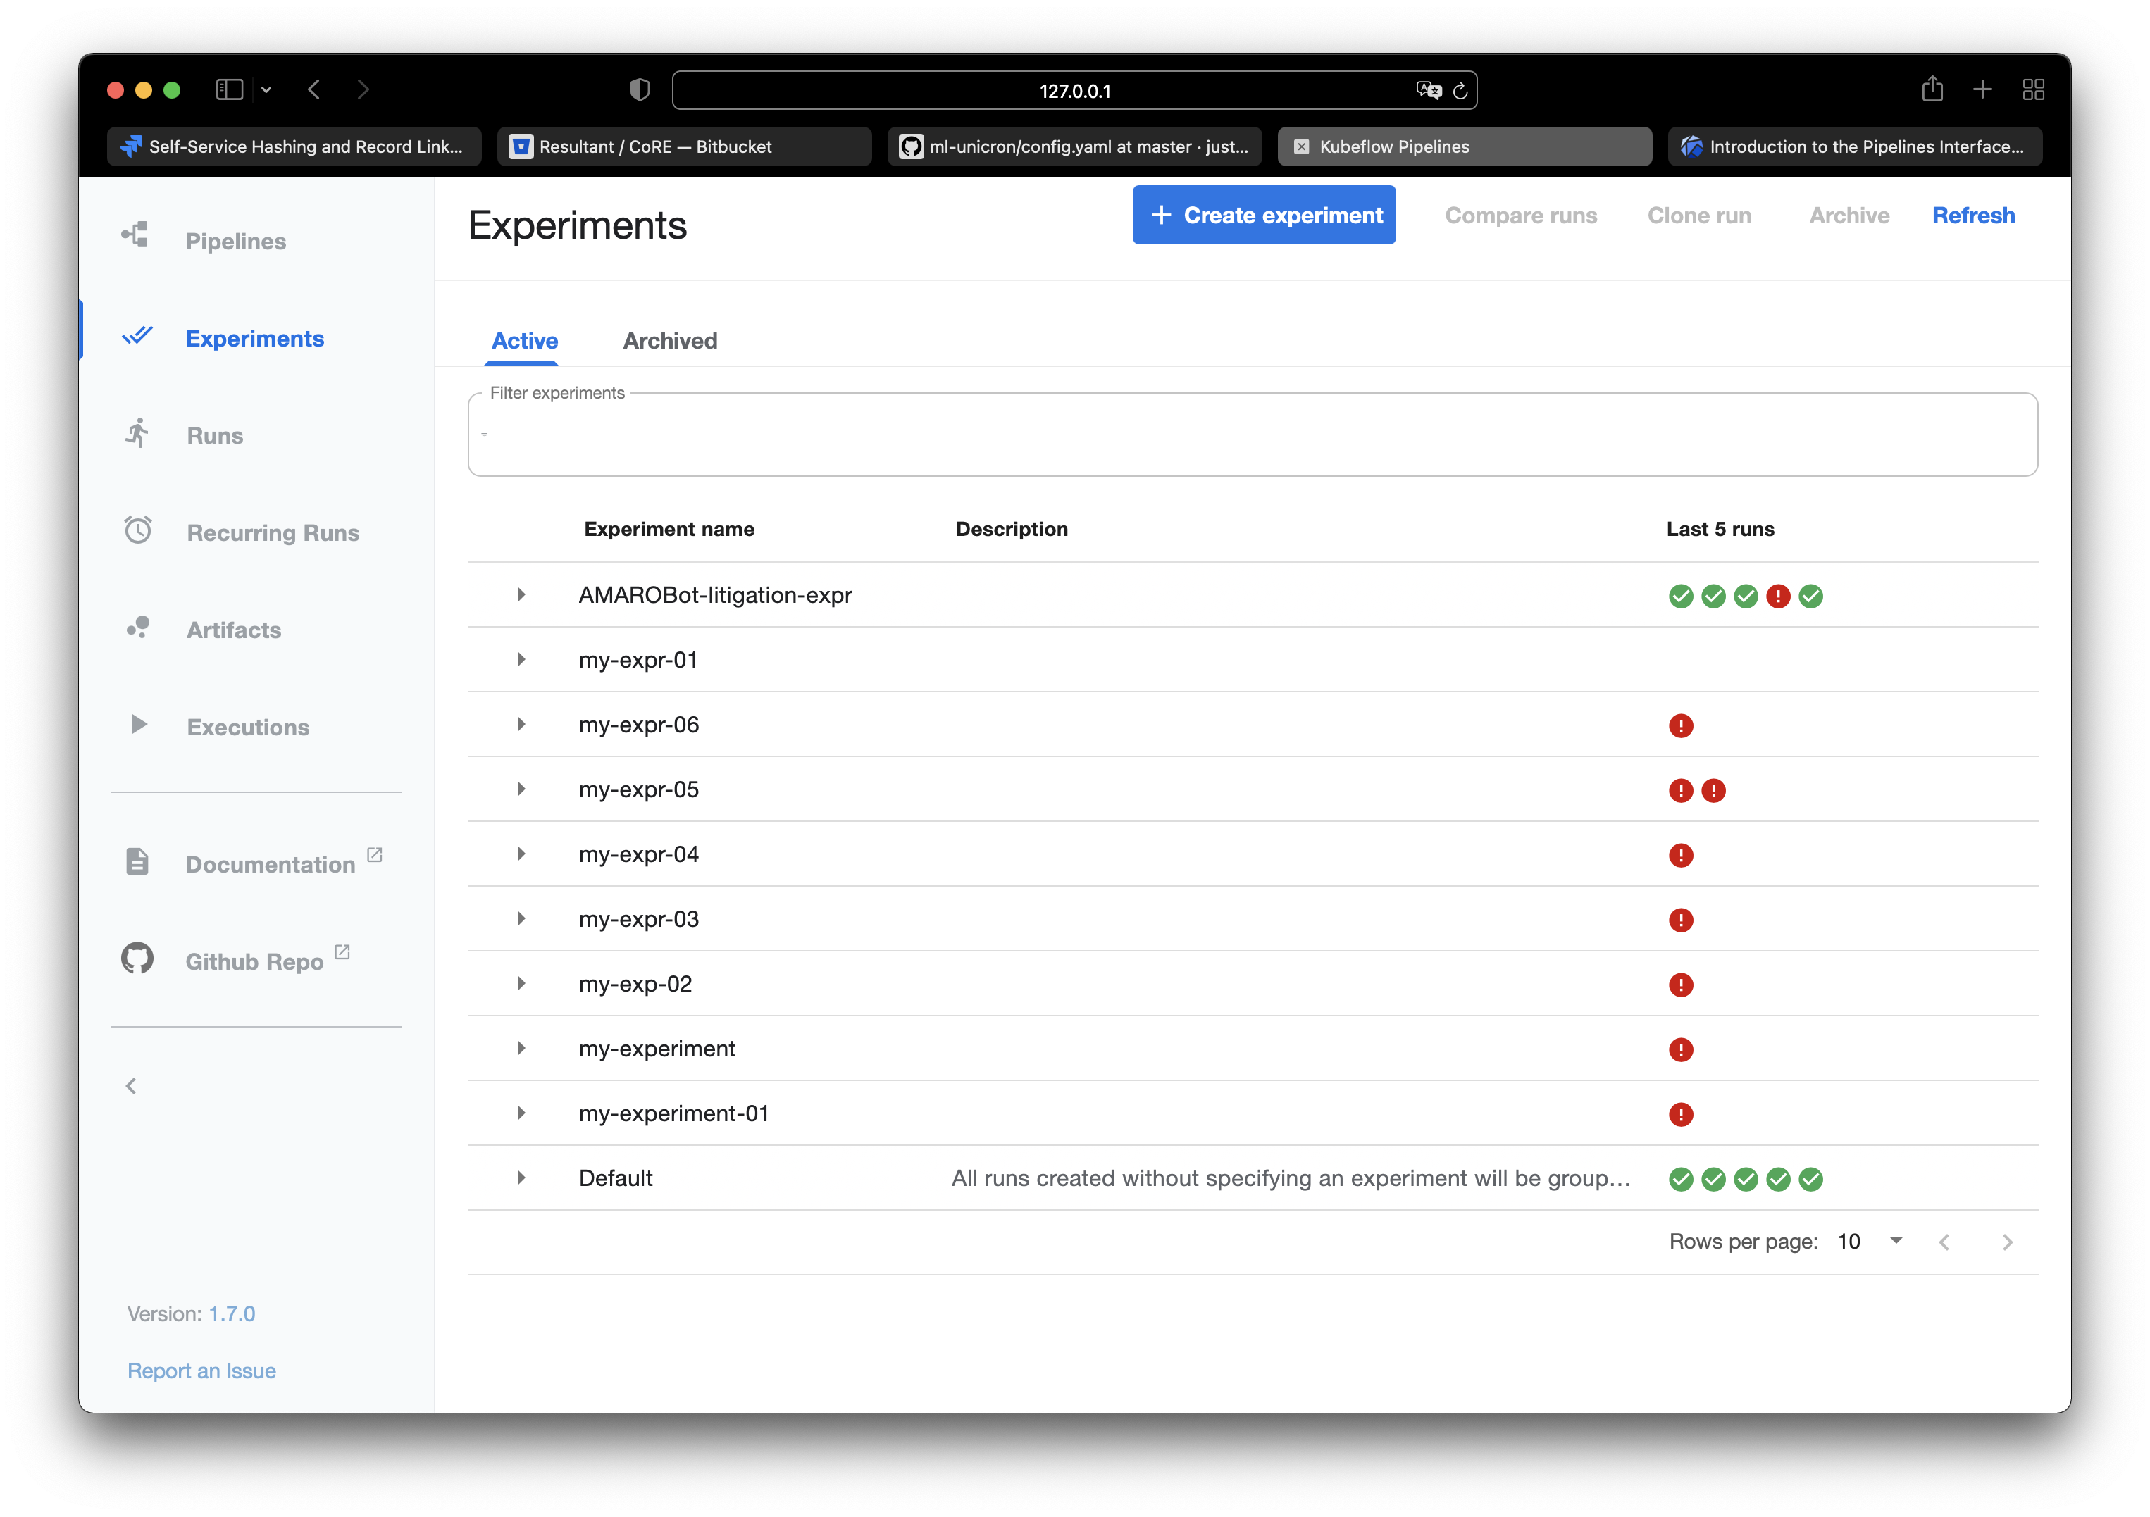
KFP Overview-Experiments
KFP Experiments are collections of multiple runs.
Experiments are good way to organize model training with different parameters.

Slide 5
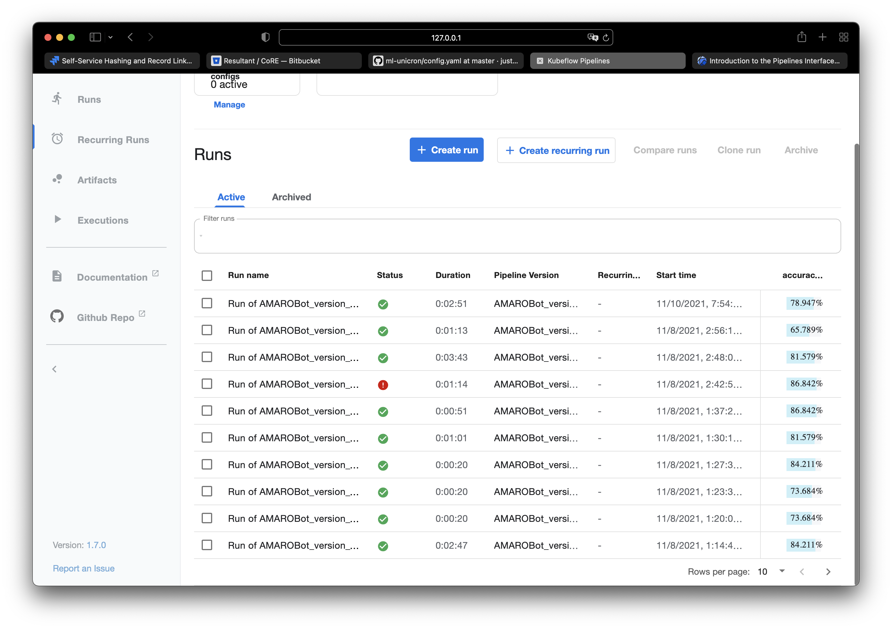
KFP Overview-Runs
Each run is an execution of all the jobs in the pipeline.
A score parameter(e.g., accuracy) can be declared as output for each run for comparison.
Runs are either one-off or scheduled.

Slide 6
KFP Concerns
It has a learning curve
Knowledge of Docker, KFP SDK, YAML, basic Kubernetes concepts are necessary.
In transition from SDK V1 to SDK V2
Documents are not keeping up
Some components are deprecated (e.g., python based visualization)
Not friendly to local debugging
It runs exclusive on Kubernetes clusters and require a container registries.
Not very intuitive to do local testing and debugging.

Slide 7
Requirements for Adopting KFP
Item | Estimated time cost
Environment setup: KFP, private container registry, code repo, Kubernetes cluster. | Days
Skills training for light users: YAML, KFP SDK | Days~Weeks
Skills training for heavy users: YAML, KFP SDK, Docker | Weeks
Quality monitoring of components and pipelines | NA

