Slide 1



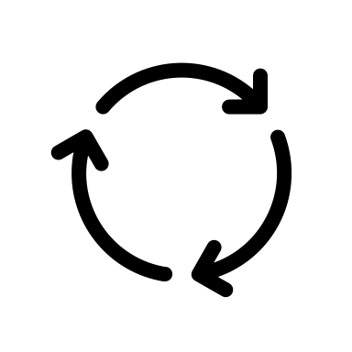
Recv Queue
Parse HTTP
Request Body
New Connection
👀
Accept
Main Thread
Net Thread
Worker Thread
EPOLL
Pack HTTP
Response Body
Send Queue

