Slide 1
Determining the Local Stress in an inhomogeneous solid
Michael Tonks

Slide 2
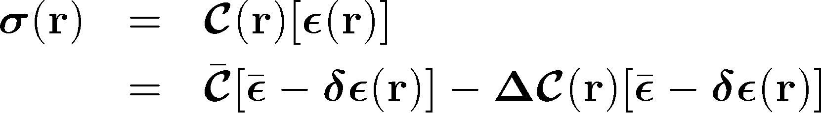
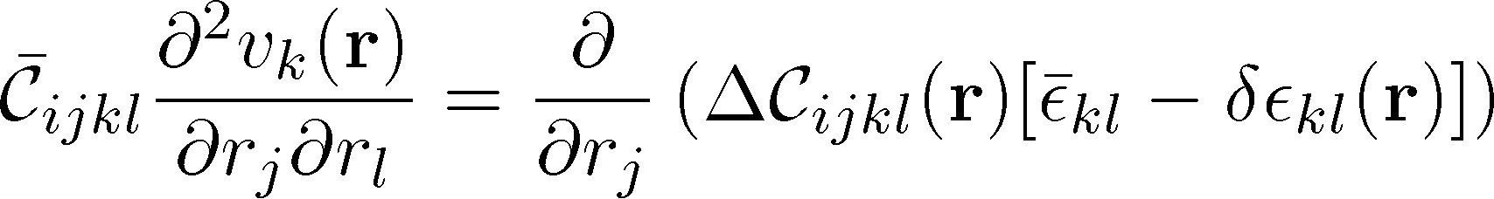
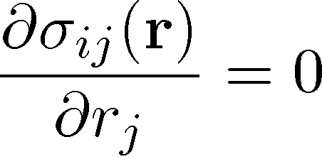

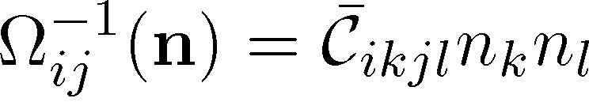
Stress Calculation
Consider an inhomogeneous linear elastic body
From stress equilibrium
Using a Fourier transform and solving for the strain gives
Wang et al., 2002, JAP, 92:3, 1351-1360

Slide 3
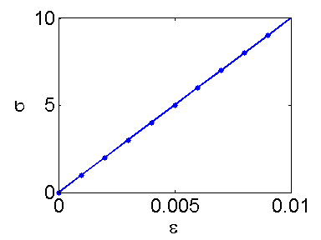

Code Verification
We first test the code on a simple isotropic homogeneous problem
Tensile test with small deformations (linear elastic)
  E = 1000, ν = 0.3
ε

Slide 4
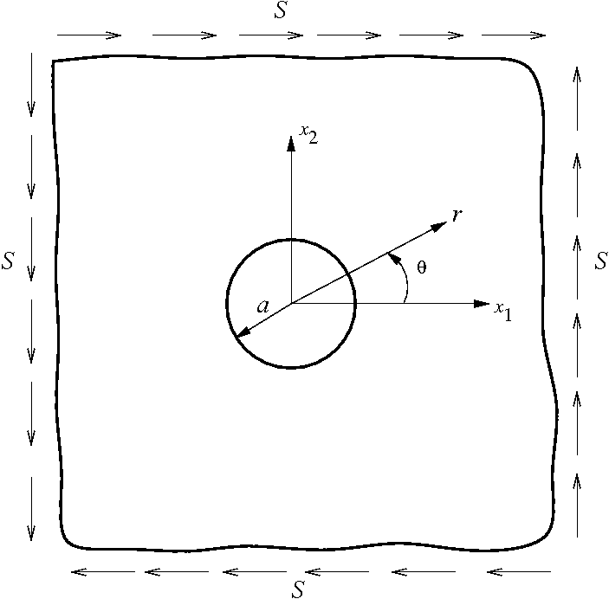
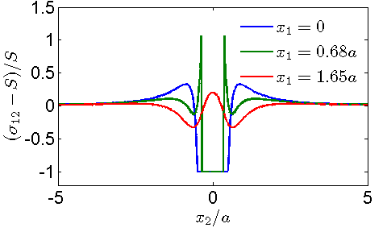
Plate in shear with a Circular Hole
We compare the analytical and computational solution
Computational
Analytical

Slide 5
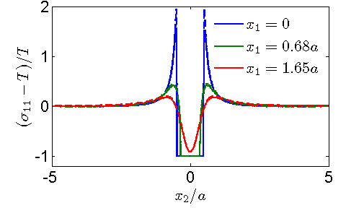
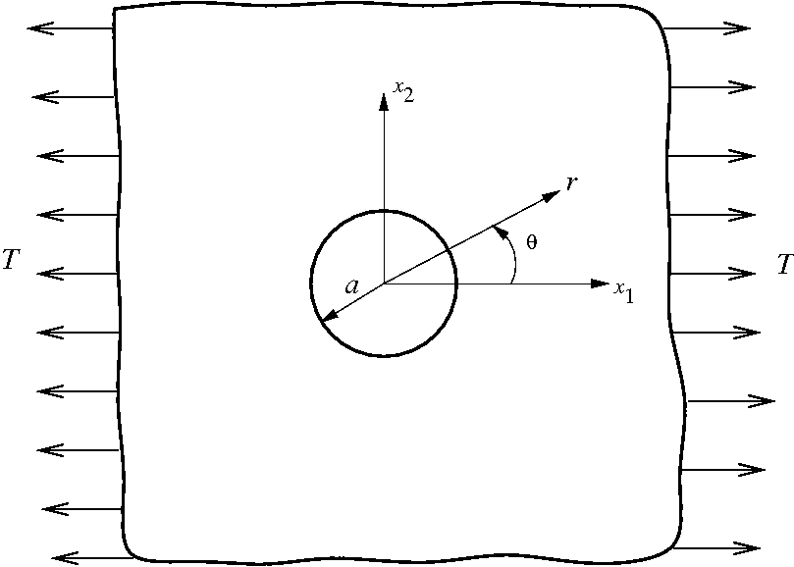
Plate in Tension with a Circular Hole
We compare the analytical and computational solution
Computational
Analytical

Slide 6
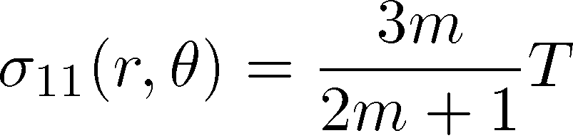
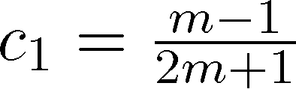
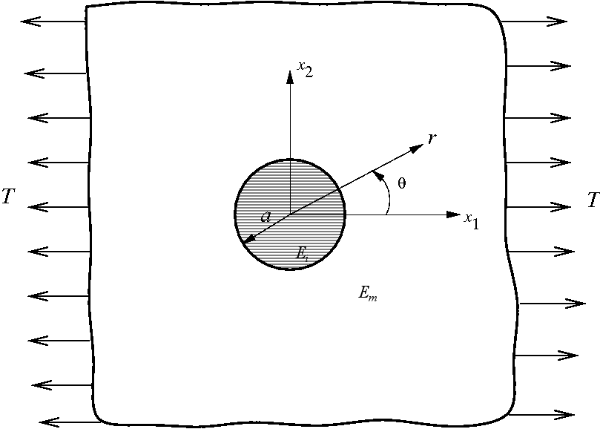
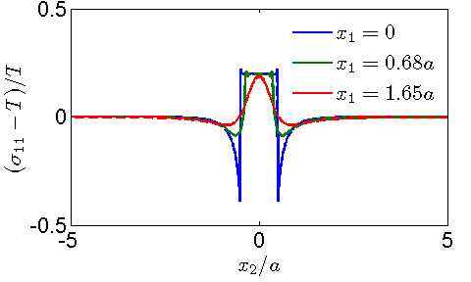
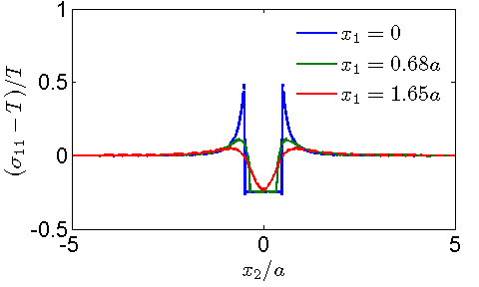

Plate in Tension with a Circular Inclusion
We compare the analytical and computational solution
inside the inclusion
Computational
Analytical
m = 0.5
m = 2.0

