Slide 1
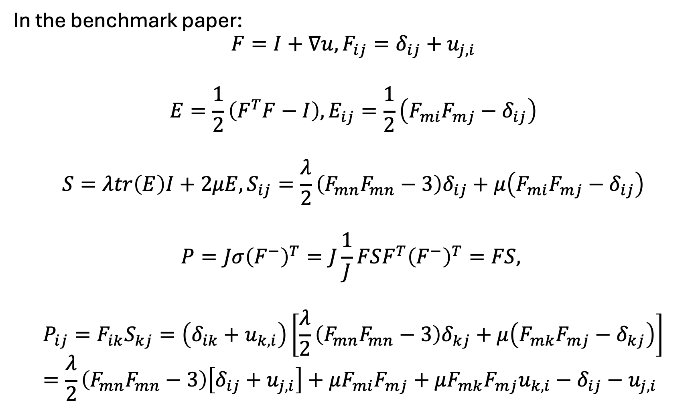
In the benchmark paper:
$$F=I+∇u, F_{ij}=δ_{ij}+u_{j,i}$$
$$E=\frac{1}{2}\left(F^{T}F−I\right), E_{ij}=\frac{1}{2}\left(F_{mi}F_{mj}−δ_{ij}\right)$$
$$S=λtr\left(E\right)I+2μE, S_{ij}=\frac{λ}{2}\left(F_{mn}F_{mn}−3\right)δ_{ij}+μ\left(F_{mi}F_{mj}−δ_{ij}\right)$$
$$P=Jσ{\left(F^{−}\right)}^{T}=J\frac{1}{J}FSF^{T}{\left(F^{−}\right)}^{T}=FS,$$
$$P_{ij}=F_{ik}S_{kj}=\left(δ_{ik}+u_{k,i}\right)\left[\frac{λ}{2}\left(F_{mn}F_{mn}−3\right)δ_{kj}+μ\left(F_{mk}F_{mj}−δ_{kj}\right)\right]=\frac{λ}{2}\left(F_{mn}F_{mn}−3\right)\left[δ_{ij}+u_{j,i}\right]+μF_{mi}F_{mj}+μF_{mk}F_{mj}u_{k,i}−δ_{ij}−u_{j,i}$$

Slide 2
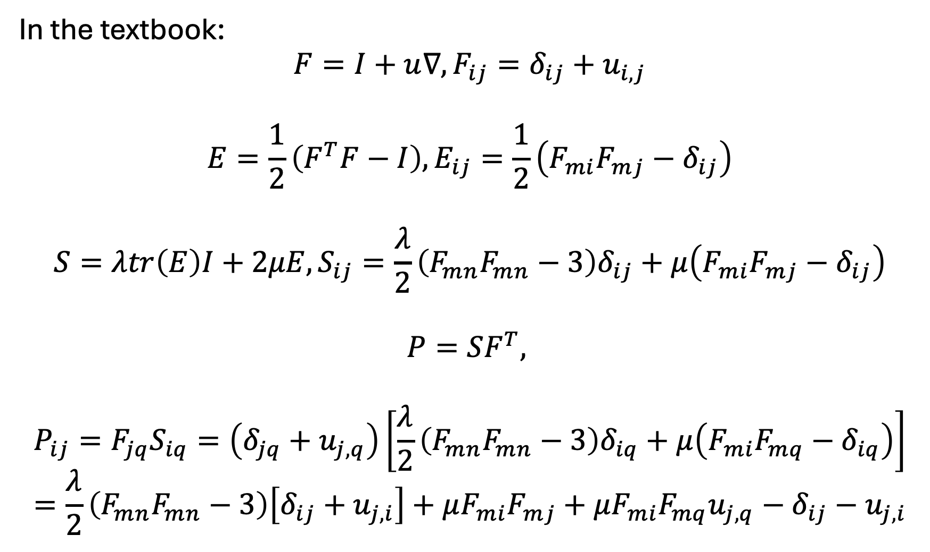
In the textbook:
$$F=I+u∇, F_{ij}=δ_{ij}+u_{i,j}$$
$$E=\frac{1}{2}\left(F^{T}F−I\right), E_{ij}=\frac{1}{2}\left(F_{mi}F_{mj}−δ_{ij}\right)$$
$$S=λtr\left(E\right)I+2μE, S_{ij}=\frac{λ}{2}\left(F_{mn}F_{mn}−3\right)δ_{ij}+μ\left(F_{mi}F_{mj}−δ_{ij}\right)$$
$$P=SF^{T},$$
$$P_{ij}=F_{jq}S_{iq}=\left(δ_{jq}+u_{j,q}\right)\left[\frac{λ}{2}\left(F_{mn}F_{mn}−3\right)δ_{iq}+μ\left(F_{mi}F_{mq}−δ_{iq}\right)\right]=\frac{λ}{2}\left(F_{mn}F_{mn}−3\right)\left[δ_{ij}+u_{j,i}\right]+μF_{mi}F_{mj}+μF_{mi}F_{mq}u_{j,q}−δ_{ij}−u_{j,i}$$

Slide 3
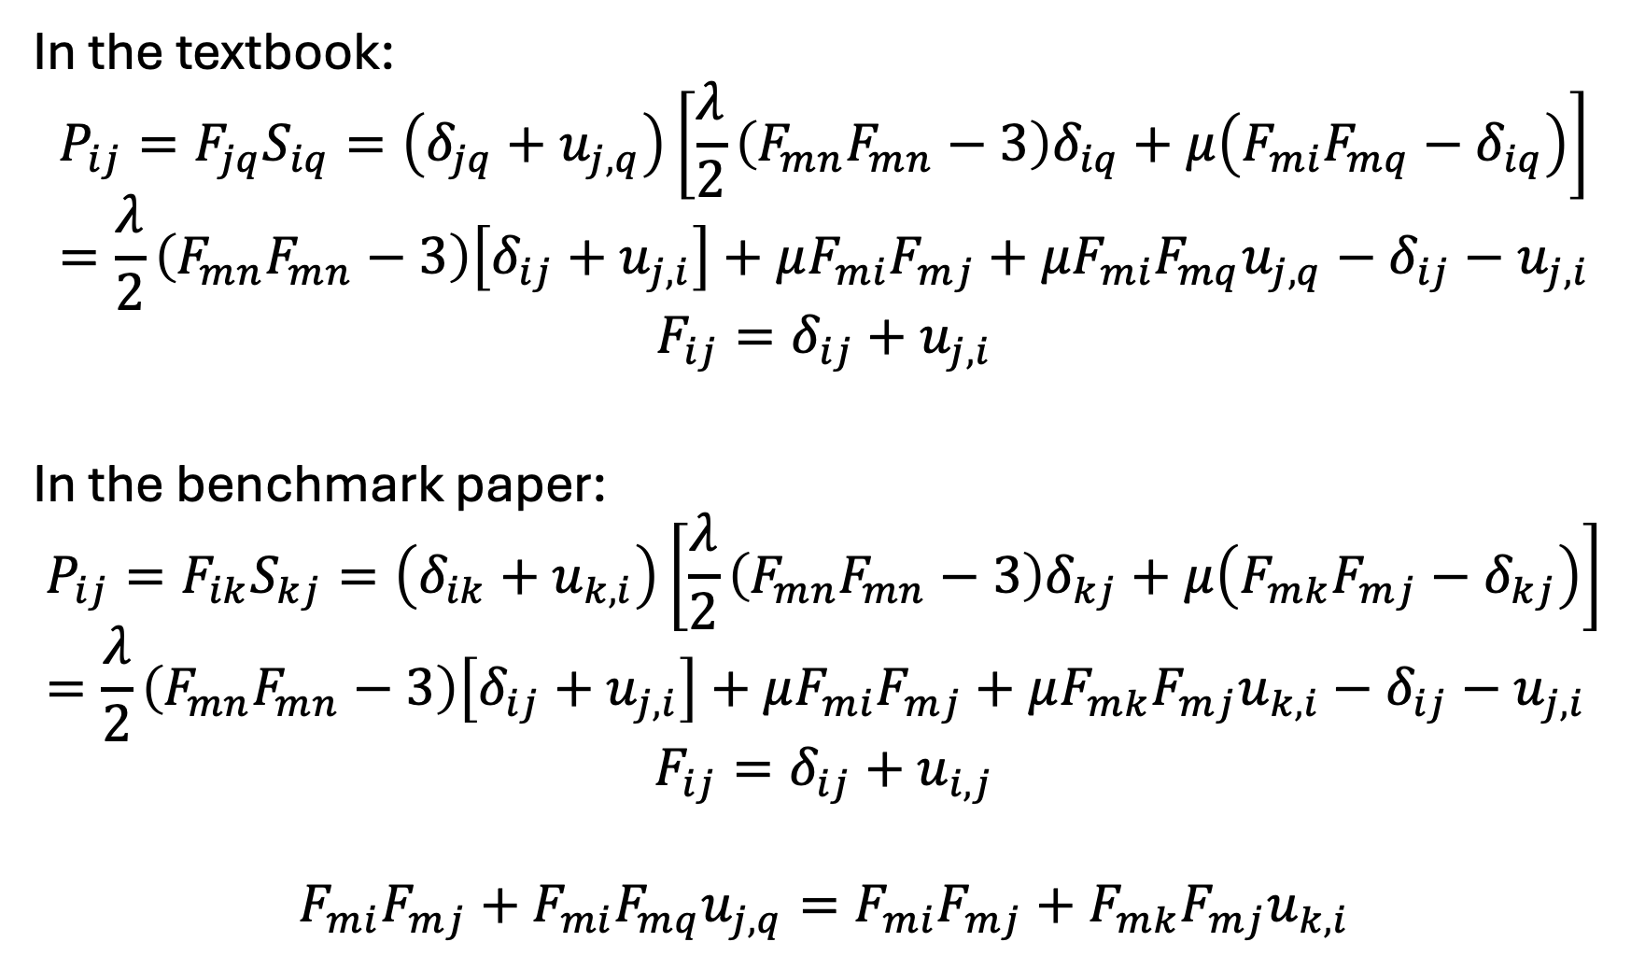
In the textbook:
$$P_{ij}=F_{jq}S_{iq}=\left(δ_{jq}+u_{j,q}\right)\left[\frac{λ}{2}\left(F_{mn}F_{mn}−3\right)δ_{iq}+μ\left(F_{mi}F_{mq}−δ_{iq}\right)\right]=\frac{λ}{2}\left(F_{mn}F_{mn}−3\right)\left[δ_{ij}+u_{j,i}\right]+μF_{mi}F_{mj}+μF_{mi}F_{mq}u_{j,q}−δ_{ij}−u_{j,i}$$
$$F_{ij}=δ_{ij}+u_{j,i}$$
In the benchmark paper:
$$P_{ij}=F_{ik}S_{kj}=\left(δ_{ik}+u_{k,i}\right)\left[\frac{λ}{2}\left(F_{mn}F_{mn}−3\right)δ_{kj}+μ\left(F_{mk}F_{mj}−δ_{kj}\right)\right]=\frac{λ}{2}\left(F_{mn}F_{mn}−3\right)\left[δ_{ij}+u_{j,i}\right]+μF_{mi}F_{mj}+μF_{mk}F_{mj}u_{k,i}−δ_{ij}−u_{j,i}$$
$$F_{ij}=δ_{ij}+u_{i,j}$$
$$F_{mi}F_{mj}+F_{mi}F_{mq}u_{j,q}=F_{mi}F_{mj}+F_{mk}F_{mj}u_{k,i}$$
$$?$$
$$F_{ij}=δ_{ij}+u_{j,i}$$
$$F_{ij}=δ_{ij}+u_{i,j}$$
$$F_{ij}=δ_{ij}+u_{j,i}$$

Slide 4
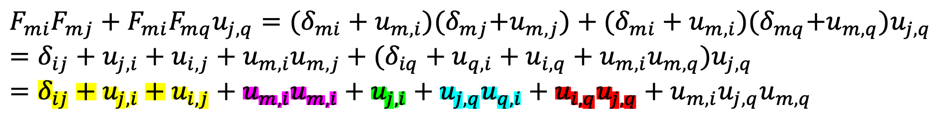
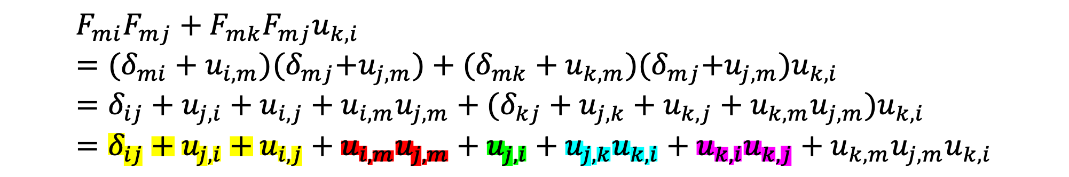
In the textbook, $F_{ij}=δ_{ij}+u_{i,j}$:
$$F_{mi}F_{mj}+F_{mi}F_{mq}u_{j,q}=(δ_{mi}+u_{m,i}){(δ}_{mj}+u_{m,j})+(δ_{mi}+u_{m,i}){(δ}_{mq}+u_{m,q})u_{j,q}=δ_{ij}+u_{j,i}+u_{i,j}+u_{m,i}u_{m,j}+(δ_{iq}+u_{q,i}+u_{i,q}+u_{m,i}u_{m,q})u_{j,q}=δ_{ij}+u_{j,i}+u_{i,j}+u_{m,i}u_{m,i}+u_{j,i}+u_{j,q}u_{q,i}+u_{i,q}u_{j,q}+u_{m,i}{u_{j,q}u}_{m,q}$$
In the benchmark paper, $F_{ij}=δ_{ij}+u_{j,i}$:
$$F_{mi}F_{mj}+F_{mk}F_{mj}u_{k,i}=(δ_{mi}+u_{i,m}){(δ}_{mj}+u_{j,m})+(δ_{mk}+u_{k,m}){(δ}_{mj}+u_{j,m})u_{k,i}=δ_{ij}+u_{j,i}+u_{i,j}+u_{i,m}u_{j,m}+(δ_{kj}+u_{j,k}+u_{k,j}+u_{k,m}u_{j,m})u_{k,i}=δ_{ij}+u_{j,i}+u_{i,j}+u_{i,m}u_{j,m}+u_{j,i}+u_{j,k}u_{k,i}+u_{k,i}u_{k,j}+u_{k,m}{u_{j,m}u}_{k,i}$$
Same!

Slide 5
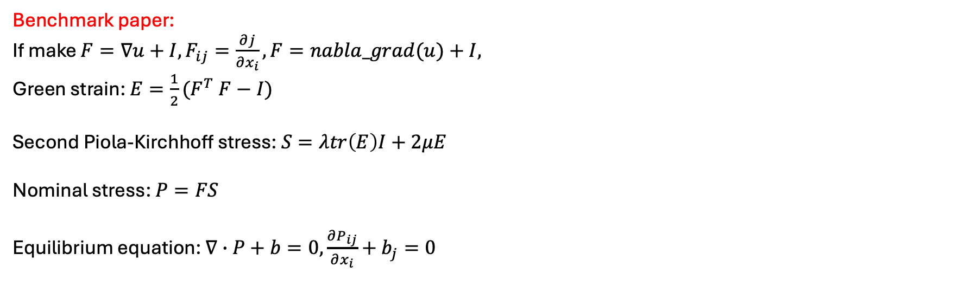
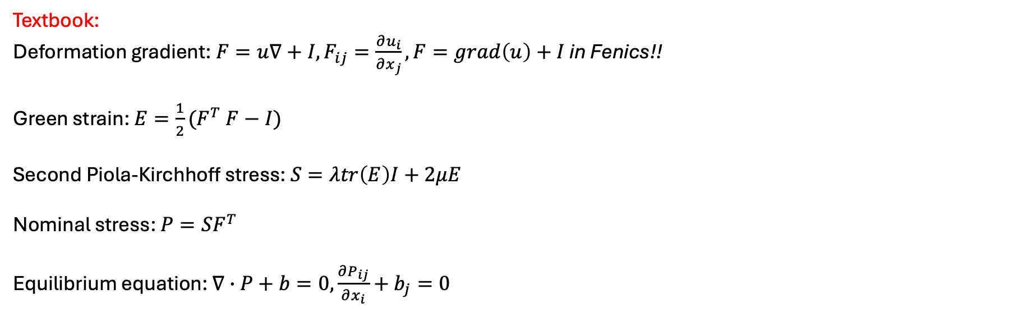
Textbook:
Deformation gradient: $F=u∇+I, F_{ij}=\frac{∂u_{i}}{∂x_{j}}, F=grad\left(u\right)+I$ in Fenics!!
Green strain: $E=\frac{1}{2}(F^{T} F−I)$
Second Piola-Kirchhoff stress: $S=λtr\left(E\right)I+2μE$
Nominal stress: $P=SF^{T}$
Equilibrium equation: $∇∙P+b=0,\frac{∂P_{ij}}{∂x_{i}}+b_{j}=0$
Benchmark paper:
If make $F=∇u+I,F_{ij}=\frac{∂j}{∂x_{i}}, F=nabla_grad(u)+I,$
Green strain: $E=\frac{1}{2}(F^{T} F−I)$
Second Piola-Kirchhoff stress: $S=λtr\left(E\right)I+2μE$
Nominal stress: $P=FS$
Equilibrium equation: $∇∙P+b=0,\frac{∂P_{ij}}{∂x_{i}}+b_{j}=0$

