Slide 1
Introducing springs to represent the tortional tube

Slide 2





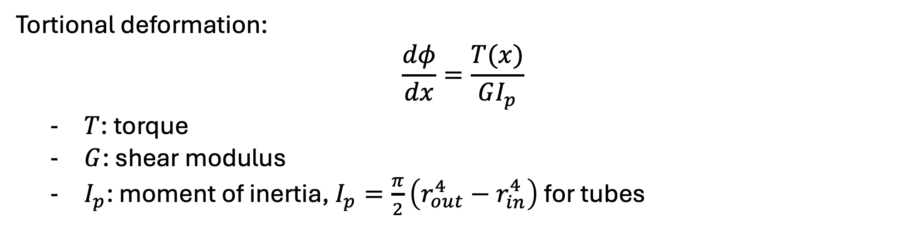






$$T_{1}$$
$$T_{2}$$
$$T_{3}$$
$$T_{4}$$
$$T_{n}$$
……
$$x_{1}$$
$$x_{2}$$
$$x_{3}$$
$$x_{4}$$
$$x_{n}$$
$$x$$
Tortional deformation:
$$\frac{dφ}{dx}=\frac{T(x)}{GI_{p}}$$
$T$: torque
$G$: shear modulus
$I_{p}$: moment of inertia, $I_{p}=\frac{π}{2}\left(r_{out}^{4}−r_{in}^{4}\right)$ for tubes

Slide 3





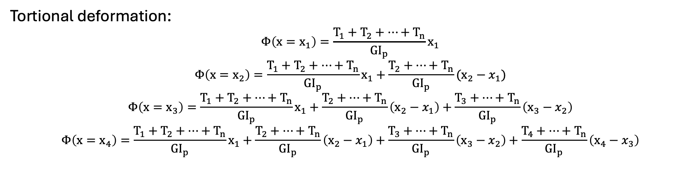






$$T_{1}$$
$$T_{2}$$
$$T_{3}$$
$$T_{4}$$
$$T_{n}$$
……
$$x_{1}$$
$$x_{2}$$
$$x_{3}$$
$$x_{4}$$
$$x_{n}$$
$$x$$
Tortional deformation:
$$Φ\left(x=x_{1}\right)=\frac{T_{1}+T_{2}+…+T_{n}}{{GI}_{p}}x_{1}$$
$$Φ\left(x=x_{2}\right)=\frac{T_{1}+T_{2}+…+T_{n}}{{GI}_{p}}x_{1}+\frac{T_{2}+…+T_{n}}{{GI}_{p}}(x_{2}−x_{1})$$
$$Φ\left(x=x_{3}\right)=\frac{T_{1}+T_{2}+…+T_{n}}{{GI}_{p}}x_{1}+\frac{T_{2}+…+T_{n}}{{GI}_{p}}\left(x_{2}−x_{1}\right)+\frac{T_{3}+…+T_{n}}{{GI}_{p}}\left(x_{3}−x_{2}\right)$$
$$Φ\left(x=x_{4}\right)=\frac{T_{1}+T_{2}+…+T_{n}}{{GI}_{p}}x_{1}+\frac{T_{2}+…+T_{n}}{{GI}_{p}}\left(x_{2}−x_{1}\right)+\frac{T_{3}+…+T_{n}}{{GI}_{p}}\left(x_{3}−x_{2}\right)+\frac{T_{4}+…+T_{n}}{{GI}_{p}}\left(x_{4}−x_{3}\right)$$

Slide 4






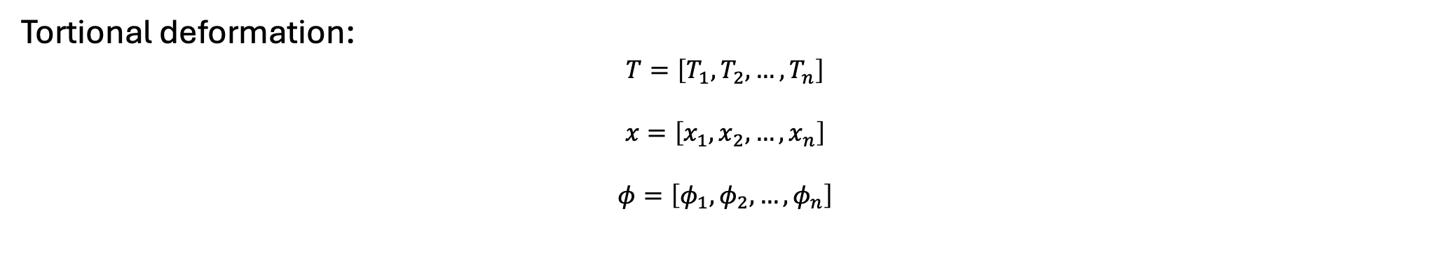






$$T_{1}$$
$$T_{2}$$
$$T_{3}$$
$$T_{4}$$
$$T_{n}$$
……
$$x_{1}$$
$$x_{2}$$
$$x_{3}$$
$$x_{4}$$
$$x_{n}$$
$$x$$
Tortional deformation:
$$T=\left[T_{1}, T_{2},…,T_{n}\right]$$
$$x=\left[x_{1}, x_{2},…,x_{n}\right]$$
$$φ=\left[φ_{1}, φ_{2},…,φ_{n}\right]$$

Slide 5


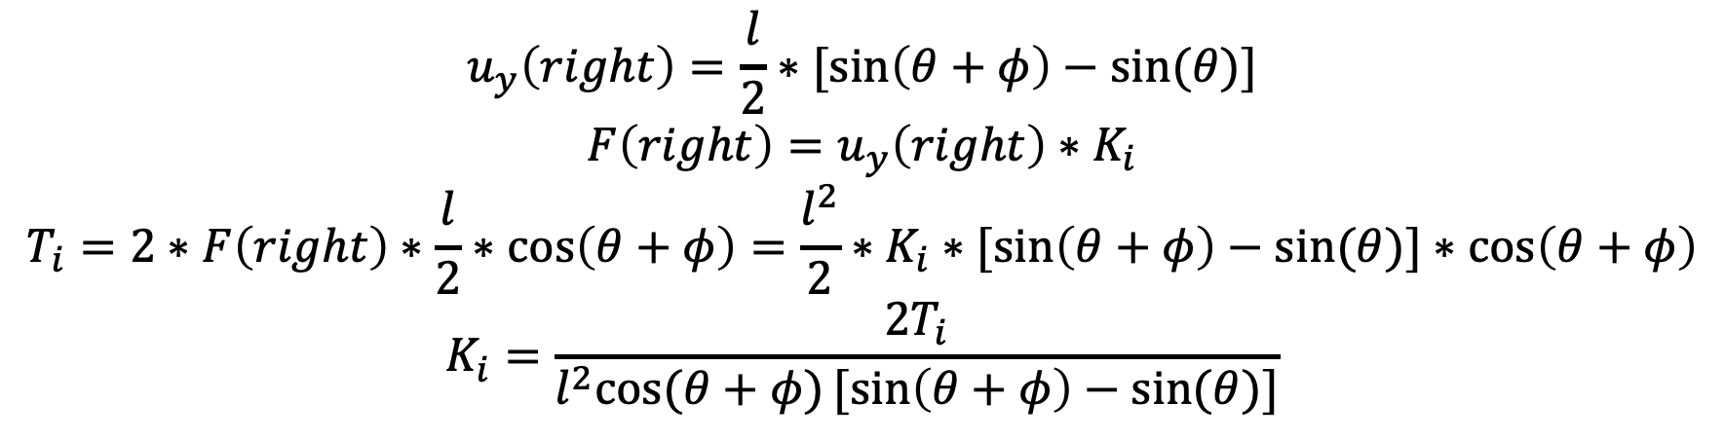
$$θ+φ$$
$$θ$$
$$u_{y}\left(right\right)=\frac{l}{2}∗[sin\left(θ+φ\right)−sin⁡(θ)]$$
$$F\left(right\right)=u_{y}\left(right\right)∗K_{i}$$
$$T_{i}=2∗F\left(right\right)∗\frac{l}{2}∗\cos\left(θ+φ\right)=\frac{l^{2}}{2}∗K_{i}∗[sin\left(θ+φ\right)−sin⁡(θ)]∗\cos\left(θ+φ\right)$$
$$K_{i}=\frac{2T_{i}}{l^{2}cos⁡(θ+φ)[sin\left(θ+φ\right)−sin⁡(θ)]}$$

Slide 6
Introducing stiffer material around center of panels

Slide 7
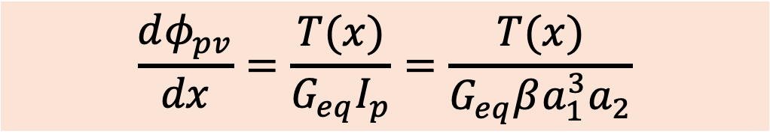

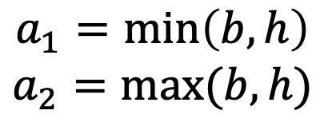


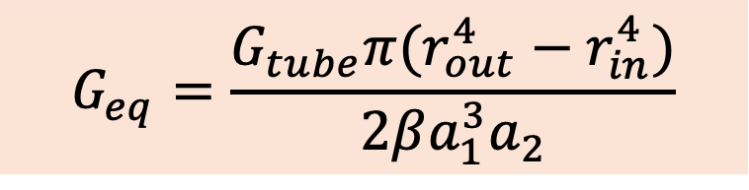

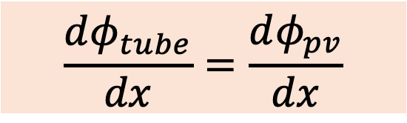
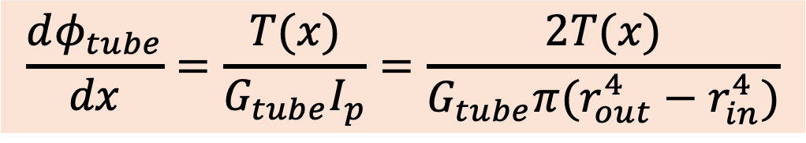
$$r_{in}$$
$$\frac{dφ_{tube}}{dx}=\frac{T(x)}{G_{tube}I_{p}}=\frac{2T(x)}{G_{tube}π(r_{out}^{4}−r_{in}^{4})}$$
$$r_{out }$$
$$a_{1}=\min\left(b,h\right)$$
$$a_{2}=max⁡(b,h)$$
$$\frac{dφ_{pv}}{dx}=\frac{T(x)}{G_{eq}I_{p}}=\frac{T(x)}{G_{eq}βa_{1}^{3}a_{2}}$$
$$h$$
$$a_{2}/a_{1}$$ | 1 | 1.2 | 1.5 | 1.75 | 2.0 | 2.5 | 3 | 4 | 6 | 8 | 10 | $$∞$$
$$β$$ | 0.141 | 0.166 | 0.196 | 0.214 | 0.229 | 0.249 | 0.263 | 0.281 | 0.299 | 0.307 | 0.313 | 0.333
$$b$$
$$\frac{dφ_{tube}}{dx}=\frac{dφ_{pv}}{dx}$$
$$G_{eq}=\frac{G_{tube}π(r_{out}^{4}−r_{in}^{4})}{2βa_{1}^{3}a_{2}}$$

Slide 8
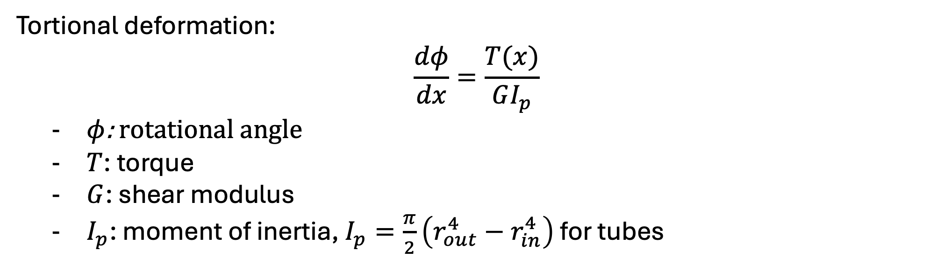
$$T_{1}$$
$$T_{2}$$
$$T_{3}$$
$$T_{4}$$
$$T_{n}$$
Robin BC
……
$$x_{1}$$
$$x_{2}$$
$$x_{3}$$
$$x_{4}$$
$$x_{n}$$
$$x$$
Tortional deformation:
$$\frac{dφ}{dx}=\frac{T(x)}{GI_{p}}$$
$φ$: rotational angle
$T$: torque
$G$: shear modulus
$I_{p}$: moment of inertia, $I_{p}=\frac{π}{2}\left(r_{out}^{4}−r_{in}^{4}\right)$ for tubes

Slide 9
Replace Torque tube by connected springs connected to center of panels

Slide 10
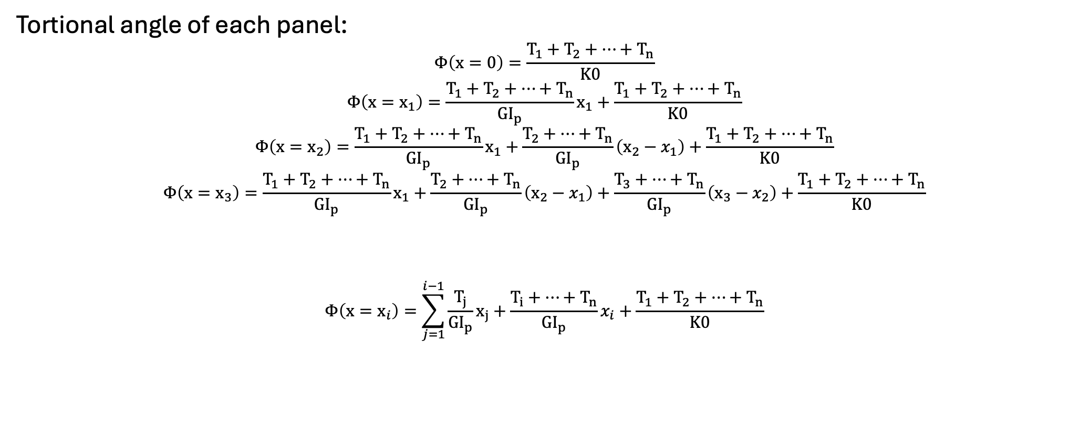
Consider tube only:
$$T_{1}$$
$$T_{2}$$
$$T_{3}$$
$$T_{4}$$
$$T_{n}$$
Robin BC
……
$$x_{1}$$
$$x_{2}$$
$$x_{3}$$
$$x_{4}$$
$$x_{n}$$
$$x$$
Tortional angle of each panel:
$$Φ\left(x=0\right)=\frac{T_{1}+T_{2}+…+T_{n}}{K0}$$
$$Φ\left(x=x_{1}\right)=\frac{T_{1}+T_{2}+…+T_{n}}{{GI}_{p}}x_{1}+\frac{T_{1}+T_{2}+…+T_{n}}{K0}$$
$$Φ\left(x=x_{2}\right)=\frac{T_{1}+T_{2}+…+T_{n}}{{GI}_{p}}x_{1}+\frac{T_{2}+…+T_{n}}{{GI}_{p}}\left(x_{2}−x_{1}\right)+\frac{T_{1}+T_{2}+…+T_{n}}{K0}$$
$$Φ\left(x=x_{3}\right)=\frac{T_{1}+T_{2}+…+T_{n}}{{GI}_{p}}x_{1}+\frac{T_{2}+…+T_{n}}{{GI}_{p}}\left(x_{2}−x_{1}\right)+\frac{T_{3}+…+T_{n}}{{GI}_{p}}\left(x_{3}−x_{2}\right)+\frac{T_{1}+T_{2}+…+T_{n}}{K0}$$
$$Φ\left(x=x_{i}\right)=\sum_{j=1}^{i−1}{\frac{T_{j}}{{GI}_{p}}x_{j}}+\frac{T_{i}+…+T_{n}}{{GI}_{p}}x_{i}+\frac{T_{1}+T_{2}+…+T_{n}}{K0}$$
……..

Slide 11
$$T_{1}$$
$$T_{2}$$
$$T_{3}$$
$$T_{4}$$
$$T_{n}$$
Robin BC
……
$$x_{1}$$
$$x_{2}$$
$$x_{3}$$
$$x_{4}$$
$$x_{n}$$
$$x$$
Tortional deformation:
$$T=\left[T_{1}, T_{2},…,T_{n}\right]$$
$$x=\left[x_{1}, x_{2},…,x_{n}\right]$$
$$φ=\left[φ_{1}, φ_{2},…,φ_{n}\right]$$

Slide 12
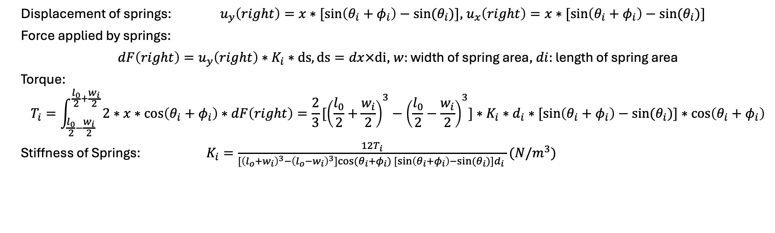



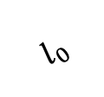
Robin boundary condition along height:
$$x$$
$$w_{i}$$
$$l_{0}$$
$$θ_{i}+φ_{i}$$
$$θ_{i}$$
$$d_{i}$$
Displacement of springs: $u_{y}\left(right\right)=x∗[sin\left(θ_{i}+φ_{i}\right)−sin⁡(θ_{i})]$, $u_{x}\left(right\right)=x∗[sin\left(θ_{i}+φ_{i}\right)−sin⁡(θ_{i})]$
Force applied by springs:
$dF\left(right\right)=u_{y}\left(right\right)∗K_{i}∗ds, ds=dx×di$, $w:$ width of spring area, $di:$ length of spring area
Torque:
$$T_{i}=\int_{\frac{l_{0}}{2}−\frac{w_{i}}{2}}^{\frac{l_{0}}{2}+\frac{w_{i}}{2}}{2∗x∗\cos\left(θ_{i}+φ_{i}\right)∗dF\left(right\right)}=\frac{2}{3}[{\left(\frac{l_{0}}{2}+\frac{w_{i}}{2}\right)}^{3}−{\left(\frac{l_{0}}{2}−\frac{w_{i}}{2}\right)}^{3}]∗K_{i}∗d_{i}∗[sin\left(θ_{i}+φ_{i}\right)−sin⁡(θ_{i})]∗\cos\left(θ_{i}+φ_{i}\right)$$
Stiffness of Springs: $K_{i}=\frac{12T_{i}}{[{\left(l_{o}+w_{i}\right)}^{3}−{\left(l_{o}−w_{i}\right)}^{3}]cos⁡(θ_{i}+φ_{i})[sin\left(θ_{i}+φ_{i}\right)−sin⁡(θ_{i})]d_{i} }(N/m^{3})$

Slide 13
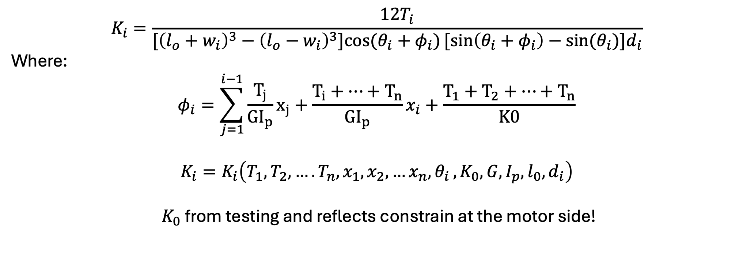
Stiffness of springs connected to the i^{th} panel:
$$K_{i}=\frac{12T_{i}}{[{\left(l_{o}+w_{i}\right)}^{3}−{\left(l_{o}−w_{i}\right)}^{3}]cos⁡(θ_{i}+φ_{i})[sin\left(θ_{i}+φ_{i}\right)−sin⁡(θ_{i})]d_{i}}$$
Where:
$$φ_{i}=\sum_{j=1}^{i−1}{\frac{T_{j}}{{GI}_{p}}x_{j}}+\frac{T_{i}+…+T_{n}}{{GI}_{p}}x_{i}+\frac{T_{1}+T_{2}+…+T_{n}}{K0}$$
$$K_{i}=K_{i}\left(T_{1},T_{2},….T_{n}, x_{1},x_{2},{…x_{n}, θ}_{i}, K_{0}, G, I_{p}, l_{0}, d_{i}\right)$$
${ K}_{0}$ from testing and reflects constrain at the motor side!

Slide 14
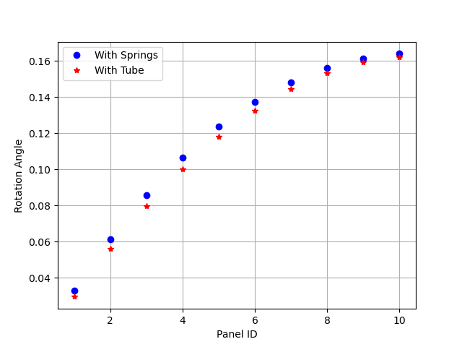
Verification:

Slide 15
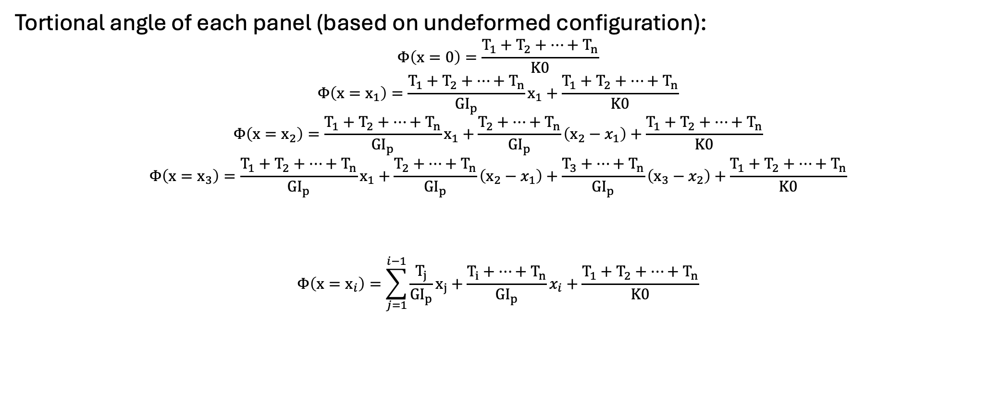
Consider tube only:
$$T_{1}$$
$$T_{2}$$
$$T_{3}$$
$$T_{4}$$
$$T_{n}$$
Robin BC
……
$$x_{1}$$
$$x_{2}$$
$$x_{3}$$
$$x_{4}$$
$$x_{n}$$
$$x$$
Tortional angle of each panel (based on undeformed configuration):
$$Φ\left(x=0\right)=\frac{T_{1}+T_{2}+…+T_{n}}{K0}$$
$$Φ\left(x=x_{1}\right)=\frac{T_{1}+T_{2}+…+T_{n}}{{GI}_{p}}x_{1}+\frac{T_{1}+T_{2}+…+T_{n}}{K0}$$
$$Φ\left(x=x_{2}\right)=\frac{T_{1}+T_{2}+…+T_{n}}{{GI}_{p}}x_{1}+\frac{T_{2}+…+T_{n}}{{GI}_{p}}\left(x_{2}−x_{1}\right)+\frac{T_{1}+T_{2}+…+T_{n}}{K0}$$
$$Φ\left(x=x_{3}\right)=\frac{T_{1}+T_{2}+…+T_{n}}{{GI}_{p}}x_{1}+\frac{T_{2}+…+T_{n}}{{GI}_{p}}\left(x_{2}−x_{1}\right)+\frac{T_{3}+…+T_{n}}{{GI}_{p}}\left(x_{3}−x_{2}\right)+\frac{T_{1}+T_{2}+…+T_{n}}{K0}$$
$$Φ\left(x=x_{i}\right)=\sum_{j=1}^{i−1}{\frac{T_{j}}{{GI}_{p}}x_{j}}+\frac{T_{i}+…+T_{n}}{{GI}_{p}}x_{i}+\frac{T_{1}+T_{2}+…+T_{n}}{K0}$$
……..

Slide 16

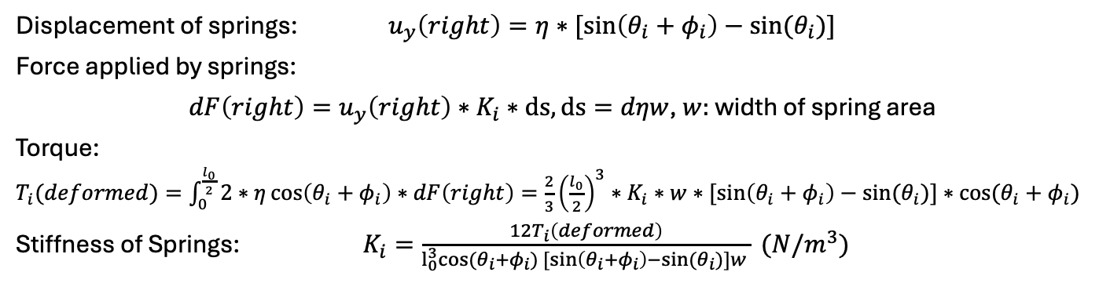
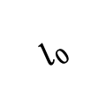





Robin boundary condition along height:
$$w$$
$$η$$
$$l_{0}$$
$$θ_{i}$$
$$l_{0}$$
$$θ_{i}+φ_{i}$$
$$y$$
Displacement of springs: $u_{y}\left(right\right)=η∗[sin\left(θ_{i}+φ_{i}\right)−sin⁡(θ_{i})]$
Force applied by springs:
$dF\left(right\right)=u_{y}\left(right\right)∗K_{i}∗ds, ds=dηw$, $w:$ width of spring area
Torque:
$T_{i}(deformed)=\int_{0}^{\frac{l_{0}}{2}}{2∗η\cos\left(θ_{i}+φ_{i}\right)∗dF\left(right\right)}=\frac{2}{3}{\left(\frac{l_{0}}{2}\right)}^{3}∗K_{i}∗w∗[sin\left(θ_{i}+φ_{i}\right)−sin⁡(θ_{i})]∗cos⁡(θ_{i}+φ_{i})$
Stiffness of Springs: $K_{i}=\frac{12T_{i}\left(deformed\right)}{l_{0}^{3}cos⁡(θ_{i}+φ_{i})[sin\left(θ_{i}+φ_{i}\right)−sin⁡(θ_{i})]w } (N/m^{3})$

Slide 17

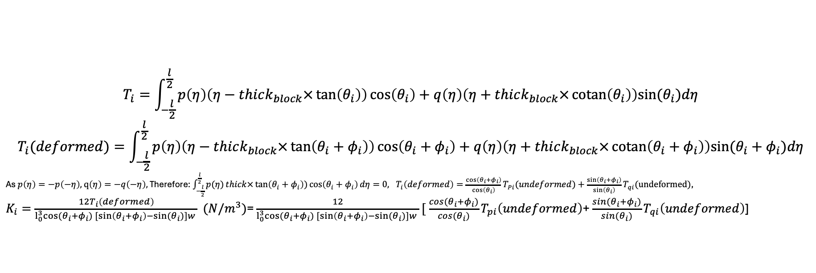

Robin boundary condition along height:
Fixed force magnitude (magnitude
Of stress is not changing after
deformation)
$$w$$
$$η$$
$$l_{0}$$
$$θ_{i}$$
$$l_{0}$$
$$θ_{i}+φ_{i}$$
$$y$$
$$P$$
$$q$$
$$T_{p}$$
$$T_{q}$$
$$T_{i}=\int_{−\frac{l}{2}}^{\frac{l}{2}}{p\left(η\right)\left(η−thick_{block}×\tan\left(θ_{i}\right)\right)\cos\left(θ_{i}\right)+q\left(η\right)\left(η+thick_{block}×\operatorname{cotan}\left(θ_{i}\right)\right)sin⁡(θ_{i})dη}$$
$$T_{i}(deformed)=\int_{−\frac{l}{2}}^{\frac{l}{2}}{p\left(η\right)\left(η−thick_{block}×\tan\left(θ_{i}+φ_{i}\right)\right)\cos\left(θ_{i}+φ_{i}\right)+q\left(η\right)\left(η+thick_{block}×\operatorname{cotan}\left(θ_{i}+φ_{i}\right)\right)sin⁡(θ_{i}+φ_{i})dη}$$
As $p\left(η\right)=−p\left(−η\right),$ $q\left(η\right)=−q\left(−η\right),$ Therefore: $\int_{−\frac{l}{2}}^{\frac{l}{2}}{p(η)}thick×\tan\left(θ_{i}+φ_{i}\right))\cos\left(θ_{i}+φ_{i}\right)dη=0, T_{i}\left(deformed\right)=\frac{\cos\left(θ_{i}+φ_{i}\right)}{\cos\left(θ_{i}\right)}T_{Pi}(undeformed)+\frac{\sin\left(θ_{i}+φ_{i}\right)}{\sin\left(θ_{i}\right)}T_{qi}(undeformed)$,
$K_{i}=\frac{12T_{i}\left(deformed\right)}{l_{0}^{3}cos⁡(θ_{i}+φ_{i})[sin\left(θ_{i}+φ_{i}\right)−sin⁡(θ_{i})]w } (N/m^{3})$= $\frac{12}{l_{0}^{3}cos⁡(θ_{i}+φ_{i})[sin\left(θ_{i}+φ_{i}\right)−sin⁡(θ_{i})]w }[ \frac{cos⁡(θ_{i}+φ_{i})}{\cos{(θ_{i})}}T_{pi}\left(undeformed\right)$+ $\frac{sin⁡(θ_{i}+φ_{i})}{\sin{(θ_{i})}}T_{qi}\left(undeformed\right)$]
On bottom surface:

Slide 18
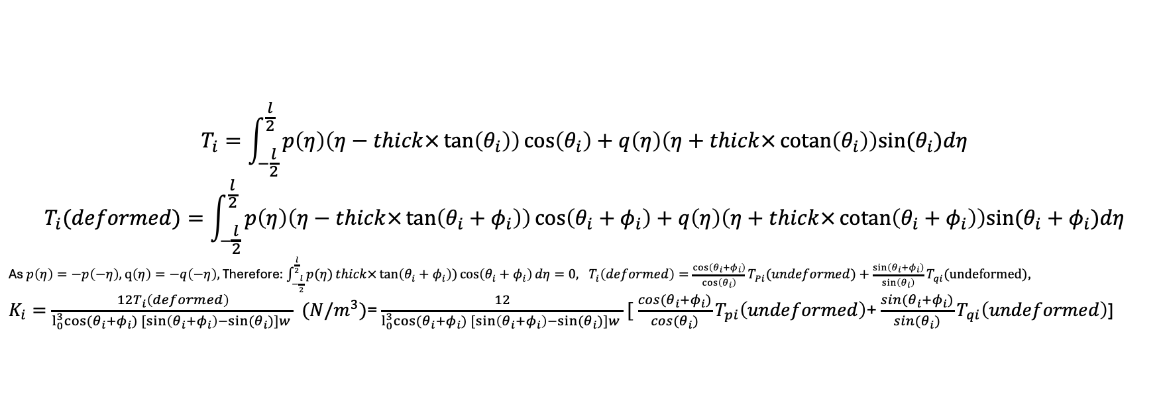
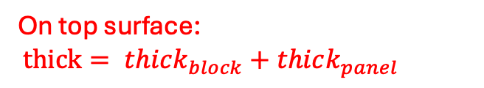
Robin boundary condition along height:
Fixed force magnitude (magnitude
Of stress is not changing after
deformation)
$$w$$
$$η$$
$$l_{0}$$
$$θ_{i}$$
$$l_{0}$$
$$θ_{i}+φ_{i}$$
$$y$$
$$P$$
On top surface:
$thick= thick_{block}+thick_{panel}$
$$q$$
$$T_{p}$$
$$T_{q}$$
$$T_{i}=\int_{−\frac{l}{2}}^{\frac{l}{2}}{p\left(η\right)\left(η−thick×\tan\left(θ_{i}\right)\right)\cos\left(θ_{i}\right)+q\left(η\right)\left(η+thick×\operatorname{cotan}\left(θ_{i}\right)\right)sin⁡(θ_{i})dη}$$
$$T_{i}(deformed)=\int_{−\frac{l}{2}}^{\frac{l}{2}}{p\left(η\right)\left(η−thick×\tan\left(θ_{i}+φ_{i}\right)\right)\cos\left(θ_{i}+φ_{i}\right)+q\left(η\right)\left(η+thick×\operatorname{cotan}\left(θ_{i}+φ_{i}\right)\right)sin⁡(θ_{i}+φ_{i})dη}$$
As $p\left(η\right)=−p\left(−η\right),$ $q\left(η\right)=−q\left(−η\right),$ Therefore: $\int_{−\frac{l}{2}}^{\frac{l}{2}}{p(η)}thick×\tan\left(θ_{i}+φ_{i}\right))\cos\left(θ_{i}+φ_{i}\right)dη=0, T_{i}\left(deformed\right)=\frac{\cos\left(θ_{i}+φ_{i}\right)}{\cos\left(θ_{i}\right)}T_{Pi}(undeformed)+\frac{\sin\left(θ_{i}+φ_{i}\right)}{\sin\left(θ_{i}\right)}T_{qi}(undeformed)$,
$K_{i}=\frac{12T_{i}\left(deformed\right)}{l_{0}^{3}cos⁡(θ_{i}+φ_{i})[sin\left(θ_{i}+φ_{i}\right)−sin⁡(θ_{i})]w } (N/m^{3})$= $\frac{12}{l_{0}^{3}cos⁡(θ_{i}+φ_{i})[sin\left(θ_{i}+φ_{i}\right)−sin⁡(θ_{i})]w }[ \frac{cos⁡(θ_{i}+φ_{i})}{\cos{(θ_{i})}}T_{pi}\left(undeformed\right)$+ $\frac{sin⁡(θ_{i}+φ_{i})}{\sin{(θ_{i})}}T_{qi}\left(undeformed\right)$]

Slide 19

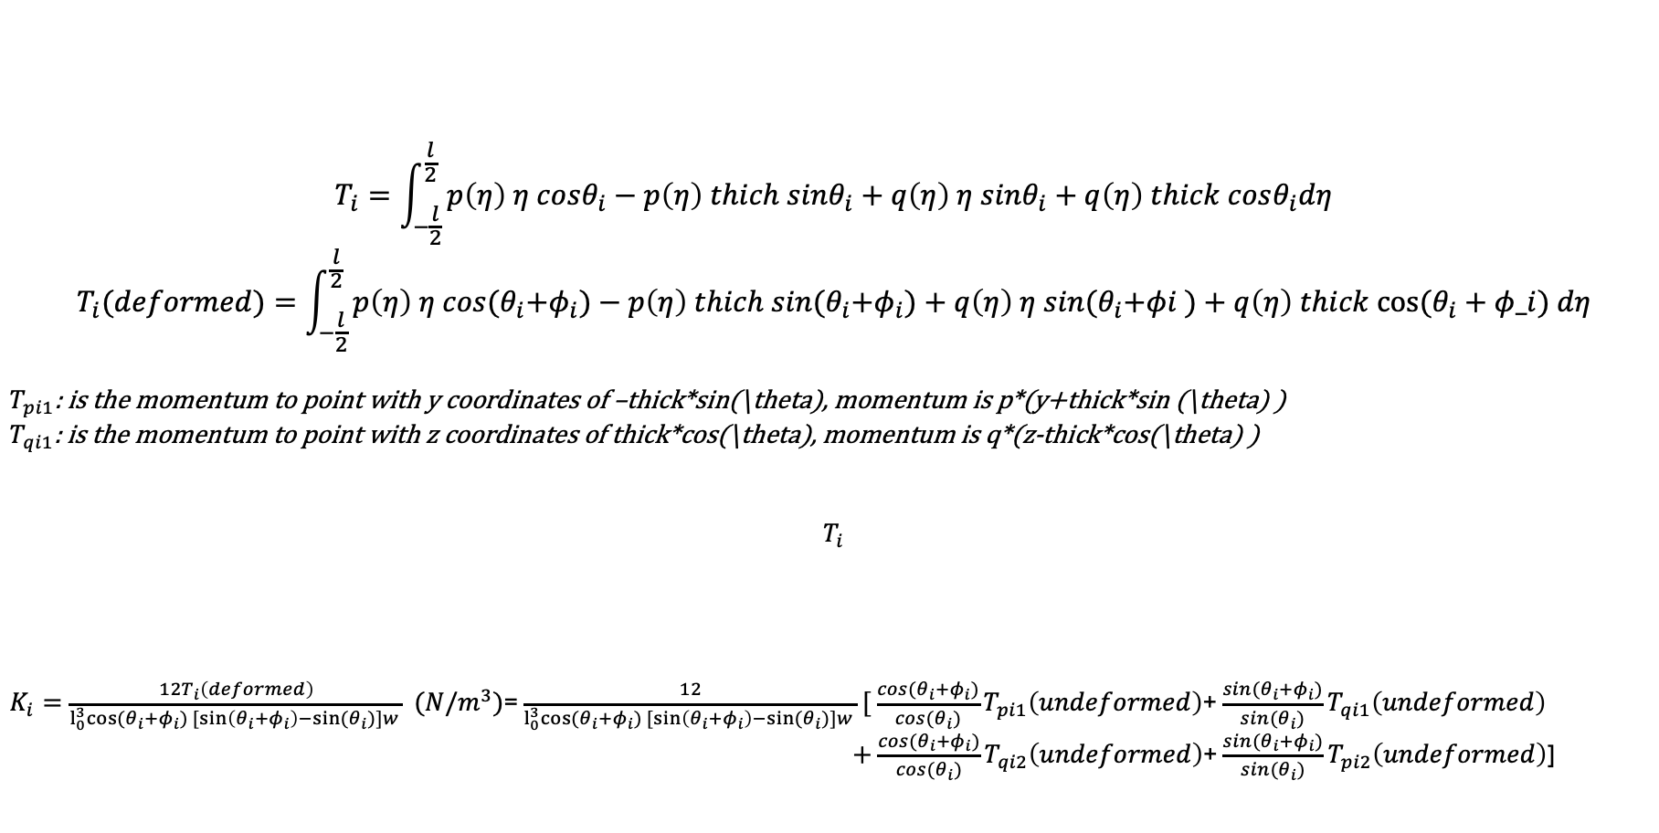



To separate different terms
$$T_{pi1}$$
$$T_{pi2}$$
$$T_{qi1}$$
$$T_{qi2}$$
$$T_{i}=\int_{−\frac{l}{2}}^{\frac{l}{2}}{p\left(η\right) η cosθ_{i}−p\left(η\right) thich sinθ_{i}+q\left(η\right) η sinθ_{i}+q\left(η\right) thick cosθ_{i}dη}$$
$$T_{i}(deformed)=\int_{−\frac{l}{2}}^{\frac{l}{2}}{p\left(η\right) η cos{(θ}_{i}+φ_{i})−p\left(η\right) thich sin{(θ}_{i}+φ_{i})+q\left(η\right) η sin{(θ}_{i}+φi )+q\left(η\right) thick cos⁡(θ_{i}+φ_i) dη}$$
$T_{pi1}$: is the momentum to point with y coordinates of –thick*sin(\theta), momentum is p*(y+thick*sin (\theta) )
$T_{qi1}$: is the momentum to point with z coordinates of thick*cos(\theta), momentum is q*(z-thick*cos(\theta) )
$$T_{i}$$
$K_{i}=\frac{12T_{i}\left(deformed\right)}{l_{0}^{3}cos⁡(θ_{i}+φ_{i})[sin\left(θ_{i}+φ_{i}\right)−sin⁡(θ_{i})]w } (N/m^{3})$= $\frac{12}{l_{0}^{3}cos⁡(θ_{i}+φ_{i})[sin\left(θ_{i}+φ_{i}\right)−sin⁡(θ_{i})]w }[ \frac{cos⁡(θ_{i}+φ_{i})}{\cos{(θ_{i})}}T_{pi1}\left(undeformed\right)$+ $\frac{sin⁡(θ_{i}+φ_{i})}{\sin{(θ_{i})}}T_{qi1}\left(undeformed\right)$
$+$ $\frac{cos⁡(θ_{i}+φ_{i})}{\cos{(θ_{i})}}T_{qi2}\left(undeformed\right)$+ $\frac{sin⁡(θ_{i}+φ_{i})}{\sin{(θ_{i})}}T_{pi2}\left(undeformed\right)$]

Slide 20
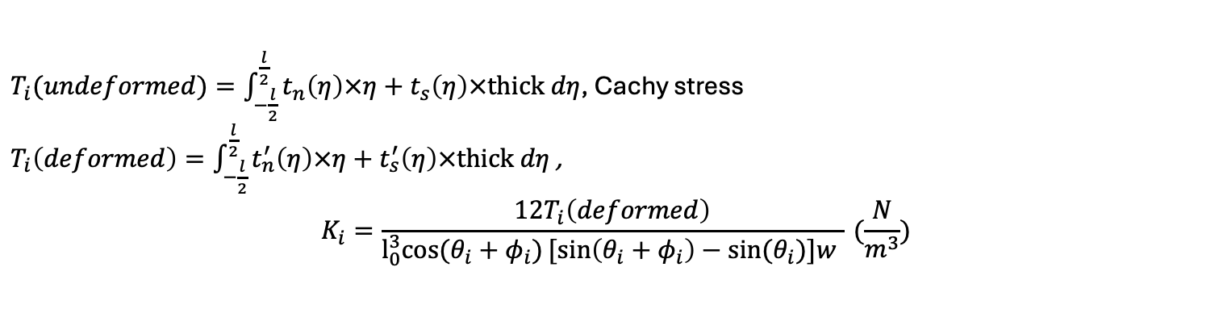
Robin boundary condition along height:
$$t_{n}$$
$$w$$
$$η$$
$$l_{0}$$
$$θ_{i}$$
$$l_{0}$$
$$θ_{i}+φ_{i}$$
$$y$$
$$t_{s}$$
$T_{i}(undeformed)=\int_{−\frac{l}{2}}^{\frac{l}{2}}{t_{n}\left(η\right)×η+t_{s}\left(η\right)×thick dη}$, Cachy stress
$T_{i}\left(deformed\right)=\int_{−\frac{l}{2}}^{\frac{l}{2}}{t_{n}^{′}\left(η\right)×η+t_{s}^{′}\left(η\right)×thick dη}$ ,
$$K_{i}=\frac{12T_{i}\left(deformed\right)}{l_{0}^{3}cos⁡(θ_{i}+φ_{i})[sin\left(θ_{i}+φ_{i}\right)−sin⁡(θ_{i})]w } (\frac{N}{m^{3}})$$

Slide 21
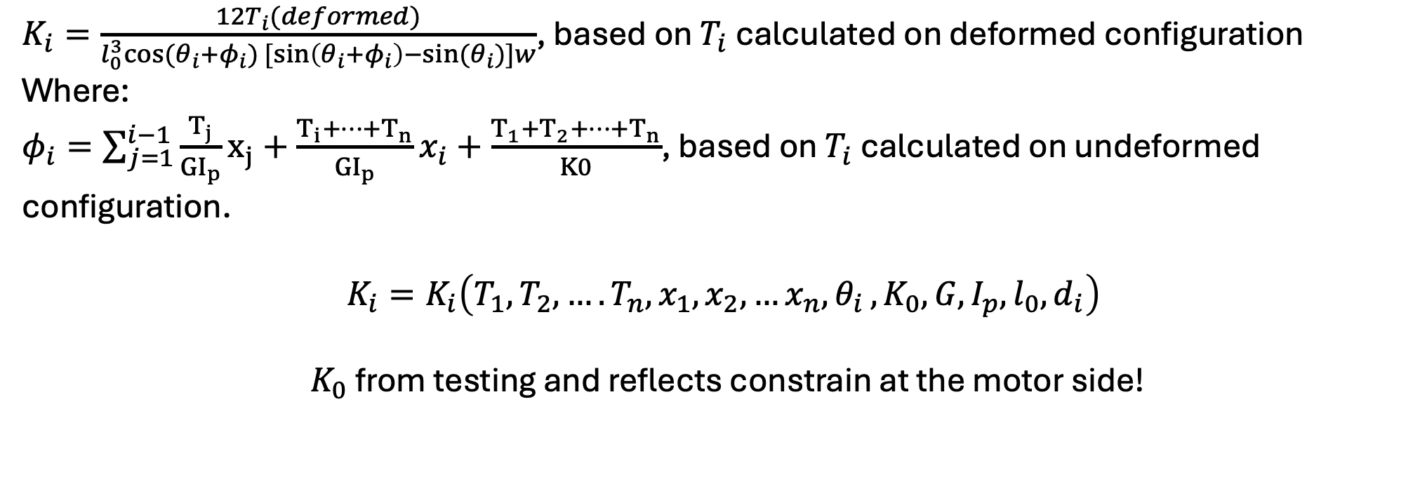
Stiffness of springs connected to the i^{th} panel:
$K_{i}=\frac{12T_{i}(deformed)}{l_{0}^{3}cos⁡(θ_{i}+φ_{i})[sin\left(θ_{i}+φ_{i}\right)−sin⁡(θ_{i})]w}$, based on $T_{i}$ calculated on deformed configuration
Where:
$φ_{i}=\sum_{j=1}^{i−1}{\frac{T_{j}}{{GI}_{p}}x_{j}}+\frac{T_{i}+…+T_{n}}{{GI}_{p}}x_{i}+\frac{T_{1}+T_{2}+…+T_{n}}{K0}$, based on $T_{i}$ calculated on undeformed configuration.
$$K_{i}=K_{i}\left(T_{1},T_{2},….T_{n}, x_{1},x_{2},{…x_{n}, θ}_{i}, K_{0}, G, I_{p}, l_{0}, d_{i}\right)$$
${ K}_{0}$ from testing and reflects constrain at the motor side!

Slide 22

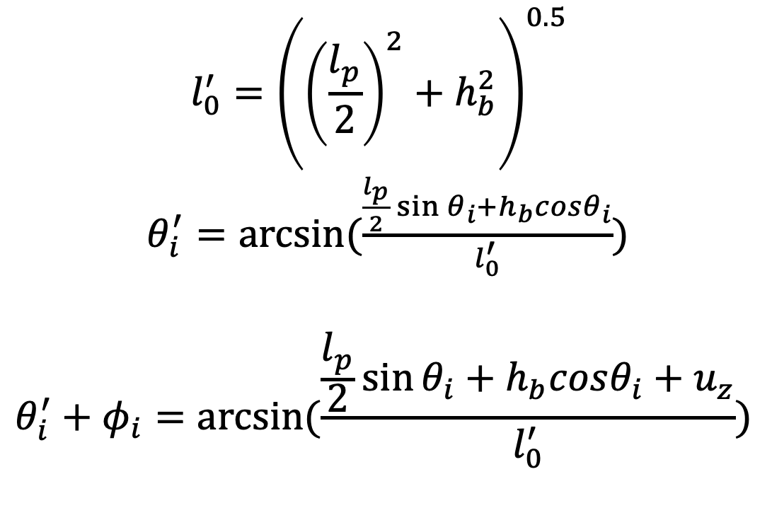



Calculate predicted $φ_{i}$:
$$l_{0}^{′}$$
$$l_{0}$$
$$θ_{i}^{′}+φ_{i}$$
$$θ_{i}^{′}$$
$$θ_{i}$$
$$θ_{i}+φ_{i}$$
$$l_{0}^{′}={\left({\left(\frac{l_{p}}{2}\right)}^{2}+h_{b}^{2}\right)}^{0.5}$$
$θ_{i}^{′}=arcsin⁡(\frac{\frac{l_{p}}{2}\sin{θ_{i}}+h_{b}cosθ_{i}}{l_{0}^{′}})$
$$θ_{i}^{′}+φ_{i}=arcsin⁡(\frac{\frac{l_{p}}{2}\sin{θ_{i}}+h_{b}cosθ_{i}+u_{z}}{l_{0}^{′}})$$

Slide 23
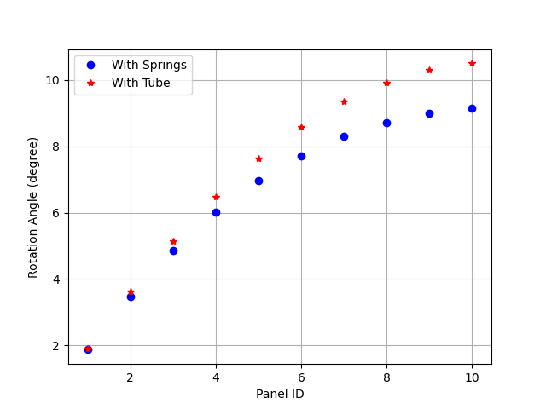

Verification:
$$P$$
$$θ_{i}+φ_{i}$$

Slide 24
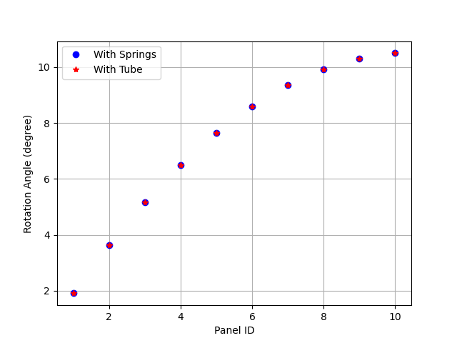





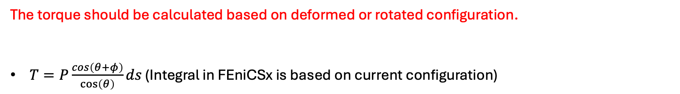

Verification:
$$P$$
$$θ_{i}+φ_{i}$$
The torque should be calculated based on deformed or rotated configuration.
$T=P\frac{cos\left(θ+φ\right)}{\cos\left(θ\right)}ds$ (Integral in FEniCSx is based on current configuration)
$$ds′$$
$$ds$$
$$y$$
$$θ$$
$$θ+φ$$
$$dy$$

Slide 25
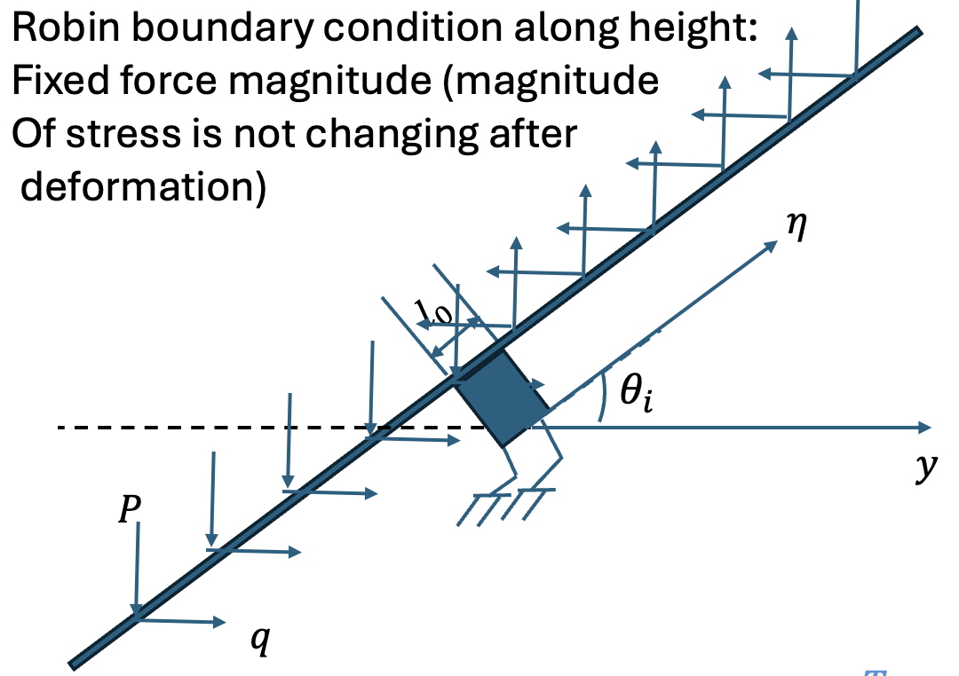

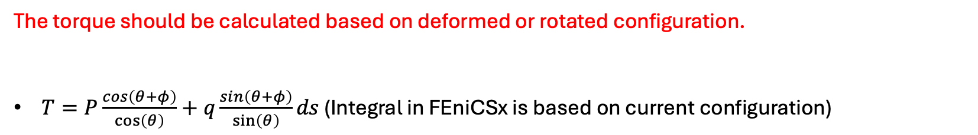
Verification:
$$P$$
$$θ_{i}+φ_{i}$$
The torque should be calculated based on deformed or rotated configuration.
$T=P\frac{cos\left(θ+φ\right)}{\cos\left(θ\right)}+q\frac{sin\left(θ+φ\right)}{\sin\left(θ\right)}ds$ (Integral in FEniCSx is based on current configuration)
$$ds′$$
$$ds$$
$$y$$
$$θ$$
$$θ+φ$$
$$dy$$

