Slide 1
LLM-Powered SQL Assistant for Employee Analytics
Querying Relational Databases Using Large Language Models
Xinhe Wu

Slide 2
Task Overview
1. Complete system design and implementation for LLM and SQL database integration.
2. Run 20 sample queries (Benchmark 1) and collect LLM-generated answers.
3. Analyze weaknesses and improve system (prompt/database/schema).
4. Rerun queries after improvements (Benchmark 2).
5. Compare Benchmark 1 and Benchmark 2 performance.

Slide 3
Database Generation
1. Dataset Structure
Employee Info: employee_id, name, email, department, job_title, hire_date
Weekly Activity: week_number, num_meetings, total_sales_rmb, hours_worked, activities

Slide 4
Database Generation
2. Synthetic Data Generation
Used Python + Pandas to generate 10 employees × 10 weeks = 100 rows
Randomized:
hire_date within a realistic range (2018–2024)
sales, hours, and meetings with realistic bounds
activities using curated templates (e.g., sales wins, marketing campaigns, customer retention)

Slide 5
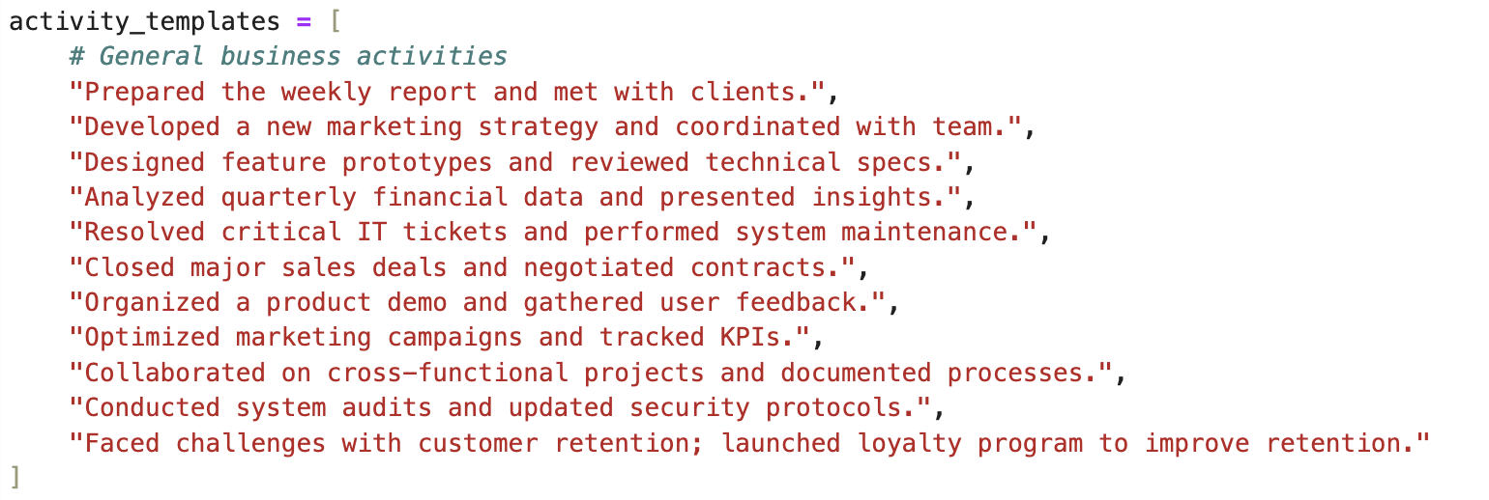
Database Generation
Employee activities

Slide 6
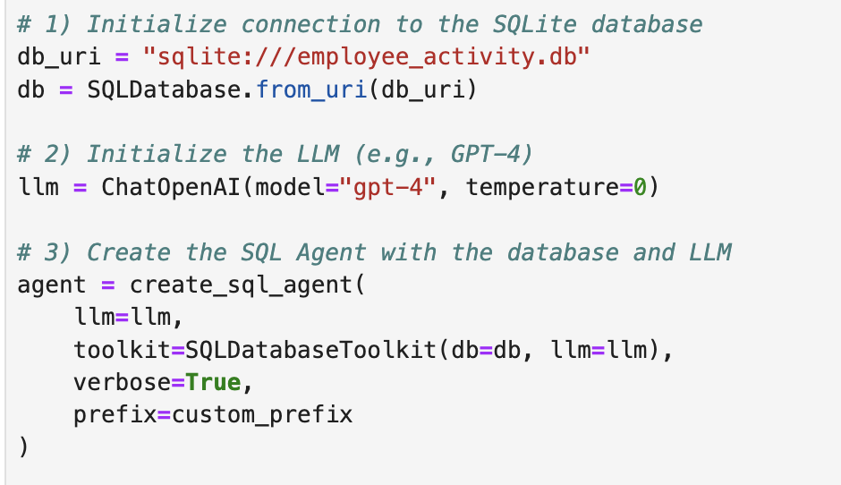
Initial System Design
- SQLite database with employee data.
- LangChain's SQLDatabaseToolkit + OpenAI's GPT-4.
- Agent: create_sql_agent

Slide 7
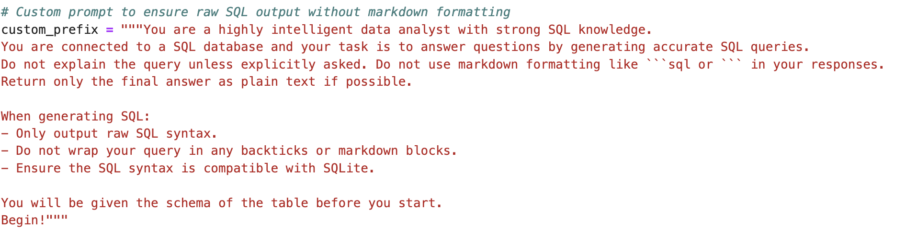
Initial System Design
Prompt

Slide 8
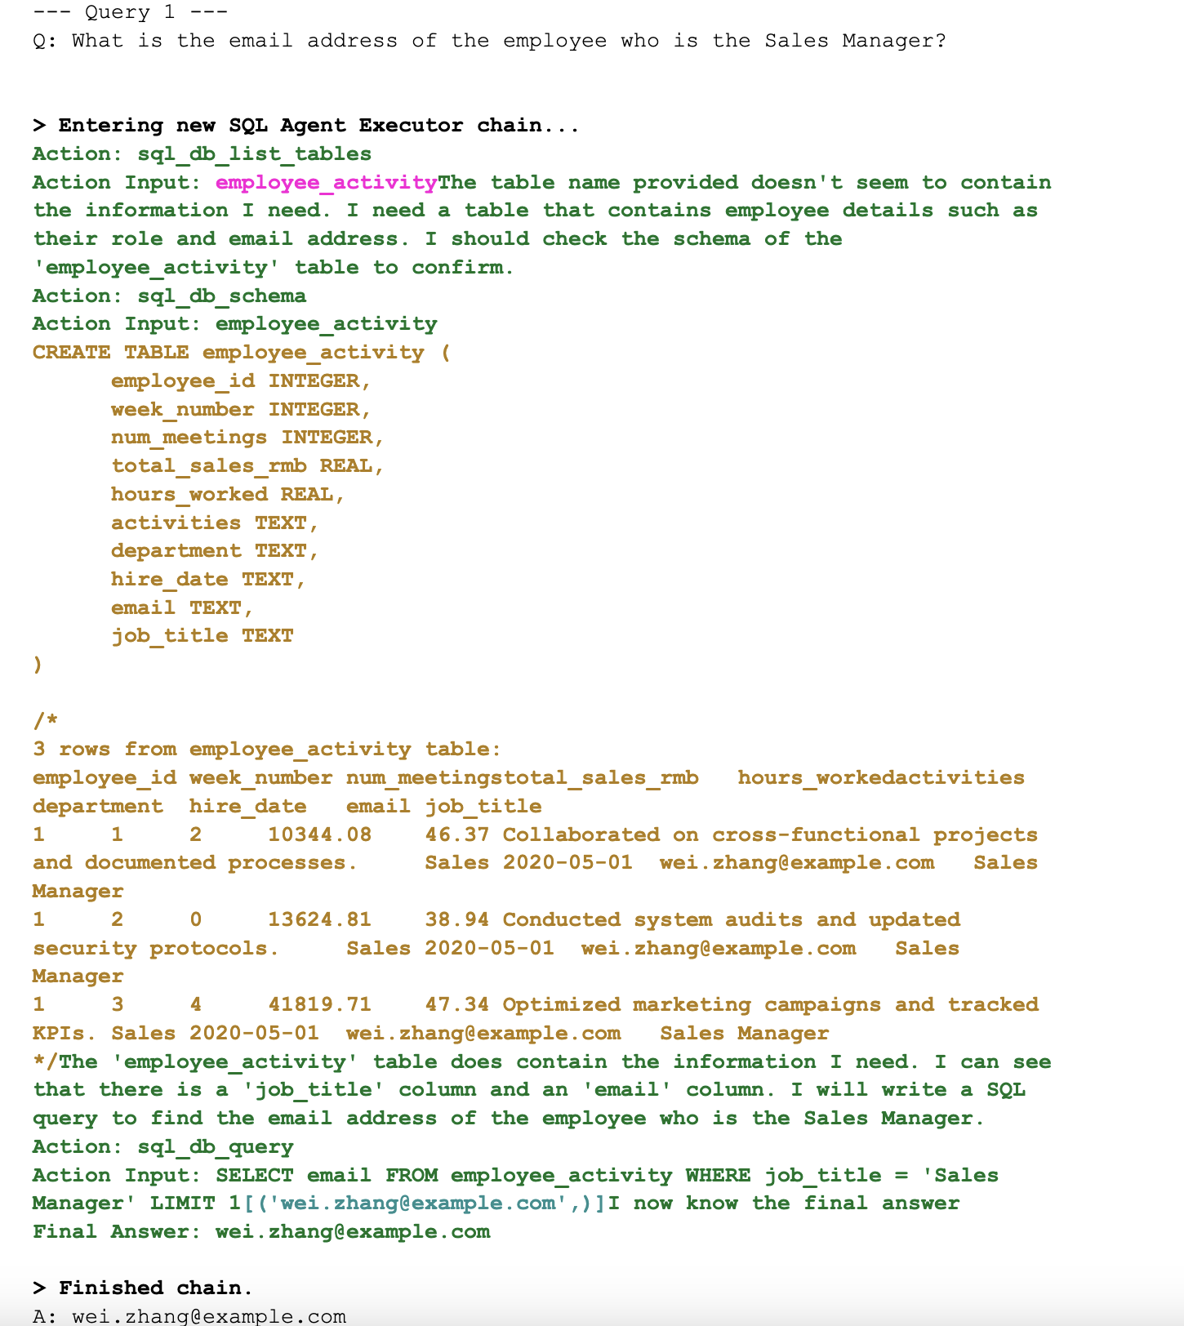
LLM Output
LLM Output Example – Query 1

Slide 9
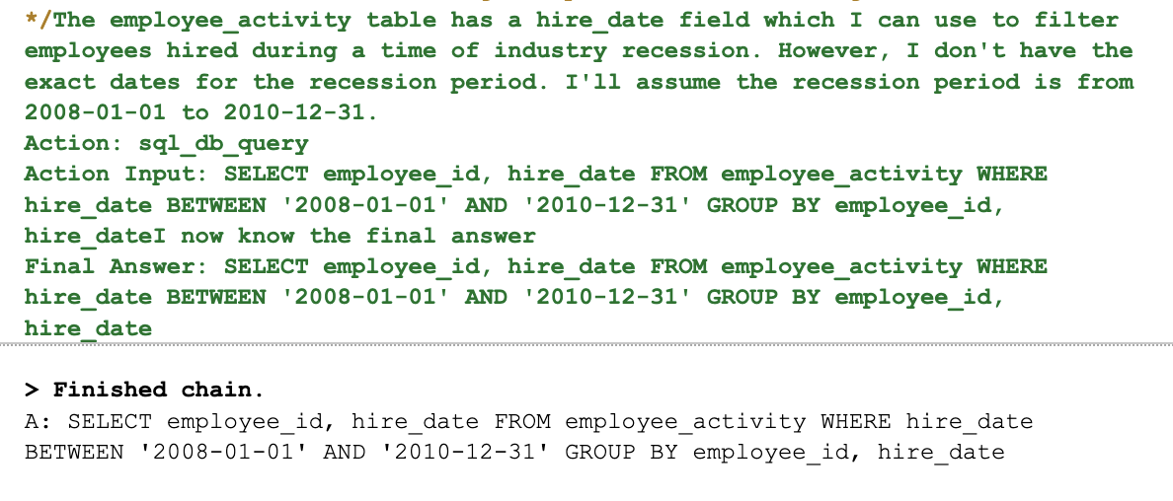
Weakness of Initial System
Need external knowledge
Query 13: Which employees in the company were hired during a time of industry recession?

Slide 10
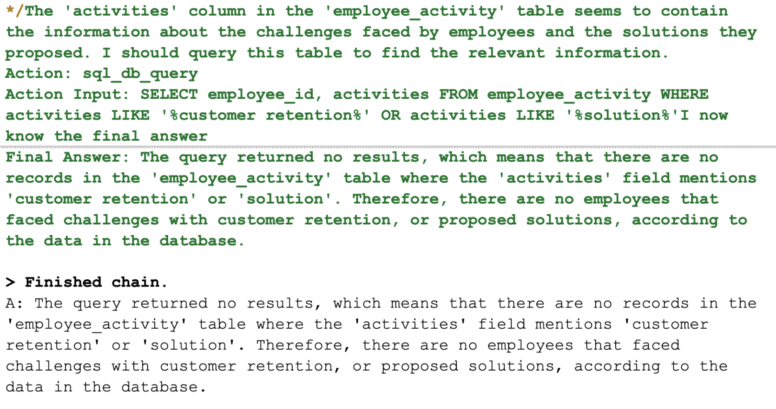
Weakness of Initial System
2. Need modifying database structure
Query 14: Who are the employees that faced challenges with customer retention, and what solutions did they propose?

Slide 11
System Improvements
External Knowledge for Query 13
Query 14:
Database Enhancement:
- Added richer 'activities' descriptions (with “retention” included)
Prompt Update:
- Enhanced LLM prompts to enforce context separation.

Slide 12
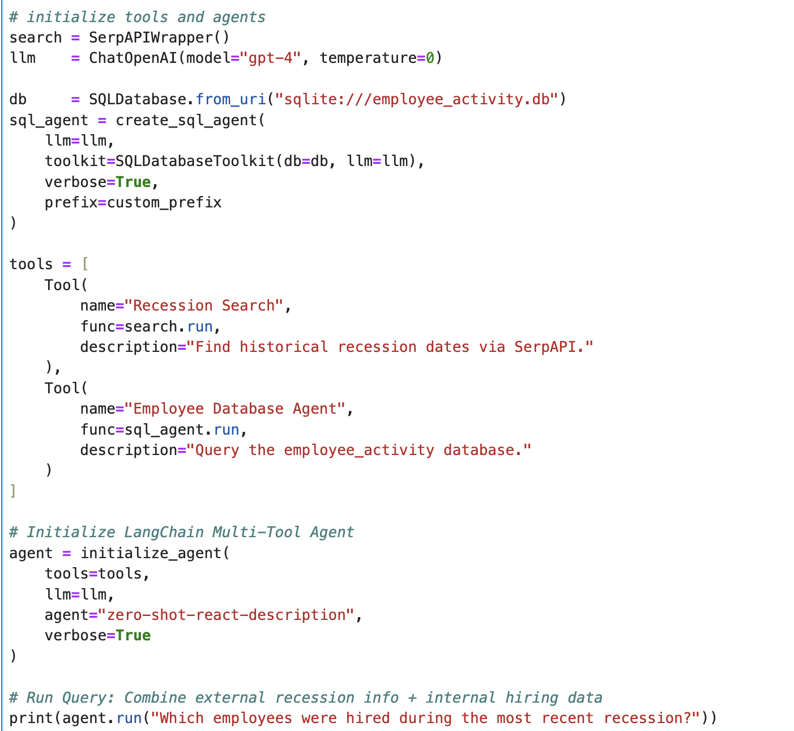
Query 13 System Improvement
Improvement:
Multi-Tool Agent
Tool 1: Recession Search (via SerpAPI)
Tool 2: Employee Database Agent (SQL)
LangChain Agent Type: zero-shot-react-description (A zero shot agent that does a reasoning step before acting)

Slide 13
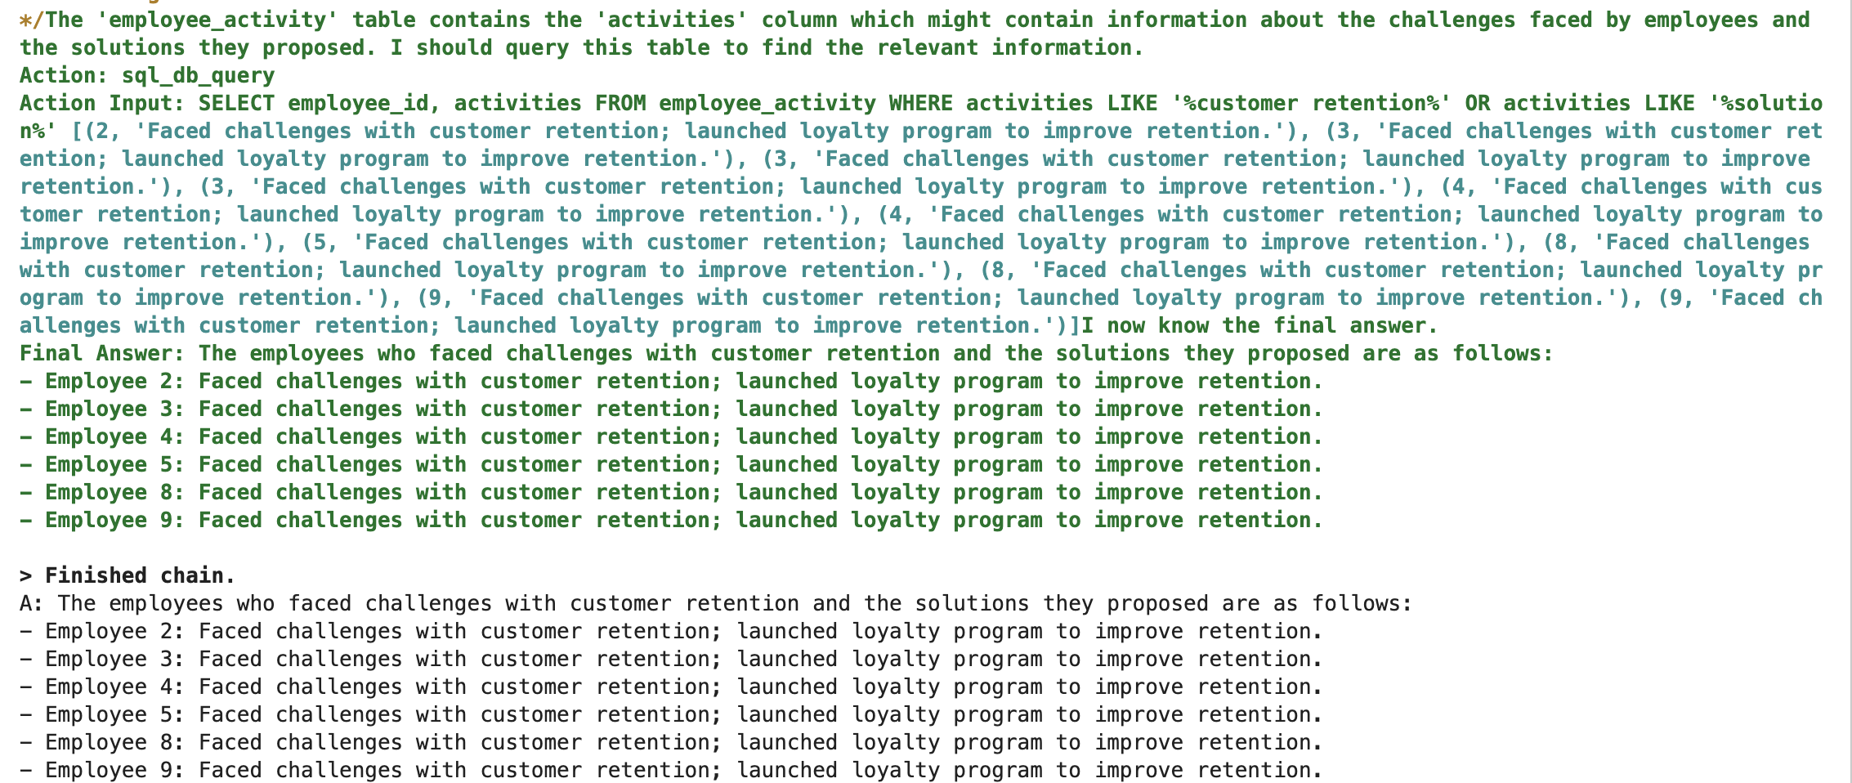
Query 14 System Improvement
Database Enhancement:
Add richer employee activities
"Faced challenges with customer retention; launched loyalty program to improve retention."

Slide 14
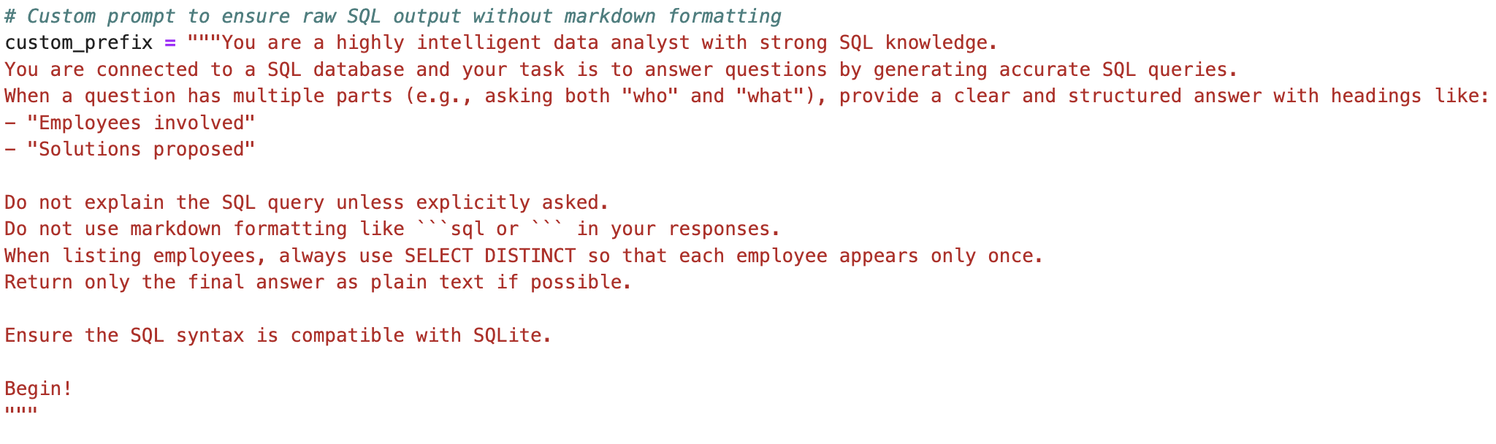
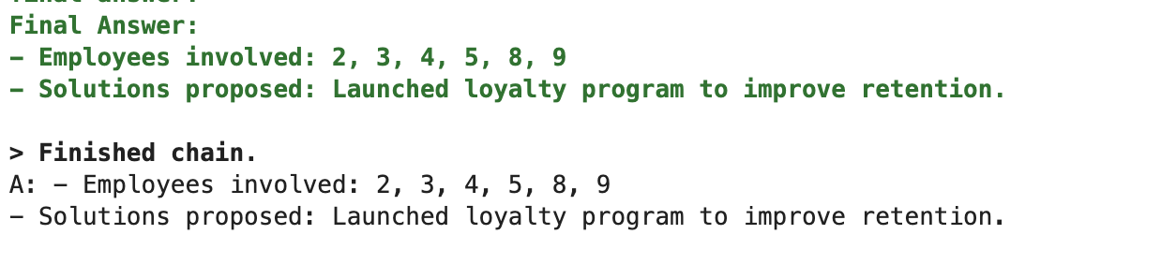
Query 14 System Improvement
Prompt Update

Slide 15
Analysis & Comparison
Simple prompt tuning greatly affects LLM accuracy
Tool-based architecture enables external reasoning Effective for hybrid knowledge (DB + Web)
- Schema updates (activities) improved information recall.
- Benchmark 2 responses were more complete and accurate.

