Slide 1
Introduction to CBMC
Software Engineering Institute
Carnegie Mellon University
Pittsburgh, PA 15213
Arie Gurfinkel
November 19, 2012
based on slides by
Daniel Kroening

Slide 2
Bug Catching with SAT-Solvers
Main Idea: Given a program and a claim use a SAT-solver to find whether there exists an execution that violates the claim.
Program
Analysis
Engine
CNF
SAT
Solver
Claim
SAT
(counterexample exists)
UNSAT
(no counterexample found)

Slide 3
Programs and Claims
Arbitrary ANSI-C programs
With bitvector arithmetic, dynamic memory, pointers, …
Simple Safety Claims
Array bound checks (i.e., buffer overflow)
Division by zero
Pointer checks (i.e., NULL pointer dereference)
Arithmetic overflow
User supplied assertions (i.e., assert (i > j) )
etc

Slide 4
Why use a SAT Solver?
SAT Solvers are very efficient
Analysis is completely automated
Analysis as good as the underlying SAT solver
Allows support for many features of a programming language
bitwise operations, pointer arithmetic, dynamic memory, type casts

Slide 5
A (very) simple example (1)
Program
Constraints
int x;
int y=8,z=0,w=0;
if (x)
z = y – 1;
else
w = y + 1;
assert (z == 7 ||
w == 9)
y = 8,
z = x ? y – 1 : 0,
w = x ? 0 :y + 1,
z != 7,
w != 9
UNSAT
no counterexample
assertion always holds!

Slide 6
A (very) simple example (2)
Program
Constraints
int x;
int y=8,z=0,w=0;
if (x)
z = y – 1;
else
w = y + 1;
assert (z == 5 ||
w == 9)
y = 8,
z = x ? y – 1 : 0,
w = x ? 0 :y + 1,
z != 5,
w != 9
SAT
counterexample found!
y = 8, x = 1, w = 0, z = 7

Slide 7
What about loops?!
SAT Solver can only explore finite length executions!
Loops must be bounded (i.e., the analysis is incomplete)
Program
Analysis
Engine
CNF
SAT
Solver
Claim
Bound (n)
SAT
(counterexample exists)
UNSAT
(no counterexample of
bound n is found)

Slide 8
CBMC: C Bounded Model Checker
Developed at CMU by Daniel Kroening and Ed Clarke
Available at: http://www.cprover.org/cbmc
On Ubuntu: apt-get install cbmc
with source code
Supported platforms: Windows, Linux, OSX
Has a command line, Eclipse CDT, and Visual Studio interfaces
Scales to programs with over 30K LOC
Found previously unknown bugs in MS Windows device drivers

Slide 9
CBMC: Supported Language Features
ANSI-C is a low level language, not meant for verification but for efficiency
Complex language features, such as
Bit vector operators (shifting, and, or,…)
Pointers, pointer arithmetic
Dynamic memory allocation: malloc/free
Dynamic data types: char s[n]
Side effects
float / double
Non-determinism

Slide 10
DEMO

Slide 11
Using CBMC from Command Line
To see the list of claims
cbmc --show-claims -I include file.c
To check a single claim
cbmc --unwind n --claim x –I include file.c
For help
cbmc --help

Slide 12
How does it work
Transform a programs into a set of equations
Simplify control flow
Unwind all of the loops
Convert into Single Static Assignment (SSA)
Convert into equations
Bit-blast
Solve with a SAT Solver
Convert SAT assignment into a counterexample

Slide 13
CBMC: Bounded Model Checker for C A tool by D. Kroening/Oxford and Ed Clarke/CMU
C Program
goto-program
Static Analysis
Parser
equations
SAFE
UNSAT
SAT solver
CNF
CNF-gen
SAT
UNSAFE + CEX
CEX-gen
CBMC

Slide 14
Control Flow Simplifications
All side effect are removed
e.g., j=i++ becomes j=i;i=i+1
Control Flow is made explicit
continue, break replaced by goto
All loops are simplified into one form
for, do while replaced by while

Slide 15
Loop Unwinding
All loops are unwound
can use different unwinding bounds for different loops
to check whether unwinding is sufficient special “unwinding assertion” claims are added
If a program satisfies all of its claims and all unwinding assertions then it is correct!
Same for backward goto jumps and recursive functions

Slide 16
Loop Unwinding
void f(...) {
...
while(cond) {
Body;
}
Remainder;
}
while() loops are unwound iteratively
Break / continue replaced by goto

Slide 17
Loop Unwinding
void f(...) {
...
if(cond) {
Body;
while(cond) {
Body;
}
}
Remainder;
}
while() loops are unwound iteratively
Break / continue replaced by goto

Slide 18
Loop Unwinding
void f(...) {
...
if(cond) {
Body;
if(cond) {
Body;
while(cond) {
Body;
}
}
}
Remainder;
}
while() loops are unwound iteratively
Break / continue replaced by goto

Slide 19
Unwinding assertion
void f(...) {
...
if(cond) {
Body;
if(cond) {
Body;
if(cond) {
Body;
while(cond) {
Body;
}
}
}
}
Remainder;
}
while() loops are unwound iteratively
Break / continue replaced by goto
Assertion inserted after last iteration: violated if program runs longer than bound permits

Slide 20
Unwinding assertion
void f(...) {
...
if(cond) {
Body;
if(cond) {
Body;
if(cond) {
Body;
assert(!cond);
}
}
}
}
Remainder;
}
while() loops are unwound iteratively
Break / continue replaced by goto
Assertion inserted after last iteration: violated if program runs longer than bound permits
Positive correctness result!
Unwinding assertion

Slide 21
Example: Sufficient Loop Unwinding
void f(...) {
j = 1
while (j <= 2)
j = j + 1;
Remainder;
}
void f(...) {
j = 1
if(j <= 2) {
j = j + 1;
if(j <= 2) {
j = j + 1;
if(j <= 2) {
j = j + 1;
assert(!(j <= 2));
}
}
}
}
Remainder;
}
unwind = 3

Slide 22
Example: Insufficient Loop Unwinding
void f(...) {
j = 1
while (j <= 10)
j = j + 1;
Remainder;
}
void f(...) {
j = 1
if(j <= 10) {
j = j + 1;
if(j <= 10) {
j = j + 1;
if(j <= 10) {
j = j + 1;
assert(!(j <= 10));
}
}
}
}
Remainder;
}
unwind = 3

Slide 23
Transforming Loop-Free Programs Into Equations (1)
Easy to transform when every variable is only assigned once!
Program
Constraints
x = a;
y = x + 1;
z = y – 1;
x = a &&
y = x + 1 &&
z = y – 1 &&

Slide 24
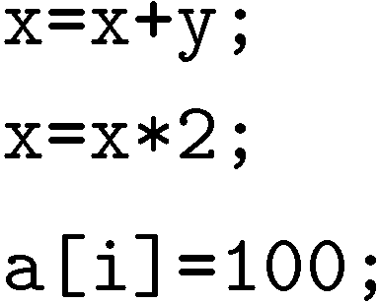
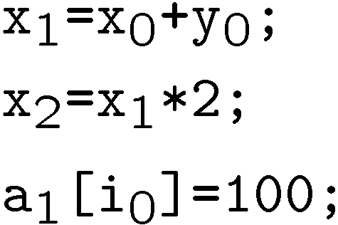

Transforming Loop-Free Programs Into Equations (2)
When a variable is assigned multiple times,
use a new variable for the RHS of each assignment
Program
SSA Program

Slide 25
What about conditionals?
Program
SSA Program
if (v)
x = y;
else
x = z;
w = x;
if (v₀)
x₀ = y₀;
else
x₁ = z₀;
w₁ = x??;
What should ‘x’ be?

Slide 26
What about conditionals?
Program
SSA Program
if (v)
x = y;
else
x = z;
w = x;
if (v₀)
x₀ = y_{0;}
else
x₁ = z_{0;}
x₂ = v₀ ? x₀ : x₁;
w₁ = x₂
For each join point, add new variables with selectors

Slide 27
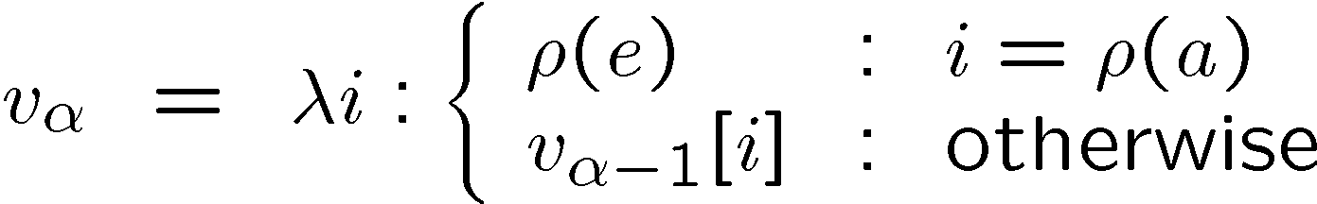

Adding Unbounded Arrays
Arrays are updated “whole array” at a time
A[1] = 5;
A[2] = 10;
A[k] = 20;
A₁=λ i : i == 1 ? 5 : A₀[i]
A₂=λ i : i == 2 ? 10 : A₁[i]
A₃=λ i : i == k ? 20 : A₂[i]
Examples:
A₂[2] == 10 A₂[1]==5 A₂[3] == A₀[3]
A₃[2] == (k==2 ? 20 : 10)
Uses only as much space as there are uses of the array!

Slide 28
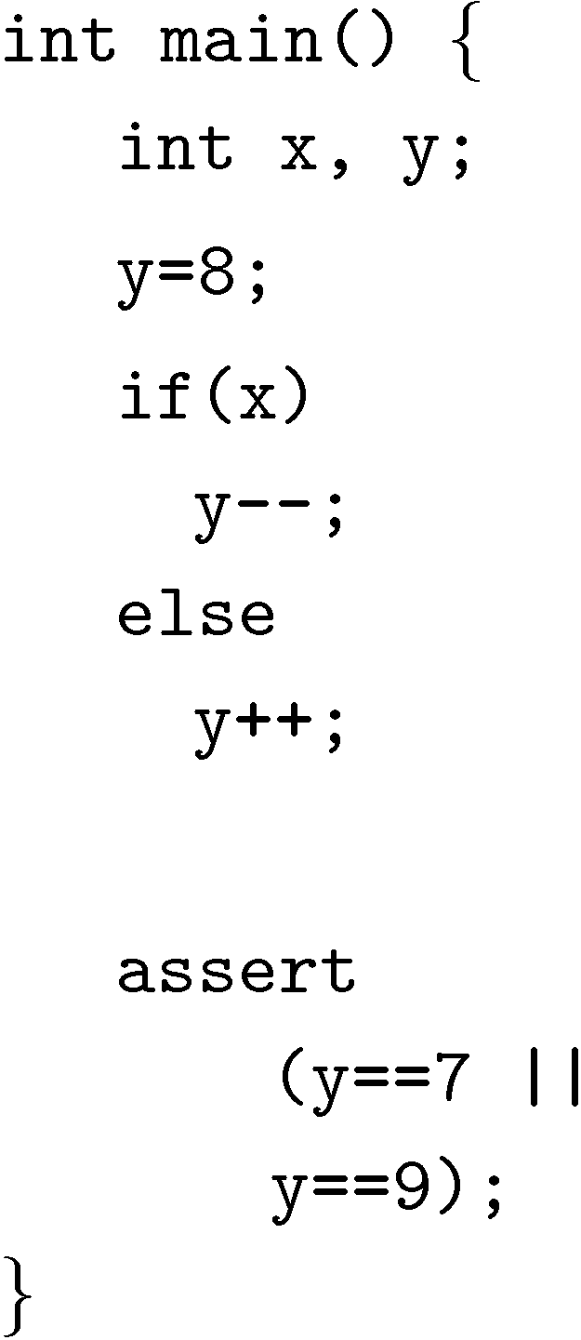
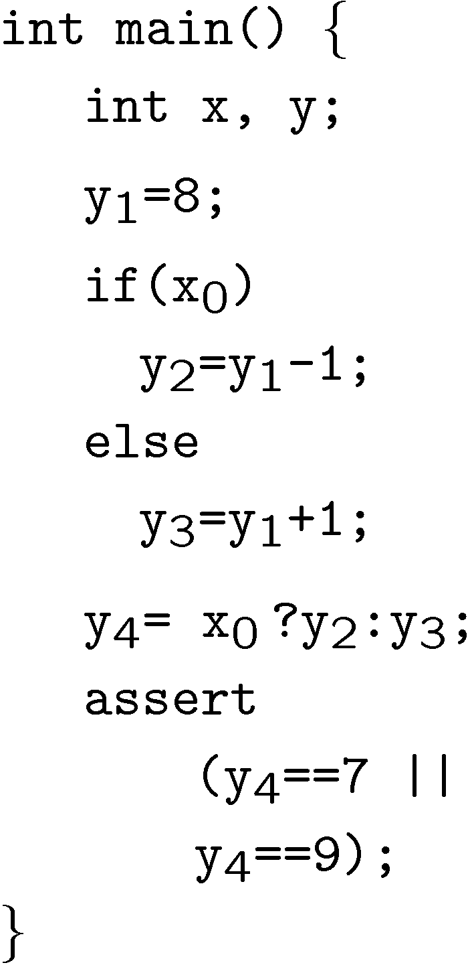
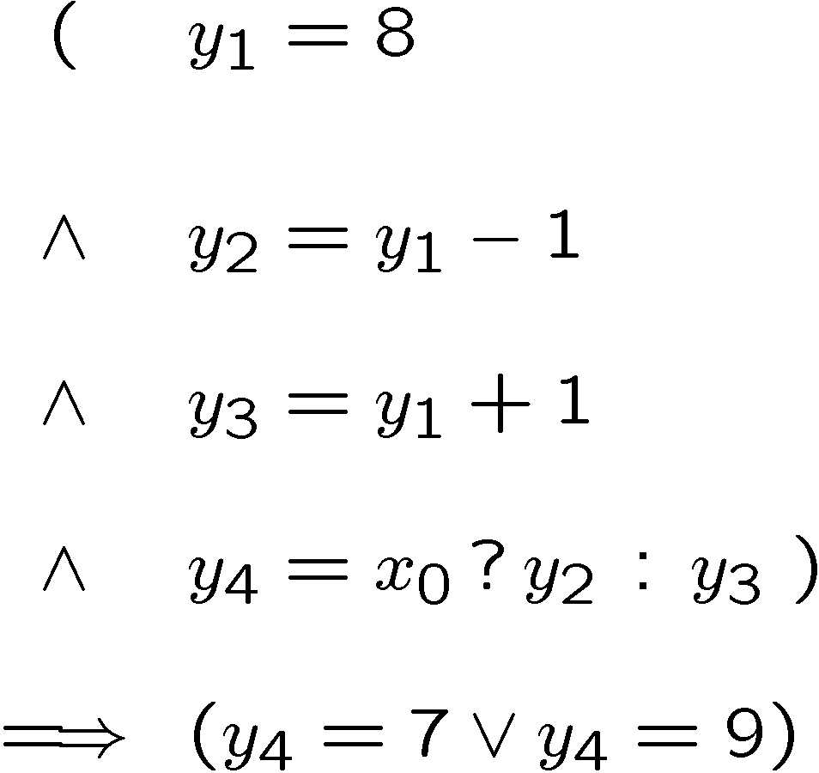
Example

Slide 29
Pointers
While unwinding, record right hand side of assignments to pointers
This results in very precise points-to information
Separate for each pointer
Separate for each instance of each program location
Dereferencing operations are expanded into case-split on pointer object (not: offset)
Generate assertions on offset and on type
Pointer data type assumed to be part of bit-vector logic
Consists of pair <object, offset>

Slide 30
Pointer Typecast Example
void *p;
int i;
char c;
int main (void) {
int input1, intput2, z;
p = input1 ? (void*)&i : (void*) &c;
if (input2)
z = *(int*)p;
else
z = *(char*)p; }

Slide 31
Dynamic Objects
Dynamic Objects:
malloc / free
Local variables of functions
Auxiliary variables for each dynamically allocated object:
Size (number of elements)
Active bit
Type
malloc sets size (from parameter) and sets active bit
free asserts that active bit is set and clears bit
Same for local variables: active bit is cleared upon leaving the function

Slide 32
Modeling with CBMC

Slide 33
From Programming to Modeling
Extend C programming language with 3 modeling features
Assertions
assert(e) – aborts an execution when e is false, no-op otherwise
Non-determinism
nondet_int() – returns a non-deterministic integer value
Assumptions
assume(e) – “ignores” execution when e is false, no-op otherwise
void assert (_Bool b) { if (!b) exit(); }
int nondet_int () { int x; return x; }
void assume (_Bool e) { while (!e) ; }

Slide 34
Example
int x, y;
void main (void)
{
x = nondet_int ();
assume (x > 10);
y = x + 1;
assert (y > x);
}
possible overflow
assertion fails

Slide 35
Using nondet for modeling
Library spec:
“foo is given non-deterministically, but is taken until returned”
CMBC stub:
int nondet_int ();
int is_foo_taken = 0;
int grab_foo () {
if (!is_foo_taken)
is_foo_taken = nondet_int ();
return is_foo_taken; }
void return_foo ()
{ is_foo_taken = 0; }

Slide 36
Assume-Guarantee Reasoning (1)
Is foo correct?
int foo (int* p) { … }
void main(void) {
…
foo(x);
…
foo(y);
…
}
Check by splitting on the argument of foo

Slide 37
Assume-Guarantee Reasoning (2)
(A) Is foo correct assuming p is not NULL?
int foo (int* p) { __CPROVER_assume(p!=NULL); … }
(G)Is foo guaranteed to be called with a non-NULL argument?
void main(void) {
…
assert (x!=NULL);// foo(x);
…
assert (y!=NULL); //foo(y);
…}

Slide 38
Dangers of unrestricted assumptions
Assumptions can lead to vacuous satisfaction
if (x > 0) {
__CPROVER_assume (x < 0);
assert (0); }
This program is passed by CMBMC!
Assume must either be checked with assert or used as an idiom:
x = nondet_int ();
y = nondet_int ();
__CPROVER_assume (x < y);

Slide 39
Example: Prophecy variables
int x, y, v;
void main (void)
{
v = nondet_int ();
x = v;
x = x + 1;
y = nondet_int ();
assume (v == y);
assert (x == y + 1);
}
v is a prophecy variable
it guesses the future value of y
assume blocks executions with a
wrong guess
syntactically: x is changed before y
semantically: x is changed after y

Slide 40
Context-Bounded Analysis with CBMC

Slide 41
Context-Bounded Analysis (CBA)
Explore all executions of TWO threads that have at most R context-switches (per thread)
T₂
T₁
Context-Swtich
(T₁ preempted by T₂)
Context-Swtich
(T₂ preempted by T₁)
Context-Swtich
(T₁ preempted by T₂)

Slide 42
CBA via Sequentialization
Reduce concurrent program P to a sequential (non-deterministic) program P’ such that “P has error” iff “P’ has error”
Check P’ with CBMC
Two-Thread Concurrent Program in C
Sequential Program
Sequentialization
CBMC
UNSAFE + CEX
OK

Slide 43
Key Idea
Divide execution into rounds based on context switches
Execute executions of each context separately, starting from a symbolic state
Run all parts of Thread 1 first, then all parts of Thread 2
Connect executions from Step 2 using assume-statements
R
T₂
T₁
Round 0
Round 1
Round 2

Slide 44
Sequentialization in Pictures
g[0]
g[1]
g[2]
T₁
T₁
T₁
T₂
T₂
Guess initial value of each global in each round
Execute task bodies
T₁
T₂
Check that initial value of round i+1 is the final value of round i

Slide 45
CBA Sequentialization in a Nutshel
Sequential Program for execution of R rounds (i.e., context switches):
for each global variable g, let g[r] be the value of g in round r
execute thread bodies sequentially
first thread 1, then thread 2
for global variables, use g[r] instead of g when running in round r
non-deterministically decide where to context switch
at a context switch jump to a new round (i.e., inc r)
check that initial value of round r+1 is the final value of round r
check user assertions

Slide 46
CBA Sequentialization 1/2
var
int round; // current round
int g[R], i_g[R]; // global and initial global
Bool saved_assert = 1; // local assertions
void main ()
initShared ();
initGlobals();
for t in [0,N) : // for each thread
round = 0;
T’_{t}();
checkAssumptions ();
checkAssertions ();
initShared ()
for each global var g, g[0] = init_value (g);
initGlobals ()
for r in [1,R): //for each round
for each global g: g[r] = i_g[r] = nondet();
checkAssumtpions ()
for r in [0,R-1):
for each global g:
assume (g[r] == i_g[r+1]);
checkAssertions ()
assert (saved_assert);

Slide 47
CBA Sequentialization: Task Body 2/2
void T’_{t} ()
Same as T_{t}, but each statement ‘st’ is replaced with:
contextSwitch (t); st[g ← g[round]];
and ‘assert(e)’ is replaced with:
saved_assert = e;
void contextSwitch ()
int oldRound;
if (nondet ()) return; // non-det do not context switch
oldRound = round;
round = nondet_int ();
assume (oldRound < round <= R-1);
For more details, see
Akash Lal and Tom Reps. “Reducing Concurrent Analysis Under a Context Bound to Sequential Analysis”,
in Proceedings of Computer Aided Verification, 2008.

