Slide 1


PipeSwitch: Fast Pipelined Context Switching for Deep Learning Applications
Zhihao Bai, Zhen Zhang, Yibo Zhu, Xin Jin
Notes:
Hello everyone.
Today I am glad to present our work, PipeSwitch: Fast Pipelined Context Switching for Deep Learning Applications.
End.

Slide 2








Deep learning powers intelligent applications in many domains
Notes:
Deep learning powers an emerging family of intelligent applications in many domains, from search engine and social networks, to retail and transportation, and many other fields.
End.

Slide 3
Training and inference
Training
Inference
High throughput
Low latency
Notes:
There are typically two components to build a deep learning application.
One is training, which trains deep learning models on datasets.
To improve development efficiency, training usually requires high throughput to reduce completion time.
The other is inference, which deploys trained model in the applications to serve requests.
Inference is online and directly faces users, and thus has strict Service Level Objectives (SLOs) on latency.
End.

Slide 4
GPUs clusters for DL workloads
GPU
GPU
GPU
GPU
GPU
GPU
GPU
GPU
Notes:
To support these deep learning applications, GPUs are one of the most widely-used accelerators.
To run deep learning workloads in a large scale, enterprises build GPU clusters that are either privately or publicly shared by multiple users.
Such GPU clusters are usually specifically designed with high speed networks and specialized task schedulers.
End.

Slide 5
Separate clusters for training and inference
Cluster for
training
GPU
GPU
GPU
GPU
Cluster for
inference
GPU
GPU
GPU
GPU
Notes:
However, such shared GPU clusters are not completely shared.
For GPU clusters, the dominant practice today is to provision dedicated GPUs for training and inference separately.
In order to meet strict SLOs, inference clusters are often over-provisioned for the peak load.
Consequently, when the workload of inference is below the peak workload, many GPUs for inference become idle, which leads to low utilization.
End.

Slide 6
Utilization of GPU clusters is low
Today: separate clusters
Ideal: shared clusters
50%
100%
Training
25%
75%
Daytime
Midnight
50%
50%
Inference
25%
25%
Daytime
Midnight
Daytime
Midnight
Notes:
Let us consider a pattern of inference workload.
The inference workload fluctuates in correlation with the number of active users and shows clear peaks and valleys within each day.
The peak demand during daytime could be more than 2 times of the valley at midnight.
During daytime, all the GPUs are busy, so the utilization is maximized.
However, during midnight, there are a lot of GPUs which are idle.
It would be a great match to utilize inference GPUs during less busy times for training.
Ideally, multiple DL applications should be able to be packed to the same GPU to maximize GPU utilization via time-sharing or space-sharing.
This is exactly how operating systems achieve high CPU utilization via task scheduling and context switching.
End.

Slide 7
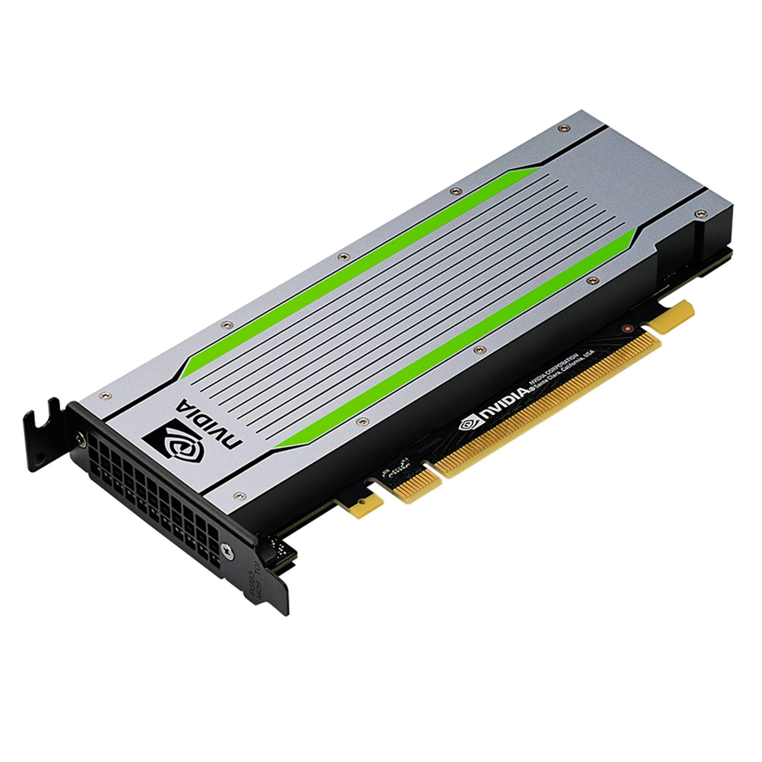
Context switching overhead is high
New model
Old model
Notes:
Why cannot we use GPUs in the same way?
This is caused by the high overhead of context switching.
In other words, loading a deep learning model to GPU takes too much time.
It can take several seconds to switch tasks on GPU and serve the first inference.
This violates the SLOs of inference tasks.
End.

Slide 8
Context switching overhead is high
Infer
ResNet
Train
BERT
NVIDIA T4
Latency: 6s
Notes:
For example, we measured the switching overhead. We switch from training BERT to inferring ResNet, on NVIDIA T4 GPU.
The latency to finish the first inference request is 6 seconds.
End.

Slide 9
Drawbacks of existing solutions
Infer
ResNet
NVIDIA MPS
High overhead due to contention
Salus[MLSys’20]
Requires all the models to be preloaded into the GPU memory
Train
BERT
NVIDIA T4
Latency: 6s
Notes:
Some methods tries to solve this problem.
MPS is NVIDIA’s official support to share one GPU between multiple tasks, but the overhead is high due to the contention between different tasks.
Salus is a recent work, which supports fast job switching and memory sharing. However, Salus requires all the models to be preloaded into the GPU memory.
Unfortunately, the GPU memory is much more limited than host memory and cannot preload many models.
For example, T4 have only 16 GB GPU memory.
Moreover, the memory footprints of inference tasks are also increasing, as the models are getting larger.
End.

Slide 10
Goal: fast context switching
Infer
ResNet
Enable GPU-efficient multiplexing of multiple DL apps with fine-grained time-sharing
Achieve millisecond-scale context switching latencies and high throughput
Train
BERT
NVIDIA T4
Latency: 6s
Notes:
Thus, we argue that a context switching design that minimizes the switching overhead, especially quickly switching the contents on GPU memory, is a better approach for efficiently time-sharing GPUs.
The DNN models can be held in host memory, and the GPU can quickly context-switch between the models either for training or inference.
This way, the number of applications that can be multiplexed is not limited by the GPU memory size, and each application is able to use the entire GPU computation and memory resources during its time slice.
So, how could we reduce the overhead of context switching?
End.

Slide 11


PipeSwitch overview: architecture
New
Task
Controller
Standby
Worker
Standby
Worker
Memory
Daemon
Active
Worker
GPU
Notes:
We proposed our work, PipeSwitch, which achieves fast context switching leveraging the layered structures of deep learning models.
PipeSwitch enables GPU-efficient multiplexing of multiple deep learning applications on GPU servers. It exploits the characteristics of DL applications to achieve millisecond-scale task switching overhead in order to satisfy SLO requirements. Such fast task switching enables more flexible fine-grained scheduling to improve GPU utilization for dynamic workloads. Here we provide an overview of the architecture and task execution. This slide shows a PipeSwitch server. It contains four types of components: a controller, a memory daemon, an active worker, and multiple standby workers.
The controller is the central component. It receives tasks from the clients, and controls other components to execute tasks.
The memory daemon manages the GPU memory and the DNN models. It allocates the GPU memory to the active worker and transfers the model from the host memory to the GPU memory.
The active worker is the worker that currently executes a task in the GPU.
Standby workers are inactive works. They are idle, are initializing a new task, or are cleaning its environment for the previous task.

Slide 12
PipeSwitch overview: execution
Stop the current task and prepare for the next task.
Execute the task with pipelined model transmission.
Clean the environment for the previous task.
New
Task
Controller
Standby
Worker
Standby
Worker
Memory
Daemon
Active
Worker
GPU
Notes:
So, how is a task executed?
To start a new task, the controller preempts the current task by notifying the active worker. At the same time, the controller notifies an idle standby worker to initialize its environment for the new task.
After the active worker stops the current task, the controller notifies the memory daemon and the standby worker to execute the task with pipelined model transmission. The memory daemon allocates the memory to the standby worker and transmits the required model to the GPU. The standby worker becomes the new active worker to execute the new task.
The previous active worker becomes a standby worker and cleans the environment for the previous task.

Slide 13
Sources of context switching overhead
Model transmission
Memory allocation
Task initialization
Task cleaning
Notes:
To reduce the overhead in this process, a first question to ask is, where does the overhead come from?
Based on measurement, we break the overhead down into four components.
Model transmission is for transmitting the model from the host memory to the GPU memory.
Memory allocation is for allocating GPU memory for the new model.
Task initialization is for starting the new model and creating the environment. For example, launching the process, loading PyTorch library, and initializing CUDA context.
Task cleaning is for stopping the old model and cleaning its GPU environment. For example, freeing the GPU memory.
So, how can we reduce these overhead?

Slide 14
How to reduce the overhead?
Model transmission
Pipelined
model transmission
Memory allocation
Task initialization
Task cleaning
Notes:
Model transmission overhead is bounded by the PCIe bandwidth, which cannot be easily reduced. However, we designed pipelined model transmission technique, which leverages the layered structure of deep learning models to pipeline model transmission and task execution, so that the transmission overhead is hidden behind the task execution.

Slide 15
DL models have layered structures
Input
Layer-1
Forward
Propagation
Layer-2
Backward
Propagation
…
Layer-N
Output
Notes:
We noticed that deep learning models typically have well-defined structures, which makes it possible to switch context with low overhead. DNN models are usually deep, consisting of multiple layers stacking one on another.
Furthermore, the computation of DNN models takes place layer by layer as well.
Thus, it is possible to build a pipeline that overlaps the computation and GPU memory swapping for fast context switching.

Slide 16
Sequential model transmission and execution
Transmit layer 0
Execute layer 0
T₀
T₁
T₂
T_{n-1}
E₀
E₁
E₂
E_{n-1}
model transmission
over PCIe
task execution
on GPU
Notes:
Typically, when we want to run a new model in the GPU, we first need to load the model into GPU and then execute the task.
As we discussed before, deep learning models have layered structures. Here, T0 means transmitting parameters for the first layer, and E0 means executing the first layer.

Slide 17
Pipelined model transmission and execution
PCIe
T₀
T₁
T₂
T_{n-1}
GPU
E₀
E₁
E₂
E_{n-1}
Notes:
Thus, a naïve pipeline is to overlap transmission and execution layer-by-layer.

Slide 18
Pipelined model transmission and execution
Transmit layer 0
PCIe
T₀
T₁
T₂
T_{n-1}
GPU
E₀
E₁
E₂
E_{n-1}
Notes:
Firstly, we transmit parameters of the first layer to GPU.

Slide 19
Pipelined model transmission and execution
Transmit layer 1
PCIe
T₀
T₁
T₂
T_{n-1}
GPU
E₀
E₁
E₂
E_{n-1}
Execute layer 0
Notes:
After finishing transmitting the first layer, we start to compute the first layer. At the same time, we transmit parameters for the second layer.

Slide 20
Pipelined model transmission and execution
Transmit layer 2
PCIe
T₀
T₁
T₂
T_{n-1}
GPU
E₀
E₁
E₂
E_{n-1}
Execute layer 1
Notes:
Similarly, after transmitting the second layer, we execute the second layer and transmit the next layer in parallel. We repeat this process until finishing executing the task. Thus, we hide the overhead for transmission behind execution.

Slide 21
Pipelined model transmission and execution
Multiple calls to PCIe;
Synchronize transmission and execution.
PCIe
T₀
T₁
T₂
T_{n-1}
GPU
E₀
E₁
E₂
E_{n-1}
Notes:
There are two sources of overhead. One is the overhead to invoke multiple calls to PCIe to transmit parameters. For a large amount of data, e.g., combining the whole model to a large tensor, the time is dominated by the data size. However, when we divide the model into many layers, invoking PCIe call for each layer would cause significant extra overhead.
The other is the synchronization overhead between the transmission and the execution, which is necessary for the computation to know when a layer is ready to compute.

Slide 22
Pipelined model transmission and execution
Group
(0, i)
Group
(i+1, j)
Group
(k, n-1)
PCIe
Group
(0, i)
Group
(i+1, j)
Group
(k, n-1)
GPU
Notes:
To solve this challenge, we make a further optimization by grouping. We combine multiple layers into a group, and the pipeline is performed on per-group granularity. In this way, the pipelining overhead is paid once for each group, instead of each layer. Grouping introduces a tradeoff between pipelining efficiency and pipelining overhead. On the one hand, using small groups enables more overlap between transmission and execution, but it also pays more pipelining overhead. On the other hand, using big groups has minimal pipelining overhead, but reduces the chance for overlapping.

Slide 23
Pipelined model transmission and execution
Group
(0, i)
Group
(i+1, j)
Group
(k, n-1)
PCIe
Exponential time to find the optimal strategy
Two heuristics for pruning
Group
(0, i)
Group
(i+1, j)
Group
(k, n-1)
GPU
Notes:
Naively, we can enumerate all possible combinations to find the optimal grouping strategy. However, the complexity of such a method is exponential, and it is hard for models with hundred of layers like ResNet-152. We introduced two pruning techniques to improve the efficiency. Although they do not lower the complexity, they works efficiently in practice, and you can find more details in our paper.

Slide 24
How to reduce the overhead?
Model transmission
Pipelined
model transmission
Memory allocation
Unified
memory management
Task initialization
Task cleaning
Notes:
The memory allocation overhead is mainly caused by function calls to GPU to request GPU memory. To load the new mode to GPU, we need to request GPU memory for each parameter of the new model one by one, which caused many function calls. Thus, we designed unified memory management.

Slide 25
Unified memory management
Manage model parameters.
Allocate GPU memory.
Pointer
Memory
Daemon
Workers
Offset
GPU memory
Notes:
The basic idea is to request a large amount of GPU memory at the beginning and then manage the GPU memory by ourselves instead of by GPU drivers. It is possible because the memory pattern of a given model is deterministic and simple.
At the beginning, the memory daemon will request a large amount of GPU memory.
Then there are two stages to shared this memory with workers.
Firstly, when we start workers, the memory daemon shares the pointer to the GPU memory to them via inter-process communication (IPC) provided by GPU drivers. This stage is time-consuming.
Secondly, when a worker becomes active, the memory daemon allocates required GPU memory to the worker by sending the offset with respect to the pointer to the worker via sockets. As the offset is simply a 64-bit integer, it is fast. Then the worker will add this GPU memory to the PyTorch memory management module for execution.
By this design, we avoid expensive function calls to GPU drivers, and reduced the memory overhead.

Slide 26
How to reduce the overhead?
Model transmission
Pipelined
model transmission
Memory allocation
Unified
memory management
Task initialization
Active-standby
worker switching
Task cleaning
Notes:
To reduce the overhead for finalization and initialization, we designed active-standby worker switching.

Slide 27
Active-standby worker switching
Time
Init.
Execute
Clean
Old Task
Init.
Execute
Clean
New Task
New Task Starts
Notes:
This figure shows the naïve method which launches a new task. The old process cleans its environment. The new process initializes. After that, the new task can be executed.

Slide 28
Active-standby worker switching
Time
Init.
Execute
Clean
Old Task
Init.
1
Init.
2
Execute
Clean
New Task
New Task Starts
Notes:
This figure shows the naïve method which launches a new task. The old process cleans its environment. The new process initializes. After that, the new task can be executed.

Slide 29
Active-standby worker switching
Time
Init.
Execute
Clean
Old Task
Init.
1
Init.
2
Execute
Clean
New Task
Launch the process.
Create CUDA context.
Allocate GPU memory.
New Task Starts
Notes:
An optimization is to initialize the new process in advance, which leads to standby workers. The current task is executed by the active worker, and the standby workers initialize part of the environment in advance, including launching new processes and initialize CUDA context. Some resources like GPU memory cannot be prepared in advance, because the GPU is occupied completely by the active worker. When we need to load a new model, the standby worker could skip most of the initialization overhead.

Slide 30
Active-standby worker switching
Time
Init.
Execute
Clean
Old Task
Init.
1
Init.
2
Execute
Clean
New Task
New Task Starts
Notes:
A further optimization is to clean the old task and initialize the new task concurrently. The main overhead of cleaning the old task is to deleting tensor objects and freeing the GPU memory. This process does not modify content in the GPU memory. Thus, during the cleaning, we could start loading the new model to the GPU.

Slide 31
Implementation
Testbed: AWS EC2
p3.2xlarge: PCIe 3.0x16, NVIDIA Tesla V100 GPU
g4dn.2xlarge: PCIe 3.0x8, NVIDIA Tesla T4 GPU
Software
CUDA 10.1
PyTorch 1.3.0
Models
ResNet-152
Inception-v3
BERT-base
Notes:
With this design, we implemented a prototype of PipeSwitch.
Our evaluations are performed on AWS EC2 instances. Concretely, we use two types of instances.
One is training-oriented p3.2xlarge, which provides better PCIe bandwidth and NVIDIA V100 GPUs.
The other is inference-oriented g4dn.2xlarge, which provides lower PCIe bandwidth and NVIDIA T4 GPU.
We implemented the prototype of PipeSwitch in Python and C++ and integrate it with PyTorch. For example, we add some functions into the GPU memory management module of PyTorch, so that we could insert GPU memory allocated by the memory daemon to the memory pool of PyTorch.
We use three models for evaluation, including ResNet-152, Ineption-v3 and BERT-base.

Slide 32
Evaluation
Can PipeSwitch satisfy SLOs?
Can PipeSwitch provide high utilization?
How well do the design choices of PipeSwitch work?
Notes:
Evaluations show that PipeSwitch achieves low overhead and high utilization for different models and different GPU types.
We want to answer three questions.
Can PipeSwitch satisfy SLOs?
Can PipeSwitch provide high utilization?
How well do the design choices of PipeSwitch work?

Slide 33
Evaluation
Can PipeSwitch satisfy SLOs?
Can PipeSwitch provide high utilization?
How well do the design choices of PipeSwitch work?
Notes:
In this presentation, we will focus on the first two questions.

Slide 34
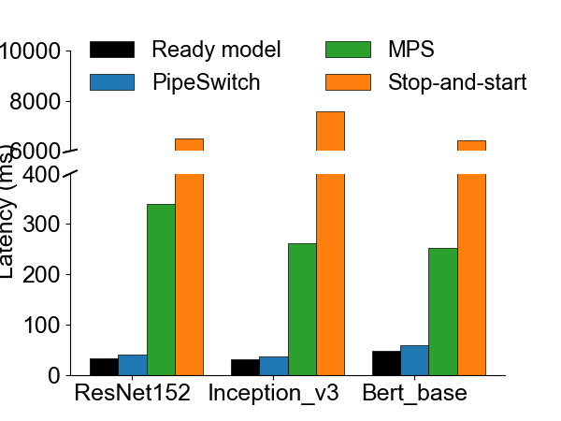
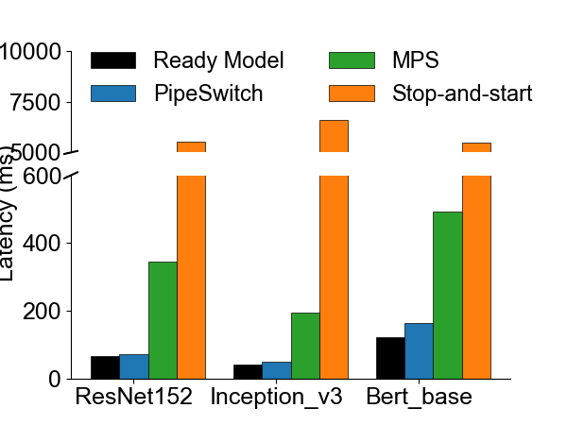
PipeSwitch satisfies SLOs
NVIDIA Tesla V100
NVIDIA Tesla T4
Notes:
Firstly, PipeSwitch satisfies SLOs. Consider such a scenario. The GPU is executing a training task, and we need to execute an inference task now. These two figures shows their latency on NVIDIA V100 GPUs and T4 GPUs, respectively. We compare 4 different methods.

Slide 35
PipeSwitch satisfies SLOs
NVIDIA Tesla V100
NVIDIA Tesla T4
33ms
Notes:
Ready model means, there is no training, and the model for inference is already in the GPU and is ready to execute. It provides a lower bound for the latency. For example, the latency for ResNet-152 is 33ms.

Slide 36
PipeSwitch satisfies SLOs
NVIDIA Tesla V100
NVIDIA Tesla T4
39ms
Notes:
PipeSwitch is our work. With all the optimizations, the latency of our system or ResNet is 39ms, introducing only 6ms overhead.

Slide 37
PipeSwitch satisfies SLOs
NVIDIA Tesla V100
NVIDIA Tesla T4
340ms
Notes:
MPS is NVIDIA’s official support to share GPU between multiple processes. Due to the on-demand memory swap and contention between multiple tasks, its overhead is larger than PipeSwitch.

Slide 38
PipeSwitch satisfies SLOs
NVIDIA Tesla V100
NVIDIA Tesla T4
6.5s
Notes:
Stop-and-start is to kill the current process and load a new process for the new task. This is the method in existing systems.

Slide 39
PipeSwitch satisfies SLOs
NVIDIA Tesla V100
NVIDIA Tesla T4
PipeSwitch achieves low context switching latency.
Notes:
These results show that PipeSwitch satisfies SLOs with low overhead.

Slide 40
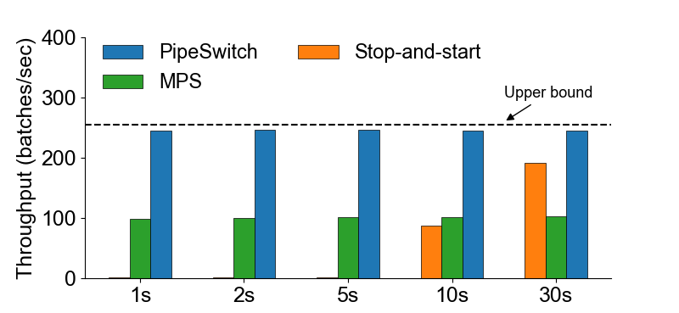
PipeSwitch provide high utilization
Scheduling cycles
Notes:
After latency, let look at the utilization. Consider such a scenario where we change the model on the GPU periodically. This figure shows the average throughput for different methods.
Labels under the x-axis indicates the scheduling cycles. For example, 1s means the models in the GPU changes every second.
Upper bound is the throughput achieved by the ready model. There is no switching, and the model resides in the GPU all the time.

Slide 41
PipeSwitch provide high utilization
Scheduling cycles
Notes:
PipeSwitch achieves nearly the same throughput as the upper bound for all the different scheduling cycles, even for the scheduling cycle 1s.

Slide 42
PipeSwitch provide high utilization
Scheduling cycles
Notes:
MPS achieves worse throughput, less half of the upper bound.

Slide 43
PipeSwitch provide high utilization
Scheduling cycles
Notes:
Stop-and-start has nearly 0 throughput for small scheduling cycle because its overhead is larger than the scheduling cycle. When the scheduling cycle increases enough, it has a much better throughput. This is why this method exists in real systems.

Slide 44
PipeSwitch provide high utilization
PipeSwitch achieves near 100% utilization.
Scheduling cycles
Notes:
These results show that PipeSwitch achieves near 100% utilization.

Slide 45
Summary
GPU clusters for DL applications suffer from low utilization
Limited share between training and inference workloads
PipeSwitch introduces pipelined context switching
Enable GPU-efficient multiplexing of DL apps with fine-grained time-sharing
Achieve millisecond-scale context switching latencies and high throughput
Notes:
In conclusion, GPU clusters for DL applications suffer from low utilization, due to limited sharing between training and inference workloads.
PipeSwitch introduces pipelined context switching. It enables GPU-efficient multiplexing of DL apps with fine-grained time-sharing. It achieves millisecond-scale context switching latencies and high throughput.

Slide 46
Thank you!
zbai1@jhu.edu
Notes:
That’s all for this presentation. Thank you very much.

