Slide 1


PipeSwitch: Fast Pipelined Context Switching for Deep Learning Applications
Zhihao Bai, Zhen Zhang, Yibo Zhu, Xin Jin
Notes:
Hello everyone.
Today I am glad to present our work, PipeSwitch: Fast Pipelined Context Switching for Deep Learning Applications.
End.

Slide 2








Deep learning powers intelligent applications in many domains
Notes:
Deep learning powers an emerging family of intelligent applications in many domains, from search engine and social networks, to retail and transportation, and many other fields.
End.

Slide 3
Training and inference
Training
Inference
High throughput
Low latency
Notes:
There are typically two components to build a deep learning application.
One is training, which trains deep learning models on datasets and requires high throughput.
The other is inference, which deploys trained model in the applications to serve requests and requires low latency.
End.

Slide 4
GPUs clusters for DL workloads
GPU
GPU
GPU
GPU
GPU
GPU
GPU
GPU
Notes:
To run deep learning workloads in a large scale, enterprises build GPU clusters that are either privately or publicly shared by multiple users.
End.

Slide 5
Separate clusters for training and inference
Cluster for
training
GPU
GPU
GPU
GPU
Cluster for
inference
GPU
GPU
GPU
GPU
Notes:
However, such shared GPU clusters are not completely shared.
For GPU clusters, the dominant practice today is to provision dedicated GPUs for training and inference separately.
In order to meet strict SLOs, inference clusters are often over-provisioned for the peak load.
End.

Slide 6
Utilization of GPU clusters is low
Today: separate clusters
Ideal: shared clusters
50%
100%
Training
25%
75%
Daytime
Midnight
50%
50%
Inference
25%
25%
Daytime
Midnight
Daytime
Midnight
Notes:
Let us consider a pattern of inference workload.
The inference workload fluctuates in correlation with the number of active users and shows clear peaks and valleys within each day.
Thus, during the valley in midnight, there are a lot of unused GPUs.
It would be a great match to utilize inference GPUs during less busy times for training.
Ideally, multiple DL applications should be able to be packed to the same GPU to maximize GPU utilization via time-sharing or space-sharing.
End.

Slide 7
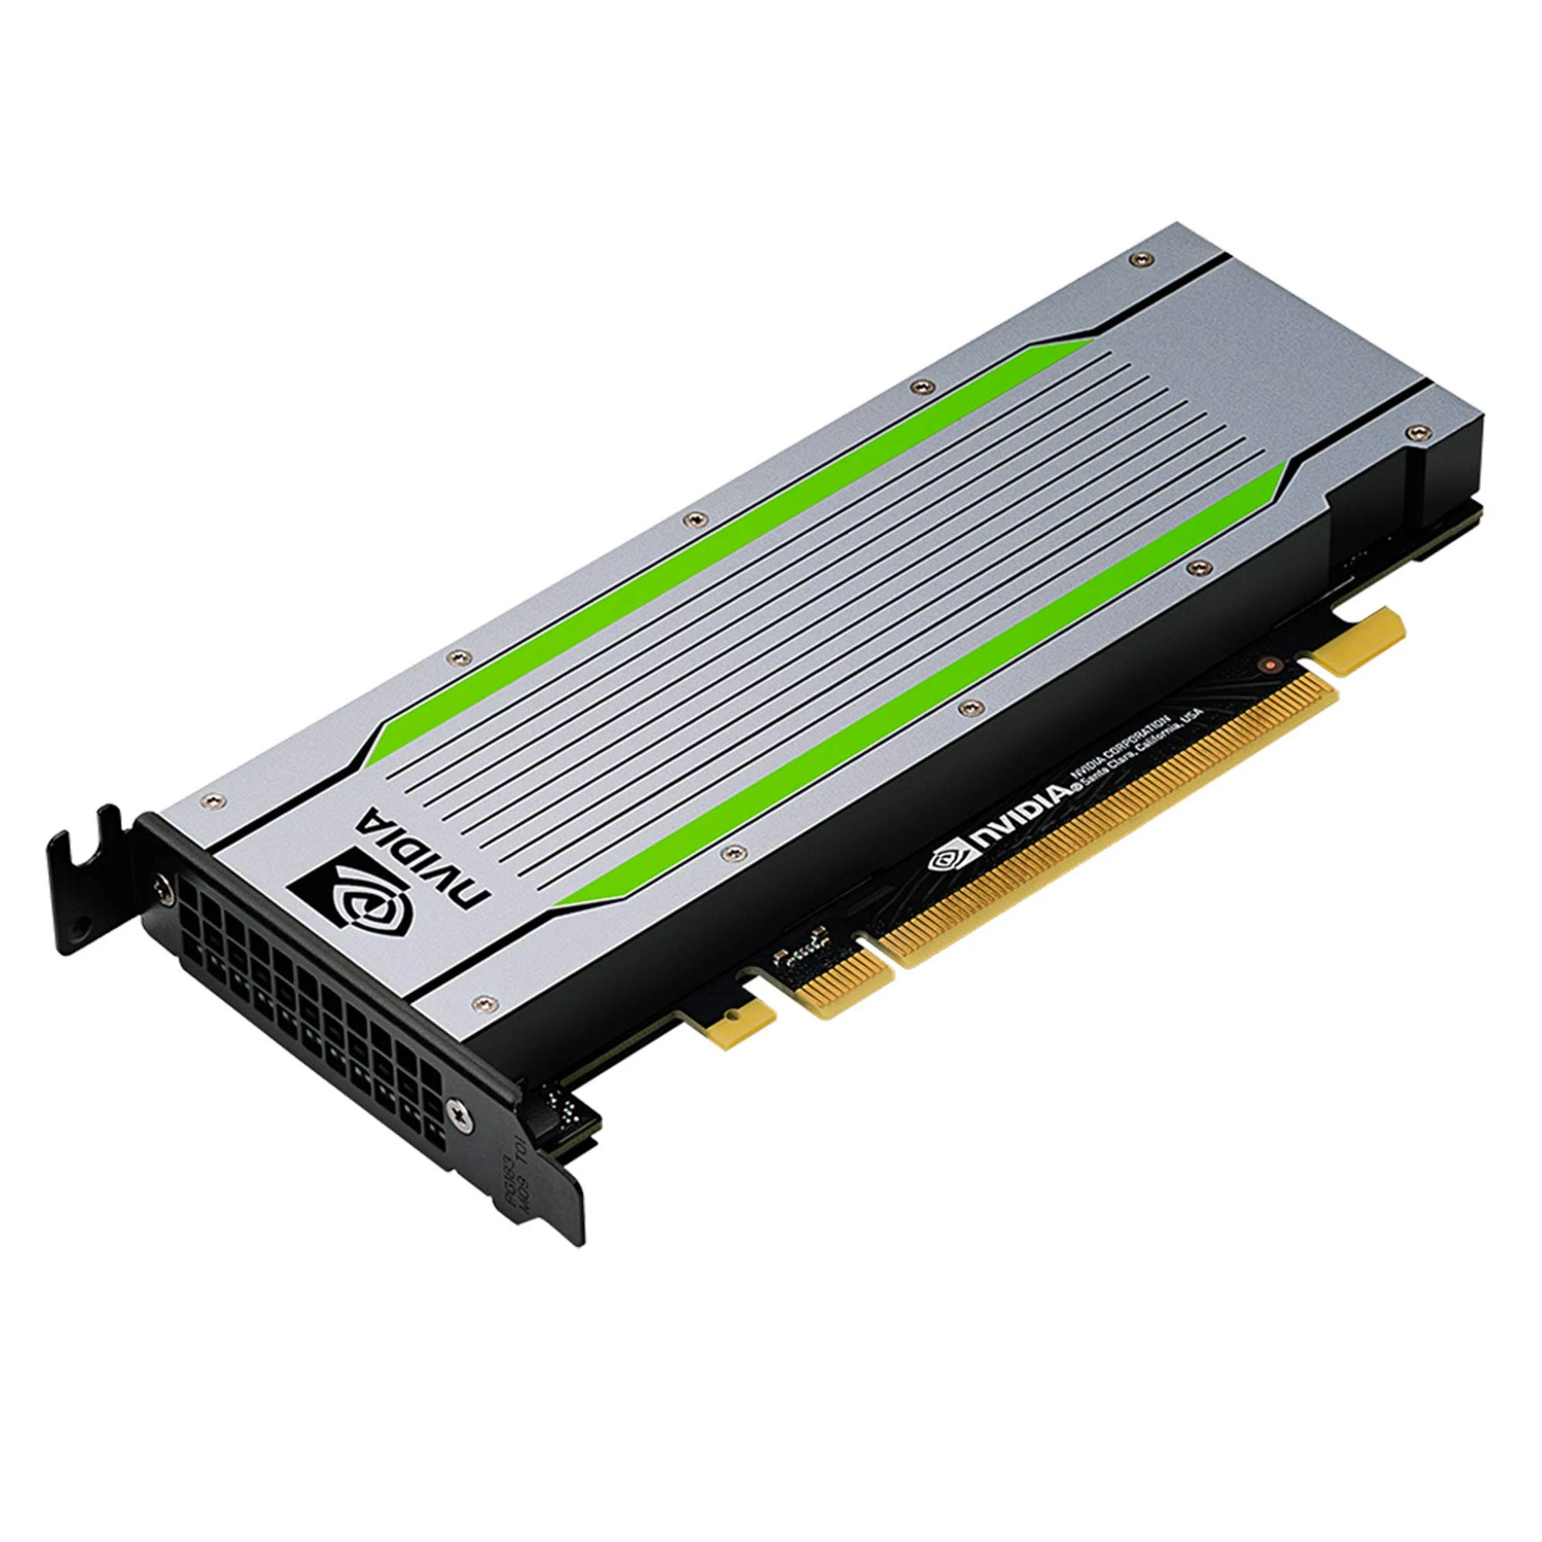
Context switching overhead is high
New model
Old model
Notes:
Why cannot we use GPUs in this way?
This is caused by the high overhead of context switching.
End.

Slide 8
Context switching overhead is high
Infer
ResNet
Train
BERT
NVIDIA T4
Latency: 6s
Notes:
For example, it takes 6 seconds to switch from BERT to ResNet on an NVIDIA T4 GPU.
End.

Slide 9
Drawbacks of existing solutions
Infer
ResNet
NVIDIA MPS
High overhead due to contention
Salus[MLSys’20]
Requires all the models to be preloaded into the GPU memory
Train
BERT
NVIDIA T4
Latency: 6s
Notes:
Some methods tries to solve this problem.
MPS is NVIDIA’s official support to share one GPU between multiple tasks, but the overhead is high due to the contention between different tasks.
Salus is a recent work, which supports fast job switching and memory sharing. However, Salus requires all the models to be preloaded into the GPU memory, which is much more limited than host memory.
End.

Slide 10
Goal: fast context switching
Infer
ResNet
Enable GPU-efficient multiplexing of multiple DL apps with fine-grained time-sharing
Achieve millisecond-scale context switching overhead and high throughput
Train
BERT
NVIDIA T4
Latency: 6s
Notes:
Thus, we argue that a fast context switching is desired.
It should enable GPU-efficient multiplexing of multiple DL apps with fine-grained time-sharing.
It should achieve millisecond-scale context switching overheads and high throughput.
The deep learning models can be held in host memory, and the GPU can quickly context-switch between the models either for training or inference.
This way, the number of applications that can be multiplexed is not limited by the GPU memory size, and each application is able to use the entire GPU computation and memory resources during its time slice.
End.

Slide 11


PipeSwitch overview: architecture
New
Task
Controller
Standby
Worker
Standby
Worker
Memory
Daemon
Active
Worker
GPU
Notes:
We proposed our work, PipeSwitch, which achieves such fast context switching by leveraging the layered structures of deep learning models.
This slide shows a PipeSwitch server. It contains four types of components.
The controller is the central component. It receives tasks from the clients, and controls other components to execute tasks.
The memory daemon manages the GPU memory and the deep learning models.
The active worker is the worker that currently executes a task in the GPU.
Standby workers are inactive workers.

Slide 12
Sources of context switching overhead
Model transmission
Memory allocation
Task initialization
Task cleaning
Notes:
To reduce the overhead in this process, we first break the overhead down into four components.
Model transmission is for transmitting the model from the host memory to the GPU memory.
Memory allocation is for allocating GPU memory for the new model.
Task initialization is for starting the new model and creating the environment.
Task cleaning is for stopping the old model and cleaning its GPU environment.

Slide 13
How to reduce the overhead?
Model transmission
Pipelined
model transmission
Memory allocation
Task initialization
Task cleaning
Notes:
Model transmission overhead is bounded by the PCIe bandwidth, which cannot be easily reduced. We designed pipelined model transmission technique to handle this challenge.

Slide 14
DL models have layered structures
Input
Layer-1
Forward
Propagation
Layer-2
Backward
Propagation
…
Layer-N
Output
Notes:
Deep learning models are usually deep, consisting of multiple layers stacking one on another.
Furthermore, the computation of DNN models takes place layer by layer as well.
Thus, it is possible to build a pipeline that overlaps the computation and GPU memory swapping.

Slide 15
Sequential model transmission and execution
Transmit layer 0
Execute layer 0
T₀
T₁
T₂
T_{n-1}
E₀
E₁
E₂
E_{n-1}
model transmission
over PCIe
task execution
on GPU
Notes:
Typically, we need to load the model into GPU before executing the task.
Here, T0 means transmitting parameters for the first layer, and E0 means executing the first layer.

Slide 16
Pipelined model transmission and execution
PCIe
T₀
T₁
T₂
T_{n-1}
GPU
E₀
E₁
E₂
E_{n-1}
Notes:
A naïve pipeline is to overlap transmission and execution layer-by-layer.

Slide 17
Pipelined model transmission and execution
Transmit layer 0
PCIe
T₀
T₁
T₂
T_{n-1}
GPU
E₀
E₁
E₂
E_{n-1}
Notes:
Firstly, we transmit parameters of the first layer to GPU.

Slide 18
Pipelined model transmission and execution
Transmit layer 1
PCIe
T₀
T₁
T₂
T_{n-1}
GPU
E₀
E₁
E₂
E_{n-1}
Execute layer 0
Notes:
After finishing transmitting the first layer, we start to execute the first layer. At the same time, we transmit parameters for the second layer.

Slide 19
Pipelined model transmission and execution
Transmit layer 2
PCIe
T₀
T₁
T₂
T_{n-1}
GPU
E₀
E₁
E₂
E_{n-1}
Execute layer 1
Notes:
Similarly, after transmitting the second layer, we execute the second layer and transmit the next layer in parallel. We repeat this until the end. Thus, we hide the overhead for transmission behind execution.

Slide 20
Pipelined model transmission and execution
Multiple calls to PCIe;
Synchronize transmission and execution.
PCIe
T₀
T₁
T₂
T_{n-1}
GPU
E₀
E₁
E₂
E_{n-1}
Notes:
However, there are still two sources of overhead.
One is invoking hundreds of PCIe calls to transmit parameters.
The other is the synchronization between the transmission and the execution, which is necessary for the computation to know when a layer is ready to compute.

Slide 21
Pipelined model transmission and execution
Group
(0, i)
Group
(i+1, j)
Group
(k, n-1)
PCIe
Group
(0, i)
Group
(i+1, j)
Group
(k, n-1)
GPU
Notes:
To solve this challenge, we make a further optimization by grouping. We combine multiple layers into a group, and the pipeline is performed on per-group granularity. In this way, the pipelining overhead is paid once for each group, instead of each layer. Grouping introduces a tradeoff between pipelining efficiency and pipelining overhead.

Slide 22
Pipelined model transmission and execution
Group
(0, i)
Group
(i+1, j)
Group
(k, n-1)
PCIe
Exponential time to find the optimal strategy
Two heuristics for pruning
Group
(0, i)
Group
(i+1, j)
Group
(k, n-1)
GPU
Notes:
Naively, we can enumerate all possible combinations to find the optimal grouping strategy. However, the complexity of such a method is exponential. We introduced two pruning techniques to improve the efficiency, and they works well in practice. You can find more details in our paper.

Slide 23
How to reduce the overhead?
Model transmission
Pipelined
model transmission
Memory allocation
Unified
memory management
Task initialization
Task cleaning
Notes:
The memory allocation overhead is caused by the large number of requests for GPU memory for each parameter of the new model. To solve this, we designed unified memory management.

Slide 24
Unified memory management
Manage model parameters.
Allocate GPU memory.
Pointer
Memory
Daemon
Workers
Offset
GPU memory
Notes:
The basic idea is to request a large amount of GPU memory at the beginning and then manage the GPU memory by ourselves instead of by GPU drivers. It is possible because the memory pattern of a given model is deterministic and simple.
Then there are two stages to shared this memory with workers.
Firstly, when we start workers, the memory daemon shares the pointer to the GPU memory to them via IPC provided by GPU drivers. This stage is time-consuming.
Secondly, when a worker becomes active, the memory daemon allocate required GPU memory to the worker by sending the offset with respect to the pointer to the worker via sockets. As the offset is simply a 64-bit integer, it is fast.
By this design, we avoid expensive function calls to GPU drivers, and reduced the memory overhead.

Slide 25
How to reduce the overhead?
Model transmission
Pipelined
model transmission
Memory allocation
Unified
memory management
Task initialization
Active-standby
worker switching
Task cleaning
Notes:
To reduce the overhead for finalization and initialization, we designed active-standby worker switching.

Slide 26
Active-standby worker switching
Time
Init.
Execute
Clean
Old Task
Init.
Execute
Clean
New Task
New Task Starts
Notes:
This figure shows the naïve method which launches a new process. The old process cleans its environment. The new process initializes. After that, the new task can be executed.

Slide 27
Active-standby worker switching
Time
Init.
Execute
Clean
Old Task
Init.
1
Init.
2
Execute
Clean
New Task
New Task Starts

Slide 28
Active-standby worker switching
Time
Init.
Execute
Clean
Old Task
Init.
1
Init.
2
Execute
Clean
New Task
Launch the process.
Create CUDA context.
Allocate GPU memory.
New Task Starts
Notes:
An optimization is to initialize part of the new process in advance, which leads to standby workers.
For example, launching new processes and initializing CUDA context.
Some resources like GPU memory cannot be prepared in advance, because the GPU is occupied completely by the active worker.

Slide 29
Active-standby worker switching
Time
Init.
Execute
Clean
Old Task
Init.
1
Init.
2
Execute
Clean
New Task
New Task Starts
Notes:
A further optimization is to clean the old task and initialize the new task concurrently. Cleaning the old task is to delete tensor objects and free the GPU memory. These operations do not modify content in the GPU memory. Thus, during the cleaning, we could start loading the new model to the GPU.

Slide 30
Implementation
Testbed: AWS EC2
p3.2xlarge: PCIe 3.0x16, NVIDIA Tesla V100 GPU
g4dn.2xlarge: PCIe 3.0x8, NVIDIA Tesla T4 GPU
Software
CUDA 10.1
PyTorch 1.3.0
Models
ResNet-152
Inception-v3
BERT-base
Notes:
With this design, we implemented a prototype of PipeSwitch.
Our evaluations are performed on two types of instances on AWS.
One is training-oriented p3, which provides better PCIe bandwidth and NVIDIA V100 GPUs.
The other is inference-oriented g4.
We implemented the prototype of PipeSwitch in Python and C++ and integrate it with PyTorch.

Slide 31
Evaluation
Can PipeSwitch satisfy SLOs?
Can PipeSwitch provide high utilization?
How well do the design choices of PipeSwitch work?
Notes:
In evaluation, we want to answer three questions.
Can PipeSwitch satisfy SLOs?
Can PipeSwitch provide high utilization?
How well do the design choices of PipeSwitch work?

Slide 32
Evaluation
Can PipeSwitch satisfy SLOs?
Can PipeSwitch provide high utilization?
How well do the design choices of PipeSwitch work?
Notes:
In this presentation, we will focus on the first two questions.

Slide 33
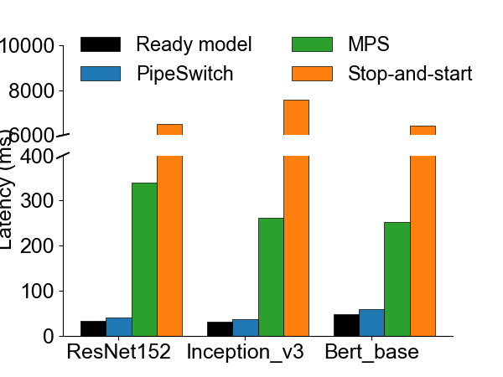
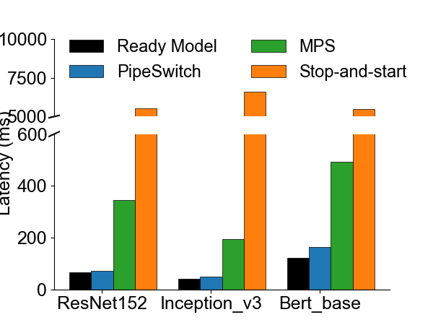
PipeSwitch satisfies SLOs
NVIDIA Tesla V100
NVIDIA Tesla T4
6.5s
340ms
39ms
33ms
Notes:
Consider such a scenario where we switch from a training task to an inference task. These two figures shows their latency to finish the first inference request on different instances.
Ready model means, there is no training, and the model for inference is already in the GPU and is ready to execute. It provides a lower bound for the latency. For example, the latency for ResNet-152 is 33ms.
PipeSwitch is our work. With all the optimizations, the latency of our system or ResNet is 39ms, introducing only 6ms overhead.
MPS and stop-and-start achieve much larger overhead.

Slide 34
PipeSwitch satisfies SLOs
NVIDIA Tesla V100
NVIDIA Tesla T4
PipeSwitch achieves low context switching overhead.
Notes:
These results show that PipeSwitch achieves low context switching overhead.

Slide 35
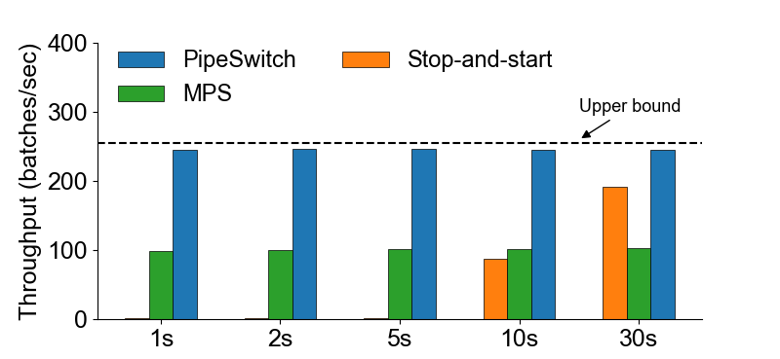
PipeSwitch provides high utilization
Scheduling cycles
Notes:
After latency, let look at the utilization. Consider such a scenario where we change the model on the GPU periodically. This figure shows the average throughput under different scheduling cycles.
Labels for the x-axis mean the scheduling cycles. For example, 1s means the models in the GPU changes every second.
Upper bound is the throughput achieved by the ready model. There is no switching, and the model resides in the GPU all the time.
PipeSwitch achieves nearly the same throughput as the upper bound for all the different scheduling cycles.
The throughput of MPS and stop-and-start is far from the upper bound.

Slide 36
PipeSwitch provide high utilization
PipeSwitch achieves near 100% utilization.
Scheduling cycles
Notes:
These results show that PipeSwitch achieves near 100% utilization.

Slide 37
Summary
GPU clusters for DL applications suffer from low utilization
Limited sharing between training and inference workloads
PipeSwitch introduces pipelined context switching
Enable GPU-efficient multiplexing of DL apps with fine-grained time-sharing
Achieve millisecond-scale context switching latencies and high throughput
Notes:
In conclusion, GPU clusters for DL applications suffer from low utilization due to limited sharing between training and inference workloads.
PipeSwitch introduces pipelined context switching. It enables GPU-efficient multiplexing of DL apps with fine-grained time-sharing. It achieves millisecond-scale context switching latencies and high throughput.

Slide 38
Thank you!
zbai1@jhu.edu
Notes:
That’s all for this presentation. Thank you very much.

