Slide 1
Neural Packet Classification
Eric Liang¹, Hang Zhu², Xin Jin², Ion Stoica¹
¹UC Berkeley, ²JHU

Slide 2
Packet Classification
Fundamental problem in computer networking
Building block for access control, QoS, defense against attacks
Payload
Header
Payload
Header
Flow classification
Fiber
optics
Fiber
optics
Src IP addr
Classifier (Rule Database)
Dst IP addr
Predicate | Action
----- | -----
----- | -----
100k rules or more!
Src port #
Dst port #
Router /
Firewall
Protocol type
Notes:
What is packet classification?
...
The way to think about it is as a router or firewall, you want to do flow classification on incoming packets based on a large list of rules..
This involves making decisions on incoming packets based on their headers.
The main challenge of this is that you have to do this at very high speed, on potentially hundreds of thousands of rules.

Slide 3
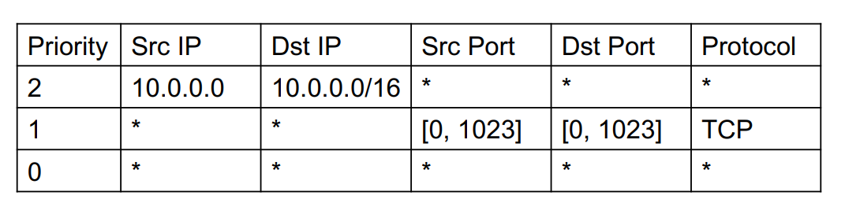
Packet Classifier Example
exact match
match any
match range
Notes:
Here's a very simple example of a packet classifier here with just three rules.
You can see these rules are ordered and have a priority, so here the rule with priority 2 is first.
Each rule can match against packet headers in a number of ways, including exact match (here matching srcip 10.0.0.0), ranges, and wildcards.

Slide 4
How hard is this problem?
Packet
(matching R1 and R4)
Similar to point-location problem
Hard time-space tradeoff
O(log N) time and O(N^{d}) space
O(log^{d} N) time and O(N) space
N: # of rules; d: # of attributes N ~= 100k, d = 5
But harder: rules have priorities and can overlap in space
R0
R4
R1
R5
Y
R4
R3
X
Notes:
Not prefix-matching
Similar to the well known theoretical point-location problem
The basic idea is in D-dim space, find all hypercubes corresponding to a given point
so here we have rules R0...R6 in 2d space, and we have a packet that matches R1 and R4 (R4 has priority)
Problem has a hard...
btw, note that when d=1, as in the case with a binary search tree, the problem becomes trivial
but here d=5 so these bounds are pretty bad
But it's actually harder, as you can see the rules have priorities...

Slide 5
Existing solutions
Hardware-based (Ternary Content Addressable Memory)
Power and cost too high for large classifiers
Software-based data structures
Build a multi-dimensional "classification tree" -- really a k-d index
Goal of software-based solutions is to optimize for
Access time: number of DRAM accesses
Memory: total size of tree in memory
^ metrics we care about

Slide 6
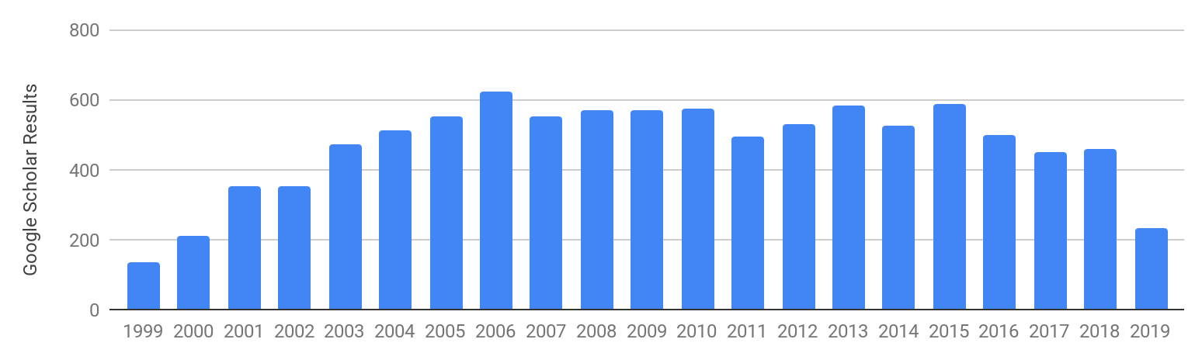
Twenty years of research in packet classification
HiCuts ('99), HyperCuts ('03), EffiCuts ('10), CutSplit ('15)
Engineered with hand-tuned heuristics targeting different objectives
Notes:
There's been twenty years of research into software based solutions for packet classifications. And there's been many hundreds of papers on this topic.
One of the first solutions was HiCuts algorithm in 1999, followed by HyperCuts, EffiCuts and CutSplit.
The main thing to note is that algorithms are all engineered with hand-tuned heuristics loosely optimizing some objective that can be brittle.
For example, HiCuts and HyperCuts are designed to build very shallow trees in many cases, but sometimes can consume enormous amounts of memory. EffiCuts and CutSplit seek a more balanced objective between time and memory.

Slide 7
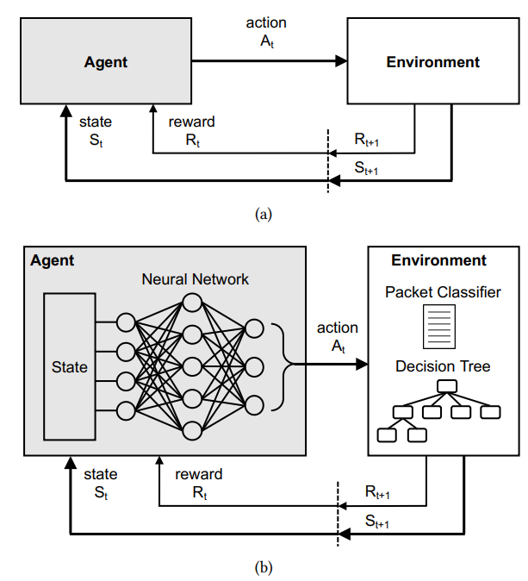
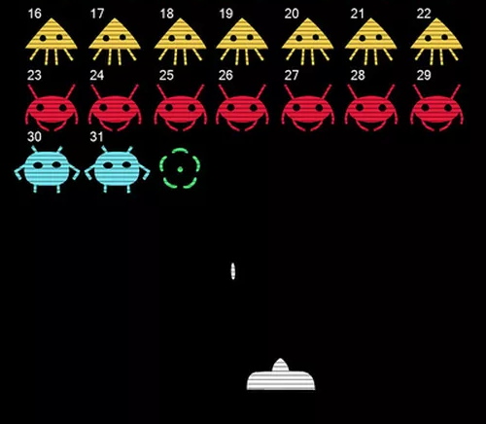
Our solution: Reinforcement Learning (RL) based
move left
+1 point
Use RL to synthesize a classification tree
Deployable for real: build a tree in simulation => deploy that artifact directly to production
Notes:
We're revisiting this problem with a different take using deep reinforcement learning.
Goal of RL is to train an agent to make decisions in an environment.
The environment provides the current state to the agent as input. Note here that the state can be quite complex if you use a neural network for the agent, for example if the agent is being trained to play SpaceInvaders, it could be an image.
The agent computes an action to take in the env (e.g., move left), and the environment provides feedback in terms of reward (here +1 point).
It also provides a new state, closing the loop. Over time, you want the agent to take actions maximizing the total reward it will receive.
So our take is to use RL to synthesize a packet classification tree.
As we'll see one advantage of this approach is that it's deployable for real: we're using RL to build an tree in simulation, but that tree is a real data structure that can be deployed straightforwardly into existing systems

Slide 8

TLDR; NeuroCuts algorithm
Frames building packet classification trees as an RL environment
i.e., game / sequential decision process
Deep RL will lets us build significantly faster packet classifiers
packet classification rules
Train a NeuroCuts
Agent with RL
deploy artifact
optimized tree data structure
Notes:
Our proposed algorithm Neurocuts, frames ...
Turns out Deep RL ...
At a high level, neurocuts takes packet rules ... after RL training produces an optimized tree data structure, which is an artifact that can be deployed to production hardware.
One thing about NeuroCuts I want to emphasize here is that, in contrast to the typical goal of RL, we only care about the artifact generated by the agent.
So this means we can throw away the agent after training is finished. Also, it means the agent doesn't need to generalize to many scenarios. It can just specialize on being really really good at building trees for one particular classifier.

Slide 9
Why Reinforcement Learning?
Existing solutions are based on greedy heuristics (e.g., maximize split entropy, balance this space measure, etc.).
RL can do better than greedy approaches because it models the long-term outcomes of actions
And can optimize directly for the end objective
Historically, efficient RL formulation => super-human performance (e.g., AlphaZero, AlphaStar)
Notes:
You might be wondering why RL?
One thing we noticed about prior approaches was they were based primarily on greedy heuristics. E.g., at a particular node of the tree, you want to maximize the split entropy, balance some metric, etc.
RL can do better...
This actually makes it a more principled way to approach the optimization problem, since you can directly optimize for your end objective
Historically (e.g., past few years), efficient RL formulation has quickly led to superhuman performance ...

Slide 10
Why not an end-to-end solution?
packets
Infer which rule should be matched
Pros:
maybe don't need to build a data structure at all
Model?
decisions
Cons:
very large space of inputs => very hard to check model correctness
need a very large model to get good errors for large packet classifiers
packet inference costs too high (need decisions in hundreds of nanoseconds)
need specialized inference hardware
Notes:
Another question is while we're considering ML based solutions, why not replace the tree structure entirely with a learned model?
Idea here is learn a model to infer which rule should be matched.
Pros: ...
Cons: ..

Slide 11
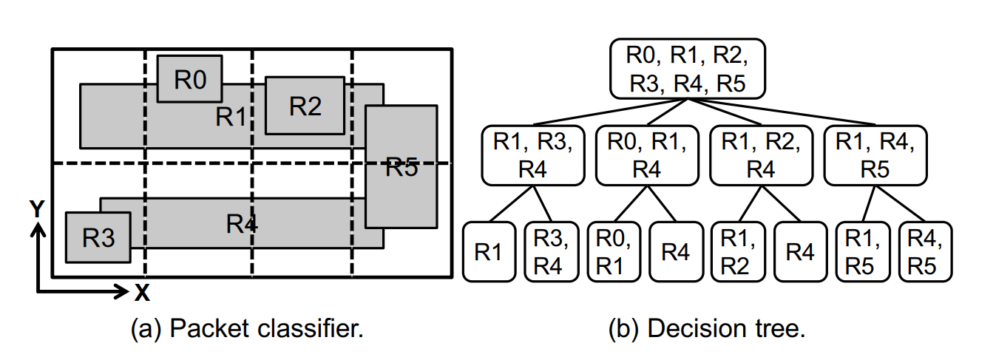
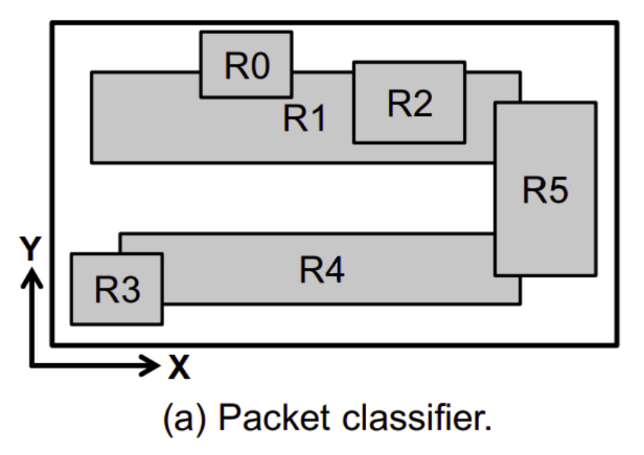
Rules of the Game: (1) Node Cutting
Notes:
Ok so how do we build these tree structures. Well here's a simple example.
On the left I have an example packet classifier with rules R0..R5. On the right is the start of a decision tree. You can see that right now it's just a single node, which is slow to search since to match a packet you have to do a linear scan over all the rules.
We can improve this situation somewhat by cutting the node into 4 slices along the x-dimension. So you see this generates four child nodes with fewer rules each.
Note that while rules R0... R5 are only in one sub node each, rules R1 and R4 end up replicated into multiple subtrees. This is part of the reason this problem is so hard.
Now say I then cut along the y-dim into two slices, then that does effectively divide the nodes into small enough pieces that we can consider the tree finished.

Slide 12
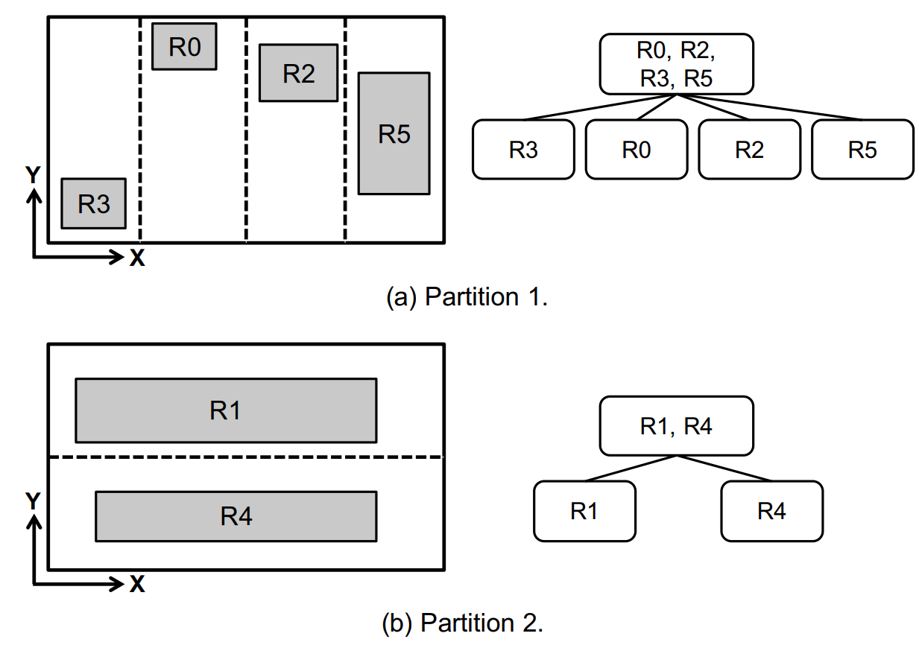
(2) Rule Partition: Avoiding Rule Replication
Notes:
One way of avoiding the rule replication problem is to partition rules into disjoint subsets.
In this example the rules have been partitioned into "small rules" and "large rules".
As you can see this leads to significantly smaller trees. However the tradeoff is that now at runtime we have to search both trees to determine which rule is matched.

Slide 13
Building classification trees
Most existing algorithms build on these two actions:
Node cut
Rule partition
Many heuristics on how to determine exactly how to cut / partition tree
i.e., exploit the problem structure

Slide 14
Adapting RL for building packet classifiers
^ defining this is the challenge
Notes:
Let's look at the procedure from a RL framing. You have an environment, which includes the packet classifier rules, and also the partially built state of the decision tree. Of course the goal is to learn an agent that can effectively work in such an environment.
One thing to note here is that the challenge is primarily in defining the inputs and outputs of the environment, not so much in the RL algorithm itself.

Slide 15
First Attempt
Naive MDP (Markov Decision Process) formulation of environment:
assume DFS order of building tree node-by-node
action is to cut or partition current node
N0
N0
N0
reward = -depth[tree] +
alpha * -size[tree]
N1
N2
N1
N2
...
action a₁
action a₂
N3
N4
N5
state s₀
state s₁
state s₂
state s_{N}
Notes:
A common solution in this situation is using forums such as StackOverflow where people ask API experts

Slide 16
What are the challenges here?
N0
N0
N1
N2
...
N0
N0
...
...
N999999
N1000000
N1
N2
N1
N2
Size of state grows with each step
reward = -52
Rewards are delayed until end
N3
N4
N5
Need to learn to understand complex state
+ weak reward attribution => learning signal is too high variance
Notes:
Size of state grows with each step
This means the neural network must take a dynamically changing input
While this is possible, processing this sort of graph data is an active (and very new) area of research
Second problem is the sparsity of rewards
Say N=100k, then it might take millions of steps to build a tree.
Getting a reward after 1 million steps is far too difficult a reward assignment problem
Explain
Hard to understand the state
Attribution is too weak
High variance => btw for those that don't know RL, high variance is a common excuse for RL not working

Slide 17
Optimization #1
Node states are independent of parent or sibling nodes
s₂ can be represented as a fixed-length vector describing N3's bounding hypercube:
{SrcIPMin, SrcIPMax,
DstIPMin, DstIPMax,
SrcPortMin, SrcPortMax,
DstPortMin, DstPortMax,
ProtocolMin, ProtocolMax}
N0
N1
N2
N3
N4
N5
state s₂

Slide 18
Optimization #2
Building a tree is a branching decision process, not sequential MDP
Calculate rewards not by summing over time, but agg. across tree branches
N0
Suppose this is the final state s_{n}, how do we calculate the total teward (advantage) for the root node N0?
N1
N2
N3
N4
N5
state s_{n}

Slide 19
Optimization #2
Building a tree is a branching decision process, not sequential MDP
Calculate rewards not by summing over time, but agg. across tree branches
Sequential Decision Process
N0
N1
N3
N4
N5
N2
done (reward = -3)
reward
= -2.1
reward
= -2.4
reward
= -2.6
reward
= -2.8
reward
= -2.9 (temporally discounted)
O(n) step delay between action and reward => action attribution is very weak (sparse reward problem)
Notes:
So viewing the tree rollout as a sequential process we have this order. And when the rollout is done we get a reward of -3 (depth is 3 and we want to minimize the depth).
When you calculate the reward/adv for each state, since this problem only gives you a single reward at the end, you get basically the same total reward for each state if you ignore the temporal discount.
So basically the problem is that the O(n) step delay between action and reward makes it hard to attribute which actions led to the rewards.

Slide 20
Optimization #2
Building a tree is a branching decision process, not sequential MDP
Calculate rewards not by summing over time, but agg. across tree branches
Branching Decision Process
N2
done (reward = -1)
N3
done (reward = -1)
N0
N1
reward
= min(r_{child}) - 1
= -3
N4
done (reward = -1)
reward
= min(r_{child}) - 1
= -2
O(logn) delay between action and reward
N5
done (reward = -1)
Notes:
OTOH if you view the rollout as a branching decision process, things get easier. Each leaf node has a reward of -1, and the intermediate rewards are calculate by taking a min-agg over children and taking into account the interior node's contribution to the tree depth as well. So here the rewards are -2 and -3.
Now there's only an O(logn) delay between action and reward and you can see action->reward causality is much better represented.

Slide 21
Defining the Learning Problem
Action space:
Either Cut or Partition
Cut: choose dimension to cut, how many pieces to cut into
Partition: specify heuristic to use, or dimension and threshold
Observation space:
Encoding of node state (binary string)
Encoding partitioning state (binary string)
Encoding of allowed actions mask (binary mask)
Notes:
Now we can define the learning problem

Slide 22
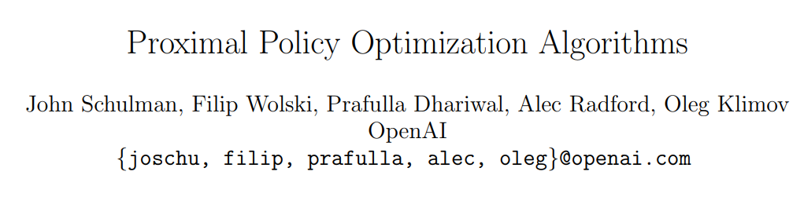
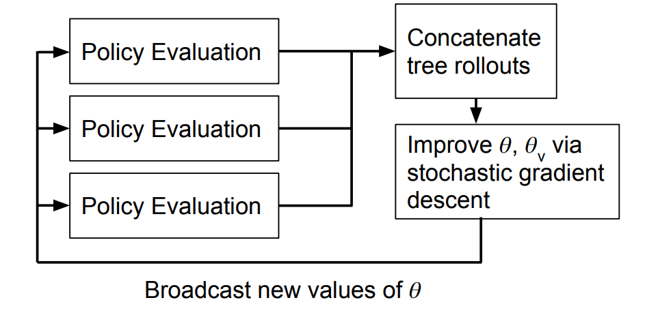
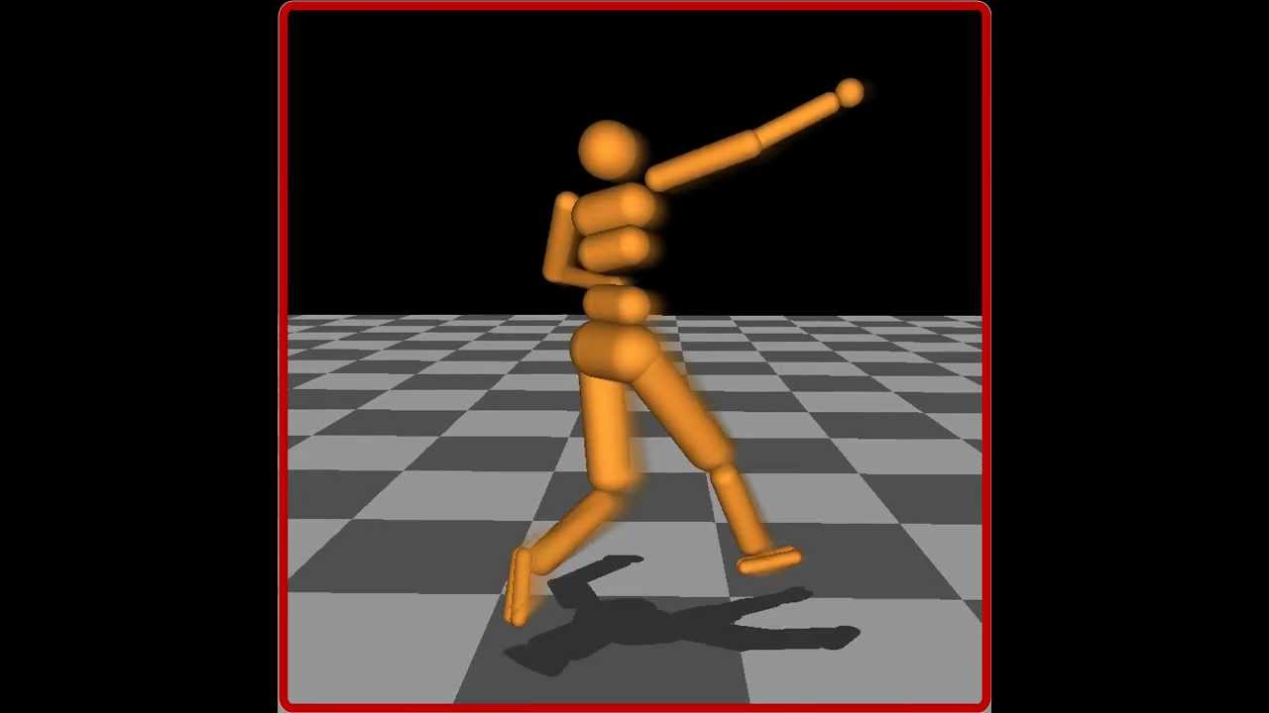
Implementation
Chose Proximal Policy Optimization (2017), but there are many reasonable choices of algorithm
Used parallel off-the-shelf PPO implementation from RLlib (ICML '18)
Notes:
We implemented NeuroCuts using the PPO algorithm, which is one of the most widely used RL algorithms today and has been successful across a variety of domains. This choice really isn't fundamental though, there are many other algorithms that could have worked.
Neurocuts is also amenable to parallelism, in fact we used a parallel off the shelf implementation of PPO from RLlib.

Slide 23
Evaluation on ClassBench
Standard benchmark for packet classifier performance
Synthetic packet classifiers ranging from 1000 to 100k rules in size, based on
Access control list (ACL),
Firewall (FW),
IP chain (IPC) rule sets
Compare NeuroCuts against
HiCuts
HyperCuts
EffiCuts
CutSplit
521 citations
625 citations
172 citations
8 citations
Notes:
by the way these aren't random baselines, they have hundreds of citations except for cutsplit is pretty new

Slide 24
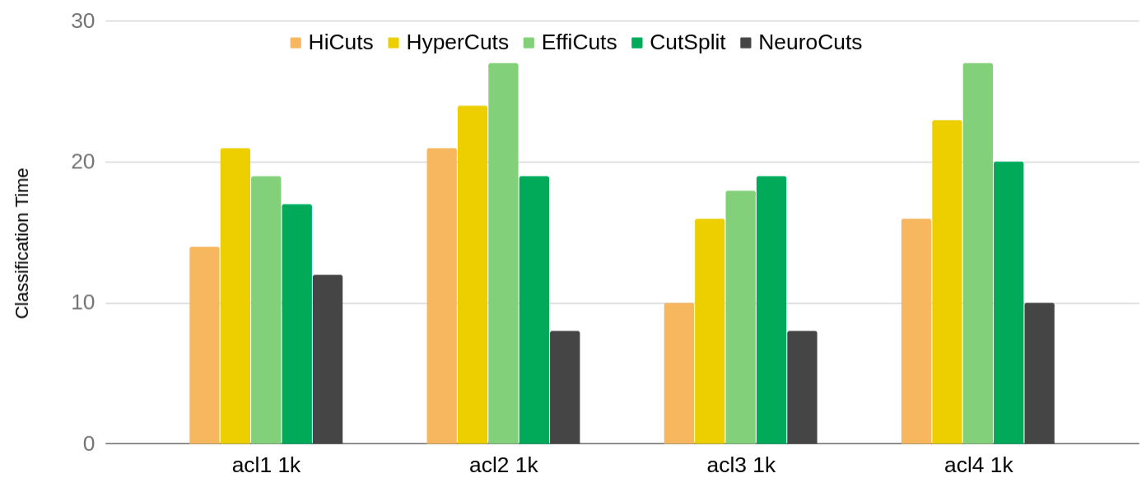
Time-Optimized NeuroCuts
Classification time
Classifier name
Notes:
First we compare against other algorithms on classification time, tuning NeuroCuts rewards to minimize this.
X-axis is the classbench ruleset, here just acl1 to acl4 1k.
The Y axis shows the worst-case classification time (tree depth), lower is better.
NeuroCuts is shown in black.
As you can see NeuroCuts is able to generate trees significantly better than these algorithms.

Slide 25
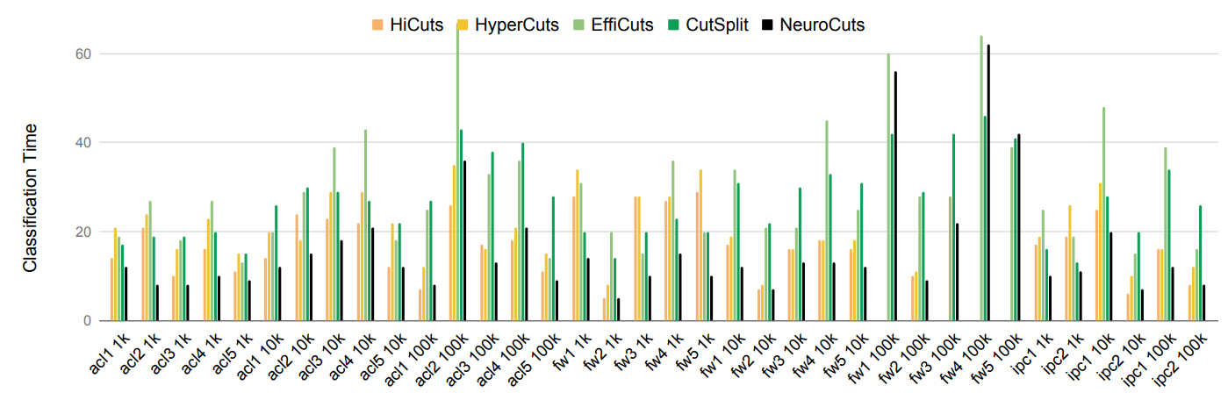
Time-Optimized NeuroCuts: Does it scale?
Summary: 18% median time improvement over all baselines. Up to 2x better.
Notes:
Does it scale? Yes. Her we compare against the full classsbench dataset with up to 100k rules.

Slide 26
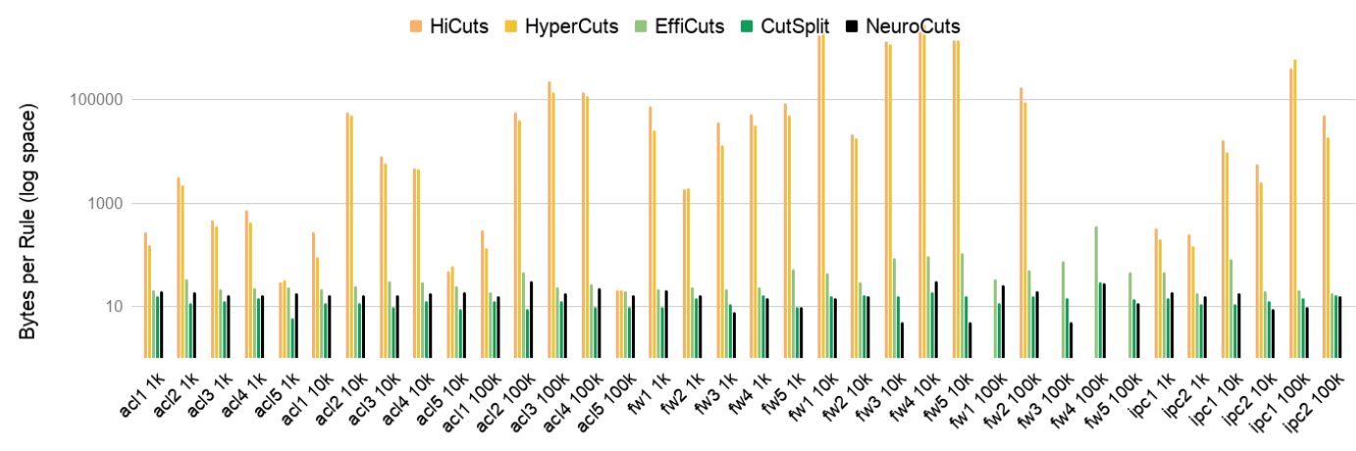
Space-Optimized NeuroCuts
Summary: up to 3x better memory over all baselines; CutSplit somewhat better at median.
Notes:
Next we try to tell NeuroCuts to minimize memory consumption.
Now on the Y-axis we show the bytes used per rule in log scale.
In the best case...., however CutSplit...

Slide 27
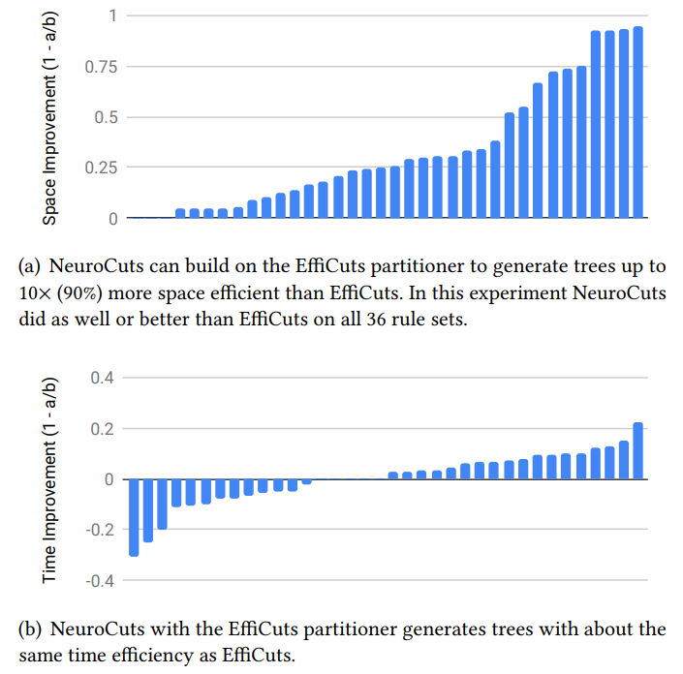
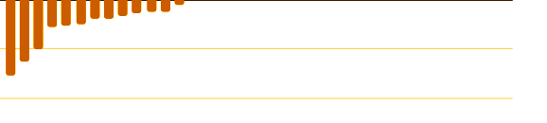
Leveraging Existing Heuristics: NeuroCuts + EffiCuts
Up to 10x space improvement building on EffiCuts.
Don't lose anything in time.
Notes:
NeuroCuts can also easily incorporate existing heuristics into its action space to leverage domain knowledge.
Here we show that NeuroCuts can enhance the EffiCuts partitioner to provide a 10x space improvement. This showing CDF of amount improved, anything positive is good.
Without losing anything in time.

Slide 28
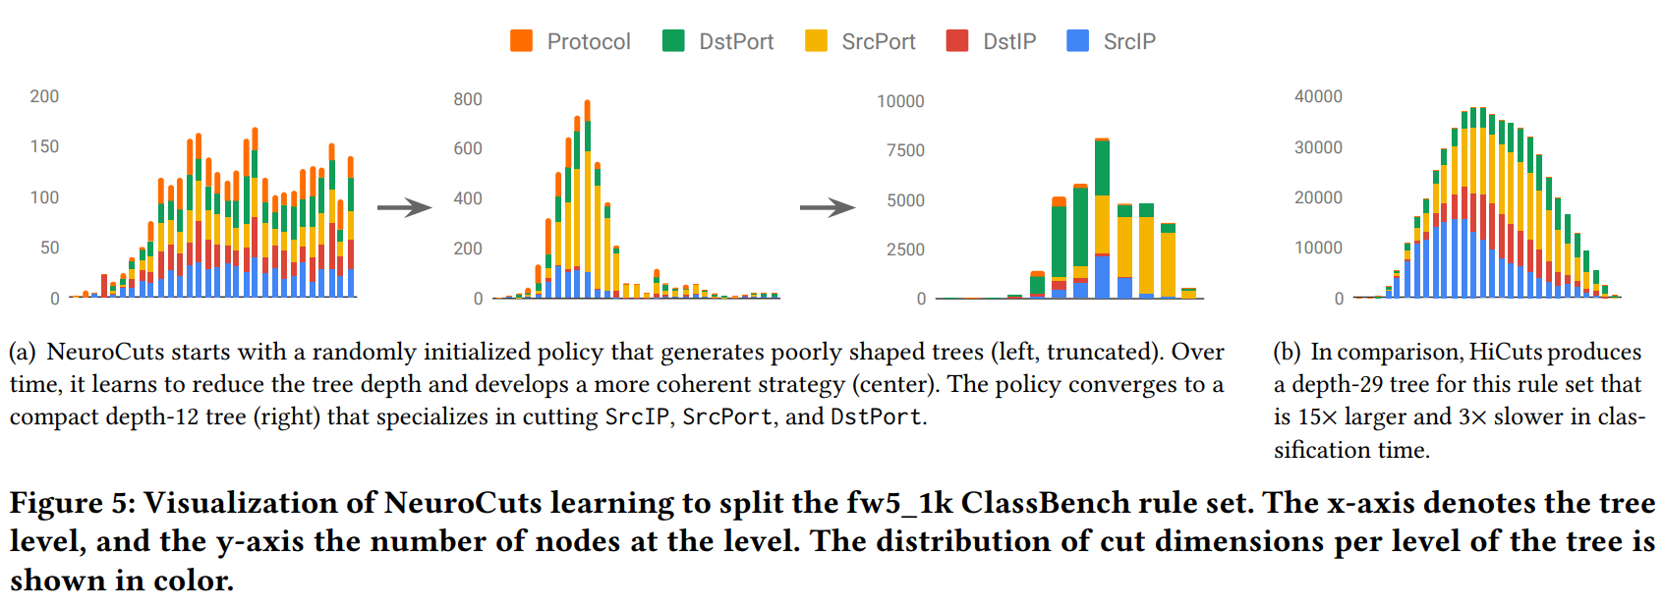
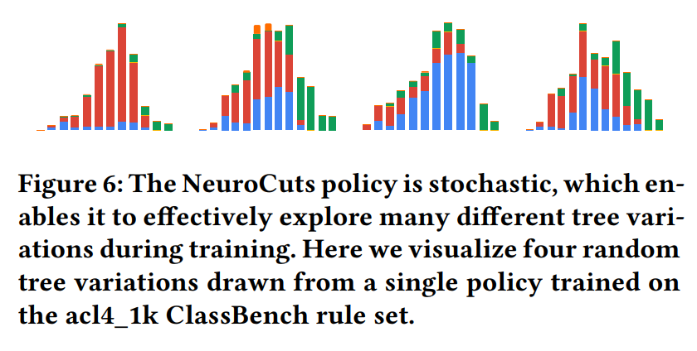
Intuition
N3
Encoded current node:
s = 010001...11000101
color = dimension of node split
action sampled; update tree; repeat until done
nodes at level
FCNet([256, 256])
Action Distribution π(a|s)
dim=[0.3, 0.1, 0.2, ...]
num=[0.05, 0.7, 0.1, ...]
type=[0.1, 0.9]
level of tree
Notes:
Now I'll provide some intuition on how NeuroCuts works.
Let's take N3 as the current node. The agent "sees" the encoded bitstring representing this node, and passes it through a small neural network (here two 256-unit fully connected layers). This neural network parameterizes a probability distribution (pi(a|s)) over the action space. This defines which dimensions are preferred, number of cuts, cut vs partition. The agent samples a concrete action from this probability distribution, updates the tree, and repeats.
What kind of tree does this generate? On the right I'm showing a visualization of a tree generated for the acl4_1k dataset. On the bottom axis is the tree level. So this is a 12-level tree. On the y axis we show the number of nodes at each level. And the color shows which dimension the node is split on. So we can see this tree is mostly split on SrcIP with a bit of SrcIP and DstPort thrown in.

Slide 29
Stochastic policy enables exploration
nodes at level
level of tree
stochastic policy means each rollout creates a different tree (above)
allows agent to explore benefits of different choices
can resample to get even better trees
Notes:
So it turns out if you take the exact same trained agent and tell it generate a few more trees, you get very different looking structures. While the first tree sample mostly cut on DstIP, the others have much more of a mix of blue and green.
So this stochasticity of the policy allows the agent to explore the cost / benefits of different choices.

Slide 30
How does learning progress?
Observation: for most classifiers, there exists a simple random distribution over actions that can generate a reasonable tree
Can think of learning as happening in two phases:
Phase I: going from poorly formed tree to learning a reasonable initial solution
Phase II: leveraging the modeling capacity of the neural network to converge to an optimized solution
Notes:
How does learning progress? One observation we made in our experiments was that ...
So you can think ...
Phase I ... you can see the tree on the left consists or purely random cuts (actually it's truncated)
Phase II ... that's where deep learning really comes in

Slide 31
Conclusion
We introduce a tractable RL formulation of the packet classification problem
Results beat state of the art in important dimensions:
18% median improvement in time over all baselines
Up to 3x improvement in time and space over all baselines
Future: other data structures with complex performance heuristics
E.g., Indexing for spatial databases
Thanks!
Notes:
In the future we think Neurocuts

