Slide 1


CellSDN: Software-Defined Cellular Core networks
Xin Jin
Princeton University
Joint work with Li Erran Li, Laurent Vanbever, and Jennifer Rexford

Slide 2
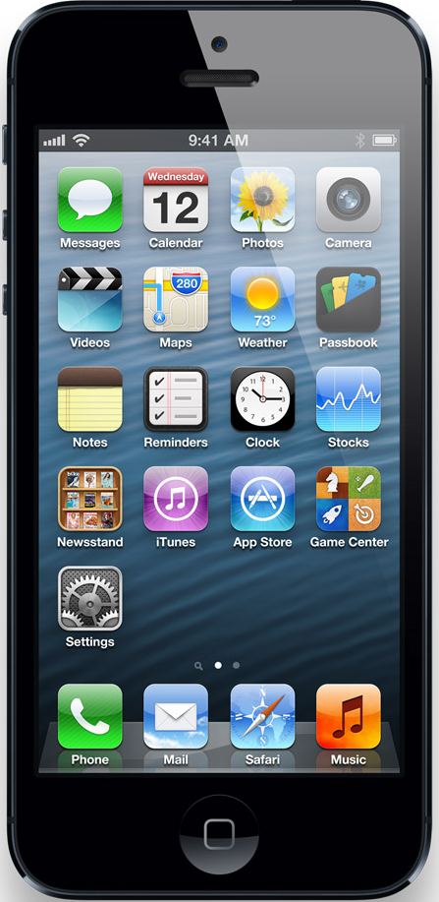
Cellular Core Network Architecture
Base Station
Serving Gateway
Packet Data Network Gateway
User Equipment
Serving Gateway
Internet
access
core

Slide 3
Cellular core networks are not flexible
Most functionalities are implemented at
Packet Data Network Gateway
Application identification, content filtering (DPI), monitoring and billing, …
This is not flexible
Packet Data Network Gateway
Combine functionalities from different vendors
Easy to add new functionality
Only expand capacity for bottlenecked functionality

Slide 4
Cellular core networks are not scalable
A lot of processing and state!
Base Station
Serving Gateway
Packet Data Network Gateway
User Equipment
Serving Gateway
Internet
access
core

Slide 5

Cellular core networks are not cost-effective
Unit Revenue & Unit Cost Trends
Capex & Opex
Base Station
Revenue
Network cost
Serving Gateway
$/GB
Packet Data Network Gateway
User Equipment
Serving Gateway
Internet
time
access
core
Figure from S. Elby, “Carrier vision of SDN and future applications to achieve a more agile mobile business,”,
Keynote at the SDN & OpenFlow World congress, October 2012.

Slide 6

Can we make cellular core networks like data center networks?
✔ Flexible
✔ Scalable
✔ Cost-Effective

Slide 7
Can we make cellular core networks like data center networks?
Yes! With CellSDN!
✔ Flexible
✔ Scalable
✔ Cost-Effective

Slide 8

Characteristics of Cellular Core Networks
Fine-grained and sophisticated policies
“North south” traffic pattern: in cellular core networks, most traffic is from/to the Internet
In data centers, 76% traffic is intra data center traffic. [Cisco Global Cloud Index]
Asymmetric edge: low-bandwidth access edge vs. high-bandwidth gateway edge
with diverse needs!

Slide 9


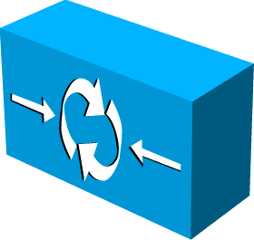
CellSDN Overview
Commodity hardware
No change
No change
+ CellSDN software
Controller
Internet

Slide 10
video traffic to gold plan customer to go through a firewall then a video transcoder
Fine-grained and sophisticated policies
“ I want
and
balance the load among
all transcoders and firewalls in the network!”

Slide 11
video traffic to gold plan customer to go through a firewall than a video transcoder
Decouple the problem
“ I want
and
balance the load among all transcoders and firewalls in the network!”

Slide 12
application type + subscriber attributes ➔ an ordered list of middleboxes
Decouple the problem
Service Policy: meet customer demand
balance the load among all transcoders and firewalls in the network

Slide 13
application type + subscriber attributes ➔ an ordered list of middleboxes
Decouple the problem
Service Policy: meet customer demand
Traffic Management Policy: meet operational goal
network resource allocation: e.g. load balance among multiple middlebox instances

Slide 14
Challenge: Scalability
Packet Classification: decide which service policy to be applied to a flow
How to classify millions of flows?
Path Implementation: generate switch rules to implement paths given by traffic management policy
How to implement millions of paths?

Slide 15
“North south” Traffic Pattern
Too expensive to do packet classification
at Gateway Edge!
Internet
~1 million devices
~10 million flows
~400 Gbps – 2 Tbps
~1K devices
~10K flows
~1 Gbps
Access Edge
Gateway Edge
Low link speed
Small number of active flows
High link speed
Huge number of active flows

Slide 16


Asymmetric Edge: Packet Classification
Opportunity: Most traffic initiates
from the access edge!
Internet
Access Edge
Gateway Edge
Packet Classification
software
Simple Forwarding
hardware
Encode classification results in packet header
Classification results are implicitly piggybacked in header

Slide 17
Challenge: Scalability
Packet Classification: decide which service policy to be applied to a flow
How to classify millions of flows?
Path Implementation: generate switch rules to implement paths given by traffic management policy
How to implement millions of paths?

Slide 18
Multi-Dimensional Aggregation
Use multi-dimensional tags rather than flat tags
Selectively match on one or multiple dimensions
Supported by TCAM in today’s switches
Policy Tag
BS ID
UE ID
Aggregate flows that share a common policy (even across UEs and BSs)
Aggregate flows going to the same (group of) base stations
Aggregate flows going to the same (recently-moved) device

Slide 19
Policy Consistency Under UE Mobility
UE Mobility: frequent and unplanned
Policy consistency: crucial for stateful middleboxes
All packets of a flow go through the same middlebox instances even in the presence of mobility
Multi-dimensional tags ensures policy consistency in a scalable way
Transcoder 1
BS 1
Old flow
Handover
BS 2
Old Flow
New Flow
New Flow
Transcoder 2

Slide 20
Control Plane Load
Packet classification
Handle every flow
Frequent switch update
Policy path setup
Handle every policy path
Infrequent switch update
Internet

Slide 21
Hierarchical Controller
Local agent (LA) at each base station
Offload packet classification to local agents
Controller
LA
LA
LA
Internet
LA

Slide 22
Implementation & Evaluation
Prototype based on Floodlight
Controller
Calculate ~3.4K new policy paths/min
Handle ~3 million new flows/min
LA
Support ~1K service policies for ~1K base station with no more than 2K TCAM entries
LA
LA
Internet
LA

Slide 23
Conclusion
CellSDN uses commodity switches and middelboxes to build flexible and cost-effective cellular core networks
CellSDN supports fine-grained service policies and traffic management policies
CellSDN achieves scalability with
Novel asymmetric edge design
Novel selectively multi-dimensional aggregation
Novel hierarchical controller design

Slide 24
Thanks!
Contact xinjin@cs.princeton.edu
for more information!

