Slide 1






Pegasus: Tolerating Skewed Workloads in Distributed Storage with In-Network Coherence Directories
Jialin Li, Jacob Nelson, Ellis Michael, Xin Jin, Dan R. K. Ports
Notes:
In this presentation, I will talk about our work Pegasus, a new approach to load balancing in distributed storage systems using in-network coherence directories

Slide 2





Many real-workloads are
skewed and dynamic
Notes:
Real-world workloads are often highly skewed. For example, a tweet from a celebrity like Justin Bieber can attract millions of views, retweets and comments. But if you look at tweets from other non-popular people, like me, they basically get zero traffic. In fact the workloads commonly follow a power law, where a small percentage of popular items accounts for the majority of the traffic in a system. At the same time, the set of popular objects are not static – they change dynamically and rapidly as new trends rise and fall.

Slide 3



Skewed workloads lead to load imbalance
popular objects can overload storage servers
Notes:
These skewed and dynamic workloads present a major challenge to distributed storage systems. As objects are partitioned in a distributed storage system, the server that unfortunately stores some popular objects will receive a lot more traffic than the others. If the object becomes popular enough, it may even overload the entire server. To avoid servers being overloaded, operators need to significantly over provision the system, wasting resources and incurring higher cost.

Slide 4

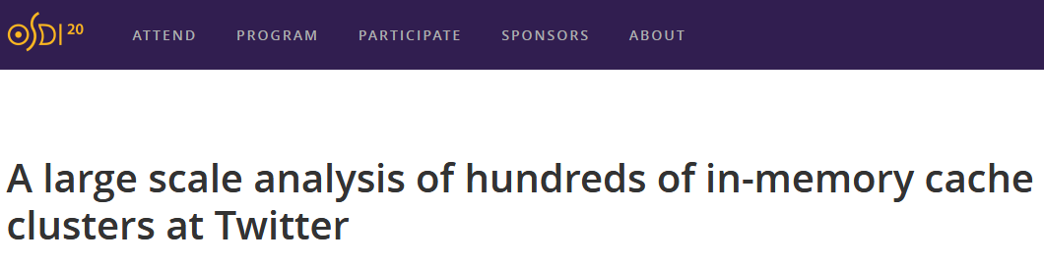


Skewed workloads are diverse
read-heavy
write-heavy
read-write mixed
small objects
large objects
combination of both
Notes:
Real-world workloads are not only highly skewed, they are also quite diverse. For example, if you look at Twitter’s paper which is also published at this conference, they report that their storage systems are dealing with not just read-heavy workloads, but also read-write mixed and even write-heavy workloads. The variance in object sizes in these systems is also quite big. The implication is that load balancing techniques that target one specific workload, like read-heavy with tiny objects, will not work well in a real deployment.

Slide 5
Two approaches to deal with highly skewed workloads
Caching
Selective Replication
Cache popular objects in a faster tier
Caching tier absorbs traffic to popular objects
More uniform load on backend storage servers
Replicate popular objects on multiple servers
Requests to replicated objects can be forwarded to any replica
Distribute load across servers
Notes:
So what are the existing solutions that deal with these highly skewed workloads? There are two common approaches. The first approach is to cache the most popular objects in a faster caching tier. The caching tier then can absorb traffic going to these popular objects, and as a result, making the load on the backend storage servers more uniform. The second approach is to replicate the most popular objects on multiple servers. Requests to these objects then can be forwarded to any server with a copy, effectively distributing load across the servers

Slide 6

Existing solutions have limitations
Caching
Selective Replication
non read-heavy workloads
dynamic replicated objects & locations
fast in-memory storage systems
strong consistency
Notes:
Unfortunately, both of these approaches have significant limitations. A caching approach is only effective for read-heavy workloads, because write requests still need to be processed by the backend storage systems, and they would incur extra cache invalidation traffic. Caching is also only effective when the caching tier is magnitude faster than the storage tier. As storage systems themselves are getting faster for example with in-memory storage and new non-volatile memory technologies, an in-memory caching tier is no longer effective for load balancing. Recently, there are proposals to cache data directly in the network switches, but that approach also comes with severe limitations like restrictions on the size of the object. Well, in a selective replication approach, as the workload is dynamic, it is very challenging for the clients to track which set of objects are currently replicated and the locations of the copies. Existing solutions also either do no provide strong consistency for the replicated objects or use very expensive coherence protocol. So, Is there a way to overcome all these limitations?

Slide 7

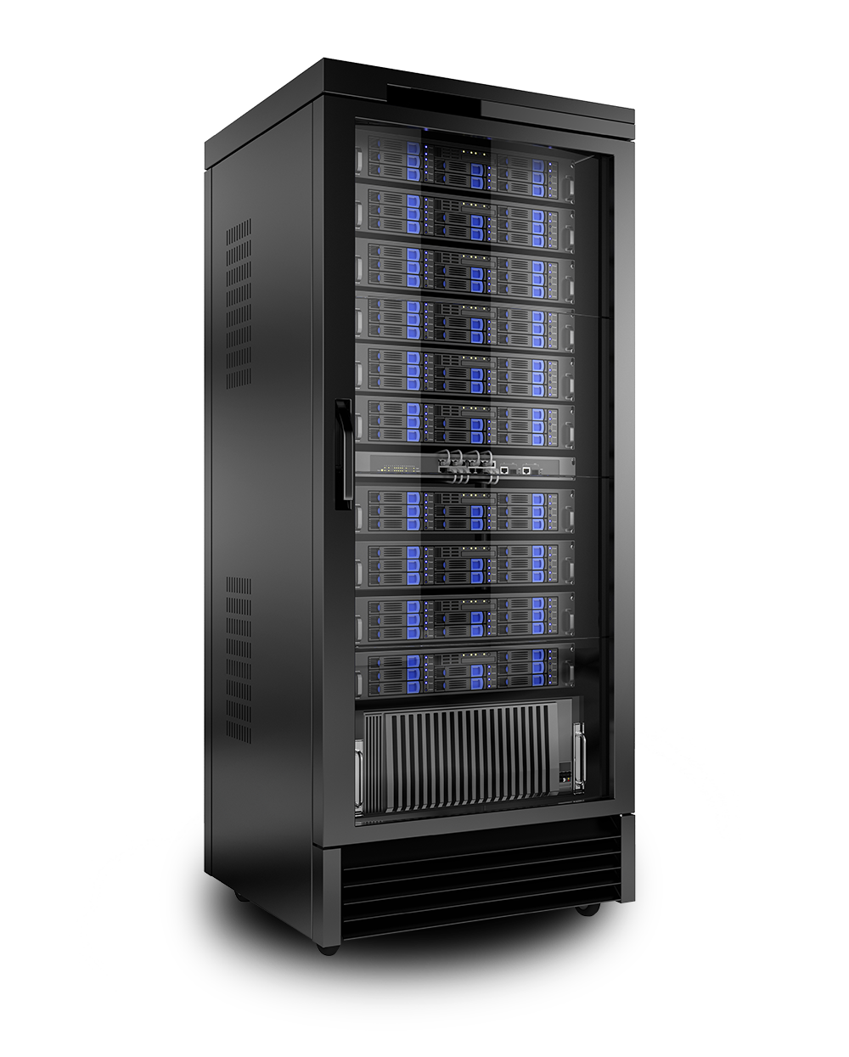
Our system: Pegasus
rack-scale storage system
highly skewed and dynamic workloads
fast in-memory storage systems
programmable top-of-rack switch
any object sizes
all read-write ratios
strong consistency
Notes:
Well, yes! Now, let me introduce to you our system, Pegasus. Pegasus is a rack-scale storage system, which consists of 32-128 storage servers connected to a single, programmable top-of-rack switch. Pegasus overcomes the limitations of existing solutions, specifically, it provides good load balancing properties for highly skewed and dynamic workloads, it works with fast in-memory storage systems, it is effective for any object sizes, and workloads with different read-write ratios, and lastly, it guarantees linearizability.

Slide 8

Observation: rack as a whole has spare processing capacity
Rack
How to route requests to the right server?
A
A
How to ensure consistency?
A
Notes:
Our key observation is that, in a rack scale system, even when some of the servers are overloaded because of skewed workload, there are still spare processing capacity elsewhere in the rack. So if we can replicate popular objects to these servers and steer traffic to the appropriate servers, we can effectively balance load in the rack. But there are two challenges: first, how do we route client requests to the right server? and second, how do we guarantee consistency among the replicated copies of these objects?

Slide 9
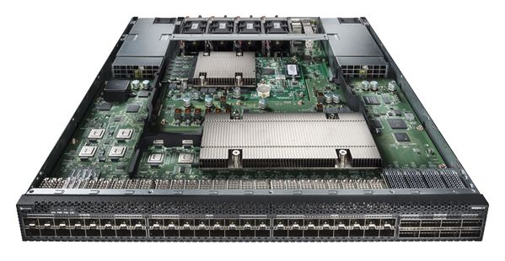
Pegasus’ approach
in-network coherence directory
selective replication
+
Barefoot P4 switch
Notes:
In Pegasus, we address these challenges by augmenting the selective replication approach (that is, to replicate the most popular objects on multiple servers), with an in-network coherence directory that is implemented directly in the programmable top-of-rack switch

Slide 10
Coherence directory for replicated data
Inspired by CPU cache coherence protocols
Centralized directory that tracks:
Which objects are replicated
Location of replicated objects
Forwards requests to server with spare capacity
Ensures strong consistency
Notes:
Our idea of using a coherence directory is inspired by CPU cache coherence protocols. It is a centralized directory that tracks which set of objects are currently replicated, and the location of these objects. The directory processes all storage requests and forwards requests to the right server with spare processing capacity. And the directory ensures strong consistency among all the copies of the replicated objects.

Slide 11
Coherence directory illustrated
WRITE A
READ B
Replicated
Obj ID
Replica Set
Coherence Directory
A
S1
S2
How to build a directory that can handle all the traffic?
B
S2
S1
S0
D
S0
S2
S0
B
D
How to ensure consistency with a lightweight protocol?
S1
A
B
S2
B
D
A
Notes:
Let me illustrate Pegasus’ coherence directory with an example. Say three objects A, B, and D are currently replicated. We track both the ID and the locations of the objects in the coherence directory. One important benefit of the coherence directory is that it can forward client requests to the right server without needing the clients to know it. When the directory receives a read request, it can pick a server in the object’s replica set with spare processing capacity to forward the request to. Surprisingly, the other powerful capability of the coherence directory is that it can rebalance the replica set on every write. When receiving a write request, the coherence directory can select a different set of servers to forward the request to. The key point here is that, to avoid subsequent requests reading the old version, we only need to update the directory with the new replica set, because all requests will go through the directory first. There are, however, two major challenges. First, since the directory needs to process all traffic going to the system, how do we make sure it won’t become the performance bottleneck. Second, how do we design a coherence protocol that guarantees linearizability but without the expensive invalidation overhead in existing solutions

Slide 12
Implementing coherence directory in the network
rack-scale storage system
All requests and replies traverse the ToR switch
ToR serves as a central point
Line-rate packet processing
No throughput bottleneck
Zero latency overhead
Notes:
To address the first challenge, we observe that in a rack-scale system, all requests and replies need to traverse the top-of-rack switch. So the ToR switch essentially serves as a central point of the system, making it the ideal place to implement the coherence directory. Moreover, switches are designed to process packets at line-rate, so they won’t become the throughput bottleneck of the rack. Also, since requests and replies need to traverse the ToR anyway, putting a directory there adds zero latency overhead.

Slide 13
Pegasus version-based coherence protocol
Switch processes all requests
Switch tracks which servers have the latest copy
Updates the directory when receiving replies
How to deal with network asynchrony?
Use version numbers!
Notes:
For the second challenge, note that since the switch processes all the requests, to guarantee strong consistency, we only need to have the switch tracks which servers have the latest copy of an object, and forwards requests accordingly. And that can be done by updating the coherence directory when the switch receives replies from the servers. But how to deal with asynchrony in the network such as message drop, delay, and reordering? In Pegasus, we handle that with a lightweight version-based protocol

Slide 14



Pegasus’ coherence protocol in action
READ A
WRITE A←b
Ver
REPLY A
Ver 4
from S0
S0
A=b
Guarantees linearizability
1 RTT
Non-blocking
No extra invalidation traffic
Coherence Directory
Next Ver
4
5
Obj ID
Compl Ver
Replicas
S1
A
3
4
S1
S0
S2
A=a
B
1
S2
S1
S0
S2
WRITE A←b
Ver 4
WRITE A←b
Ver 4
A=b
REPLY A
Ver 4
from S2
Notes:
More concretely, we augment the coherence directory with 2 set of version numbers: a single next version number, and one completed version for each replicated object. When a write request reaches the switch, the directory writes the next version number into the packet header, and increments the number on the switch. Then the switch selects servers with spare capacity to forward the requests to, in this case S0 and S2. After the servers process the writes, they attach the same version number into their reply messages. When the reply message reaches the switch, the switch compares the version number in the packet with the completed version number in the directory. In this case the number is bigger, so the switch updates the number in the directory, and resets the replica to contain only S0. Now when the second reply reaches the switch, the two numbers are equal, so the switch simply adds S2 to the replica set. Now, when a subsequent read request arrives at the switch, the switch looks up the replica set in the directory, and can forward the read to either S0 or S2, both of which have the latest copy of the object. Our version-based coherence protocol has the following nice properties: it guarantees linearizability, all requests are completed in 1 round trip time, the protocol is non-blocking, and importantly it does not generate extra invalidation traffic.

Slide 15
Other protocol details
Adding and removing replicated objects
Pegasus controller monitors object access frequencies
Updates coherence directory with most popular objects
Avoiding duplicate requests
Server maintains a client table
Retried write requests forward to the same server
Server selection policy
Random
Weighted round-robin
Handling server and rack failure
Multi-rack deployment
Each rack runs a Pegasus instance
Chain replication across racks
Notes:
There are some other protocol details, including how to add and remove replicated objects, how to avoid duplicate requests, and how does the switch select servers for request forwarding. You can refer to our paper for more details. One point we want to emphasize is that selective replication in a Pegasus rack is for load balancing, not for fault tolerance. To tolerate server and rack failures, we use a multi-rack deployment, and run chain replication across racks.

Slide 16
Coherence directory switch implementation
Replicated Keys Lookup
Version Number Engine
Replica
Set Directory
Req
Address Rewrite Table
Req
Statistics
Engine
RKey
RKey
Pkt
Egr
Reply
!RKey
!RKey
Notes:
So far, I have talked about the high level design of the Pegasus coherence directory. We have implemented such a directory on a real Barefoot Tofino programmable switch using a pipelined approach. The first stage is a lookup table that checks if the key in the request or reply is for a replicated object. The second stage stores the directory version numbers and compares them with version numbers in the packet headers. The third stage maintains and updates the current replica set for each replicated objects. Once the switch picks the appropriate storage server for a request, the next stage rewrites the packet destination address accordingly. Lastly, we use a stage to track certain statistics such as object access rate for the controller to update the directory.

Slide 17
Efficient switch implementation
Switch only stores small metadata
Only needs to replicate the most popular O(nlogn) objects, where n is the number of servers (extension of [1])
Consumes less than 3.5% of switch SRAM
[1] Small Cache Big Effect: Provable Load Balancing for Randomly Partitioned Cluster Services.
Bin Fan et al., 2011
Notes:
One key benefit of the Pegasus design is that it enables very resource efficient switch implementation. First, the switch only stores small metadata. Secondly, it only needs to maintain states for the small number of replicated popular objects. In fact, the system only needs to replicated the most popular nlogn objects to achieve strong load balancing properties, where n is the number of servers, not objects. This result is an extension of a previous work on caching systems. Our switch implementation only consumes less than 3.5% of switch SRAM, making it feasible to coexist with other switch functionalities.

Slide 18
Evaluation
28 nodes with dual socket Xeon Silver 4114, 48 GB RAM per socket
Mellanox ConnectX-4 25Gb NICs
Connected to an Arista 7170-64S (Barefoot Tofino-based) switch
Open-loop clients, Poisson inter-arrival distribution
Client requests choose keys following:
Uniform distribution
Zipf distribution (skewed workload)
Measured max throughput subject to a 99%-latency SLO
Comparison systems:
Consistent hashing with 16 virtual nodes
NetCache
Notes:
Lastly, let me show you some evaluation of our system. In our experiments, we generate client requests following either a uniform or a Zipfian key distribution, and measure the maximum throughput subject to a 99% latency SLO. We compare Pegasus with two other systems: first, a traditional consistent hashing system with 16 virtual nodes per server. Second, NetCache, a recent work that caches application data directly in programmable switches. Note that compare to Pegasus, NetCache uses a lot more switch resources, and it has a number of restrictions on the workload such as object sizes.

Slide 19

Pegasus is effective under highly skewed workloads
10x
throughput improvement
Notes:
First, we show that Pegasus is effective at load balancing under highly skewed, read-only workloads. Here, we measure the maximum throughput of the three systems with increasing skewness in the workloads. Note that Zipfian 1.2 is a very high skew level, but recent work has shown that such high skew does exist in real deployment. As you can see, throughput of consistent hashing drops significantly when the workload is skewed. Pegasus, on the other hand, is able to maintain its high throughput for all skewness levels. In fact, Pegasus achieves a 10x throughput improvement over consistent hashing when the workload is highly skewed. We can see that NetCache also achieves good load balancing. Actually it has a higher throughput when the workload is more skewed, because the cache in the switch provides additional processing capacity. However, here the workloads are read-only. What happens when there are writes in the workload?

Slide 20
Pegasus equally effective under different read/write ratios
Pegasus
throughput drop by > 80%
more than
11x improvement
NetCache
Consistent Hashing
Notes:
Well, here we use workloads with high skew, and vary the write ratio. 0 here means the workload is read-only, and 1 means it’s write-only. Even though NetCache performs really well when the workload is read-only, as soon as the workload contains a non-trivial amount of writes, its throughput drops by more than 80%. Pegasus on the other hand, is able to maintain its throughput level across all read/write ratios. In fact, Pegasus achieves a more than 11x throughput improvement over NetCache when the workload is write-intensive. In some other evaluations, we have also shown that Pegasus is equally effective at load balancing for various object sizes and for highly dynamic workloads. Please refer to our paper for more details.

Slide 21
Conclusion
New approach to distributed storage load balancing
Build a coherence directory directly in ToR switch
Tracks location and forwards requests for popular objects
Guarantees strong consistency
Resulting system: Pegasus
> 10x throughput improvement compared to existing approaches
Equally effective under a variety of workloads
Read-heavy, write-heavy, read-write mixed
Small and large objects
Notes:
In conclusion, today I talked about our new approach to distributed storage load balancing, by building a coherence directory directly in the top-of-rack switch. The directory tracks the location and forwards requests for the set of popular replicated objects, and simultaneously guarantees strong consistency. The resulting system, Pegasus, achieves a more than 10x throughput improvement compared to existing approaches, and it is equally effective under a wide range of workloads, including different read-write ratios and various object sizes. That’s all for my presentation, thank you and I’m happy to take questions now.

Slide 22
Backup Slides

Slide 23


Two approaches to deal with highly skewed workloads
Caching
GET
GET
Cache popular objects in a faster tier
Caching tier absorbs traffic to popular objects
More uniform load on backend storage servers
GET
Caching Layer

Slide 24
Two approaches to deal with highly skewed workloads
GET
Selective Replication
GET
GET
Replicate popular objects on multiple servers
Requests to replicated objects can be forwarded to any replica
Distribute load across servers

Slide 25
Coherence directory illustrated
WRITE A
READ B
Replicated
Obj ID
Replica Set
Coherence Directory
A
S1
S2
How to build a directory that can handle all the traffic?
B
S2
S1
S0
D
S0
S2
S0
B
D
How to ensure consistency with a lightweight protocol?
S1
A
B
WRITE
REPLY
S2
B
D
A
Notes:
Let me illustrate Pegasus’ coherence directory with an example.
Can push the reply part to slide 14.
“The other powerful thing about CD is for write requests…”

Slide 26
Coherence directory addresses key challenges in selective replication
Selective replication challenges:
Dynamic set of replicated objects and their locations
Guarantee strong consistency
A coherence directory can
Track identity and location of every replicated objects
Forward requests to the right storage servers
read: one server in the replica set
write: any server(s) in the rack
Implement a coherence protocol to guarantee linearizability
Where to implement the coherence directory?
How to design an efficient coherence protocol?
Replicated
Obj ID
S0
Replica Set
B4
D2
A1
S1
S1
A1
B4
B4
S2
S1
S0
S2
D2
S0
S2
B4
D2

Slide 27
We only need to replicate the most popular
O(nlogn) objects
n is the number of storage servers
(generalization of previous result [Fan et al. ’11])
Notes:
The surprising result is that we only need to replicate the most popular O(nlogn) objects to achieve strong load balancing property, where n is the number of storage servers. This is a surprisingly low number, especially it only depends on the number of servers, not the number of objects. Our analysis is a generalization of a previous result on caching system.

Slide 28








Why O(nlogn) is sufficient?
aggregate capacity
> total object load
enough spare capacity
replicate top O(nlogn) objects on all servers
remove load from top O(nlogn) objects
forwarding strategy: forward to the least-loaded server
any server can handle any request
→ exist a way to redistribute the load without overloading any server
Adversarial analysis [Fan et al. ’11]:
Normalized load on a server is bounded
Notes:
But why is replicating nlogn objects sufficient? First, we assume the total processing capacity of all servers is more than the combined load of all objects. This is a reasonable assumption because it is the minimum capacity provision you need without overloading the entire system. Now if we remove the load from the most popular nlogn objects, based on an adversarial analysis from a prior work, the remaining load across the servers are guaranteed to be balanced and no server will be overloaded. Now, if we replicate these popular objects on all the servers, then any request for these objects can go to any of the servers. Based on our capacity assumption, there is enough spare capacity elsewhere in the system to handle their load. As a result, there exist some way to redistribute their load without overloading any server. Well, one simple forwarding strategy that satisfies this condition is to forward to the least-loaded server for replicated objects. (animation)

