Slide 1

Dynamic Control of Software-Defined Networks
Xin Jin
Committee: Jennifer Rexford (advisor),
David Walker, Ratul Mahajan, Nick Feamster, Aarti Gupta

Slide 2
Traditional network
Coupled data plane (switch hardware) and control plane (switch software)
Closed, proprietary interface
Hard to change and innovate
Control
Control
Control
Network
Control
Control

Slide 3
Software-Defined Networking (SDN)
Decoupled data plane and control plane
Open interface, e.g., OpenFlow
Easy to change and innovate
Network Services
Control Platform
Control Plane
Data Plane
Network

Slide 4
This talk:
New algorithms and systems
to build the network control platform

Slide 5
Challenge 1: Many services
Network
Services
Routing
Monitoring
Load
Balancing
Firewall
Control Platform
Composing multiple services
Defending against malicious and buggy services
Providing flexibility in choosing programming languages for development

Slide 6
Challenge 2: Many events
Cyber attack
Traffic shift
Device failure
Server overload
Host mobility
Device upgrade
A
B
E
Network
D
C

Slide 7
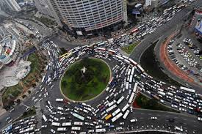


Challenge 2: Many events
Traffic shift
Congestion
Revenue loss
100 ms slowdown reduces sales by 1%
100 ms slowdown reduces # searches by 0.2%
400 ms slowdown reduces traffic by 9%
http://www.gduchamp.com/media/StanfordDataMining.2006-11-28.pdf
http://services.google.com/fh/files/blogs/google_delayexp.pdf
http://www.slideshare.net/stoyan/yslow-20-presentation/4-The_importance_of_performance_ulli500

Slide 8
Challenge 2: Many events
Composing updates from multiple applications
Distributing updates across multiple switches

Slide 9
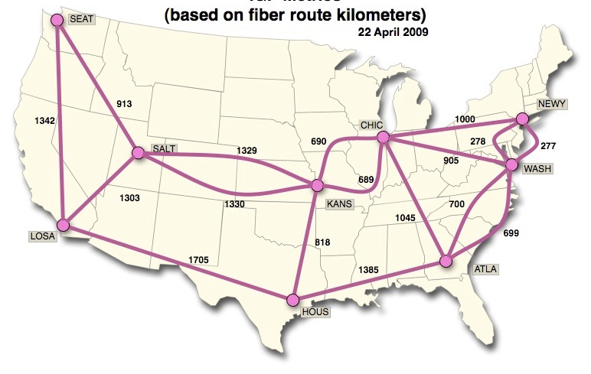
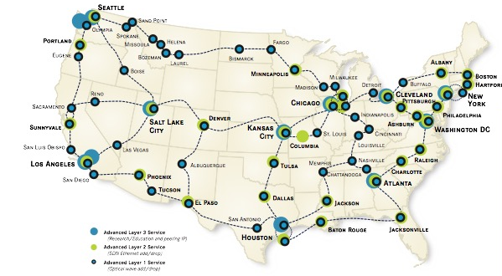
Challenge 3: Many layers
Network Layer
Network switch (Router)
Optical Layer
Optical switch

Slide 10
Challenge 3: Many layers
Jointly managing the network and optical layers
Dynamically changing device configurations in face of network events
Coordinating updates between the network and optical layers

Slide 11
Contributions
Efficient
algorithm
System
prototype
CoVisor
[NSDI’15]
Efficient policy compilation
Open-source prototype, integrated into ONOS
Dionysus
[SIGCOMM’14]
Efficient update scheduling
Prototype on real testbed, evaluation on realistic data
Owan
[SIGCOMM’16]
Efficient topology reconfiguration
Prototype on real testbed, evaluation on realistic data

Slide 12
CoVisor: Dynamic Service Composition
[NSDI’15] Xin Jin, Jennifer Gossels, Jennifer Rexford, David Walker, “CoVisor: A compositional hypervisor for software-defined networks”, in USENIX Symposium on Networked Systems Design and Implementation (NSDI), May 2015.

Slide 13
Goal: Manage multiple services on the same network
Routing
Monitoring
Load
Balancing
Firewall
Control Platform
Network

Slide 14
Operation of network services
Policy on switch A
Routing
Priority | Match | Action
1 | dstip=2.0.*.* | fwd(2)
0 | * | fwd(3)
dstip=2.0.*.*
1
2
A
3
B
E
“other traffic”
Network
D
C

Slide 15
What if we have more than one service?

Slide 16
Example: Composing two policies
Monitoring on srcip
Routing on dstip
Priority | Match | Action
3 | srcip=1.0.0.* | count
0 | * | count
Priority | Match | Action
7 | dstip=2.0.0.0 | fwd(2)
0 | * | fwd(3)
Problem: How to combine two policy tables into a single policy table to be installed on the switch?
2
1
Switch
3

Slide 17
Simply installing two policy tables on the switch does not work
Monitoring on srcip
Routing on dstip
Priority | Match | Action
3 | srcip=1.0.0.* | count
0 | * | count
Priority | Match | Action
7 | dstip=2.0.0.0 | fwd(2)
0 | * | fwd(3)
Priority | Match | Action
3 | srcip=1.0.0.* | count
0 | * | count
7 | dstip=2.0.0.0 | fwd(2)
0 | * | fwd(3)
What if we have a packet with srcip=1.0.0.0 and dstip=2.0.0.0? Only forwarded, not counted!

Slide 18
Overview of service management
Well-defined composition interface and semantics
Parallel composition (||)
Sequential composition (>>)
Override composition ( )
Network operator: use the interface to specify the relationship between multiple services
CoVisor: use efficient algorithms to compile multiple policy tables into a single policy table

Slide 19
Parallel composition (||) [ICFP’11]
Two services process packets in parallel
Computing a cross-product for the composition
Monitoring
Routing
Priority | Match | Action
3 | srcip=1.0.0.* | count
0 | * | count
Priority | Match | Action
7 | dstip=2.0.0.0 | fwd(2)
0 | * | fwd(3)
Priority | Match | Action
? | srcip=1.0.0.*, dstip=2.0.0.0 | count, fwd(2)
? | srcip=1.0.0.* | count, fwd(3)
? | dstip=2.0.0.0 | count, fwd(2)
? | * | count, fwd(3)
A packet with srcip=1.0.0.0 and dstip=2.0.0.0 is both counted and forwarded.

Slide 20

Key challenge: Efficiently handle policy updates
Computation overhead
The computation time to compile policy updates
Rule-update overhead
The rule-updates to update switches to the new policy
Routing
Monitoring
Priority | Match | Action
7 | dstip=2.0.0.0 | fwd(2)
5 | dstip=2.0.0.* | fwd(1)
0 | * | fwd(3)
Priority | Match | Action
3 | srcip=1.0.0.* | count
0 | * | count
Priority | Match | Action
? | srcip=1.0.0.*, dstip=2.0.0.0 | count, fwd(2)
? | srcip=1.0.0.* | count, fwd(3)
? | dstip=2.0.0.0 | count, fwd(2)
? | * | count, fwd(3)

Slide 21
Naïve solution
Priority assignment: linearly increase from bottom
Update overhead
m, n: sizes of two policies in composition
Computational overhead: O(mn)
Rule-update overhead: O(mn)
Priority | Match | Action
3 | ∙∙∙ | ∙∙∙
2 | ∙∙∙ | ∙∙∙
1 | ∙∙∙ | ∙∙∙
0 | ∙∙∙ | ∙∙∙
Priority | Match | Action
5 (3) | ∙∙∙ | ∙∙∙
4 (new) | ∙∙∙ | ∙∙∙
3 (2) | ∙∙∙ | ∙∙∙
2 (1) | ∙∙∙ | ∙∙∙
1 (new) | ∙∙∙ | ∙∙∙
0 (0) | ∙∙∙ | ∙∙∙
Update

Slide 22
Incremental update
Priority assignment: add priorities of original policies
Update overhead
m, n: sizes of two policies in composition
Computational overhead: O(m+n)
Rule-update overhead: O(m+n)
Priority | Match | Action
3+7=10 | ∙∙∙ | ∙∙∙
3+0=3 | ∙∙∙ | ∙∙∙
0+7=7 | ∙∙∙ | ∙∙∙
0+0=0 | ∙∙∙ | ∙∙∙
Priority | Match | Action
3+7=10 | ∙∙∙ | ∙∙∙
3+5=8 (new) | ∙∙∙ | ∙∙∙
3+0=3 | ∙∙∙ | ∙∙∙
0+7=7 | ∙∙∙ | ∙∙∙
0+5=5 (new) | ∙∙∙ | ∙∙∙
0+0=0 | ∙∙∙ | ∙∙∙
Update

Slide 23
Sequential composition (>>) [NSDI’13]
Two services process packets one after another
Priority assignment: concatenate priorities
Load balancing: Choose server, rewrite dstip
Routing: Route based on dstip
Pri. | Match | Action
3 | srcip=0.0.0.*, dstip=1.2.3.4 | dstip=10.0.0.1
∙∙∙ | ∙∙∙ | ∙∙∙
Pri. | Match | Action
1 | dstip=10.0.0.1 | fwd(1)
∙∙∙ | ∙∙∙ | ∙∙∙
Priority | Match | Action
 | srcip=0.0.0.*, dstip=1.2.3.4 | dstip=10.0.0.1, fwd(1)
3 ◦ 1 = 25
011
001
High
Bits
Low
Bits

Slide 24
Override composition ( ) [CoVisor’15]
One service chooses to act or defer the processing to another service
Priority assignment: offset priorities
Elephant Flow Routing (E)
Default Routing (D)
Pri. | Match | Action
1 | srcip=1.0.0.0, dstip=2.0.0.0 | fwd(1)
Priority | Match | Action
1 | dstip=2.0.*.* | fwd(2)
0 | * | fwd(3)
Priority | Match | Action
1 + 8 (max priority of D) = 9 | srcip=1.0.0.0, dstip=2.0.0.0 | fwd(1)
1 | dstip=2.0.*.* | fwd(2)
0 | * | fwd(3)

Slide 25
Topology management
Abstraction: Each service operates on a virtual topology
Benefits: Information hiding, portability, composition, etc.
Service
Service
Service
Network OS
Challenge: Devirtualization
Compile policies from the virtual network to the physical network
Devirtualization algorithm
Symbolic analysis + sequential composition

Slide 26
Access control
Abstraction: Each service operates on a virtual switch model
Benefits: Defend against malicious or buggy services
Virtual switch model: Limited functionalities
Constraint on visibility: What header fields can match, e.g., IP routing cannot see MAC addresses , TCP/UDP ports
Constraint on capability: What actions can perform, e.g., IP routing cannot modify any packet header fields

Slide 27
Implementation and Evaluation
Implementation
Open-source prototype: https://github.com/xinjin/CoVisor
Integrated into ONOS with
Evaluation
Sequential composition: L3-L4 Firewall >> L3 Router
Parallel composition: L2 Monitor || L2 Router
Topology virtualization: Gateway between an Ethernet island and an IP core

Slide 28
Evaluation: L3-L4 Firewall >> L3 Router
Computation overhead of inserting one rule to L3-L4 Firewall Policy

Slide 29
Evaluation: L3-L4 Firewall >> L3 Router
Rule-update overhead of inserting one rule to L3-L4 Firewall Policy

Slide 30
Summary: CoVisor is a network hypervisor for service compositions
1
Efficient algorithm
Incrementally compile policy compositions and updates
2
System prototype
Project website: http://covisor.cs.princeton.edu
Integrated into ONOS with

Slide 31
Dionysus: Dynamic Update Scheduling
[SIGCOMM’14] Xin Jin, Hongqiang Harry Liu, Rohan Gandhi, Srikanth Kandula, Ratul Mahajan, Ming Zhang, Jennifer Rexford, Roger Wattenhofer, “Dynamic scheduling of network updates”, in ACM SIGCOMM, August 2014.

Slide 32

What is network update
Updating policy tables in switches
Control Platform
A
B
E
Network
D
C

Slide 33
Example of network update
A
B
C
A
B
C
F3: 10
Update
F2: 5
F3: 10
F2: 5
F1: 5
F1: 5
F4: 5
D
E
D
E
F4: 5
Current State
Target State
Link capacity: 10 units
Flow ID
Flow Size

Slide 34
Goals for network update
1
Time: Fast response to dynamics
Quick adaptation to failures, host mobility, cyber attacks, etc.
2
Consistency: Smooth transient behavior
Loop, blackhole, access control violation
Congestion

Slide 35
What is consistent network update
A
B
C
A
B
C
F2: 5
F3: 10
F2: 5
F3: 10
F1: 5
F1: 5
F4: 5
D
E
D
E
F4: 5
Current State
Target State
A
B
C
F2: 5
F3: 10
F1: 5
F4: 5
D
E
Congestion on B-E
Transient State
Asynchronous updates can cause congestion
Need to carefully order update operations

Slide 36
Existing solutions are slow
Existing solutions are static [ConsistentUpdate’12, SWAN’13, zUpdate’13]
Pre-compute an order for update operations
Downside: Do not adapt to runtime conditions
Slow in face of highly variable operation completion time
Measurement: >10X difference between the median and the 99th percentile for operation completion time
Static
Plan A
F3
F2
Static
Plan B
F3
F2
F1
F4
F1
F4

Slide 37

Static schedules can be slow
F3
F2
F1
F1
Static
Plan A
F2
F2
F4
F1
F3
F3
F4
F4
1
2
3
4
5
Time
1
2
3
4
5
Time
F1
F1
F3
F2
F1
F2
F2
Static
Plan B
F3
F3
F4
F4
F4
1
2
3
4
5
Time
1
2
3
4
5
Time
No static schedule is a clear winner under all conditions!
A
B
C
A
B
C
F3: 10
Update
F2: 5
F3: 10
F2: 5
F1: 5
F1: 5
F4: 5
D
E
D
E
F4: 5
Current State
Target State

Slide 38
Dynamic schedules are adaptive and fast
Static
Plan A
F3
F2
F4
F1
Dynamic
Plan
F3
F2
F1
F4
F3
F2
F1
Adapts to actual conditions!
Static
Plan B
F4
No static schedule is a clear winner under all conditions!
A
B
C
A
B
C
F3: 10
Update
F2: 5
F3: 10
F2: 5
F1: 5
F1: 5
F4: 5
D
E
D
E
F4: 5
Current State
Target State

Slide 39
Challenges of the scheduling problem for network updates
1
Multiple resources
Updating a flow affects multiple links (link capacity resource) and switches (switch rule table resource)
2
Resource consumption and release
Updating a flow consumes resources on new paths and releases resources on old paths

Slide 40
Idea: Use a dependency graph to represent a network update
Node
Operation node: Represent flow update operations
Resource node: Represent resources, i.e., link capacity and switch table size
Edge
Represent resource consumption and release between operation nodes and resource nodes

Slide 41
Example for dependency graph
A
B
C
A
B
C
F3: 10
Update
F2: 5
F3: 10
F2: 5
F1: 5
F1: 5
F4: 5
D
E
D
E
F4: 5
Current State
Target State
Move
F3
No free capacity
on B-E
B-E: 0
Move
F4
Move
F2
A-E: 0
Move
F1

Slide 42
Example for dependency graph
A
B
C
A
B
C
F3: 10
Update
F2: 5
F3: 10
F2: 5
F1: 5
F1: 5
F4: 5
D
E
D
E
F4: 5
Current State
Target State
Move
F3
Moving F2
requires 5 units
of capacity on B-E
B-E: 0
5
Move
F4
Move
F2
5
Moving F2
releases 5 units
of capacity to A-E
A-E: 0
Move
F1

Slide 43
Example for dependency graph
A
B
C
A
B
C
F3: 10
Update
F2: 5
F3: 10
F2: 5
F1: 5
F1: 5
F4: 5
D
E
D
E
F4: 5
Current State
Target State
Move
F3
10
B-E: 0
5
Move
F4
Move
F2
5
5
A-E: 0
5
Move
F1

Slide 44
Example for dependency graph
A
B
C
A
B
C
F3: 10
Update
F2: 5
F3: 10
F2: 5
F1: 5
F1: 5
F4: 5
D
E
D
E
F4: 5
Current State
Target State
B-E: 10
5
Move
F4
Move
F2
5
5
A-E: 0
5
Move
F1

Slide 45
Adaptive critical-path scheduling
Schedule operation nodes on critical paths first
Update dependency graph when operations finish
Recompute critical paths on updated dependency graph
Critical path

Slide 46
Handling cycles
5
A-B: 5
Move
F3
20
20
5
Move
F2
Move
F1
A-B: 0
20
20
5
C-D: 0
Move
F4

Slide 47
Handling cycles
5
A-B: 5
Move
F3
Schedule
20
20
5
Move
F2
Move
F1
A-B: 0
20
20
5
C-D: 0
Move
F4

Slide 48
Handling cycles
Deadlock!
A-B: 0
20
20
Move
F2
Move
F1
20
20
C-D: 0

Slide 49
Handling cycles
5
A-B: 5
Move
F3
20
20
5
Move
F2
Move
F1
A-B: 0
20
20
5
C-D: 0
Partial
movement
Move
F4

Slide 50
Handling cycles
5
A-B: 0
Move
F3
20
15
5
Move
F2
Move
F1
A-B: 0
20
15
5
C-D: 5
Move
F4
Partial movement for 4 rounds
to resolve the cycle

Slide 51
Network update pipeline
Current
State
Target
State
Consistency
Property
Dependency Graph Generator
Update Scheduler
Network

Slide 52
Implementation and evaluation
Implementation
Software: Controller prototype
Hardware: Testbed with 8 Arista switches that emulates a wide area network
Evaluation: traces and topologies from a cloud service provider
Wide area network (WAN): ~50 sites
Data center network (DC): ~500 switches

Slide 53
Evaluation: Update time for traffic engineering updates
(State-of-the-Art)

Slide 54
Summary: Dionysus is a scheduler for fast and consistent network updates
1
Efficient algorithm
Dynamically schedule update operations
2
System prototype
Prototype on real testbed, evaluation on topology and traces from Microsoft networks

Slide 55
Owan: Dynamic Topology Reconfiguration
[SIGCOMM’16] Xin Jin, Yiran Li, Da Wei, Siming Li, Jie Gao, Lei Xu, Guangzhi Li, Wei Xu, Jennifer Rexford, “Optimizing Bulk Transfers with Software-Defined Optical WAN”, in ACM SIGCOMM, August 2016.

Slide 56
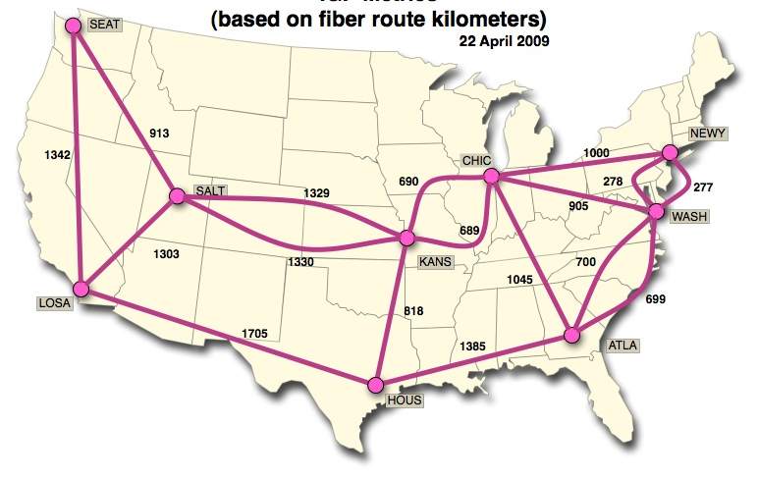
Globally-distributed applications have big data to transfer over the WAN

Slide 57
Software-Defined Networking (SDN)
Global traffic engineering with centralized control, e.g., Google B4, Microsoft SWAN
Given
Traffic Demand
Network Topology
Controller
Network Topology
Compute
Routing
Rate Allocation
Optimize
Completion Time
Deadlines Met

Slide 58
Network-layer topology is built over an optical layer in a modern WAN
Seattle
Network
Link
Network Layer
Los Angels
Network switch (Router)
Seattle
Optical
Circuit
Optical Layer
Los Angels
Optical switch

Slide 59
Reconfigure optical layer to change network-layer topology
Configuration A
10
R₀
R₁
10
10
Network Layer
R₂
R₃
10
R₀
O₀
O₁
R₁
Optical Layer
R₂
O₂
O₃
R₃
Router
Optical Switch
Optical Circuits

Slide 60
Reconfigure optical layer to change network-layer topology
Configuration A
Configuration B
10
10
R₀
R₁
R₀
R₁
10
10
10
Network Layer
10
R₂
R₃
R₂
R₃
10
10
R₀
O₀
O₁
R₁
R₀
O₀
O₁
R₁
Optical Layer
R₂
O₂
O₃
R₃
R₂
O₂
O₃
R₃
Router
Optical Switch
Wavelength Multiplexing

Slide 61
Reduce transfer completion time by topology reconfiguration
Plan A
Plan B
Plan C
Step 1
Step 2
F₀(Demand=10)
F₀(Demand=10)
F₀(Demand=10)
10
R₀
R₁
R₀
R₁
R₀
R₁
R₀
R₁
10
10
10
10
10
10
10
10
10
10
10
10
10
R₂
10
R₃
R₂
R₃
R₂
R₃
R₂
R₃
10
F₁(Demand=10)
F₁(Demand=10)
F₁(Demand=10)
Unused
Capacity
Inefficiently Used
Capacity
F₀
A
F₀
B
F₀
C
F₁
F₁
F₁
0
0.5
1
0
0.5
1
0
0.5
1
Time
Time
Time

Slide 62
Owan: Joint control of optical and network layers to optimize data transfers
Router
Request Submission/
Rate Allocation
Controller
Optical Switch
Client DC
Routing
Configuration
Optical
Configuration
R₁
C₁
O₁
C₀
R₀
O₀
O₂
C₂
R₂
Access Network
Wide Area Network

Slide 63
Owan: Joint control of optical and network layers to optimize data transfers
Given
Traffic Demand
Constraints
Optical Topology
# of Router Ports
Compute
Network Topology
Optical Reach
Routing
# of Regenerators
Rate Allocation
# of Wavelengths
Optimize
Completion Time
Link Capacity
Deadlines Met

Slide 64
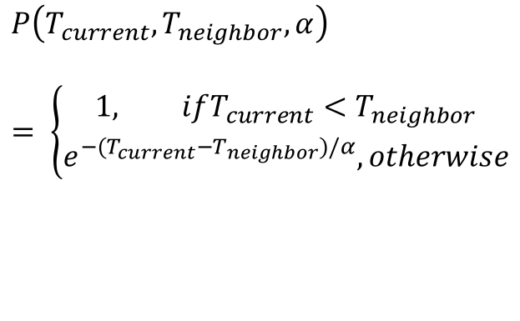
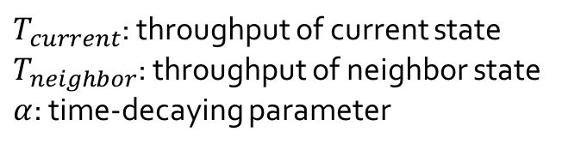
Computing Network Configuration
Compute new topology based on traffic demand
Use simulated annealing: probabilistically search for a topology with high throughput
Transition Probability
$$P\left(T_{current},T_{neighbor}, α\right)$$
$$= \left\{\begin{aligned}1, ifT_{current}<T_{neighbor} \\ e^{−(T_{current}−T_{neighbor})/α}, otherwise\end{aligned}\right.$$
Current
Topology
$T_{current}$: throughput of current state
$T_{neighbor}$: throughput of neighbor state
$α$: time-decaying parameter
States: Different Topologies

Slide 65
Computing Network Configuration
Generate neighbor state by random swapping links
Heuristically search for optical circuits to build new links: balance the consumption of regenerators
A
A
E
B
B
E
D
C
D
C
Current state
(Current topology)
Neighbor state
(Neighbor topology)

Slide 66
Computing Network Configuration
Compute throughput of neighbor state
Routing: prioritize short paths
Rate allocation: order transfers with classic scheduling disciplines for different objectives
Update network configuration
Extend Dionysus to coordinate updates in optical and network layers
SJF
(Shortest Job First)
EDF
(Earliest Deadline First)
……
Average Transfer
Completion Time
# of Deadlines Met
Other Objective

Slide 67
Implementation and evaluation
Implementation
Software: Controller prototype
Hardware: Testbed with 9 sites to emulate the Internet2 network
Evaluation
Testbed experiments (9 sites)
Simulations based on topologies and traces from an ISP network (~40 sites) and an inter-DC network (~25 sites)

Slide 68
Evaluation: Improvement on transfer completion time

Slide 69
Summary: Owan is a traffic management system for wide-area data transfers
1
Efficient algorithm
Dynamically reconfigure network topology
2
System prototype
Prototype on real testbed, evaluation on topology and traces from AT&T networks

Slide 70
Research summary
Software-defined platforms for network management
Dynamic service composition: CoVisor [NSDI’15]
Dynamic update scheduling: Dionysus [SIGCOMM’14]
Dynamic topology reconfiguration: Owan [SIGCOMM’16]
Secure virtual switching on end hosts: DomS [Hot-ICE’12]
Host-based network control: Sourcey [SOSR’16]
End-to-end network support for emerging applications
Data center network: EnsembleRouting [INFOCOM’13]
Cellular core network: SoftCell [CoNEXT’13]
Mobile network: optimize video streaming [HotMobile’15]

Slide 71
Thanks!
Xin Jin
xinjin@cs.princeton.edu
www.cs.princeton.edu/~xinjin

