Slide 1


Twenty Years After: Hierarchical Core-Stateless Fair Queueing
Zhuolong Yu
Jingfeng Wu, Vladimir Braverman, Ion Stoica, Xin Jin

Slide 2
Fair Queueing
Fair queueing is a canonical mechanism to provide fair bandwidth allocation to network traffic.
10
8
4
2
2
5
4
There is a long history of research on fair queueing since 1980s.
Still being studied: AFQ [NSDI’18], SP-PIFO [NSDI’19], Calendar Queue [NSDI’20]
Require per-flow state
Complex data structure and queue management (e.g., queue priority rotation)

Slide 3
Core-Stateless Fair Queueing (CSFQ)
No per-flow state
FQ
CSFQ
FQ
FQ
CSFQ
CSFQ
FQ
Core stateless
CSFQ
FQ
CSFQ
FQ
FQ
CSFQ
CSFQ
Other Fair Queueing
Core-Stateless Fair Queueing

Slide 4


Core-Stateless Fair Queueing (CSFQ)
pkt
rate
pkt with label
pkt
rate estimator +
packet labeling
packet dropping
packet dropping
$$α$$
$$α$$
fair share
estimator
fair share
estimator
edge switch
core switch

Slide 5
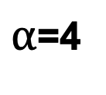

Core-Stateless Fair Queueing (CSFQ)
Carried in the label
Flow rate (f_{i})
Fair share rate ( )
Packet drop ratio
$$α$$
Maintained in every switch
Flow rate
Bandwidth=10
$α$=4
Accepted rate
8
Drop ratio=50%
4
2
Drop ratio=0%
2
5
Drop ratio=20%
4

Slide 6
Core-Stateless Fair Queueing (CSFQ)
CSFQ was proposed twenty years ago, but didn’t take off
Requires changes to the packet header and coordination between switches in the network
Needs hardware support to perform operations at line rate (fair share estimation, probabilistic drop, etc)
Data center under a single administrative domain
Programmable switches

Slide 7
Core-Stateless Fair Queueing (CSFQ)
CSFQ was proposed twenty years ago, but didn’t take off
Requires changes to the packet header and coordination between switches in the network
Needs hardware support to perform operations at line rate (fair share estimation, probabilistic drop, etc)
Data center under a single administrative domain
Traffic in DCN today is naturally structured in a multi-level hierarchy.
Fair queueing is not enough…
Need hierarchical fair queueing
A1
B1
B2
A2
B3
B4

Slide 8
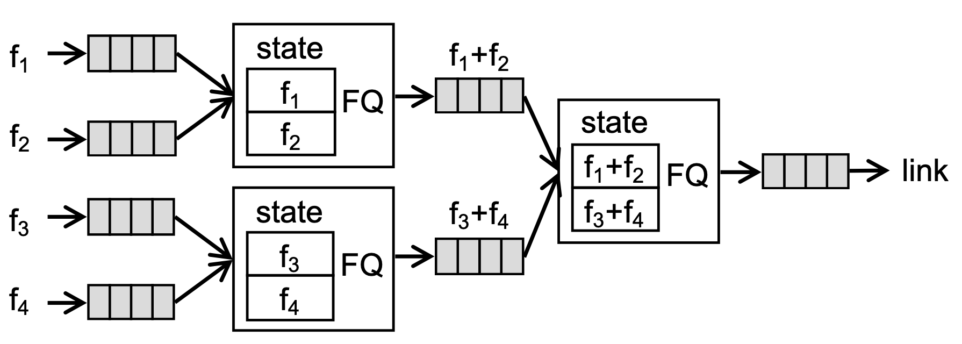
Hierarchical Fair Queueing
Tenant a
10
Tenant a
10
8
4
8
3
2
2
2
2
Tenant b
5
4
Tenant b
5
5
Fair Queueing
Hierarchical Fair Queueing
Existing solutions require per-flow state, complex queue management and a hierarchy of queues.

Slide 9
Hierarchical CSFQ
HCSFQ enables hierarchical fair queueing on commodity hardware at line rate.
Challenges
Naively extending CSFQ to HCSFQ requires a hierarchy of queues
The operations in CSFQ are not directly supported by primitives in programmable switches

Slide 10
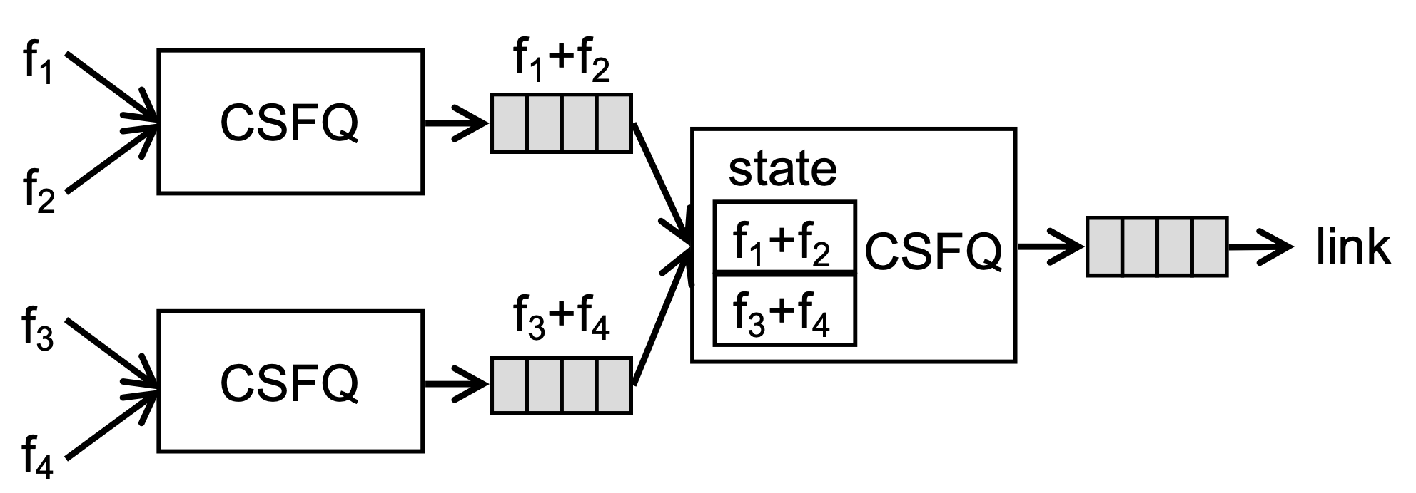
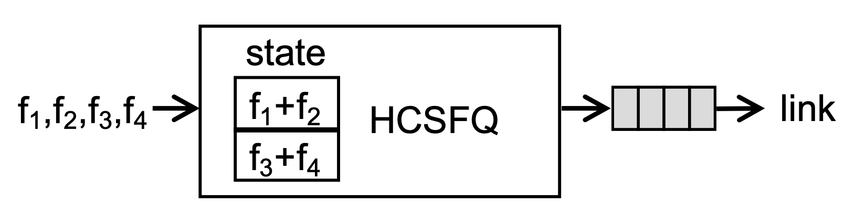
Hierarchical Computation
A naïve design
HCSFQ design

Slide 11
Hierarchical Computation
HCSFQ design
Maintain aggregated states for each hierarchy
f₁+f₂+f₃+f₄
f₁+f₂
f₃+f₄
f₁
f₂
f₃
f₄

Slide 12
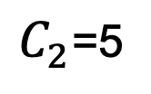

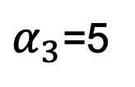
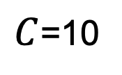
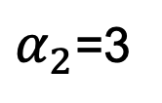
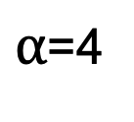
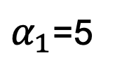
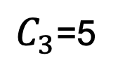
Hierarchical Computation
C=10
Tenant a
8
3
state
2
2
CSFQ is a special case that maintains only one aggregated node.
f₁+f₂
HCSFQ
Tenant b
5
f₃
5
$C$=10
$C_{1}$=10
$α$=4
$α_{1}$=5
1
$C_{2}$=5
2
3
$C_{3}$=5
$α_{2}$=3
$α_{3}$=5
8
2
5
Drop ratio: 50% 0% 20%
8
2
5
10
5
Drop ratio: 62.5% 0% 0%

Slide 13
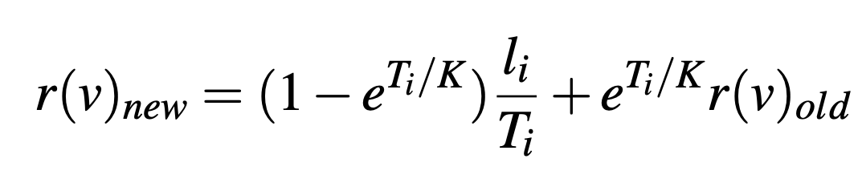
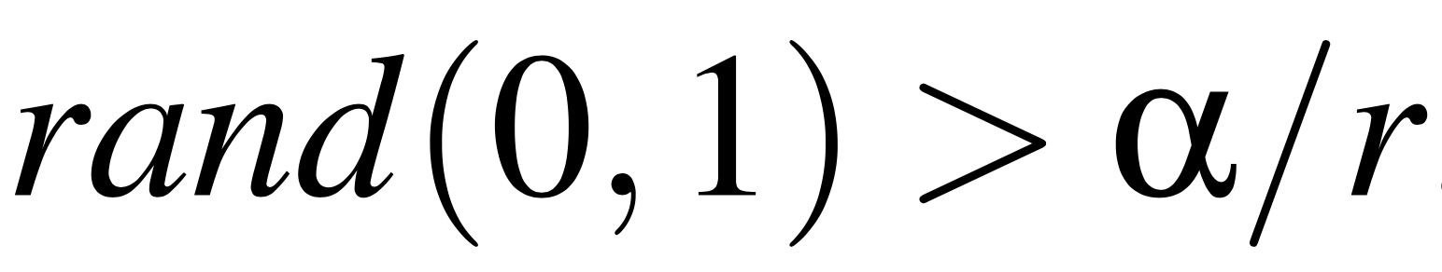
Data Plane Design
packet length
Rate estimator
exp
div
mul
time interval
Probabilistic dropping
fair share rate
random float
div
arrival rate
Fair share estimator
dependency

Slide 14
Data Plane Design
Current rate
Rate estimator
update per window
Total bytes
Within the window
Window-based mechanism
Probabilistic dropping
fair share rate
arrival rate
Fair share estimator

Slide 15
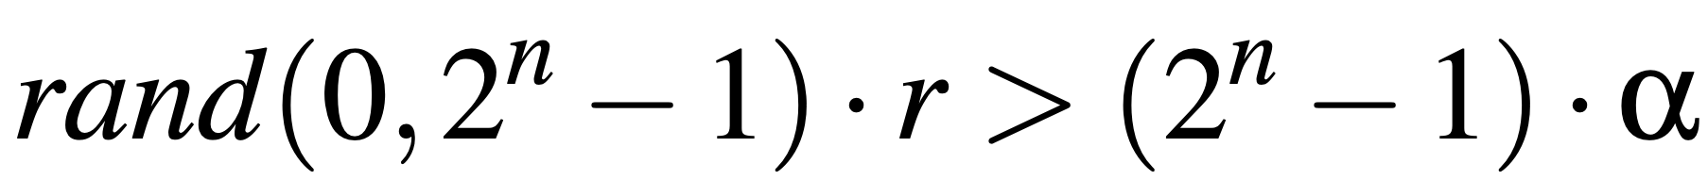
Data Plane Design
Current rate
Rate estimator
update per window
Total bytes
Within the window
Window-based mechanism
Probabilistic dropping
Use bit shift to do multiplications
Fair share estimator

Slide 16

Data Plane Design
Current rate
Rate estimator
update per window
Total bytes
Within the window
Window-based mechanism
Probabilistic dropping
Use bit shift to do multiplications
Fair share estimator
Use a small number of recirculation packets to update (at most one packet per window)
$$α$$
Separately generated by switch to avoid reordering

Slide 17
Evaluation
Testbed evaluation
6.5 Tbps Barefoot Tofino switch
5 servers with an 8-core CPU and a 40G NIC
Simulation
Simulator: Netbench
Comparison: AFQ, SP-PIFO, TCP, DCTCP
Topology: Leaf-spine topology

Slide 18
Evaluation
How HCSFQ works on the testbed
How HCSFQ works for a large-scale DCN workload in simulations
More results in the paper:
Weighted fair queueing,
Fair queueing with different TCP settings,
The gap between prototype implementation and ideal theory,
DCN workload with injected UDP traffic,
Incast,
DCN workload with multiple tenants.

Slide 19
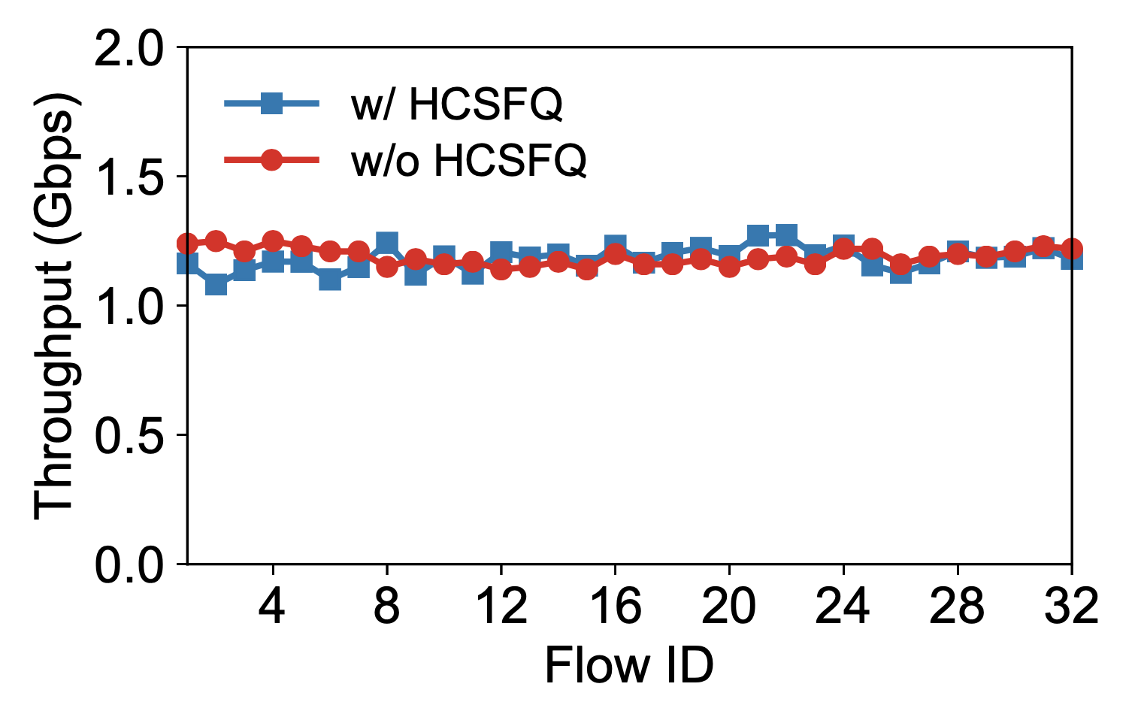
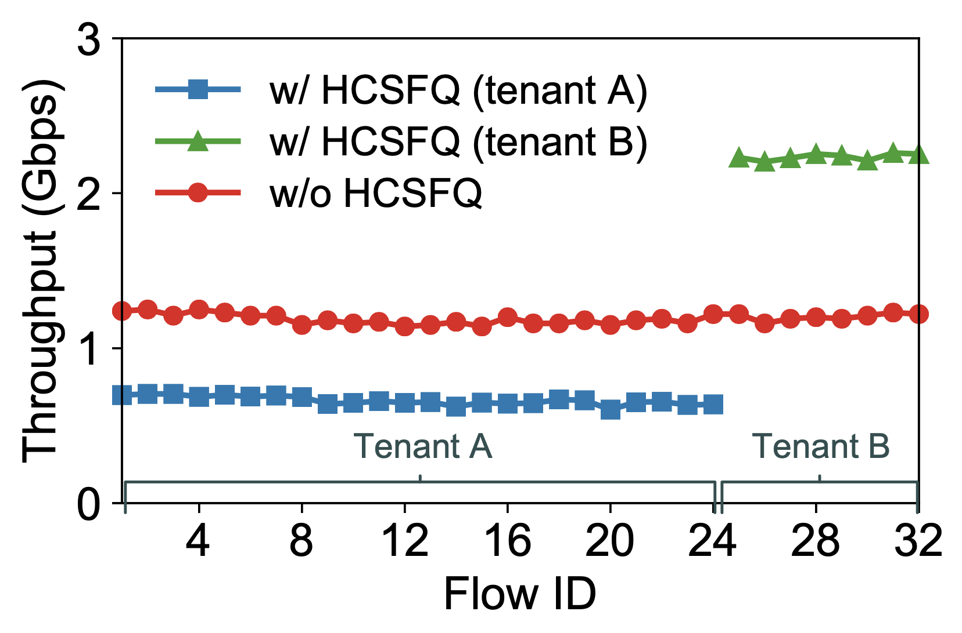
Testbed Experiments
3x
Fair queueing
Hierarchical fair queueing

Slide 20
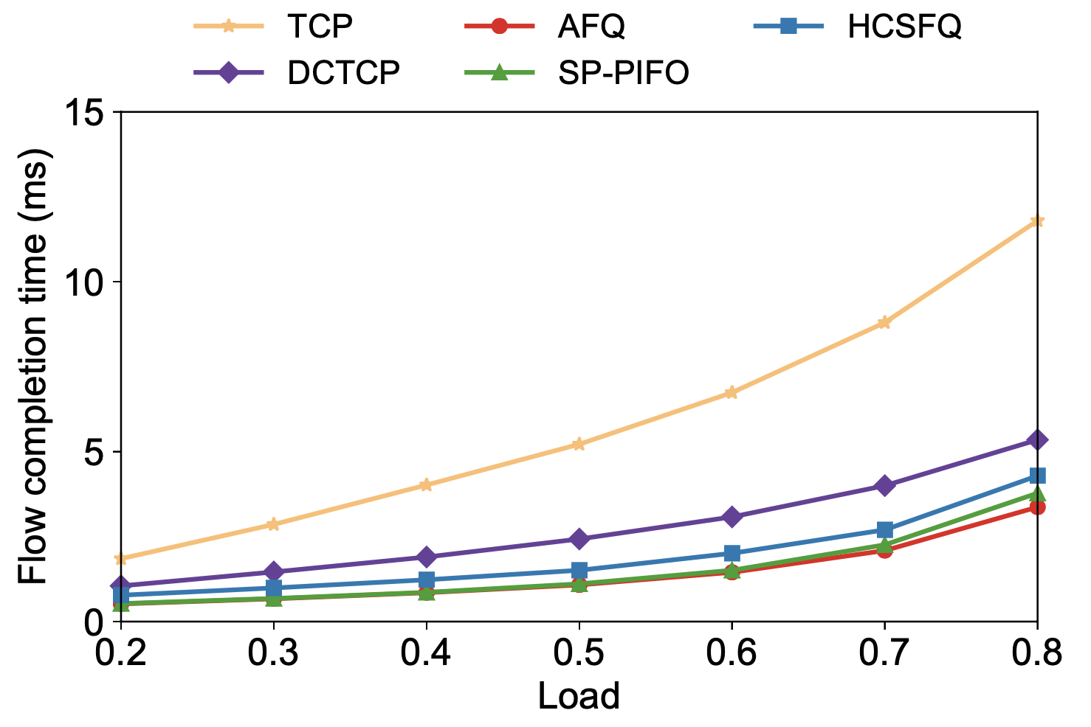
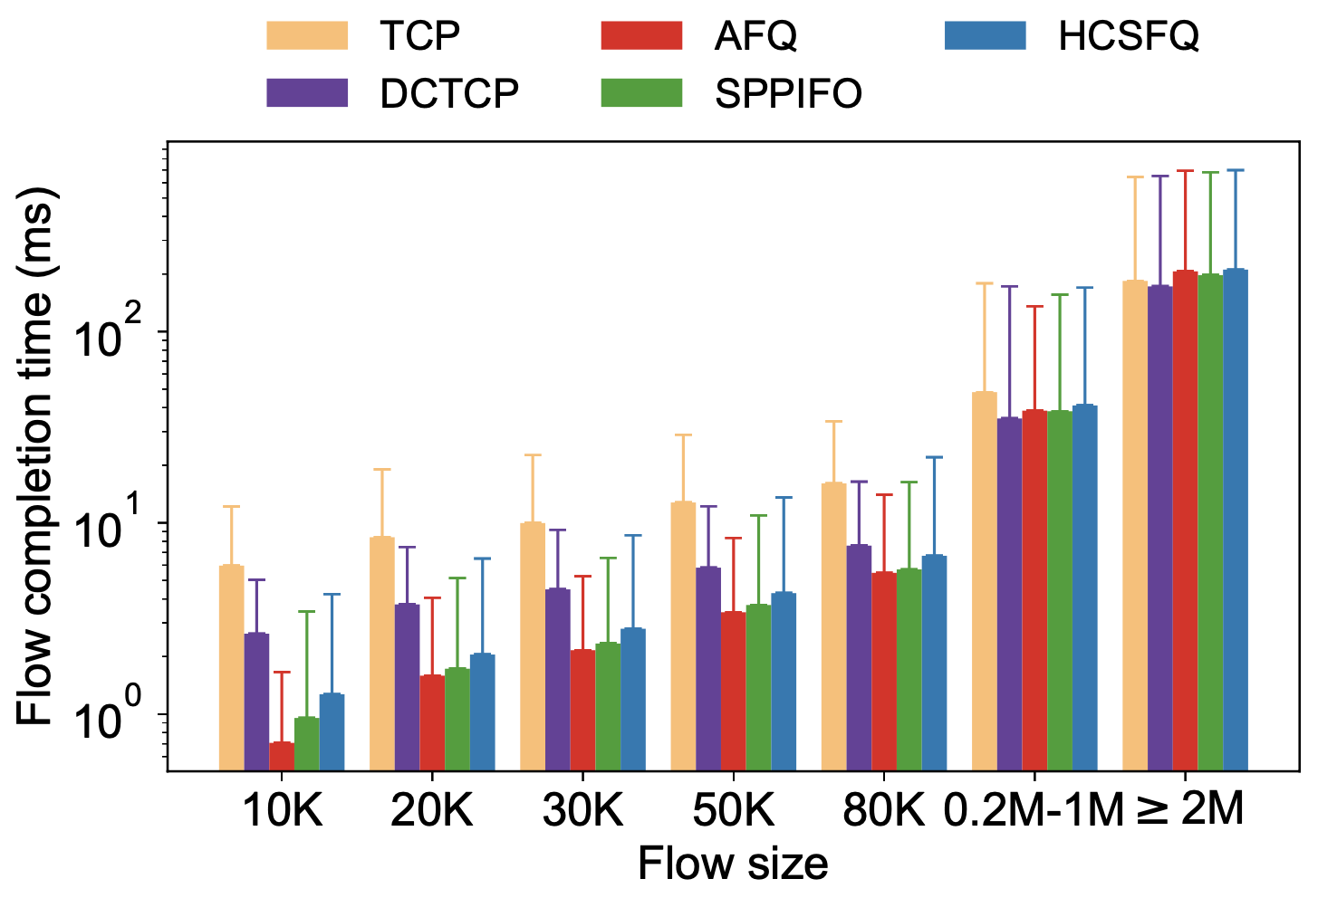
Large-scale DCN simulations
Average flow completion time for
flows less than 100KB
Flow completion time breakdown for 70% load

Slide 21

Conclusion
HCSFQ provides hierarchical fair queueing on hardware switches at line rate.
HCSFQ requires no per-flow state at core switches and no hierarchical queue management.
https://github.com/netx-repo/HCSFQ

Slide 22

Thank you!
zhuolong@cs.jhu.edu

