Slide 1
KinX
Tony, Shahab, Jaikun, Brandon
Mission: Connecting Families in a World of Information

Slide 2
Road Map
Prototypes
Tasks
Experimental Method
Results
Plan of Action

Slide 3
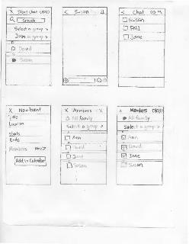
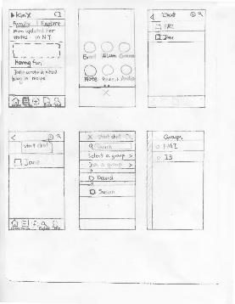
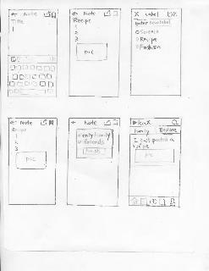
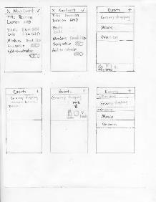
Prototypes

Slide 4
Tasks
Group Messaging
Creating and sharing Calendars
Creating Recipes (Notes)

Slide 5
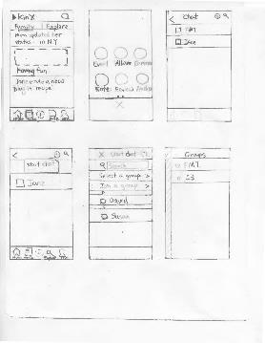
Scenario 1
You are preparing to go home and you would like to send a message to immediately notify your family members that you are coming home for Thanksgiving two days early.

Slide 6
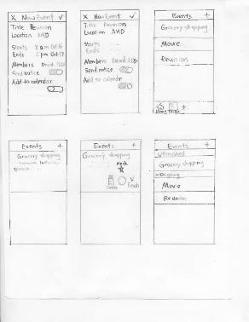
Scenario 2
You are planning a family reunion next month and would like to send a calendar invite to your family so you can coordinate the best time. You would like to add this calendar to your own calendar.

Slide 7
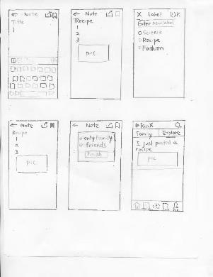
Scenario 3
You recently were taught a delicious cake recipe. Create a note labeled Recipe and post it to the family forum to share with your relatives.

Slide 8
Experimental Method
Subjects
Subject 1: Australian PhD staying in the US for 5 months. She communicates with family using email Facebook and Google Chat
Subject 2: Korean PhD Student. She with family communicates using KakaoTalk and Skype. Never uses the phone.
Subject 3: PhD student. She communicates with family using Skype, WhatsApp
Environment
Subject 1: Old Union
Subject 2: Escondido Village after dinner
Subject 3: In her dorm
Procedure
Introduction, demo, perform task, and gather feedback
Test measures
How intuitive it was to navigate through the app (reactions and feedback)

Slide 9
Results
Layout and icons were unintuitive
Hard time accessing chat and note features
User expected to be automatically taken back after creating an event

Slide 10
Potential Solutions
Add a navigation panel to every screen
Make Icons more representative of their functions
Design a more intuitive layout
Create an option to reset home screen

Slide 11
Summary
Learned
How to make the layout more user-friendly
What aspects need work
Need to
Solidify the functions within each feature
Figure out layout will be the most intuitive and effective

