Slide 1
KinX
Bring families together
Tony, Shahab, Jiakun, Brandon

Slide 2
Overview
User feedback
Revised design & Rationale
Showcase Mid-fi prototypes
Tools

Slide 3
Tasks
Start a group chat
Add a family event and send notice
Post a Note on a family forum

Slide 4
Low-fi prototype
Observation | Insights
Buttons cause confusion | Icons are unrecognizable
Cannot find “Notes” | Counter-intuitive Layout of home screen
Try to edit navigation bar | Space for customization
Wait for automatic return | Smooth transition

Slide 5
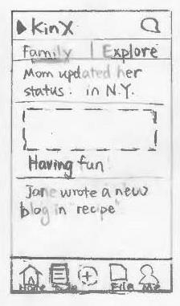
Icons & Labels

Slide 6
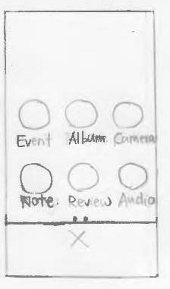
Layout 1
File management
Social network

Slide 7
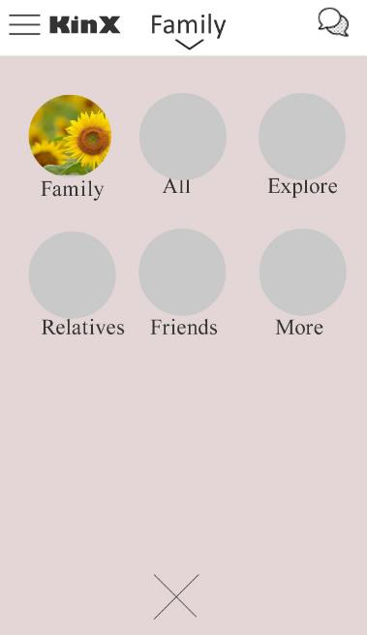
Layout 2
Multiple groups

Slide 8
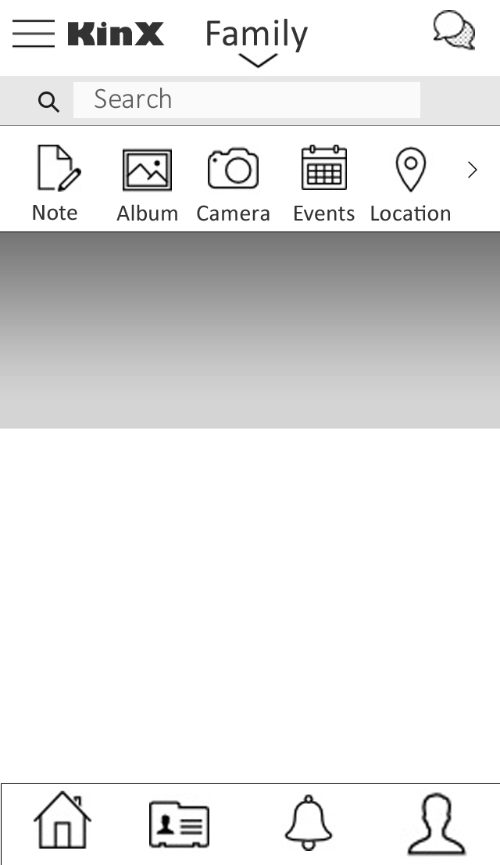
Customization
Profile Picture

Slide 9
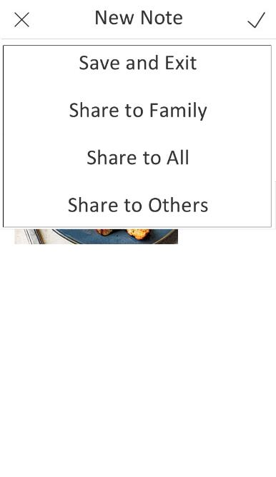
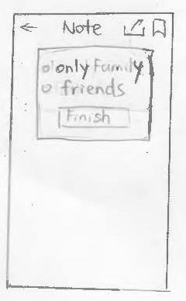
Transition
Tapping on sharing items brings back home screen

Slide 10
Live Demo
https://projects.invisionapp.com/d/main#/console/2005556/45146431/preview

Slide 11
Tools
Image processing: Photoshop
Transition: InVision for cooperation
Limitation: Fixed-path, greyscale

Slide 12
Summary
Familiar icons and labels
Layouts illustrates information architectures
Create options for personalization
Smooth transitions between tasks

Slide 13
Thanks!

