Slide 1


ReAct: Synergizing Reasoning and Acting in Language Models
CIS4930-0001 | Florida State University
Research Paper Analysis: Yao et al. (2022)

Slide 2

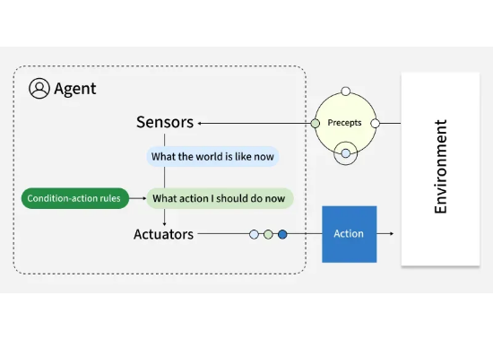
The Problem: LLM Logic Gaps
Prior to ReAct, Large Language Models (LLMs) operated in two isolated modes:
Reasoning (Chain-of-Thought): Breaks down prompts into a series of thoughts, improving reasoning ability.
Acting (Interaction): Generates tool calls to services like a search engine API, enabling interaction with the external environment.
Result: An agent can think about a task, and an agent can manipulate a tool, but it cannot do both at the same time.

Slide 3

Main Challenges in Prior LLMs
The "Multi-Hop" Difficulty: Most real-world questions (e.g., "What is the capital of the country where the inventor of X was born?") require several steps of info retrieval.
Error Handling: In "Action-only" models, a single bad search query leads to a total failure as there is no reasoning to catch the error.
Hallucination: "Reasoning-only" models confidently invent facts because they have no "window" to the current world state.
Isolated Training: Previous attempts at combining reasoning and acting required fine-tuning models on specific task actions, which didn't generalize well.

Slide 4

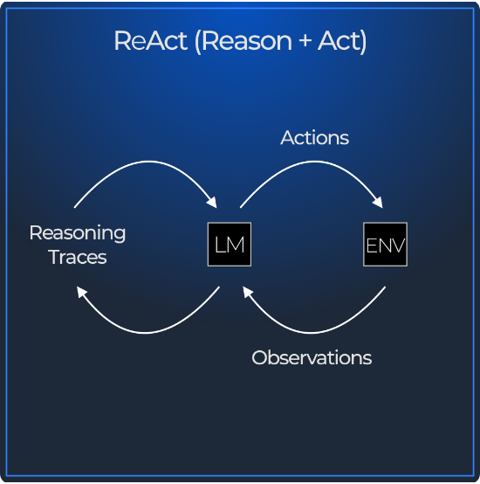
The Solution: Synergy
Bridging Thought and Action
ReAct mimics human behavior: we talk to ourselves as we solve tasks.
Interleaving: Reasoning helps to plan and adjust actions effectively.
Grounding: Actions provide real-world facts to support reasoning.
Reliability: Reduces "hallucination" by enabling models to cite external observations.

Slide 5






High-Level Overview
ReAct is a unified paradigm where an LLM generates reasoning traces and actions in an interleaved manner.
Thought
Action
Observation
The model writes down its plan, synthesizes observations, and tracks what remains to be done.
The model executes a command (e.g., Search, Lookup, Finish) to interact with an external environment.
The model receives feedback from the environment, which informs the next step of reasoning.

Slide 6
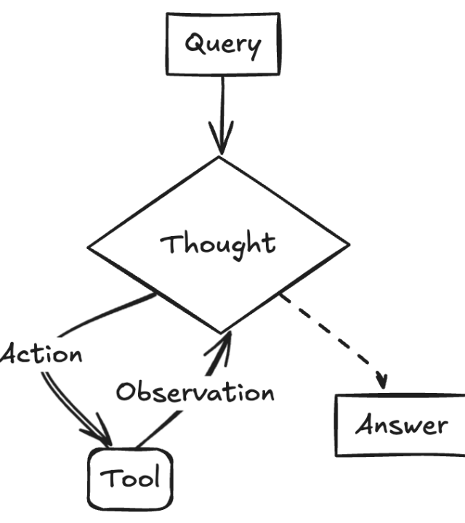
A Clever Interleaving
ReAct enables simultaneous reasoning and acting via Few-Shot Prompting.
In-Context Learning: By showing the model 3-4 examples of a Thought-Action-Observation loop, it learns to mimic this structure.
Feedback Loops: If an Action returns an error, the next Thought recognizes this and reformulates the query.
ReAct is not just better reasoning; it is reasoning that responds to the environment.

Slide 7



What Was Missing?
Prior to ReAct, the field lacked a dynamic error-correction mechanism that combined the following three traits:
Traceability
Adaptability
Generalization
The ability to see why an agent chose a specific action based on its internal logic.
The ability to change the search strategy mid-flight if the first search result is "Not Found."
A method that works across different domains (QA, Web-browsing, Games) without retraining.

Slide 8

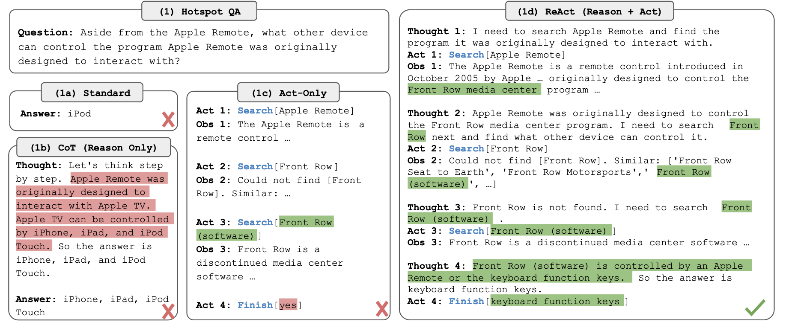

Slide 9
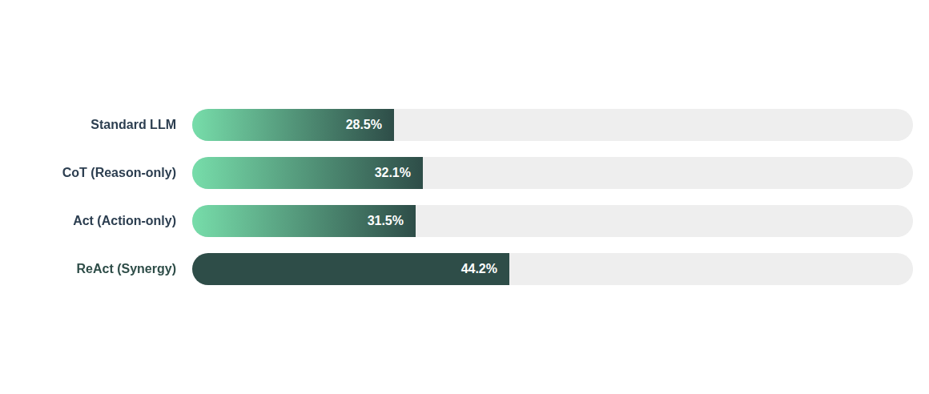
Quantitative Results: HotpotQA
Task: Multi-hop Knowledge Question Answering (Exact Match %)
Note: ReAct significantly reduces hallucination and improves success in multi-step retrieval.

Slide 10






Industry Impact: AI Agents
ReAct is the foundational design for modern LLM agents used in industry today:
LangChain
Coding Agents
Search Engines
The most popular framework for LLM apps uses "ReAct Agents" as the default for tool-using tasks.
Services like Cursor use the ReAct loop to carry out tasks by exploring relevant information, reasoning out a plan, and executing tool calls
Modern "AI Overviews" in search engines use ReAct logic to decide when to stop searching and start answering.

Slide 11
Assumptions & Limitations
Constraint | Details / Challenges
Base Model Capability | Models must be "smart" enough to follow complex few-shot instructions (usually 70B+ parameters).
Token Cost | Generating long reasoning traces increases costs per request significantly.
Latency | Greater numbers of actions and observations creates multiple round-trips to APIs, slowing down the final response.
Loop Toxicity | Open Question: How do we stop a model that gets stuck in an infinite search loop for a non-existent fact?

Slide 12
Questions?
ReAct: Bridging Thought and Action
Key Takeaway: Reasoning plans the journey; Action executes the steps. ReAct is the synergy that enables real autonomy in agents.

Slide 13




Sources
https://legacywalk.fsu.edu/sites/default/files/media/slides/westcott-1-700.jpg
Source: legacywalk.fsu.edu
https://media.geeksforgeeks.org/wp-content/uploads/20250813103427075673/simple.webp
Source: www.geeksforgeeks.org
https://cdn.prod.website-files.com/645a411baa30ca12b39891d5/671df6accc65d8e321eec821_Neradot-ReAct.png
Source: www.neradot.com
https://miro.medium.com/1*B-xl5kNgpnLld4_xmqJ1bw.png
Source: abdullahalsazib.medium.com

