Slide 1
Tutorials for
Google Colab and PyTorch
CIS 4930/5930 Fall 2026

Slide 2
Today’s Outline
Pre-requisite
Google Colab and Alternatives
PyTorch Basic
CNN Example: Image Classification
Presenting your model: Gradio and Streamlit

Slide 3
Pre-requisite
Basic python knowledge
Google account for Colab (OR PC/Mac with a GPU OR Other online platform)
- Why you need a GPU for deep learning

Slide 4
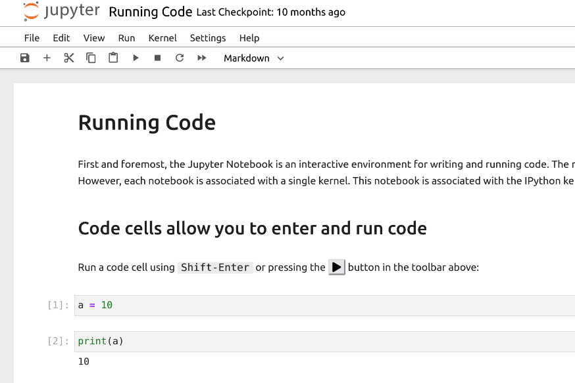
Python Basic
Python is a high-level, interpreted, general-purpose programming language known for its simplicity and readability. Unlike C++, Python is a scripting language that does not need to be compile.
Run by executing file: `python main.py`
Run in console interactively:
Run in Jupyter notebook –like tools (In our class):
import random
# Generate a random number between 1 and 10
random_number = random.randint(1, 10)
print("Random number:", random_number)
>>> print("Hello, I'm Python!")
Hello, I'm Python!

Slide 5
Python Basic (con’t)
In this class, we assume that you already know some of python usages. Like basic "if", "for", how to install and import package, etc.
Below are some free tutorials you can find online. if you are not familiar with python environment and python language, you may find they are useful.
Tutorial: How to install Python
windows: https://www.youtube.com/watch?v=TNAu6DvB9Ng
mac: https://www.youtube.com/watch?v=nhv82tvFfkM
Tutorial: Create Anaconda Virtual Environment for Jupyter Notebook
windows: https://www.youtube.com/watch?v=sv0ca-6liM8
mac: https://www.youtube.com/watch?v=SF_w7LBV_Zo
Tutorial (Python for beginners) (about 1 hour):
https://www.youtube.com/watch?v=kqtD5dpn9C8

Slide 6
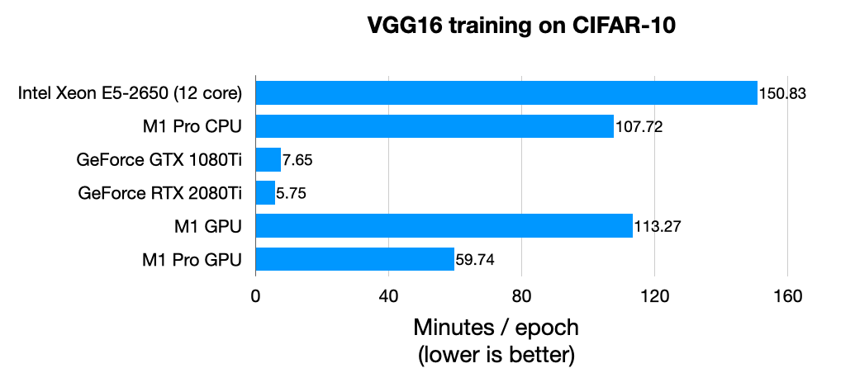

A Machine with GPU
In this class you need to have a machine with GPU in order to train your neural network.
Why you need a GPU?

Slide 7
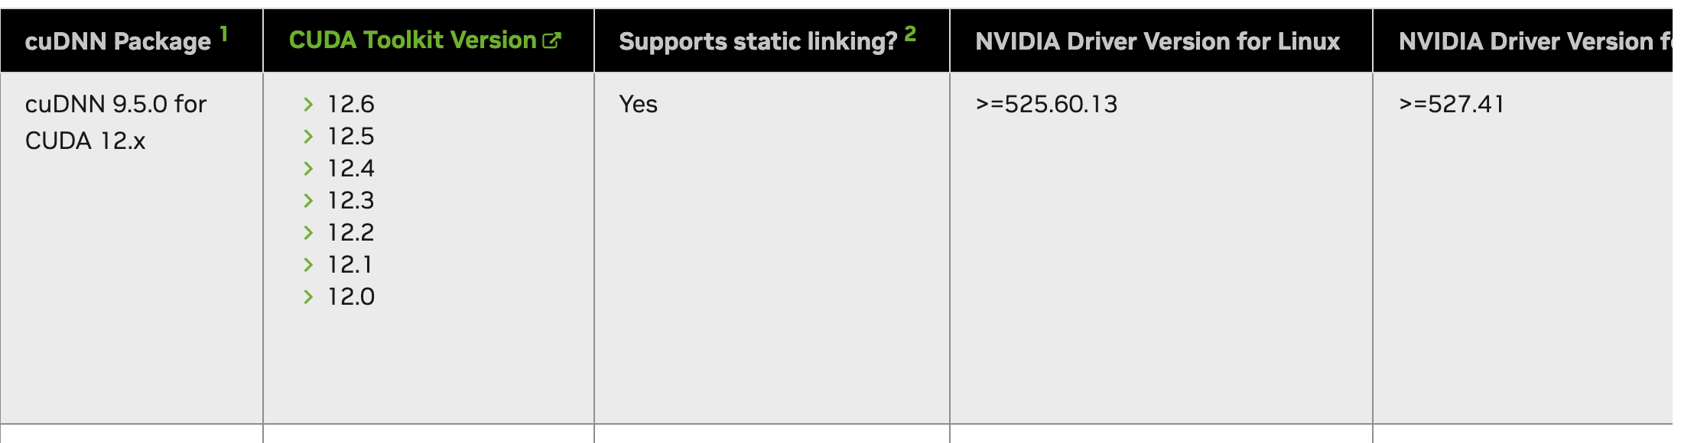
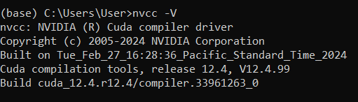
A Machine with GPU (con’t)
You can use your local computer with Nvidia GPU. (For mac, you can use MPS with not promising performance)
Correct corresponding version:
Nvidia driver, CUDA toolkit, cuDNN libray
Command line to check if you already have CUDA toolkit installed
https://docs.nvidia.com/deeplearning/cudnn/latest/reference/support-matrix.html
How to install cuda toolkit on windows: https://wiki.cci.arts.ac.uk/books/how-to-guides/page/how-to-install-cuda-toolkit-on-your-personal-windows-pc
Accelerated PyTorch training on Mac: https://developer.apple.com/metal/pytorch/
Notes:
However, using Nvidia GPU with CUDA requires you a lot of energy to set up the environment. And, currently, GPUs made by Apple or AMD does not have good performance compared to Nvidia.

Slide 8
Create Running Environment
Each Python project can have its own unique running environment
Recommended tool: Anaconda and Pip
  Allows users to create and manage isolated environments easily
  different projects can use different versions of Python and packages
    Example: Numpy, Sklearn, PyTorch, Pandas, etc.
  ensures consistent package versions and environment behavior across Windows, macOS, and Linux
  Useful tutorials:
    https://www.anaconda.com/docs/getting-started/getting-started
    https://www.youtube.com/watch?v=1nDNhiRg4DY
Other choice: uv
  Documentations: https://docs.astral.sh/uv/

Slide 9
Google Colab and Alternatives
Getting start with Colab:
  Runing Code, GPU Runtime, File Manipulation, Linux Commands on Colab, Tips
Alternatives:
  PC(Recommended)/MAC with a GPU: Jupyter notebook with Conda virtual environment(optional)
  Paid options: Colab Pro, Paperspace, etc.

Slide 10
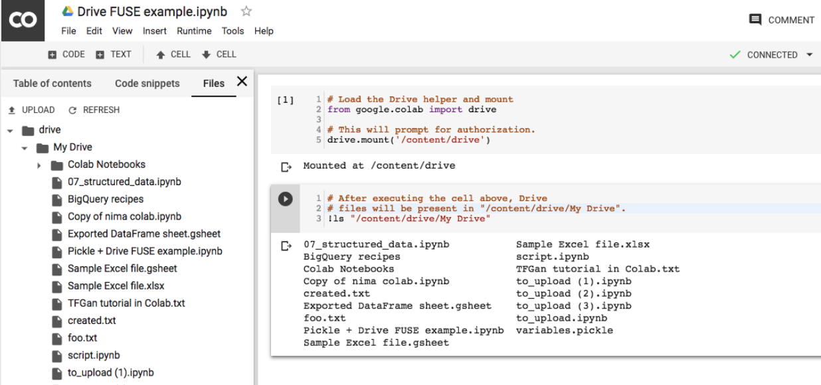
Google Colab
A ready-to-use python environment with free GPU hours
You can see it as an online version of Jupyter notebook. I recommend you to use this since it already comes with some common packages and python environment if you do not have a decent GPU on your local computer
https://colab.research.google.com/
You need a free google account in
order to use it.
Notes:
We assumed that you already know some of python usage. If not, I provides some link for you in the slides for installing python or getting familiar with the basics of how to use it.

Slide 11
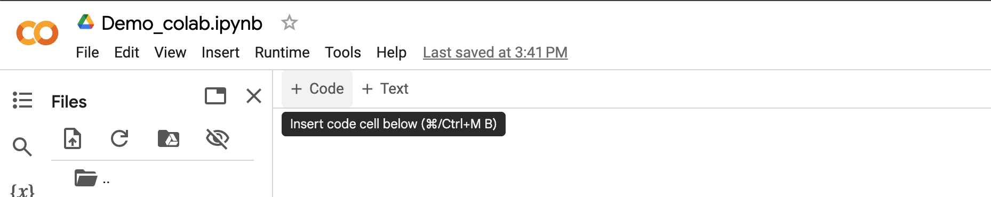
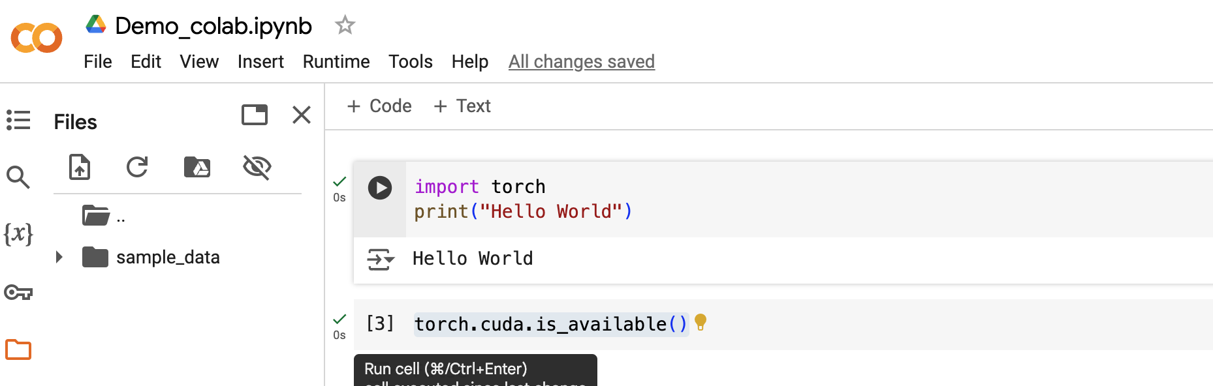
Add and Run Code
Click "+Code" to add python code
OR
Click "+Text" to add plain text(markdown)
Click the run button to run the code
OR
You can select the "Runtime" in the menu to run multiple blocks of code

Slide 12
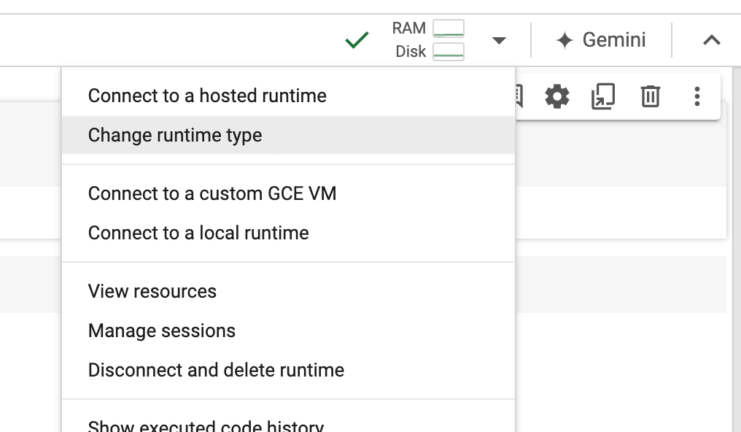
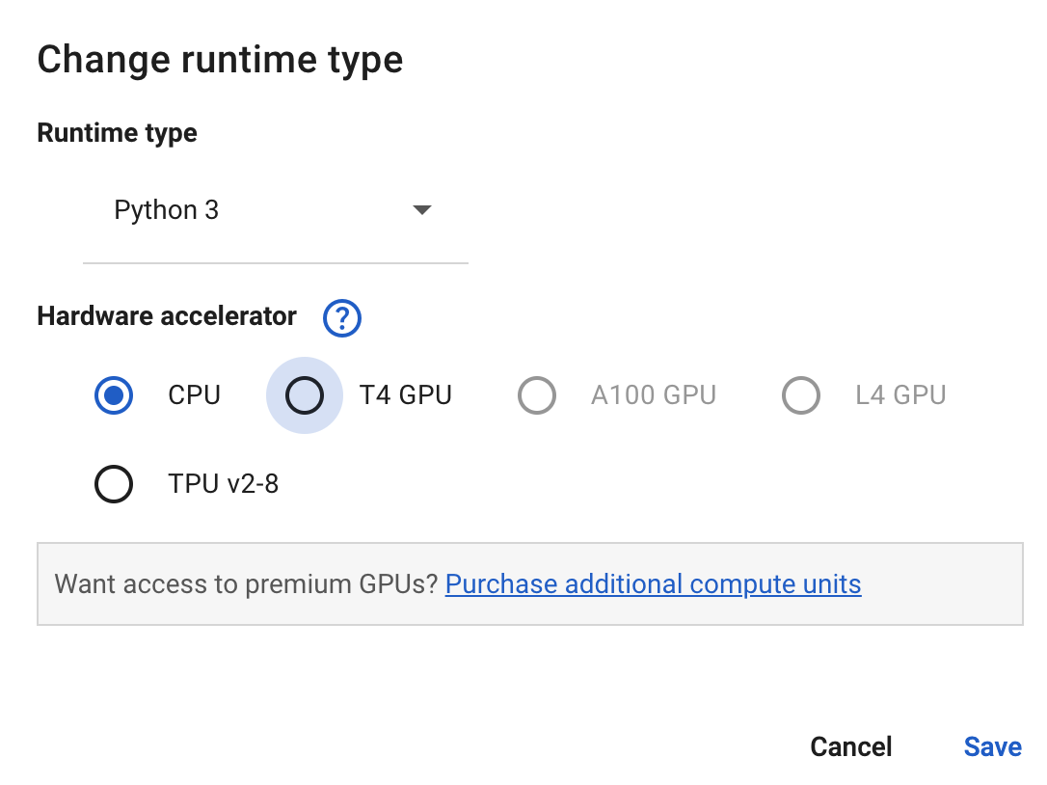
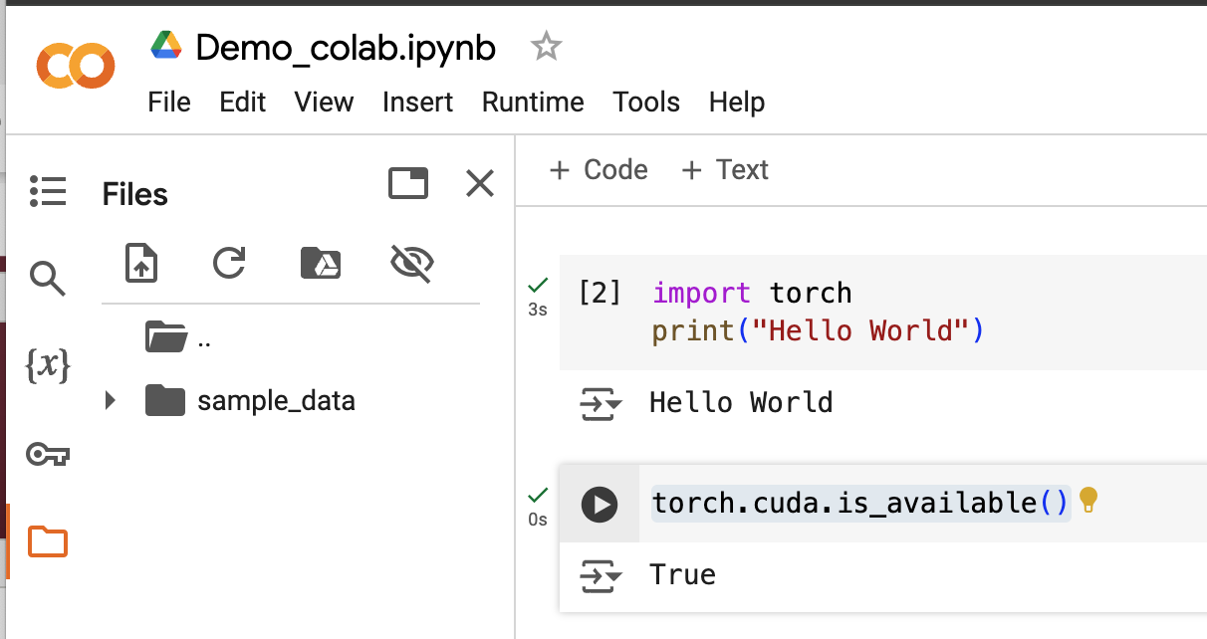
Select GPU environment and Verify
Select the button next to resource monitor icon and choose "Change runtime type"
Choose "T4 GPU" which is free to use and save
You can run the
`torch.cuda.is_available() again to verify your configuration

Slide 13
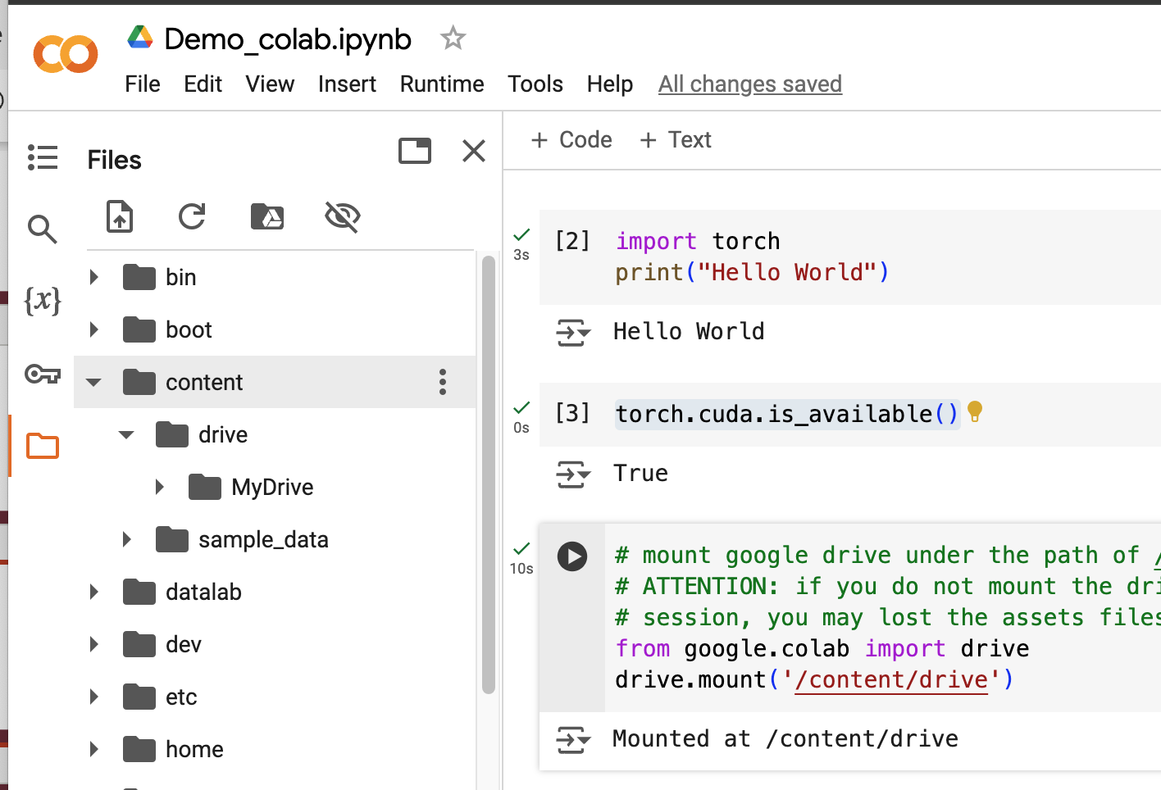
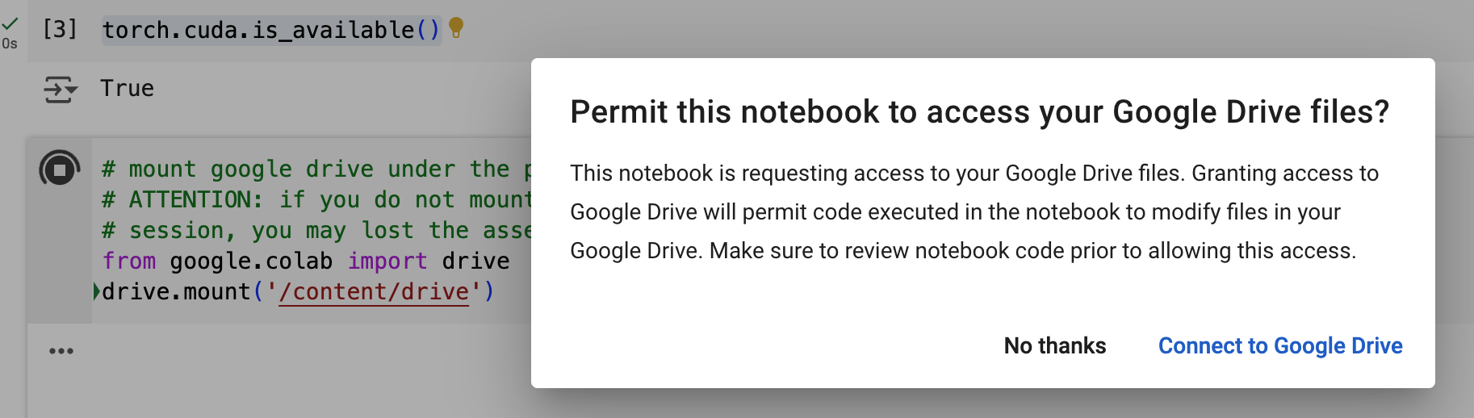
Mount Google Drive
ALERT: the files in your temporary session will be lost after you restart your notebook
Use the code below to mount your google drive(15GB free) and grant the permission
You can find the mounted folder in the side
bar, where you can upload your files
from google.colab import drive
drive.mount('/content/drive')

Slide 14
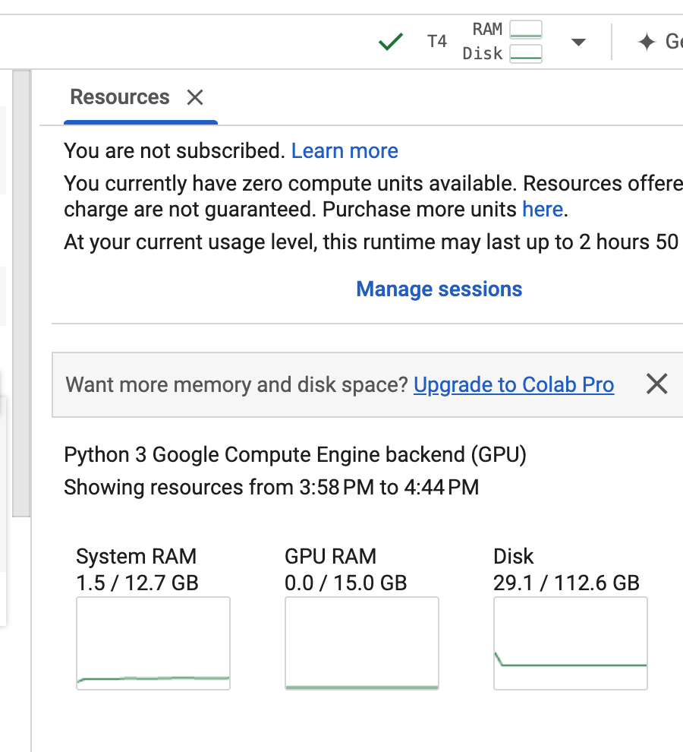
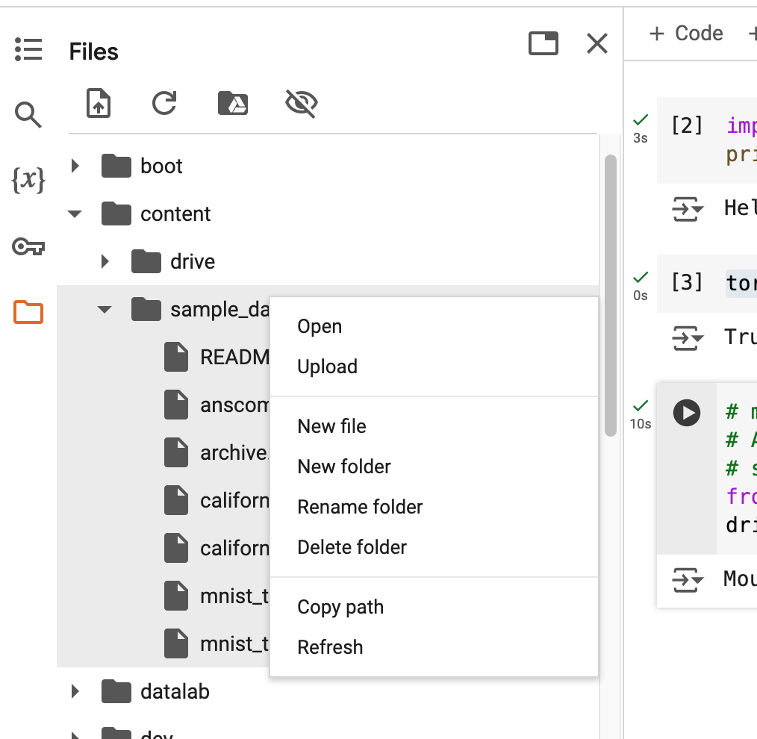
Upload or Download dataset
If you have a large dataset, you can also upload or download it directly to your temporary session
Right click the folder and select upload
View your usage here
(Notice: you do have a time limitation to use the GPU session, after that, you will lost all your temporary data)

Slide 15
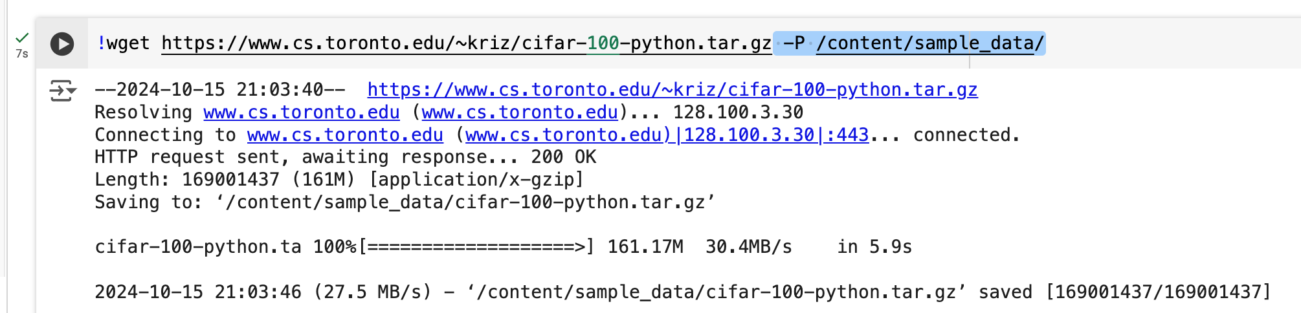
Upload or Download dataset
Or, you can download your dataset from URL to your session.
Google Colab supports linux commands in the code block with a suffix "!" (use "%cd" to change directory), for example, use "!wget" to download files
!wget https://www.cs.toronto.edu/~kriz/cifar-100-python.tar.gz -P /content/sample_data/

Slide 16
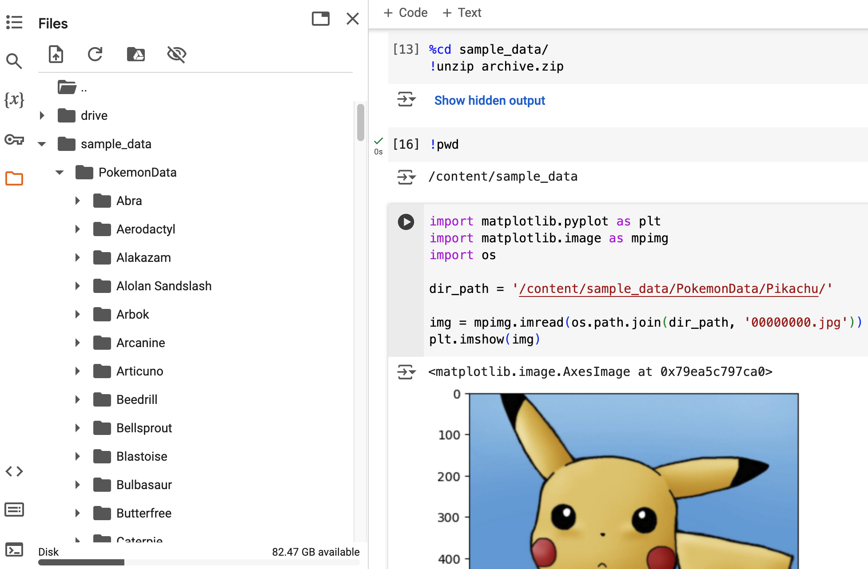
Read files
Use "%cd" enter into the folder contains your dataset,
Use "!unzip" to unzip the file
Use matplotlib to read and show image

Slide 17

Attention:
Google Colab notebooks have an idle timeout of 90 minutes and absolute timeout of 12 hours.
This means, if user does not interact with his Google Colab notebook for more than 90 minutes, its instance is automatically terminated.
Maximum lifetime of a Colab instance:12 hours.
To keep your colab active: try https://stackoverflow.com/questions/57113226/how-can-i-prevent-google-colab-from-disconnecting
There is a cooldown period, so you may have to use multiple free accounts

Slide 18
Alternatives
Paperspace (Plan or on-demand instance): for example, free plan or $8 month for faster free GPU: https://www.paperspace.com
VastAI - Similar to above: https://vast.ai
Google Cloud, PyTorch lighting, or AWS, etc...
Notice: If you have a good gaming PC that have RTX 4090, etc. You can always use your own PC for training. (For environment setup, please refer to the pre-requisite part)

Slide 19
PyTorch Basic
Introduction:
  Basic Concepts, Build your network, Pipelines for training/testing/saving/loading model
PyTorch Documentation

Slide 20
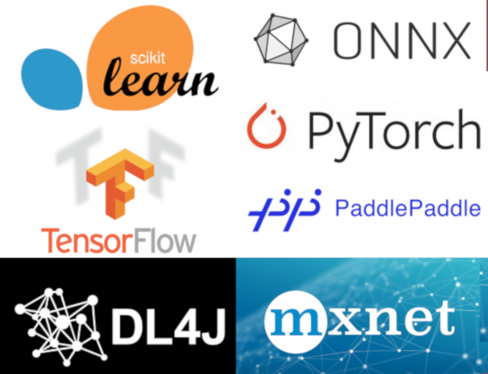
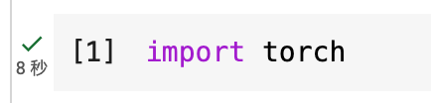
PyTorch Introduction
A popular machine learning framework
For training machine learning model
Developed at Facebook AI and Research lab
Implementing a neural network in PyTorch is simpler and intuitive than other frameworks
Converting NumPy objects to tensors is natively integrated with PyTorch’s core data structures
https://thenewstack.io/the-ultimate-guide-to-machine-learning-frameworks/

Slide 21
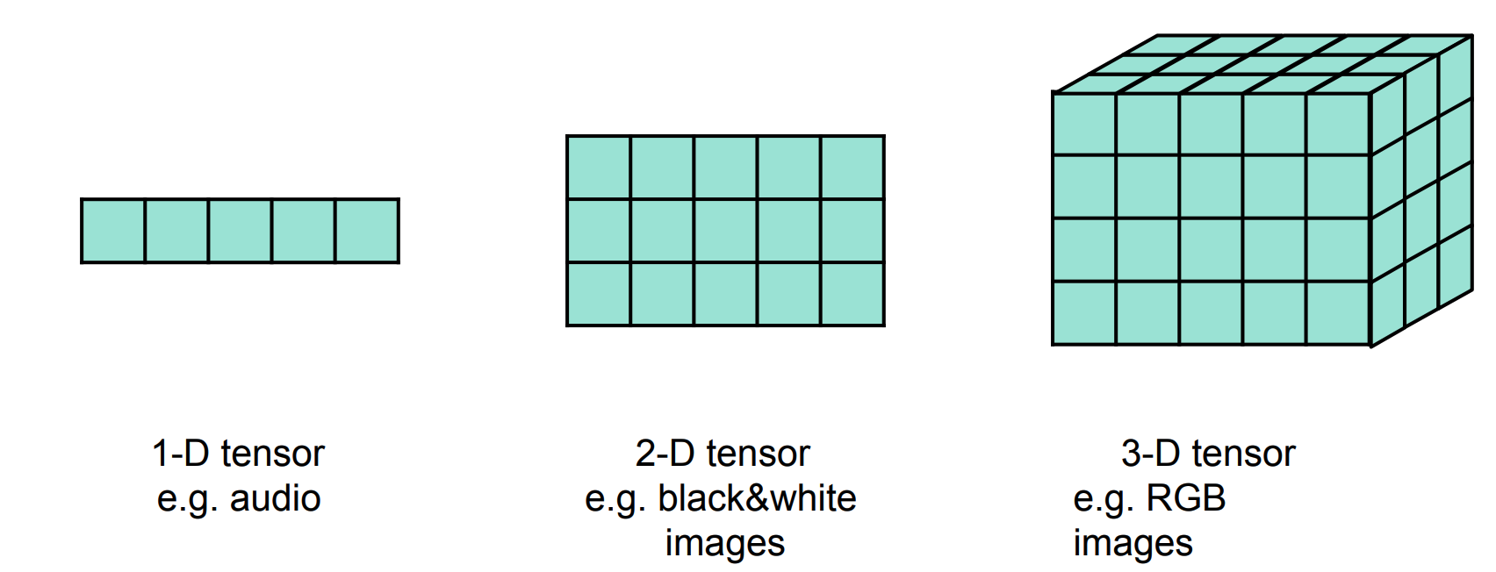
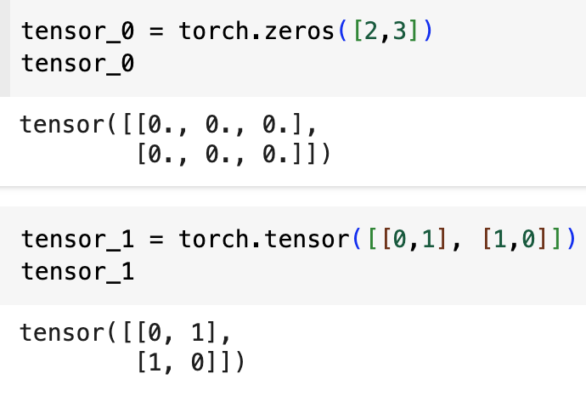
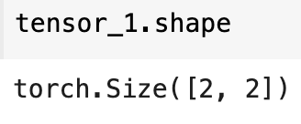
Key Concepts:
Tensor: A tensor is a mathematical object that generalizes scalars, vectors, and matrices into higher-dimensional spaces.
Create tensors
4
5
5
3
5
Check tensor's shape:
(5, ) -> dim0
(3, 5 ) -> dim0, dim1
(4, 5, 3 ) -> dim0, dim1, dim2

Slide 22
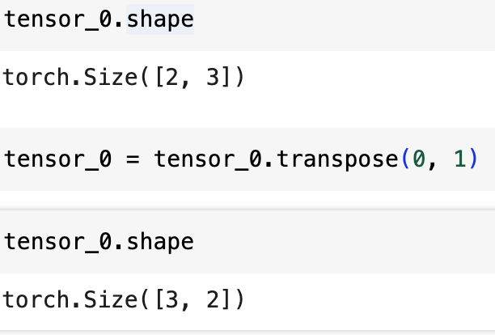
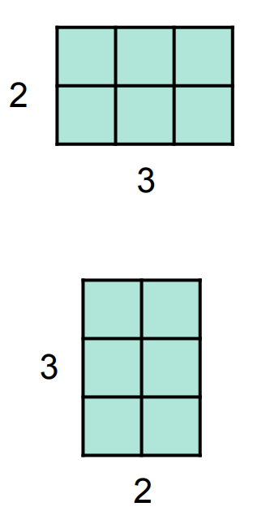
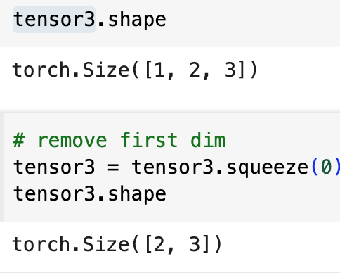
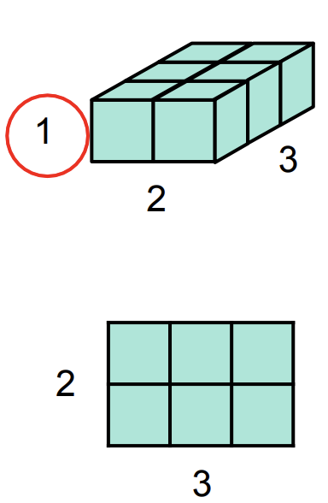
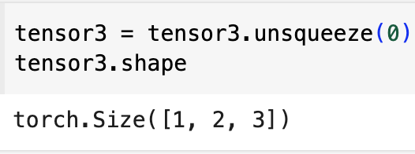
Key Concepts:
Tensor operations example:
Transpose:
Remove Dim:
Expand Dim:

Slide 23
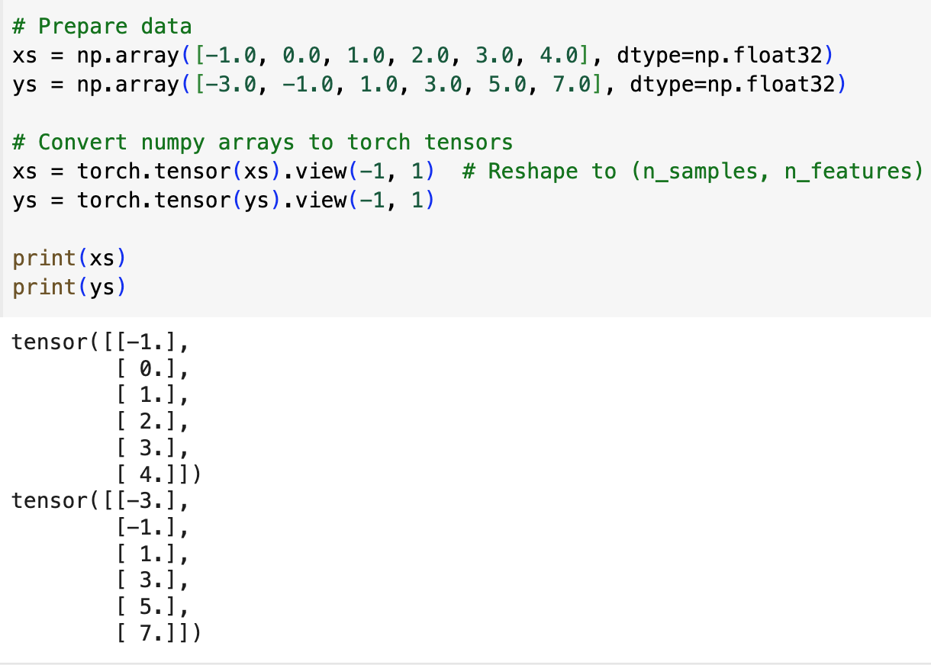
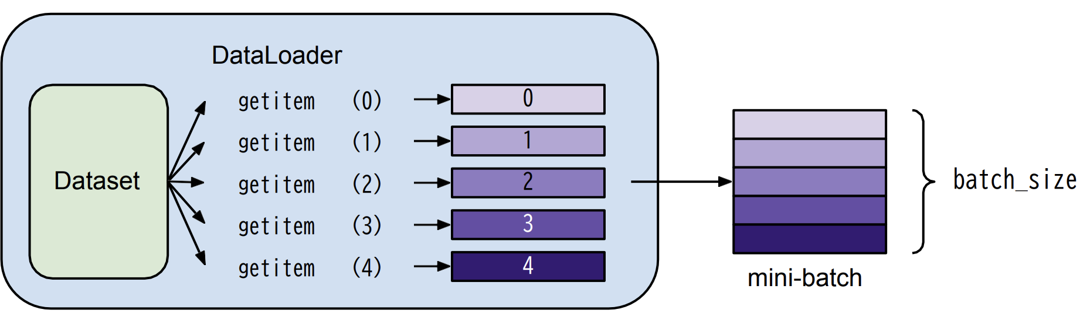
ML Steps in PyTorch
Pre-process data
Define network
Define loss function
Define optimizer
Training model
Validation and Testing
In a real å
In a real example, you may use the code below to load data:
dataset = MyDataset('data.csv')
dataloader = DataLoader(dataset, batch_size=4, shuffle=True)
Notes:
Batch is a subset of Data, so instead of using the entire dataset for each update of the model's parameters, the data is divided into smaller batches.
Smaller batches fit into memory better, especially with large datasets, so it can save memory. Also, smaller batch can frequently the model's parameters can be made more frequently, leading to faster convergence.
If you have 1,000 data points and a batch size of 100, it means the model will process 100 data points at a time.
When shuffle is set to True , the data is randomly shuffled before each iteration, so the order of the data is different in each epoch. Shuffling the data can be useful in training deep learning models because it helps prevent the model from memorizing the order of the data.

Slide 24
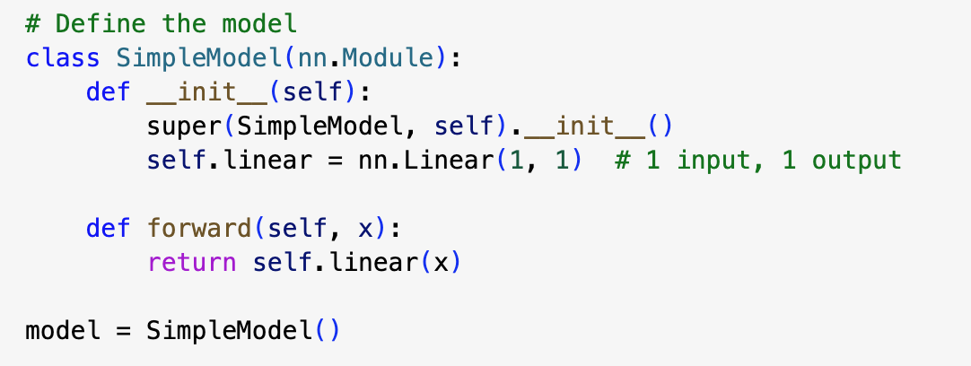
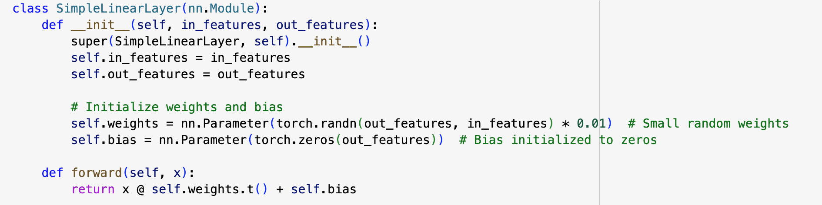
ML Steps in PyTorch
Pre-process data
Define network
Define loss function
Define optimizer
Training model
Validation and Testing
In a real å
nn.Linear (fully connected layer)
Under the hood, you may define your own layer manually
Output = (Weight * Input) + Bias​
Y = AX + B (Linear)

Slide 25
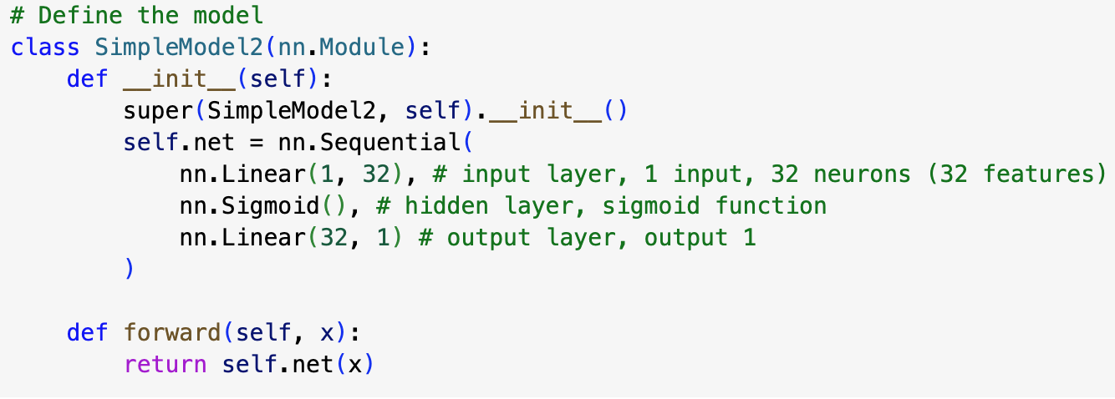
ML Steps in PyTorch
Pre-process data
Define network
Define loss function
Define optimizer
Training model
Validation and Testing
More layers in a container
Whole Example:
https://colab.research.google.com/drive/1_ru4CdNgz_MrtiPs5qUOaRoW_5q1R6cl?usp=sharing
Notes:
Sequential container put multiple layers together and run them in order
Sigmod transforms the output of the linear layer to a range between 0 and 1.
It introduces non-linearity into the model, allowing it to learn more complex patterns.

Slide 26

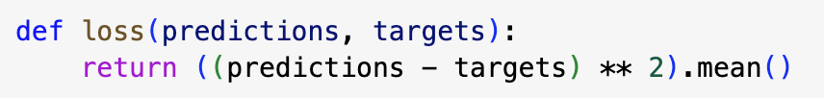
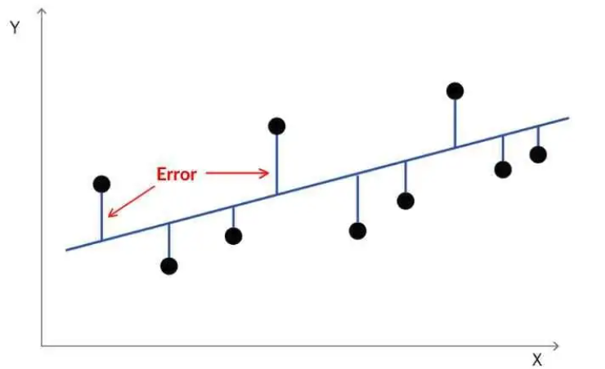
ML Steps in PyTorch
Pre-process data
Define network
Define loss function
Define optimizer
Training model
Validation and Testing
In a real å
Under the hood, it just something like this:
Other Example:
# Cross Entropy (for classification tasks) criterion = nn.CrossEntropyLoss()

Slide 27
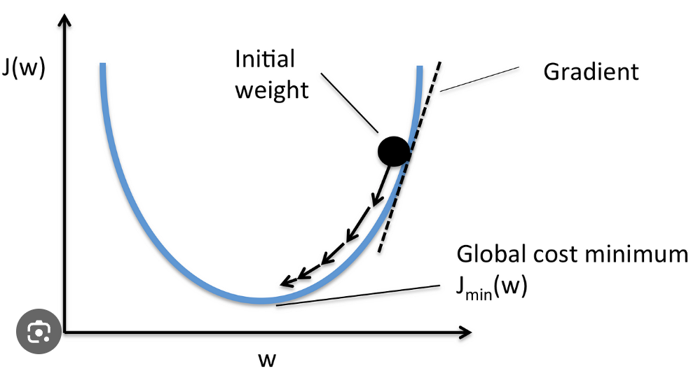
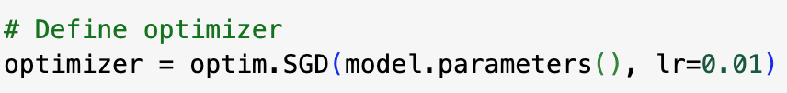
ML Steps in PyTorch
Pre-process data
Define network
Define loss function
Define optimizer
Training model
Validation and Testing
In a real å
Here we use Stochastic Gradient Descent Optimizer
Notes:
we can differentiate our model's w's and our model's b's against the loss function to get the gradients for w and b.
These gradients then help us get the direction towards the bottom of the loss curve, so we can generate our next guesses by reassigning w and b within our model to a new value in the direction
learning rate is the size of the steps you take toward minimizing the error (or loss). A small learning rate means you take tiny steps, while a large learning rate means you take bigger steps.
If the learning rate is too high, you might overshoot the minimum and the model may fail to converge
If it's too low, training will take a long time and may get stuck in local minima, resulting in slow convergence.

Slide 28
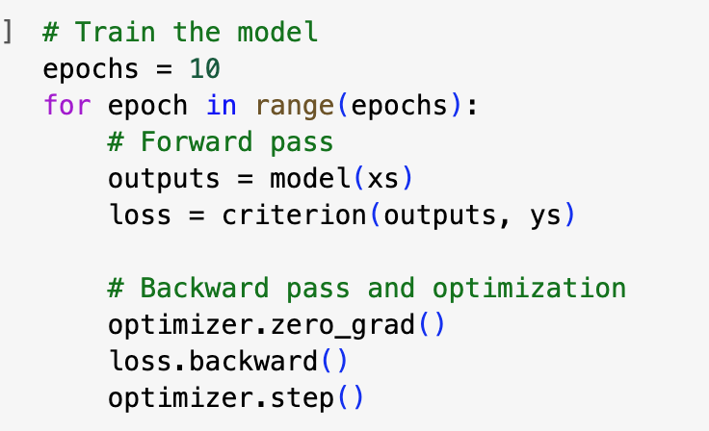
ML Steps in PyTorch
Pre-process data
Define network
Define loss function
Define optimizer
Training model
Validation and Testing
Take the input: put xs to model,
Calculate the loss
Zero the gradients before the backward pass in current iteration
optimizer.zero_grad()
loss.backward() # Compute gradients
Optimizer.step() # # Update parameters based on gradients
Notes:
An epoch in machine learning is one complete pass through the entire training dataset.
Training over multiple epochs allows the model to learn and refine its parameters gradually, improving accuracy over time. Each epoch helps the model learn from the entire dataset, reducing error and improving performance.
Thinking about playing piano 100 times

Slide 29
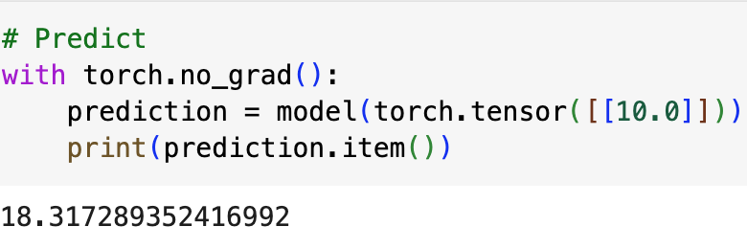
ML Steps in PyTorch
Pre-process data
Define network
Define loss function
Define optimizer
Training model
Validation and Testing
torch.no_grad() :
Prevents calculations from being added into gradient computation graph. Usually used to prevent accidental training on validation/testing data.
model.eval(): put model in evaluation mode
Notes:
model.eval() Changes behaviour of some model layers, such as dropout and batch normalization.

Slide 30
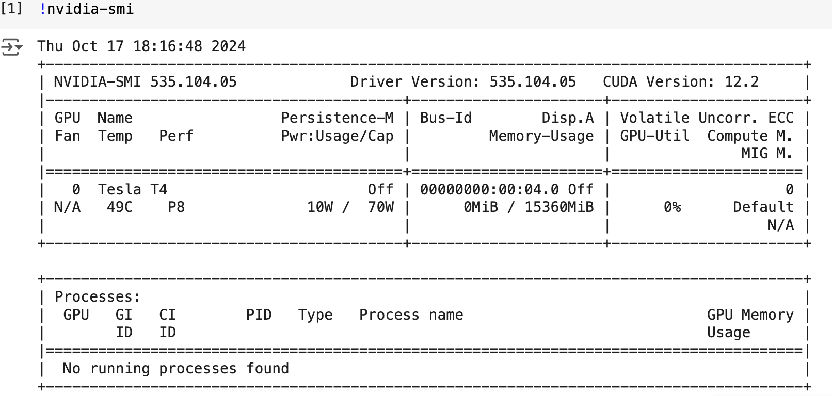
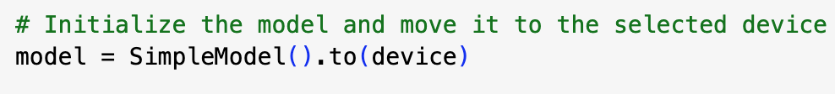
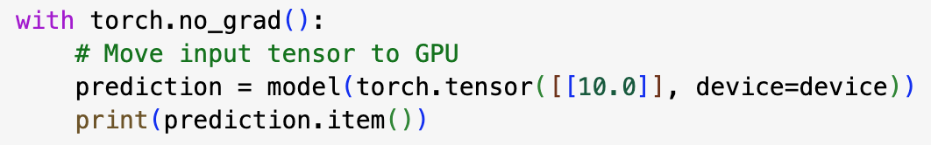
ML Steps in PyTorch
Pre-process data
Define network
Define loss function
Define optimizer
Training model
Validation and Testing
"mps" If mac
Use GPU: move input and model to GPU

Slide 31
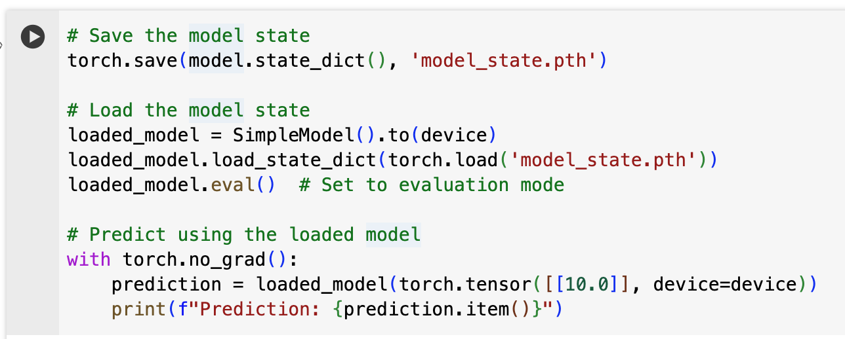
ML Steps in PyTorch
Pre-process data
Define network
Define loss function
Define optimizer
Training model
Validation and Testing
Save and load model
Notes:
torch.save(model, 'model.pth')
It's generally recommended to save the model’s state dictionary (model.state_dict()) because it’s lighter and more flexible. You can reload the model into different architectures if necessary.

Slide 32
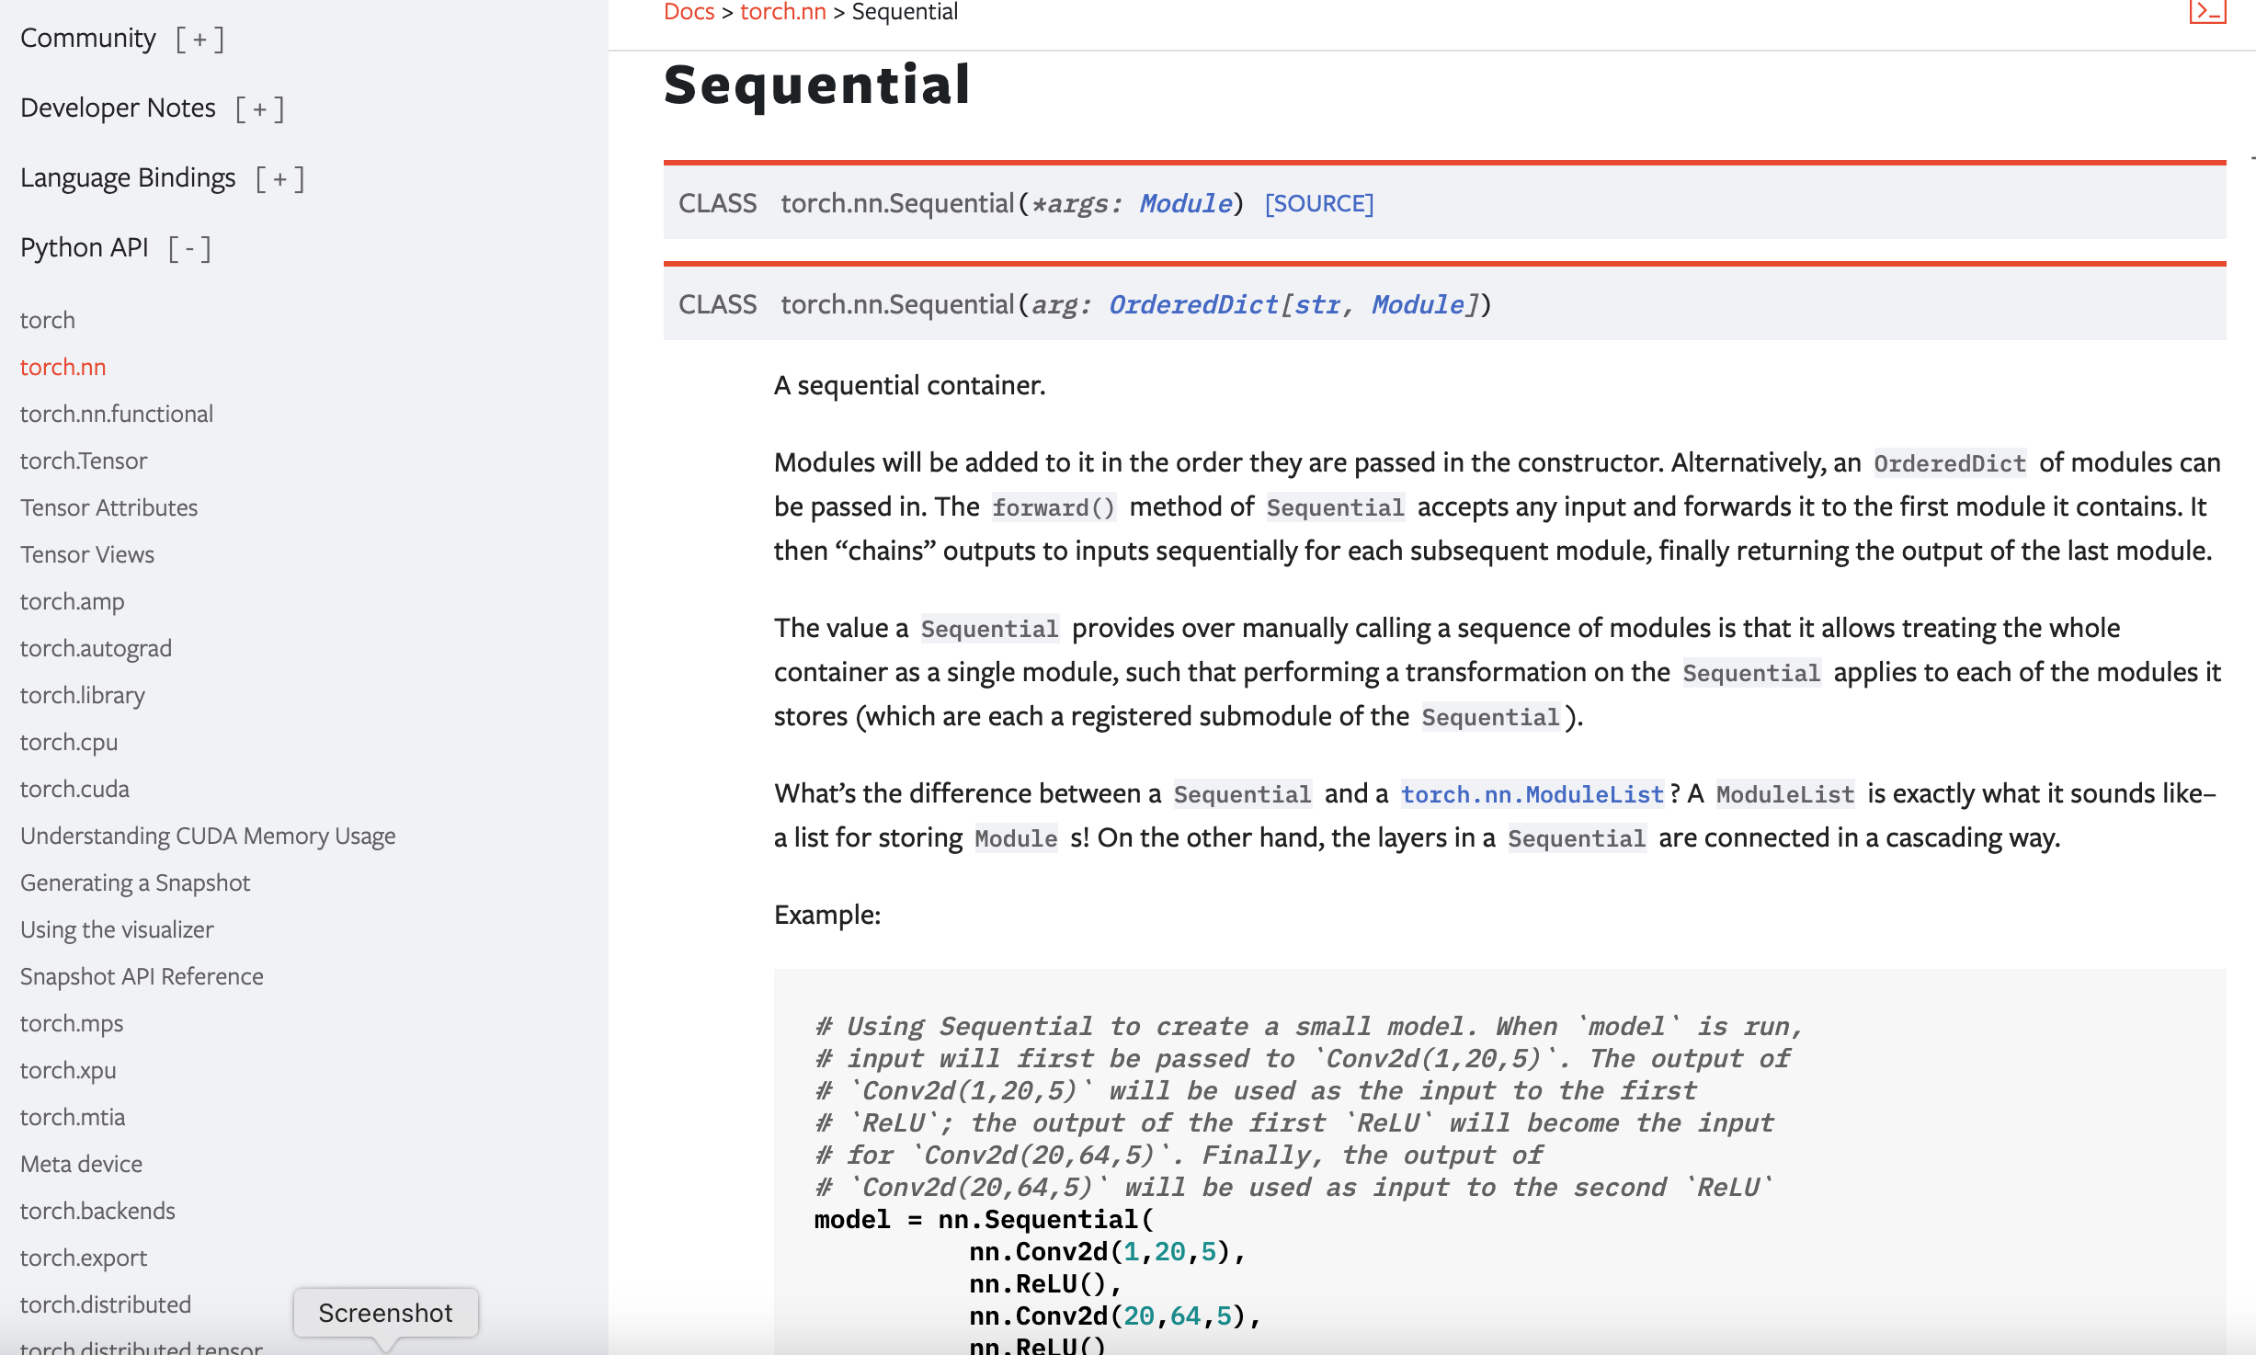
PyTorch document
https://pytorch.org/docs/stable/

Slide 33
Live Demo
Choosing a Neural Network: CNN vs. RNN vs. Transformer

Slide 34
Thank you

